Slide 1
Governance of Banks Using Blockchain Technology
Presented By:
DINESH LINGANABOINA(210303124694)
ADEPU DEEPAK(210303124154)
MADAVI SAI RAJ (210304124005)
MADDIGUNTA KARTHIK (210304124009)
Guided By:
SHAIKH AMIN FAROOQBHAI
Designation:
CSE Department
PIET, Parul University
Internal Project Presentation August, 2024

Slide 2
Content
Introduction
Problem Statement
Research Paper Summary (in Tabular form)
Flowchart of the system
Implementation Details
Demonstration of the Project
Testing
  Test cases
Conclusion
Future Work
References
Project Presentation 2024

Slide 3
Introduction
Welcome to our presentation on the "Governance of Banks Using Blockchain Technology." In today's financial landscape, transparency, security, and efficiency are more crucial than ever. Traditional banking systems often face challenges related to trust and accountability, which can hinder effective governance.
Our project leverages the power of blockchain technology to address these challenges. By integrating decentralized solutions, we aim to enhance the governance framework of banks, ensuring that all stakeholders have access to transparent and secure processes. Today, we will walk you through our implementation, key features, and the impact this innovative approach can have on the banking sector. Thank you for joining us!
Project Presentation 2024

Slide 4
Problem Statement
Traditional banking governance systems lack transparency, are prone to inefficiencies, and can be vulnerable to manipulation, leading to trust issues between stakeholders. By integrating blockchain technology, we aim to enhance transparency, accountability, and security in the governance of banks.
Key Points:
Transparency: Blockchain enables real-time, tamper-proof records of governance decisions and transactions.
Security: Smart contracts and decentralized networks reduce the risk of fraud or manipulation.
Efficiency: Automation through smart contracts minimizes delays and human errors in governance processes.
Accountability: Immutable audit trails ensure that all stakeholders are held accountable for decisions and actions.
Project Presentation 2024

Slide 5
Summary
S.NO | Paper Title | Publisher | Year | Take-away points
1. | Implementation of Blockchain for Secure Bank Transactions | IEEE | 2020 | 1.Blockchain enhances transaction security by providing decentralized data storage and encryption. 2.It minimizes fraudulent activities by ensuring transparent and tamper-proof transaction records.
2. | Expeditious banking using Blockchain Technology | IEEE | 2020 | 1.Blockchain accelerates transaction processing and reduces manual intervention in banking. 2.It enables real-time data verification, which helps in faster decision-making
3. | BlockchainTechnologyChangingLandscapeofBankingIndustry | Springer | 2023 | 1.Blockchain adoption is transforming traditional banking models, enhancing operational efficiency. 2.It strengthens customer trust by providing transparency and secure transaction records.
Project Presentation 2024

Slide 6
S.NO | Paper Title | Publisher | Year | Take-away points
4. | Block Chain Technology Application to the Banking Sector | Springer | 2023 | 1.Blockchain integration offers reliable solutions to banking inefficiencies and delays. 2.It promotes trust through decentralized ledger systems, reducing reliance on intermediaries.
5. | OpenBanking and APIs for Transformation in Banking | Anshu Premchand,Anurag Choudhry | 2024 | 1.Open banking APIs supported by blockchain enable seamless data sharing between financial institutions. 2.It drives innovation in banking services, creating a more customer-centric experience.
6. | Analysis of Banking and Block Chain Technology In Supply Chain Management System | IJARSCT | 2022 | 1.Blockchain in banking and supply chain enhances traceability and accountability across the network. 2.It reduces operational delays by offering real-time tracking and data accuracy.
Project Presentation 2023

Slide 7
S.NO | Paper Title | Publisher | Year | Take-away points
7. | Blockchain Implementation in Financial Sector and Cyber Security System | IJARSCT | 2023 | Blockchain technology is essential for improving cybersecurity in the financial sector.
8. | A SystemBuild on Block chain technology to Identify and Fight Bogus check scams | international journals | 2022 | Blockchain helps in identifying counterfeit transactions by validating transaction history.
9. | A Way of Implementation of Blockchain Technology in the Field of Finance with Evidence of Results | IEEE | 2020 | Blockchain implementation in finance shows measurable improvements in transaction accuracy.
10. | Blockchain Technology for Protecting Banking Transactions Without Using Tokens | IJARSCT | 2020 | Blockchain ensures secure banking transactions without relying on traditional tokenization.
Project Presentation 2023

Slide 8
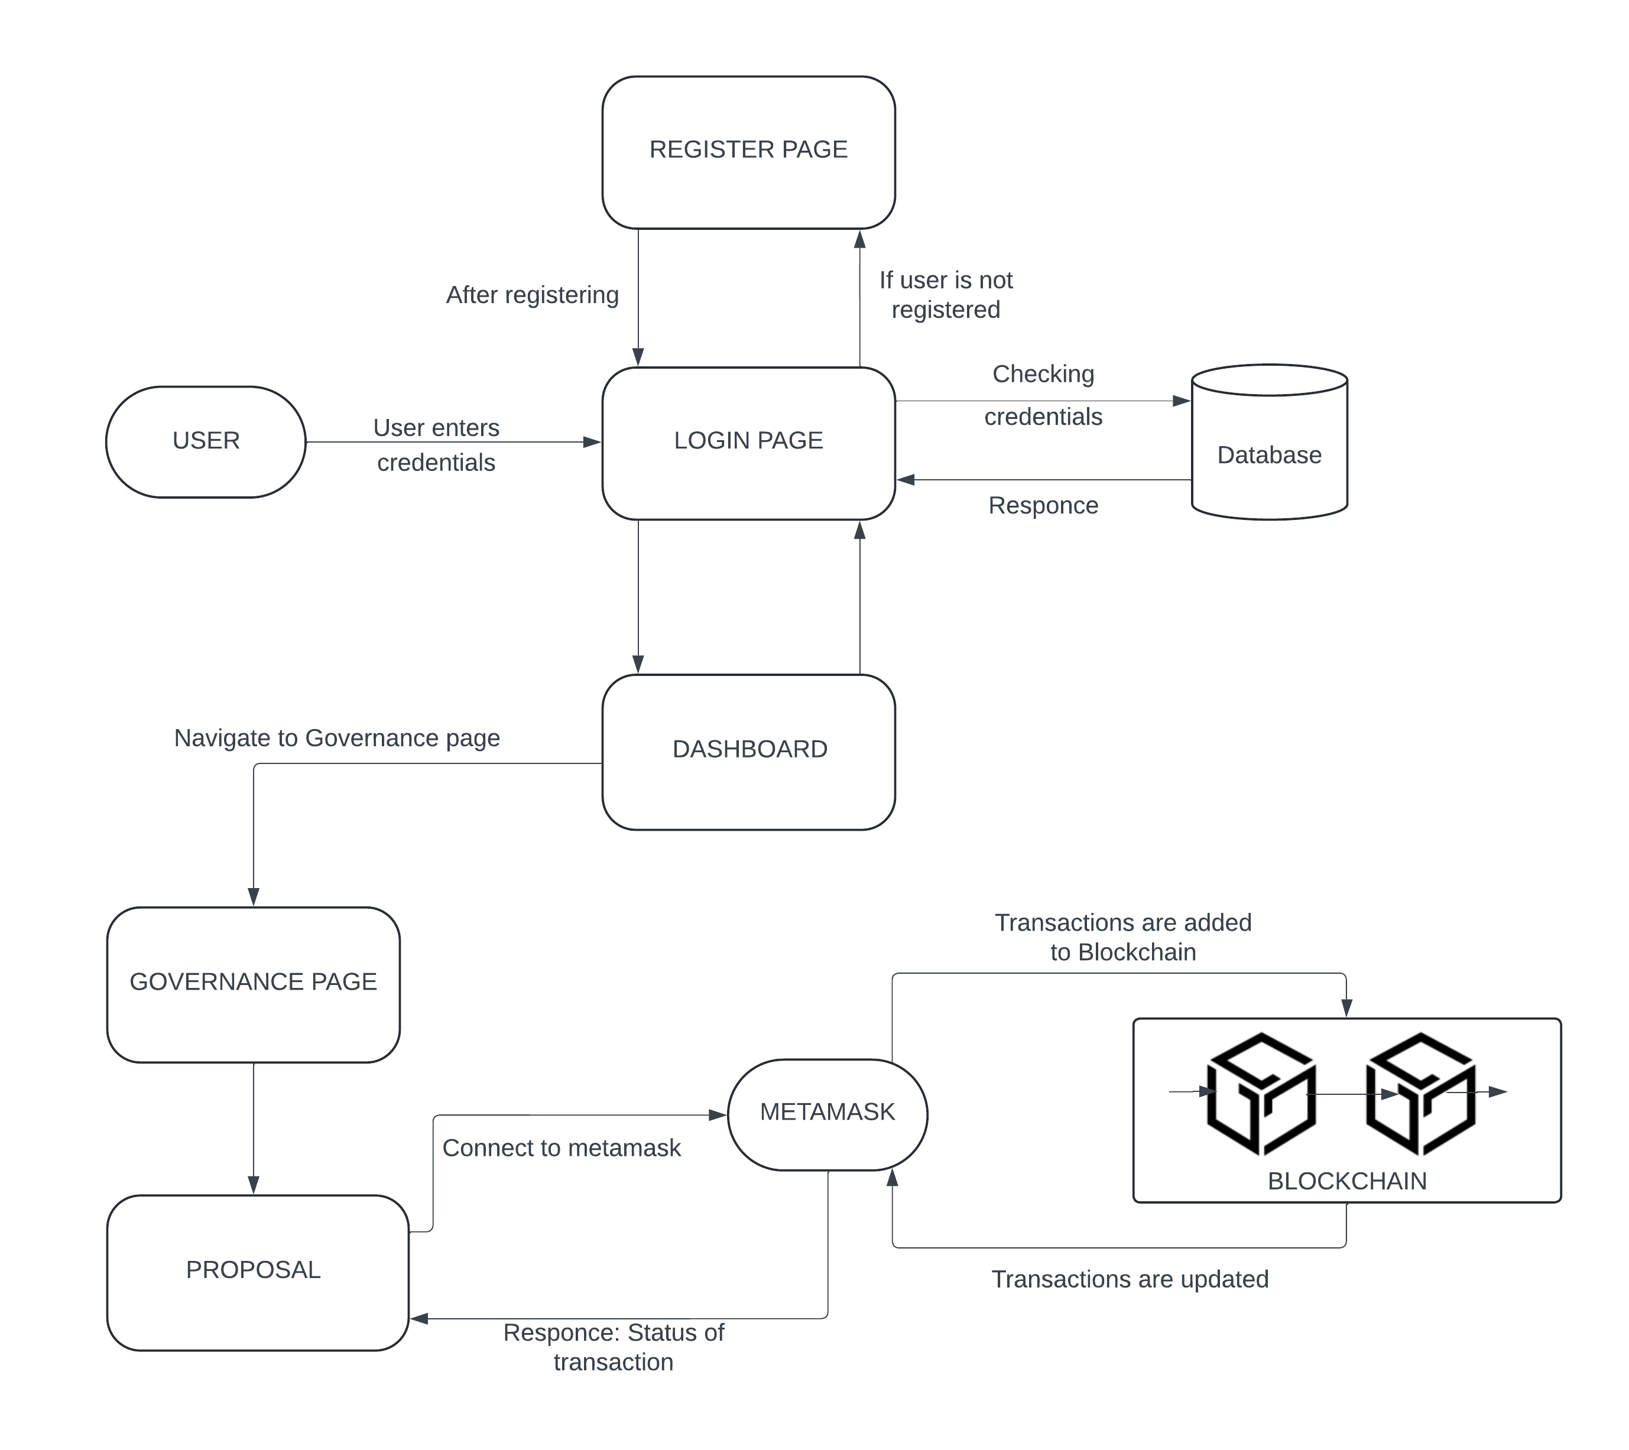
Flowchart of the system
Project Presentation 2024

Slide 9
Implementation Details
Our project leverages modern web technologies and blockchain to enhance transparency, security, and efficiency in bank governance.
Project Implementation: Governance of Banks Using Blockchain Technology:
Frontend:
  HTML, CSS, JavaScript: We built a responsive and user-friendly interface using standard web technologies to ensure seamless interaction for users.
  React.js: React.js was used to create a dynamic, modular, and scalable front-end structure, providing real-time updates and a smooth user experience.
Backend:
  Node.js: A lightweight, efficient backend using Node.js to handle API requests and server-side logic, ensuring fast processing and communication between the front and back ends.
Project Presentation 2024

Slide 10
  MongoDB: Used as the database for storing and managing bank governance data, offering scalability and flexibility in handling large datasets.
Blockchain Integration:
  Web3.js: We integrated Web3.js to connect our application with the Ethereum blockchain, enabling decentralized governance features like transparent voting, decision-making, and audit trails.
  Smart Contracts: Smart contracts were employed to automate and secure key governance processes, ensuring trust and immutability.
Project Presentation 2024

Slide 11
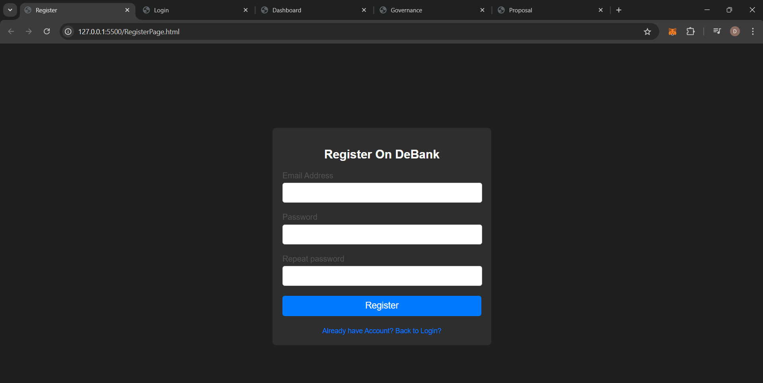
Screen shots of implemented work
Registeration Page:
Project Presentation 2024

Slide 12
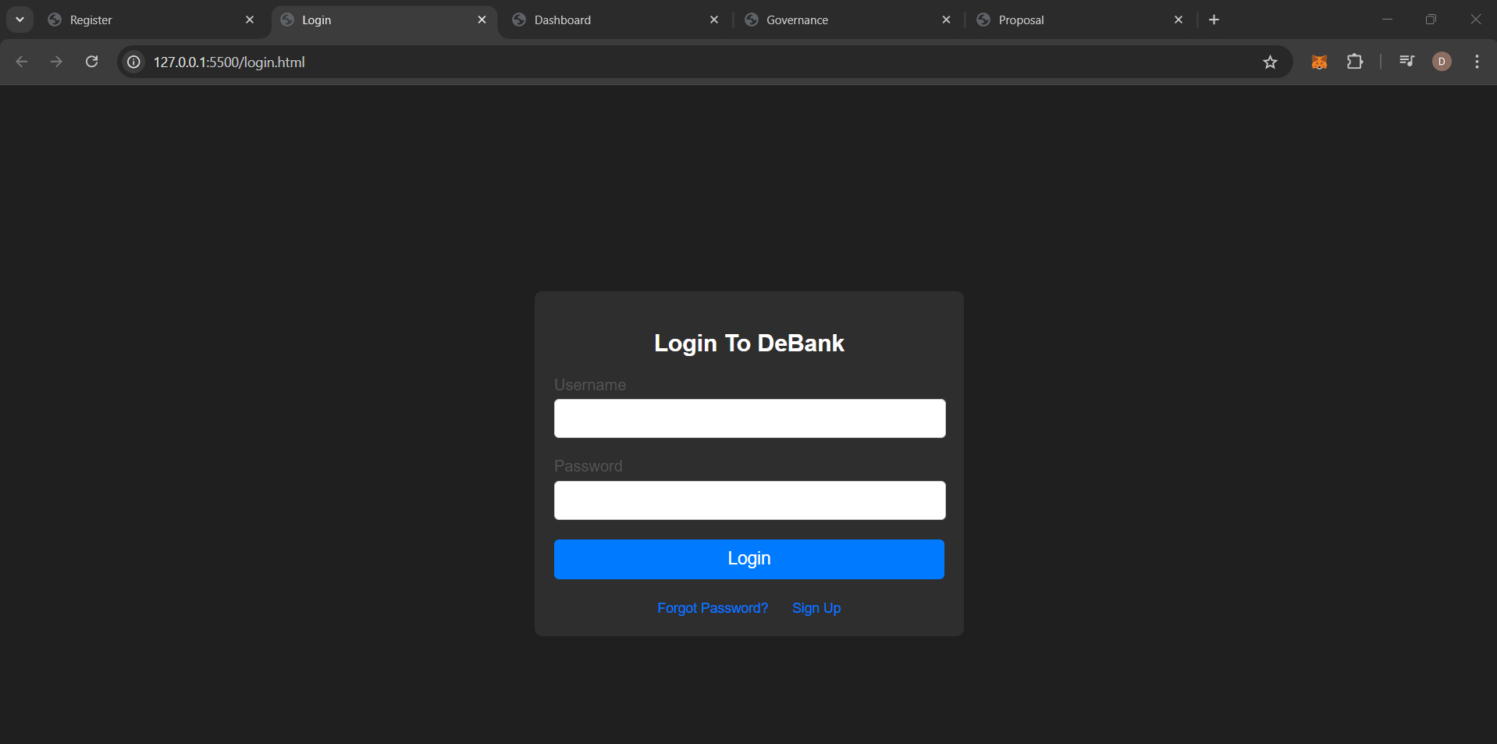
Login Page:
Project Presentation 2024

Slide 13
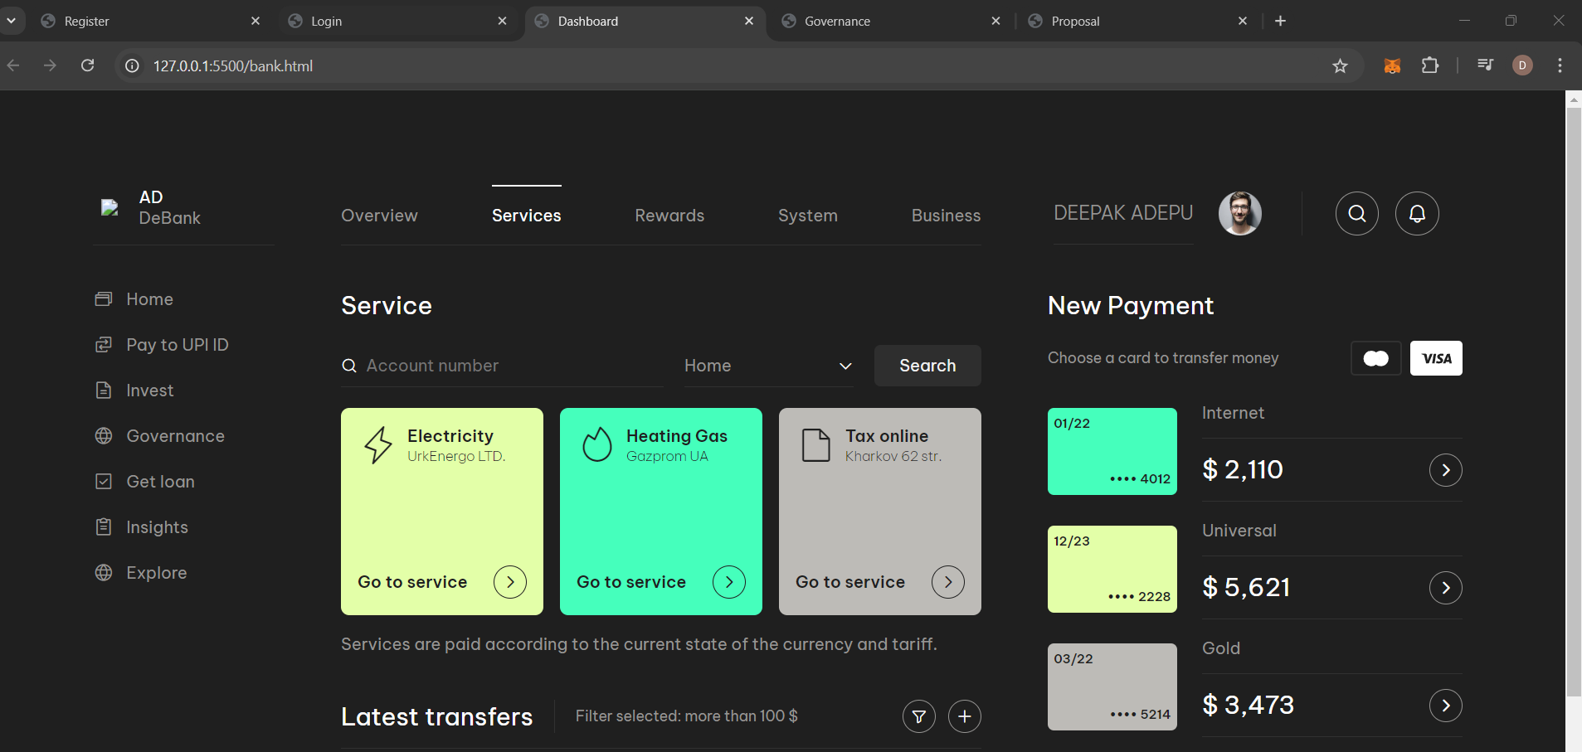
Dashboard:
Project Presentation 2024

Slide 14
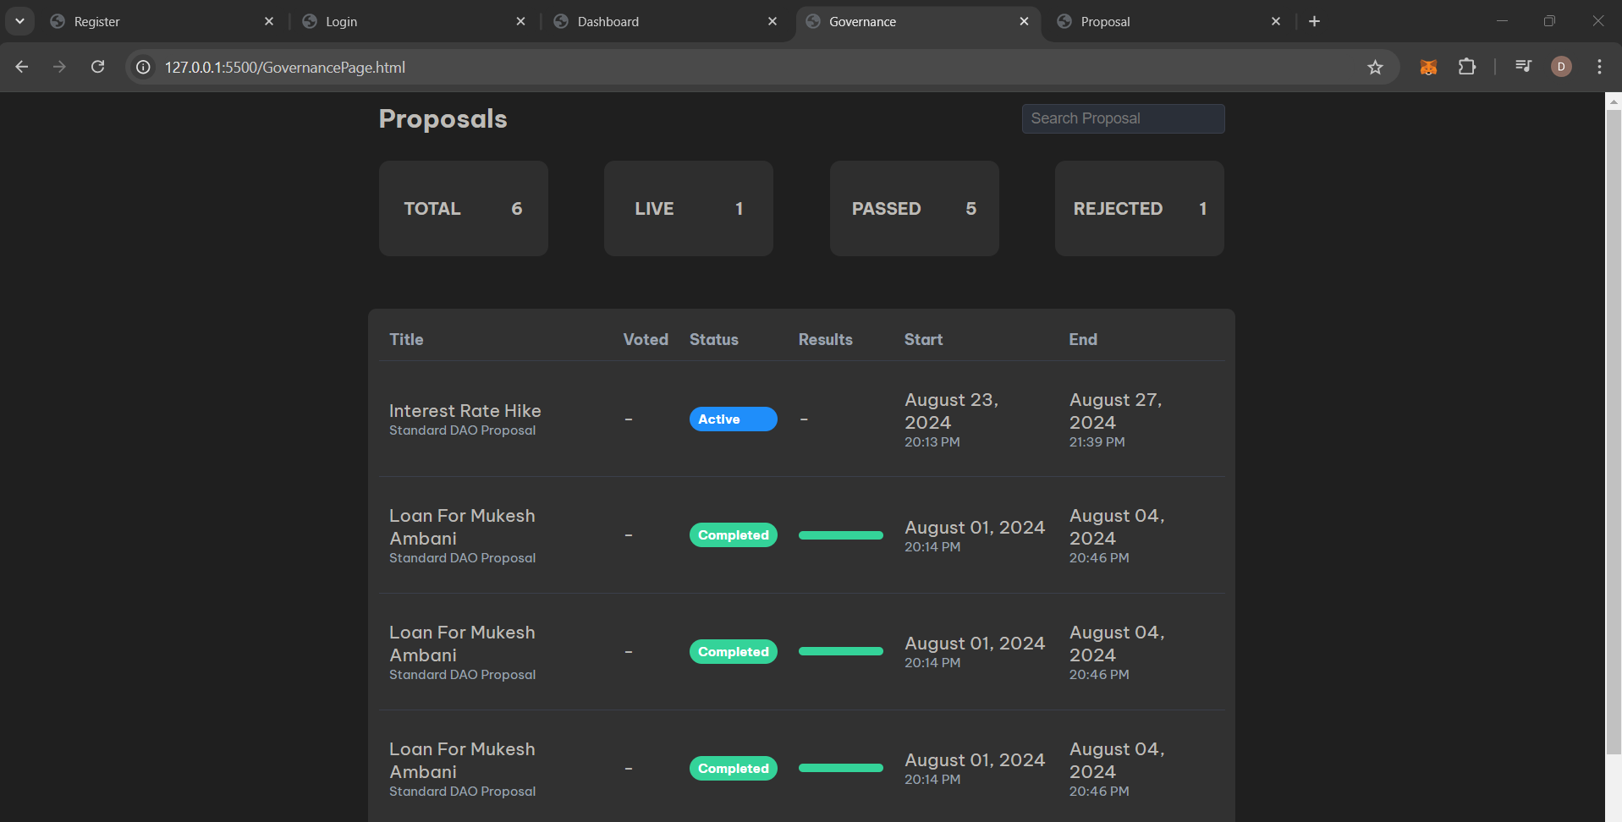
Governance Page:
Project Presentation 2024

Slide 15
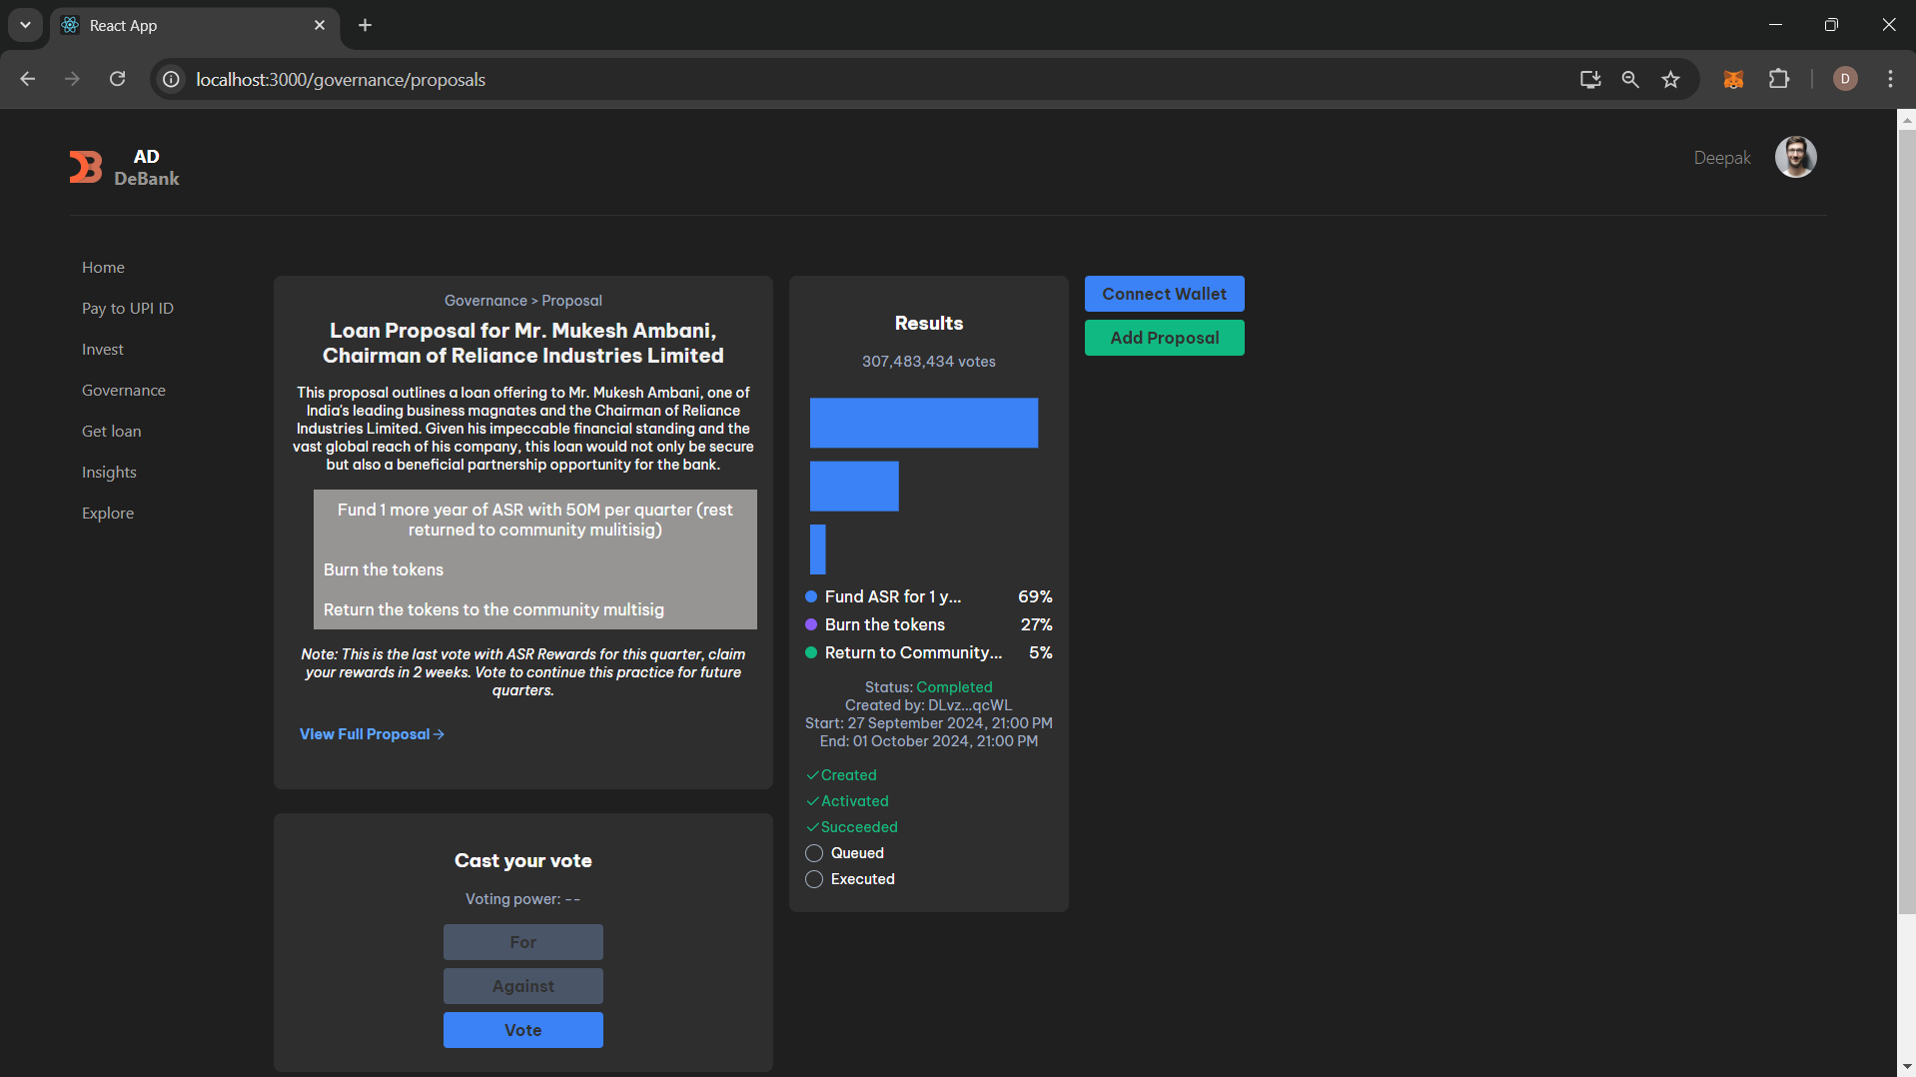
Proposal page:
Project Presentation 2023

Slide 16
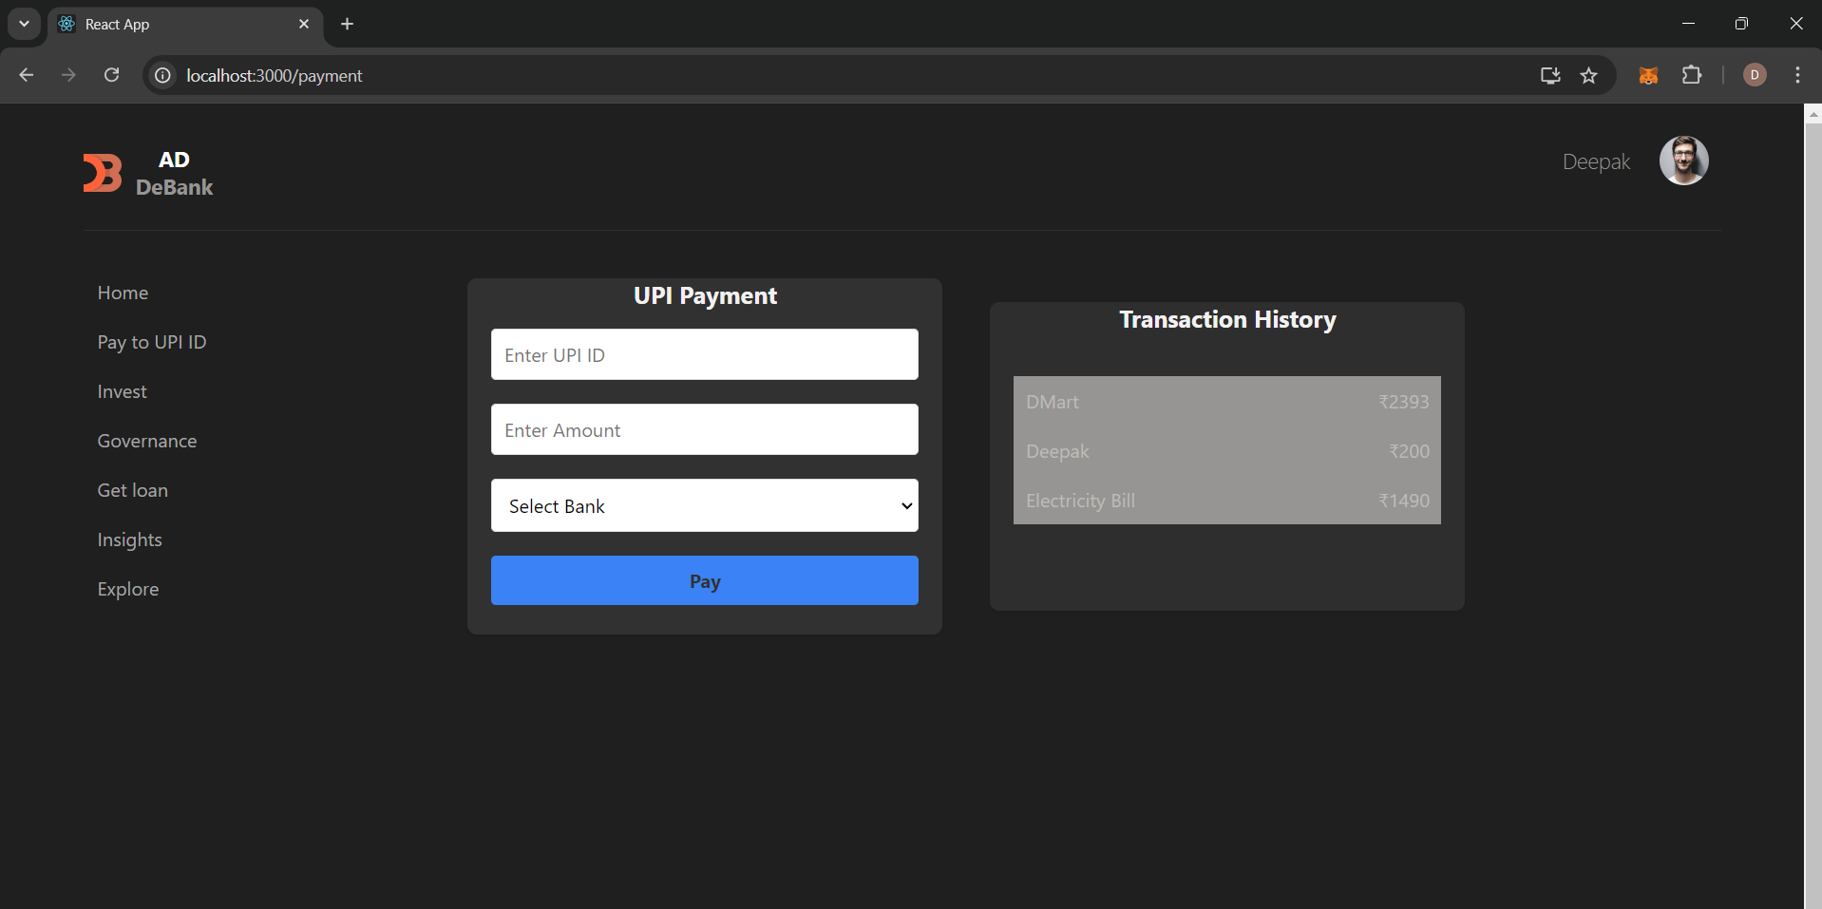
Payment page:
Project Presentation 2023

Slide 17
Testing of the Project
Test Case ID | Test Case Description | Precondition | Test Steps | Expected Results | Status
TC-001 | User should be able to register successfully | Application is running | 1. Go to Registration page. 2. Fill in valid details. 3. Submit the form. | A success message should appear, and the user should be redirected to the login page. | Passed
TC-002 | User should log in with valid credentials | User is registered | 1. Navigate to Login page. 2. Enter valid credentials. 3. Click on Login. | User should be logged in and redirected to the dashboard. | Passed
TC-003 | User should see homepage content after login | User is logged in | 1. Log in. 2. Check the homepage. | Homepage content (e.g., menu, items) should be displayed. | Passed
TC-004 | User should be able to log out successfully | User is logged in | 1. Click on Logout button. | User should be logged out and redirected to the Login page. | Passed
Project Presentation 2024

Slide 18
Test Case ID | Test Case Description | Precondition | Test Steps | Expected Results | Status
TC-005 | Admin should be able to approve new product listings | Admin is logged in | 1. Navigate to the Admin Panel. 2. Approve a product listing. | Product should be approved and visible on the user end. | Passed
TC-006 | User should be able to connect wallet | wallet is not connected | 1.Navigate to Proposal page 2.Click on connect wallet button 3.Sign in the transaction | Wallet should be connected to the proposal page | Passed
TC-007 | User should be able to vote "For" or "Against" | vote not registered | 1. In proposal page select "For" or "Against". 2.Click on "vote" button. 3.Approve the transaction in Metamask | vote should be registered after approving transaction , transaction should appeare in blockExplorer | Passed
Project Presentation 2023

Slide 19
Test Case ID | Test Case Description | Precondition | Test Steps | Expected Results | Status
TC-008 | user should be able to send fiat to onther users through UPI payment method | 1. Navigate to Payment section 2. Enter Amount, Desired UPI id ans select Bank Account 3.Click on "PAY" button | 1. Navigate to the Admin Panel. 2. Approve a product listing. | Transaction should be appeared in "Transaction History" Tab | Passed
Project Presentation 2023

Slide 20
Conclusion
The integration of blockchain can lead to more efficient decision-making, improved risk management, and enhanced trust among stakeholders. However, challenges such as regulatory hurdles, scalability concerns, and integration with legacy systems must be carefully managed to ensure successful implementation.
In conclusion, blockchain technology provides a promising framework to revolutionize the governance of banks, paving the way for a more secure, efficient, and transparent financial system. This project has highlighted the critical role that blockchain can play in future banking governance models, driving innovation and ensuring long-term stability in the industry.
Project Presentation 2024

Slide 21
Future Work
In future iterations, the decentralized voting system can be enhanced by implementing additional features such as real-time vote counting, secure voter identification mechanisms, advanced data analytics for voter insights.
These enhancements will further enhance the efficiency, security, and accessibility of the voting process, making it more inclusive and trustworthy.
Project Presentation 2024

Slide 22
References
Satoshi Nakamoto”Bitcoin: A Peer-to-Peer Electronic Cash System”2009
Ashvine Kumar , Priyanka Omkar Bhoir”A Way of Implementation of Block Chain Technology in The Field Finance With The Evidence of Result”2023
Anita Gehlot,Rajesh Singh”Analysis of Banking and Block Chain Technology In Supply Chain Management System”2022
Shaliza Alwi,Irfah Najihah Basir Malan,”Block Chain Technology Application to the Banking Sector”2023
Niturkar Pallavi Pravin,Kulat Pratiksha Anil”Block chain technology for protecting the banking transaction without using tokens”2020
Kuppani Sathish,Jayendra Gopal Thatipudi”Blockchain based Enhancement of Digital Revolution in Financial Sector”2023
Dr. Sukhavasi Santha kumari,Mr. MahabubBasha S”Blockchain Implementation in Financial Sector and Cyber Security System”2023
Project Presentation 2024

Slide 23
8. Manjit Kour”Blockchain Technology Changing Landscape of Banking Industry”2023
9. Varsha Naik,Riya Pejawar”Expeditious banking using Blockchain Technology”2020
10. Akhilesh NS,Aniruddha MN”Implementation of Blockchain for Secure Bank Transactions”2020
Project Presentation 2024

Slide 24
Thank you
Project Presentation 2024

