Slide 1

Project Presentation

Slide 2
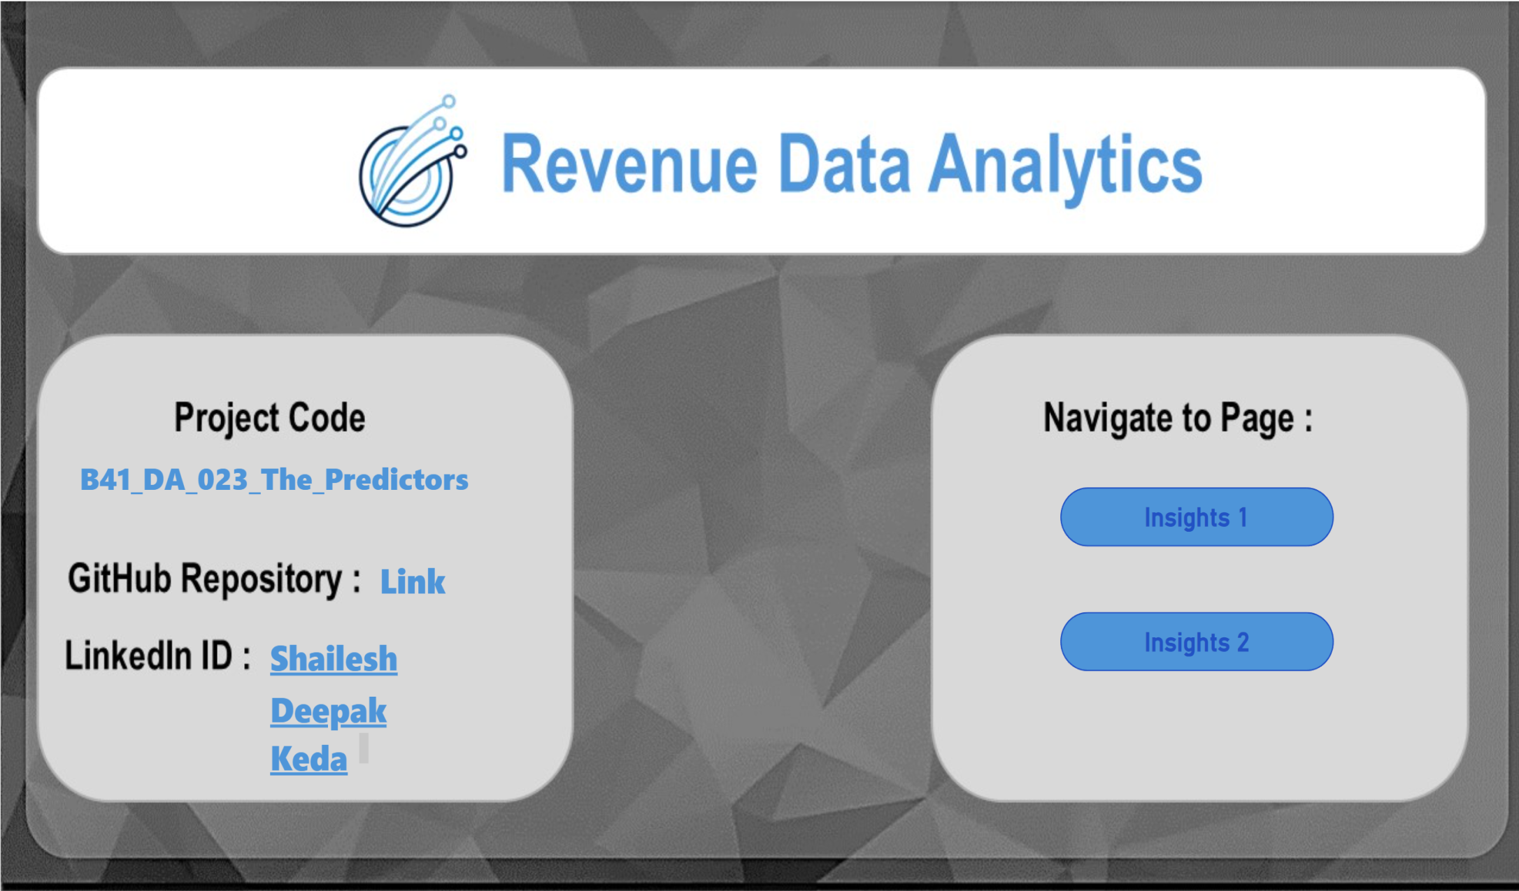
Home Page

Slide 3
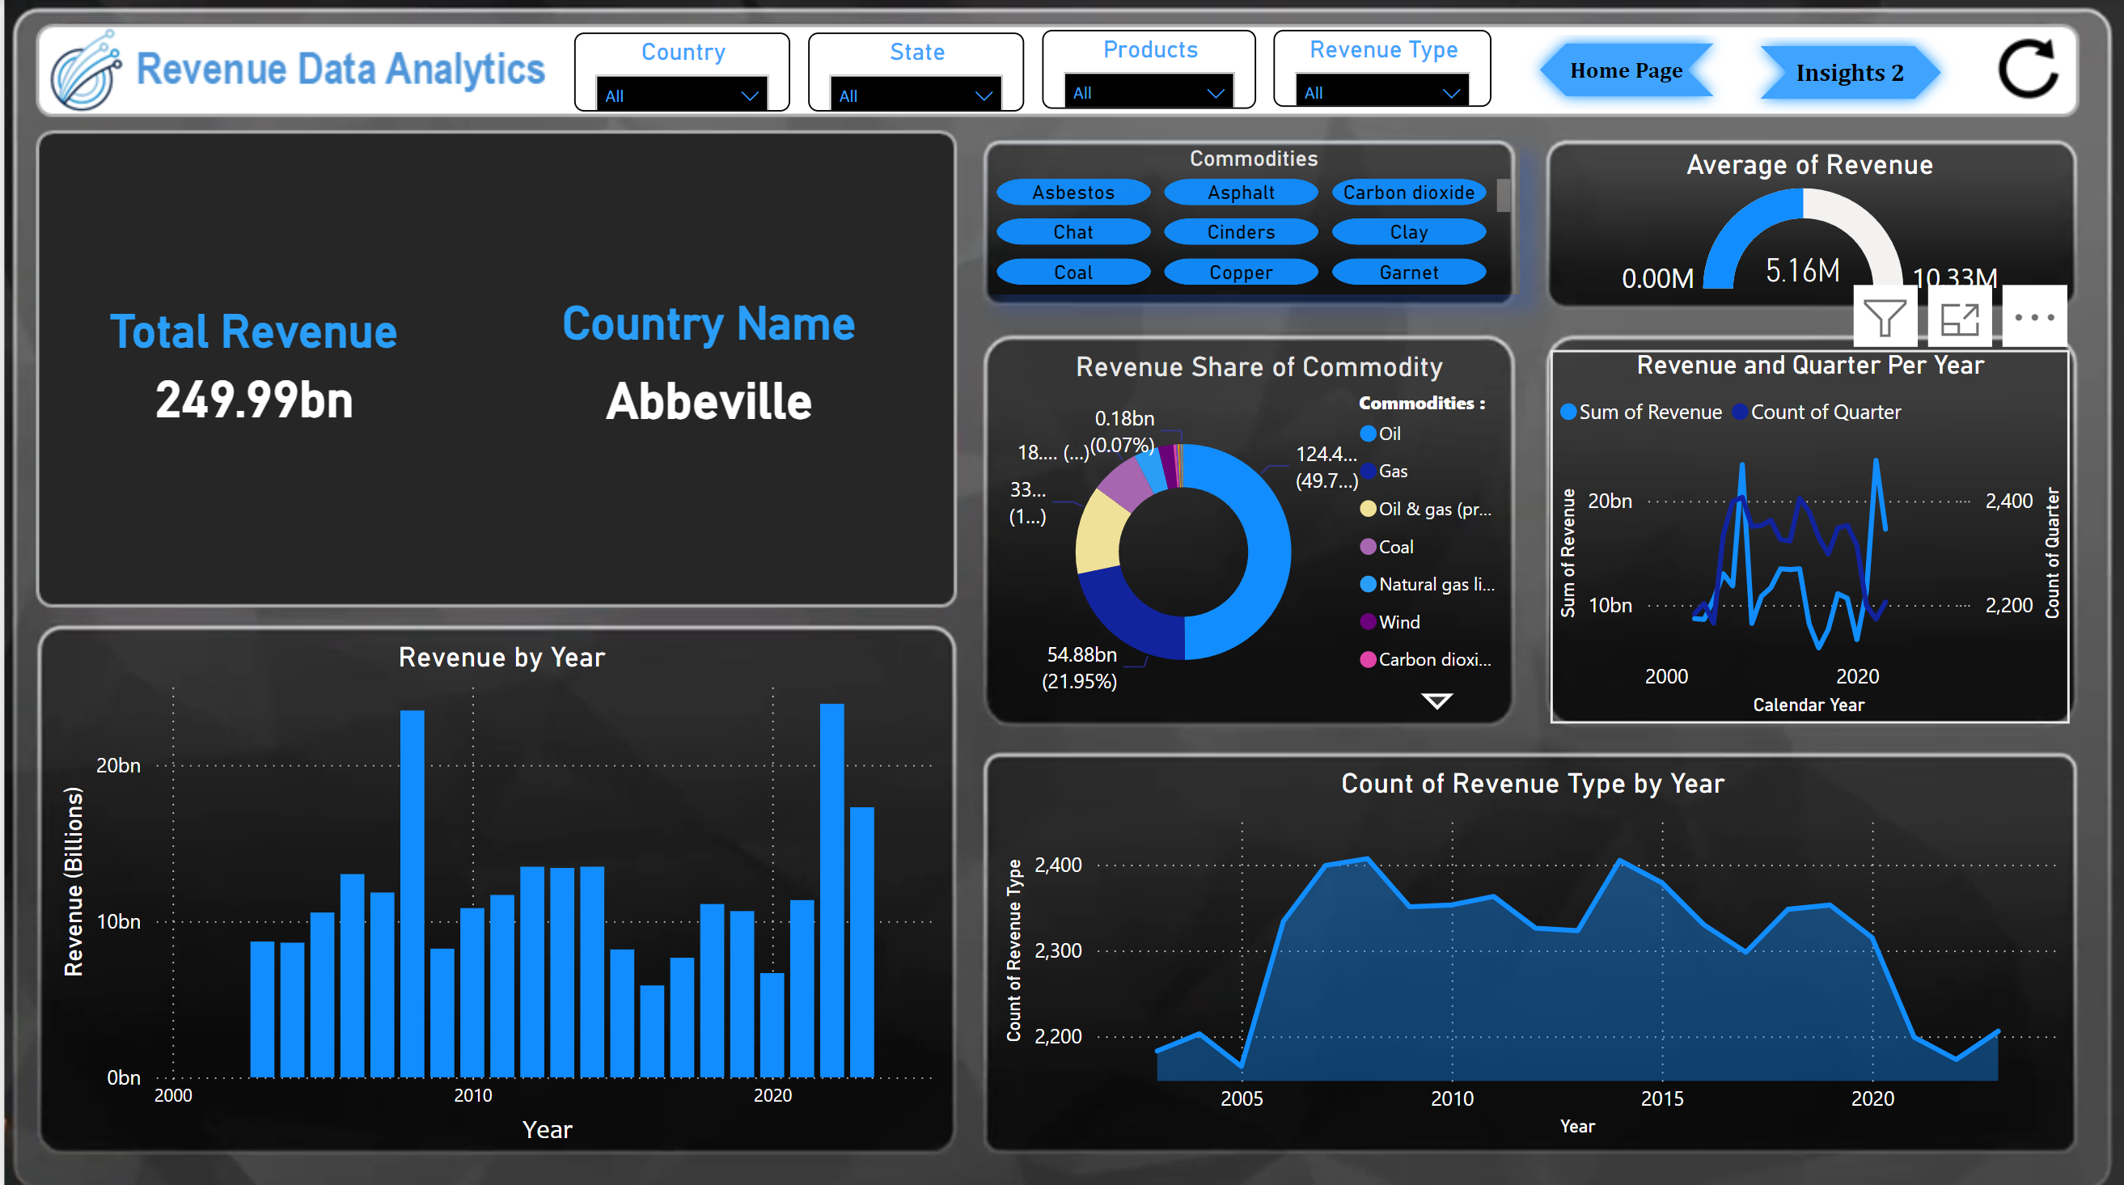
Insights 1

Slide 4
Above dashboard "Revenue Data Analytics" provides a comprehensive overview of revenue.
Include Button Give you flexibility Move between Different Pages and Charts.
Also Slicer Help you use like Filter so you manage charts so easily.
We see separate Chart with its all information in upcoming slides.

Slide 5
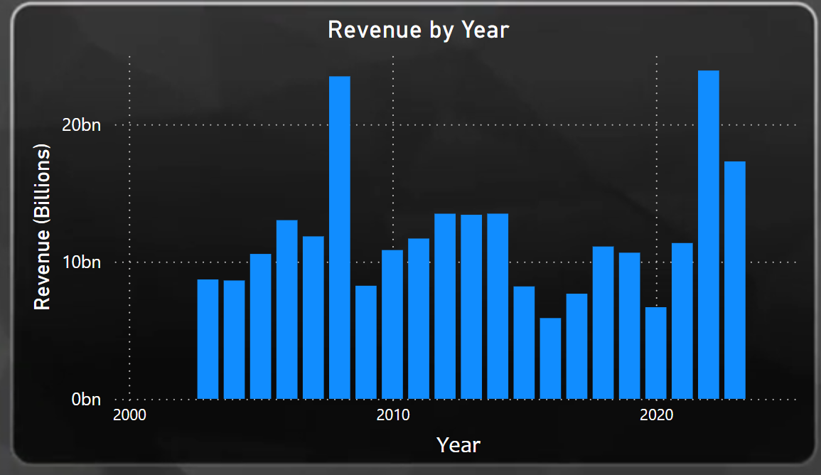

Slide 6
This chart "Revenue by Year“ represents annual revenue trends from 2000 to 2020. Key observations include:
Peak Revenue: There is a significant spike in revenue around 2010, surpassing 20 billion units. This might indicate a major event or a successful product launch during that year.
Consistent Growth: Revenue shows a gradual increase from 2000 up to 2010, indicating a period of steady growth.
Recent Surge: Toward the end of the timeline (close to 2020), revenue again reaches a high point, nearing the 20 billion mark. This suggests a resurgence or strong performance during these years.

Slide 7
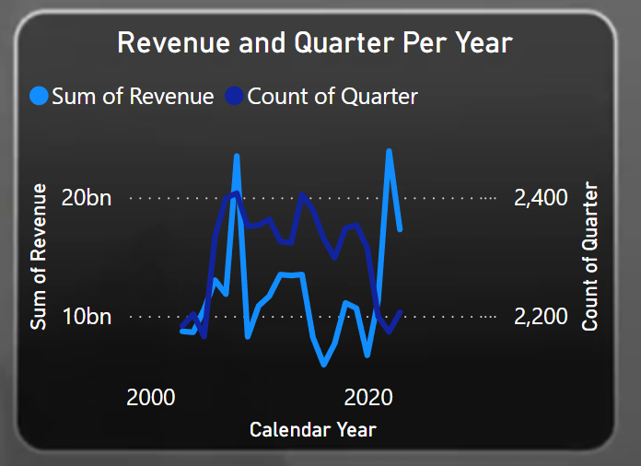

Slide 8
This chart "Revenue and Quarter Per Year" compares the sum of revenue (in billions) and the count of quarters per year over time.
Revenue Trends:
There are noticeable fluctuations in the sum of revenue, with peaks observed around 2010 and 2020.
Revenue declines sharply at certain points, showing potential volatility in the market.
Count of Quarters:
The count of quarters (likely representing active reporting periods) remains relatively stable but shows slight variations over time.
A notable dip in the count of quarters occurs during some years, potentially aligning with lower revenue periods.

Slide 9
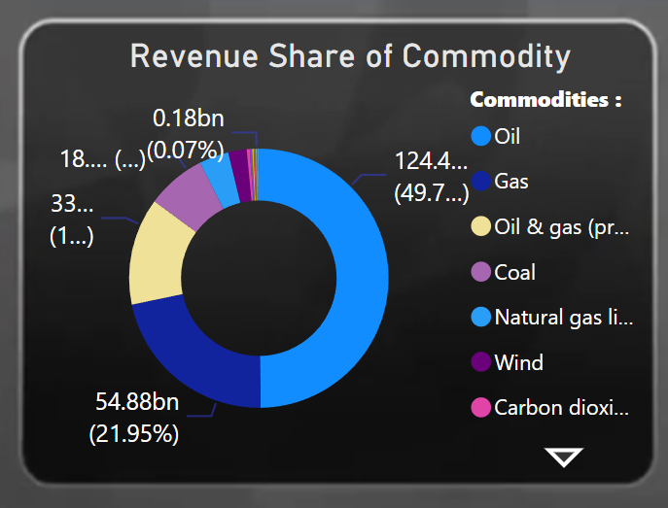

Slide 10
from the "Revenue Share of Commodity" pie chart:
Overall Observations:
Oil Dominates: Oil holds the largest share of revenue, contributing nearly 50% of the total.
Gas is Second: Gas comes in second place, accounting for a significant portion of the revenue.
Other Commodities are Minor: The remaining commodities (Oil & gas (processed), Coal, Natural gas liquids, Wind, Carbon dioxide) have relatively small shares compared to oil and gas.

Slide 11
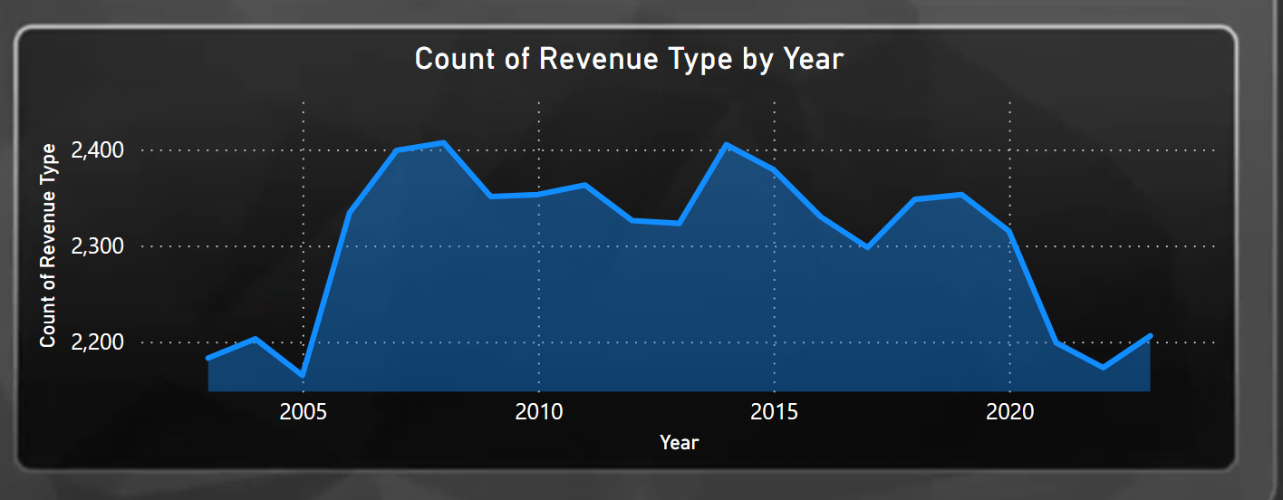

Slide 12
from the "Count of Revenue Type by Year" line graph:
Overall Observations:
Fluctuations: The number of revenue types seems to have fluctuated over the years, with periods of increase and decrease.
Peak in 2010: The highest point appears to be around 2010, with a subsequent decline.
Recent Stability: There seems to be a period of relative stability in the number of revenue types from 2015 to 2020.

Slide 13
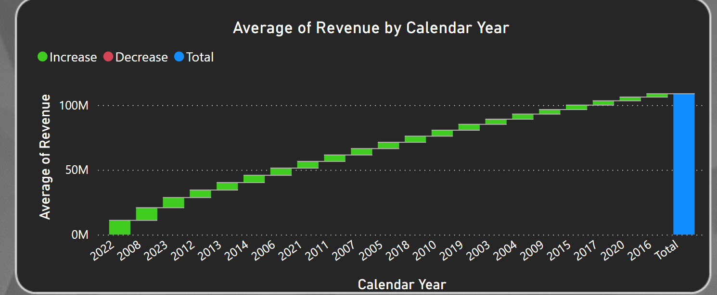

Slide 14
from the "Average of Revenue by Calendar Year" bar chart:
Overall Observations:
Steady Growth: The average revenue appears to have increased steadily over the years, with a few minor dips.
Significant Increase in 2021: There is a notable jump in average revenue in 2021.
Highest Revenue in 2022: The highest average revenue is observed in 2022.

Slide 15
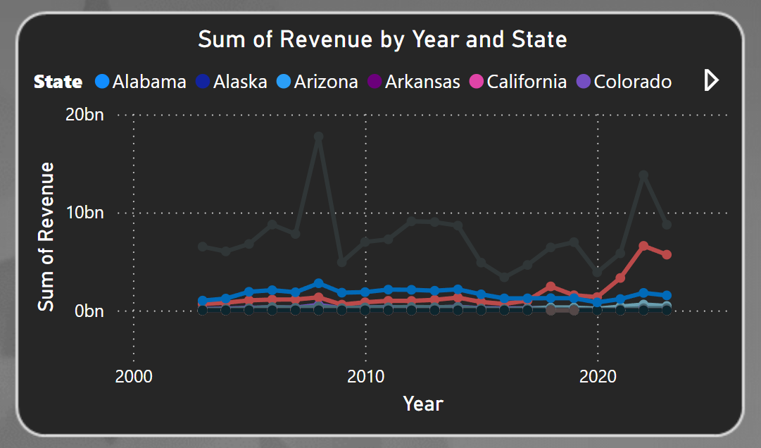

Slide 16
from the "Sum of Revenue by Year and State" line chart:
Overall Observations:
Uneven Growth: The revenue for all states appears to have fluctuated over the years, with periods of growth and decline.
California Dominates: California consistently shows the highest revenue among the states.
Colorado's Rise: Colorado's revenue seems to have experienced the most significant growth, particularly in recent years.

Slide 17
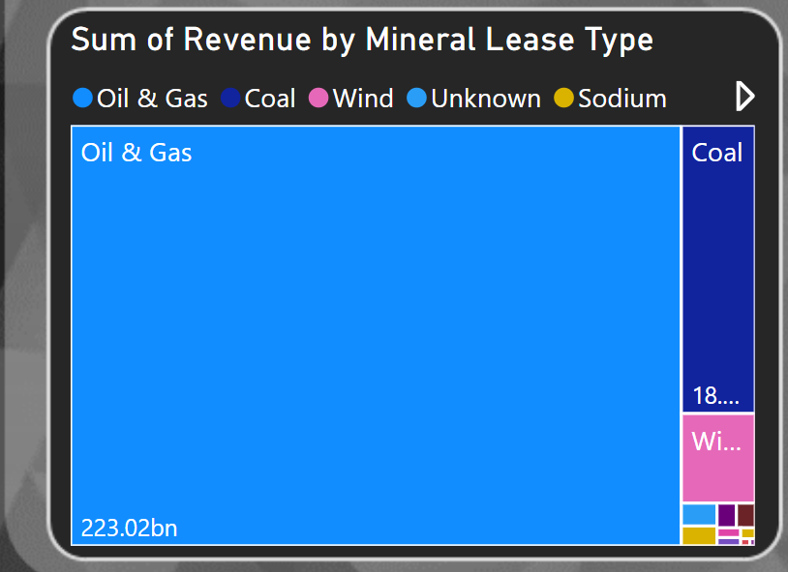

Slide 18
from the "Sum of Revenue by Mineral Lease Type" bar chart:
Overall Observations:
Oil & Gas Dominance: Oil & Gas leases generate the vast majority of the revenue by a significant margin.
Coal Second: Coal leases are the second-highest revenue generator.
Other Types Minimal: Wind, Unknown, and Sodium leases contribute very little to the overall revenue.

Slide 19
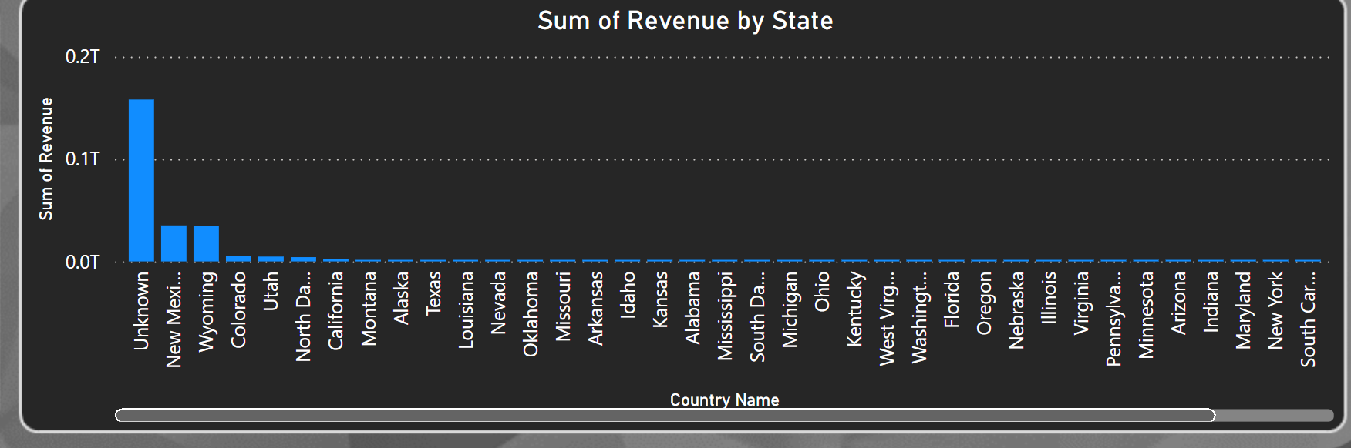

Slide 20
from the "Sum of Revenue by State" bar chart:
Overall Observations:
Uneven Distribution: Revenue generation varies significantly across different states.
Top Performers: A few states stand out with substantially higher revenue compared to others.
Majority of States Have Low Revenue: Most states have relatively low revenue contributions.

Slide 21


