Slide 1



Program- MCA Semester- IV Subject- Project
Faculty Name- Er. Mohit Jain

Slide 2

Learning Objective
By the end of this session, learner will be able to understand about:
The step-by-step process of preparing a project synopsis
To identify the essential components that must be included in a project report

Slide 3
Project
Project consists of two phases.
Phase 1: Project Synopsis
Phase 2: Prepare Project Report
Project Synopsis Submission for Approval The learner needs to submit the project synopsis for approval through Google form only.
The project synopsis should be prepared in consultation with the guide and the guide should approve the project synopsis.

Slide 4
Content of Project Synopsis
a) Title of the project - Maximum 20 words
b) Introduction and Objectives of the Study - Maximum 200 words
c) Literature Review and Problem Statement - Maximum 500 words
d) Research Methodology and References - Maximum 500 words

Slide 5
Instructions for Submitting the Project Synopsis
File formats supported to upload 'Synopsis and Guide Acceptance form' is in pdf only.
The file size to be uploaded should not exceed 3MB.
Multiple submission of project synopsis is not allowed.
Learner needs to ensure that he/she provides a valid e-mail id and mobile number.
The submitted project synopsis will be processed by the Project Steering Committee.
Synopsis which does not stick to the guidelines, will be rejected and has to be resubmitted for approval again.

Slide 6
Possible reasons for synopsis rejection could be
Guide not approved.
Project synopsis not signed by the guide and or the learner.
Additional explanation needed.
Scope of work needs to be enhanced.
Plagiarized content in project synopsis.

Slide 7
Cont…
If the project synopsis is rejected due to Guide being rejected, the learner needs to resubmit both the project synopsis and the guide details over google form only.

Slide 8
Qualification of a Supervisor / Guide
Supervisor / Guide should hold at least a post-Graduation degree (M.Tech / MСА).
Supervisor must have some research / Project experience.
Supervisor should have a minimum of 3 years of Industry /Teaching experience.
Supervisor should have scored at least 55% aggregate marks during Post Graduate Program.

Slide 9
Project Steering Committee (PSC)
To directly monitor and track the projects, Project Steering Committee is set up at the University.
The functions of this committee include:
Verifying the submitted documents of proposed guide and complete the Guide Approval process.
Coordination and tracking of all project related activities.
Evaluating the project synopsis submitted by the learner and conveying the result of the same to the learner through E-mail.
Providing suggestions for improvement.
Grading approved synopsis for award of marks.

Slide 10
Do's & Don'ts for preparing project synopsis
Do’s :
Use SMART (Specific, Measurable, Achievable, Realistic, Timely) project objectives.
Select an appropriate topic and title related to your specialization.
Don’ts:
Don't use past tense except under literature review.
Do not formulate more than 5 objectives.
*Not more than one learner is permitted to work on the same project.
If the title is almost identical, the content of the project must be different.

Slide 11
Phase 2: Project Work
As project work is an important part of MCA course curriculum, it has been marked 8 credits.
The following guidelines need to be followed for MCA projects.
The project must be related to the specialization pursued.
The learner and the guide have the freedom to identify an appropriate topic.
The project title should be specific and focused towards the objectives of the project.
Project work should be undertaken on the same topic that has been approved by PSC.

Slide 12
Components of Project Report
Title of the Project
Introduction of the Study
Objective(s) of the Study
Literature Review & identify
Research Gap Research Methodology (Research Hypotheses, Research Model, Research Plan, Sampling Plan, Research Procedure).
Data analysis & Interpretation
Results & Discussions
Suggestions/Recommendations
Limitations and Scope of Future Research
Conclusion
References & Bibliography

Slide 13
FORMATTING PATTERN OF THE PROJECT REPORT & SYNOPSIS
Total No. of Pages: 100 approx
Font Type: Times New Rowan
Font Size (Running Mater) : 12 pts
Font Size (Headings) : 16pts
Font Size (Sub Headings) . 14pts
Row Spacing : 1.5
Alignment : Justified
Page Size : A4
Page Setup: Top: 1 Bottom: 1 Left: 1.5 Right: 1

Slide 14
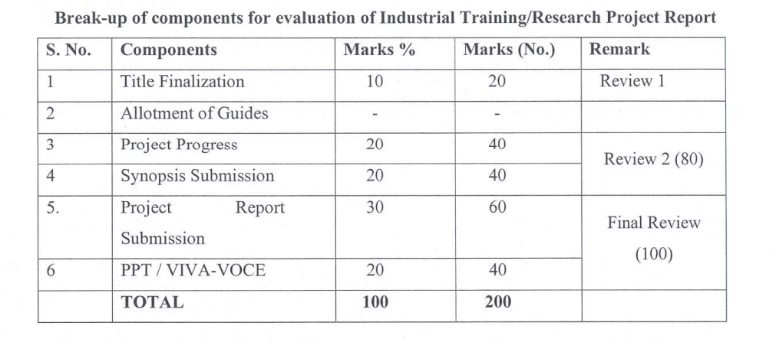
Project Evaluation:

Slide 15
Project Work Execution Plan (Tentative Dates )
Particulars | Date
Title Finalization | 31th August 2026
Synopsis Submission | 19th September 2026
Final Report Submission | 7th November 2026
Final Presentation Submission | 21st November 2026

Slide 16
Project PPT Contain
Presentation slides should have:
Title of the Project
Table of content
Introduction
Problem Statement
Objectives of the Project
Technology Stack
System Architecture / Design
Implementation
Testing and Validation Results and Output

Slide 17
Presentation Guidelines
The presentation should reflect academic and professional standards.
Learners must be formally dressed (business or smart casual attire recommended) during Viva presentation.
Clearly state your name, enrolment number, and project title at the beginning of the presentation.
Time limit: 15-20 minutes for the entire presentation.
Avoid reading directly from the slides or script present in your own words with confidence.

Slide 18
Project Viva Voce/ Presentation
The Soft copy of the final project report and power point presentation should be submit over Google form within the timeline stipulated by the University.
The learner should make a PowerPoint presentation of the project and submit it along the project report as Annexure.
Any Project related Query mail over E-mail-mcaproject@onlinevgu.com

Slide 19
Thank You

