Slide 1

Hotel Management system
Your Name
Enrollment No.

Slide 2
TABLE OF CONTENT
Introduction
Problem Statement
Objectives
Technology Stack
System Architecture /Design
Implementation
Testing and Validation
Results and Output
Appendices
Limitations & Future Scope
Conclusion and Suggestions
References & Bibliography

Slide 3
INTRODUCTION
Need for automated billing due to increasing infrastructure growth
Aim to replace manual, error-prone systems
Empowered by Java and SQL for a secure, efficient experience
Features real-time data handling, authentication, and notification

Slide 4
PROBLEM STATEMENT
Customer management, and billing processes are inefficient without automation.
There is no real-time tracking of room availability, leading to potential booking conflicts.
Manual preparation of invoices and reports increases workload and risks inaccuracies.
The absence of a centralized system makes it difficult to manage customer data securely.

Slide 5
OBJECTIVES OF THE PROJECT
To design and develop an automated Hotel Management System using Java and MySQL.
To enable efficient room booking, cancellation, and availability tracking.
To store and manage customer details securely.
To automate billing and invoice generation to reduce manual errors.

Slide 6
TECHNOLOGY STACK
Frontend: Java Swing / JavaFX
Backend: Java JDBC
Database: MySQL
IDE: NetBeans / Eclipse
OS: Windows / Linux

Slide 7
SYSTEM ARCHITECTURE / DESIGN
2-tier architecture: GUI (Java) + Database (MySQL)
ER Diagram: Customers, Rooms, Bookings, Bills tables; relationships between them
Flow: Booking → Check-in → Billing → Report

Slide 8
IMPLEMENTATION
GUI forms: Login, Booking, Customer management, Billing
SQL operations: Insert, Update, Delete, Select
Room status updates after booking/check-out
Automated bill calculation (room charges, taxes)

Slide 9
TESTING AND VALIDATION
Unit testing: Each form + database function verified
Integration testing: Booking → Billing → Report flow tested
Validation: Input checks for room number, date, customer data

Slide 10
RESULTS AND OUTPUT
Error-free booking and billing
Quick report generation
Real-time room status visibility
Improved customer data handling

Slide 11
LIMITATIONS & FUTURE SCOPE
No online booking feature yet
No mobile app
Future plans: online reservation, mobile support, analytics dashboard

Slide 12
CONCLUSION AND SUGGESTIONS
The system achieves its goal of automating key hotel operations.
Recommended: add online interface and user role management for better security.

Slide 13
REFERENCES & BIBLIOGRAPHY
Java: The Complete Reference – H. Schildt
MySQL documentation: https://dev.mysql.com/doc/
Oracle Java Tutorials: https://docs.oracle.com/javase/tutorial/

Slide 14
APPENDICES
Sample SQL code: INSERT INTO customers ..., UPDATE rooms ...
Screenshots: Booking form, Bill screen, Room status table
ER diagram sketch

Slide 15
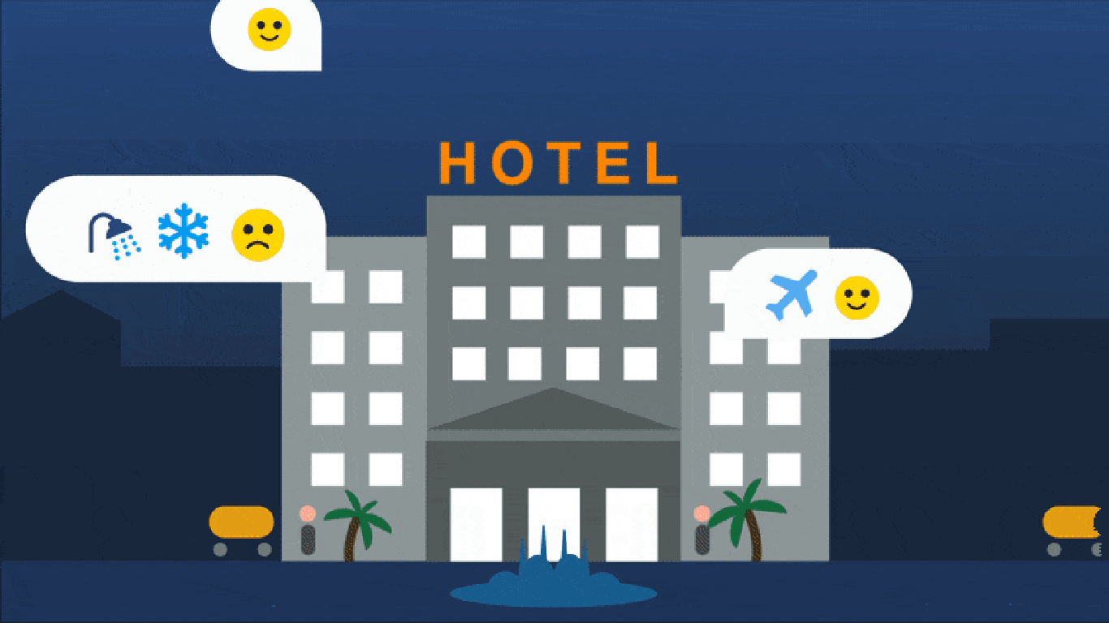

Slide 16
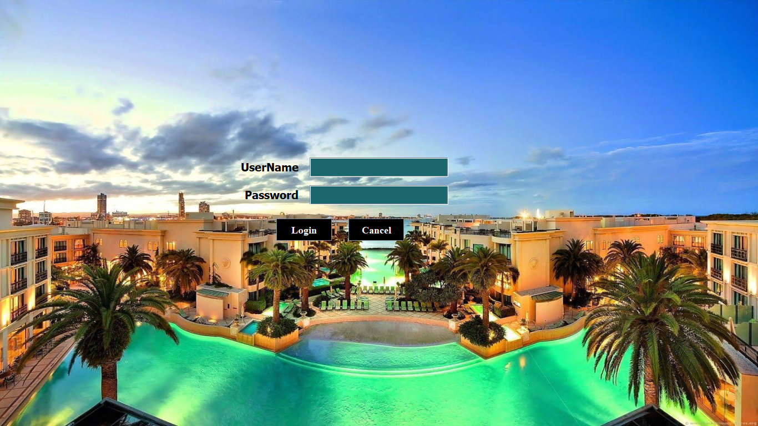

Slide 17
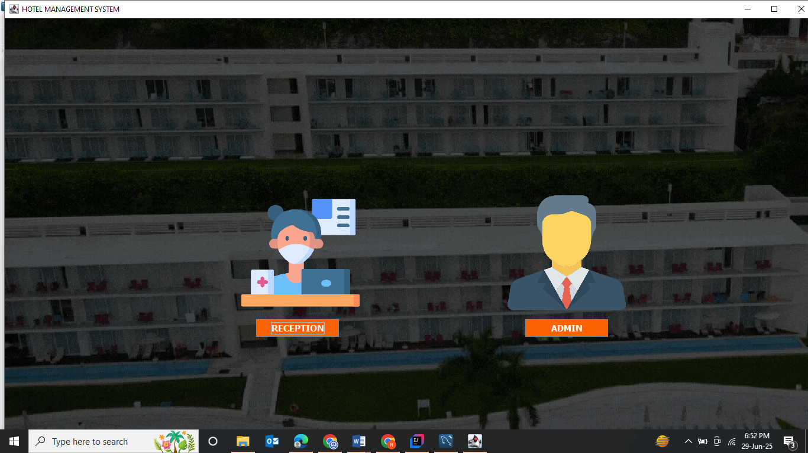

Slide 18
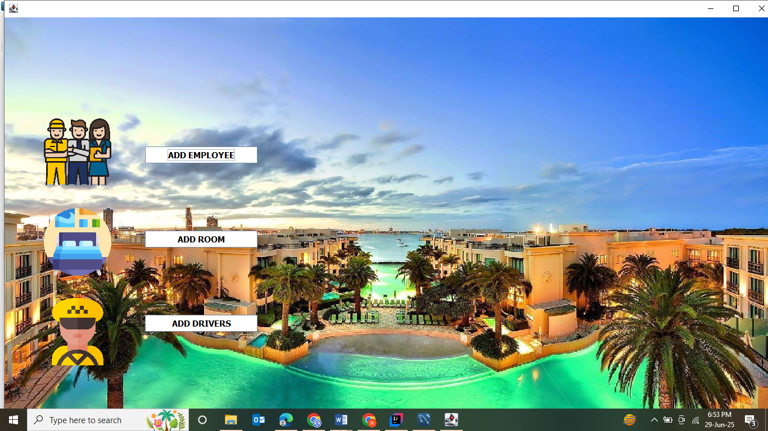

Slide 19
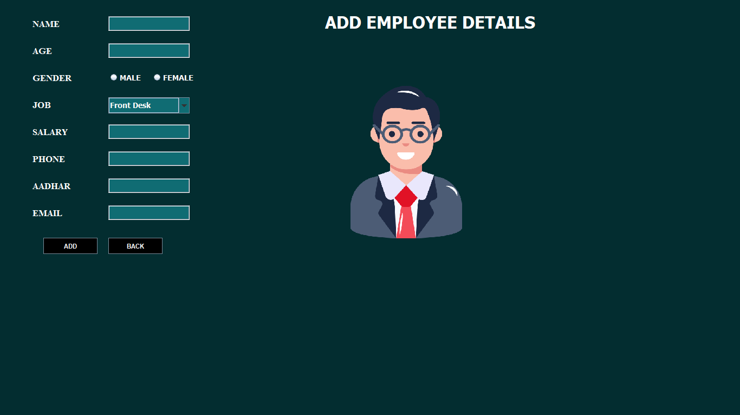

Slide 20
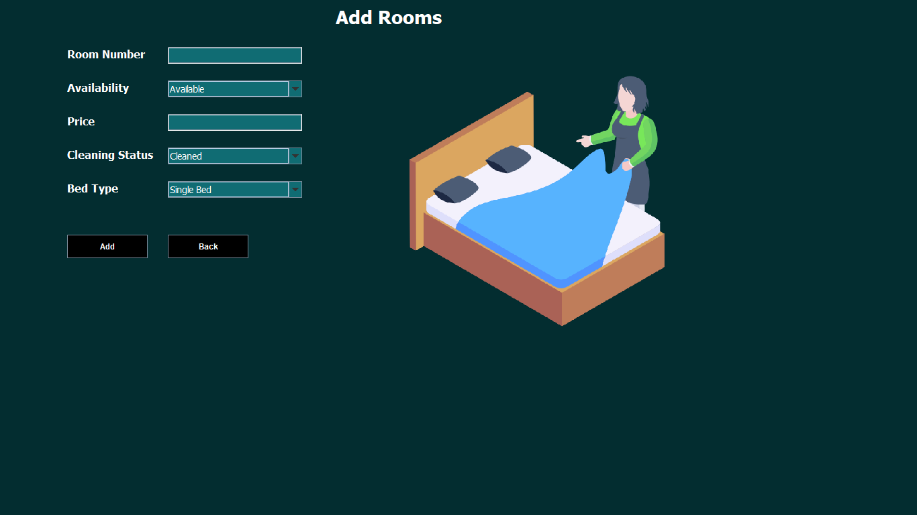

Slide 21
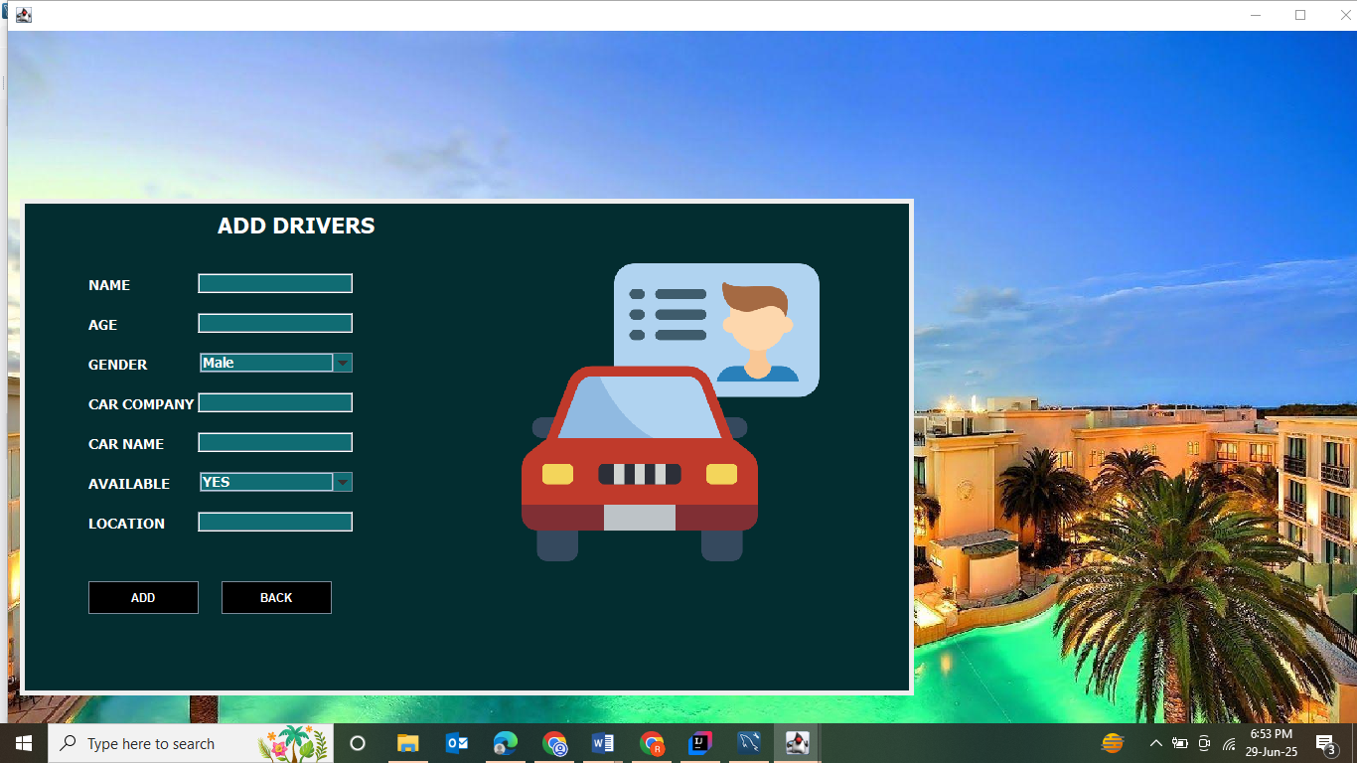

Slide 22
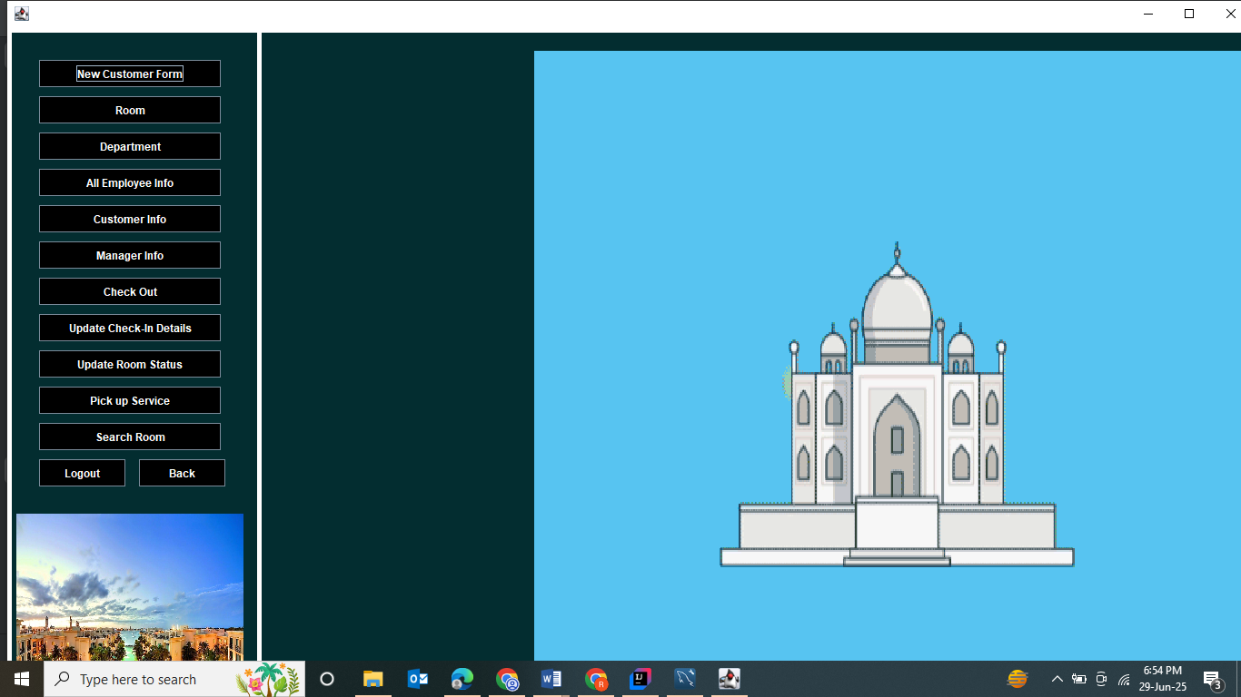

Slide 23
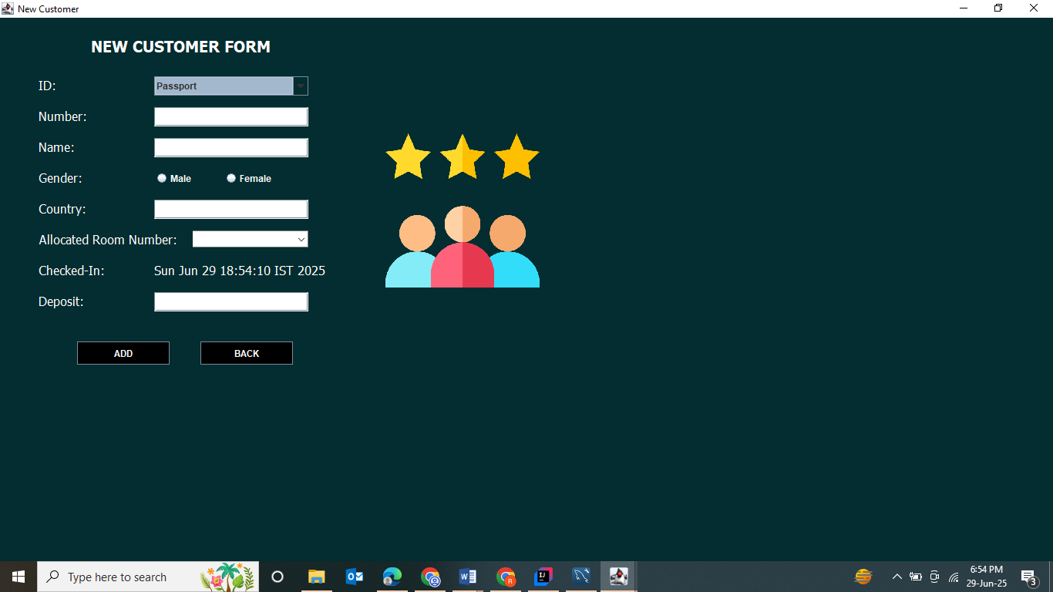

Slide 24
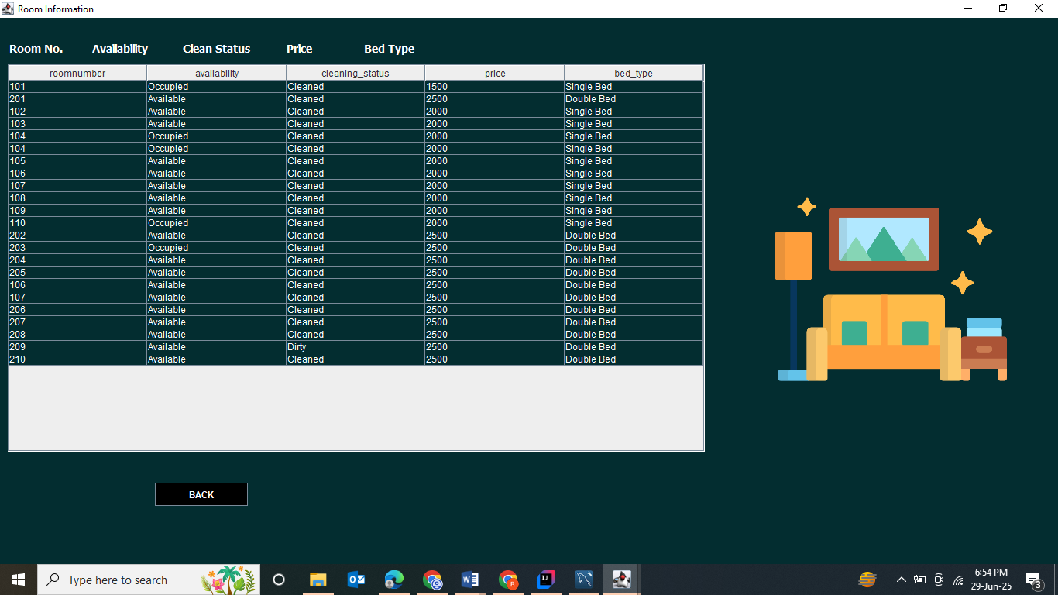

Slide 25
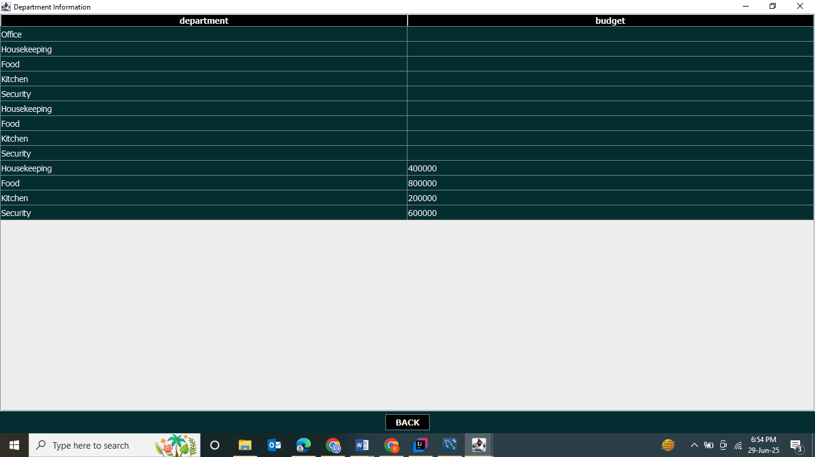

Slide 26
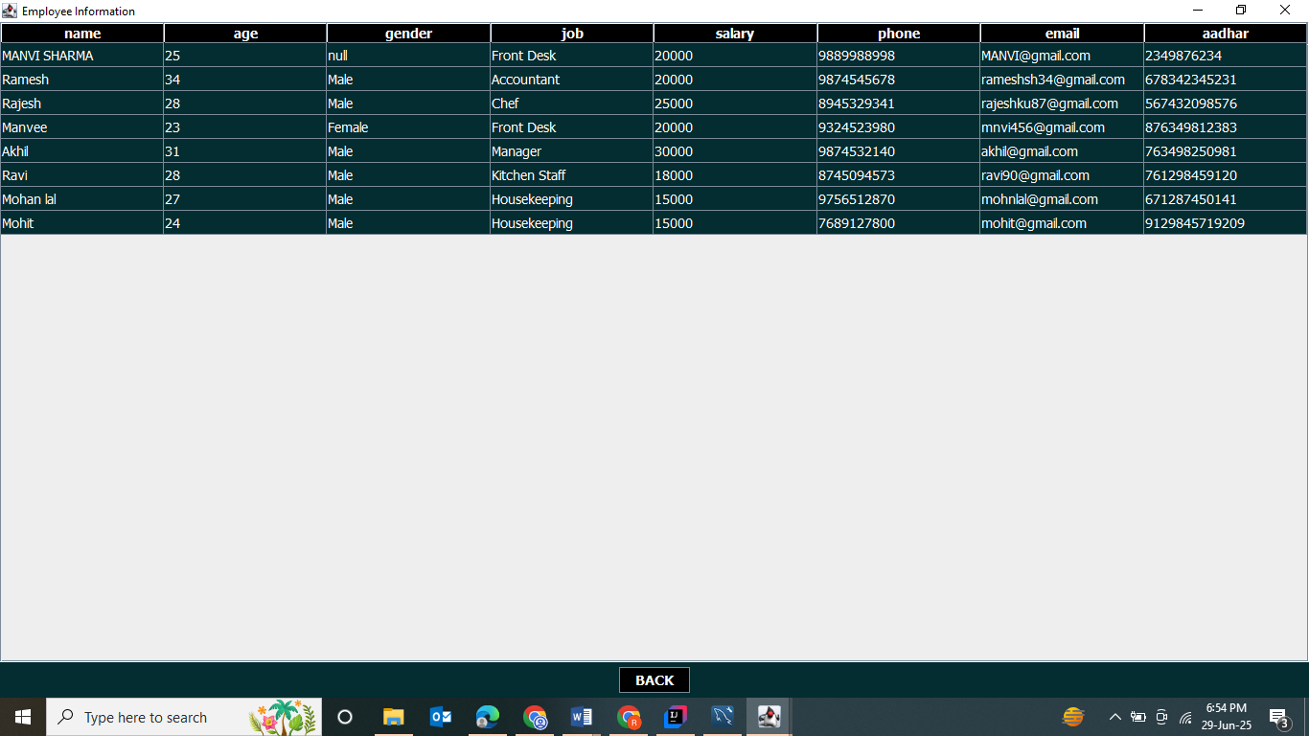

Slide 27
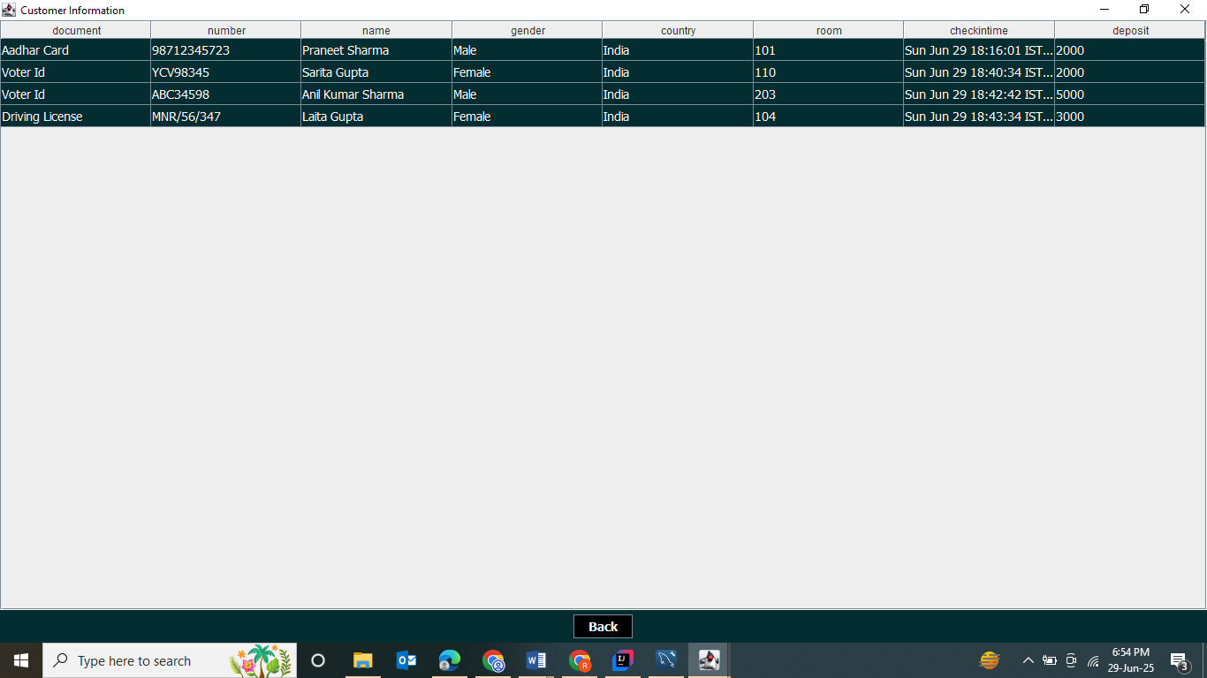

Slide 28
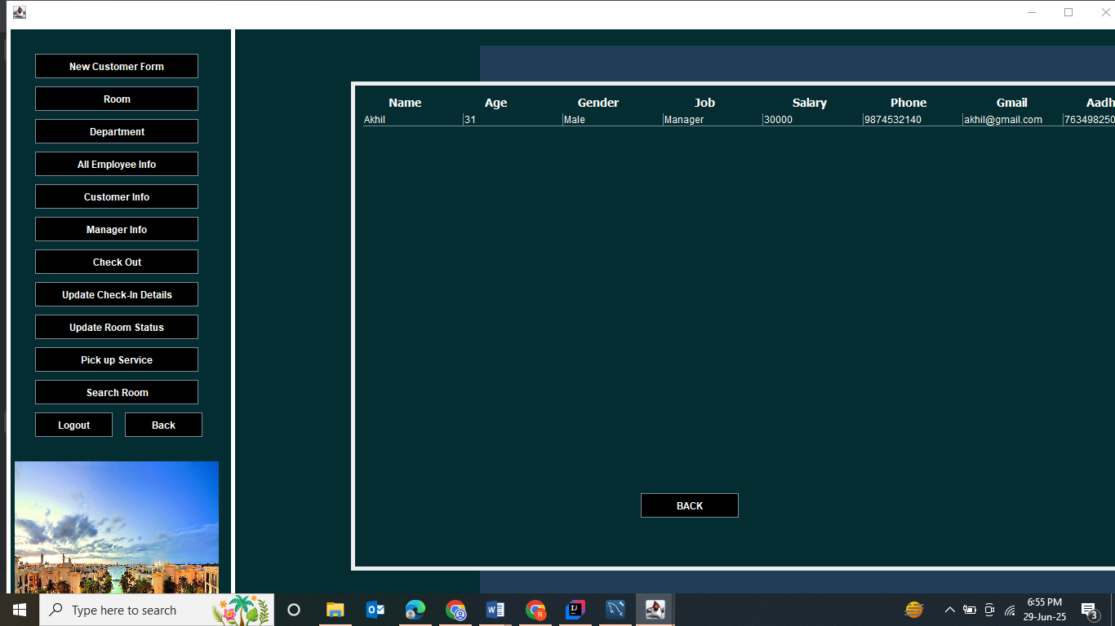

Slide 29
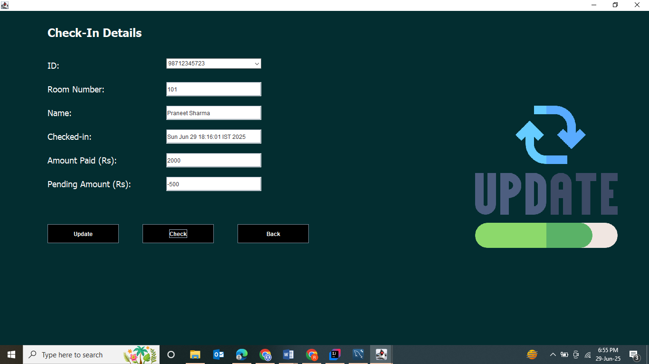

Slide 30
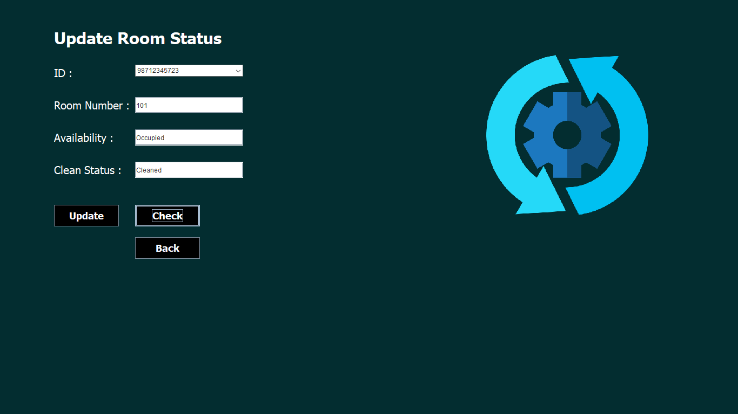

Slide 31
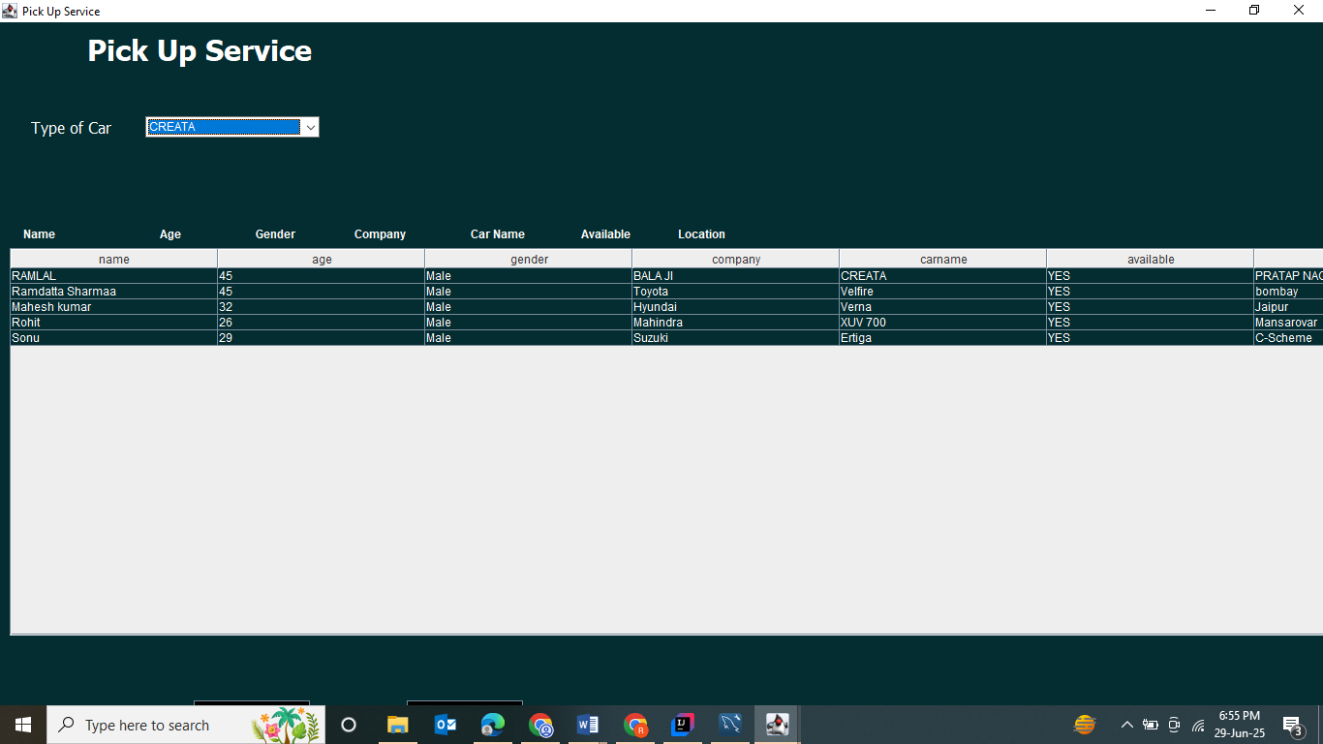

Slide 32
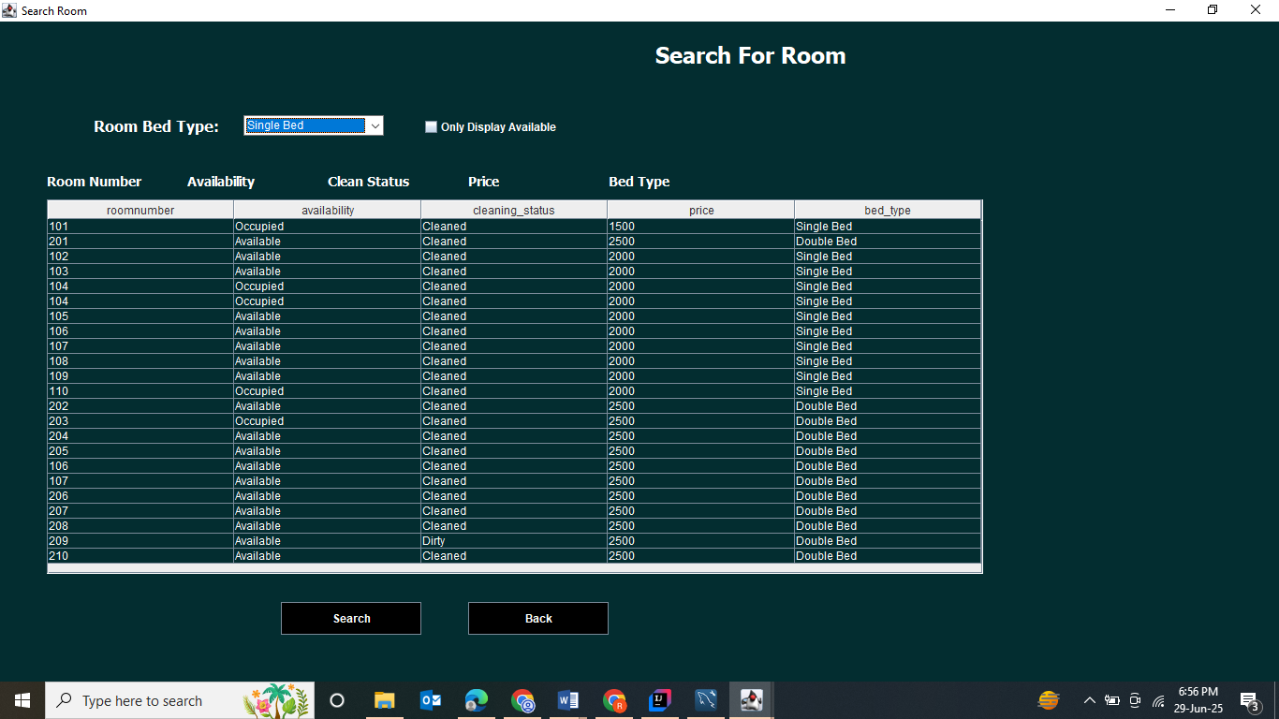

Slide 33
