Slide 1
UNIT – 5 Git & Version Control Getting Started with Git, Working with A Local Repository, Branches and Merging, Working with A Remote Repository, Test project with all test cases, finding bugs, check previous versions, deploying procedures, documentation.

Slide 2
GIT And Version Control
What is Git?
Git is an open-source distributed version control system. It is designed to handle minor to major projects with high speed and efficiency. It is developed to co-ordinate the work among the developers. The version control allows us to track and work together with our team members at the same workspace.
Git is foundation of many services like GitHub and GitLab, but we can use Git without using any other Git services. Git can be used privately and publicly.
Git was created by Linus Torvalds in 2005 to develop Linux Kernel. It is also used as an important distributed version-control tool for the DevOps.
It is used for:
Tracking code changes
Tracking who made changes
Coding collaboration

Slide 3
What does Git do?
Manage projects with Repositories
Clone a project to work on a local copy
Control and track changes with Staging and Committing
Branch and Merge to allow for work on different parts and versions of a project
Pull the latest version of the project to a local copy
Push local updates to the main project.
Working with Git:
Initialize Git on a folder, making it a Repository
Git now creates a hidden folder to keep track of changes in that folder
When a file is changed, added or deleted, it is considered modified
You select the modified files you want to Stage
The Staged files are Committed, which prompts Git to store a permanent snapshot of the files
Git allows you to see the full history of every commit.
You can revert back to any previous commit.
Git does not store a separate copy of every file in every commit, but keeps track of changes made in each commit!
Git configuration Level:
--system
-- global
--local

Slide 4
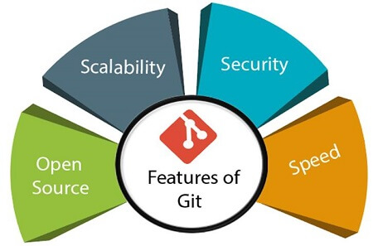
Features of Git

Slide 5
Open Source Git is an open-source tool. It is released under the GPL (General Public License) license.
Scalable Git is scalable, which means when the number of users increases, the Git can easily handle such situations.
Distributed One of Git's great features is that it is distributed. Distributed means that instead of switching the project to another machine, we can create a "clone" of the entire repository.
Also, instead of just having one central repository that you send changes to, every user has their own repository that contains the entire commit history of the project. We do not need to connect to the remote repository; the change is just stored on our local repository.
If necessary, we can push these changes to a remote repository.

Slide 6
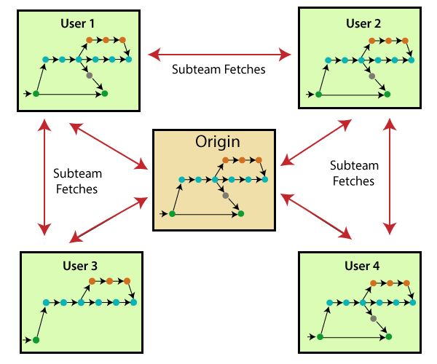

Slide 7
Security Git is secure. It uses the SHA1 (Secure Hash Function) to name and identify objects within its repository. Files and commits are checked and retrieved by its checksum at the time of checkout.
Speed Git is very fast, so it can complete all the tasks in a while. Most of the git operations are done on the local repository, so it provides a huge speed. Also, a centralized version control system continually communicates with a server somewhere. Performance tests conducted by Mozilla showed that it was extremely fast compared to other VCSs.
Supports non-linear development Git supports seamless branching and merging, which helps in visualizing and navigating a non-linear development. A branch in Git represents a single commit. We can construct the full branch structure with the help of its parental commit.
Branching and Merging Branching and merging are the great features of Git, which makes it different from the other SCM tools. Git allows the creation of multiple branches without affecting each other. We can perform tasks like creation, deletion, and merging on branches, and these tasks take a few seconds

Slide 8
some features that can be achieved by branching:We can create a separate branch for a new module of the project, commit and delete it whenever we want.
We can have a production branch, which always has what goes into production and can be merged for testing in the test branch.
We can create a demo branch for the experiment and check if it is working. We can also remove it if needed.
The core benefit of branching is if we want to push something to a remote repository, we do not have to push all of our branches. We can select a few of our branches, or all of them together.

Slide 9
Data Assurance The Git data model ensures the cryptographic integrity of every unit of our project. It provides a unique commit ID to every commit through a SHA algorithm. We can retrieve and update the commit by commit ID. Most of the centralized version control systems do not provide such integrity by default.
Staging Area The Staging area is also a unique functionality of Git. It can be considered as a preview of our next commit, moreover, an intermediate area where commits can be formatted and reviewed before completion.
When you make a commit, Git takes changes that are in the staging area and make them as a new commit. We are allowed to add and remove changes from the staging area. The staging area can be considered as a place where Git stores the changes. Although, Git doesn't have a dedicated staging directory where it can store some objects representing file changes (blobs). Instead of this, it uses a file called index.
Maintain the clean history Git facilitates with Git Rebase; It is one of the most helpful features of Git. It fetches the latest commits from the master branch and puts our code on top of that. Thus, it maintains a clean history of the project.

Slide 10
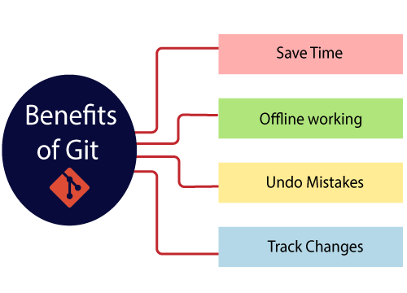
Benefits of Git

Slide 11
Saves Time Git is lightning fast technology. Each command takes only a few seconds to execute so we can save a lot of time as compared to login to a GitHub account and find out its features.
Offline Working One of the most important benefits of Git is that it supports offline working. If we are facing internet connectivity issues, it will not affect our work. In Git, we can do almost everything locally. Comparatively, other CVS like SVN is limited and prefer the connection with the central repository.
Undo Mistakes One additional benefit of Git is we can Undo mistakes. Sometimes the undo can be a savior option for us. Git provides the undo option for almost everything.
Track the Changes Git facilitates with some exciting features such as Diff, Log, and Status, which allows us to track changes so we can check the status, compare our files or branches.

Slide 12
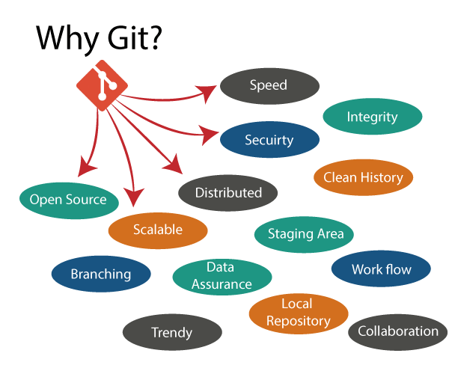
Why Git?

Slide 13
Over 70% of developers use Git!
Developers can work together from anywhere in the world.
Developers can see the full history of the project.
Developers can revert to earlier versions of a project.
Git Integrity Git is developed to ensure the security and integrity of content being version controlled. It uses checksum during transit or tampering with the file system to confirm that information is not lost. Internally it creates a checksum value from the contents of the file and then verifies it when transmitting or storing data.
Trendy Version Control System Git is the most widely used version control system. It has maximum projects among all the version control systems. Due to its amazing workflow and features, it is a preferred choice of developers.
Everything is Local Almost All operations of Git can be performed locally; this is a significant reason for the use of Git. We will not have to ensure internet connectivity.
Collaborate to Public Projects There are many public projects available on the GitHub. We can collaborate on those projects and show our creativity to the world. Many developers are collaborating on public projects. The collaboration allows us to stand with experienced developers and learn a lot from them; thus, it takes our programming skills to the next level.
Impress Recruiters We can impress recruiters by mentioning the Git and GitHub on our resume. Send your GitHub profile link to the HR of the organization you want to join. Show your skills and influence them through your work. It increases the chances of getting hired.

Slide 14
What is GitHub?
GitHub is a Git repository hosting service. GitHub also facilitates with many of its features, such as access control and collaboration. It provides a Web-based graphical interface.
GitHub is an American company.
It hosts source code of your project in the form of different programming languages and keeps track of the various changes made by programmers.
It offers both distributed version control and source code management (SCM) functionality of Git. It also facilitates with some collaboration features such as bug tracking, feature requests, task management for every project.
Git is not the same as GitHub.
GitHub makes tools that use Git.
GitHub is the largest host of source code in the world, and has been owned by Microsoft since 2018.

Slide 15
Features of GitHub
GitHub is a place where programmers and designers work together. They collaborate, contribute, and fix bugs together. It hosts plenty of open source projects and codes of various programming languages.
Some of its significant features are as follows.
Collaboration
Integrated issue and bug tracking
Graphical representation of branches
Git repositories hosting
Project management
Team management
Code hosting
Track and assign tasks
Conversations
Wikisc

Slide 16
Benefits of GitHub
It is easy to contribute to open source projects via GitHub.
It helps to create an excellent document.
We can attract recruiter by showing off your work. If you have a profile on GitHub, you will have a higher chance of being recruited.
It allows your work to get out there in front of the public.
We can track changes in your code across versions.

Slide 17
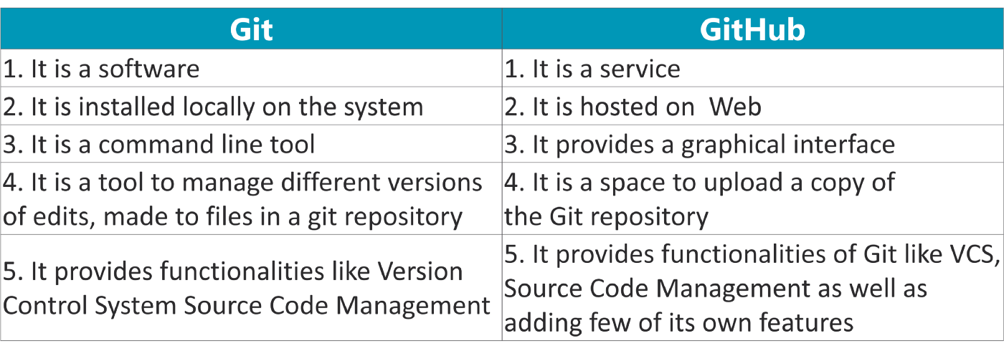
Differences between Git and GitHub

Slide 18
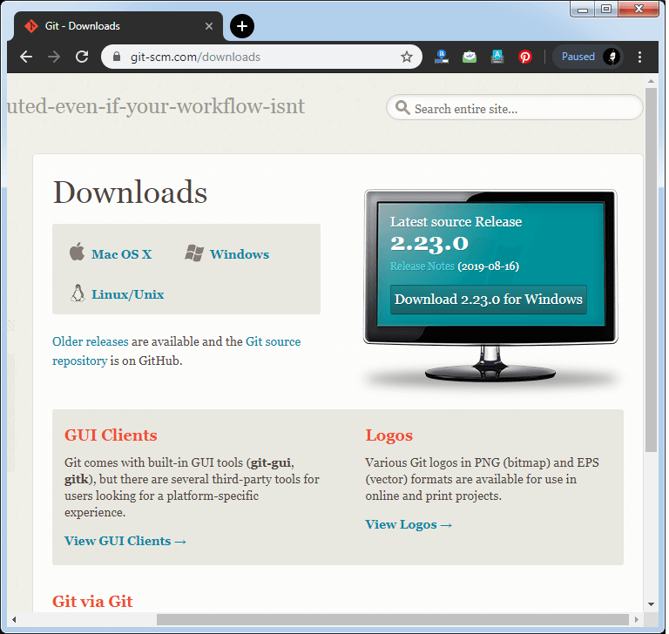
How to download Git?

Slide 19
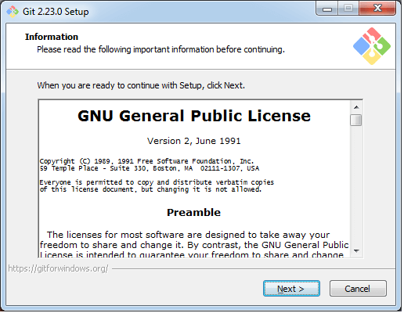
Step2 Click on the downloaded installer file and select yes to continue. After the selecting yes the installation begins, and the screen will look like as

Slide 20
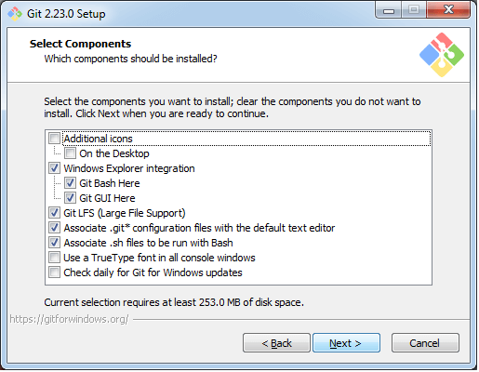
Click on next to continue. Step3 Default components are automatically selected in this step. You can also choose your required part.

Slide 21
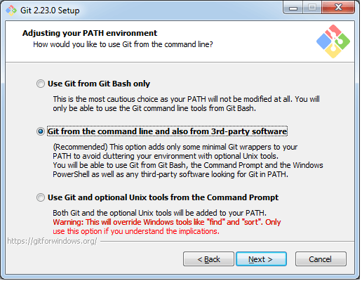
Step4: The default Git command-line options are selected automatically. You can choose your preferred choice. Click next to continue.

Slide 22
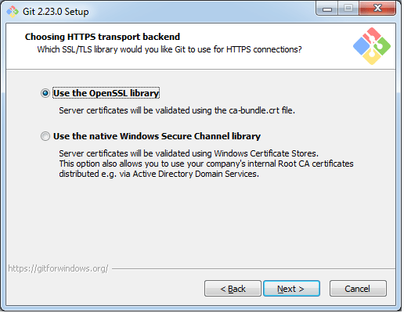
Step5 The default transport backend options are selected in this step. Click next to continue.

Slide 23
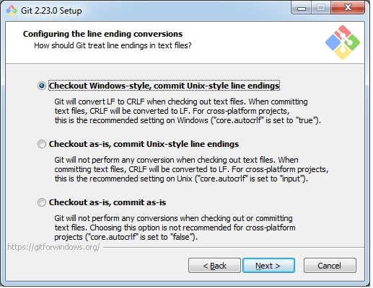
Step6: Select your required line ending option and click next to continue.

Slide 24
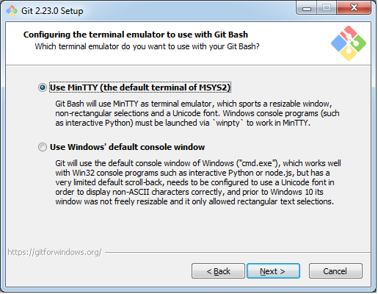
Step7 Select preferred terminal emulator clicks on the next to continue.

Slide 25
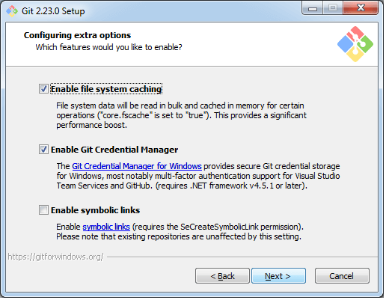
Step8 This is the last step that provides some extra features like system caching, credential management and symbolic link. Select the required features and click on the next option.

Slide 26
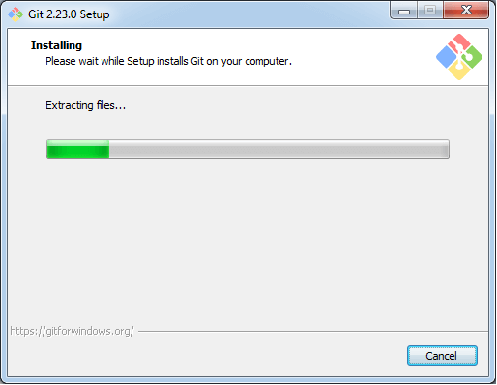
Step9 The files are being extracted in this step.

Slide 27
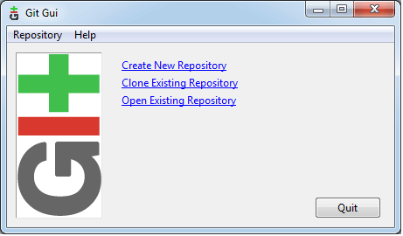
Therefore, The Git installation is completed. Now you can access the Git Gui and Git Bash. The Git Gui looks like as

Slide 28
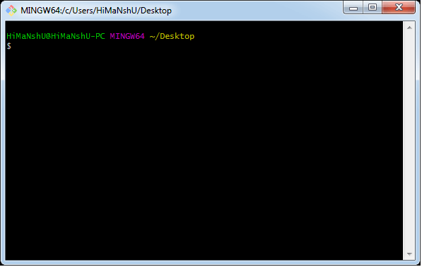
I It facilitates with three features. Create New Repository Clone Existing Repository Open Existing Repository

Slide 29
The first thing we need to do, is to check if Git is properly installed:
Example:
git --version
git version 2.30.2.windows.1
Configure Git
Example:
git config --global user.name “DEEPIKA-POKURI"
git config --global user.email “Deepika@gmail.com"

Slide 30
Creating Git Folder
Example:
mkdir myproject
cd myproject
mkdir makes a new directory.
cd changes the current working directory.
Initialize Git
Once you have navigated to the correct folder, you can initialize Git on that folder:
Example:
git init
Initialized empty Git repository in /Users/user/myproject/.git/

Slide 31
GIT Repository
Repositories in GIT contain a collection of files of various different versions of a Project. These files are imported from the repository into the local server of the user for further updations and modifications in the content of the file. A VCS or the Version Control System is used to create these versions and store them in a specific place termed as a repository.
Repositories in Git are of two types:
Local Repository: Git allows the users to perform work on a project from all over the world because of its Distributive feature. This can be done by cloning the content from the Central repository stored in the GitHub on the user’s local machine. This local copy is used to perform operations and test them on the local machine before adding them to the central repository.
Remote Repository: Git allows the users to sync their copy of the local repository to other repositories present over the internet. This can be done to avoid performing a similar operation by multiple developers. Each repository in Git can be addressed by a shortcut called remote.
Git provides tools to perform work on these repositories according to the needs of the user. This workflow of performing modifications to a Repository is referred to as the Working Tree.

Slide 32
Working with local repositories
1)git init:
Usage: git init [repository name]
This command is used to start a new repository.
2) git add:
Usage: git add [file]
This command adds a file to the staging area.
3) git commit
Usage: git commit -m “[ Type in the commit message]”
This command records or snapshots the file permanently in the version history.
4) git status
Usage: git status
This command lists all the files that have to be committed.
5)git config
Usage: git config –global user.name “[name]”
Usage: git config –global user.email “[email address]”
This command sets the author name and email address respectively to be used with your commits.

Slide 33
6) git branch
i)Usage: git branch (or) git branch --list
This command lists all the local branches in the current repository.
ii)Usage: git branch [branch name]
This command creates a new branch.
iii)Usage: git branch -d [branch name]
This command deletes the feature branch.
7)git checkout
i)Usage: git checkout [branch name]
This command is used to switch from one branch to another.
ii)Usage: git checkout -b [branch name]
This command creates a new branch and also switches to it.
8)git merge
Usage: git merge [branch name]
This command merges the specified branch’s history into the current branch.

Slide 34
Working with remote repositories
1)git remote
i)Usage: git remote add [variable name] [Remote Server Link]
This command is used to connect your local repository to the remote server.
Ex:git remote add origin remote server link
ii)List named remote repositories:
$ git remote –v
2)git clone
Usage: git clone [url]
This command is used to obtain a repository from an existing URL.
3) git push
Usage: git push [variable name] [branch]
This command sends the branch commits to your remote repository.
4) git pull
Usage: git pull [Repository Link]
This command fetches and merges changes on the remote server to your working directory.
5) git log
Usage: git log
This command is used to list the version history for the current branch.

Slide 35
Test project with all test cases
Using the TestProject integration with GitHub, your synchronized projects are stored as repositories with all of their tests (with simple YAML format) in them. Each change that you make in your test, will automatically be stored and documented so you can seamlessly keep track of your progress.

Slide 36
Using TestProject’s built-in integration with GitHub enables you to:
Split your test automation into different environments
Synchronize entire projects with GitHub: the tests will be saved in YAML format and contain all the information to run autonomously
Seamlessly keep and access test history
Manage different versions and save all of your team’s progress
Run any previous test versions using TestProject CLI/Offline
Import various test versions back into TestProject
See what has changed in your tests directly on GitHub
Integrate your CI (Continuous Integration) flow directly into GitHub repos (below is an example diagram for a CI flow with TestProject-GitHub Integration)

Slide 37
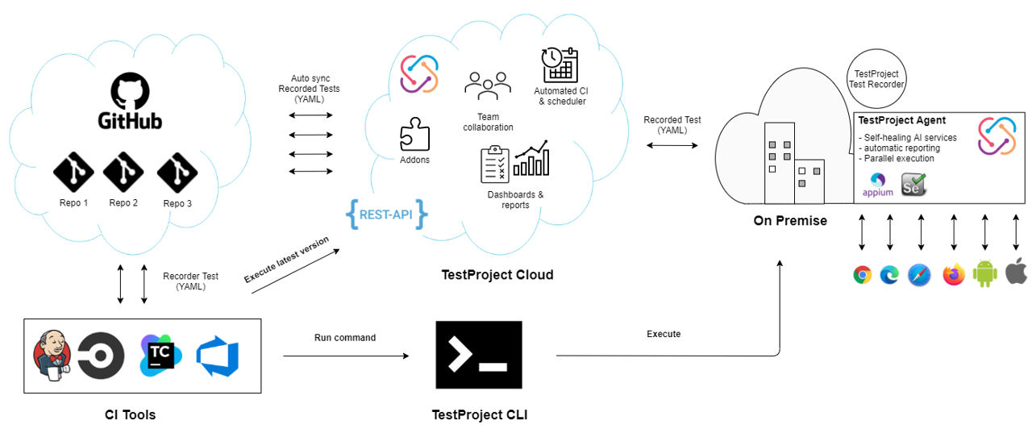

Slide 38
Test cases in GitLab can help your teams create testing scenarios in their existing development platform.
Now your Implementation and Testing teams can collaborate better, as they no longer have to use external test planning tools, which require additional overhead, context switching, and expense.

Slide 39
To create a test case in a GitLab project:
Go to CI/CD > Test Cases.
Select the New test case button. You are taken to the new test case form. Here you can enter the new case’s title, description, attach a file, and assign labels.
Select the Submit test case button. You are taken to view the new test case.
To view a test case:
In a project, go to CI/CD > Test Cases.
Select the title of the test case you want to view.

Slide 40
To edit a test case:
View a test case.
Select Edit title and description ().
Edit the test case’s title or description.
Select Save changes
To archive a test case, on the test case’s page, select the Archive test case button.
To view archived test cases:
Go to CI/CD > Test Cases.
Select Archived.

Slide 41
Finding bugs
SpotBugs is a program which uses static analysis to look for bugs in Java code. It is free software, distributed under the terms of the GNU Lesser General Public License.
SpotBugs is a fork of FindBugs (which is now an abandoned project), carrying on from the point where it left off with support of its community.
SpotBugs requires JRE (or JDK) 1.8.0 or later to run. However, it can analyze programs compiled for any version of Java, from 1.0 to 1.9.
SpotBugs checks for more than 400 bug patterns.

Slide 42
Using SpotBugs
SpotBugs can be used standalone and through several integrations, including:
Ant
Maven
Gradle
Eclipse
To automatically configure the Eclipse SpotBugs plugin from the SpotBugs Maven plugin configuration, use m2e-code-quality.
SpotBugs is extensible. New detectors can be added through plugins. Popular SpotBugs plugins include:
fb-contrib
find-sec-bugs

Slide 43
git-bisect - Use binary search to find the commit that introduced a bug
git bisect <subcommand> <option>
Basic bisect commands
Git bisect start
Git bisect bad
Git bisect good

Slide 44
check previous versions
Going back in history is very simple. The checkout command can copy any snapshot from the repo to the working directory.
The checkout command output totally clarifies the situation. Older git versions will complain about not being on a local branch. But you don’t need to worry about that right now.
Returning to the latest version in the master branch
git checkout master
master’ is the name of the default branch. By checking out a branch by name, you go to its latest version.

Slide 45
deploying procedures
Heroku manages app deployments with Git, the popular version control system. You don’t need to be a Git expert to deploy code to Heroku, but it’s helpful to learn the basics.
You must have Git and the Heroku CLI installed to deploy with Git.
Git installation instructions
Heroku CLI installation instructions

Slide 46
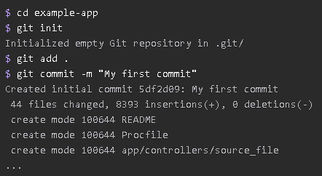
Create a heroku remote
You deploy your app by pushing its code to a special Heroku-hosted remote that’s associated with your app.

Slide 47
For new app
The heroku create CLI command creates a new empty application on Heroku, along with an associated empty Git repository. If you run this command from your app’s root directory, the empty Heroku Git repository is automatically set as a remote for your local repository.

Slide 48
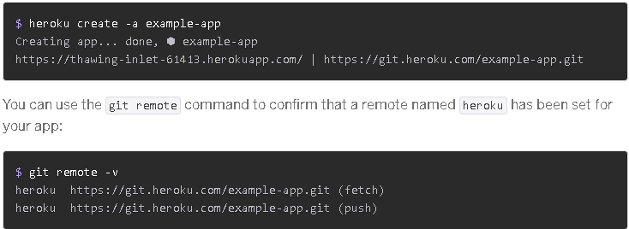

Slide 49
For an existing app
Add a remote to your local repository with the
Heroku git:remote command followed with heroku app.
Example heroku git:remote –a example-app
Rename a remote
By default, the Heroku CLI names all of the Heroku remotes it creates for your app heroku. You can rename your remotes with the git remote rename command. For example, rename heroku to heroku-staging:
Git remote rename heroku heroku-staging
Deploy your code
To deploy your app to heroku. Use git push command to push the code from your local repository’s main branch to your heroku remote.
Git push heroku main

Slide 50
To reset or purge an app’s Heroku Git repository, use the heroku-repo CLI plugin:
Heroku plugin:install heroku-repo
Heroku repo:reset –app appname

