Slide 1


CONVOLUTIONAL NEURAL NETWORK
DEEPIKA R
Deep2neuron Internship

Slide 2
Contents
Neural network
Introduction to CNN
What is CNN
How CNN recognize images?
CNN components
Input
Convolution
Non –linearity (ReLu)
Pooling

Slide 3
Contents .
Fully connected layer
Overall architecture
CNN architecture
Applications
RNN
LSTM
RNN Vs LSTM

Slide 4
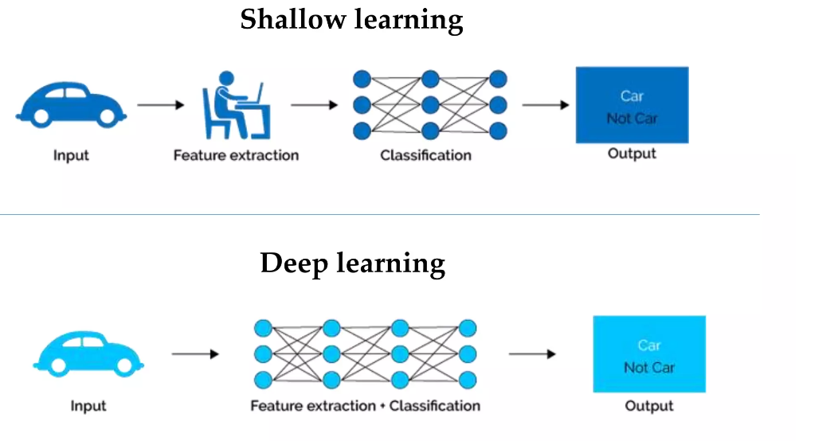
.

Slide 5
Neural network
.
Artificial Neural Network(ANN)
Regression and classification
NEURAL NETWORK
Convolutional Neural Network(CNN)
Computer vision
Recurrent Neural Network(RNN)
Time series analysis

Slide 6
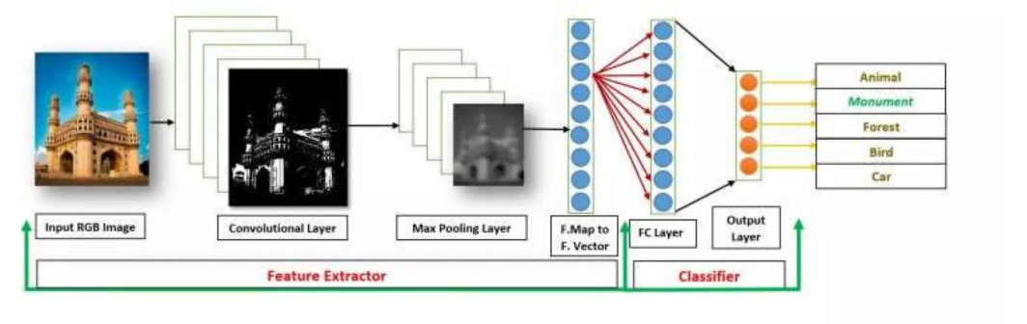
Introduction to CNN
Convolutional Neural Networks (CNNs) learns multi-level features and classifier in a joint fashion and performs much better than traditional approaches for various image classification and segmentation problems.

Slide 7
What is CNN?
It is a class of deep learning
Convolutional neural network (CNNs) is one of the main categories to do images recognition, images classifications, objects detections, recognition faces etc.,
It is similar to the basic neural network.
CNN also have learnable parameter like neural network i.e., weights, biases etc.
CNN is heavily used in computer vision

Slide 8
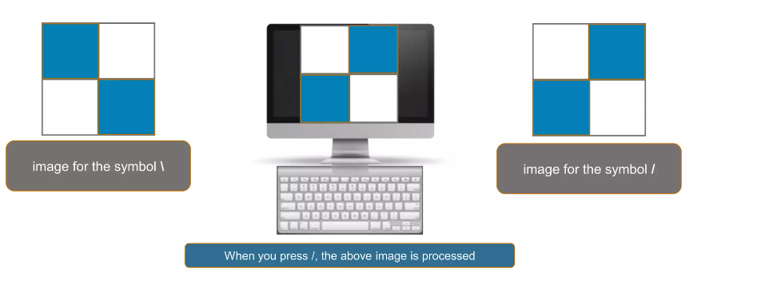
How CNN recognize images?
Consider two images:

Slide 9
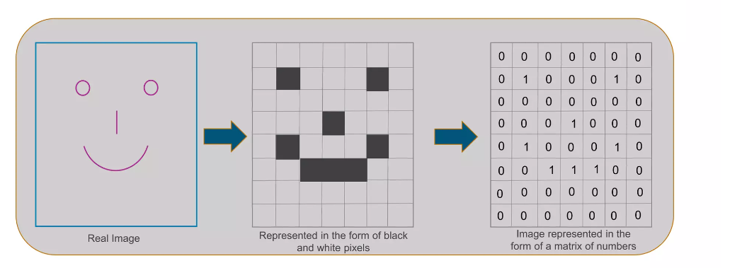
How CNN recognize images?

Slide 10
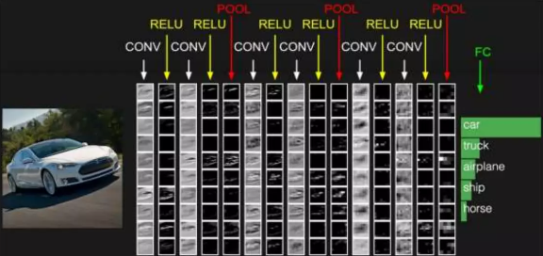
CNN components
There are four main components in the CNN:
1. Convolution
2. Non-Linearity
3. Pooling or Sub Sampling
4. Classification (Fully Connected Layer)

Slide 11
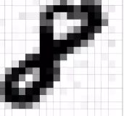
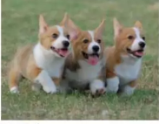
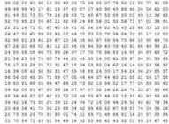
Input
An Image is a matrix of pixel values.
If we consider a gray scale image, the value of each pixel in the matrix will range from 0 to 255.
If we consider an RGB image, each pixel will have the combined values of R, G and B.
What we see
What computer see

Slide 12
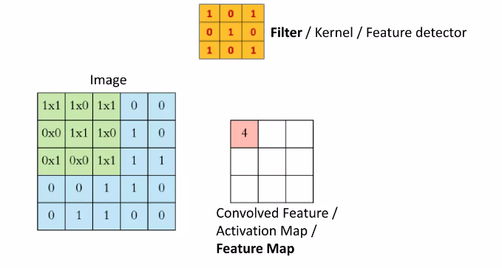
Convolution
The primary purpose of Convolution in case of a CNN is to extract features from the input image.

Slide 13
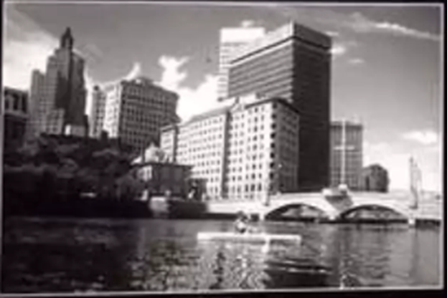
Example input
Convolutional input…

Slide 14
Convolution
The size of the output volume is controlled by three parameters that we need to decide before the convolution step is performed:
1.Depth: Depth corresponds to the number of filters we use for the convolution operation.
2.Stride: Stride is the number of pixels by which we slide our filter matrix over the input matrix.
3.Zero-padding: Sometimes, it is convenient to pad the input matrix with zeros around the border, so that we can apply the filter to bordering elements of our input image matrix.
With zero-padding wide convolution
Without zero-padding narrow convolution

Slide 15
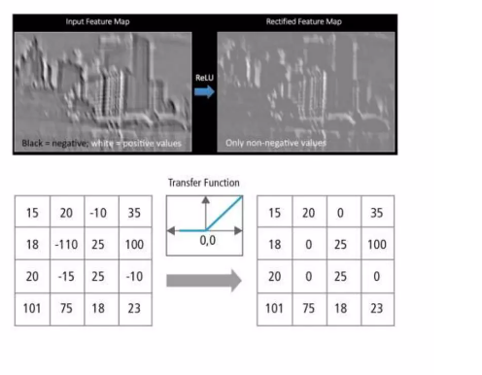
Non Linearity(ReLu)
Replaces all negative pixel values in the feature map by zero.
The purpose of ReLU is to introduce non- linearity in CNN, since most of the real-world data would be non-linear.
Other non-linear functions such as tan h (-1,1)or sigmoid (0,1) can also be used instead of ReLU (0,input)

Slide 16
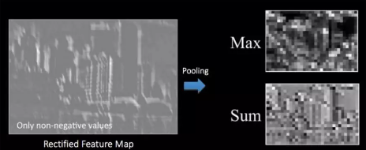
Pooling
Reduces the dimensionality of each feature map but retains the most important information. Pooling can be of different types: Max, Average, Sum etc.

Slide 17
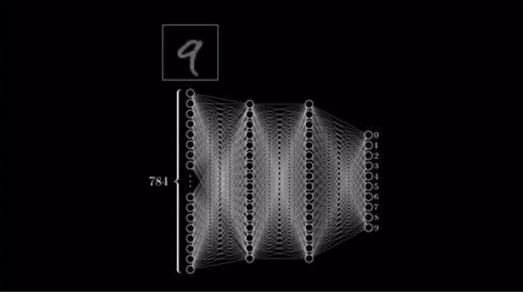
Fully connected layer
A traditional Multi-Layer Perceptron.The term "Fully Connected" implies that every neuron in the previous layer is connected to every neuron on the next layer.
Their activations can hence be computed with a matrix multiplication followed by a bias offset.
The purpose of the Fully Connected layer is to use the high-level features for classifying the input image into various classes based on the training dataset.

Slide 18
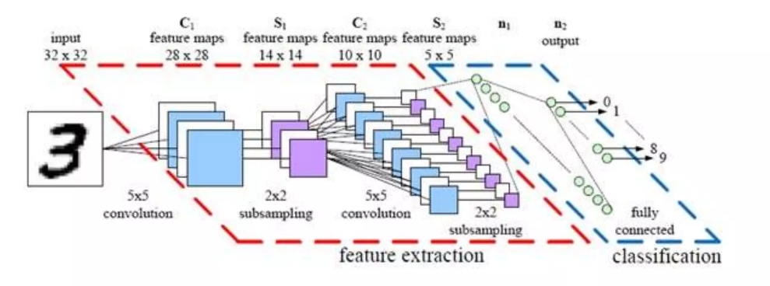
Overall CNN architecture

Slide 19
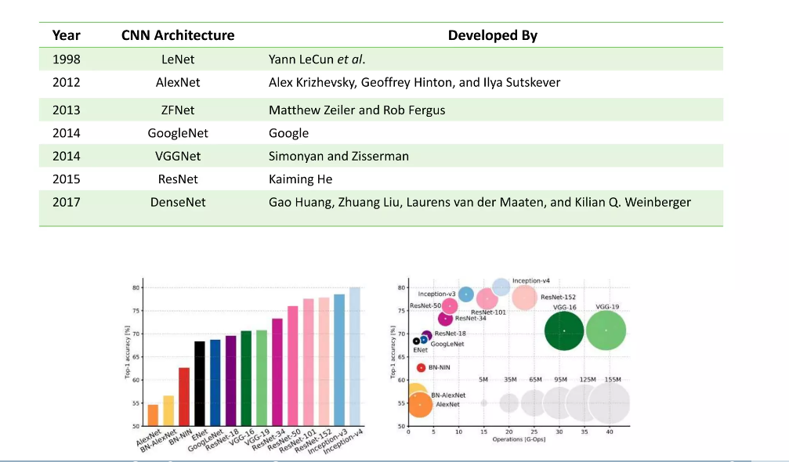
CNN architecture

Slide 20
Applications
OCR and image recognition
Decoding Facial Recognition
Analyzing Documents
Grey Areas
Detecting objects in self-driving cars
Social media face recognition
Image analysis in medicine Advertising

Slide 21
RECURRENT NEURAL NETWORK(RNN)

Slide 22
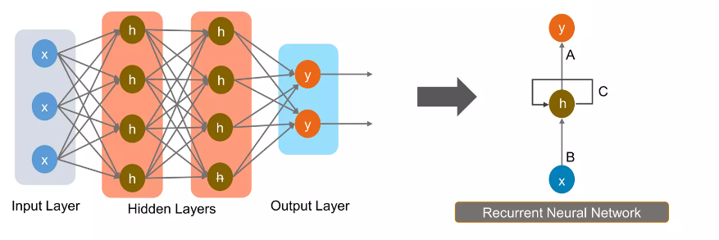
What is RNN?
Recurrent Neural Networks (RNNs) are a type of artificial neural network architecture designed for processing sequential data.
At each time step, an RNN takes an input and also receives an internal hidden state from the previous time step. This hidden state serves as a memory of the network, allowing it to capture information from past inputs.
Recurrent Neural Network works on the principle of saving the output of a layer and feeding this back to the input in order to predict the output of the layer.

Slide 23
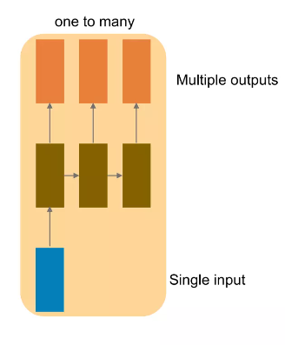
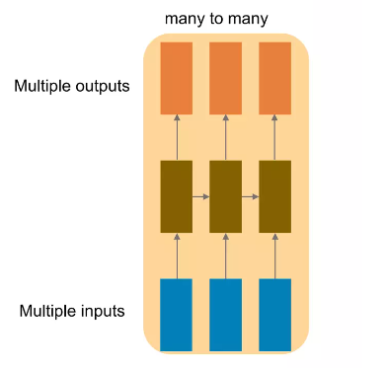
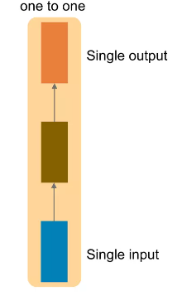
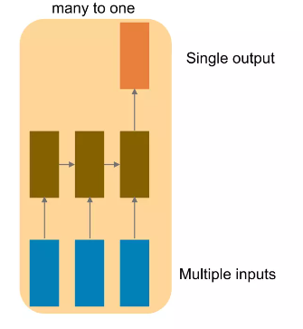
Types of RNN

Slide 24
Applications
Image captioning-RNN is used to caption an image by analyzing the activities present in it.
Time series prediction-Any time series problem like predicting the prices of stocks in a particular month can be solved using RNN.
Natural Language Processing-Text mining and Sentiment analysis can be carried out using RNN for Natural Language Processing.
Machine Translation-Given an input in one language, RNN can be used to translate the input into different languages as output.

Slide 25
LONG SHORT TERM MEMORY(LSTM)

Slide 26
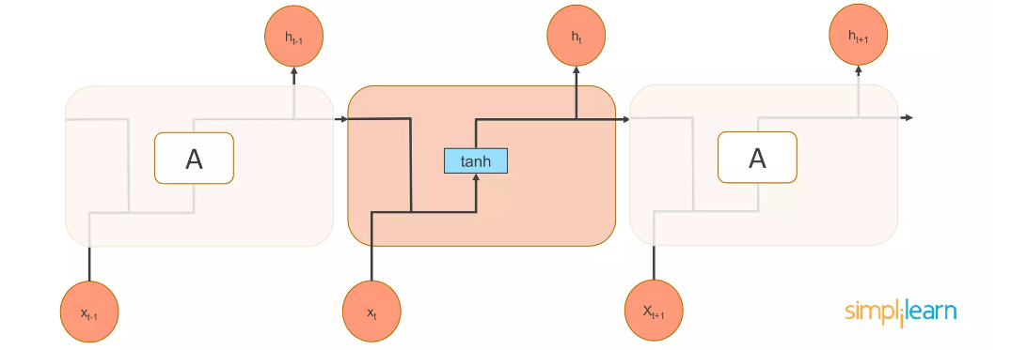
What is LSTM?
LSTMs are special kind of Recurrent Neural Networks capable of learning long-term information for long periods of time is their default behavior.
Al recurrent neural networks have the form of a chain of repeating modules of neural network. In standard RNNs, this repeating module have a very simple structure, such as a single tanh layer.

Slide 27
3-Step process of LSTM
.
Forget irrelevant parts of previous state
Step-1
Selectively update cell state value
Step-2
Output certain parts of cell state
Step-3

Slide 28
Application
LSTM (Long Short-Term Memory) networks are widely applied in:
Natural Language Processing (NLP)
Speech Recognition
Time Series Analysis
Image and Video Captioning
Music Generation
Anomaly Detection
Gesture Recognition
Medical Applications

Slide 29
RNN Vs LSTM
RNN
LSTM
Struggles to capture long-term dependencies effectively due to the vanishing gradient problem.
Does not have explicit gating mechanisms.
Simpler architecture with fewer parameters.
Limited memory capacity and can forget information quickly.
Specifically designed to address the vanishing gradient problem, allowing them to capture long-term dependencies more effectively.
Incorporates gating mechanisms (input gate, forget gate, output gate) that regulate the flow of information, enabling better memory control.
More complex architecture with additional parameters and gating mechanisms.
Enhanced memory capacity and can selectively remember or forget information using gating mechanisms.

Slide 30
Thank you
.

