Slide 1

Project Presentation on: Housing Price Prediction Project
Submitted By:
Deepak Papneja
Internship 28

Slide 2
ACKNOWLEDGMENT
I WOULD LIKE TO THANK ALL OF MY MENTORS IN DATATRAINED EDUCATION AND FLIPROBO TECHNOLOGIES WHO GUIDED ME IN THIS ENTIRE JOURNEY OF MACHINE LEARNING PROGRAM SO THAT I HAVE GOT ABILITY TO COMPLETE THESE KIND OF PROJECTS. I WOULD ALSO LIKE TO EXPRESS MY GRATITUDE TOWARDS ANALYTICSVIDHYA.COM, GEEKSFORGEEKS.ORG, STACKOVERFLOW.COM, TOWARDSDATASCIENCE.COM, MEDIUM.COM, ETC. ONLINE SOURCES WHICH I HAVE ALWAYS FOLLOWED IN MY ENTIRE JOURNEY OF MACHINE LEARNING.

Slide 3
INTRODUCTION
It’s always said that food, clothes and shelter are the basic necessities of each and every person on this planet. So, to have own house is everybody’s dream. And in the context of buying own house, the price is the major factor. The price is the most effective feature to decide whether it is affordable for someone or not. And in this project, I am trying to make a model which predicts the price of a particular house based on its specification/ features/ factors.
A US-based housing company named Surprise Housing has decided to enter the Australian market. The company uses data analytics to purchase houses at a price below their actual values and flip them at a higher price. For the same purpose, the company has collected a data set from the sale of houses in Australia. The data is provided in the CSV fileS.
So, in this project, I will use my data analysis and machine learning techniques to check the relationship between the sale price and all other features available. And then using machine learning techniques, I will develop a model which will try to predict the prices with the accuracy as much as possible.

Slide 4
Mathematical/ Analytical Modeling of the Problem
There are two datasets in this project which are provided to us. One is Train dataset and other is Test dataset. I developed my model using Train dataset and by using this model, I predicted the ‘SalePrice’ of Test dataset which is asked in this project. This is a regression problem.
There are a lot of features (81) in this dataset. Some of the features are having a lot of Nan values like ore than 90%. So, I deleted those features. Also, there are some other features which have one value for almost 90% of datapoints so I also dropped those features and hence, developed my model in this way. It will be shown with time to time in this project report with the screenshots attached.
I also did analysis part on this project by analyzing univariate and bivariate analysis and got some decisions based on these plots.
The dataset has total 1460 entries each having 81 variables.
The test dataset has 80 columns rather than training dataset which has 81 columns as the target variable SalePrice is to be found here.
Regarding formats, some columns have integer values, some have float values and some other have text values. This is also shown in the following screenshot depicting the datatypes of this dataset.

Slide 5
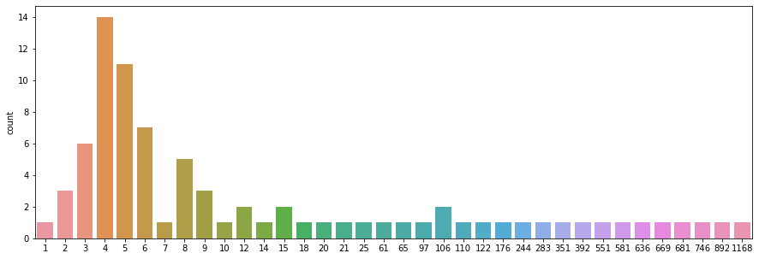
Data Preprocessing Done
Firstly, I checked the Nan values in the dataset and found that there were some features which were having almost 90% NAN values so, I decided to drop these features. Also, there were features id and utilities from which, id was having unique value for each and every datapoint, hence, I dropped that. Also, utilities feature was having one value for all datapoints so I deleted that. To check this, I also used nunique function to give me the unique values associated with each feature and decided based on this.
I formed a combined dataset where I joined train dataset and test dataset for further proceedings of imputation and encoding.
Then I divided all features into two categories- categorical and continuous features. For imputation of the features of both the categories, I used the Simple Imputer with strategy ‘mean’ for continuous features and ‘most_frequent’ for the categorical features and hence, imputation was done.
Fig. 1. Countplot of nunique values

Slide 6
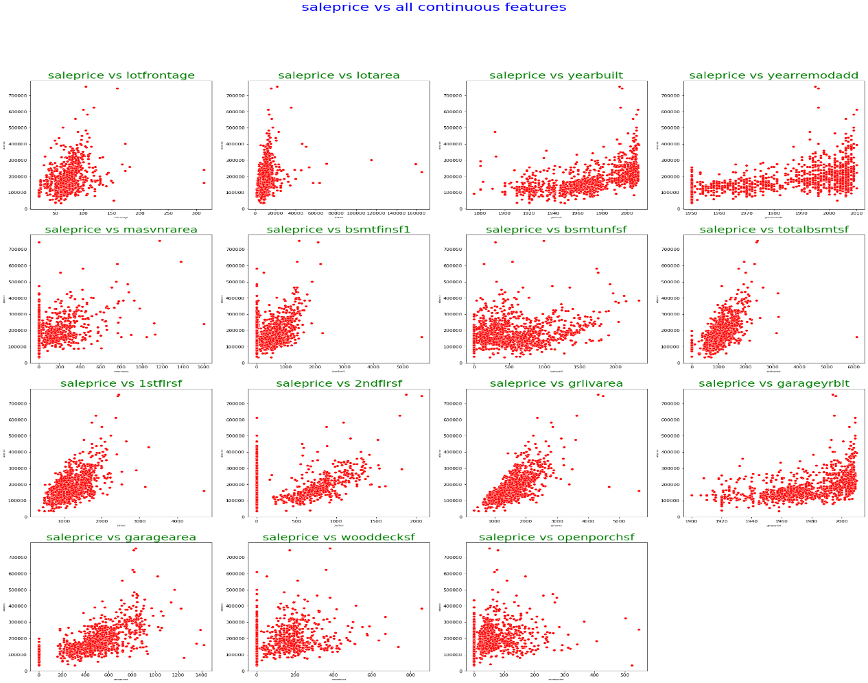
UNIVARIATE ANALYSIS:
Scatter plots: These plots have been used to analyze the relationship between continuous features and the target variable.

Slide 7
INTERPRETATIONS FROM UNIVARIATE ANALYSIS USING SCATTER PLOTS:
The above plot shows maximum lotfrontage lies between 0 and 100.
Maximum lotarea lies between 0 and 20000.
Yearbuilt feature: it shows that the newly built is the house, more is the price.
Yearremmodadd feature: most of the datapoints lie between 1990 and 2010.
Masvnrarea: a lot of datapoints having 0 value. And the next concentration is upto 200.
Bsmtfinsf1: here, also most of the datapoints have values nearly zero.
Bsmtunfsf: its values are scattered from 0 to 1500 mainly.
Totalbsmtsf: its maximum values lie in the range of 1000. More is its value, more is sale price.
1stflrsf: it’s scattered from 0 to 1000. More is its value, more is sale price.
2ndflrsf: for a large range of datapoints, it has 0 value. For the rest, it varies from 500 to 1500.
Grlivarea: more is the area, more is the sale price.
Garageyrblt: the latest is the garage built, more is the sale price.
Garagearea: more is the area, more is the sale price.
Wooddecksf: it has 0 value for many datapoints.
Openporchsf: it also has 0 value for many datapoints. For the rest, more is its value, more is the sale price.

Slide 8
UNIVARIATE ANALYSIS :
Swarmplots: These plots have been plotted between categorical features and the target variable. As there are 51 categorical features, so I plotted there 3 plots- first two plots between 20 categorical features and the target variable and the third one is between 11 categorical features and target variable.
First swarmplot:
Based on this plot, I analyzed that the 3 features 'roofmatl','street' and 'condition2’ was having one particular value for most of the datapoints as shown in subplot 3,10 and 12 of the following figure and hence, I checked the value.counts() for these 3 features which showed that they were holding one particular value for almost 90% data, which made them irreluctant for my model and hence, I dropped these features as shown in screenshot.

Slide 9
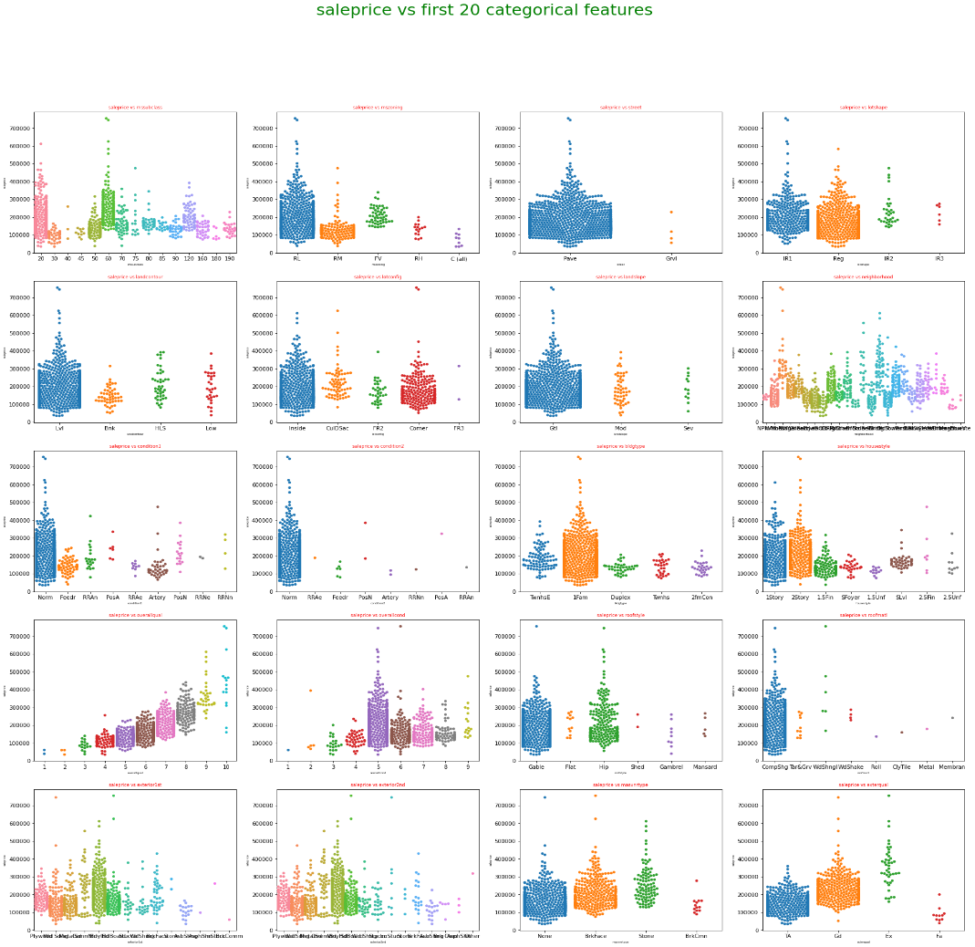
Fig. First Swarmplot

Slide 10
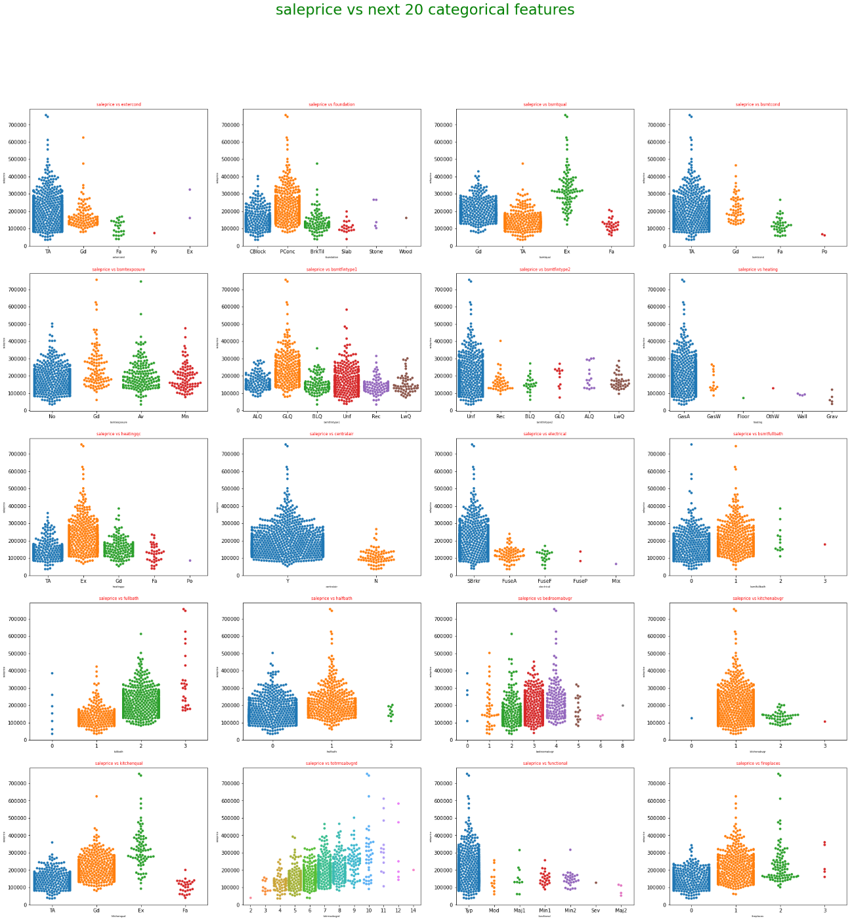
Second Swarmplot:
Then I plotted the second swarmplot between next 20 categorical features and the target variable and analyzed that there was one feature ‘heating’ which was having one particular value for almost 95% values as depicted from subplot 8 of this plot. So, dropped that particular feature.
Fig. Second Swarmplot

Slide 11
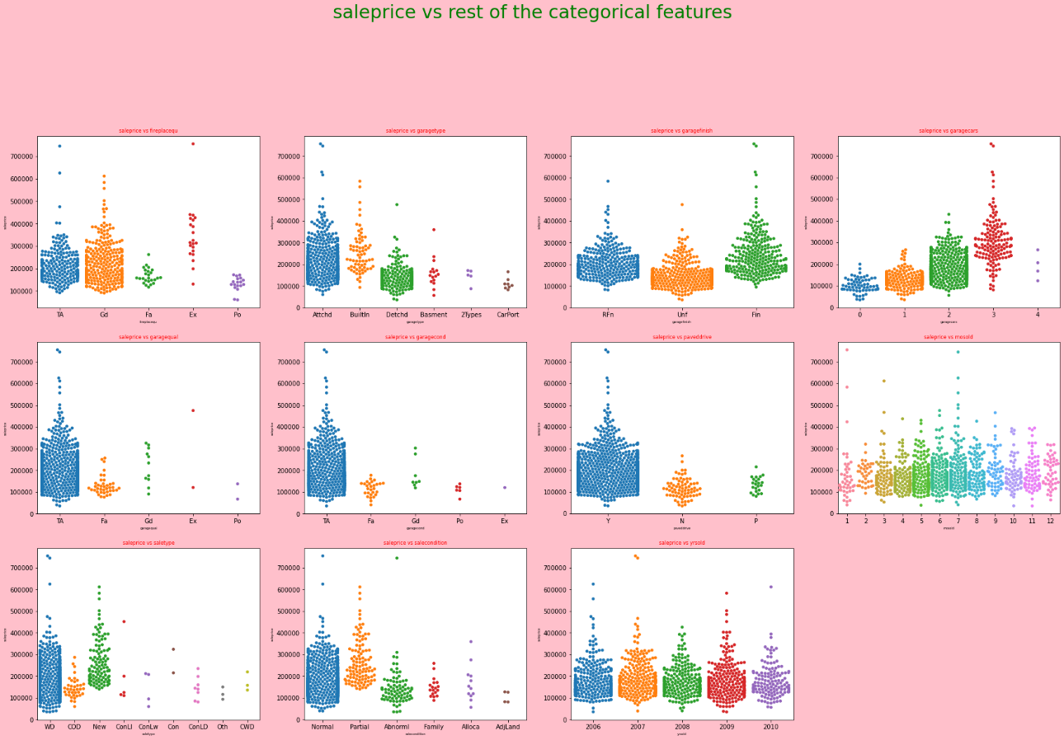
Third Swarmplot:
This last swarmplot showed that two features 'garagequal' and 'garagecond' were having one particular value for almost 90% of the dataset as shown in subplot 5 & 6 of this plot. So, after checking their count_values, I dropped these featurtes.
Fig. Third Swarmplot

Slide 12
ASSUMPTIONS
There were basic assumptions which I assumed in my model. These are:
Zscore of 3 is chosen for removing outliers from my train dataset.
Dataloss criteria in case of outliers removal has chosen to be less than 10%.
For skewness removal. I chose the -0.5 to +0.5 as the accepted range of skewness for my model. So, I chose that particular transformation technique after applying of which I got this range of skewness for my train dataset.
For removing features based on the correlation between the independent features, I chose -0.8 to +0.8 as the accepted range. If some feature had higher correlation with some other feature outside of this range, then the feature which had lower correlation with the target variable was dropped.
For removing multicollinearity, the accepted range of vif I chose to be <5.
For selecting the best features based on SelectKBest method, I chose 27 features from the total 54 features fed to it.

Slide 13
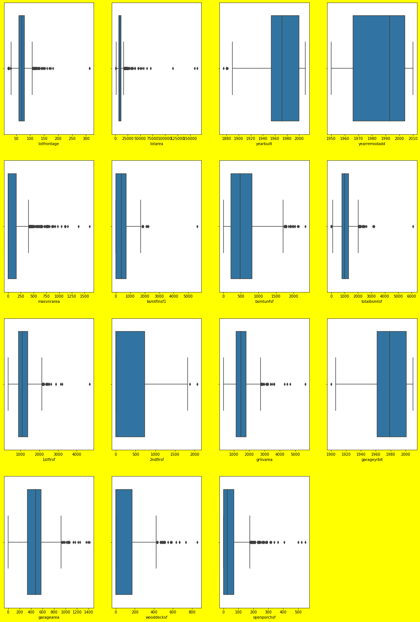
Outliers Removal: I removed the outlier from train dataset using zscore method. Firstly, I analyzed outliers using boxplots and then found that there were 97 datapoints which I needed to delete in order to remove outliers from my train dataset. As the data loss was less than 10% (it was almost 8%), so, I deleted those datapoints and hence, left with 1071 records from 1168 records that was available earlier.

Slide 14
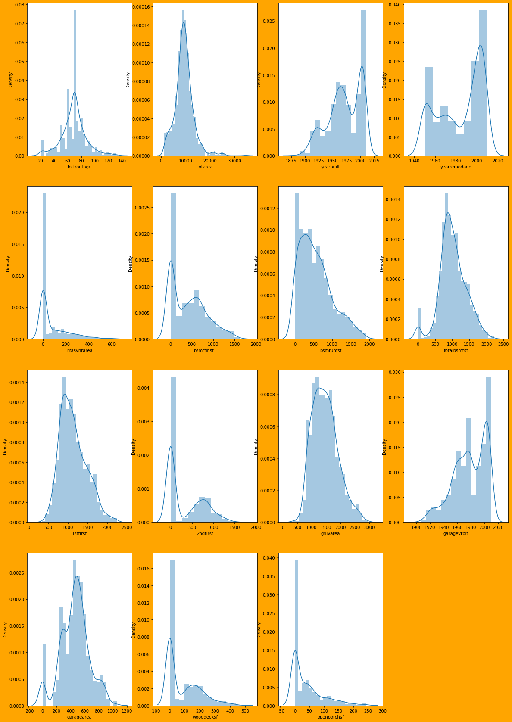
Skewness Removal:
Then I plotted distribution plot for checking skewness in the train dataset and found that there was a lot of skewness associated with some features. Hence, after quantifying them, I used PowerTransformer for removing the skewness and got the skewness in the range -0.5 to +0.5.

Slide 15
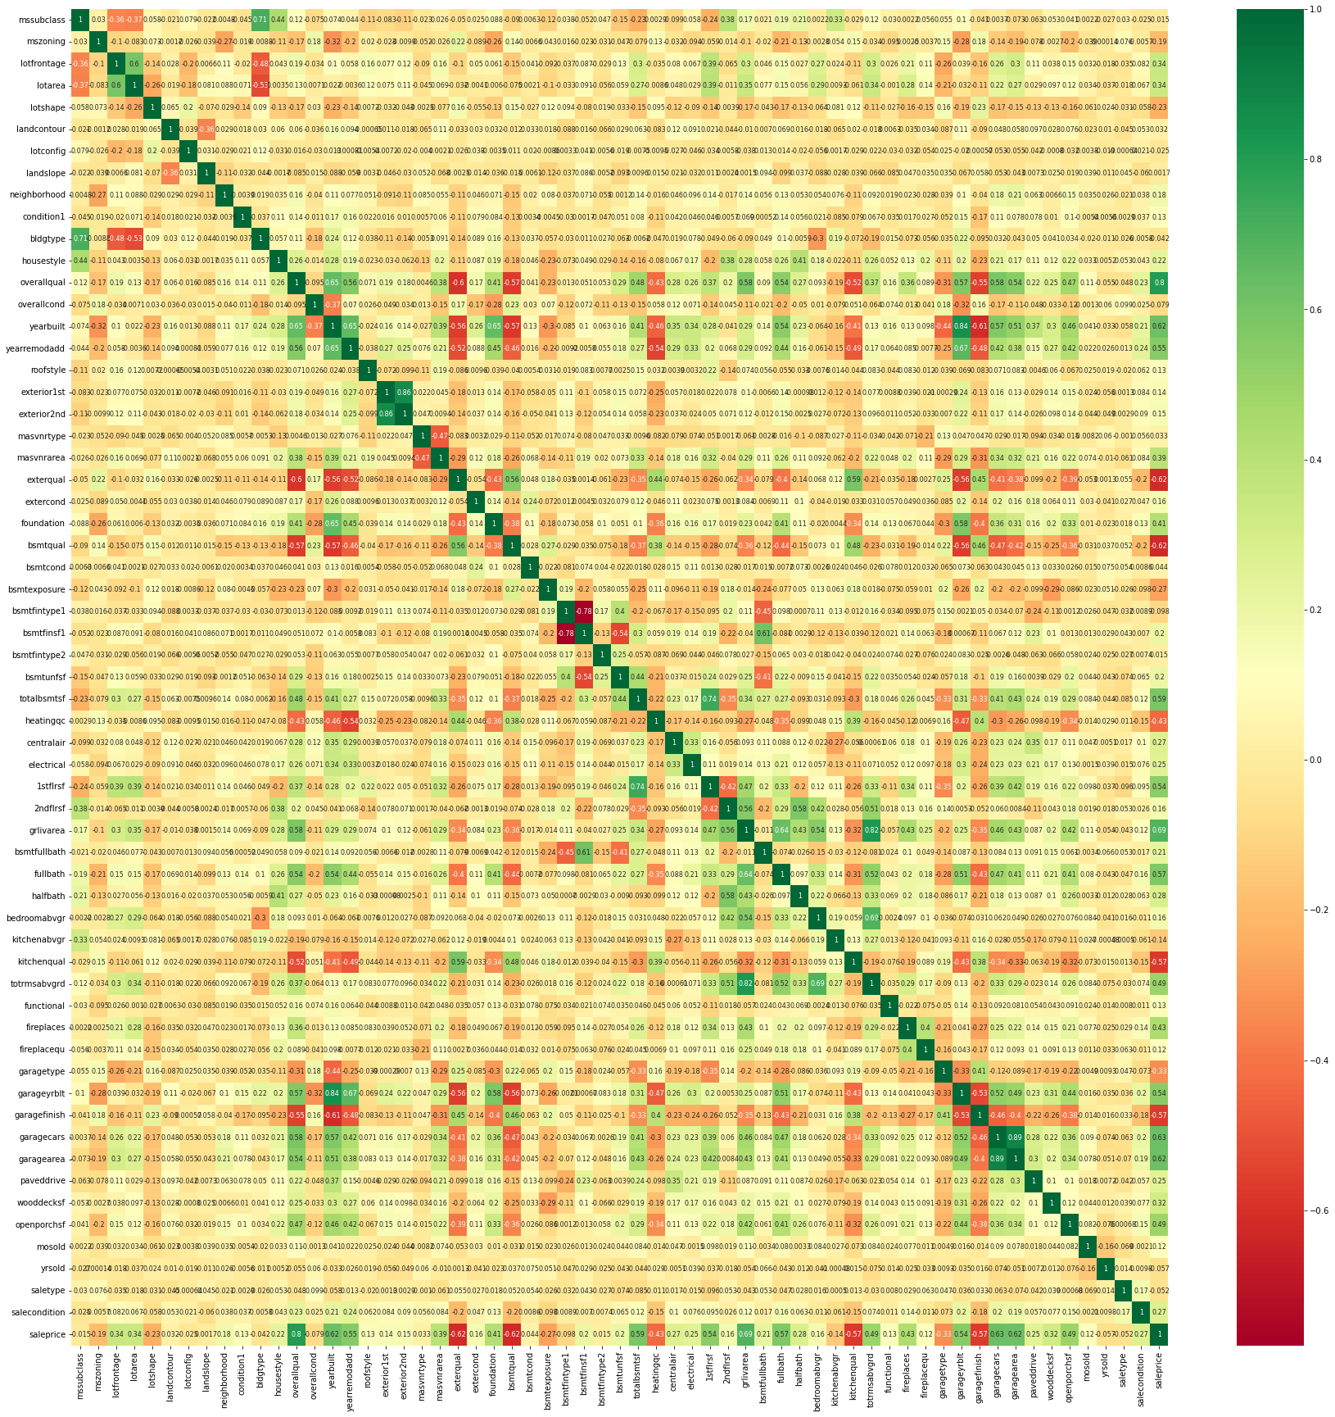
Features deletion based on correlation between the features:
I plotted heatmap of correlation matrix and deleted some of the features based on the correlation value between them. I am pasting here the heatmap of correlation matrix before features deletion and after features deletion. I deleted garagearea, exterior1st, garageyrblt and totrmsabvgrd features based on this correlation matrix and hence, I got the heatmap with the correlation values between the features in the range -0.8 to +0.8.
Fig. Correlation Heatmap before feature deletion

Slide 16
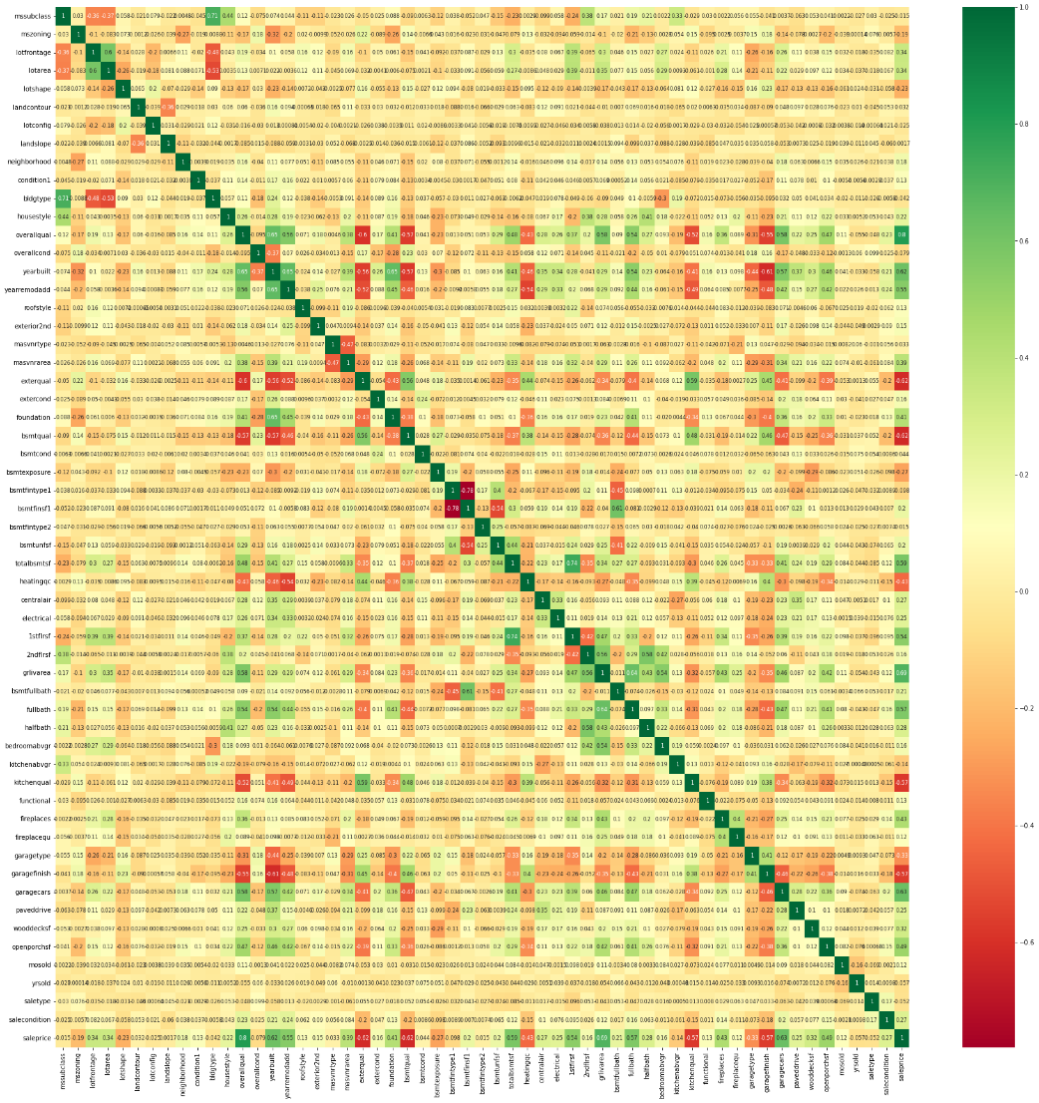
Fig. Correlation Heatmap after feature Deletion.

Slide 17
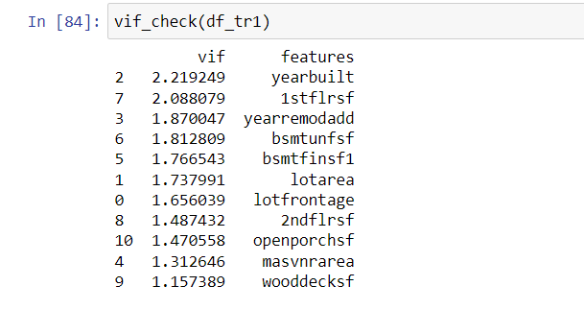
Mullticollinearity Removal:
I removed multicollinearity based on vif values. Some features were deleted based on these vif values and at the end, I got vif values in the range of <5.
Scaling:
I used StandardScaler for applying scaling on the continuous features of my dataset
Screenshot vif values after feature deletion.

Slide 18
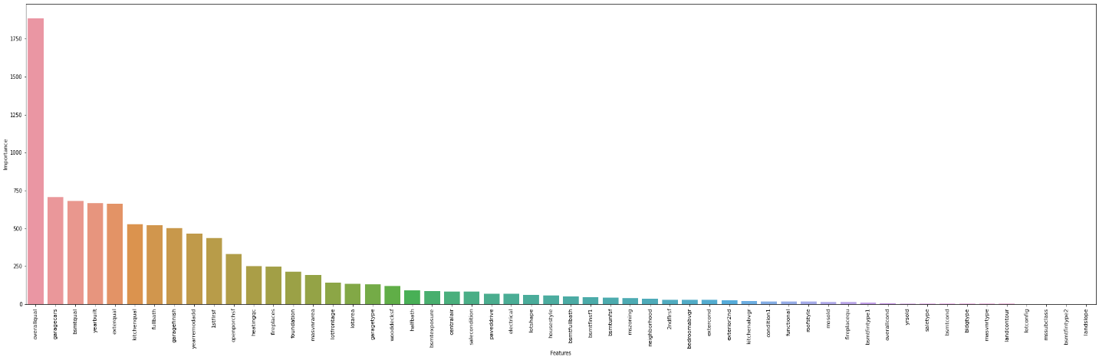
Feature Selection based on SelectKBest method:
I used SelectKBest method with f_regression score_func to find the best features and selected first 27 features out of 54 features and developed my model with that. I also plotted a graph showing scores of each and every feature of the dataset found from SelectKBest method.

Slide 19
Testing of Identified Approaches (Algorithms)
I used following algorithms for my model:
LinearRegression.
DecisionTreeRegressor.
KNeighborsRegressor.
AdaBoostRegressor.
RandomForestRegressor.
XGBoostRegressor
Regularization Techniques/ algos: Lasso and Ridge.
SVR

Slide 20
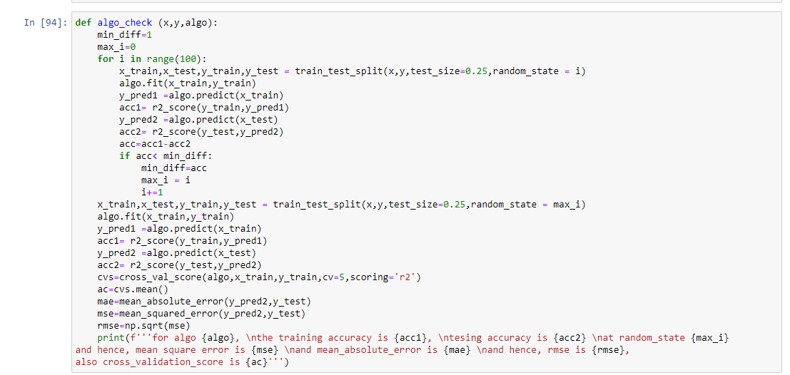
Run and Evaluate selected models
I used the below mentioned function to find out the result for each algorithm I tried.

Slide 21
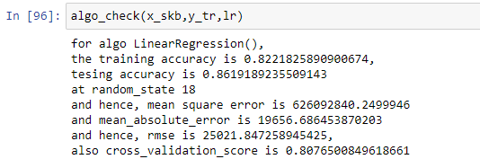
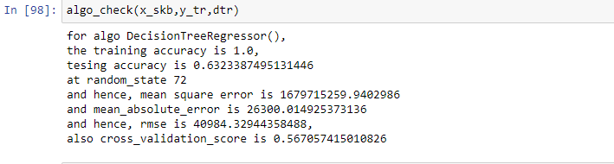
Output of linear Regression:
Output of DecisionTreeRegressor:

Slide 22
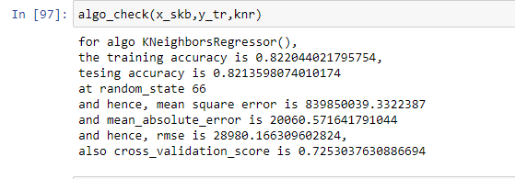
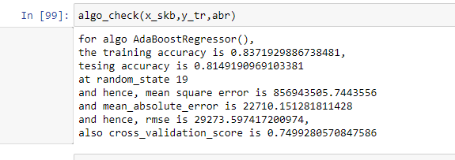
Output for KNeighborsRegressor:
Output for AdaBoostRegressor:

Slide 23
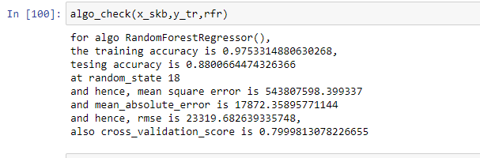
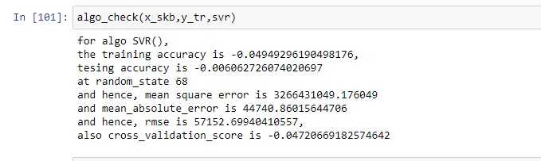
Output for RandomForestRegressor:
Output for SVR:

Slide 24
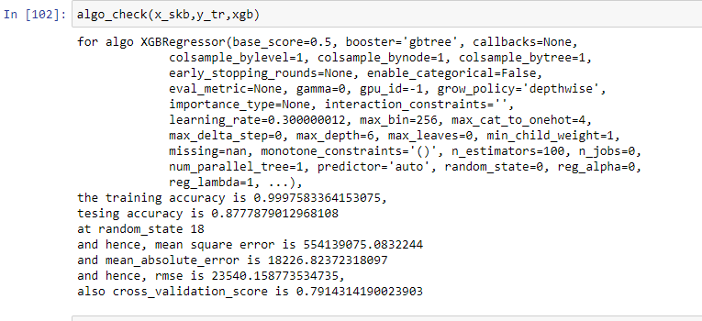
Output for XGBRegressor:

Slide 25
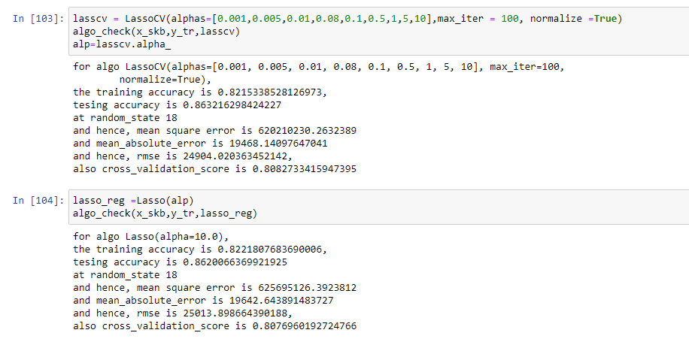
Output for Regularization Lasso:

Slide 26
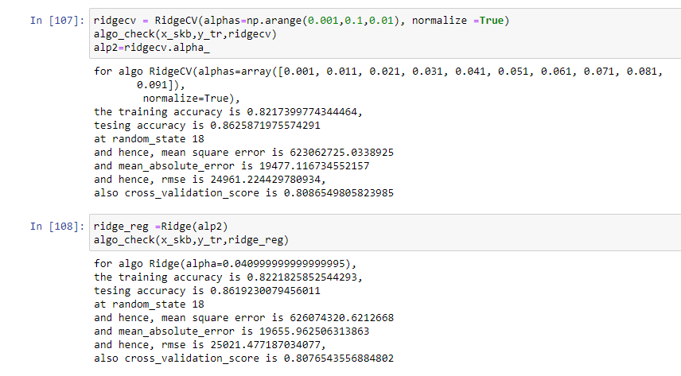
Output for Regularization Ridge:

Slide 27
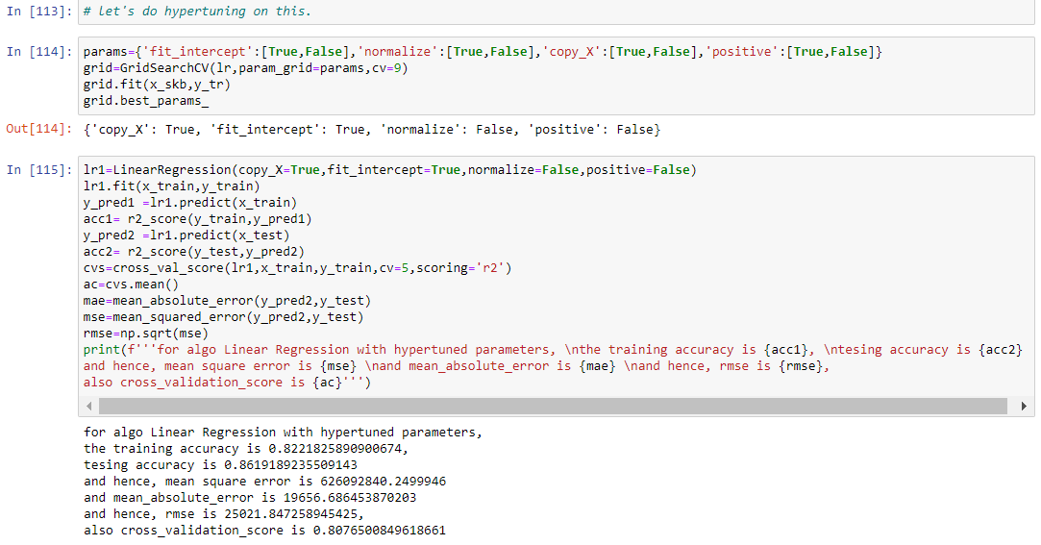
Key Metrics for success in solving problem under consideration
Based on the above results and taken r2_score metrics for evaluation, I concluded that LinearRegression algorithm gave the best results and also best cross_val_score. So, I finalized LinearRegression algorithm for my model and developed my model with this algorithm.
In order to improve it further, I used GridSearchCV for hypertuning its parameters and got the generalized results as shown in below attached screenshot.

Slide 28
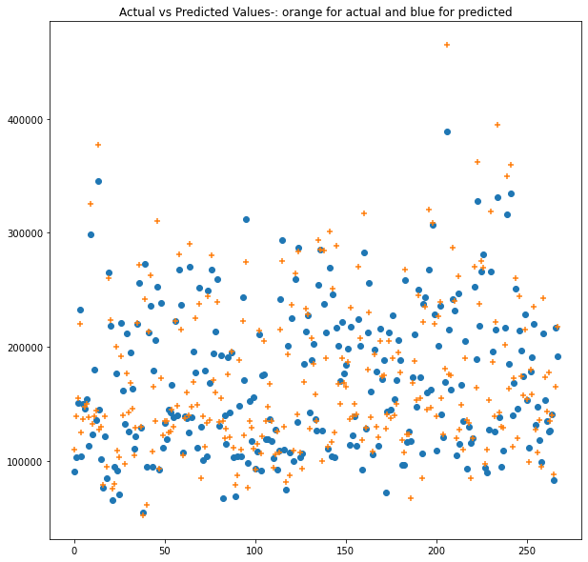
RESULTS Visualization
All the plots which I have plotted, I have explained them in their respective area in this report. Here, I am going to explore the inferences from the plots of the predicted values got from the algorithm chosen LinearRegression.
Plot 1. Actual vs Predicted:
This plot was drawn between actual values fed to LinearRegression algorithm of the testing pat=rt of the train dataset, y_test and its predicted values y_pred2. Y_test values are here shown by + sign in orange color and the predicted ones are shown by dot in blue color.

Slide 29
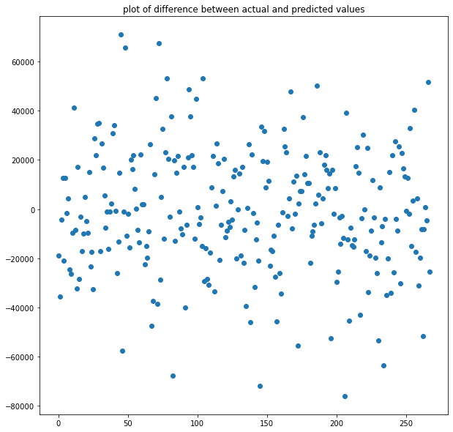
Plot 2. Actual-Predicted values plot:
This plot was drawn on the behavior/ frequency of difference between actual and predicted values. It shows that the maximum difference between actual and predicted values lie in the range of -2000 to +2000

Slide 30
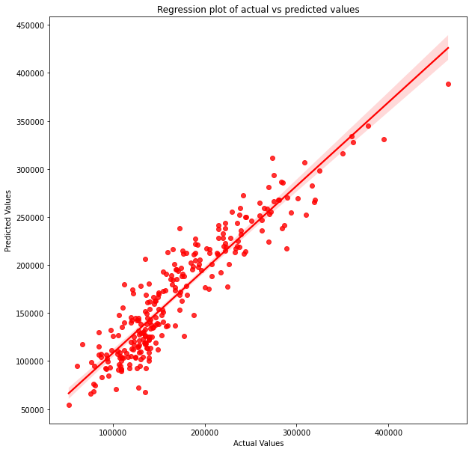
Plot 3. Regression plot between actual and predicted values.
This plot shows that the maximum predicted values lie near the best fit line.

Slide 31
Interpretation of the Results
Based on the above results, it was interpreted that the predicted values lie near the best fit line which shows that the above model is acceptable.
Also, the above plot shows that the maximum deviation of the predicted one from the actual values lie in the range of -2000 to +2000 which is acceptable as the minimum value of actual y is 52,000 and its maximum value is 465000.
Also, as the mean_absolute_error comes out to be 19,656, so, (mae/(y_test.max()-y_test.min()))*100 comes out to be 4.75% which is acceptable range.

Slide 32
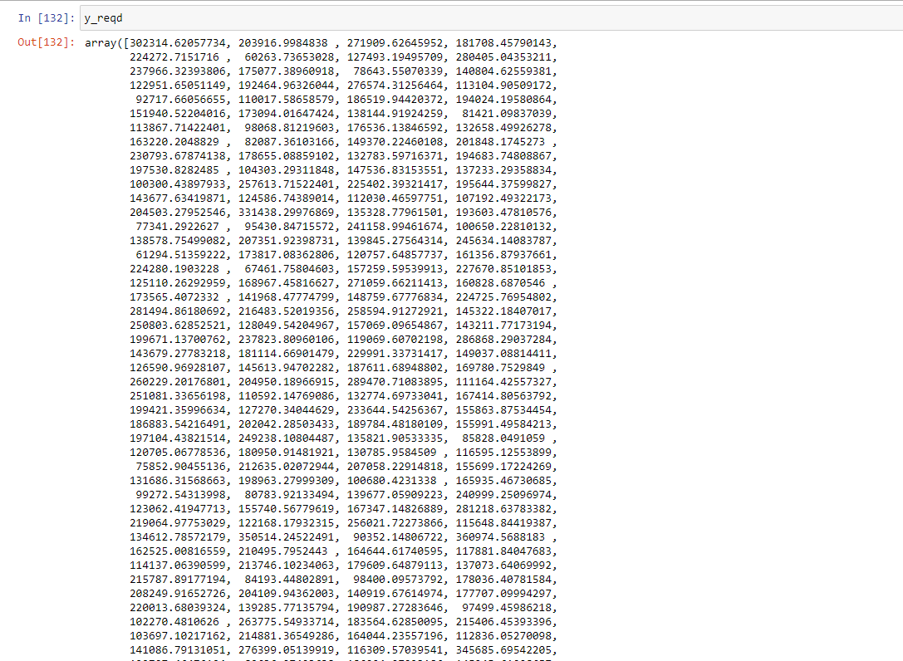
CONCLUSION
Key Findings and Conclusions of the Study
I found that LinearRegression algo worked well with my model. So, I finalized my model with this algo and hence, found the SalePrice for my test dataset which comes out to be.

Slide 33
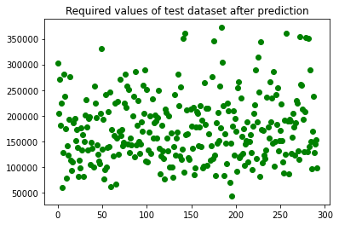
Fig. Predicted SalePrice values for Test dataset.

Slide 34
THANK YOU

