Slide 1
E-retail factors for customer activation and retention: A case study from Indian e-commerce customers
Submitted By:
Deepak Papneja
Internship 28
9464281077

Slide 2
PROJECT OVERVIEW:
Customer satisfaction has emerged as one of the most important factors that guarantee the success of online store; it has been posited as a key stimulant of purchase, repurchase intentions and customer loyalty. A comprehensive review of the literature, theories and models have been carried out to propose the models for customer activation and customer retention. Five major factors that contributed to the success of an e-commerce store have been identified as: service quality, system quality, information quality, trust and net benefit. The research furthermore investigated the factors that influence the online customers repeat purchase intention. The combination of both utilitarian value and hedonistic values are needed to affect the repeat purchase intention (loyalty) positively. The data is collected from the Indian online shoppers. Results indicate the e-retail success factors, which are very much critical for customer satisfaction.

Slide 3
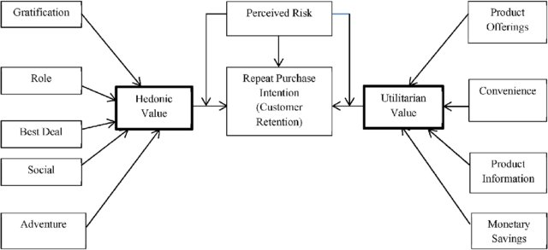

Slide 4
Problem Statement
The goal is to analyse the dataset provided to us with the description of the problem. We are provided two excel file which are interpreting the things same but the only difference is that one file is in the form in which all the values of the columns are in string or object format whereas in the other file, these values are in the encoded format. The goal of this project is
1). To analyse the outcomings of this dataset and to interpret their effects on the concerned companies/authorities.
2). For this analysis, the EDA part needs to be done on this dataset and using visualization techniques, the inferences or conclusions need to be mentioned.

Slide 5
ANALYSIS AND VISUALIZATION
The dataset provided to us contains 269 rows and 71 columns. This dataset can be divided into three different parts for better understanding:
a). One: is the customers' basic information and their ways to approach to the online shopping sites and their usual behaviour on these sites. This information is available from column no 1 to column no. 17.
b). Second: is the basic survey report from the customers regarding their demands or choices from these companies. This information is available from column no.18 to column no.47.
c). Third: is their response to these companies based on the performances of these companies based on different parameters. This information is available from column no.48 to second last column and in the very last column of this dataset, their choice of best company based on the above all parameters and hence their reference to their friends based on their choices.
So, I downloaded this dataset and started working on this. I started working on the dataset which was having string values for all of the columns. Then later on, I also downloaded its encoded counterpart which I used to calculate the correlation between some columns to justify my findings as will be explained further.

Slide 7
ANALYSIS AND VISUALIZATIONS

Slide 8
Libraries Used:
Pandas as pd
Numpy as np
Matplotlib.pyplot as plt
%matplotlib inline
Seaborn as sns
imported warnings

Slide 9
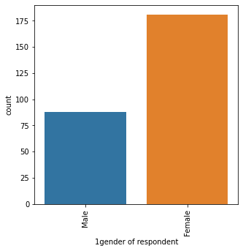
Column 1:
for column 1gender of respondent,
count values are
Female 181
Male 88
Name: 1gender of respondent, dtype: int64
ratio of Female is : 67.29 %

Slide 10
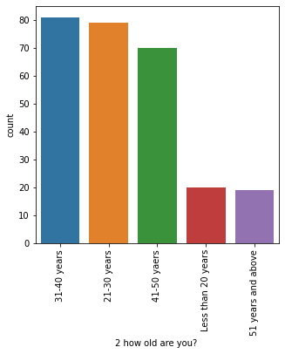
Column2:
for column 2 how old are you? ,
count values are 31-40 years 81 21-30 years 79 41-50 yaers 70 Less than 20 years 20 51 years and above 19
Name: 2 how old are you? , dtype: int64
ratio of 31-40 years is : 30.11 %

Slide 11
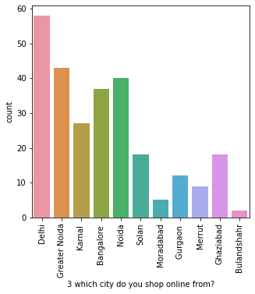
Column3:
for column 3 which city do you shop online from?,
count values are Delhi 58 Greater Noida 43 Noida 40 Bangalore 37 Karnal 27
Solan 18 Ghaziabad 18 Gurgaon 12 Merrut 9 Moradabad 5 Bulandshahr 2
Name: 3 which city do you shop online from?, dtype: int64
ratio of Delhi is : 21.56 %
it's clear that almost 21% of whole customers come from delhi. more, precisely, if we talk about particular ncr, then almost 42% customers come from ncr regions. and if we talk about metro cities like delhi and bangalore, more than 35% (means one-third) customers come from metro cities region. so, the companies should take this thing in mind while making some offers or strategies for these regions.

Slide 12
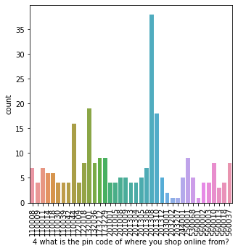
Column 4:
for column 4 what is the pin code of where you shop online from?,
count values are 201308 38 132001 19 201310 18 110044 16 250001 9 173229 9 173212 9 560010 8 132036 8 122018 8 560037 8 110008 7
110011 7 201306 7 110014 6 110018 6 201305 5 201008 5 201009 5 201312 5 244001 5 530068 5 122009 4 201001 4 560003 4 201304 4 110009 4
201303 4 560002 4 560018 4 110042 4 110030 4 201005 4 110039 4 560013 3 203001 2 203202 1 560001 1 203207 1
Name: 4 what is the pin code of where you shop online from?, dtype: int64 ratio of 201308 is : 14.13 %

Slide 13
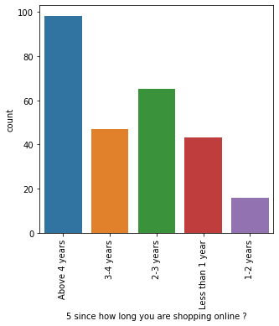
COLUMN 5
for column 5 since how long you are shopping online ?,
count values are Above 4 years 98 2-3 years 65 3-4 years 47 Less than 1 year 43 1-2 years 16
Name: 5 since how long you are shopping online ?, dtype: int64
ratio of Above 4 years is : 36.43 %
it means more than 36% customers are shopping online for more than 4 years.

Slide 14
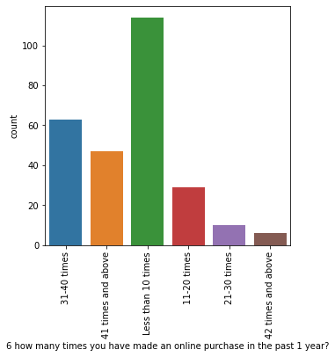
COLUMN 6
for column 6 how many times you have made an online purchase in the past 1 year?,
count values are Less than 10 times 114 31-40 times 63 41 times and above 47 11-20 times 29 21-30 times 10 42 times and above 6
Name: 6 how many times you have made an online purchase in the past 1 year?, dtype: int64
ratio of Less than 10 times is : 42.38 %
43% customers have shopped online less than 10 times in last year.

Slide 15
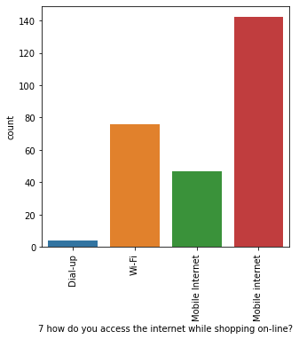
Column7
for column 7 how do you access the internet while shopping on-line?,
count values are Mobile internet 142 Wi-Fi 76 Mobile Internet 47 Dial-up 4
Name: 7 how do you access the internet while shopping on-line?, dtype: int64
ratio of Mobile internet is : 52.79 %
so, 52% customers use mobile phone to access the internet while shopping.. it's a very good ratio. so, it means the online platforms should work to make their websites/apps to work
better on mobile phones as mostlt customers rely on this medium to reach them.

Slide 16
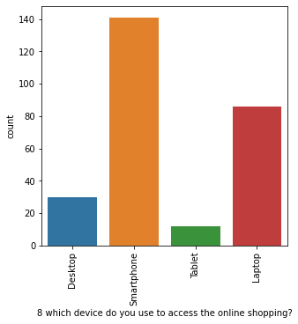
Column8
for column 8 which device do you use to access the online shopping?,
count values are Smartphone 141 Laptop 86 Desktop 30 Tablet 12
Name: 8 which device do you use to access the online shopping?, dtype: int64
ratio of Smartphone is : 52.42 %
it's giving same interpretation as above column. again, 52% customers use smartphones to reach online platforms for shopping.

Slide 17
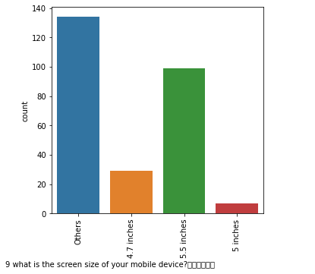
Column 9
for column 9 what is the screen size of your mobile device? ,
count values are Others 134 5.5 inches 99 4.7 inches 29 5 inches 7
Name: 9 what is the screen size of your mobile device?\t\t\t\t\t\t , dtype: int64
ratio of Others is : 49.81 %
so, here, we can analyse that it's not certain that which screensize the customers use to acces the internet for online shopping. yet it can be
said that 5.5 inches is the single option with high number of cusyomers using them.

Slide 18
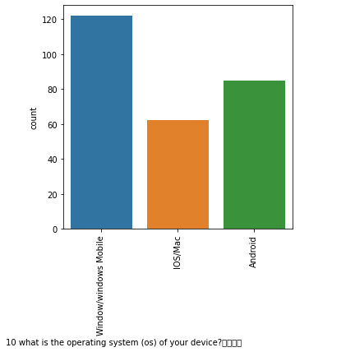
Column10
for column 10 what is the operating system (os) of your device? ,
count values are Window/windows Mobile 122 Android 85 IOS/Mac 62
Name: 10 what is the operating system (os) of your device?\t\t\t\t , dtype: int64
ratio of Window/windows Mobile is : 45.35 %
so, here, it's apparent that windows mobile is the first choice of the customers. yet android and ios are also having a good ratio of customers.
so, from this, we can make sure that the websites/apps of online shooping companies should be user friendly with all of the operating systems.

Slide 19
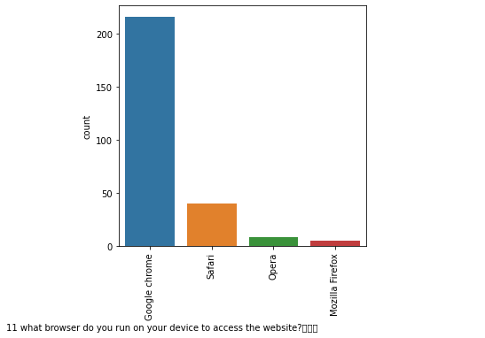
Column11
for column 11 what browser do you run on your device to access the website? ,
count values are Google chrome 216 Safari 40 Opera 8 Mozilla Firefox 5
Name: 11 what browser do you run on your device to access the website?\t\t\t , dtype: int64
ratio of Google chrome is : 80.3 %
yes, this is the main benefit of analysis that we can make by analyzing this column. it's very clear here that almost 80% of the customers use google chrome browser
to access the website. it's a good ratio which can't be ignored and hence, the companies should think giving maximum ads on this browser and also the best offers
should be displayed here from time to time so that the maximum range of customers can be attracted.

Slide 20
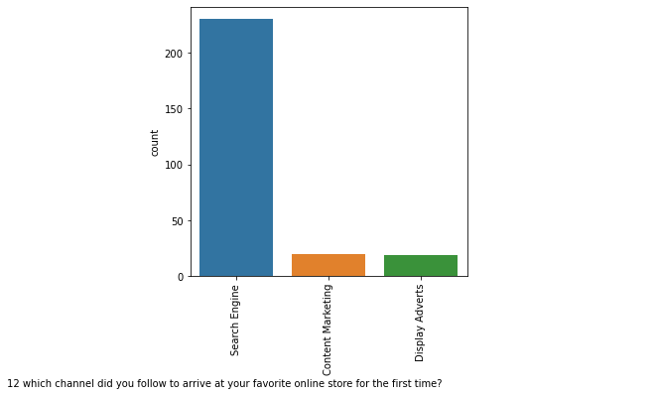
Column12
for column 12 which channel did you follow to arrive at your favorite online store for the first time? ,
count values are Search Engine 230 Content Marketing 20 Display Adverts 19
Name: 12 which channel did you follow to arrive at your favorite online store for the first time? , dtype: int64
ratio of Search Engine is : 85.5 %
again, the same thing which we inferred from last column that as the search engine is being used the most by the customers to reach the website for the first time and as
we depicted from last column, that google chrome search engine is the first choice of customers so the companies should pay more attention on this platform and start
investing more here so as to attract the customers more and to retain them.

Slide 21
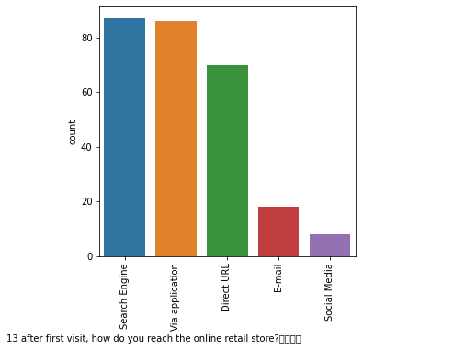
Column13
for column 13 after first visit, how do you reach the online retail store? , count values are Search Engine 87 Via application 86 Direct URL 70 E-mail 18 Social Media 8 Name: 13 after first visit, how do you reach the online retail store?\t\t\t\t , dtype: int64 ratio of Search Engine is : 32.34 %
so, after visiting the website of company for the first time, the customers use different mediums to reach them. search engine and apps play vital role in this era. however, the role of direct url can't be ignored also. and as emails and social media play less role in attracting the customers so companies can lower down their budget in these two fields and the saved money can be invested in the first 3 options.

Slide 22
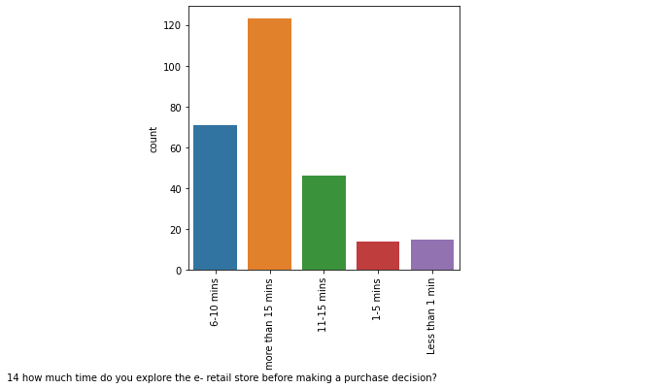
Column 14
for column 14 how much time do you explore the e- retail store before making a purchase decision? ,
count values are more than 15 mins 123 6-10 mins 71 11-15 mins 46 Less than 1 min 15 1-5 mins 14
Name: 14 how much time do you explore the e- retail store before making a purchase decision? , dtype: int64
ratio of more than 15 mins is : 45.72 %
almost 45% of customers spend more than 15 minutes for making a purchase decision. so, it means the companies can send more alternatives options for comparisons,
the related products options and the best offers in those 15 minutes so that if a person stays active on the portal for those 15 minutes, he/she can have idea of products
listed on the portal and also of the best offers, so that if he/she doesn't make plan to purchase from that portal and moves to some other portal then the best offers / related products
on the first portal might be attracting him/her and may be he/she makes plan to revisit the first portal again and makes the decision.

Slide 23
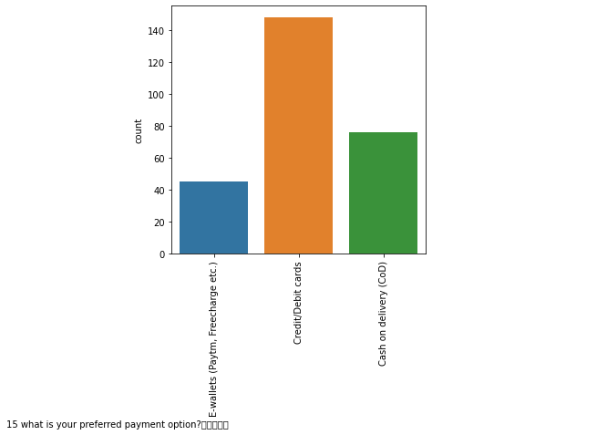
for column 15 what is your preferred payment option? ,
count values are Credit/Debit cards 148 Cash on delivery (CoD) 76 E-wallets (Paytm, Freecharge etc.) 45
Name: 15 what is your preferred payment option?\t\t\t\t\t , dtype: int64 ratio of Credit/Debit cards is : 55.02 %
almost 55% customers use credit/debit cards for making the payments. so, they will always look for the best offers on these cards while purchasing any
product through different online shopping platforms and wherever they get the best offers, they will move to that portal. so, acc. to my analysis, as 55% ratio of
the customers is a very good one, so, companies should start giving more offers on this payment option in order to attract more customers and also to retain their old ones.

Slide 24
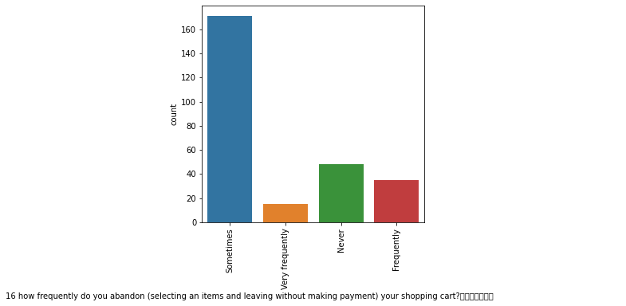
for column 16 how frequently do you abandon (selecting an items and leaving without making payment) your shopping cart? ,
count values are Sometimes 171 Never 48 Frequently 35 Very frequently 15
Name: 16 how frequently do you abandon (selecting an items and leaving without making payment) your shopping cart?\t\t\t\t\t\t\t , dtype: int64
ratio of Sometimes is : 63.57 %
so, it's clear that whenever any cutomer explore any online portal for shopping and selects the products, it's very rare that he/she leaves that portal without finally paying for the product and
booking his/her required products. so, it means if a company succeeds in attracting the customers towards their portal by developing trust and providing offers, convenience etc. and retain
the customers on their portal for those 15 minutes, then it's very rare that the customer leaves the portal without buying anything. so, the prime importance of the companies to attract the
customers through all the channels especially through search engine as the customers use that the most and that too by attracting through google chrome browser, and retains the customer
busy or attracted for those crucial 15 minutes, then there are very less chances of the customers leaving that portal without purchasing anything.

Slide 25
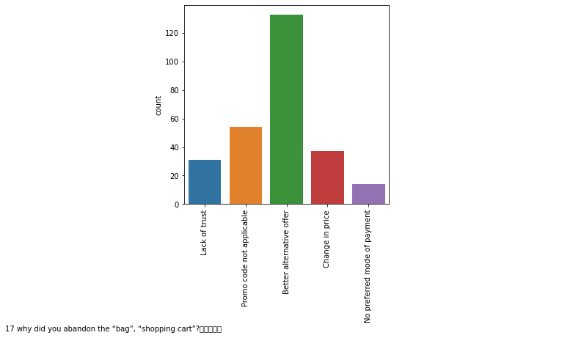
for column 17 why did you abandon the “bag”, “shopping cart”? ,
count values are Better alternative offer 133 Promo code not applicable 54 Change in price 37 Lack of trust 31 No preferred mode of payment 14
Name: 17 why did you abandon the “bag”, “shopping cart”?\t\t\t\t\t , dtype: int64
ratio of Better alternative offer is : 49.44 %
so, as stated above, better alternative offer is the main reason that the customers don't buy the products and leave it as it is without paying. now, this best alternative
offer can be on the same portal or another portal and if, it's on another portal then they need to get those offers / alternatives on the same portal also so that the customers' trust
on the portal be maintained. amost 50% of customers faced this situation. and also, if they get the better alternative offer on the same portal then it will be better for that company as
its products will be sld and also, the customers will gain good trust in that comapny as he/she will think that there are a lot of alternatives/options available on this site and they will recommend
this portal to other persons also.

Slide 26
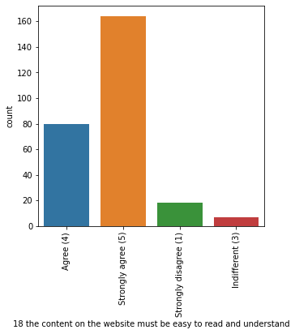
for column 18 the content on the website must be easy to read and understand,
count values are Strongly agree (5) 164 Agree (4) 80 Strongly disagree (1) 18 Indifferent (3) 7
Name: 18 the content on the website must be easy to read and understand, dtype: int64 ratio of Strongly agree (5) is : 60.97 %
ratio of Totally Agreed count is : 90.71 %
61% customers strongly agree and almost 90% customers agree on the point that the contents on the website must be easy to read and understand. T
his is the obvious thing as the customers who shop on online portals are the simple persons, they need the online platforms to be in easy form as in their
daily routine language so that they might get attached to it easily and can enjoy shopping there.

Slide 27
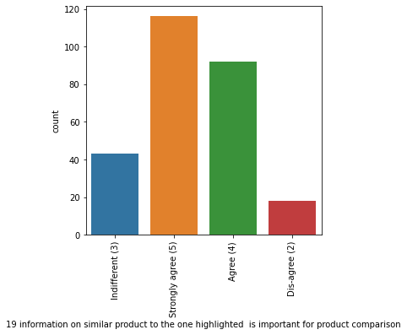
for column 19 information on similar product to the one highlighted is important for product comparison,
count values are Strongly agree (5) 116 Agree (4) 92 Indifferent (3) 43 Dis-agree (2) 18 Name: 19 information on
similar product to the one highlighted is important for product comparison, dtype: int64
ratio of Strongly agree (5) is : 43.12 % ratio of Totally Agreed count is : 77.32 %
so, more than 77% customers agreed on the fact that the information on similar product to the one highlighted is very important for
comparison and hence, on comparison, they can make any plan regarding this.

Slide 28
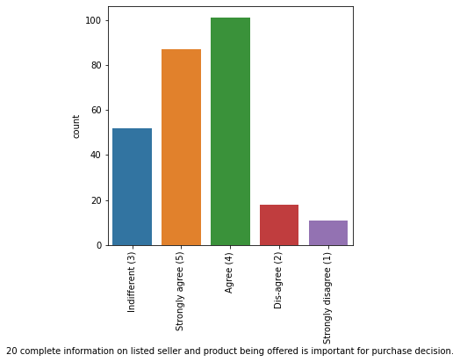
for column 20 complete information on listed seller and product being offered is important for purchase decision.,
count values are Agree (4) 101 Strongly agree (5) 87 Indifferent (3) 52
Dis-agree (2) 18 Strongly disagree (1) 11
Name: 20 complete information on listed seller and product being
offered is important for purchase decision., dtype: int64
ratio of Agree (4) is : 37.55 % ratio of Totally Agreed count is : 69.89 %
so, the seller and product information holds very much importance for the buyer to make any decision. so, this should be properly listed on the product.

Slide 29
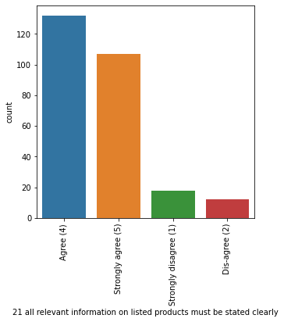
for column 21 all relevant information on listed products must be stated clearly,
count values are Agree (4) 132 Strongly agree (5) 107 Strongly disagree (1) 18 Dis-agree (2) 12
Name: 21 all relevant information on listed products must be stated clearly, dtype: int64 ratio of Agree (4) is : 49.07 %
ratio of Totally Agreed count is : 88.85 %
same things are revealed again as almost 90% customers want that all the relevant information regarding product should be listed clearly.
these things sgould be followed by an online company in order to enhance its trust in the customers and hence, to increase it sales. this can
be verified by checking the correlation between this column and column 18 the content on the website must be easy to read and understand, as
done below. since, correlation between the two features is very high almost 0.89, hence, both of the features are depicting the same kind of interpretations.

Slide 30
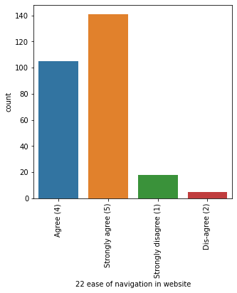
for column 22 ease of navigation in website,
count values are Strongly agree (5) 141 Agree (4) 105 Strongly disagree (1) 18 Dis-agree (2) 5
Name: 22 ease of navigation in website, dtype: int64 ratio of Strongly agree (5) is : 52.42 %
ratio of Totally Agreed count is : 91.45 %

Slide 31
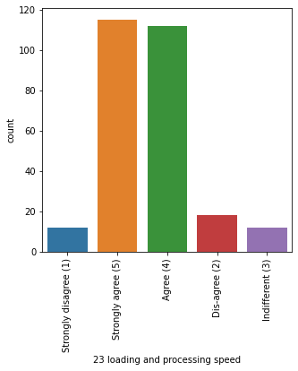
for column 23 loading and processing speed,
count values are Strongly agree (5) 115 Agree (4) 112 Dis-agree (2) 18 Strongly disagree (1) 12 Indifferent (3) 12
Name: 23 loading and processing speed, dtype: int64 ratio of Strongly agree (5) is : 42.75 %
ratio of Totally Agreed count is : 84.39 %
so, from the above two columns, it's interpreted that the websites/apps of the online portal should have loading and processing speed
higher and also, the navigation speed from one page to another should also be very high. because a slow buffering websites always
loose their clientage besides giving any benefits as the patience level in customers and time to do anything is very less now-a-days.
each and every person needs to fulfill its requirement at the fingertips. so, this becomes a major suggestion/key role for the companies to
increase the speed of their websites in order to enhace their business.

Slide 32
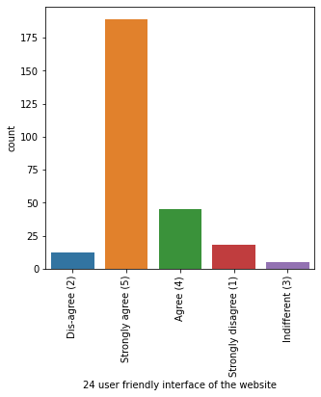
for column 24 user friendly interface of the website,
count values are Strongly agree (5) 189 Agree (4) 45 Strongly disagree (1) 18 Dis-agree (2) 12 Indifferent (3) 5
Name: 24 user friendly interface of the website, dtype: int64 ratio of Strongly agree (5) is : 70.26 %
ratio of Totally Agreed count is : 86.99 %
so, it's depicting the same thing as we learnt from column no.18 as it's also stated in column no. 18 that the contents on the website
must be easy to read. so, if a website has the contents readable or understandable easily then it's user friendly or vice-versa. this also
can be verifed by the correlation value of this feature with the column 18 the content on the website must be easy to read and understand,
as done below. since, the correlation value is very much higher as 0.81 here, so , both of these columns are interpreting similar things.

Slide 33
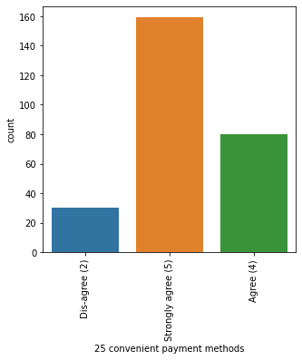
for column 25 convenient payment methods,
count values are Strongly agree (5) 159 Agree (4) 80 Dis-agree (2) 30 Name: 25 convenient payment methods, dtype: int64
ratio of Strongly agree (5) is : 59.11 % ratio of Totally Agreed count is : 88.85 %
almost 89% customers think that the payment methods should be convenient. it should be easy to pay on the portal.

Slide 34
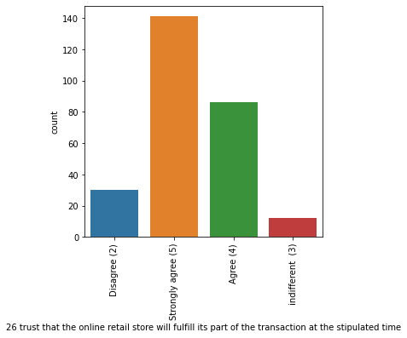
for column 26 trust that the online retail store will fulfill its part of the transaction at the stipulated time,
count values are Strongly agree (5) 141 Agree (4) 86 Disagree (2) 30 indifferent (3) 12
Name: 26 trust that the online retail store will fulfill its part of the transaction at the stipulated time, dtype: int64
ratio of Strongly agree (5) is : 52.42 % ratio of Totally Agreed count is : 84.39 %
so, it's a trust point. acc. to 84% customers, the online retail store will fulfill its part at the stipulated time.

Slide 35
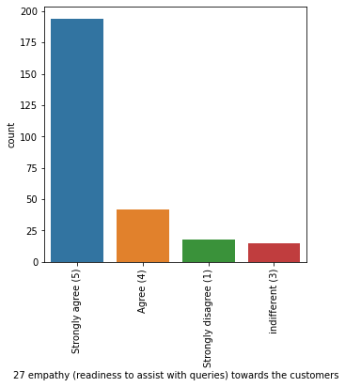
for column 27 empathy (readiness to assist with queries) towards the customers,
count values are Strongly agree (5) 194 Agree (4) 42 Strongly disagree (1) 18 indifferent (3) 15
Name: 27 empathy (readiness to assist with queries) towards the customers, dtype: int64 ratio of Strongly agree (5) is : 72.12 %
ratio of Totally Agreed count is : 87.73 %
yes, this is also the main point that the companies should consider, i.e. the issue redressal/ grivience redressal system should be
so fast and convenient that if a customer finds any issue on the online platform, then his/her queries should be resolved at the first
instant. and also, the staff/system associated with the issue redressal system should be cooperative and polite and that system should consider the value of customer's money and time.

Slide 36
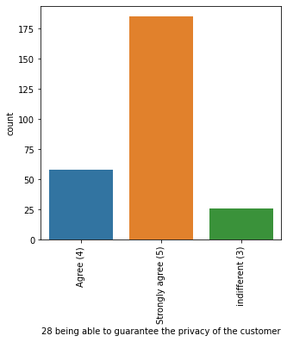
for column 28 being able to guarantee the privacy of the customer,
count values are Strongly agree (5) 185 Agree (4) 58 indifferent (3) 26
Name: 28 being able to guarantee the privacy of the customer, dtype: int64
ratio of Strongly agree (5) is : 68.77 % ratio of Totally Agreed count is : 90.33 %
acc. to above suggestions, it's highly recommended that the privacy of the customers be maintained because it's such type of thing which holds it's importance over all other things.

Slide 37
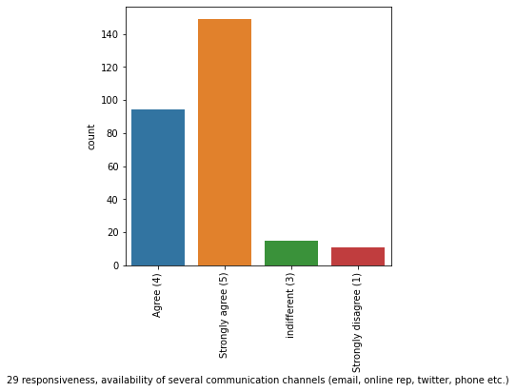
for column 29 responsiveness, availability of several communication channels (email, online rep, twitter, phone etc.),
count values are Strongly agree (5) 149 Agree (4) 94 indifferent (3) 15 Strongly disagree (1) 11
Name: 29 responsiveness, availability of several communication channels (email, online rep, twitter, phone etc.), dtype: int64
ratio of Strongly agree (5) is : 55.39 % ratio of Totally Agreed count is : 90.33 %
it's neccessary to available om several communication channels. almost 90% of customers think this.

Slide 38
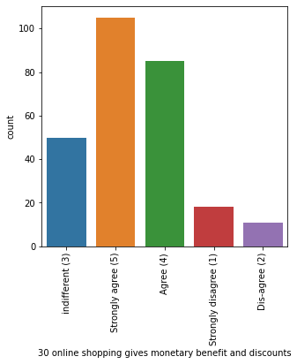
for column 30 online shopping gives monetary benefit and discounts,
count values are Strongly agree (5) 105 Agree (4) 85 indifferent (3) 50 Strongly disagree (1) 18 Dis-agree (2) 11
Name: 30 online shopping gives monetary benefit and discounts, dtype: int64 ratio of Strongly agree (5) is : 39.03 %
ratio of Totally Agreed count is : 70.63 %
70% customers think that online shopping gives monetary benefits.

Slide 39
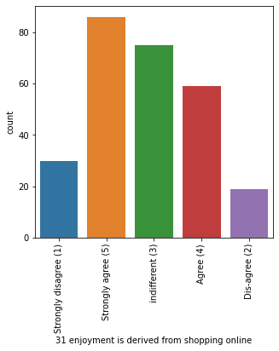
for column 31 enjoyment is derived from shopping online,
count values are Strongly agree (5) 86 indifferent (3) 75 Agree (4) 59 Strongly disagree (1) 30 Dis-agree (2) 19
Name: 31 enjoyment is derived from shopping online, dtype: int64 ratio of Strongly agree (5) is : 31.97 %
ratio of Totally Agreed count is : 53.9 %
there are mixed sentiments regarding enjoyment..

Slide 40
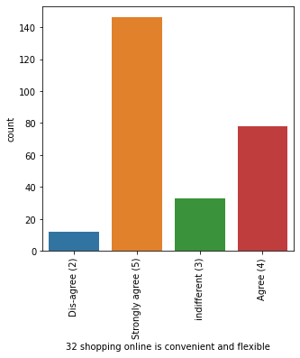
for column 32 shopping online is convenient and flexible,
count values are Strongly agree (5) 146 Agree (4) 78 indifferent (3) 33 Dis-agree (2) 12
Name: 32 shopping online is convenient and flexible, dtype: int64 ratio of Strongly agree (5) is : 54.28 %
ratio of Totally Agreed count is : 83.27 %
In

Slide 41
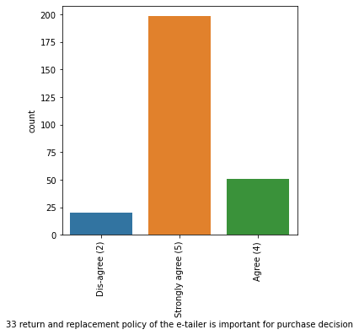
for column 33 return and replacement policy of the e-tailer is important for purchase decision,
count values are Strongly agree (5) 198 Agree (4) 51 Dis-agree (2) 20
Name: 33 return and replacement policy of the e-tailer is important for purchase decision, dtype: int64
ratio of Strongly agree (5) is : 73.61 % ratio of Totally Agreed count is : 92.57 %
this is the main feature of online shopping which attracts the customers the most towards inline shopping. so, this facility of return
and replacement policy should be provided by online company to attract the customers.

Slide 42
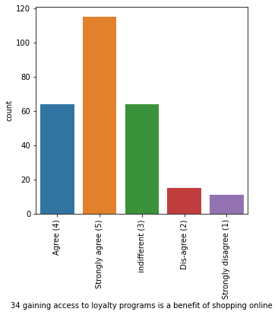
for column 34 gaining access to loyalty programs is a benefit of shopping online,
count values are Strongly agree (5) 115 Agree (4) 64 indifferent (3) 64 Dis-agree (2) 15 Strongly disagree (1) 11
Name: 34 gaining access to loyalty programs is a benefit of shopping online, dtype: int64 ratio of Strongly agree (5) is : 42.75 %
ratio of Totally Agreed count is : 66.54 %
two-third of the customers are agreed on the fact that loyalty program is online shopping's benefit.

Slide 43
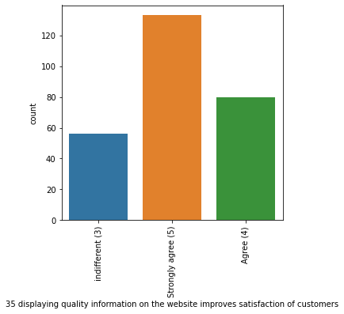
for column 35 displaying quality information on the website improves satisfaction of customers,
count values are Strongly agree (5) 133 Agree (4) 80 indifferent (3) 56
Name: 35 displaying quality information on the website improves satisfaction of customers, dtype: int64
ratio of Strongly agree (5) is : 49.44 % ratio of Totally Agreed count is : 79.18 %
again same thing which was depicted by column 18 the content on the website must be easy to read and understand.

Slide 44
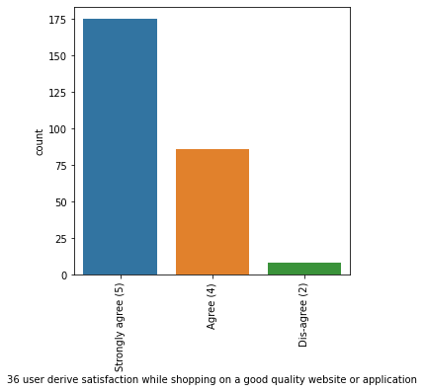
for column 36 user derive satisfaction while shopping on a good quality website or application,
count values are Strongly agree (5) 175 Agree (4) 86 Dis-agree (2) 8
Name: 36 user derive satisfaction while shopping on a good quality website or application, dtype: int64
ratio of Strongly agree (5) is : 65.06 % ratio of Totally Agreed count is : 97.03 %

Slide 45
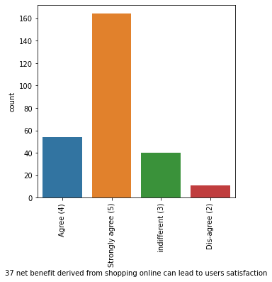
for column 37 net benefit derived from shopping online can lead to users satisfaction,
count values are Strongly agree (5) 164 Agree (4) 54 indifferent (3) 40 Dis-agree (2) 11
Name: 37 net benefit derived from shopping online can lead to users satisfaction, dtype: int64 ratio of Strongly agree (5) is : 60.97 %
ratio of Totally Agreed count is : 81.04 %

Slide 46
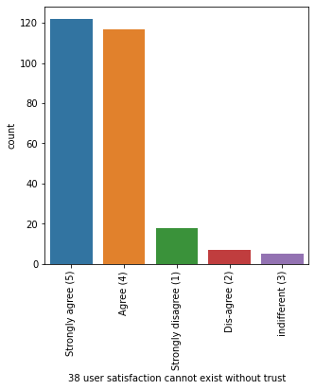
for column 38 user satisfaction cannot exist without trust,
count values are Strongly agree (5) 122 Agree (4) 117 Strongly disagree (1) 18 Dis-agree (2) 7 indifferent (3) 5
Name: 38 user satisfaction cannot exist without trust, dtype: int64 ratio of Strongly agree (5) is : 45.35 %
ratio of Totally Agreed count is : 88.85 %
all of the above three columns depict that almost 90% customers think that users get satisfied when they trust on particular online shopping company.
this satisfaction comes when they work on good quality website. so, in order to impart trust in the customers, online companies need to improve quality
of their websites and should improve on all the factors which are listed in the earlier columns like the websites/apps should be user friendly, quality information
should be there, issues redressal sytem be there and there should be list of products for the comparisons.

Slide 47
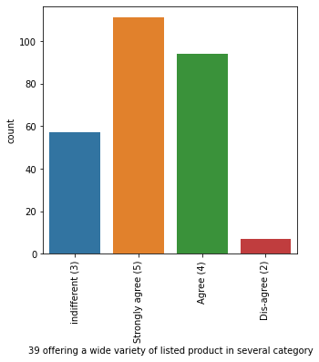
for column 39 offering a wide variety of listed product in several category,
count values are Strongly agree (5) 111 Agree (4) 94 indifferent (3) 57 Dis-agree (2) 7
Name: 39 offering a wide variety of listed product in several category, dtype: int64 ratio of Strongly agree (5) is : 41.26 %
ratio of Totally Agreed count is : 76.21 %
so, as described in earlier columns, a wide variety of products should be available on the online shopping company. so,
as much as products will be there, the more customers will be attracted and they will be satisfied more. this will enhance their business.

Slide 48
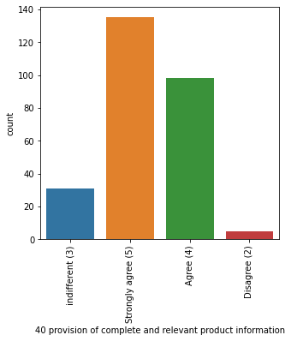
for column 40 provision of complete and relevant product information,
count values are Strongly agree (5) 135 Agree (4) 98 indifferent (3) 31 Disagree (2) 5
Name: 40 provision of complete and relevant product information, dtype: int64 ratio of Strongly agree (5) is : 50.19 %
ratio of Totally Agreed count is : 86.62 %
this is again also giving the same information as we got in earlier columns like in column 18

Slide 49
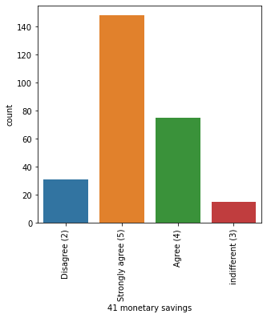
for column 41 monetary savings, co
unt values are Strongly agree (5) 148 Agree (4) 75 Disagree (2) 31 indifferent (3) 15
Name: 41 monetary savings, dtype: int64 ratio of Strongly agree (5) is : 55.02 %
ratio of Totally Agreed count is : 82.9 %
almost 82% customers are agreed on the point that the online shopping provides monetary savings.

Slide 50
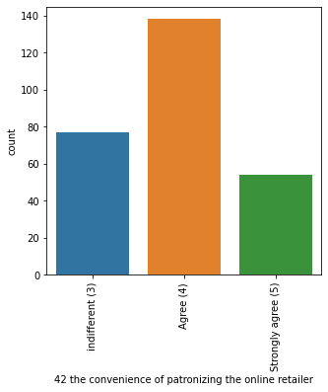
for column 42 the convenience of patronizing the online retailer,
count values are Agree (4) 138 indifferent (3) 77 Strongly agree (5) 54
Name: 42 the convenience of patronizing the online retailer, dtype: int64 ratio of Agree (4) is : 51.3 %
ratio of Totally Agreed count is : 71.38 %
so, it's not like that only customers are patronized in online shopping or only they are getting all the benefits, besides it, the online retailer are
also getting convenience of patronizing on online platforms as their payments are safe with the online shopping companies. also, if any customer
is betraying them by making excuse of quality, then they have the quality checkup team to do so. so, acc. to a lot of customers, they also feel that the oline retailers are also safe on this platform.

Slide 51
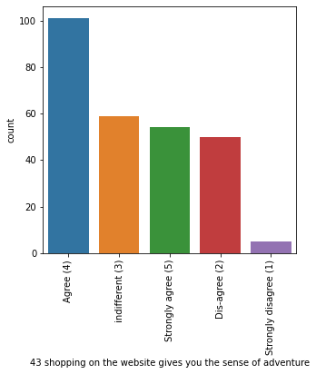
for column 43 shopping on the website gives you the sense of adventure,
count values are Agree (4) 101 indifferent (3) 59 Strongly agree (5) 54 Dis-agree (2) 50 Strongly disagree (1) 5
Name: 43 shopping on the website gives you the sense of adventure, dtype: int64 ratio of Agree (4) is : 37.55 %
ratio of Totally Agreed count is : 57.62 %
there are mix sentiments regarding this. some think that the online shopping gives the feeling of adventure. some others think that it's not so. Some
has nothing to do with this feeling. they only shop there, that's it.

Slide 52
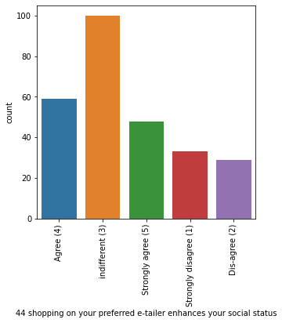
for column 44 shopping on your preferred e-tailer enhances your social status,
count values are indifferent (3) 100 Agree (4) 59 Strongly agree (5) 48 Strongly disagree (1) 33 Dis-agree (2) 29
Name: 44 shopping on your preferred e-tailer enhances your social status, dtype: int64 ratio of indifferent (3) is : 37.17 %
ratio of Totally Agreed count is : 39.78 %
there is a long list of te customers or the maximum ratio of the customers think that they don't bother about that if the shopping on their preferred site
enhances their social status or not. they don't think about this. almost 37% (more than one third) of entire customers list fall in this range.

Slide 53
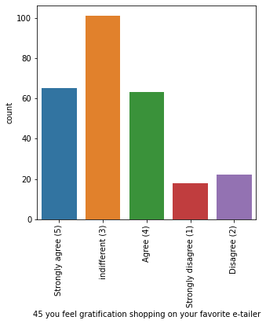
for column 45 you feel gratification shopping on your favorite e-tailer,
count values are indifferent (3) 101 Strongly agree (5) 65 Agree (4) 63 Disagree (2) 22 Strongly disagree (1) 18
Name: 45 you feel gratification shopping on your favorite e-tailer, dtype: int64 ratio of indifferent (3) is : 37.55 %
ratio of Totally Agreed count is : 47.58 %
similarly, as depicted from the last column , there is also a long list of the customers who have nothing to do with the gratification feeling. they don't bother about it.

Slide 54
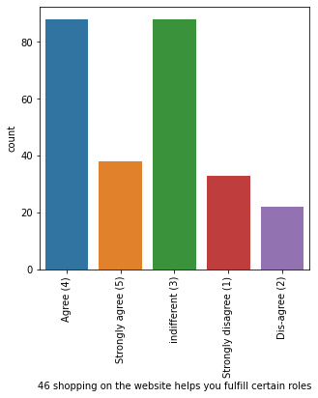
for column 46 shopping on the website helps you fulfill certain roles,
count values are Agree (4) 88 indifferent (3) 88 Strongly agree (5) 38 Strongly disagree (1) 33 Dis-agree (2) 22
Name: 46 shopping on the website helps you fulfill certain roles, dtype: int64 ratio of Agree (4) is : 32.71 %
ratio of Totally Agreed count is : 46.84 %
again , there are mixed emotions.so, we can say that when it comes to social sentiments, the customers don't even bother about it. they only
use this online shopping platform to buy the products and they have no feelings regarding their social status enhancement, their gratifcation feeling,
their fulfillment of certain roles etc. so, in short, these online shopping companies don't change any social feelings of the customers like the social sites
do. they are only a carrier to provide the items which the customers want.

Slide 55
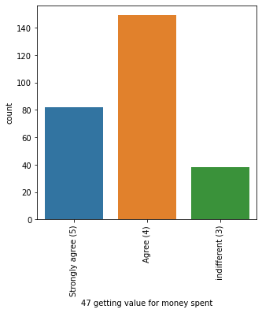
for column 47 getting value for money spent,
count values are Agree (4) 149 Strongly agree (5) 82 indifferent (3) 38
Name: 47 getting value for money spent, dtype: int64 ratio of Agree (4) is : 55.39 %
ratio of Totally Agreed count is : 85.87 %
this feature also depicts the same thing as depicted in earlier column of showing monetary benefits. yes, a large
proportion of the customers think that the value spent on online shopping sites give them a worth and they get lot of benefits from it.

Slide 56
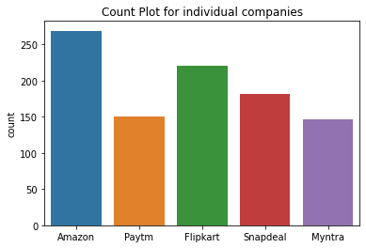
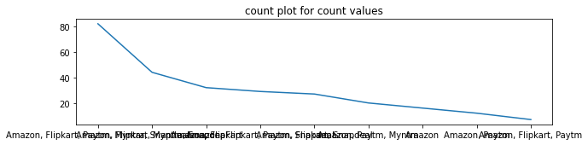
for column from the following, tick any (or all) of the online retailers you have shopped from; ,
count values are Amazon, Flipkart, Paytm, Myntra, Snapdeal 82 Amazon, Flipkart, Myntra, Snapdeal 44
Amazon, Flipkart 32 Amazon, Flipkart, Paytm, Snapdeal 29 Amazon, Flipkart, Snapdeal 27 Amazon, Paytm,
Myntra 20 Amazon 16 Amazon, Paytm 12 Amazon, Flipkart, Paytm 7 Name: from the following,
tick any (or all) of the online retailers you have shopped from; , dtype: int64 ratio of Amazon,
Flipkart, Paytm, Myntra, Snapdeal is : 30.48 %
No. of times Amazon chosen: 269 No. of times Flipkart chosen: 221 No. of times Snapdeal chosen: 182 No.
of times Paytm chosen: 150 No. of times Myntra chosen: 146 maximum times 269 the company Amazon chosen,
whose %age becomes 100.0 % minimum times 146 the company Myntra chosen, whose %age becomes 54.28 %
from the above analysis, it's clear that all customers have shopped from Amazon.com, the second one name falls in this list is Flipkart and the last one is Myntra.com.

Slide 57


for column easy to use website or application,
count values are Amazon, Flipkart, Paytm, Myntra, Snapdeal 64 Amazon, Flipkart, Myntra, Snapdeal 44 Amazon,
Flipkart 44 Amazon 29 Amazon, Flipkart, Paytm, Snapdeal 22 Amazon, Paytm, Myntra 20 Amazon, Flipkart,
Myntra 19 Paytm 12 Flipkart 8 Amazon, Paytm 7
Name: easy to use website or application, dtype: int64
ratio of Amazon, Flipkart, Paytm, Myntra, Snapdeal is : 23.79 %
No. of times Amazon chosen: 249 No. of times Flipkart chosen: 201 No. of times Snapdeal chosen: 130 No. of
times Paytm chosen: 125 No. of times Myntra chosen: 147 maximum times 249 the company Amazon chosen, whose
%age becomes 92.57 % minimum times 125 the company Paytm chosen, whose %age becomes 46.47 %
in this analysis of easy to use website or app, again amazon tops in the list with 92.5% votes and paytm is the lowest with 46%

Slide 58
for column easy to use website or application,
count values are Amazon, Flipkart, Paytm, Myntra, Snapdeal 64 Amazon, Flipkart, Myntra, Snapdeal 44
Amazon, Flipkart 44 Amazon 29 Amazon, Flipkart, Paytm, Snapdeal 22 Amazon, Paytm, Myntra 20 Amazon, Flipkart,
Myntra 19 Paytm 12 Flipkart 8 Amazon, Paytm 7
Name: easy to use website or application, dtype: int64
ratio of Amazon, Flipkart, Paytm, Myntra, Snapdeal is : 23.79 %
No. of times Amazon chosen: 249 No. of times Flipkart chosen: 201 No. of times Snapdeal chosen: 130 No. of times
Paytm chosen: 125 No. of times Myntra chosen: 147 maximum times 249 the company Amazon chosen, whose %age
becomes 92.57 % minimum times 125 the company Paytm chosen, whose %age becomes 46.47 %
in this analysis of easy to use website or app, again amazon tops in the list with 92.5% votes and paytm is the lowest with 46%

Slide 59


for column visual appealing web-page layout,
count values are Amazon, Flipkart 87 Amazon 44 Amazon, Flipkart, Paytm, Myntra, Snapdeal 36
Amazon, Paytm, Myntra 20 Amazon, Myntra 15 Myntra 15 Flipkart, Myntra 15 Amazon, Flipkart, Myntra, Snapdeal 14
Flipkart 12 Amazon, Flipkart, Paytm, Snapdeal 11
Name: visual appealing web-page layout, dtype: int64
ratio of Amazon, Flipkart is : 32.34 %
No. of times Amazon chosen: 227 No. of times Flipkart chosen: 175 No. of times Snapdeal chosen: 61 No. of
times Paytm chosen: 67 No. of times Myntra chosen: 115 maximum times 227 the company Amazon chosen, whose
%age becomes 84.39 % minimum times 61 the company Snapdeal chosen, whose %age becomes 22.68 %
it means webpage of amazon appeals the customers the most with 84% likings and webpage of snapdeal with minimum likings of 22% is liked the least.

Slide 60


for column wild variety of product on offer,
count values are Amazon, Flipkart 130 Amazon 43 Amazon, Myntra 20 Flipkart, Myntra 15 Myntra 15
Amazon, Flipkart, Myntra, Snapdeal 14 Amazon, Flipkart, Paytm 13 Flipkart 12 Paytm 7
Name: wild variety of product on offer, dtype: int64
ratio of Amazon, Flipkart is : 48.33 %
No. of times Amazon chosen: 220 No. of times Flipkart chosen: 184 No. of times Snapdeal chosen: 14 No. of times
Paytm chosen: 20 No. of times Myntra chosen: 64 maximum times 220 the company Amazon chosen, whose %age becomes 81.78 %
minimum times 14 the company Snapdeal chosen, whose %age becomes 5.2 %
again, amazon is on the top here with 81 % votes for having wide variety of products. and snapdeal is having least votes of 5%. so, snapdeal needs to work on this.

Slide 61


for column complete, relevant description information of products,
count values are Amazon, Flipkart 100 Amazon 43 Amazon, Flipkart, Paytm 24 Amazon, Paytm, Myntra 20
Amazon, Flipkart, Myntra 15 Amazon, Flipkart, Paytm, Myntra, Snapdeal 15 Amazon, Flipkart, Myntra, Snapdeal 14
Snapdeal 12 Flipkart, Snapdeal 11 Flipkart 8 Amazon, Flipkart, Snapdeal 7
Name: complete, relevant description information of products, dtype: int64
ratio of Amazon, Flipkart is : 37.17 %
No. of times Amazon chosen: 238 No. of times Flipkart chosen: 194 No. of times Snapdeal chosen: 59 No. of
times Paytm chosen: 59 No. of times Myntra chosen: 64 maximum times 238 the company Amazon chosen, whose %age
becomes 88.48 % minimum times 59 the company Snapdeal chosen, whose %age becomes 21.93 %
again ,amazon is on the top regarding providing relevant information with 88% votes and snapdeal is performing poor here also with 21% votes.

Slide 62


for column fast loading website speed of website and application,
count values are Amazon 51 Amazon, Paytm 44 Amazon, Flipkart, Myntra 30
Amazon, Flipkart, Paytm, Myntra, Snapdeal 30 Amazon, Flipkart 30 Amazon, Flipkart, Snapdeal 25
Amazon, Flipkart, Paytm 25 Amazon, Flipkart, Myntra, Snapdeal 14 Snapdeal 12 Flipkart 8
Name: fast loading website speed of website and application, dtype: int64
ratio of Amazon is : 18.96 %
No. of times Amazon chosen: 249 No. of times Flipkart chosen: 162 No. of times Snapdeal chosen: 81
No. of times Paytm chosen: 99 No. of times Myntra chosen: 74 maximum times 249 the company Amazon chosen,
whose %age becomes 92.57 % minimum times 74 the company Myntra chosen, whose %age becomes 27.51 %
amazon is the fastest amongst all these with 92% votes and myntra is the slowest with 27%votes.

Slide 63


for column reliability of the website or application,
count values are Amazon 61 Amazon, Flipkart 50 Amazon, Flipkart, Paytm 36
Amazon, Paytm, Myntra 35 Amazon, Flipkart, Snapdeal 18 Myntra 15 Flipkart 15
Amazon, Flipkart, Myntra, Snapdeal 14 Amazon, Flipkart, Paytm, Snapdeal 13 Paytm 12
Name: reliability of the website or application, dtype: int64
ratio of Amazon is : 22.68 %
No. of times Amazon chosen: 227 No. of times Flipkart chosen: 146 No. of times Snapdeal chosen: 45 No. of
times Paytm chosen: 96 No. of times Myntra chosen: 64 maximum times 227 the company Amazon chosen,
whose %age becomes 84.39 % minimum times 45 the company Snapdeal chosen, whose %age becomes 16.73 %
again amazon is on the top and snapdeal is at the bottom.

Slide 64


for column quickness to complete purchase,
count values are Amazon 66 Amazon, Flipkart, Paytm 47 Amazon, Flipkart 37 Amazon, Flipkart, Myntra 30
Paytm 25 Amazon, Paytm, Myntra 20 Amazon, Flipkart, Paytm, Myntra, Snapdeal 15 Flipkart 15 Flipkart, Myntra, Snapdeal 14
Name: quickness to complete purchase, dtype: int64 ratio of Amazon is : 24.54 %
No. of times Amazon chosen: 215 No. of times Flipkart chosen: 158 No. of
times Snapdeal chosen: 29 No. of times Paytm chosen: 107 No. of times Myntra chosen: 79
maximum times 215 the company Amazon chosen, whose %age becomes 79.93 % minimum times 29
the company Snapdeal chosen, whose %age becomes 10.78 %
here, also amazon on the top to be quicker on completing payments for the purchase and snapdeal is the slowest.

Slide 65
for column quickness to complete purchase,
count values are Amazon 66 Amazon, Flipkart, Paytm 47 Amazon, Flipkart 37 Amazon, Flipkart, Myntra 30
Paytm 25 Amazon, Paytm, Myntra 20 Amazon, Flipkart, Paytm, Myntra, Snapdeal 15 Flipkart 15 Flipkart, Myntra, Snapdeal 14
Name: quickness to complete purchase, dtype: int64
ratio of Amazon is : 24.54 %
No. of times Amazon chosen: 215 No. of times Flipkart chosen: 158 No. of times Snapdeal chosen: 29
No. of times Paytm chosen: 107 No. of times Myntra chosen: 79 maximum times 215 the company Amazon chosen,
whose %age becomes 79.93 % minimum times 29 the company Snapdeal chosen, whose %age becomes 10.78 %
here, also amazon on the top to be quicker on completing payments for the purchase and snapdeal is the slowest.

Slide 66


for column speedy order delivery ,
count values are Amazon 107 Amazon, Flipkart 82 Amazon, Flipkart, Snapdeal 36
Amazon, Flipkart, Myntra 15 Flipkart 15 Flipkart, Myntra, Snapdeal 14
Name: speedy order delivery , dtype: int64 ratio of Amazon is : 39.78 %
No. of times Amazon chosen: 240 No. of times Flipkart chosen: 162 No. of times Snapdeal chosen: 50 No. of
times Paytm chosen: 0 No. of times Myntra chosen: 29 maximum times 240 the company Amazon chosen, whose %age
becomes 89.22 % minimum times 0 the company Paytm chosen, whose %age becomes 0.0 %
yes, this is also a main field for which the customers are highly concious. yes, again amazon is at the top of delivering products quickly and no one has chosen paytm for this.

Slide 67


for column privacy of customers’ information, count values are Amazon 71 Amazon, Flipkart 54
Amazon, Flipkart, Myntra 25 Amazon, Flipkart, Paytm, Myntra, Snapdeal 24 Paytm 18 Myntra 15 Amazon, Paytm 15
Flipkart 15 Amazon, Flipkart, Myntra, Snapdeal 14 Amazon, Flipkart, Paytm 11 Amazon, Flipkart, Snapdeal 7
Name: privacy of customers’ information, dtype: int64 ratio of Amazon is : 26.39 %
No. of times Amazon chosen: 221 No. of times Flipkart chosen: 150 No. of times Snapdeal chosen: 45
No. of times Paytm chosen: 68 No. of times Myntra chosen: 78 maximum times 221 the company Amazon chosen,
whose %age becomes 82.16 % minimum times 45 the company Snapdeal chosen, whose %age becomes 16.73 %
also, customers are sure about amazon that it maintains its customers' privacy. but for snapdeal, it's not the case. very few trust it on this issue. so, it needs to work on this.

Slide 68


for column security of customer financial information,
count values are Amazon 51 Amazon, Flipkart, Paytm, Myntra, Snapdeal 42
Flipkart 33 Amazon, Flipkart, Snapdeal 25 Amazon, Flipkart 24 Amazon, Paytm, Myntra 20 Amazon, Snapdeal 19
Myntra 15 Paytm 15 Amazon, Flipkart, Myntra, Snapdeal 14 Amazon, Flipkart, Paytm 11 Name: security of customer financial information, dtype: int64 ratio of Amazon is : 18.96 %
No. of times Amazon chosen: 206 No. of times Flipkart chosen: 149
No. of times Snapdeal chosen: 100 No. of times Paytm chosen: 88 No. of times Myntra chosen: 91
maximum times 206 the company Amazon chosen, whose %age becomes 76.58 % minimum times 88 the company Paytm chosen, whose %age becomes 32.71 %
this is also the topmost feature which everyone wants. and again, amazon is at the top here abd paytm is at the lowest position here.

Slide 69


for column perceived trustworthiness, c
ount values are Amazon 76 Amazon, Flipkart, Snapdeal 36 Amazon, Myntra 35 Amazon,
Flipkart 31 Flipkart 27 Amazon, Flipkart, Myntra, Snapdeal 25 Myntra 15 Amazon, Flipkart, Paytm, Myntra, Snapdeal 13
Amazon, Flipkart, Paytm 11 Name: perceived trustworthiness, dtype: int64 ratio of Amazon is : 28.25 %
No. of times Amazon chosen: 227 No. of times Flipkart chosen: 143 No. of times Snapdeal chosen: 74
No. of times Paytm chosen: 24 No. of times Myntra chosen: 88 maximum times 227 the company Amazon chosen,
whose %age becomes 84.39 % minimum times 24 the company Paytm chosen, whose %age becomes 8.92 %
it was obvious from the above all columns' interpretations that the amazon is most trustworthy yet and yes, we got it. and paytm, is again at the lowest position here.

Slide 70


for column presence of online assistance through multi-channel,
count values are Amazon, Flipkart, Myntra, Snapdeal 61 Amazon 60 Amazon, Flipkart 39
Amazon, Snapdeal 26 Myntra 20 Amazon, Flipkart, Myntra 15 Amazon, Myntra 15 Amazon, Flipkart, Paytm 13
Paytm 12 Flipkart 8 Name: presence of online assistance through multi-channel, dtype: int64
ratio of Amazon, Flipkart, Myntra, Snapdeal is : 22.68 %
No. of times Amazon chosen: 229 No. of times Flipkart chosen: 136 No. of times Snapdeal chosen: 87 No. of
times Paytm chosen: 25 No. of times Myntra chosen: 111 maximum times 229 the company Amazon chosen, whose
%age becomes 85.13 % minimum times 25 the company Paytm chosen, whose %age becomes 9.29 %
so, here, also amazon is the best company among all these to provide online assistance throgh multiple channels and paytm is at the lowest option.

Slide 71


for column longer time to get logged in (promotion, sales period),
count values are Amazon 57 Amazon, Flipkart 38 Paytm 38 Myntra 35
Amazon, Flipkart, Snapdeal 29 Snapdeal 25 Flipkart, Paytm 15 Flipkart, Paytm, Snapdeal 13
Amazon, Paytm 11 Flipkart 8 Name: longer time to get logged in (promotion, sales period), dtype: int64 ratio of Amazon is : 21.19 %
No. of times Amazon chosen: 135 No. of times Flipkart chosen: 103
No. of times Snapdeal chosen: 67 No. of times Paytm chosen: 77 No. of times Myntra chosen: 35
maximum times 135 the company Amazon chosen, whose %age becomes 50.19 % minimum times 35 the company Myntra chosen, whose %age becomes 13.01 %
ok, this is the first time where amazon topped in a negative feature. amazon is taking the longest time amongst all to log in and myntra is performing the best in this field.

Slide 72


for column longer time in displaying graphics and photos (promotion, sales period),
count values are Amazon, Flipkart 60 Amazon 39 Myntra 35 Snapdeal 34
Myntra, Snapdeal 25 Flipkart, Snapdeal 19 Paytm 15 Flipkart 15 Amazon, Myntra, Snapdeal 14
Amazon, Paytm 13 Name: longer time in displaying graphics and photos (promotion, sales period), dtype: int64 ratio of Amazon, Flipkart is : 22.3 %
No. of times Amazon chosen: 126 No. of times Flipkart chosen: 94
No. of times Snapdeal chosen: 92 No. of times Paytm chosen: 28 No. of times Myntra chosen: 74
maximum times 126 the company Amazon chosen, whose %age becomes 46.84 % minimum times 28 the company Paytm chosen, whose %age becomes 10.41 %
again amazon topped here in a negative approach. it's taking longest time to load pictures and all. and paytm is taking lowest.
so,amazon should work on these fields of longer time to login and longer time to load pictures.

Slide 73


for column late declaration of price (promotion, sales period),
count values are Myntra 75 Paytm 52 Snapdeal 41 Flipkart 38 Amazon 38 Amazon, Paytm 13
Paytm, Snapdeal 7 Amazon, Flipkart 5 Name: late declaration of price (promotion, sales period), dtype: int64 ratio of Myntra is : 27.88 %
No. of times Amazon chosen: 56 No. of times Flipkart chosen: 43
No. of times Snapdeal chosen: 48 No. of times Paytm chosen: 72 No. of times Myntra chosen: 75
maximum times 75 the company Myntra chosen, whose %age becomes 27.88 % minimum times 43 the
company Flipkart chosen, whose %age becomes 15.99 %
myntra is opening its cards at the end among all on declaring prices and flipkart is performing best here.

Slide 74


for column longer page loading time (promotion, sales period),
count values are Myntra 61 Paytm 59 Flipkart 32 Snapdeal 23 Amazon, Flipkart 18
Amazon 16 Paytm, Snapdeal 15 Amazon, Snapdeal 14 Amazon, Paytm 13 Flipkart, Snapdeal 11
Amazon, Paytm, Myntra 7 Name: longer page loading time (promotion, sales period), dtype: int64 ratio of Myntra is : 22.68 %
No. of times Amazon chosen: 68 No. of times Flipkart chosen: 61
No. of times Snapdeal chosen: 63 No. of times Paytm chosen: 94
No. of times Myntra chosen: 68 maximum times 94 the company Paytm chosen,
whose %age becomes 34.94 % minimum times 61 the company Flipkart chosen, whose %age becomes 22.68 %
paytm is takking longest page loading time and flipkart is taking lowest time.

Slide 75


for column limited mode of payment on most products (promotion, sales period),
count values are Snapdeal 87 Amazon 62 Flipkart 31 Amazon, Flipkart 29 Paytm 25
Paytm, Snapdeal 15 Amazon, Paytm 13 Myntra, Snapdeal 7
Name: limited mode of payment on most products (promotion, sales period), dtype: int64
ratio of Snapdeal is : 32.34 %
No. of times Amazon chosen: 104 No. of times Flipkart chosen: 60
No. of times Snapdeal chosen: 109 No. of times Paytm chosen: 53
No. of times Myntra chosen: 7 maximum times 109 the company Snapdeal chosen,
whose %age becomes 40.52 % minimum times 7 the company Myntra chosen, whose %age becomes 2.6 %
snapdeal is selected the most by customers having limited mode of payments on most products whereas myntra is selected the least.

Slide 76


for column longer delivery period,
count values are Paytm 72 Snapdeal 64 Flipkart 44 Amazon 37 Paytm, Snapdeal 26
Myntra 26 Name: longer delivery period, dtype: int64
ratio of Paytm is : 26.77 %
No. of times Amazon chosen: 37 No. of times Flipkart chosen: 44 No. of times Snapdeal
chosen: 90 No. of times Paytm chosen: 98 No. of times Myntra chosen: 26 maximum times 98
the company Paytm chosen, whose %age becomes 36.43 % minimum times 26 the company Myntra chosen, whose %age becomes 9.67 %
paytm is taking longest time to deliver products and myntra is delivering the products the faster among all.

Slide 77


for column change in website/application design,
count values are Amazon 96 Paytm 63 Amazon, Flipkart 45 Myntra 30 Flipkart 20
Snapdeal 8 Flipkart, Myntra 7 Name: change in website/application design, dtype: int64
ratio of Amazon is : 35.69 %
No. of times Amazon chosen: 141 No. of times Flipkart chosen: 72 No. of
times Snapdeal chosen: 8 No. of times Paytm chosen: 63 No. of times Myntra chosen: 37
maximum times 141 the company Amazon chosen, whose %age becomes 52.42 % minimum
times 8 the company Snapdeal chosen, whose %age becomes 2.97 %
it means amazon is changing its website/app design most frequently whereas snapdeal is changing it least frequently.

Slide 78


for column frequent disruption when moving from one page to another,
count values are Amazon 53 Myntra 52 Snapdeal 49 Paytm 39 Flipkart 26 Amazon, Flipkart 25
Myntra, Snapdeal 14 Flipkart, Snapdeal 11
Name: frequent disruption when moving from one page to another, dtype: int64
ratio of Amazon is : 19.7 %
No. of times Amazon chosen: 78 No. of times Flipkart chosen: 62 No.
of times Snapdeal chosen: 74 No. of times Paytm chosen: 39 No. of times
Myntra chosen: 66 maximum times 78 the company Amazon chosen, whose %age
becomes 29.0 % minimum times 39 the company Paytm chosen, whose %age becomes 14.5 %
amazon is performing poor in this regard and paytm is performing the best in this regard.

Slide 79


for column website is as efficient as before,
count values are Amazon 94 Flipkart 47 Amazon, Flipkart 45
Amazon, Flipkart, Paytm 25 Amazon, Paytm 18 Paytm 15 Myntra, Snapdeal 14 Snapdeal 11
Name: website is as efficient as before, dtype: int64
ratio of Amazon is : 34.94 %
No. of times Amazon chosen: 182 No. of times Flipkart chosen: 117
No. of times Snapdeal chosen: 25 No. of times Paytm chosen: 58
No. of times Myntra chosen: 14 maximum times 182 the company Amazon chosen,
whose %age becomes 67.66 % minimum times 14 the company Myntra chosen, whose %age becomes 5.2 %
amazon is performing in the best way here and myntra is performing the worst here.

Slide 80


for column which of the indian online retailer would you recommend to a friend?,
count values are Amazon 79 Amazon, Flipkart 62 Flipkart 39 Amazon, Myntra 30 Amazon, Paytm, Myntra 20
Amazon, Flipkart, Myntra 15 Amazon, Paytm 13 Flipkart, Paytm, Myntra, Snapdeal 11
Name: which of the indian online retailer would you recommend to a friend?, dtype: int64
ratio of Amazon is : 29.37 %
No. of times Amazon chosen: 219 No. of times Flipkart chosen: 127 No. of times Snapdeal chosen: 11
No. of times Paytm chosen: 44 No. of times Myntra chosen: 76
maximum times 219 the company Amazon chosen, whose %age becomes 81.41 %
minimum times 11 the company Snapdeal chosen, whose %age becomes 4.09 % overall positive likes for Amazon :3774
overall positive likes for Flipkart :2700 overall positive likes for Snapdeal :1091 overall positive likes for Paytm :1093
overall positive likes for Myntra :1409 overall negative likes for Amazon :745 overall negative likes for Flipkart :539 overall negative likes for Snapdeal :551
overall negative likes for Paytm :524 overall negative likes for Myntra :388
so, it was as apparent from the last all features as amazon was performing the best in all the factors except some of them that's why it has become the first choice of the customers to be r
eferred to their friends. so, amazon is performing the best here with 81% customers will refer it and snapdeal is performing the worst here as it got only 4% votes to be referred to the friends here.
In [98]:

Slide 81
# let's visualize the overall performances of these companies based on the votes they got.
# there are two kind of votes:
# A). one is Positive votes : - these are the votes which every company got in the columns where a company is
# getting votes in the way if it's doing good things in the favour of customers like: as amazon is maitaining
# the privacy of the customers better, it's being selected by the customers the most and hence, got positive likes.
# B). second is Negative votes:- these are the votes which a companmy is getting in the columns where a company
# is getting votes in the way it's not doing good things in the favour of customers, like, if the webpage of the amazon is
# getting more time to download, then it's not in the favour of customers and hence, getting Neagative likes.
# columns no. from 62 to 69 are producing negative likes for any company. i have mentioned this special thing in my
# function countplot().

Slide 82


Slide 83
CONCLUSION:
1. SO, AS SEEN ABOVE, THIS DATASET HAS 71 COLUMNS WHICH CAN BE DIVIDED INTO THREE PARTS:
a). ONE IS THE CUSTOMERS' BASIC INFORMATION AND THEIR WAYS TO APPROACH TO THE ONLINE SHOPPING SITES AND THEIR USUAL BEHAVIOUR ON THESE SITES FROM IST TO SEVENTEENTH COLUMN.
b). SECOND IS THE BASIC SURVEY REPORT FROM THE CUSTOMERS REGARDING THEIR DEMANDS OR CHOICES FROM THESE COMPANIES FROM EIGHTEENTH TO FORTY SEVENTH COLUMN.
c). THIRD IS THEIR RESPONSE TO THESE COMPANIES BASED ON THE PERFORMANCES OF THESE COMPANIES BASED ON DIFFERENT PARAMETERS FROM FORTY EIGHTH COLUMN TO SECOND LAST COLUMN.
d). AND IN THE VERY LAST COLUMN OF THIS DATASET, THEIR CHOICE OF BEST COMPANY BASED ON THE ABOVE ALL PARAMETERS AND HENCE THEIR REFERENCE TO THEIR FRIENDS BASED ON THEIR CHOICES.
e). SO, IN THIS WAY, THIS DATASET IS PROVIDING THE DETAILS OF THE CUSTOMERS, THEIR BEHAVIOUR AND THEIR CHOICES ACC. TO WHICH THESE RETAIL SHOPPING COMPANIES CAN MODIFY THEMSELVES SO THAT TO ENHANCE THEIR CUSTOMER BASE AND THEIR BUSINESS AND ALSO TO RETAIN THEIR OLD CUSTOMERS BY RMOVING THEIR SHORTCOMINGS.
f). ALSO, IN THE LAST COLUMNS, WHERE THE PERFORMANCES OF THE COMPANIES IS CHOSEN BY THE CUSTOMERS BY SELECTING THE COMPANIEs BASED ON THEIR EXPERIENCES WITH THESE COMPANIES , ALSO GIVE THE IDEAS TO THESE COMPANIES ABOUT THEIR SHORTCOMINGS AND THEIR FIELDS OF IMPROVEMENT.
g). IN THE VERY LAST, IT'S CONCLUDED THAT 'AMAZON.COM' IS THE FIRST CHOICE OF A LARGE PROPRTION OF THE CUSTOMERS AND HENCE, IT HAS
GOT THE MAXIMUM NO OF LIKINGS 3774 IN THE COLUMNS WHERE A COMPANY WHICH IS PERFORMING BETTER IS GETTING MORE VOTES. BUT ALSO GOT MAXIMUM NEGATIVE LIKES 774 IN THE COLUMNS WHERE A COMPANY WHICH IS PERFORMING POORER IS GETTING MORE VOES. SO, THERE IS ALSO SOME NEEDS OF IMPROVEMENT IN AMAZON.COM FOR WHICH THEY CAN TAKE FEEDBACK FROM THE OUTPUTS OF THESE COLUMNS.
h). OVERALL, IN THE VERY LAST COLUMN, 81% OF THE CUSTOMERS (219) CHOSE AMAZON TO BE THE BEST COMPANY WHICH THEY CAN REFER TO THEIR FRIENDS. HENCE, AMAZON IS THE FIRST CHOICE FOR THE CUSTOMERS.

