Slide 1
Data Structure and Algorithms
Summer Training
By
Board Infinity
Under the guidance of: Saurav roy
Course Code : CSE 443
Submitted by
Name : Deepshikha Pal
Registration No : 12217173

Slide 2
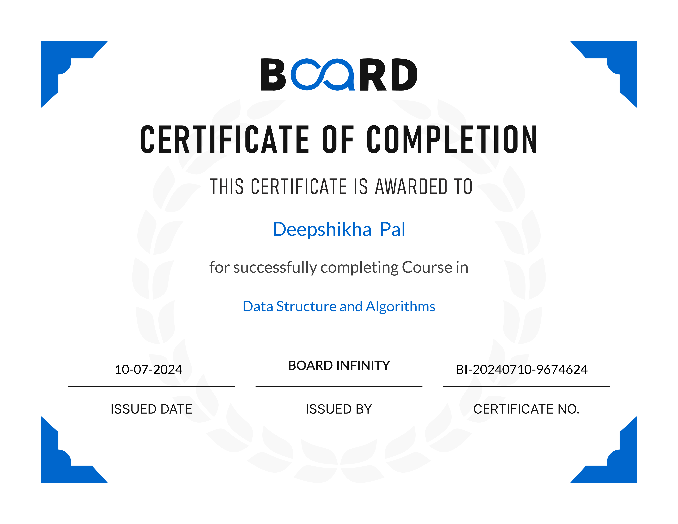
Certificate Completion

Slide 3
Summer Training
Benefits of this Summer Training
Skill Enhancement: Develop proficiency in data structures and algorithms, which are crucial for software development.
Hands-On Experience: Gain practical experience through coding exercises and projects.
Career Opportunities: Improve job prospects and increase competitiveness in the job market.
Problem-Solving Abilities: Enhance problem-solving skills and logical thinking.
Networking: Connect with industry experts and like-minded individuals.

Slide 4
About The Board Infinity
Board Infinity is an online educational platform that offers a variety of courses and programs designed to help individuals upskill and advance their careers. Here are some key points about the platform:
Core Offerings
Bootcamps: Intensive, short-term programs focused on specific skills or industries, such as data science, software development, and digital marketing.
Courses: Individual modules or courses on various topics, including programming languages, business skills, and technical certifications.
Career Services: Support for job seekers, including resume building, interview preparation, and networking opportunities.

Slide 5
About the Data Structure and Algorithms Outline
Hands-on Learning: The course emphasizes practical application with real-world coding exercises and projects.
Industry-Relevant Content: The curriculum is aligned with industry standards and expectations.
Experienced Instructors: Learn from seasoned professionals with deep expertise in data structures and algorithms.
Comprehensive Coverage: The course covers a wide range of topics, including:
Fundamental data structures (arrays, linked lists, stacks, queues, trees, graphs)
Algorithm design and analysis (divide and conquer, greedy algorithms, dynamic programming, backtracking)
Time complexity analysis and optimization

Slide 6
Technology learnt in this Course and Outcomes
Analysis of Algorithms
• Analysis of Algorithm: This section focused on understanding background analysis through programs and their functions.
• Order of Growth: I learned about the mathematical representation of growth analysis using limits and functions, including a straightforward approach to determining the order of growth.
• Asymptotic Notations: This covered the best, average, and worst-case scenarios, explained through example programs.
• Big O Notation: The concept was explained both graphically and mathematically, with calculations and applications demonstrated using Linear Search.

Slide 7
Mathematics
Digit Counting: Techniques for finding the number of digits in a number.
Progressions: Arithmetic and geometric progressions were covered.
Statistical Measures: Concepts of mean and median.
Prime Numbers: Understanding prime numbers.
LCM and HCF: Learning about Least Common Multiple (LCM) and Highest Common Factor (HCF).
Factorials: Calculating factorials.

Slide 8
Hashing
Introduction to Hashing: Time complexity analysis and applications of hashing were introduced.
Hash Functions: I learned about Direct Address Tables and various hashing functions.
Collision Handling: Discussed different collision handling techniques, including chaining and open addressing, with implementations.

Slide 9
Strings
String Data Structure: Studied string data structures in C++ .
String Algorithms: Implemented string algorithms like Rabin Karp and KMP.
Linked Lists
Introduction: An introduction to linked lists with implementations in C++ and Java.
Types of Linked Lists: Explored doubly linked lists and circular linked lists.

Slide 10
Stacks
Understanding Stacks: An overview of the stack data structure and its applications.
Stack Implementation: Implementation of stacks using arrays and linked lists in C++ .
Queues
Introduction to Queues: Basics and applications of queues.
Queue Implementation: Implemented queues using arrays and linked lists in C++ STL, including stack-based queue implementation.

Slide 11
Trees
Introduction to Trees: Covered the basics of trees, including binary trees and their applications.
Tree Traversals: Implemented various tree traversal techniques like Inorder, Preorder, Postorder, Level Order (line by line).
Binary Search Trees (BST)
Introduction to BST: An overview of Binary Search Trees, including background, introduction, and applications.
BST Operations: Implemented search, insertion, deletion, and floor operations in BST, along with exploring self-balancing BSTs.

Slide 12
Heaps
Introduction to Heaps: Basics and implementation of heaps.
Binary Heap Operations: Implemented binary heap operations like insertion, heapify, extract, decrease key, delete, and building a heap.
Heap Sort: Studied heap sort, and priority queues in C++.
Graphs
Introduction to Graphs: Basics of graph data structures and their representation using adjacency matrix and adjacency list in C++ and Java.
Graph Traversal: Implemented Breadth-First Search (BFS) and Depth-First Search (DFS) along with their applications.

Slide 13
Project Overview
LIBRARY MANAGEMENT SYSTEM
This C++ program implements a Library Management System that allows users to manage a collection of books. The program uses a Book structure to store details about each book, including its ID, title, author, and whether it is currently issued. The Library class manages a collection of Book objects and provides various functionalities such as adding new books, searching for books by ID or title, issuing and returning books, listing all books, and deleting books from the library.

Slide 14
Functionality
Book Addition: The system allows the librarian to add new books to the library's collection by providing a unique ID, title, and author name. Each new book entry is stored in the system, and it is initially marked as available for issue.
Search by ID: Users can search for a specific book by its unique ID. The system retrieves and displays the book’s details, including its title, author, and current availability status (whether issued or available).
Search by Title: The system also enables searching for books by their title. It provides detailed information about the book, similar to the search by ID feature, and helps users locate the book within the library's collection.
Book Issuing: The librarian can issue a book to a user by entering the book's ID. The system checks the availability of the book and, if it is available, marks it as issued. If the book is already issued, the system informs the librarian to avoid double issuance.

Slide 15
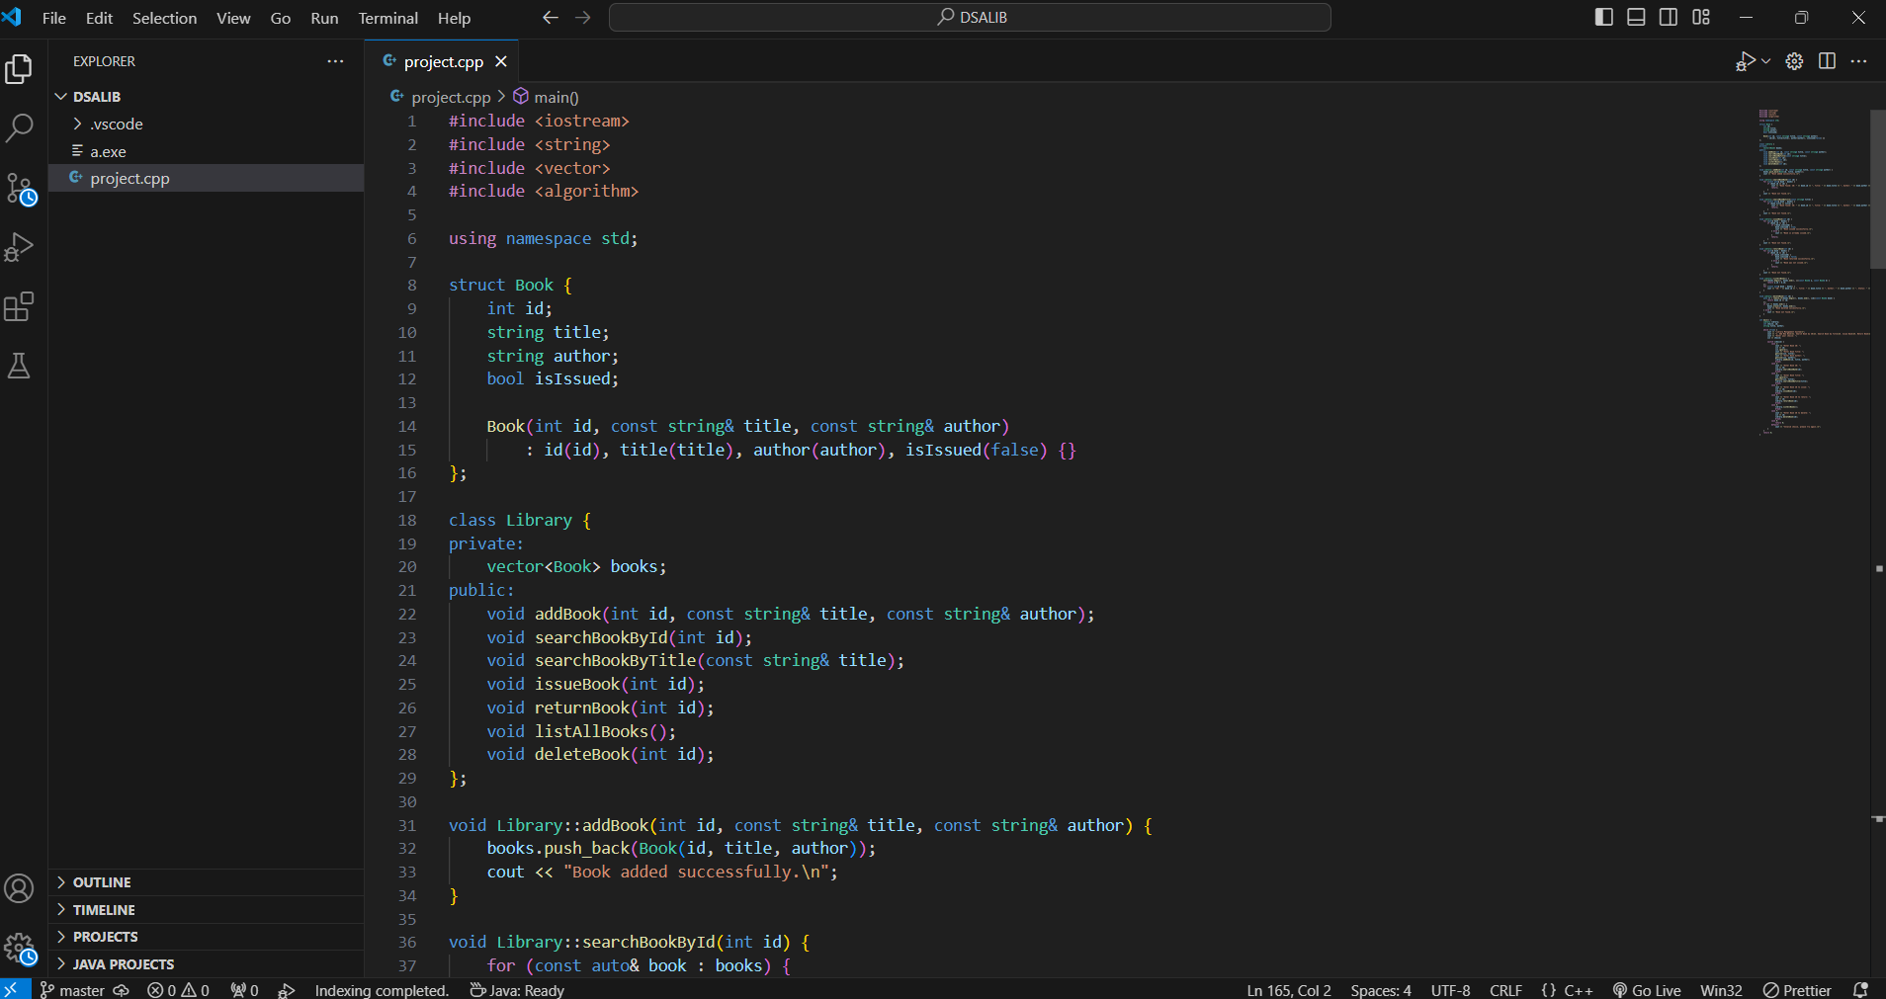
Code Implementations

Slide 16
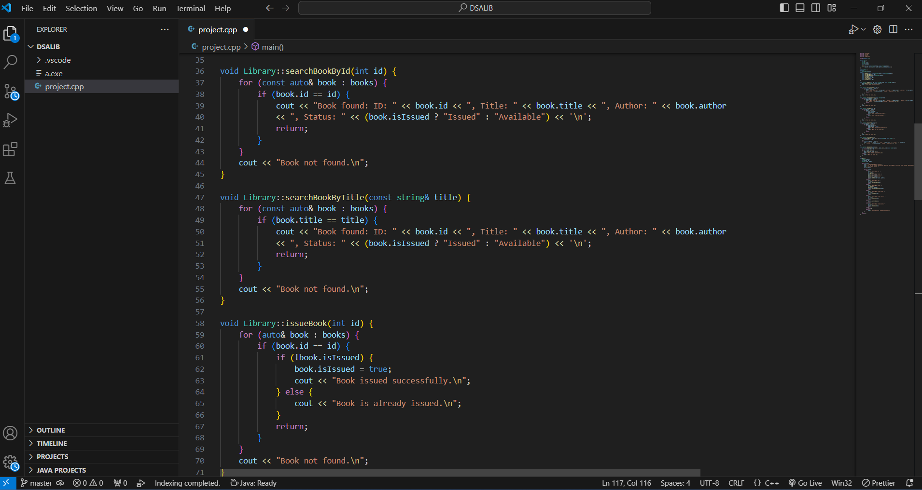

Slide 17
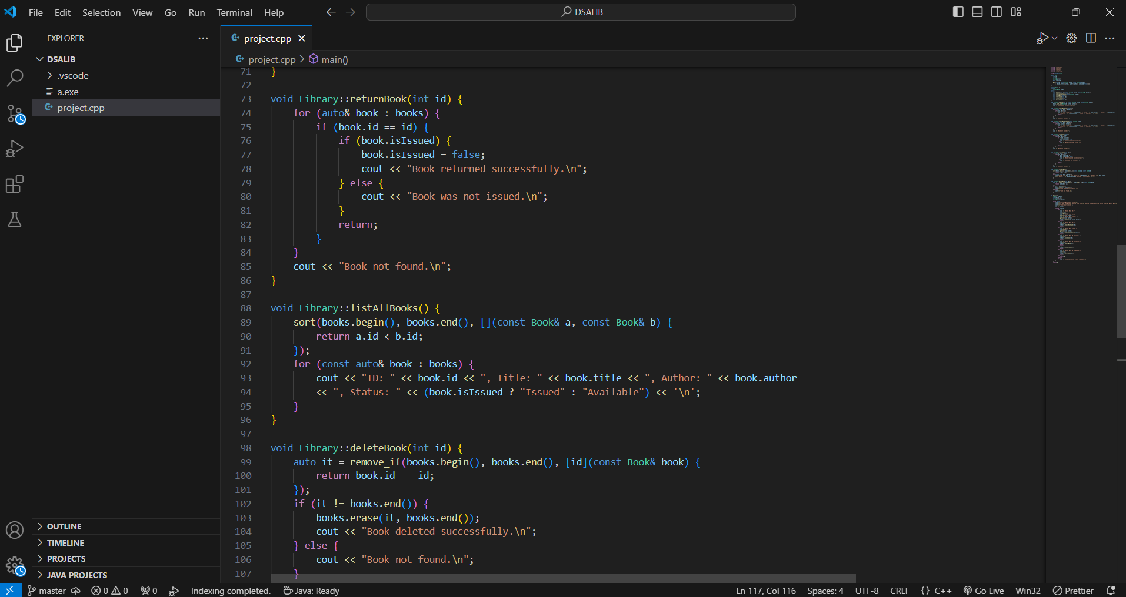

Slide 18
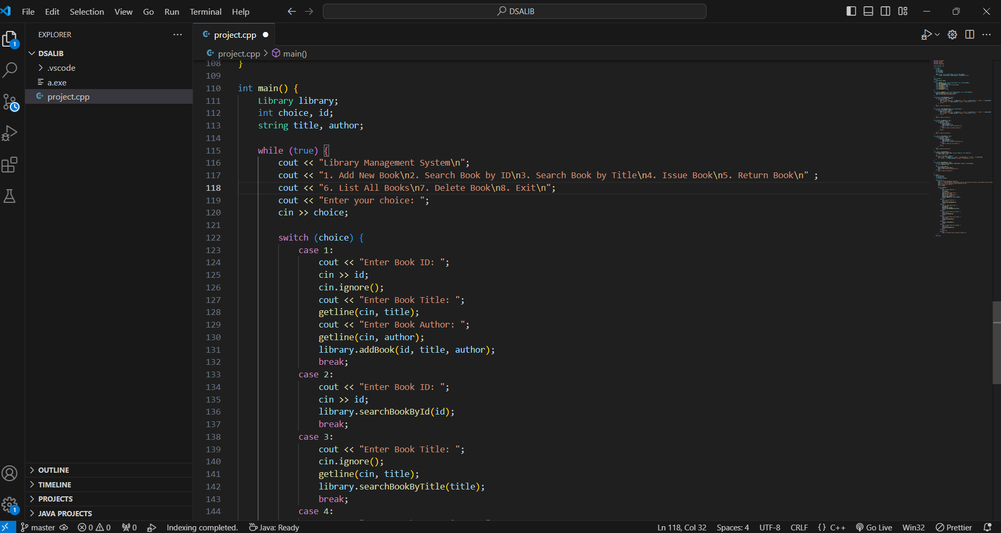

Slide 19
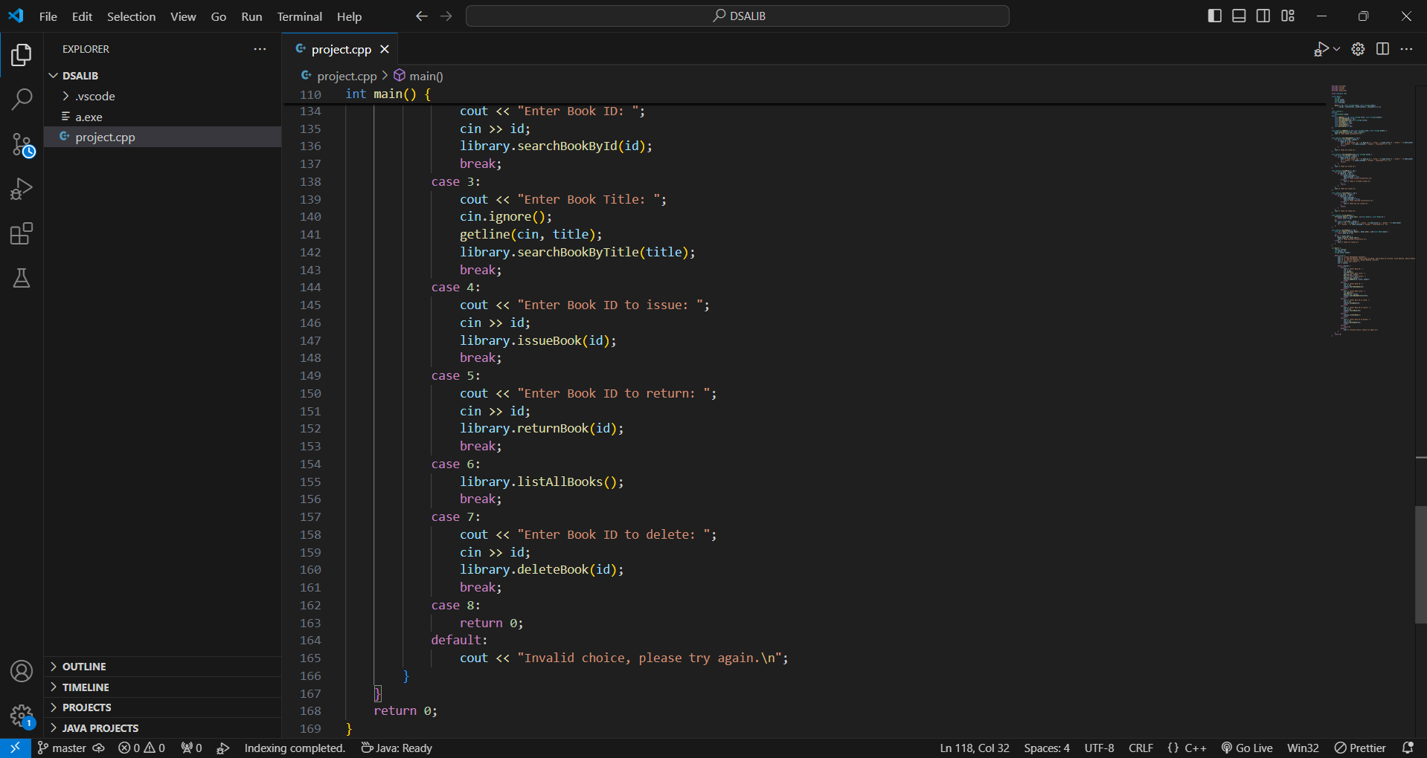

Slide 20
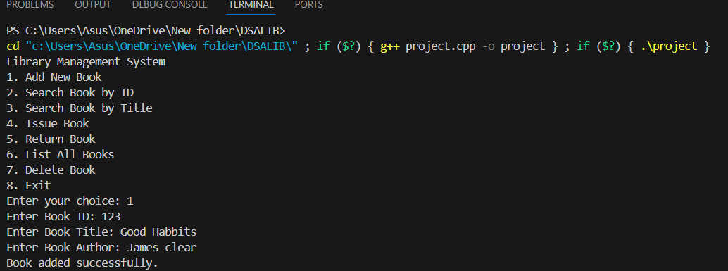
Output

Slide 21
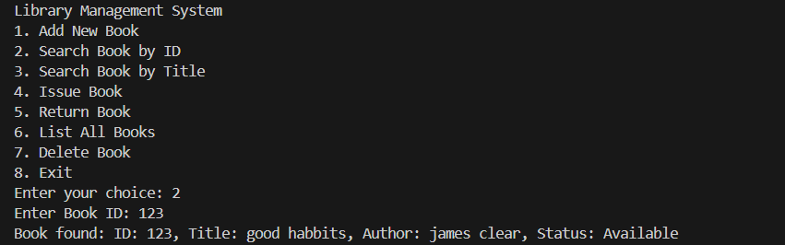

Slide 22


Slide 23
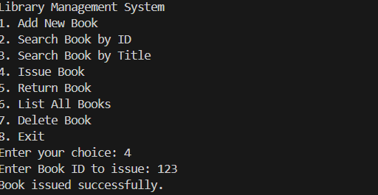

Slide 24
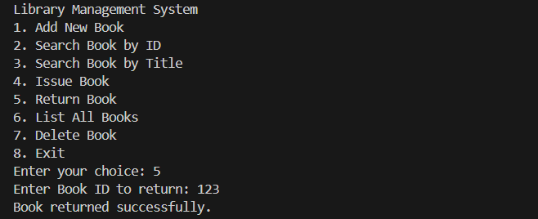

Slide 25
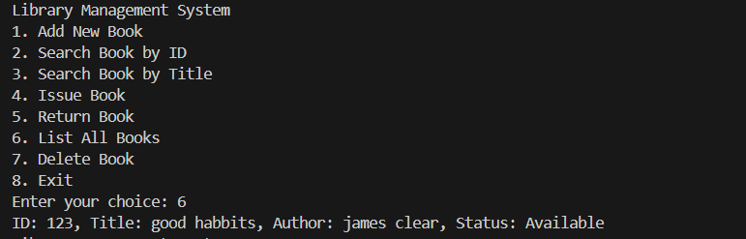

Slide 26
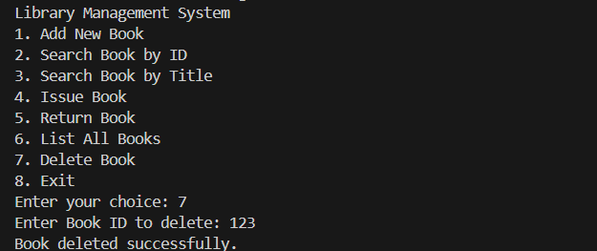

Slide 27
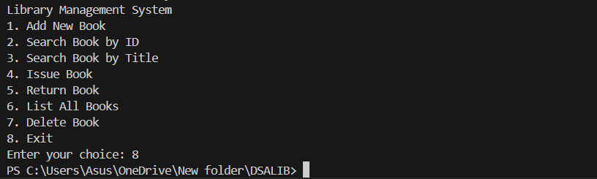

Slide 28
Learning Outcomes
Programming fundamentally revolves around the use of data structures and algorithms. Data structures manage and store data, while algorithms solve problems by processing that data. Data Structures and Algorithms (DSA) explore solutions to common problems in depth, providing insights into the efficiency of different approaches.
Understanding DSA empowers you to select the most effective methods for any given task. For example, if you need to search for a specific record in a database of 30,000 entries, you could choose between methods like Linear Search and Binary Search.

Slide 29
List All Books: The system provides an organized list of all books currently in the library, sorted by their unique IDs. The list includes each book's ID, title, author, and availability status, giving the librarian a quick overview of the library’s inventory. •
Book Deletion: If a book is no longer part of the library's collection, the librarian can delete its record by entering the book's ID. The system ensures that the book is removed from the list, keeping the library's inventory up to date.

Slide 30
Knowing DSA allows you to tackle problems with greater efficiency, making your code more scalable, which is crucial because:
• Time is valuable.
• Memory is costly.
DSA is also essential for excelling in technical interviews at product-based companies. Just as we prefer someone who can complete a task quickly and efficiently in our daily lives, companies look for developers who can solve complex problems effectively and with minimal resources.

Slide 31
BIBLIOGRAPHY
Board Infinity course.
Board Infinity Website.
Google.

Slide 32


