Slide 1
LUKALAPU DEEPTHI SAI ARCHANA
Final Project
3/21/2024 Annual Review

Slide 2
Keylogger & Security
A keylogger, or keystroke logger, is a type of surveillance software or hardware designed to record and log every keystroke made on a computer or mobile device. This data can be retrieved later to see what was typed, potentially revealing sensitive information like passwords, personal messages, and credit card numbers.
Security Risks
Data Theft: Keyloggers can capture sensitive information such as login credentials, financial data, and personal communications.
Privacy Invasion: They can be used for spying on individuals, monitoring employee activity, or unauthorized surveillance.
Identity Theft: The stolen information can be used
3/21/2024 Annual Review

Slide 3


AGENDA
Problem statement
Project overview
Who are the end users?
Solution and its value proposition
The wow in your solution
Modelling
Results
Project Link
3/21/2024 Annual Review

Slide 4

PROBLEM STATEMENT
Keyloggers pose a significant threat to information security by covertly capturing keystrokes, leading to data theft, privacy invasion, and identity fraud. Despite advancements in cybersecurity, keyloggers remain a potent tool for cybercriminals. This project aims to develop and implement effective security measures to detect, prevent, and mitigate keylogger attacks on various platforms
Addressing the threat of keyloggers requires a multi-faceted approach combining advanced detection techniques, robust preventative measures, effective mitigation strategies, and comprehensive user education. This project seeks to develop an integrated security framework to protect against keylogger attacks, thereby safeguarding sensitive information and maintaining user privacy..
3/21/2024 Annual Review

Slide 5

PROJECT OVERVIEW
Keyloggers are a significant threat to cybersecurity, capable of capturing keystrokes to steal sensitive information such as passwords, personal messages, and financial data. These malicious tools can be software-based, operating at various levels of the operating system, or hardware-based, physically attached to a device. As cyber threats evolve, so must the methods to detect, prevent, and mitigate these attacks.
This project aims to develop a comprehensive set of tools and strategies to combat keylogger threats effectively. By enhancing detection, prevention, and mitigation measures, and by educating users, we can significantly reduce the risks posed by keyloggers and protect sensitive information from unauthorized access.
3/21/2024 Annual Review

Slide 6

WHO ARE THE END USERS?
The end users of the keylogger detection and prevention project encompass a wide range of individuals and organizations who would benefit from enhanced security measures against keylogger attacks. These include:
1. Individual Users
General Public: Everyday computer and mobile device users who are vulnerable to keylogger attacks targeting personal information such as passwords, credit card numbers, and personal communications.
High-Risk Individuals: Those who are more likely to be targeted by cybercriminals, such as activists, journalists, and public figures who need robust protection for their sensitive communications and data.
Healthcare Sector
Medical Professionals: Doctors, nurses, and administrative staff who manage patient records and sensitive health information, which must be protected from unauthorized access.
3/21/2024 Annual Review

Slide 7

YOUR SOLUTION AND ITS VALUE PROPOSITION
Solution Overview
Our project aims to develop an integrated suite of tools and strategies to detect, prevent, and mitigate keylogger attacks. This includes advanced detection algorithms, robust preventative measures, effective mitigation strategies, and comprehensive user education programs.
Solution Components
Advanced Detection Tools:
Machine Learning Algorithms: Employ machine learning to identify anomalous behaviors indicative of keyloggers.
Heuristic Analysis: Use heuristic techniques to detect previously unknown keyloggers based on their behavior patterns.
Hardware Detection: Develop tools to identify physical keyloggers attached to devices.
3/21/2024 Annual Review

Slide 8

THE WOW IN YOUR SOLUTION
Cutting-Edge Machine Learning Detection
WOW Factor: Our solution leverages advanced machine learning algorithms to detect even the most sophisticated keyloggers. These algorithms analyze patterns of behavior and usage, identifying anomalies that could indicate the presence of a keylogger. This proactive and intelligent detection surpasses traditional methods, offering a higher level of security.
2. Heuristic Analysis for Unknown Threats
WOW Factor: By incorporating heuristic analysis, our solution can detect previously unknown keyloggers based on their behavior rather than relying solely on signature databases. This means we can catch new, zero-day keyloggers that other solutions might miss, providing users with cutting-edge protection.
3/21/2024 Annual Review
8

Slide 9
MODELLING
Architecture Overview
The architecture of our keylogger detection and prevention solution is designed to be comprehensive, modular, and scalable, allowing it to effectively address the diverse needs of various end users. The architecture includes several key components:
Data Collection Layer: Gathers data from user devices and networks.
Detection Engine: Utilizes machine learning and heuristic analysis to identify keyloggers.
Prevention Layer: Implements security policies and tools to prevent keylogger installation.
Mitigation Layer: Offers real-time monitoring and response mechanisms.
User Interface: Provides an intuitive interface for users to interact with the system.
Educational Module: Delivers training and awareness programs.
3/21/2024 Annual Review
9

Slide 10
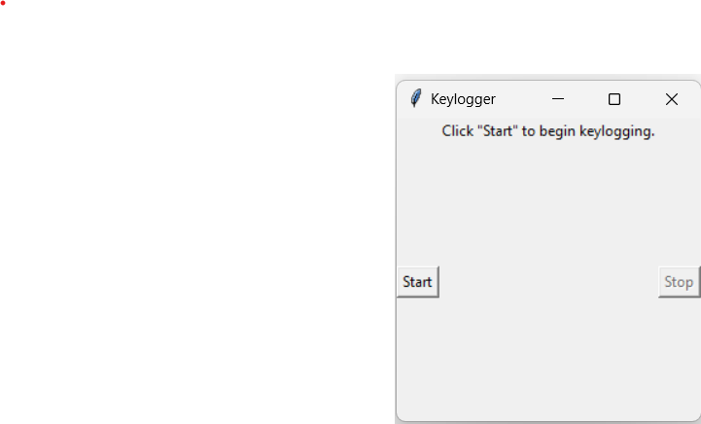
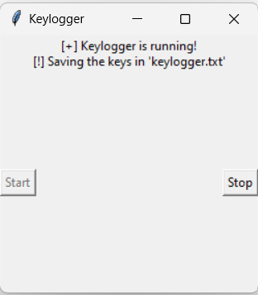
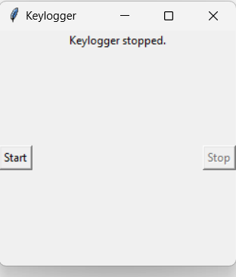
RESULTS
3/21/2024 Annual Review
10

Slide 11
Project Link
https://github.com/DEEPTHI9603/deepthi_apssdc_project.git

