Slide 1

Loan approval prediction system
MINI-PROJECT PHASE - 1
Presented By:
Rahul Hegde 1DS19IS072
Rajvaishak Nayak 1DS19IS074
Vikram Patel 1DS19IS125
Pavan HC 1DS19IS126
Under The Guidance Of
Rekha Jayaram
Assistant Prof.
Dept. of Information Science and Engineering
DSCE, Bangalore

Slide 2

CONTENTS
Introduction
Problem Statement
Literature Survey
Motivation of the Project
Objective and Scope of the Project.
Methodology
Hardware Requirements.
Software Requirements
Contribution of the Project.

Slide 3
ABSTRACT
Banks are making major part of profits through loans. Though lot of people are applying for loans.
It’s hard to select the genuine applicant, who will repay the loan. While doing the process manually, lot of misconception may happen to select the genuine applicant.
Therefore we are developing loan prediction system using machine learning, so the system automatically selects the eligible candidates. This is helpful to both bank staff and applicant.
The time period for the sanction of loan will be drastically reduced. Here we are predicting the loan data by using SVM model.

Slide 4
INTRODUCTION
A loan is the core business part of banks. The main portion the bank’s profit is directly come from the profit earned from the loans.
Though bank approves loan after a regress process of verification and testimonial but still there's no surety whether the chosen hopeful is the right hopeful or not.
This process takes fresh time while doing it manually. We can prophesy whether that
particular hopeful is safe or not and the whole process of testimonial is automated by
machine literacy style.
Loan Prognostic is really helpful for retainer of banks as well as for the hopeful also.

Slide 5
LITERATURE SURVEY
1." Loan Approval Prediction based on Machine Learning Approach" Author- Kumar Arun, Garg Ishan, Kaur Sanmeet Year- 2018The main objective of this paper is to predict whether assigning the loan to particular person will be safe or not. This paper is divided into four sections (i)Data Collection (ii) Comparison of machine learning models on collected data (iii) Training of system on most promising model (iv) Testing

Slide 6
2.“Exploring the Machine Learning Algorithm for Prediction the Loan Sanctioning Process” Author- E. Chandra Blessie, R. Rekha - Year- 2019 Extending credits to corporates and individuals for the smooth functioning of growing economies like India is inevitable. As increasing number of customers apply for loans in the banks and non- banking financial companies (NBFC), it is really challenging for banks and NBFCs with limited capital to device a standard resolution and safe procedure to lend money to its borrowers for their financial needs. Inaddition, in recent times NBFC inventories
have suffered a significant downfall in terms of the stock price. It has contributed to a contagion that has also spread to other financial stocks, adversely affecting the benchmark in recent times.In this paper, an attempt is made to condense the risk involved in selecting the suitable person who could repay the loan on time thereby keeping the bank’s nonperforming assets (NPA) on the hold. This is achieved by feeding the past records of the customer who acquired loans from the bank into a trained machine learning model which could yield an accurate result. The prime focus of the paper is to determine whether or not it will be safe to allocate the loan to a particular person. This paper has the following sections (i) Collection of Data, (ii) Data Cleaning and (iii) Performance Evaluation. Experimental tests found that the Naïve Bayes model has better performance Evaluation. Experimental tests found that the Naïve Bayes model has better performance than other models in terms of loan forecasting.

Slide 7
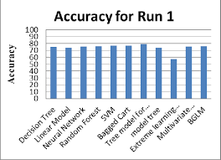
SVM works better because
3.
Accuracy when tested has been shown that algorithms have similar accuracy when compared,According to “Comparison of Support Vector Machine and Decision Tree in Predicting On Time Graduation Case Study : Universitas Pembangunan Panca Budi” it has been shown that svm runs faster as it uses kernel trick to solve non-linear problems whereas decision trees derive hyper-rectangles in input space to solve the problem.

Slide 8
PROBLEM STATEMENT
Finance companies, banks deals with different kinds of loans such as education loan, shop loans, home loans, personal loans etc.These all are part of our country's loan types. All the companies and banks are present in villages, towns, cities. After customer apply for loan these banks/companies want to validate the customer details whether the candidate is eligible for loan or not. The main purpose of the system is to approve applicant the loan based on train models.

Slide 9
MOTIVATION OF THE PROJECT
Loan approval is a very important process for banking organizations. The system approvedor reject the loan applications.
Recovery of loans is a major contributing parameter in the financial statements of a bank.
It is very difficult to predict the possibility of payment of loan by the customer. Using Machine learning we predict the loan approval.
Support vector model has been used so that the loan could be provided on some analogy of what has been done in the past and is supervised by svm technique.

Slide 10
OBJECTIVE & SCOPE OF THE PROJECT
The objective of the problem is to pick out which customer will be able to pay the debt and which customer is likely will not be able to pay the debts.The data is fed into the support vector model and the trained model upon previous results gives us the clarification about the loan approvements.

Slide 11
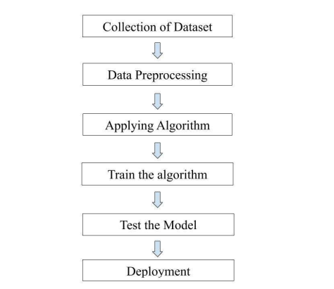
METHODOLOGY

Slide 12
HARWARE & SOFTWARE REQUIREMETS
HARDWARE TOOLS MINIMUM REQUIREMENTS
Processor i3 or above
Hard Disk 5GB
RAM 8GB
Monitor 17” Coloured
SOFTWARE TOOLS MINIMUM REQUIREMENTS
Operating System :Windows, Linux or MacOS
Technology Python: Machine Leaning
Scripting Language :Python
IDE :Jupyter Notebook

Slide 13
CONTRIBUTION OF THE PROJECT
To deal with the problem, we developed automatic loan prediction using machine learning
techniques by using SVM which was not used. We will train the machine with previous dataset. so machine can analyse and understand
the process . Then machine will check for eligible applicant and give us result.
Advantages :
Time period for loan sanctioning will be reduced.
Whole process will be automated , so human error will be avoided
Eligible applicant will be sanctioned loan without any delay.

Slide 14
REFERENCES
[1] Kumar Arun, Garg Ishan, Kaur Sanmeet, ―Loan Approval Prediction based on Machine Learning Approach‖, IOSR Journal of Computer Engineering (IOSR-JCE), Vol. 18, Issue 3,
pp. 79-81, Ver. I (May-Jun. 2016)
[2]Exploring the Machine Learning Algorithm for Prediction the Loan Sanctioning Process” Author- E. Chandra Blessie, R. Rekha - Year- 2019
[3]According to Comparison of Support Vector Machine and Decision Tree in Predicting On Time Graduation Case Study : Universitas Pembangunan Panca Budi it has been shown that svm runs faster as it uses SVM uses kernel trick to solve non-linear problems whereas decision trees derive hyper-rectangles in input space to solve the problem.

Slide 15
THANK YOU

