Slide 1

A smart web platform to book EV charging slots in advance and cut waiting time.
Domain: Electric Mobility • Smart Transportation • Sustainable Tech
Team: [K.YAKSHIT]
[A.SWARAJ]
[CH.PRANAY]
[CH.NEERAJ]
⚡
Notes:
Introduce the team and the one-line idea.

Slide 2
The Challenge
Real-world problem
⏳ 45 min wait
EV usage is growing fast
Charging stations are in high demand
⚡
Why it matters
No schedule = long waiting times
Stations are used inefficiently
Key challenges
Long queues at stations
No advance booking
Hard to manage schedules
Double booking of slots
Crowded charging station
Notes:
Frame the problem: queues, no booking, double booking.

Slide 3
Our Innovation
Core idea: slot scheduling + live visual animation in one simple website
What makes us different
Key features
Interactive booking interface
Animated car drives to the station
Visual charging progress
Simple slot cancellation
View available time slots
Book charging slots
Block duplicate bookings in a session
Show booking confirmation
Show charging progress
Notes:
Stress the mix of scheduling and animation.

Slide 4
How It Works
🌐
📋
🕒
✅
🚗
🔋
🎉
➜
➜
➜
➜
➜
➜
Open
Website
View
Slots
Select
Time
Book
Slot
Car Drives
to Station
Charging
Starts
Done
Message
Input
Processing
Algorithm
Output
User-selected charging time
JavaScript checks slot availability
Availability check + duplicate prevention
Booking confirmation + charging progress
User journey: simple, interactive and user-friendly
Notes:
Walk the flowchart left to right.

Slide 5
Technology & Algorithm
HTML
Structure
CSS
Style + car animation
JavaScript
Booking logic
Complexity
Slot lookup (array)
O(n)
Booking insertion
O(1) avg
Main algorithms
Slot availability check
Duplicate booking prevention
Cancellation • Progress simulation
Cancellation (filter)
O(n)
Space (booked slots)
O(n)
Why these technologies?
Easy to build and maintain
Lightweight, works in any browser
Great for front-end prototypes
Note: current version is a front-end prototype with no permanent database storage.
Notes:
Keep this slide quick.

Slide 6
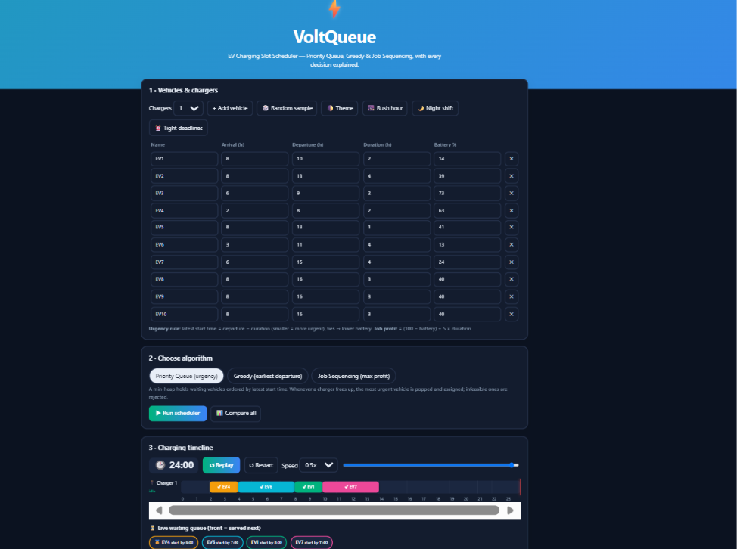
Demo & Impact
⚡
Selected Slot: 10 AM – 11 AM
Booking Status: Successfully Booked
Charging Status: In Progress
Completion: 100%
Simulated results – prototype demonstration
Notes:
Show the live demo here.

Slide 7
Future Vision
Achieved
Next steps
Scalability
Interactive website
Booking + cancellation
Animated car movement
Charging progress
Database for records
Live station availability
Login / registration
GPS navigation
Online payments
Mobile app
Multiple stations
More users and schedules
Real EV infrastructure
“Making EV charging smarter, simpler, and more accessible through technology.”
⚡
Notes:
Close with the takeaway, then open for Q&A.

Slide 8


