Slide 1
Artificial Intelligence
Project Report
Submitted To :
Prof. Poonam Bedi
Submitted By :
Deepti Sharma (09)
Sandhya (32)
Shivani Tiwary(36)
Surbhi Chaurasia(42)

Slide 2

Automatic
Question Paper
Generator App
A java app for automatically generating the question paper on a click!

Slide 3
Problem Statement
Everyday New Concepts And Ideas Released
Students Need To Practice Them.
Question Paper Creation Is A Tedious And Time Consuming Task
Some Functionality required For The Instructor To Generate And Save The Question Paper Automatically
A System Like AQPG can solve both these issues.

Slide 4
Abstract
Our system divides users in three categories-
Admin
Instructor
Learner
The Admin:
Can modify database
approving the changes required by instructor or learner in a question
has the authority to create user and dismiss upon request.
The Learner :
system generates random questions from the database of the particular subjects
judging on the capability of learner; the level is increased.
The Instructor:
Generate and save the question paper automatically.

Slide 5
Process Model:Waterfall Model
Sometimes called the classic life cycle,
Suggests a systematic, sequential approach to software development
Begins with customer specification of requirements and progresses through planning, modeling, construction, and deployment, culminating in ongoing support of the completed software.

Slide 6
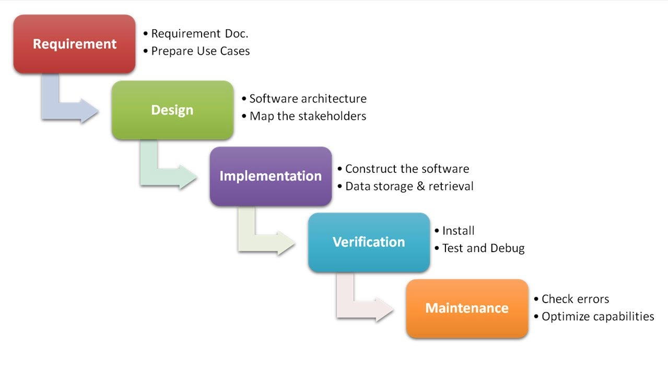

Slide 7
Software
Requirement
Specification
At a Glance
A software requirements specification (SRS)
is a description of a software system to be developed.
It lays out functional and nonfunctional requirements, and may include a set of use cases that describe user interactions that the software must provide.

Slide 8
Product Functions
Adding and Deleting Users, Courses, Questions and related information into database.
Modifying the same three entities by the Admin.
Generating Question Paper on a Click By Instructor.
Practice Sessions for Learner.
Viewing the profile and editing content by the three type of Users.
Other expected functions like verifying the user upon login password entry, etc. are there.

Slide 9
User Interface

Slide 10
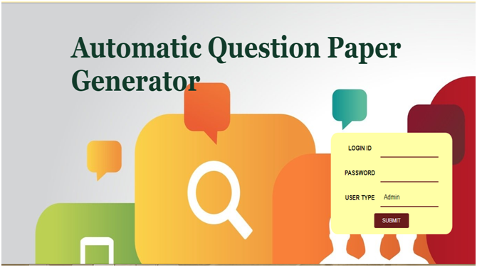

Slide 11
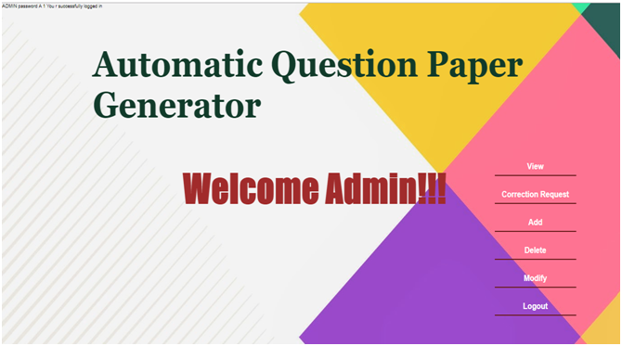

Slide 12
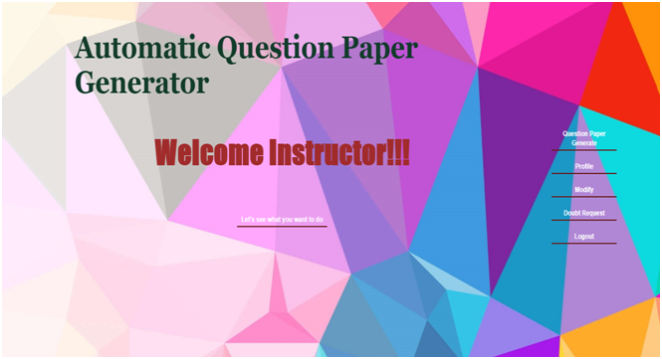

Slide 13
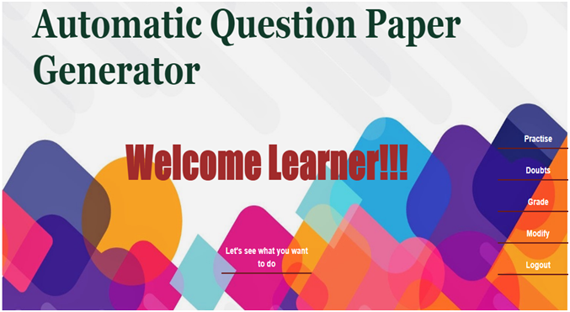

Slide 14
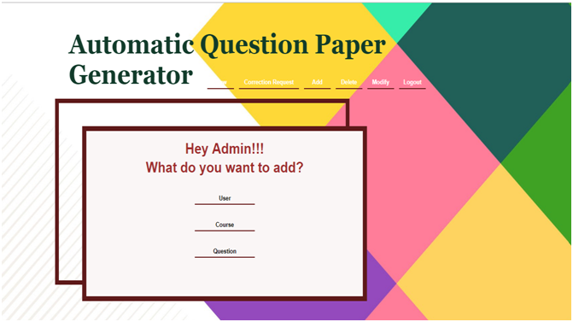

Slide 15
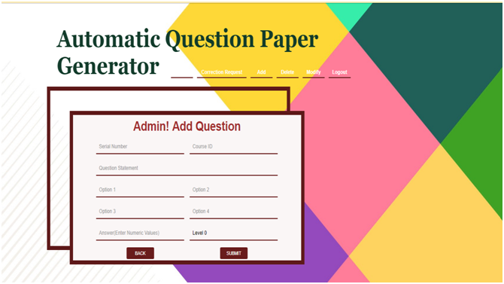

Slide 16
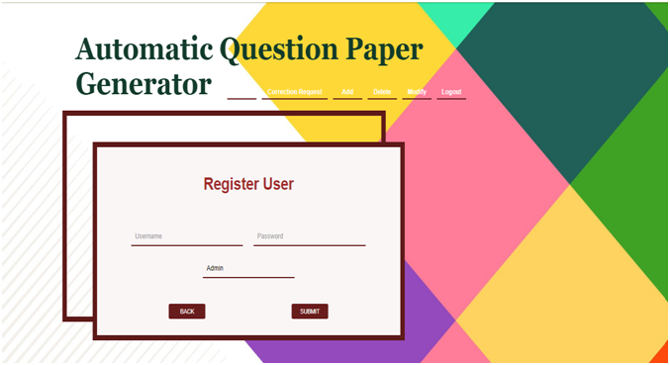

Slide 18
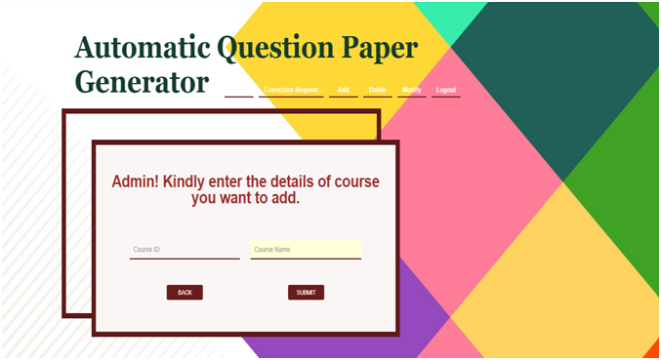

Slide 19
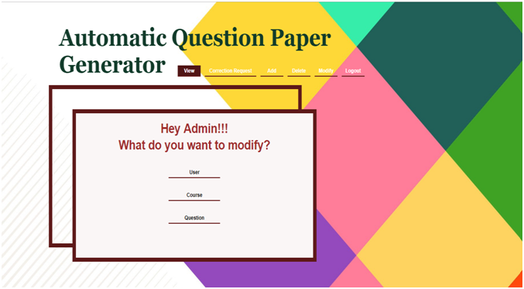

Slide 20
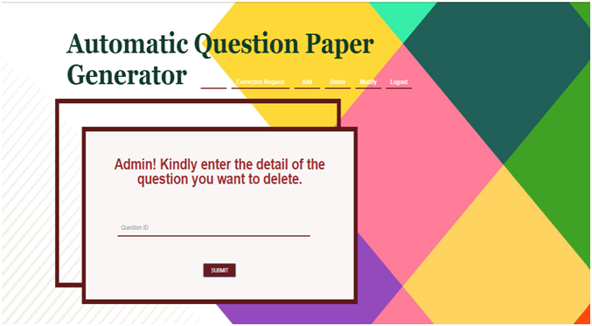

Slide 22
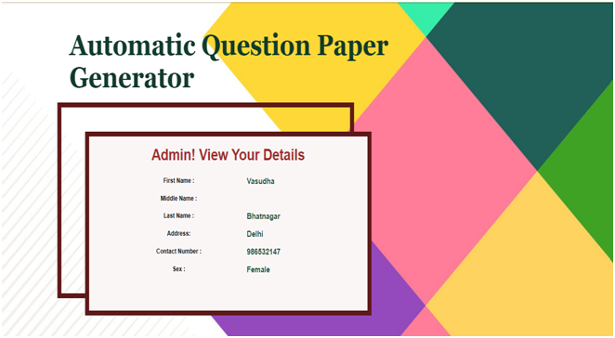

Slide 23
H/W AND S/W INTERFACE

Slide 24
Hardware Interface
a nominal display; high deficiency screen is not necessary.
internet connection
Software Interface
special database known as “QUESTION PAPER INFO” ; available to the application
Chrome or any Browser application

Slide 25
DATA
FLOW
DIAGRAM
Data Flow Diagram is a graphical representation that depicts information flow and the transforms that are applied as data move from input to output.

Slide 26
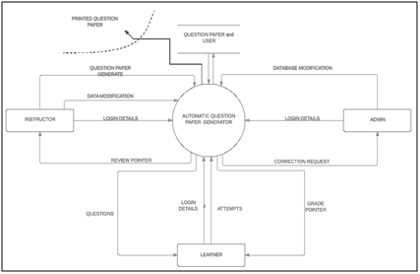
Context Level Diagram /Level0:

Slide 27
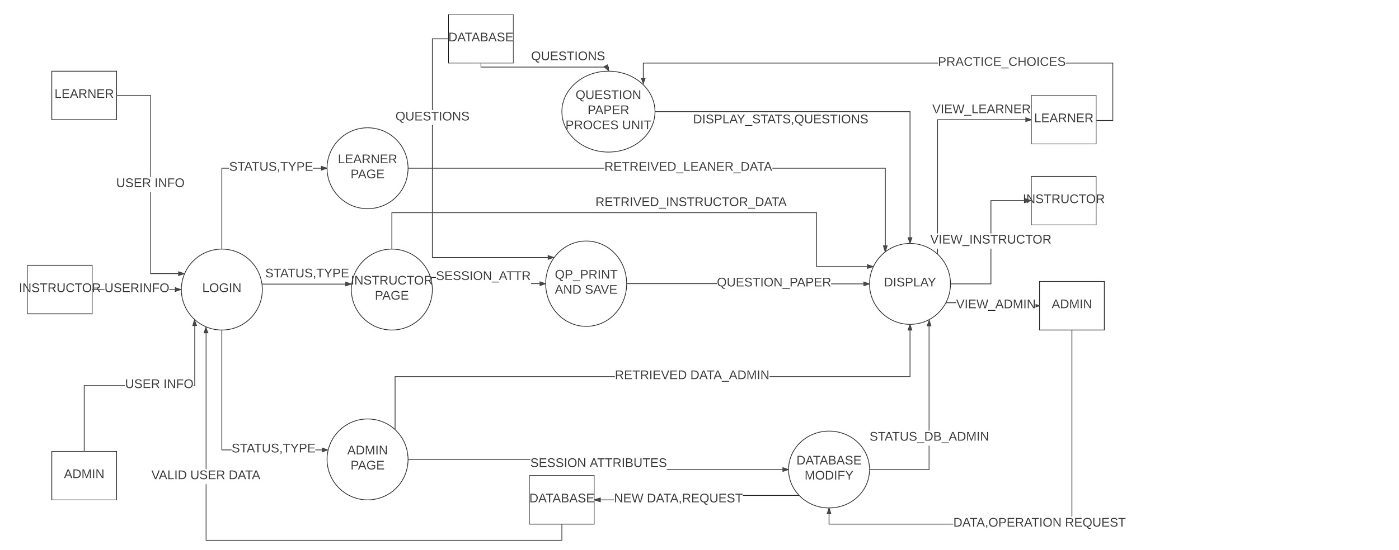
Level 1 Dfd :

Slide 28
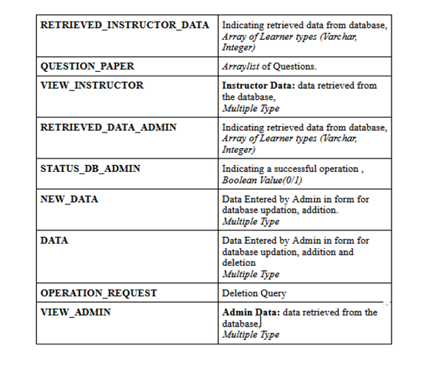

Slide 29
SYSTEM DESIGN

Slide 30
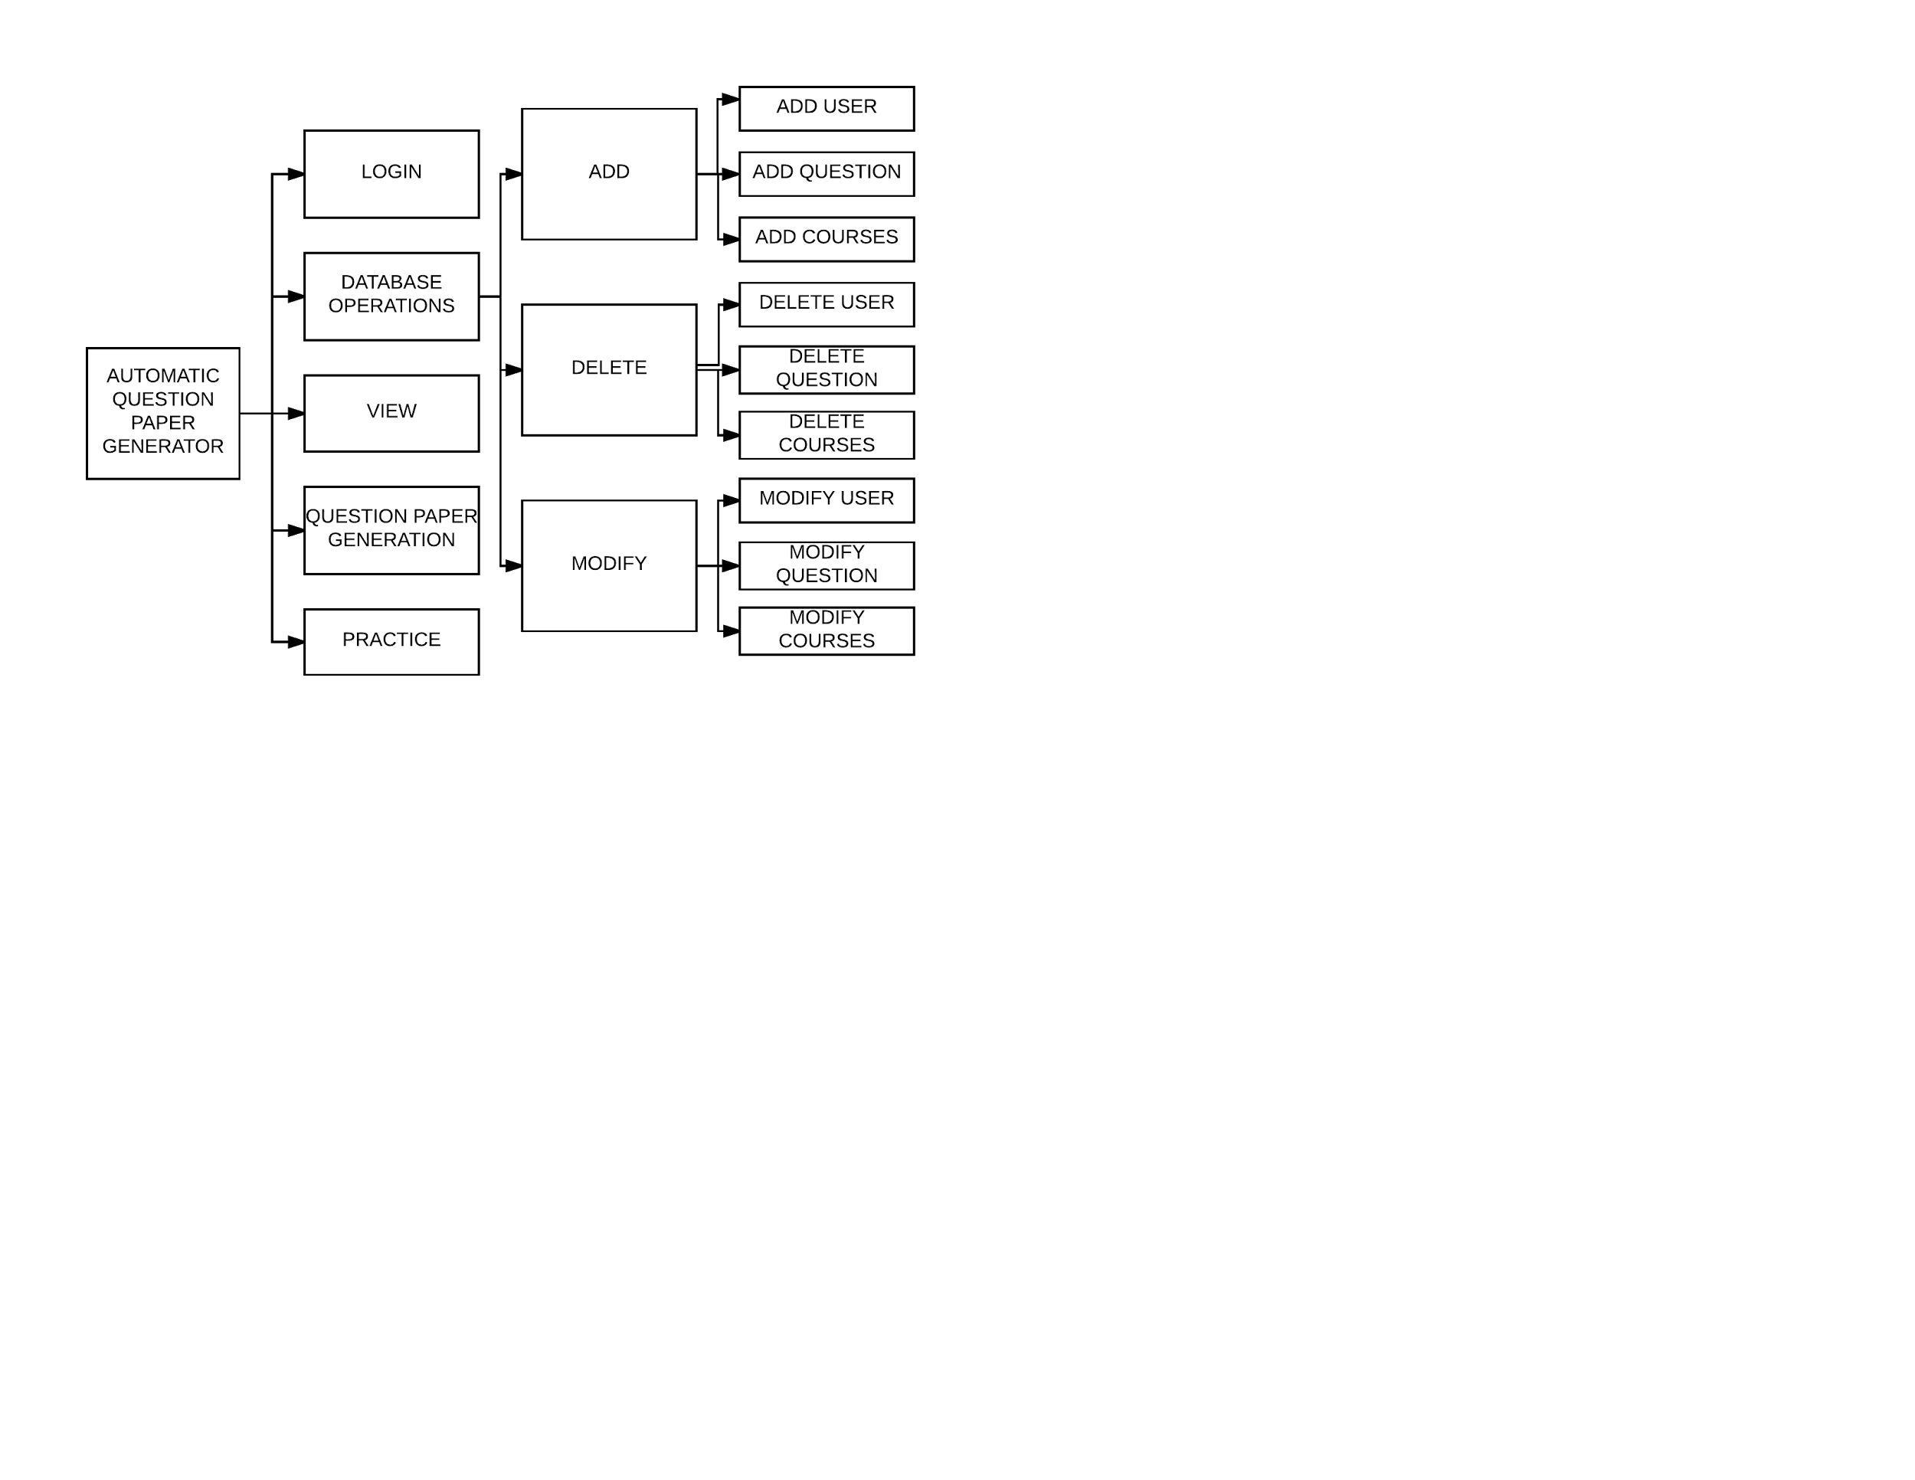
System Design

Slide 31
DATA DESIGN

Slide 32
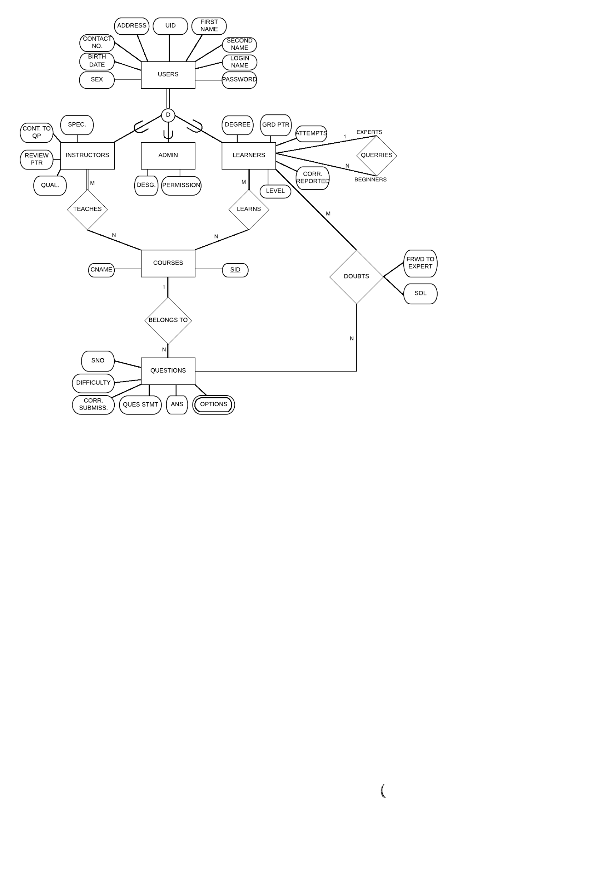

Slide 33
CONCLUSION AND FUTURE DEVELOPMENT

Slide 34

The project we have developed so far can be easily extended to many ideas and can keep on growing. Some changes that we plan to make are :
Increase the levels of question difficulty and allowing the teacher to replace a question from the given one.
Allowing chat between learner and an expert to sought out doubts.
Allowing more choices for the learner to practice his own way
Allowing String search using NLP for deleting a question by Admin.
Allowing the questions to not get repeated for the user.
Graphing the daily practice and concentration of the student just like the Github Graph of Contribution.
Graphing the Instructors capability to contribute corrections.
And many More….

Slide 35
Thank You !

