Slide 1
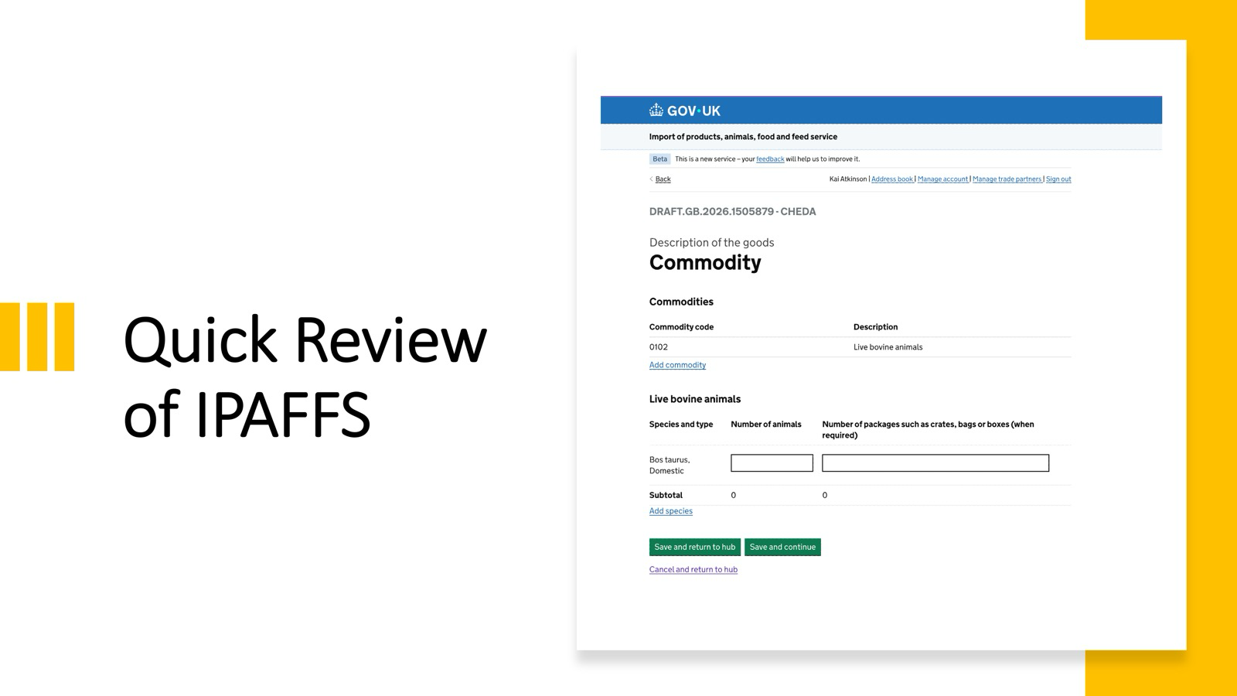
DEMO
Notes:
start with a quick overview of IPAFFS. Callouts to:
Org Picker
Journey Selection
Import PURPOSE and select BREEDING (note SLAUGHTER for DOGS)
Show the commodity weights...
This is field config

Slide 2
Field Config: origin and problem space
The problem it addresses: different commodities have different regulatory data requirements. Field config tells the IPAFFS frontend which fields to show, which dropdown options to offer, and which pages to include when an importer creates a notification.
NDC has the same need - so can we reuse it? TL;DR: no.
2018
2019-20
2022
2023
Scraped from TRACES
IMP and the Excel pipeline
CHED-A and certificate overrides
Partial retreat
“scrapy-traces” harvests commodity configs from the EU’s TRACES system into ~3,000 denormalised JSON files, one per commodity code. A frozen snapshot of TRACES, loaded into the field config database.
New IMP certificate type for EU live animal imports, defined in Excel. A second pipeline turns the spreadsheet into more denormalised JSON. Brexit occurs 31 Jan 2020.
IMP journeys become CHED-A, but 5 IMP features are “cherry-picked” in via new certificate overrides. Changes to IMP configs can now silently break CHED-A journeys.
Parts 2 and 3 of all journeys migrate off field config. What remains carries huge duplication: thousands of configs exist only because labels encode commodity codes.
A 2018 snapshot of another system’s UI, accreted through six years of policy change.
Notes:
History of Field Config
It tells the FE which pages, and within each page WHAT to render for a specific commodity code
But it also is used in the context of
- eNotification processsing
- Cloning
- Reference Data Loader (associates new CC with defaults)
- Decision Frontend
- Control Frontend
- Notification Frontend
It was being decommissioned

Slide 3
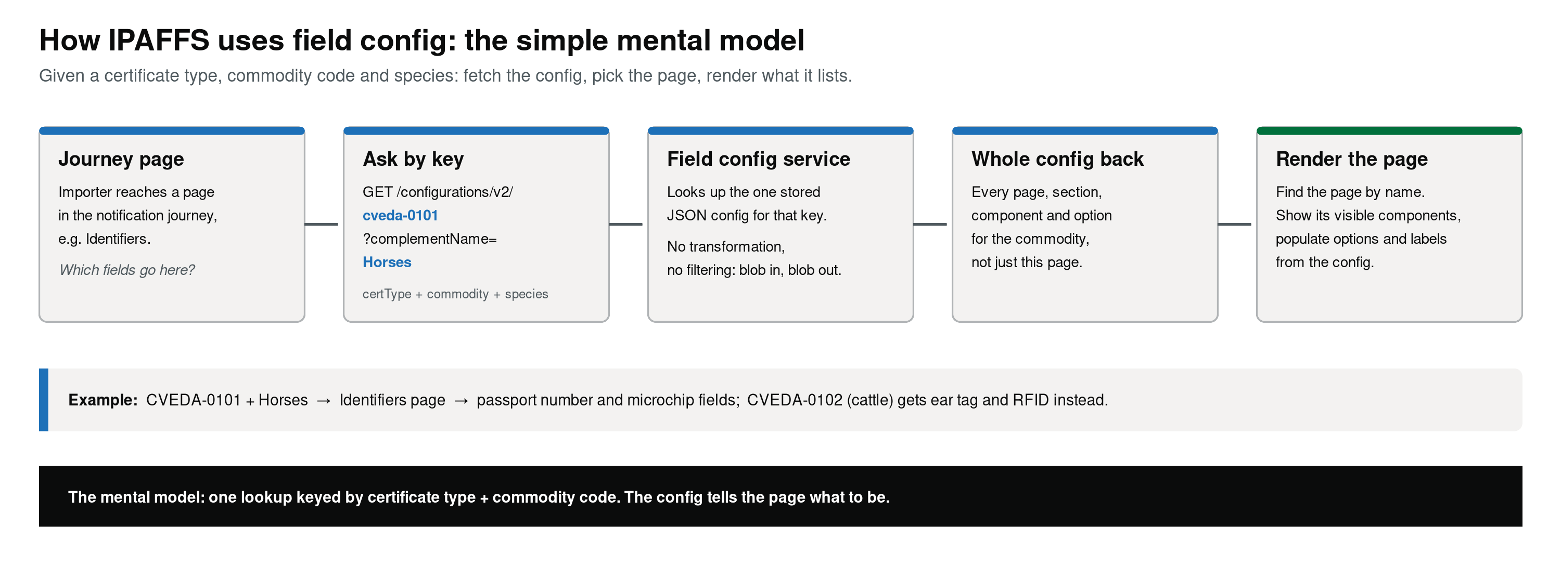
Don’t forget to look at the Field Config Data in VNET - use import PURPOSE, and check commodity item page
Notes:
Simplest view of the problem space is:
Decide which page is in scope
Fetch the config
Parse up the entire blob
Introspect it for the bit you need
Decide whether the page is in scope and what it should show

Slide 4
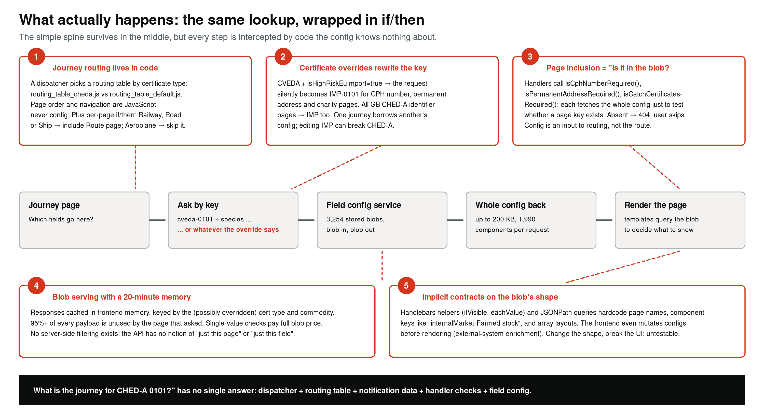
Notes:
Reality is a horror show
Remember that IPAFFS is a monolith stored and deployed in lots of small repositories. But it's a monolith - a giant soup of all the things all at once
If you want to know which page is going to be shown and what will be on those pages - you can't - it's spread out
There is no single architectural source of truth defining the user's journey through the system.. more later
- Routing tables (by certificate)
- Fallback routing tables
- Page order and navigation are in code (conditional branching)
- Certificate overrides masqurade as journeys they are not
- Field config contains page inclusion
- CHEDA, CHEDP and CHEDD don't have default configs
Field config blobs are huge, and redundant - most of it is unused

Slide 5
Not fit to carry forward: a monolith fused to IPAFFS
No single place defines a user journey. It emerges at runtime from five systems: routing dispatcher → certificate routing table → transport type → handler eligibility checks → field config. Field config is a menu the frontend may consult, not a journey definition.
1
Inner platform effect
2
Entangled concerns
3
Undifferentiated blobs
47,491 components (16.6%) embed executable JavaScript strings as field values. No schema catches a rename.
One property (options[]) is a rendering instruction, a validation constraint, and a policy statement at the same time.
200 KB responses (up to 1,990 components) returned for single-value checks: 95%+ overhead per request.
4
Reference data as config
5
Structural redundancy
6
Invisible coupling
Thousands of “unique” configs exist purely to store static IDs that belong in runtime lookups.
Genuine variation sits almost entirely at the options/values level. Page structures are 97-99% identical.
Conditional logic hidden in data (visibilityThresholdNumber) ties the data to frontend behaviour. Impossible to test.
To use this data as-is we would have to recreate today’s IPAFFS UIs - importing the same problems.
Notes:
Look at an example in the Azure Data view show
Inner Plat
(JavaScript and Logic in JSON) Instead of remaining pure declarative data,
Entangled
Rendering instructions, backend validation rules, and business policy all compiled into single configs
Invisible coupling
Secret API contracts - The relationship between the configuration data and the frontend components relies heavily on undocumented, implicit contracts
Conditional logic is directly encoded into the data via properties like visibilityThresholdNumber
Blobs!
genuine variation exists almost entirely at the options/values level, not in the structural page layouts (page structures are 97-99% the same)
Refdata as Config
Part 2 lab test drop downs encode the same value as their PK, what a waste!
Part 2 CHE DD lab tests laboratoryTests[0].complementSpeciesId

Slide 6
Our goal for whatever we’re calling NDC
User journeys vary: which pages are in scope, which pages get shown, and what is on those pages. That page-level variation is predominantly driven by commodity code. Field config is part of how IPAFFS constructs a journey - can we, and should we, reuse it in NDC?
Do not bring it into NDC
What our analysis confirms
Like IPAFFS itself, the existing field config is a monolithic design that drives multiple antipatterns. Reusing it imports them all.
Structure (pages, fields) is highly stable; options genuinely vary. They change at different rates and should be separated, per certificate type.
THE ARCHITECTURE QUESTION
What are the appropriate mechanisms to support independent, journey-level configuration of page and page-content variance at the commodity-code level - without recreating the problems of the field config paradigm?
Next: decomposing the field config database - fingerprint, classify, round-trip, collapse.

Slide 7
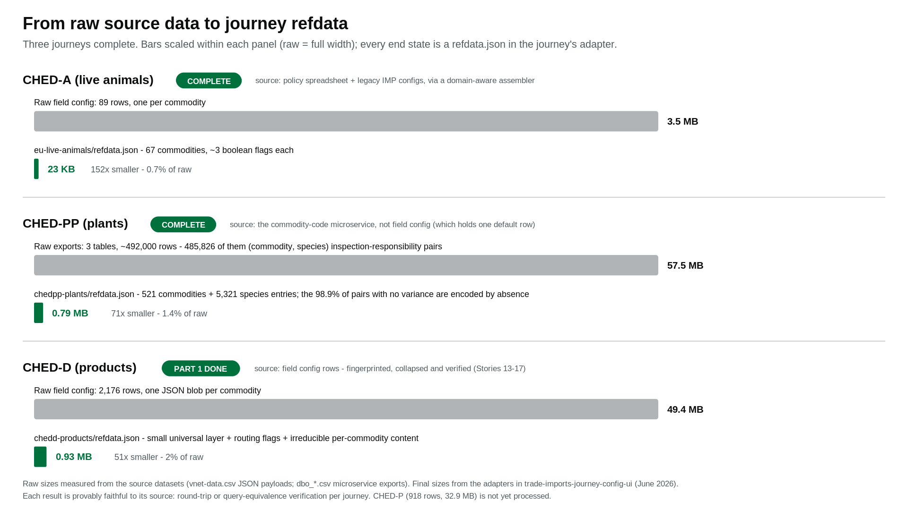
Notes:
Hypothesis is that the real data set is fairly small
there is variance but it's dimensions are small and managable, just repeated a lot
These are the file size comparisons before and after

Slide 8
The shrinkage is a layered argument; fingerprinting is the instrument
Per component: hash its data-bearing structure for each commodity, count distinct hashes across all 2,176. The distribution dictates the storage strategy.
DISTINCT HASHES
STORAGE STRATEGY
WHAT THE ENGINE LEARNS
1
Universal: store once in the components layer. Roughly 5 KB stored once instead of repeated across 2,176 configs (~11 MB). The single biggest win.
Lives in the journey skeleton. No per-commodity branching needed.
31 of 38 Part 1 components
5
Definition sets: the 5 option sets stored once as internalMarket_set_01..05, frequency-ordered; each commodity carries a string reference, not the blob.
A small lookup table the engine consults.
internalMarket: 2,116 + 26 + 1 + 1 + 1 configs (31 lack it)
1 + 9
Template + scalar: one combo_template with a {{complement}} placeholder; per commodity a single combo_complement_id; 9 small overrides. Blobs reconstructed at query time. Removed 1.6 MB (Story 16).
A default with sparse exceptions.
combo components: one shape covers 99.59% of configs
~2,176
Irreducible: every commodity has its own value, so deduplication would lose information. Stored as per-commodity scalars - the 825 KB content floor.
Per-commodity facts the engine reads at runtime.
species description, line item complement, complement IDs
Result: 2.65 MB → 1.06 MB, with the 825 KB floor proven irreducible.
The distribution is also the obligation engine's design input: it names the decision logic each component needs.
Notes:
Most of the components are identical across all 2000
Most of the variance can be collapse to 5 sets
One combo box has 9 overrides
There are 2100 commodity codes in scope (irreducable)

Slide 9
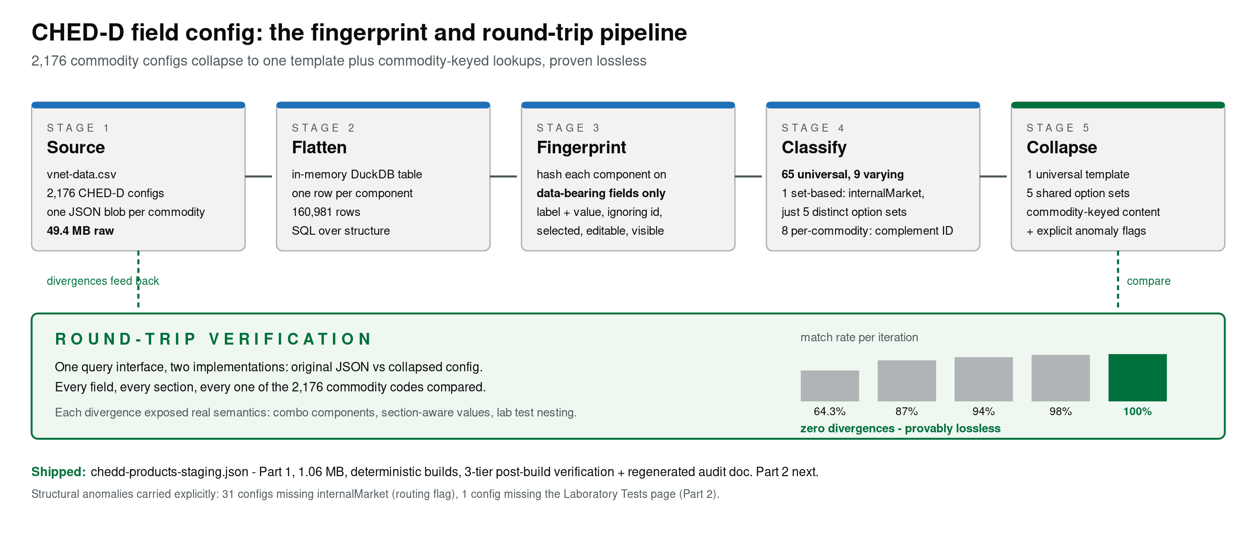
Notes:
How to take this mess apart?
Create a data pipeline that can identify commonality using fingerprinting.
Group where many things have the same fingerprint, collapse to a single things
Fingerprints are sha of data that are deterministic that mean we can group like content and reduce to the smallest number of distinct variants
Take all individual components instances - each
(commodity, page, section, component) has a fingerprint from
- sort all the lists, labels, descriptions, line_item_complements and MD5 hash it.
Many rows per commodity ~74 per commodity ~160,000 rows each
But once we have the flattened fingerprints (the 160000 rows) we can use duck db analytics to ask "how many distinct fingerprints does each component name have across all commodities?"

Slide 10
DuckDB: SQL over the source, with no ceremony
An in-memory analytical database inside the build script. One line imports the CSV; from there the collapse is a query, not a data structure.
vnet-data.csv
3,254 rows, all cert types
THE HINGE QUERY - WHERE THE DEDUP DECISION IS MADE
↓ importCSV - one line, no ETL
SELECT f.fingerprint,
GROUP_CONCAT(f.commodity_code) AS commodities,
MIN(t.options_json), MIN(t.values_json)
FROM ced_fingerprints_v2 f
JOIN ced_flat t USING (commodity_code, page_name,
section_name, component_name)
WHERE page_name = 'Commodity'
AND component_name = 'internalMarket'
GROUP BY f.fingerprint
-- returns 5 rows: 2,116 / 26 / 1 / 1 / 1 commodities
raw_configs
id, cert type, commodity code, data (JSON string)
↓ SQL: WHERE certificate_type = 'ced'; JS walks the JSON tree
ced_flat
~160,000 rows - one per (commodity, page, section, component)
↓ JS: SHA-256 over options + values + visibility flags
ced_fingerprints_v2
(commodity, page, section, component, fingerprint)
Five rows out of ~2,145 inputs. The JS layer then frequency-orders the rows, assigns internalMarket_set_01..05, and writes per-commodity references. The same pattern served Stories 13-16; Story 17 only consumed the report.
↓ SQL: GROUP BY fingerprint
variance report
universal[], varying[], definitions, commodity mappings
Why DuckDB, not Postgres or plain JS. The work is ephemeral - in-memory mode matches a build that emits one file. The queries are analytical (GROUP BY over 160 K rows): its columnar sweet spot. Zero infrastructure: a Node script, no server, no schema migration.
↓ JS: assemble layers
chedd-products-staging.json
What it did not do. Choosing what to fingerprint and the collapse strategy are pure JS. Nothing persists between builds: every run starts from :memory:, which is why same CSV in means same JSON out, byte for byte.
DuckDB gave us the GROUP BY. The collapse became writing the right SQL, not the right data structure.
Notes:
Skip this slide, it's very tech - might be interesting but for a later date
We use Duck DB to hold all the data being produced in the pipeline
But once we have the flattened fingerprints (the 160000 rows) we can use duck db analytics to ask "how many distinct fingerprints does each component name have across all commodities?"
The output of this process is a staging artefact that builds both the refdata and a file called journey json
So take note of this file at the end...

Slide 11
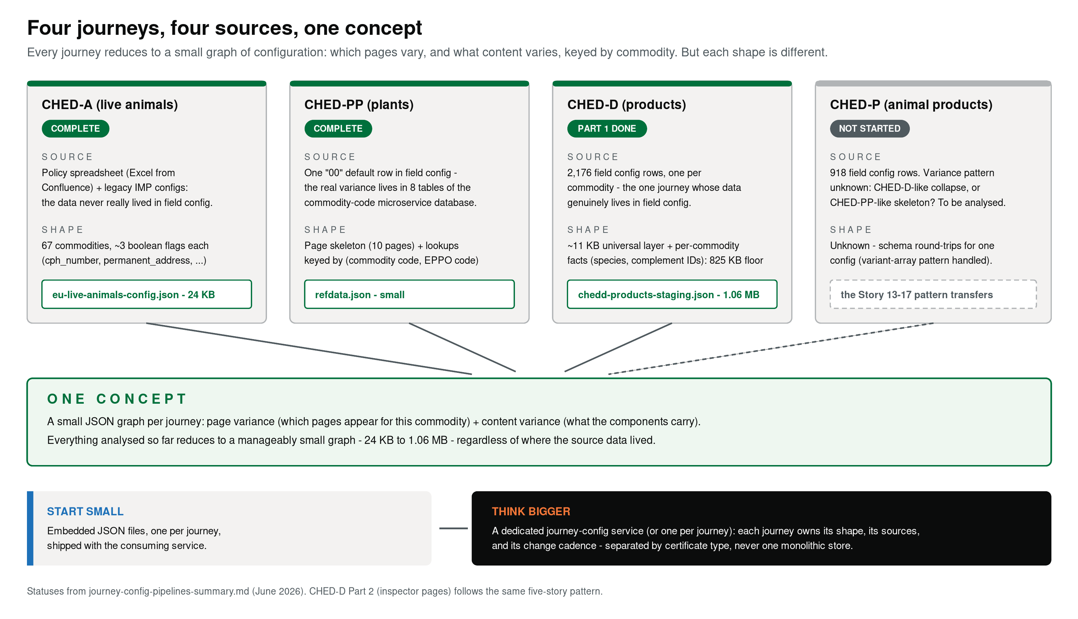
Notes:
Reasonably confident all journeys config can be collapse to something small, CHEDD is the largest
Whilst the configuration changes, the concept doesn't really change. There are sections, pages, components, pages that vary and contents that vary in fixed dimensions for each config
Each journey captures different variance in similar ways

Slide 12
Journey configuration as data
One directory per journey. Two files are data; two carry rules (next section); one assembles them.
journeys/eu-live-animals/
journey.json the page tree
refdata.json lookup tables
obligations.json requirements - Section B
resolvers.js facts + tests - Section B
index.js assembles the adapter
journey.json - the page tree
Sections contain screens; screens contain fields. The tree carries no logic: reading it tells you what is on which screen, nothing about whether anything is required or conditional.
refdata.json - animals
A routing table of a few hundred entries keyed by commodity|species, with a commodity-only fallback. Each entry holds the flags that drive conditional obligations: cph_number, permanent_address, transporter_address.
refdata.json - plants
521 commodity entries + 5,321 species entries, derived from ~486,000 (commodity, species) pairs in the upstream microservice. 98.9% of pairs carry no journey variance and are represented by absence: no species entry means PHSI-only.
Refdata is journey-private. The engine passes it to the journey's own tests and does nothing else with it - two journeys cannot couple through shared reference data.
Notes:
The pages are split into a page tree that describes
the journey
the refdata (config)
Maybe demo the service giving refdata and journey data extracted from the Field Config and IPAFFS
Show the POSTMAN collection and swagger endpoint for the journey and the refdata
The next slide shows the APIs

Slide 13
The configuration API
/api/config/* answers “what is the journey?” - documented in OpenAPI, served via Swagger UI, importable into Postman.
GET /api/config/journeys
Lists the journeys the service hosts.
GET /api/config/journeys/{key}/commodities/{code}
What selecting a commodity unlocks: routing flags, regulatory authority, marketing standard.
GET .../commodities/{code}/page-variance
Which pages apply for this commodity - the page-variance question answered directly.
The contrast with field config. Field config returned the whole blob for any question - up to 200 KB to answer a single-value check. This surface answers the question asked: a commodity lookup returns that commodity's facts, a page-variance call returns page names. Responses are sized by the question, not by the storage format.
Section A conclusion: form structure and reference data live in one place per journey, served over a documented HTTP surface.
Notes:
The APIs
Probably just show the postman collection and the swagger docs

Slide 14
The bigger idea: configuration you can execute
The configuration API serves the data. The question that follows: can the same configuration drive the journey itself?
Journey configuration
Obligation engine
Journey understanding
The UI renders that
→
→
→
journey.json, obligations.json, refdata.json, resolvers.js - inter-related facts
A pure-function library that reasons over those facts
Completeness, ordering, submittability - per notification
Server-driven UI: the display follows the engine's output
One source of truth per journey
Simple to configure
“Complete” is part of the configuration
Form structure, conditional logic and reference data live in one place, owned by the team that owns the journey. No overrides in handler code; no second service holding a slice of the form.
Plain JSON for the data, a small resolver file for the logic, a directory per journey. No JavaScript strings embedded as field values; no incompatible structural shapes.
Whether a notification is done is not computed elsewhere. The configuration that says what a journey asks for also says what makes the answer enough.
These pair to produce the outcome that matters: a whole journey can be seen and tested without being built.
What follows: a demonstration of the engine and the UI, then the mechanics.
Notes:
The bigger oppertunity is to knit the
Journey data
Config data
Into a service for reviewing that data AND
Tying it into an obligation engine becomes relatively simple

Slide 15
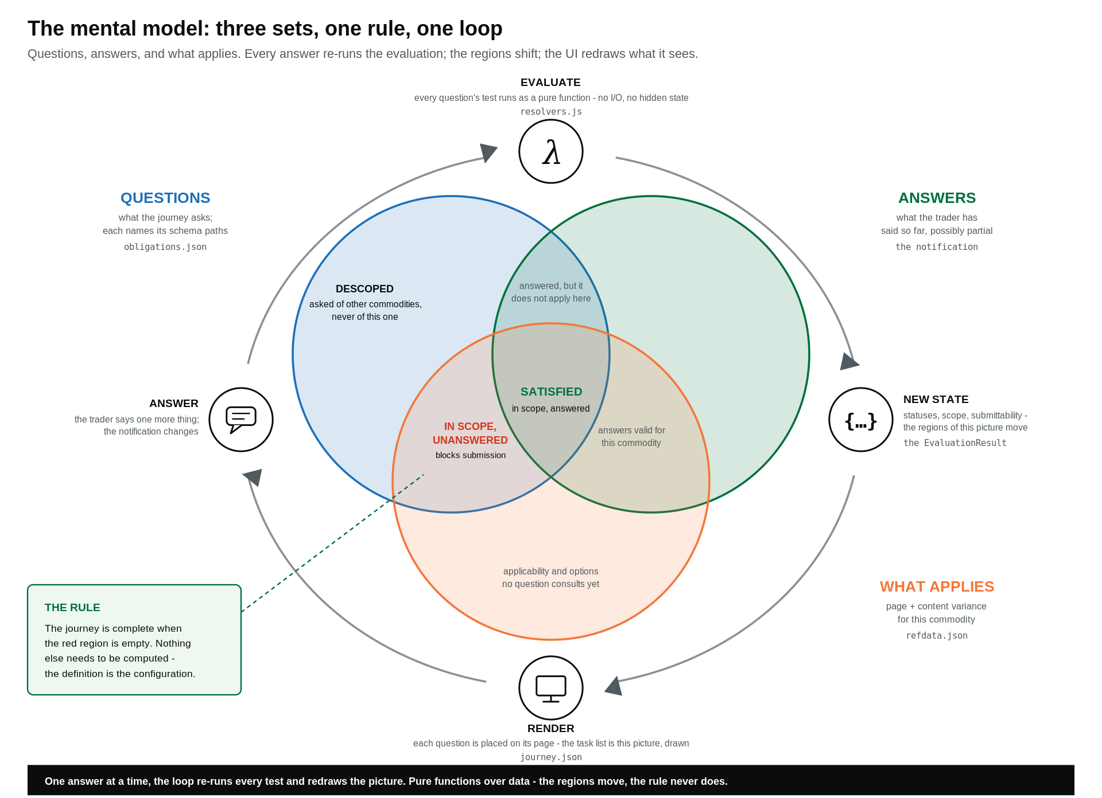

Slide 16
Obligations: rules as configuration
An obligation states what the notification must contain and why. A condition, when present, decides whether the requirement applies at all.
unconditional
conditional
{ "id": "consignment-origin",
"name": "Region of origin",
"rationale": "Origin region drives
the regulatory regime.",
"schemaPaths": ["origin.country",
"origin.region"] }
{ "id": "transit-routing",
"schemaPaths": ["destination.exitBIP"],
"condition": {
"fact": "purposeGroup",
"test": "isTransit",
"description": "Active when the purpose
group is a transit purpose." } }
Page variance as an obligation
Content variance as an obligation
The CHEDPP GMS-declaration page exists in configuration but fires only when a species has HMI authority and GMS marketing standard. The CHED-A CPH-number page fires only for high-risk-EU consignments.
The animals journey requires “permanent address” only for species kept at a fixed place; plants requires the variety-and-class selection only when both lists are populated for the commodity.
Both kinds of variance are the same construct. The two working journeys: eu-live-animals carries 23 obligations across 6 sections and 15 screens; chedpp-plants carries 28 across 7 and 16.

Slide 17
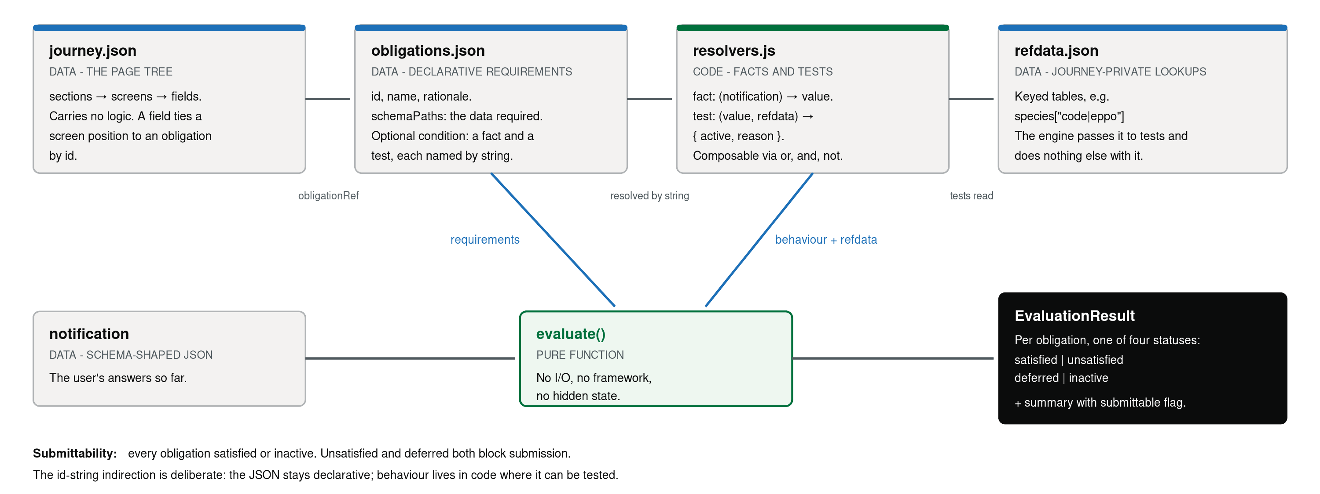
The obligation engine: how the files inter-relate
POST /api/engine/journeys/{key}/evaluate takes the raw notification as the body; withTrace=true adds reasoning.
The engine is five files plus types, under 600 lines, with zero framework imports. Two tests enforce the boundaries: one asserts the engine module graph contains no @hapi/* dependency; one asserts no UI route imports the engine in-process.

Slide 18
Server-driven UI: the concept, and the step taken here
An established pattern, not a new idea
The full concept
Airbnb - Ghost Platform (2021). Serves search, listings and checkout across web, iOS and Android from one schema. Its primitives are sections and screens: the vocabulary used here.
Lyft - Canvas. Protobuf-defined components interpreted by client renderers; cut experiment delivery from two weeks to two days.
Shopify - Shop app. Server-controlled store screen; changes ship without app releases.
The older root: server-rendered HTML. The server has always been able to drive the UI; SDUI re-applies this to component-based clients.
The server decides what to display - components, layout, content. The client owns how to render, from a library of generic components. UI changes deploy server-side.
The smallest step, taken here
The server does not send components. It sends journey understanding - sections, screens, statuses - from POST /api/engine/.../sections. The client maps that onto its own GOV.UK components.
How obligation statuses fold into UI state (first matching rule wins):
any field's obligation unsatisfied
none unsatisfied, any deferred
every obligation inactive
otherwise
incomplete
cannotStartYet
notApplicable
complete
The same evaluation gates submission and drives the task list - the two cannot diverge.

Slide 19
What this enables: the journey without the build
A journey's configuration plus a committed scenario set is enough to walk it end-to-end. The UI follows the engine's output.
Review without building
Execute without building
A journey is reviewable from its three JSON files: journey.json shows the structure, obligations.json the rules and their rationales, refdata.json the data those rules read. A reader who holds these can review a journey design.
Scenario sets run against the engine programmatically: each scenario is a notification fixture with expected statuses and submittability. Every scenario × journey × trace mode is also asserted over HTTP by the parity test - the facade and the wire cannot drift.
Variance is queryable
Sign-off through configuration
Page variance and content variance are answered by endpoints, not by rendering: /page-variance returns which pages apply for a commodity; /sections returns which screens and fields apply and their statuses - before any field is filled in.
A new journey can be reviewed and signed off through configuration and scenarios alone. Adding a journey requires no engine change; the third adapter is a directory, not a development effort in the engine.
Scenario sets are committed alongside the configuration; verification runs in CI like any other test suite.

Slide 20
Deployment path
The HTTP seam is already in place. Moving to a service is a deployment change, not a redesign.
Ships today
A journey-configuration service adds
One engine, two journeys. No journey-specific code in engine/; a third adapter requires zero engine changes.
Every page render reaches the backend over HTTP - visible in the browser's Network tab.
Boundaries are machine-enforced: kernel-isolation test and transitive-import test run in CI.
Runtime journey switching: the picker swaps the active journey per request against the same surface.
The UI could be deployed separately today by pointing apiBaseUrl at a remote backend - no code change.
A deploy boundary at the existing wire - the backend moves to its own process; consumers keep the same API.
A registry that loads journey adapters at deploy or runtime, replacing the hardcoded list.
Versioning for the JSON artefacts, so consumers pin to a known schema and migrations stay explicit.
A validator that reports all coherence violations in one pass: every obligationRef resolves, every fact and test exists, every schemaPath parses.
The replacement statement. Today, form structure lives in field config, reference data in other microservices, journey rules in frontend handler code: a change crossing two concerns crosses two systems. With this design they are co-located per journey behind one surface: the consumer asks one service what the user should see next and what submission requires.

