Slide 1

Transport for West Midlands
‘Real’ Journey Time:
Measurement and Applications
June 2018

Slide 2
Background

Slide 3
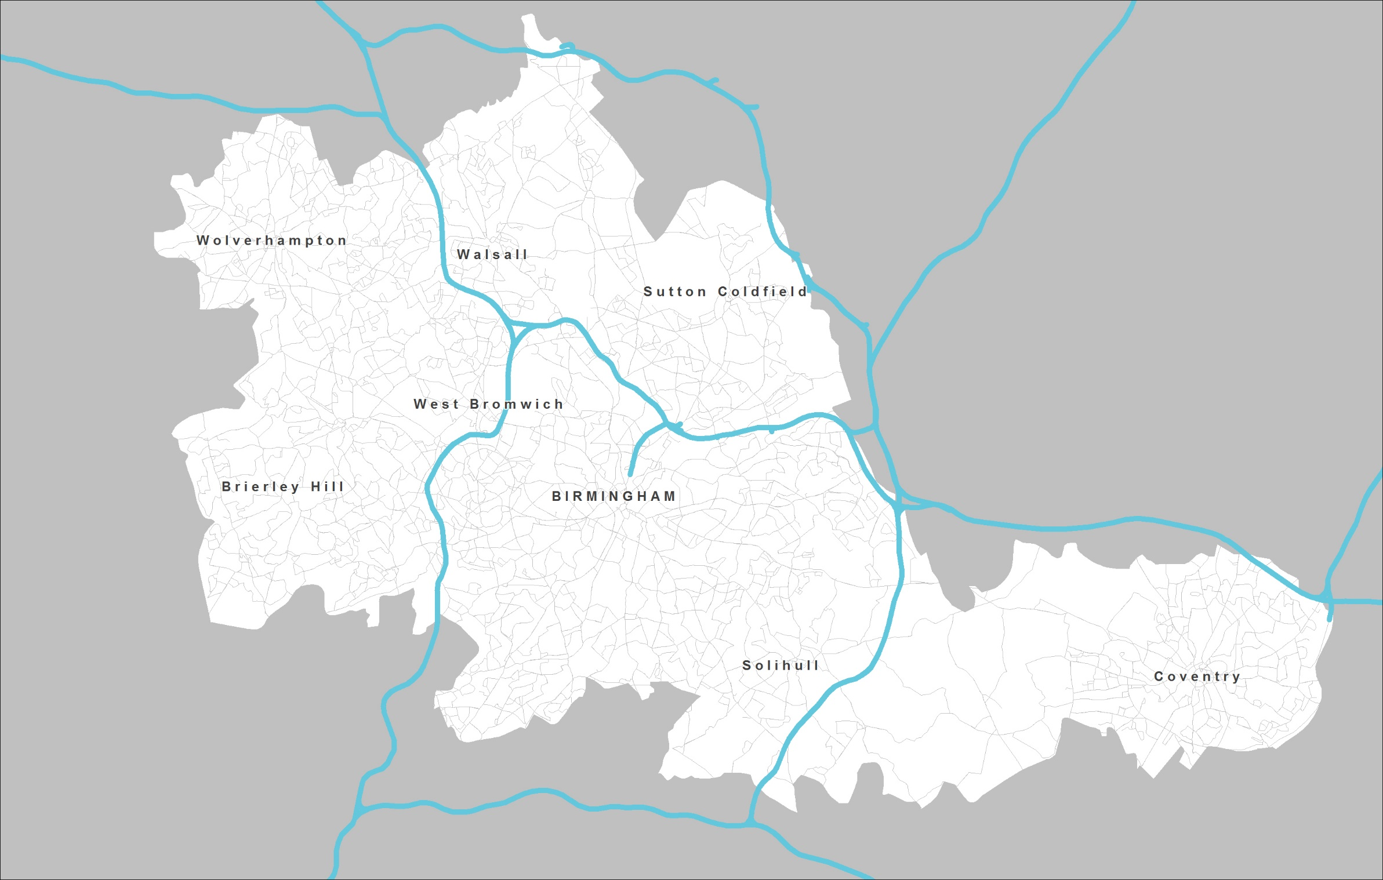
Background
Ambitions for growth
Bus vital if no (chance of a) car
aim to see many more people in work
in successful, growing town and city centres
more travel to work, and further, can’t all be by car
D u d l e y
⇧
© Crown copyright 2018 OS 100019543 West Midlands Combined Authority

Slide 4
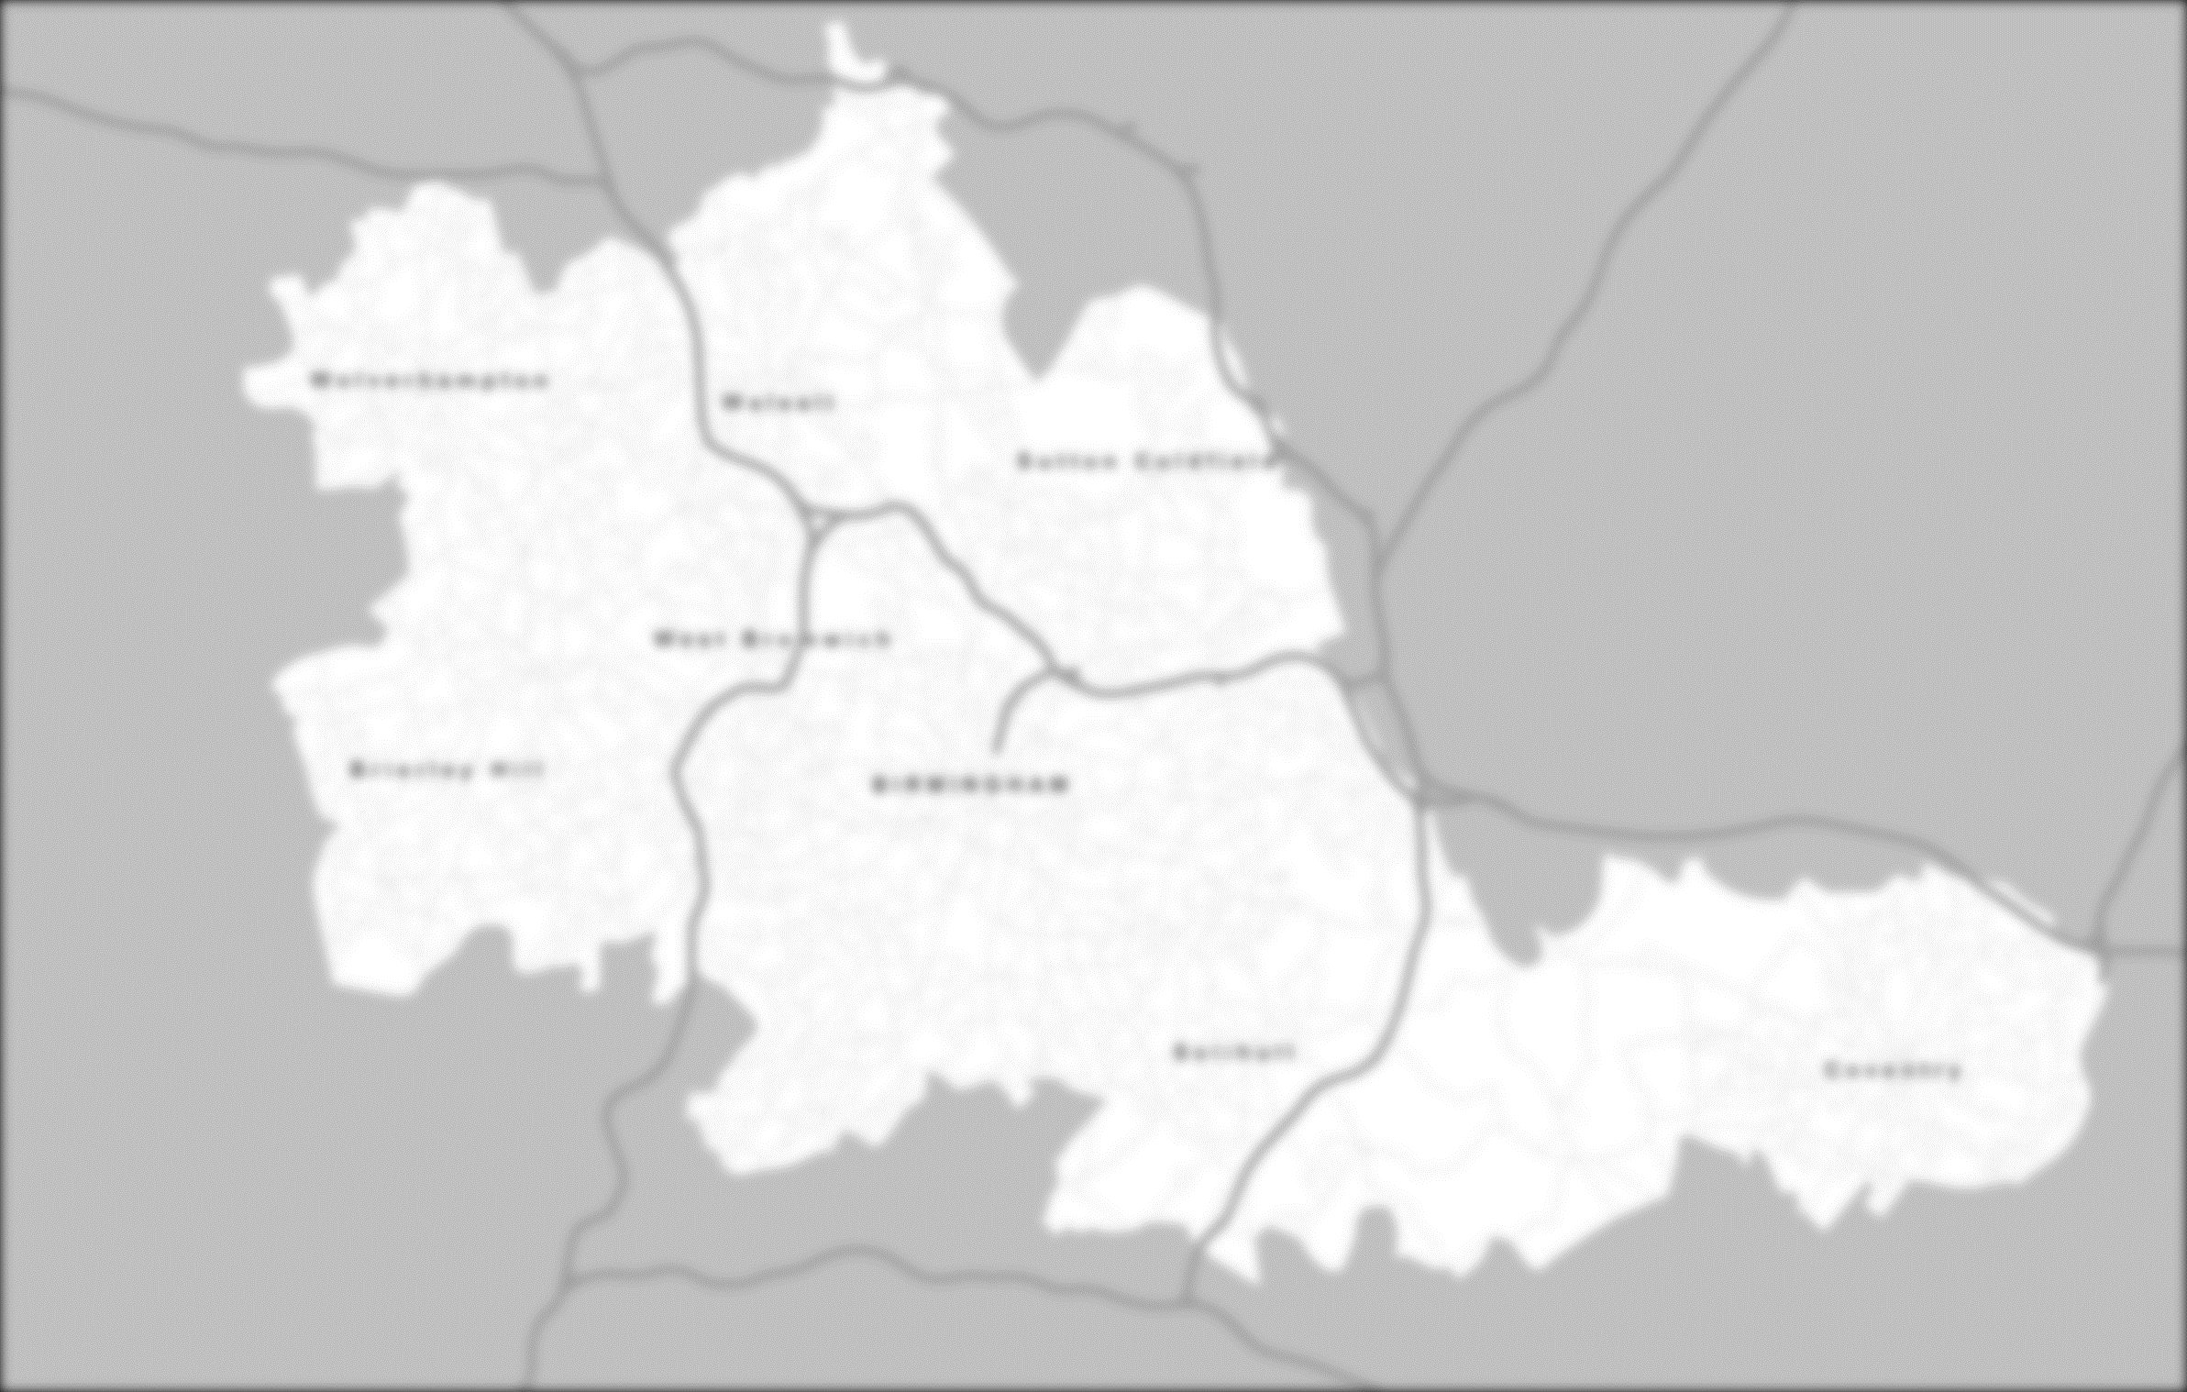
Background
Ambitions for growth
Bus vital if no (chance of a) car
aim to see many more people in work
in successful, growing town and city centres
more travel to work, and further, can’t all be by car
D u d l e y
⇧
© Crown copyright 2018 OS 100019543 West Midlands Combined Authority

Slide 5
Background
But speeds are down
Bus speeds drop 1% each year
record-breaking traffic volumes in last few years = congestion
roadspace lost to development, parking, other modes too
a threat to viability of buses – and so to ambitions for growth
D u d l e y
⇧
© Crown copyright 2018 OS 100019543 West Midlands Combined Authority

Slide 6
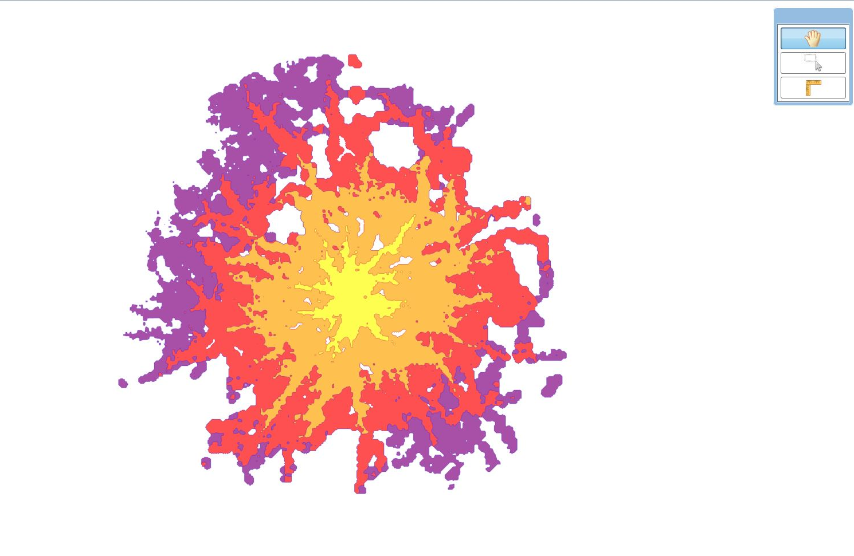
Background
But speeds are down
Bus speeds drop 1% each year
record-breaking traffic volumes in last few years = congestion
roadspace lost to development, parking, other modes too
a threat to viability of buses – and so to ambitions for growth
D u d l e y
⇧
10 years ago
© Crown copyright 2018 OS 100019543 West Midlands Combined Authority

Slide 7
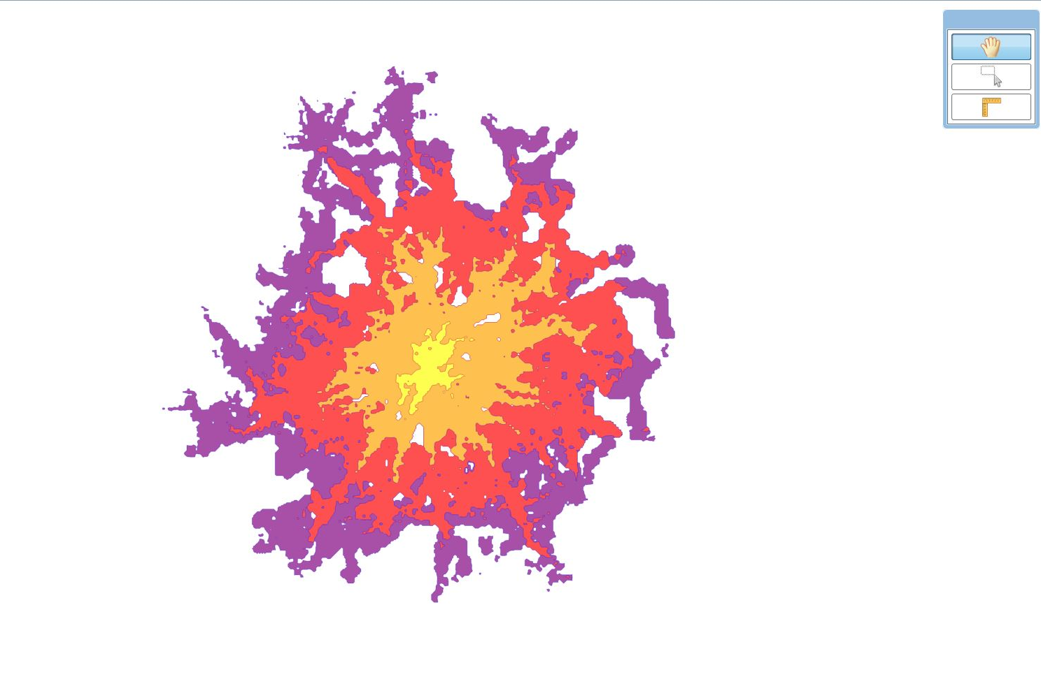
Background
But speeds are down
Bus speeds drop 1% each year
record-breaking traffic volumes in last few years = congestion
roadspace lost to development, parking, other modes too
a threat to viability of buses – and so to ambitions for growth
D u d l e y
⇧
200,000 fewer people – how to address?
Today –
© Crown copyright 2018 OS 100019543 West Midlands Combined Authority

Slide 8
Introducing RJT

Slide 9
Introducing RJT
Which season ticket would you buy?
?
Departs on time, but…
100% chance 10 mins late to work
(0% chance on-time to work)
Departs on time, but…
5% chance 60 mins late to work
(95% chance on-time to work)

Slide 10
Introducing RJT
Passenger experience – RJT approach
most passengers pick Service A – despite many small delays en route
they pick one that misses the current approach target (and rise a little early)
over one that meets the target, but where a big delay may make them very late
even though that means they spend more of their life on the bus
in reality most passengers only have Service B – big delays happen
their service is usually very good, but occasional big delays make them very late
means rising very early, every day, compared with what the timetable offers
the extra time allowed, every day, plus the timetable time, is their RJT
so RJT approach focuses on the big passenger journey delays
occasional big delays will mean a poor RJT for an otherwise good service
if these delays can be identified and fixed, ‘worst first’, RJT improves
passengers can leave less time for all their journeys – even as congestion rises

Slide 11
Measurement

Slide 12
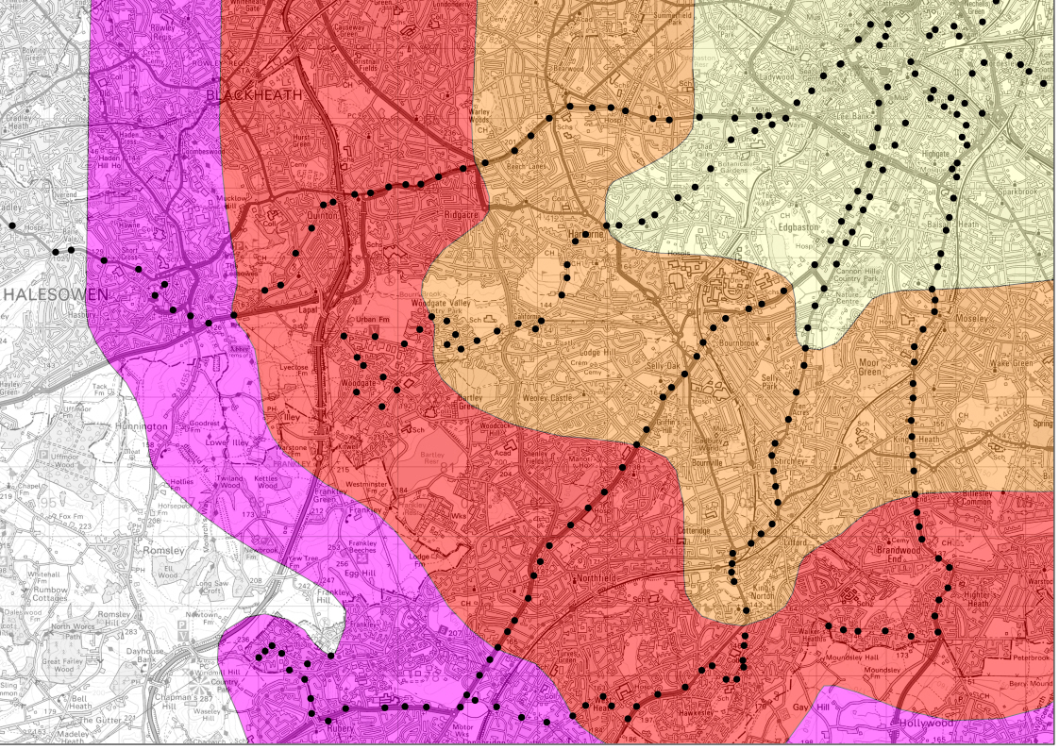
Measurement
9
23
61
50
45
Timetable
© Crown copyright 2018 OS 100019543 West Midlands Combined Authority

Slide 13
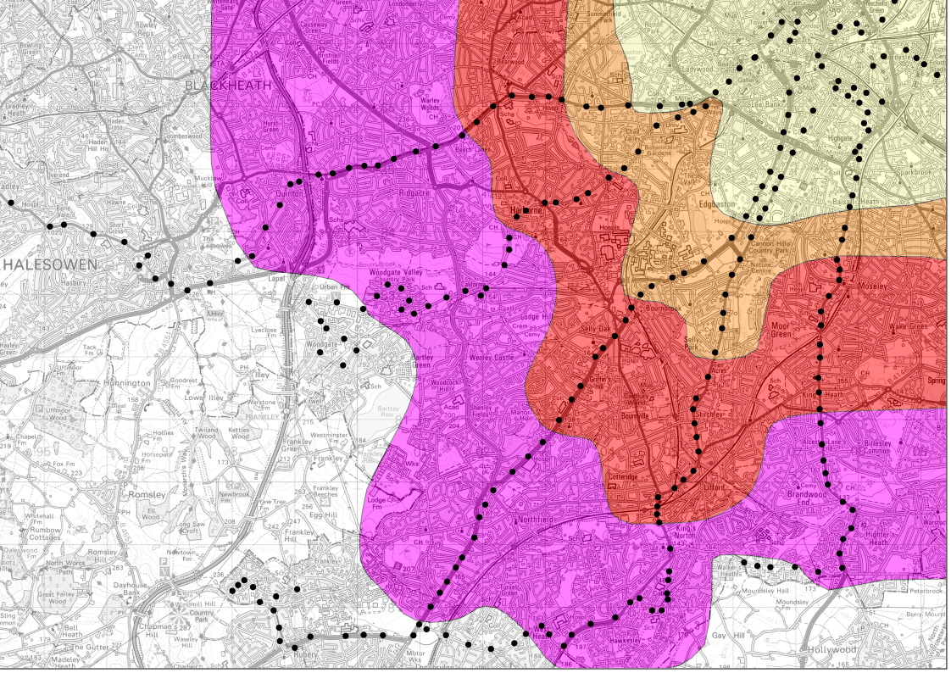
Measurement
9
23
61
50
45
RJT – another 200,000 fewer people?
© Crown copyright 2018 OS 100019543 West Midlands Combined Authority

Slide 14
Measurement
Prototype tool
construction – how we did it
exploits new Automatic Vehicle Location technology
and newly-strengthened Alliance relationships on data sharing
web-based, open and user-friendly, scalable in future, efficient storage
calculations – how it works
user defines stops, services, times, and RJT (not just 95th percentile)
wide range of queries possible, flexible outputs including ‘RJT timetable’
further development; wait times, passenger numbers, links to delay causes
capabilities – what it shows us – and quickly – about RJT
how many more people are outside one hour
counters the view from the current approach to delay
can improve even in face of growth and congestion

Slide 15
Measurement
Live demonstration

Slide 16
Thank you
Any questions?

