Slide 1

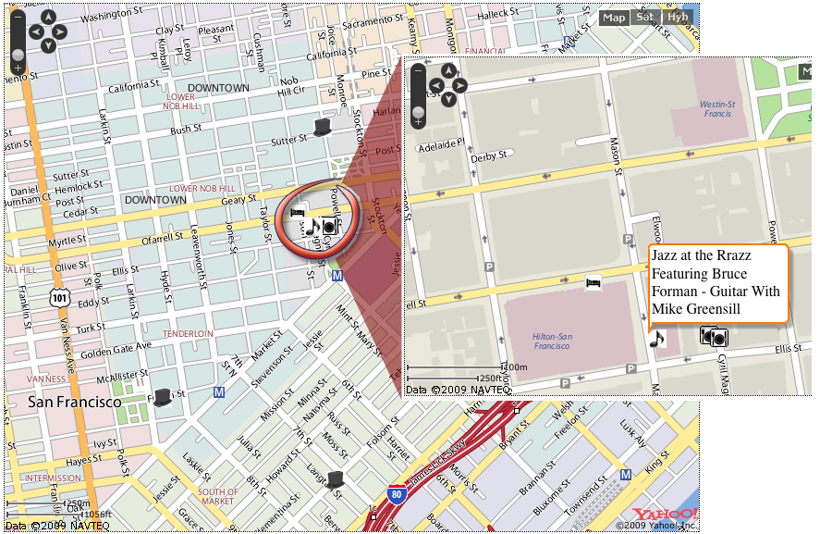
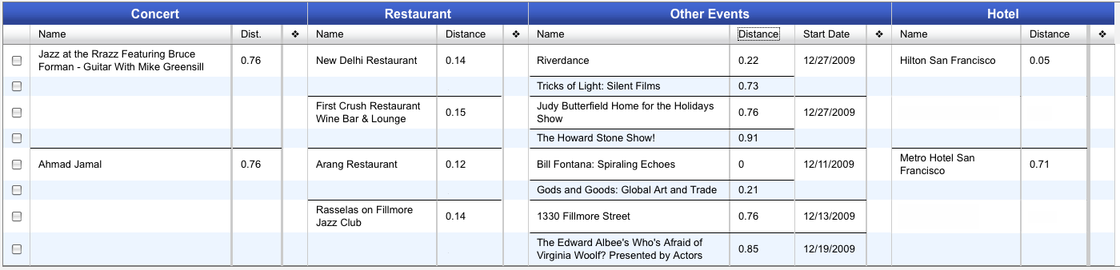
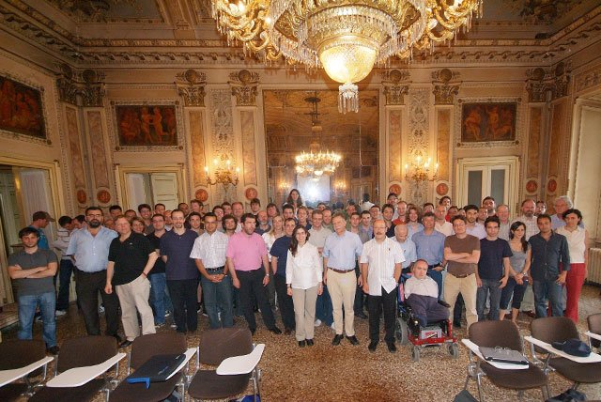
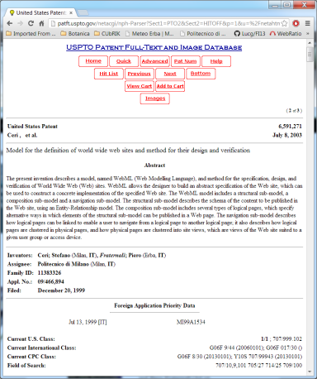
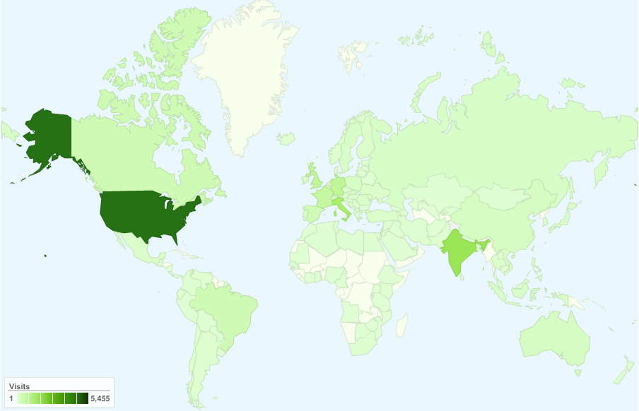
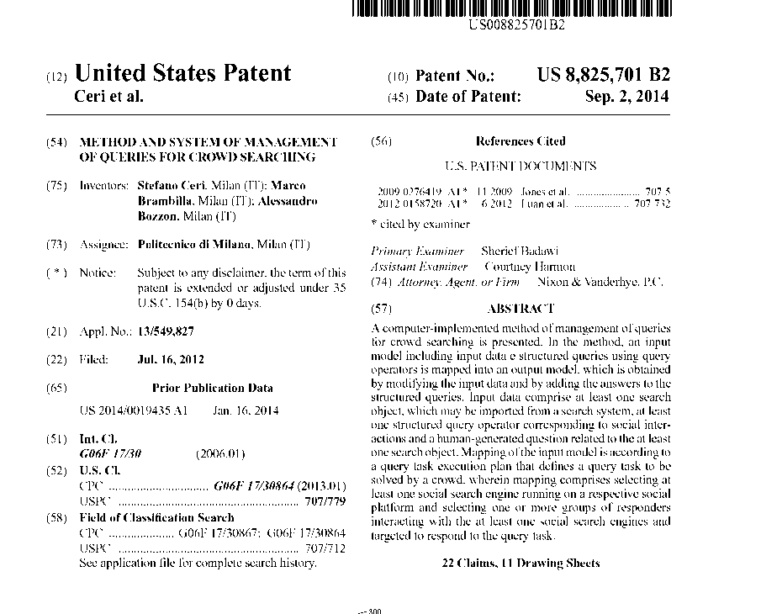
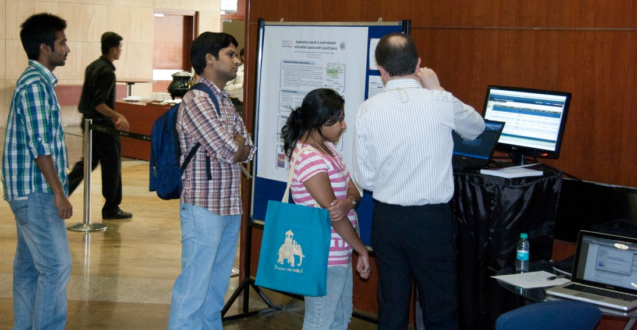
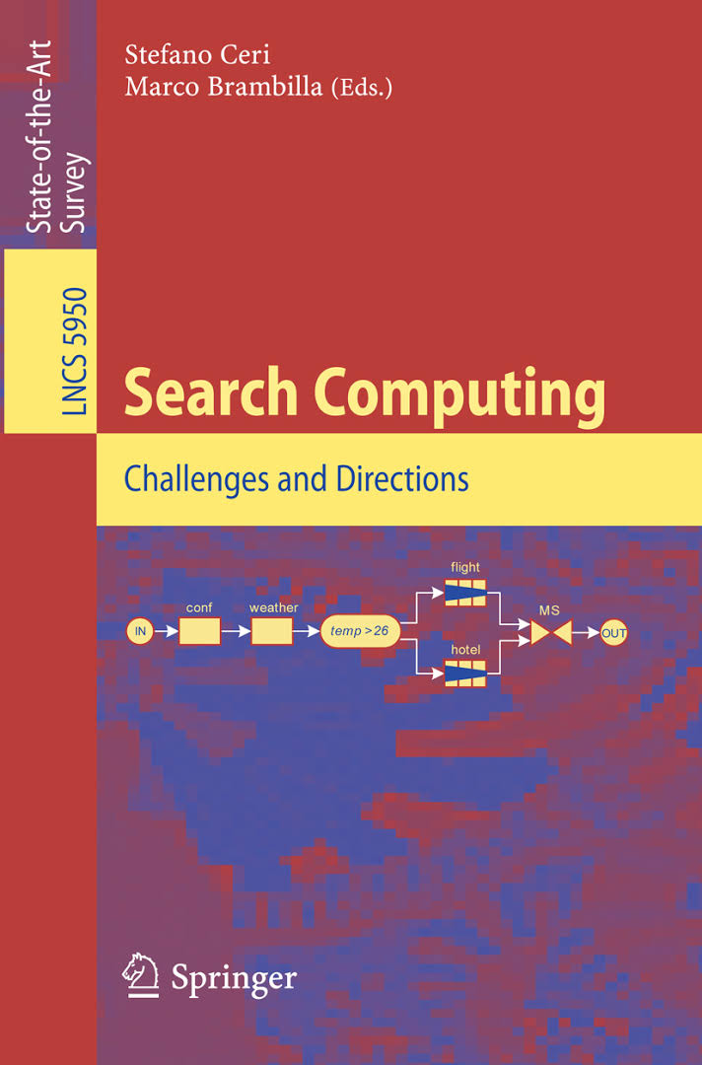
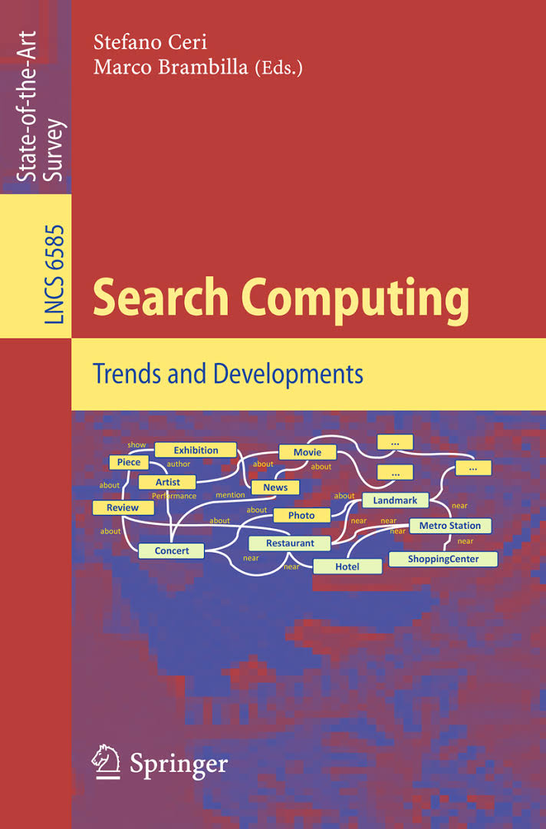
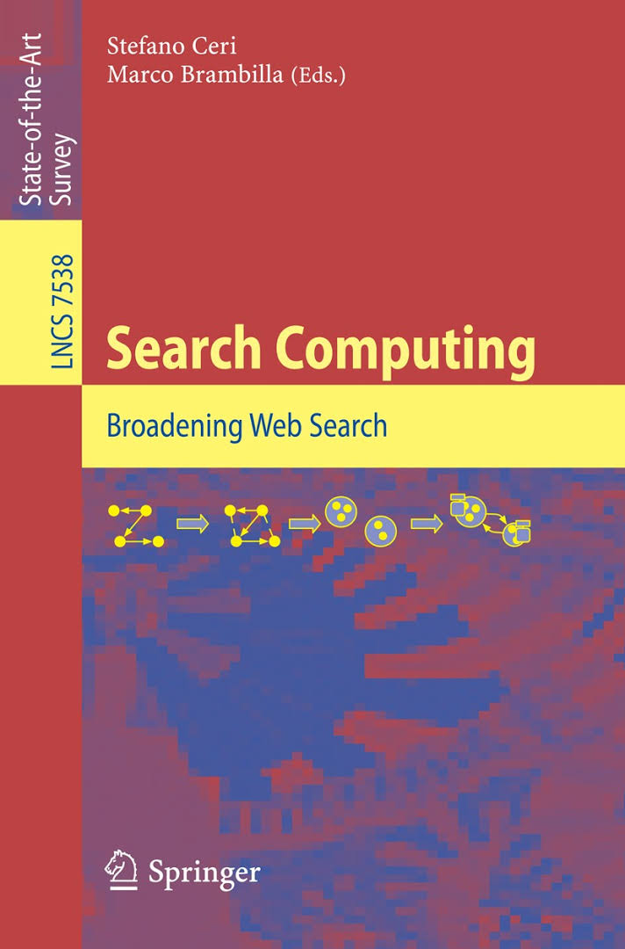

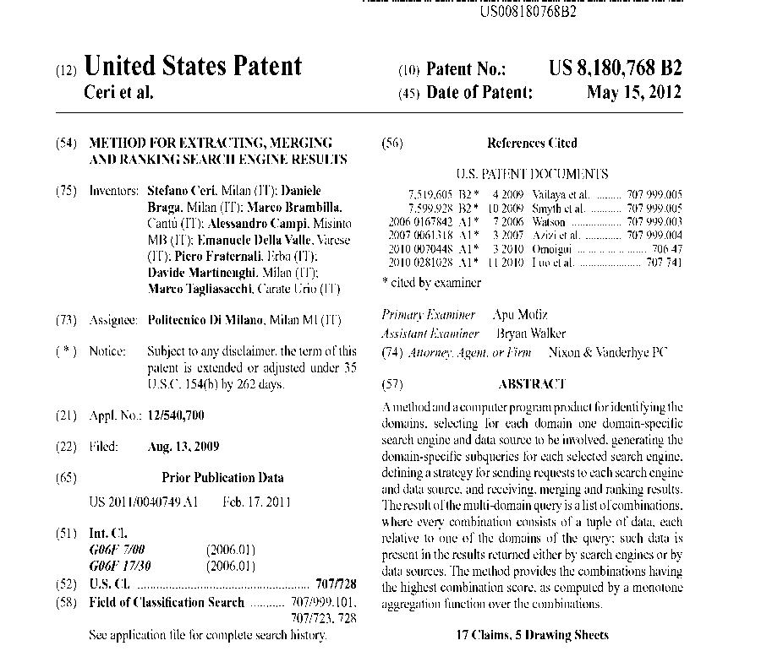
ERC WEEK
ERC’s 10th anniversary
Search Computing (SeCo)
Stefano Ceri
DEIB (Dept. Of Electronics, Information and Bio-engineering)
FOCUS: build theories, methods and tools to support search-oriented multi-dimensional queries
- Given a multi-domain query over a set of search services
- Build global solutions by integrating data produced by each service
- Rank global solutions according to a global rank function and output results in rank order
- Support user-friendly query definition and result browsing
- Support exploratory search by adding search domains during the search process
News
News
Restaurant
Exhibition
Restaurant
Piece
Exhibition
...
Concert
...
Artist
Concert
...
Artist
...
Photo
Photo
Hotel
...
Hotel
Movie
...
Metro Station
Theatre
Landmark
Metro Station
...
...
ShoppingCenter
ARCHITECTURE OF SEARCH COMPUTING
USER INTERACTION: LIQUID QUERIES, QUERY RESULTS (MAPS AND MULTI-DIMENSIONAL TABLES)
TEAM AT KICK-OFF
SeCo RESULTS:
Research publications at major scientific venues of DB/Web communities
ACM-SIGMOD, VLDB, WWW, ACM-TODS, ACM-TWEB, VLDB JOURNAL
Several working prototypes, demoes at WWW, ACM-SIGMOD
Active Web Site and Blog
Books about SeCo published by Springer-Verlag:
LNCS 5950: Search Computing Challenges and Directions (2010)
LNCS 6585: New Trends in Search Computing (2011)
LNCS 7538: Broading Web Search (2012)
DCSA: Web Information Retrieval (2013)
Two US Patents (2012, 2014)
BLOG VIEWS
DEMO AT WWW

