Slide 1

Design of Embedded and Intelligent Systems
Tollgate 1 System Modeling

Slide 2
Decision & Control in Pandemic Rescue using Semi-autonomous Platooning System
Group 3 Members:-
Galina Sidorenko
Renu Bhende
Vinay Sawant
Akhil Eddhula

Slide 3
INTRODUCTION
Here, we will discuss about autonomous robots travelling a platoon in year 2040 in scenario of pandemic.
We will discuss about the way the robots in platoon navigate and arrange themselves in platoon.
The way, the regular vehicles in platoon react during intersections or in case of an emergency vehicle.

Slide 4
SENSORS AND ACTUATORS
ENCODERS:
We use encoders to measure speed and distance travelled by the robot.
IR LIGHT SENSOR:
To follow black tracks and detect intersections.
It works by emitting a beam of Infrared lights down below surface and measure reflected signal.
CAMERA:
We use it in platooning to follow a vehicle or detect obstacles or to detect the traffic lights.
ACCELEROMETER:
It measures the acceleration of the robot. To tell whether the robot is on incline.
ULTRSONIC SENSOR:
To measure the distance to the object.
DC MOTOR:
To rotate the wheels. It is important actuator in terrestrial robots.

Slide 5
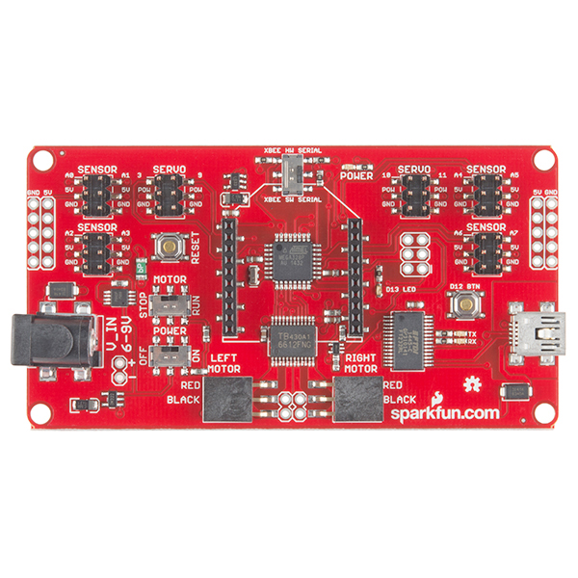
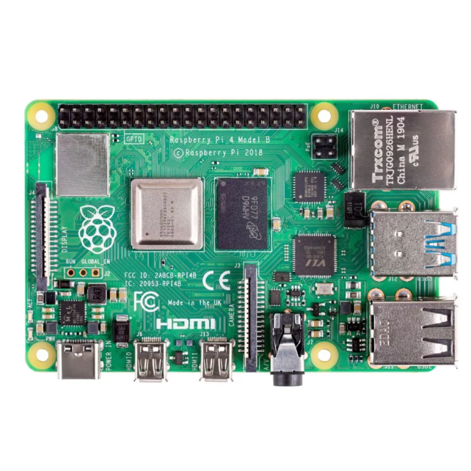
CONTROLLER BOARDS
REDBOT MAINBOARD RASPBERRY PI 4 MODEL-B

Slide 6

Types of vehicles:
emergency (have a higher priority), regular (regular vehicles can assemble in platoons)
Types of markers:
up – for central camera; backside – for platooning.
Types of obstacles: static; moving (vehicle in front, vehicle passing intersection)
Types of tracks:
H
H

Slide 7
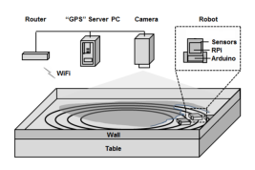
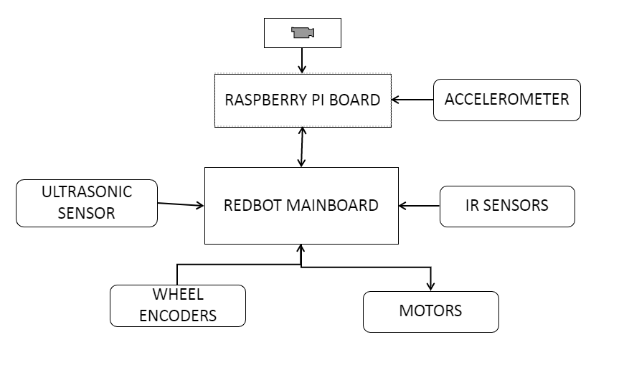
System Design and Architecture
Basic Environmental Set-up
Robot Architecture
Notes:
project_setup(2017-edited)

Slide 8
System UML Diagram
Diagram
Behaviour Diagram
Use Case Diagram
Activity Diagram
Structure Diagram
Component Diagram
Communication Diagram
Sequence Diagram
Timing Diagram
Class Diagram
Object Diagram

Slide 9
Avoiding collisions:
Go forward
Avoid static obstacles – stop or change the line if possible (permission from the server/using side sensors)
Avoid moving obstacles –
accelerate or decelerate, stop, change lines or go to the side of the road (permission from the server) to avoid crash or give way to priority vehicle which is coming from behind or in an intersection;
react to traffic lights – green: maintain current speed;
red: stop, decelerate (adjust the speed).
Is obstacle detected in a short distance?
no
yes
Is there other lane to take?
no
Stop
yes
Is it free?
no
Stop
yes
Change line
Static obstacle avoidance

Slide 10
Platooning:
Assemble into platoon – leader and followers are decided by the server.
Following in the platoon – maintain safe distances.
Braking in platoon – leader informs followers through the server to brake; braking by stop/ gradually by decreasing rotating of motors/ changing the line for some platoon members.
Leader
Server
Follower1
Follower2
Command to break
Acknowledgment

Slide 11
Abstract model implementation
Class diagram for Leader and Followers in platoon
Vehicle
Leader
-follower_pos
-formation_label
#sensor_status
+isConnectedToServer
-safe_dist
orderFollowers
changeFormation
sendPos
moveForward
moveRight
moveLeft
rotateRight
rotateLeft
Follower
-formation_label
+isObeying
requestReform

Slide 12
Entity Relationship Diagram
Entity relationship diagram for client-server model.
Emergency Vehicle
1
Sends its path
1
Main Server
Inform the robot
Robot (Leader)
1
Sends instructi-ons
M
Robots (Followers)
Reform/ Deform the platoon

Slide 13
NONFUNCTIONAL REQUIREMENTS
1. Usability - Our system can help the EVs to reach the destination by breaking the platooning using different break strategies.
2. Portability - The system can be modifiable to the different operating systems.
3. Scalability - As the number of robots and EVs increase, the system can be capable enough to increase its performance.
4. Reliability - Our system can perform efficiently throughout its lifetime under controlled environments.
5. Availability - The availability of the system is directly proportional to the battery life.

Slide 14
NONFUNCTIONAL REQUIREMENTS
6. Maintainability - When maintenance is needed the system maintenance can be done in the garage and testing can be done where the system is restored.
7. Interoperability - The system can work correctly in the presence of other robots.
8. Data Integrity - The system can hold accuracy and consistency of data over execution cycle.
9. Security - The system will be designed in such a way that it should maintained safe distance between vehicles and avoid the collision with other comminuting devices .

Slide 15
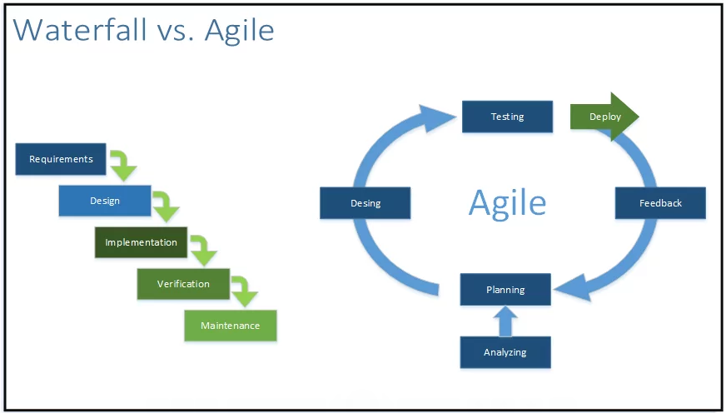
Agile vs Waterfall

Slide 16
Research questions
Robot’s deceleration {by Renu}
Control of followers in the platoon to mimic the behavior of the leader (i.e. change the platoon structure)
rely on onboard sensors (like cruise control): camera and ultrasound sensor {by Vinay}
receive commands from the leader (via Server) {by Akhil}
Braking in platooning: what distances are safe?*{by Galina}
* Vehicle-to-Vehicle Communication for Safe and Fuel-Efficient Platooning//Galina Sidorenko, Johan Thunberg, Katrin Sjöbergy, Alexey Vinel. IEEE IV 2020

Slide 17

Thank you!

