Slide 1
Design and Control for platoons in pandemic rescue
Galina Sidoreko
Renu Bhende
Vinay Sawant
Akhil

Slide 3
System Design and Architecture
Service-Client model
Robot Architecture
Notes:
project_setup(2017-edited)

Slide 4
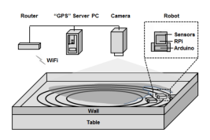
Service-Client Model

Slide 5
Robot Architecture
Block diagram
RASPBERRY PI BOARD
ACCELEROMETER
REDBOT MAINBOARD
ULTRASONIC SENSOR
IR SENSORS
WHEEL ENCODERS
MOTORS

Slide 6
System UML Diagram
Diagram
Behaviour Diagram
Use Case Diagram
Activity Diagram
Structure Diagram
Component Diagram
Communication Diagram
Sequence Diagram
Timing Diagram
Class Diagram
Object Diagram

Slide 7
Server-Client Diagram
Entity Relationship Diagram
Notes:
When nodes communicate using services, the node that sends a request for data is called the client node, and the one that responds to the request is the service node.

Slide 8
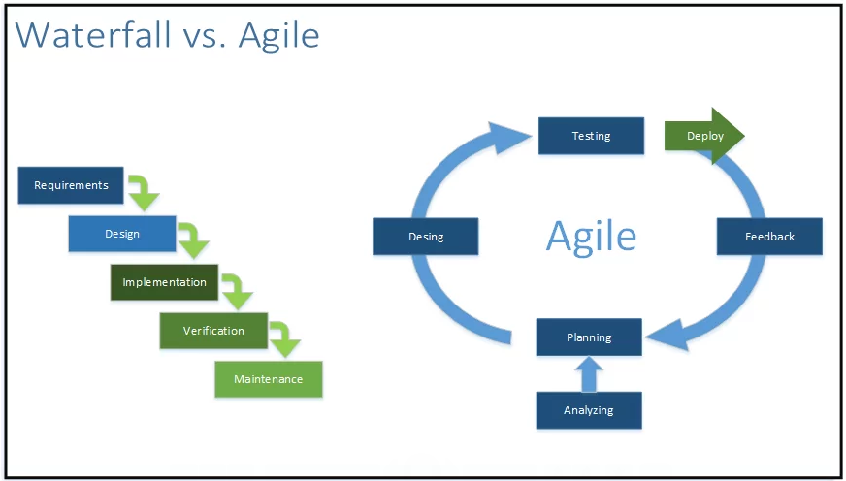
Agile vs Waterfall

Slide 9
Abstract model implementation
Class diagram for Leader and Followers in platoon
Vehicle
Leader
-follower_pos
-formation_label
#sensor_status
+isConnectedToServer
-safe_dist
orderFollowers
changeFormation
sendPos
moveForward
moveRight
moveLeft
rotateRight
rotateLeft
Follower
-formation_label
+isObeying
requestReform

