Slide 1





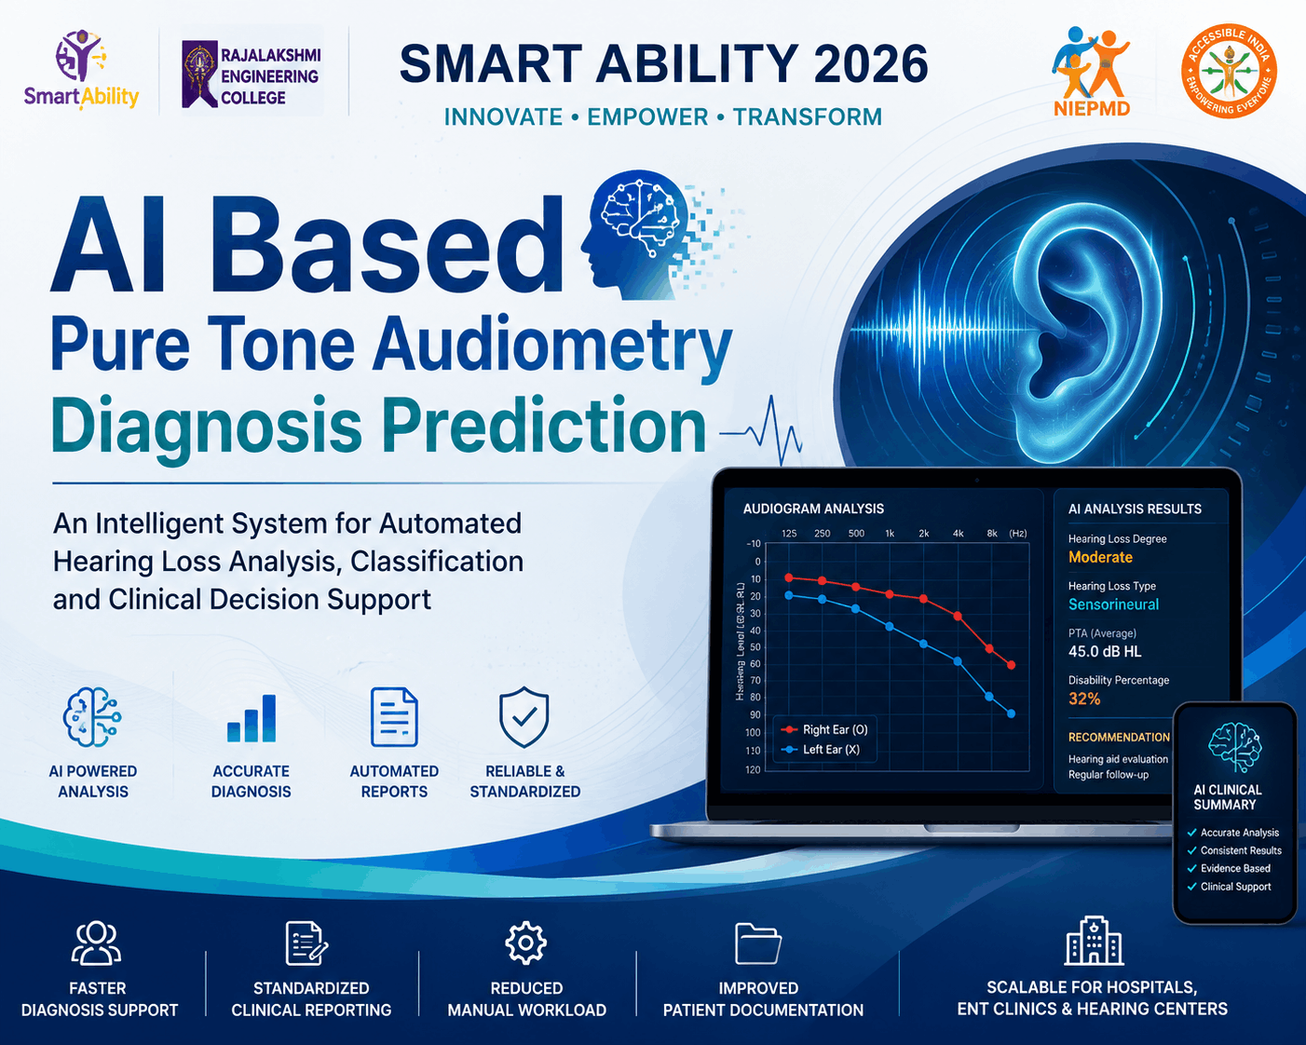
SMART ABILITY 2026
RAJALAKSHMI ENGINEERING COLLEGE
pg
Smart
Problem Statement ID : #8
Problem Statement Title: AI Based Pure Tone Audiometry Diagnosis Prediction
TEAM MEMBERS :
1)Deiva(2418010147),
2)Nivas(251701065),
3)Jeya(240501019),
4)Ajay(251501012)
MENTOR NAME • Mrs Selvarani

Slide 2
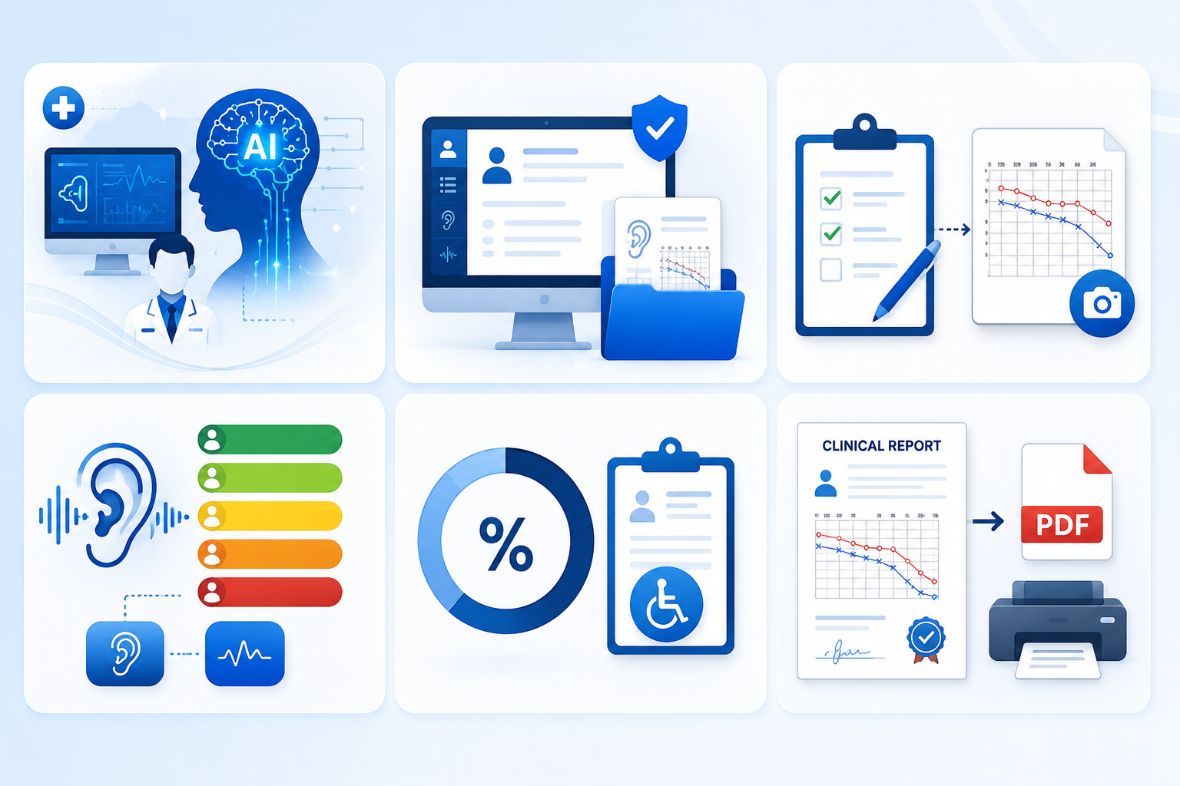
HearSense AI
HearSense AI is an AI-assisted clinical decision support platform for Pure Tone Audiometry. It enables clinicians to manage patients, enter or upload audiograms, automatically analyze hearing thresholds, classify hearing loss degree and type, estimate disability percentage, and generate professional PDF clinical reports. The solution reduces manual effort, improves consistency of interpretation, and provides explainable AI recommendations.
Key factors :
AI-powered clinical decision support platform for audiologists.
Patient management + Digital Audiogram records.
Manual entry and Audiogram Image Upload.
Automatic Hearing Loss Degree & Type Classification.
Disability Percentage Estimation.
Professional PDF Clinical Report Generation.

Slide 3
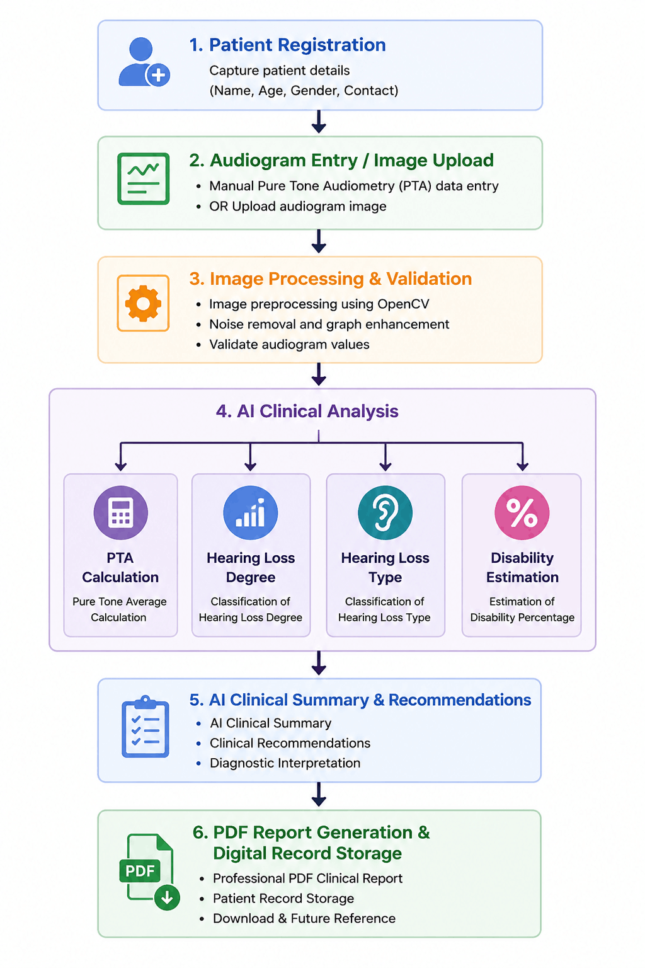
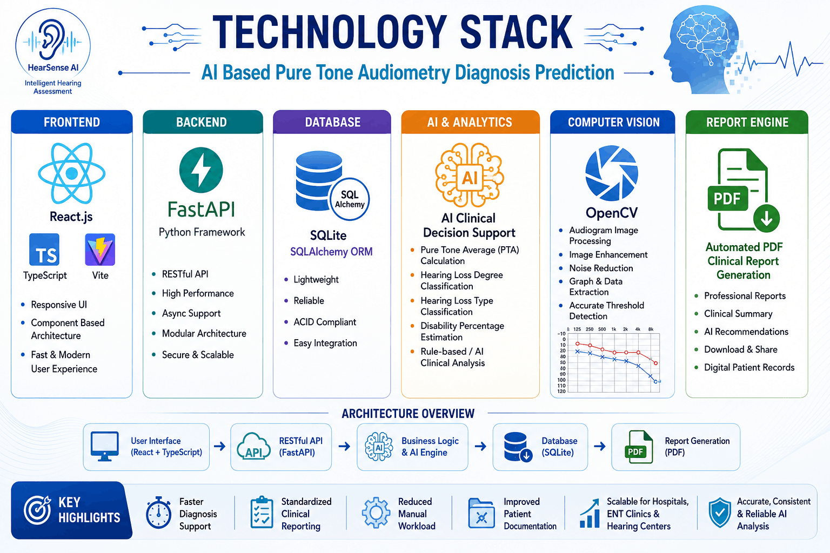
TECHNICAL APPROACH
Methodology
Technologies :

Slide 4
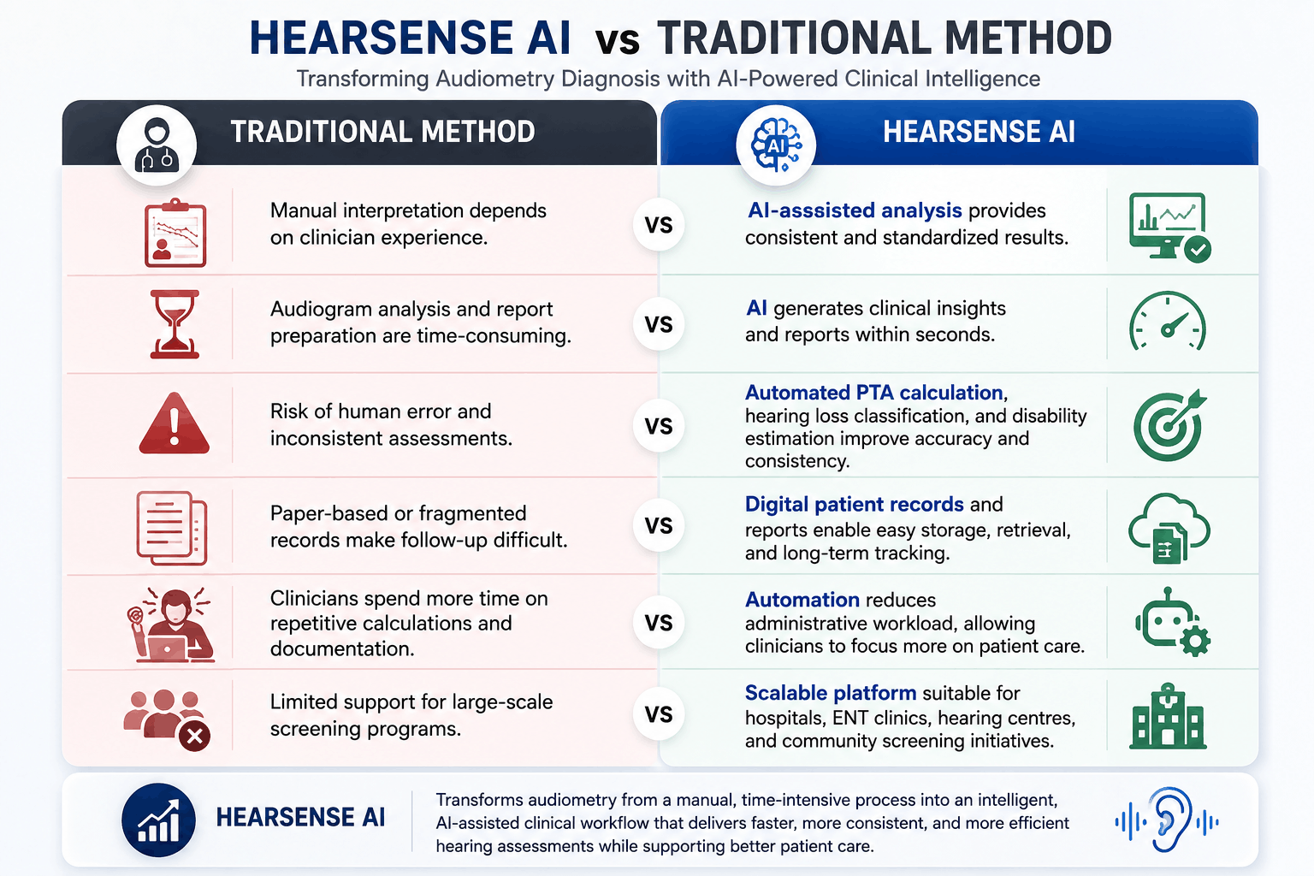
IMPACT AND BENEFITS

