Slide 1

Progress Seminar on Development Of An Application For Recipe Recommendation Using Machine Learning
Presented By
Ms. Bhautika Dongre
Mr. Adarsh Tiwari
Mr. Aaryan Kukade
Mr. Ayush Meshram
Mr. Kartik Saroj
Guided By
Dr. Mrudula Nimbarte
Mr. Hrushikesh Panchabudhe
Department of Computer Science & Engineering
S. B. JAIN INSTITUTE OF TECHNOLOGY MANAGEMENT AND RESEARCH,NAGPUR
An Autonomous Institute, Affiliated to RTMNU, Nagpur
S. B. Jain Institute of Technology Management and Research

Slide 2
Contents
Problem Statement & Objectives
Introduction
Literature Survey
System Design
Developed Modules
Technology to be Use
Advantages & Applications
Plan of Work
Conclusion
References
2
S. B. Jain Institute of Technology Management and Research

Slide 3
Problem Statement & Objectives
Problem Statement
Many people now a days face problem while cooking and searching for recipes based on the available ingredients at their home and many people usually don’t know what to cook so, our Recipe4U app helps user recommend dishes based on the available ingredients the user have.
The main aim of this project is to present user with different kinds of recipes based on the search term provided by the user.
Filters are applied on the data to find the appropriate recipe the user is looking for.
3
S. B. Jain Institute of Technology Management and Research

Slide 4
Objectives
Make it easier for people to search for recipes based on available ingredients.
To simplify the task of choosing appropriate recipe’s based on the search term using machine learning.
To recommend personalized recipe
S. B. Jain Institute of Technology Management and Research
4

Slide 5
Introduction
Individuals settle on choices regularly. “What should I eat today?”, “Is there something I will do with the left-over chicken and garlic?”.
Such decisions are not easy to make, due to a large amount of available options and one’s poor decision-making skills.
Recipe4u - Basically, we look at the client intrigue obtained from his/her profile with a few reference qualities. This project uses content-based recommendation system based on the similarity of food
S. B. Jain Institute of Technology Management and Research
5

Slide 6
The project also intends to making use of the ingredients which the user has currently and suggesting the recipes based on those ingredients
This project also focuses on the classification of cuisine based on the ingredients used in the recipe
We accomplish this by training the ingredients data with different machine learning algorithms and calculating the accuracy achieved by different algorithms and selecting the best algorithm that fit.

Slide 7
Literature Survey
Websites / Paper / Article | Reviews / Findings
recipebook.io | These websites/apps provide recipe only , without knowing client’s intrigue
recipetineats.com | These websites/apps doesn’t provide the feature of recommending recipe according to interest
Suyash Maheshwari, Manas Chourey. “Recipe Recommendation System using Machine Learning Models”. ,ISSN: 2395-0056, Volume: 06 Issue: 09 | Sep 2019 | In this paper, machine learning algorithms recommends recipe to users. It doesn’t provide recipe based on remaining ingredients
S. B. Jain Institute of Technology Management and research
7

Slide 8
Websites / Paper / Article | Reviews / Findings
Marlies De Clercq, Michiel Stock, Bernard De Baets, Willem Waegeman, “Data-driven recipe completion using machine learning methods”. Trends in food science and technology, ISSN 0924-2244, Volume: 49, 1-13, 2016 | In this paper, machine learning algorithms develops a system which give recipe but doesn’t regional cuisines.
S. B. Jain Institute of Technology Management and Research
8

Slide 9
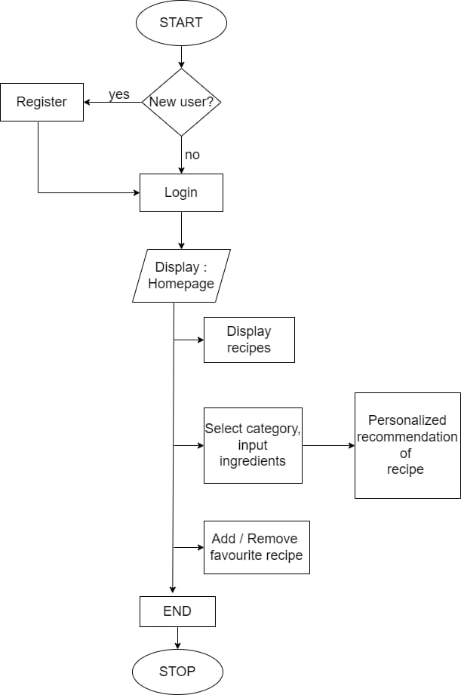
System Design: Flowchart
S. B. Jain Institute of Technology Management and research
9

Slide 10
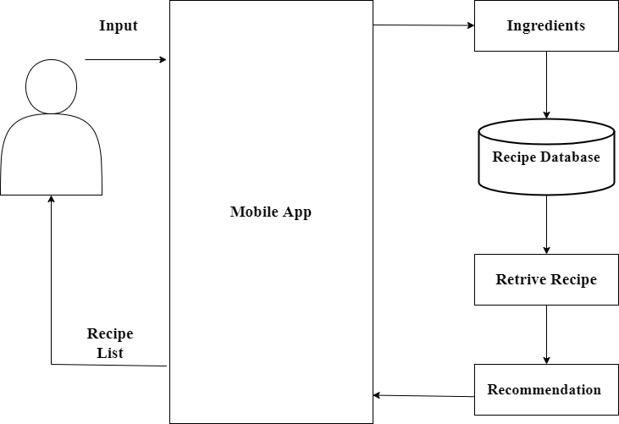
System Architecture
S. B. Jain Institute of Technology Management and Research
10

Slide 11
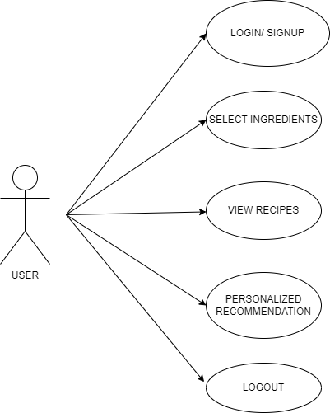
Use Case Diagram
S. B. Jain Institute of Technology Management and Research
11

Slide 12
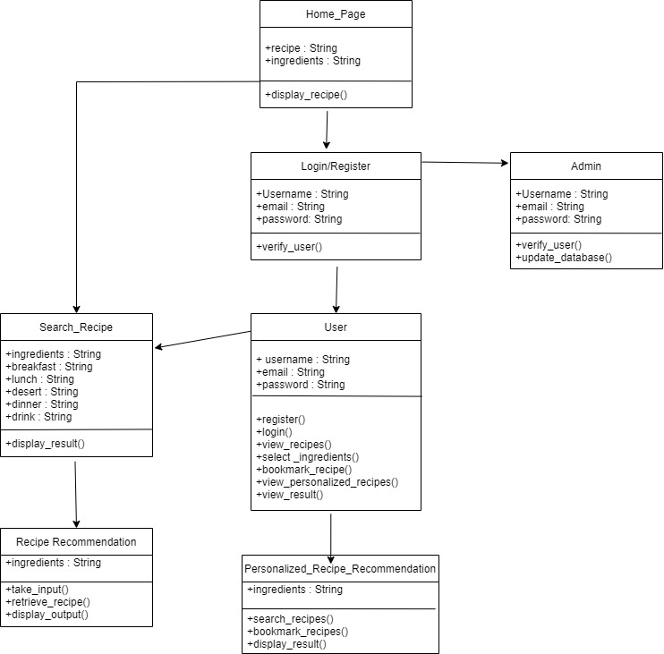
Class Diagram
S. B. Jain Institute of Technology Management and Research

Slide 13
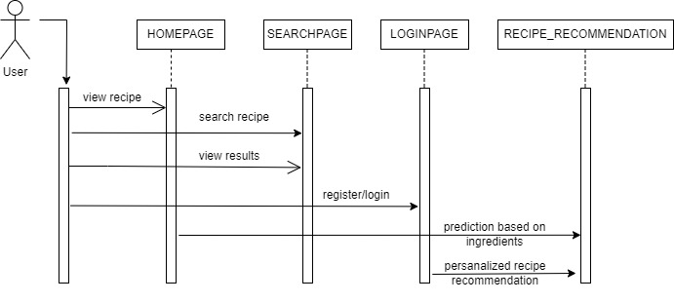
Sequence Diagram

Slide 14
Developed Modules
Module 1:
User Interface :
User can sign-up and register in the app.
User can view and can save their favorite recipe.
Module 2:
Machine Learning Model :
The model will predict the recipe after the user input the ingredients.
The model will give personalized recipe recommendation.
Module 3:
Integrating UI & Machine learning Model:
To integrate backend and frontend model together.
S. B. Jain Institute of Technology Management and Research
13

Slide 15
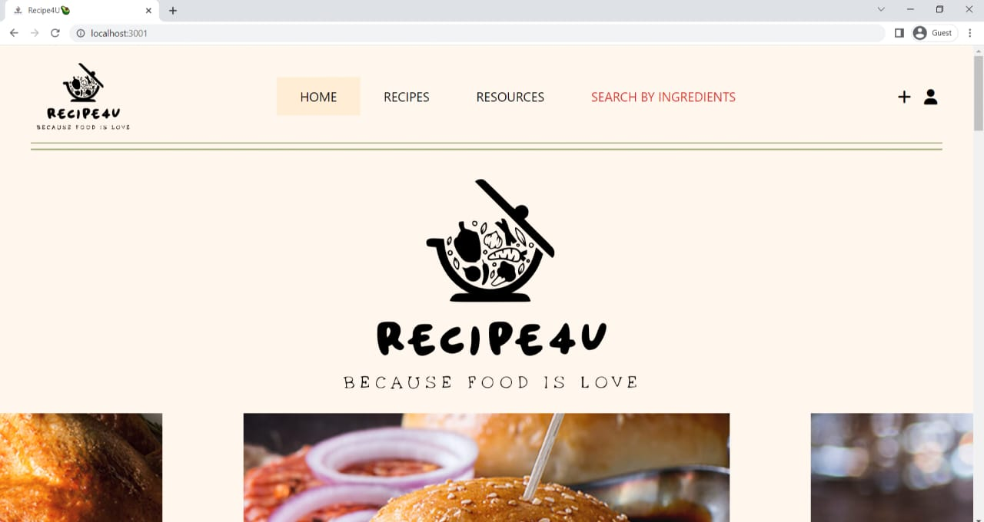
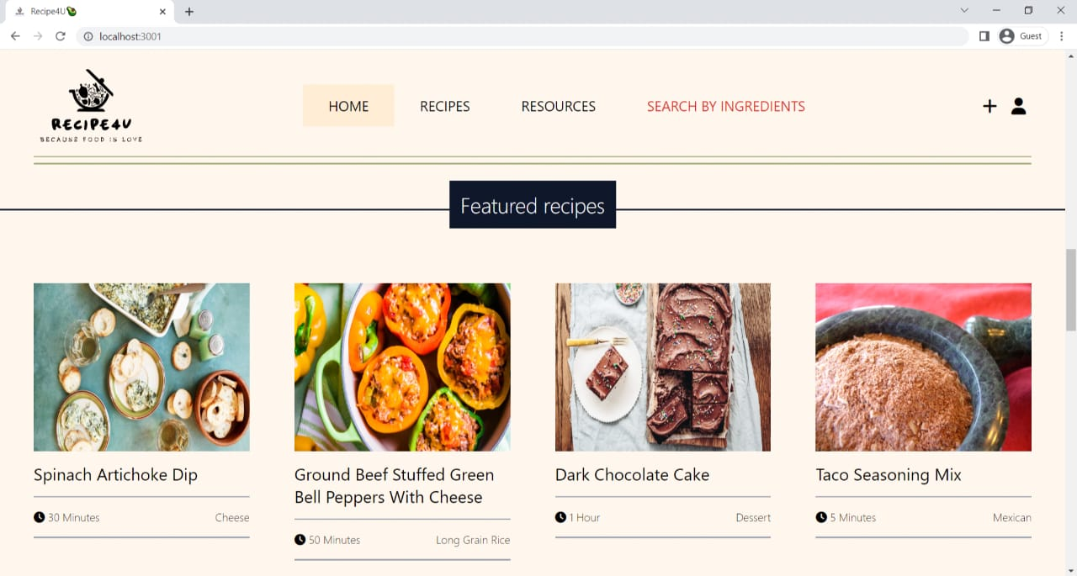
Screenshots
S. B. Jain Institute of Technology Management and Research
14

Slide 16
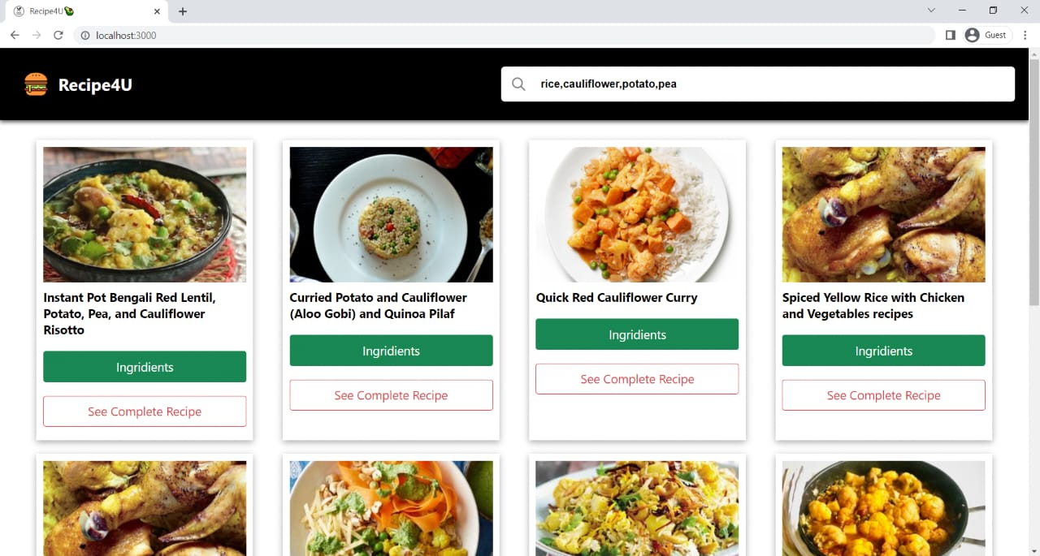
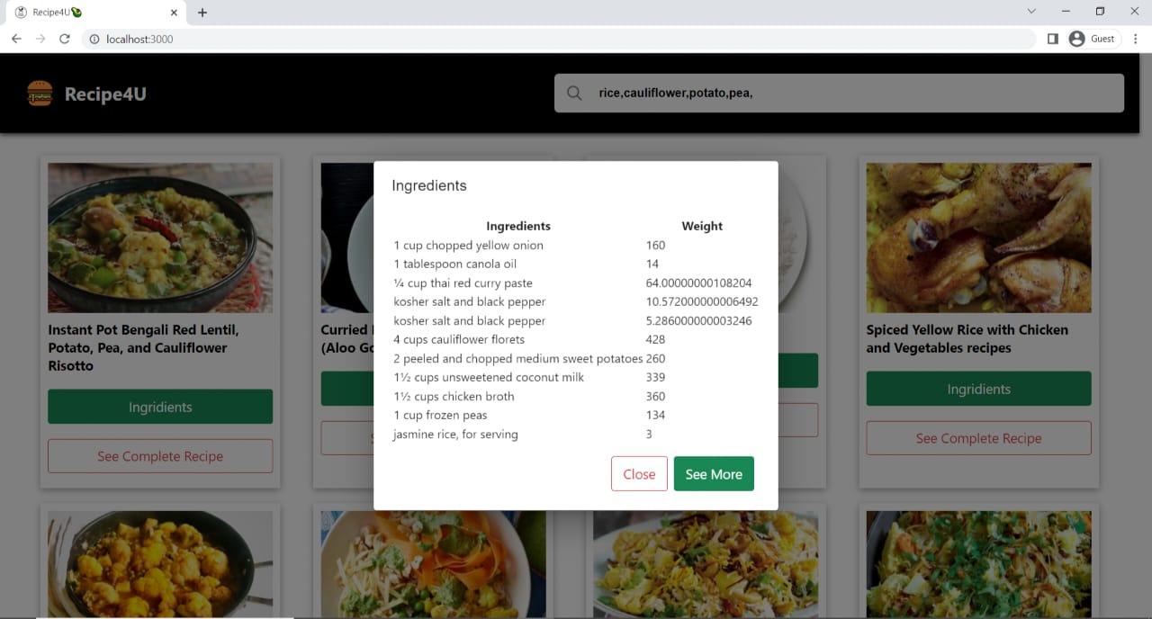
Recommended Recipe
S. B. Jain Institute of Technology Management and Research
15

Slide 17
Technology to be Used
Front End: React
Back End: Python, Node JS
Library/API/Framework: Pandas, Numpy ,Tensorflow
IDE: Vs code
S. B. Jain Institute of Technology Management and research
16

Slide 18
Advantages & Applications
Advantages:
Recommends recipe according to input given.
Provides recipe for the left-over ingredients.
Basic and easy recipe recommended for user.
classification of cuisine based on the ingredients used in the recipe.
Applications:
To simplify the task of choosing appropriate recipe’s based on the search term
Useful for people to cook their favourite cuisine.
S. B. Jain Institute of Technology Management and Research
17

Slide 19
Plan of Work
Work | Time (Days) | Status
Requirement Gathering (Project) | 3 days | Done
Analysis (Project) | 3 days | Done
Requirement gathering & Analysis (Module1) | 4 days | Done
Implementation (Module1) | 12 days | Done
Testing (Module1) | 3 days | Done
Requirement gathering & Analysis(Module2) | 3 days | Done
Implementation (Module2) | 10 days | Done
Testing (Module2) | 3 days | Done
Requirement gathering & Analysis(Module3) | 3 days | Done
Implementation (Module3) | 8 days | Done
Testing (Module3) | 4 days | Done
Report Generation &Submission | 5 days | Done
S. B. Jain Institute of Technology Management and Research
18

Slide 20
Conclusion
We have designed the webapp and completed its development. Our webapp will be a perfect personalized recipe recommender for those who cannot cook by themselves and need a handy recipe guide as well as for people who want to prepare a number of recipes using leftover food items/ingredients rather than wasting it. We have used modern tools such as Python, Machine Learning etc. for the implementation of our application. During the project tenure, we applied professional ethics and understood the importance of teamwork and communication while presenting our project.
S. B. Jain Institute of Technology Management and Research

Slide 21
References
Websites:
https://recipebook.io
https://www.recipetineats.com/free-recipe-books/
Paper:
Suyash Maheshwari, Manas Chourey. “Recipe Recommendation System using Machine Learning Models”. ,ISSN: 2395-0056, Volume: 06 Issue: 09 | Sep 2019
Marlies De Clercq, Michiel Stock, Bernard De Baets, Willem Waegeman, “Data-driven recipe completion using machine learning methods”. Trends in food science and technology, ISSN 0924-2244, Volume: 49, 1-13, 2016.
S. B. Jain Institute of Technology Management and Research
19

Slide 22
Thank You
S. B. Jain Institute of Technology Management and Research
20

