Slide 1
Preliminary Read Alignment Analysis
Based on o306001_1-sample1_704_504_OST1_S55_R1_001.fastq.gz

Slide 2
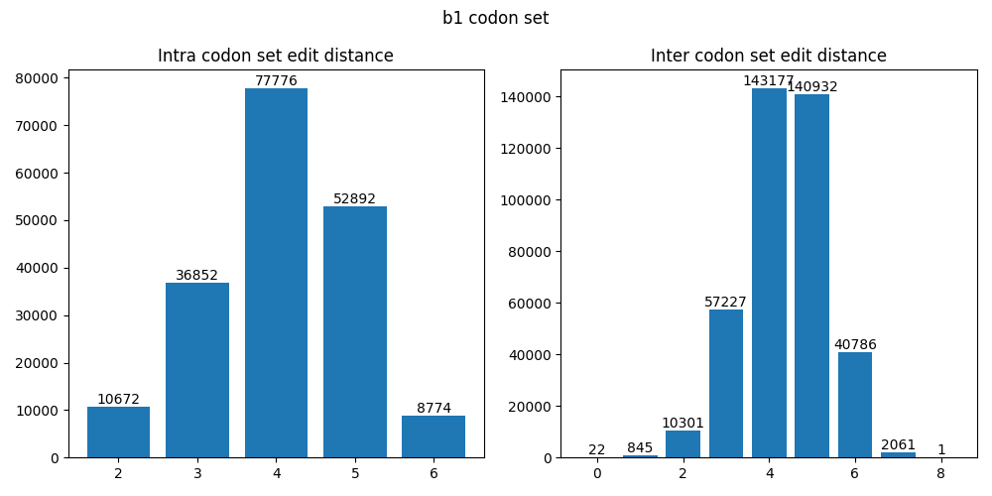
Edit Distance between Codons
As Gary pointed out we need at least an edit distance of 3 between codons of the same list (here defined as the “intra codon set edit distance, plot left).
If we have codon ATT and AAA with edit distance 2 and we have a substitution like ATT -> AAT we cannot distinguish if the AAT observed in the sequencing data comes from ATT -> AAT or AAA -> AAT which both have 1 error when
Furthermore, I suggest to avoid codons that end with the same base as the const region starts

Slide 3
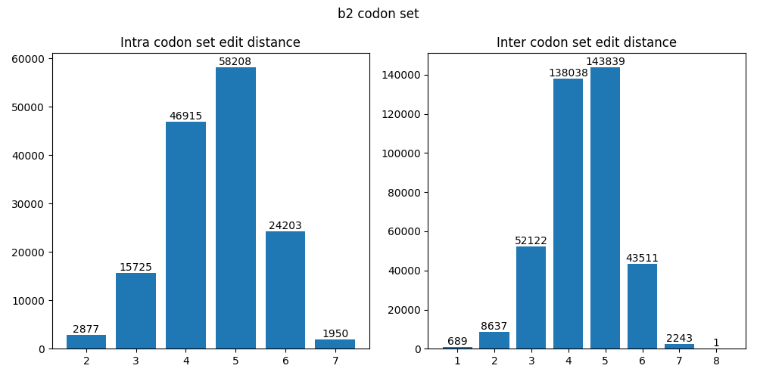
Edit Distance between Codons

Slide 4
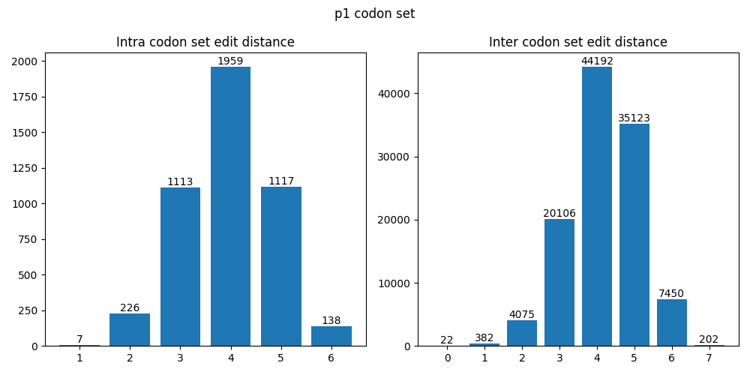
Edit Distance between Codons

Slide 5
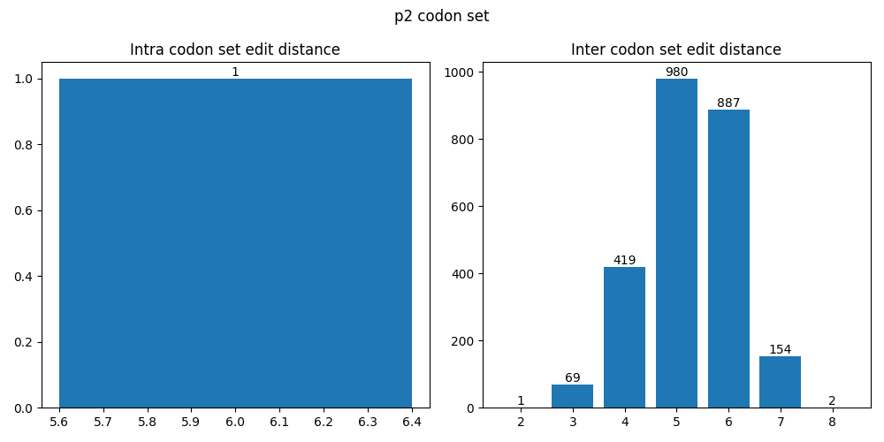
Edit Distance between Codons

Slide 6
Number of Counts per Index
Plot show number of counts per condon index. Title indicates region {number of mapped read} / {total_reads}. Line below shows how many reads were mapped with 0 error (e0) and how many with 1 error (e1). Blue bars are identical in the left and right figure. Left plot normal scale, right plot log scale.

Slide 7
Number of Counts per Index

Slide 8
Number of Counts per Index

Slide 9
Number of Counts per Index

Slide 10
Number of Counts per Index

Slide 11
Number of Counts per Index

Slide 12
Number of Counts per Index

Slide 13
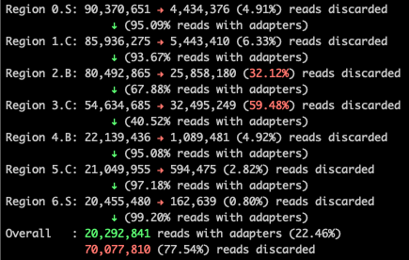
Further Analysis of Issue with 3.C Region
We observe that 59% of all reads at the ”Region 3.C” cannot be exactly mapped (see report to the left).
Analysis of the most common sequences at the constant region is show in the bar plot below. At the top, outside of the box, is the expected const region. Below we see a bar plot with the number of counts (yellow bars) for the top 5 most observed sequences at the position of the const region. We observe that the most common sequence (bottom row) is different from the expected one (letters in black). The expected sequence is only the second most. The rest of the sequences are observed only at very low, irrelevant levels (very small yellow bars in row 1-3).
This means there must have been another const region present during the library preparation or two different library preparations that used the same codons, apart from 3.C, were mixed.

Slide 14
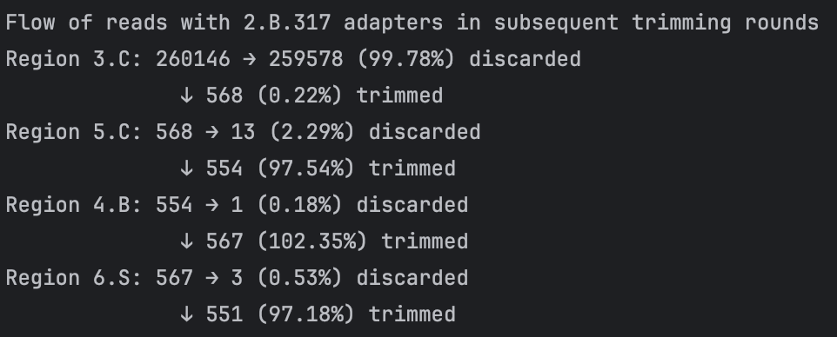
Further Analysis of Issue with 2.B.317 codon
Disclaimer: Only a subset of the reads was used for this analysis
Top:
Plot `Number of Counts per Index` for region 2.B shows an abnormally strong peak (slide 8) for codon 317 which accumulates 40.44% of all mapped reads on itself. Further analysis shows that literally all those reads are lost in subsequent trimming rounds. They are all lost as soon as we trim the constant region that follows. The report reads like: “From all reads with 2.B.317 adapters 99.78% did not contain the 3.C adapter, 0.22% contained the 3.C adapter.”
Bottom:
At the top of the plot we see the expected sequence of the const region. Below we see a bar plot with the number of counts for the top 5 most observed sequences directly after the 2.B.317 adapter. We observe that this is the same unknown most common const sequence from the previous slide. Somehow the presence of 2.B.317 correlates with the presence of the unknown const region sequence.
cons

Slide 15
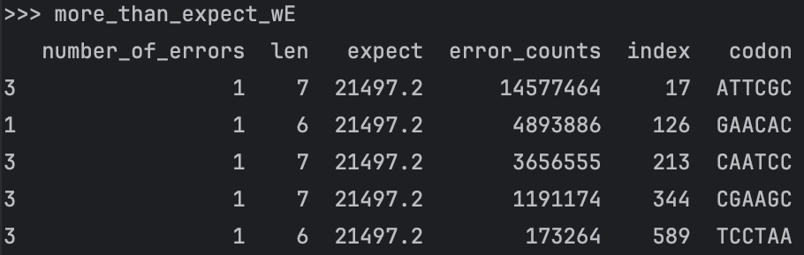
Further Analysis of Issue with 2.B
If we allow 1 error during the mapping we observe that in region 2.B we get a lot more reads (compare with Slide “Number of Counts per Index” for region 2.B, orange bars are counts that are generated by allowing errors, left figure).
Here we see that the top codon 2.B.17 (column index == 17) with sequence ATTCGC gets 14M reads that have 1 error. If we look at the top 5 most common sequences that were identified as 2.B.17 (A, left most figure) we see that the most common sequence is ATCTCGC with an insert. Also, note that the last C is actually from the const region. Only the second most most sequence is the actual exact adapter sequence ATTCGC. The only explanation I have for this is that there actually existed a codon ATCTCG but somehow is not listed or it’s a pollution.
A

Slide 16
Open Questions
Why do we another 3.C const region in this sequencing round?
Why do we see codon 2.B.317 that often?
Revise the guidelines for designing codons (discuss with Alice that is working on an implementation to ensure unique mappings)
Why could there be codons in the data that are not in the codon lists?

