Slide 1
IndicSent-M
Multimodal Sentiment Analysis for Indian Languages Using Text and Images
XLM-R + ResNet-50 on Bengali memes (MemoSen) · text vs image vs fusion · explainability
Positive
Neutral
Negative
Notes:
Project overview. All numbers in this deck are read from the evaluation outputs by scripts/make_slides.py.

Slide 2
Why memes need more than text
Motivation and problem statement
Multilingual, code-mixed. Indian social media mixes Bengali and Latin script, romanised Bengali/Hindi, emojis and cultural references.
Meaning lives across modalities. A cheerful caption on a grim picture can be sarcasm; the image alone or the text alone can mislead.
Tools lag behind. Most sentiment systems are text-only and English-centric; Indian languages are lower-resource.
Question. Does fusing caption + image beat either modality alone, and can we show why a model decided?
4,362
labelled Bengali memes used
21%
captions mixing Bengali and Latin script
7%
of memes are neutral: strong imbalance
IndicSent-M · multimodal meme sentiment
2

Slide 3
Research objectives
1
Build three model types
2
Compare fairly
Text-only (XLM-R), image-only (ResNet-50) and multimodal fusion
Same leakage-safe split, same training recipe, bootstrap confidence intervals
3
Two fusion strategies
4
Explain predictions
Feature concatenation baseline vs. bidirectional cross-attention
Word occlusion / Integrated Gradients and Grad-CAM, with stated limits
IndicSent-M · multimodal meme sentiment
3

Slide 4
Dataset: MemoSen (Bengali memes, LREC 2022)
4,372 annotations → 4,362 usable after validation & de-duplication
Inputs: meme image + transcribed caption; label positive / neutral / negative
Scripts: Bengali 2,963 · mixed 905 · Latin 494
Split: 70 / 10 / 20, stratified, grouped by near-duplicate image or caption — 0 groups leak
Removed: 6 exact duplicate, 4 invalid image
Licence: none published → research use with citation, not redistributed
IndicSent-M · multimodal meme sentiment
4

Slide 5
Preprocessing pipeline
Conservative by design: sentiment cues and scripts are preserved
1. Load
2. Validate
3. Normalise
4. Script ID
5. De-duplicate
6. Group split
xlsx captions, image files, labels
decode, size limits, drop missing
NFC · URL/@USER · keep emoji, negation, ZWJ
Bengali / Latin / mixed
dHash + text; conflicting labels dropped
union-find groups, seed 42
Not done on purpose:
lower-casing (XLM-R is cased), emoji/stop-word removal, stemming, transliteration — each would erase sentiment cues or script information. Images cached at 448 px once so training does not decode multi-megapixel files every epoch.
IndicSent-M · multimodal meme sentiment
5

Slide 6
Model architecture
Three model families, one shared training recipe
Caption
XLM-R base
(top 4 of 12 layers trained)
mean-pool 768-d
or token sequence
Fusion
concat (256+256)
or
cross-attention
text ⇄ 49 regions
MLP → softmax
pos / neu / neg
Image
ResNet-50
(layer4 trained)
pool 2048-d
or 7×7 region grid
Text-only and image-only models put a linear head directly on the pooled vector. Multimodal models always use both inputs — forward() refuses a missing modality, and tests check both change the output.
IndicSent-M · multimodal meme sentiment
6

Slide 7
Training and evaluation protocol
Identical for every experiment; test set never used for selection
Setting | Value
Loss | Cross-entropy, √-inverse-frequency class weights
Optimiser | AdamW · lr 2e-5 / 1e-4 / 1e-3
Schedule | 10 % warm-up, linear decay
Batch · epochs | 16 · ≤ 8, early stop (patience 3)
Selection | best validation macro-F1
Hardware | Apple M1, 8 GB, PyTorch MPS
Primary metric: macro-F1 — an all-negative model gets ~63 % accuracy but 0.26 macro-F1
Uncertainty: 95 % bootstrap CIs; paired bootstrap for model differences
Modality ablation: neutral image / removed caption at test time
Robustness: second split with whole source pages held out
IndicSent-M · multimodal meme sentiment
7

Slide 8
Results: test set, random group split
874 test memes · identical for every model · 95 % CIs in notes
Model | Macro-F1 | 95 % CI
Majority | 0.257 | 0.25–0.26
Text | 0.545 | 0.50–0.59
Image | 0.503 | 0.47–0.54
MM-concat | 0.578 | 0.53–0.62
MM-attention | 0.589 | 0.55–0.63
MM-concat vs Text: Δ +0.033 → not significantly different
MM-concat vs Image: Δ +0.074 → significantly better
MM-attention vs Text: Δ +0.044 → significantly better
MM-attention vs Image: Δ +0.085 → significantly better
IndicSent-M · multimodal meme sentiment
8
Notes:
Text: acc 0.6899 [0.6590389016018307, 0.7219679633867276], macro-F1 0.5449 [0.5037926916454557, 0.5890726520154802], per-class F1 pos/neu/neg 0.637/0.226/0.772
Image: acc 0.6808 [0.6498855835240275, 0.7139588100686499], macro-F1 0.5034 [0.4650687945317198, 0.5426952057496921], per-class F1 pos/neu/neg 0.562/0.167/0.781
MM-concat: acc 0.7426 [0.7127860411899314, 0.7700228832951945], macro-F1 0.5777 [0.5341675309216009, 0.6207047251305977], per-class F1 pos/neu/neg 0.672/0.242/0.819
MM-attention: acc 0.7426 [0.7128146453089245, 0.771195652173913], macro-F1 0.5889 [0.5469331450006087, 0.6291380229876695], per-class F1 pos/neu/neg 0.689/0.256/0.822
Majority: acc 0.6259 [0.5949656750572082, 0.6590389016018307], macro-F1 0.2566 [0.24868483978957437, 0.26482758620689656], per-class F1 pos/neu/neg 0.000/0.000/0.770
Source prior*: acc 0.7826 [0.7562929061784897, 0.8100686498855835], macro-F1 0.5236 [0.5034899973334469, 0.5432742915027521], per-class F1 pos/neu/neg 0.728/0.000/0.843

Slide 9
Per-class F1 and modality ablation
Model · condition | Macro-F1 | Changed
MM-concat · full input | 0.578 | –
MM-concat · neutral image | 0.511 | 23%
MM-concat · no caption | 0.470 | 14%
MM-attention · full input | 0.589 | –
MM-attention · neutral image | 0.467 | 21%
MM-attention · no caption | 0.376 | 27%
“Changed” = share of test predictions that flip when one input is neutralised. Large flips for both inputs mean the fused model relies on both.
IndicSent-M · multimodal meme sentiment
9

Slide 10
Shortcut: the source page predicts the label
Memes from the same page share watermarks and style — and very different label mixes
78%
test accuracy from page identity alone (no content)
0.524
macro-F1 of that shortcut
e.g. page “KAM” is 80 % positive; “chosha” is 98.5 % negative
Different test sets (874 vs 938 memes): compare the drop per model, not absolute values across splits.
IndicSent-M · multimodal meme sentiment
10

Slide 11
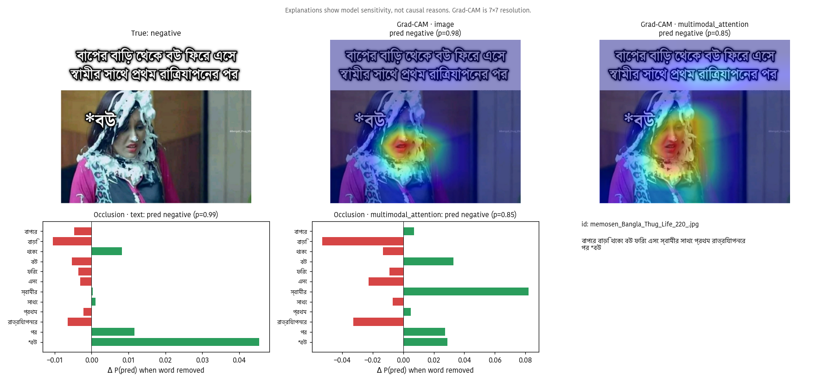
Explainability: what the models are sensitive to
Occlusion: drop in P(class) when a word is removed — exact, but ignores interactions
Integrated Gradients: completeness checked; hidden when it fails to converge on XLM-R
Grad-CAM: 7×7 sensitivity map; often highlights caption text in the image
Caveat: sensitivity ≠ cause; not proof of what an annotator meant
IndicSent-M · multimodal meme sentiment
11

Slide 12
The IndicSent-M application
Streamlit UI + FastAPI service, CPU-compatible, Docker image
Home
Never fakes a prediction: no checkpoint → setup steps; optional preview is labelled DEMO
Confidence wording: predicted-class probability, not a guarantee
Robust inputs: corrupt / oversized images, empty text, unsupported scripts handled
Tested: pytest suite covers data, models, inference, explainers, API
objectives, languages, architecture
Analyze
text / image / multimodal input, probabilities, word highlights, Grad-CAM
Model Comparison
tables, CIs, confusion matrices, ablations, both split protocols
Dataset & Methodology
statistics, pipeline, limitations
About
motivation, technologies, future work
IndicSent-M · multimodal meme sentiment
12

Slide 13
Conclusions
Random split: best macro-F1 MM-attention (0.589).
MM-concat vs text-only: not significantly different (Δ +0.033, one-sided p = 0.097; 9 comparisons, so treat p > 0.006 as fragile).
MM-attention vs text-only: significantly better (Δ +0.044, one-sided p = 0.015; 9 comparisons, so treat p > 0.006 as fragile).
Cross-attention vs concatenation: not significantly different.
Page identity alone gives 78% accuracy: random-split scores mix sentiment with page recognition.
On unseen pages every model drops 0.14–0.25 macro-F1; best is MM-concat (0.387).
Unseen pages: cross-attention vs concat significantly worse (Δ -0.049).
Neutral memes (~7 %) remain the hardest class for every model.
Future work
Hinglish memes (Memotion 3, registration)
OCR for captions
CLIP-style vision-language encoders
Several seeds + calibration
Sarcasm-aware training
Human study of explanations
IndicSent-M · multimodal meme sentiment
13

