Slide 1

DEMASCAS
Your Voice-Powered AI Desktop Assistant

Slide 2
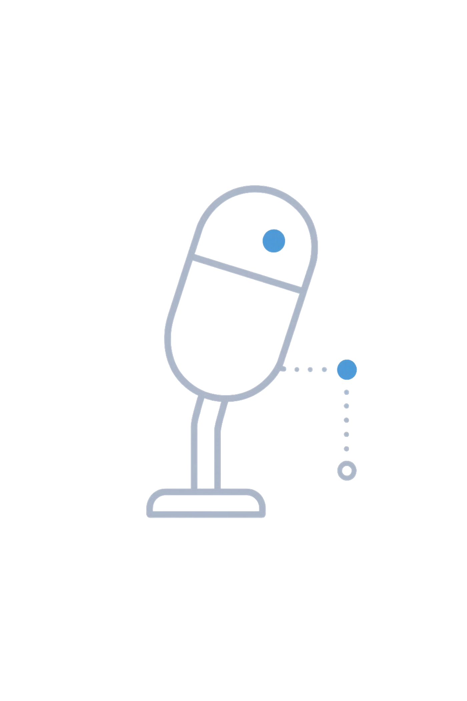
Meet DEMASCAS
JARVIS-like AI for macOS
Runs fully on your device
No cloud, no subscriptions
Voice-first, always listening
Built for Apple Silicon

Slide 3
Why DEMASCAS?
DEMASCAS addresses key challenges faced by modern computer users:
Switching apps breaks focus
Repetitive tasks waste time
No single AI controls your OS
Existing tools need the cloud
Your data stays yours

Slide 4

Wake. Speak. Done.
Your Workflow with DEMASCAS
01
02
Say "DEMASCAS" to activate
Speak your command naturally
03
04
AI understands and acts
Result spoken back to you
05
Returns to standby silently

Slide 5
What It Can Do
Browse and search the web
Open, find, and read files
Compose and reply to email
Control any app
Research and summarize topics

Slide 6
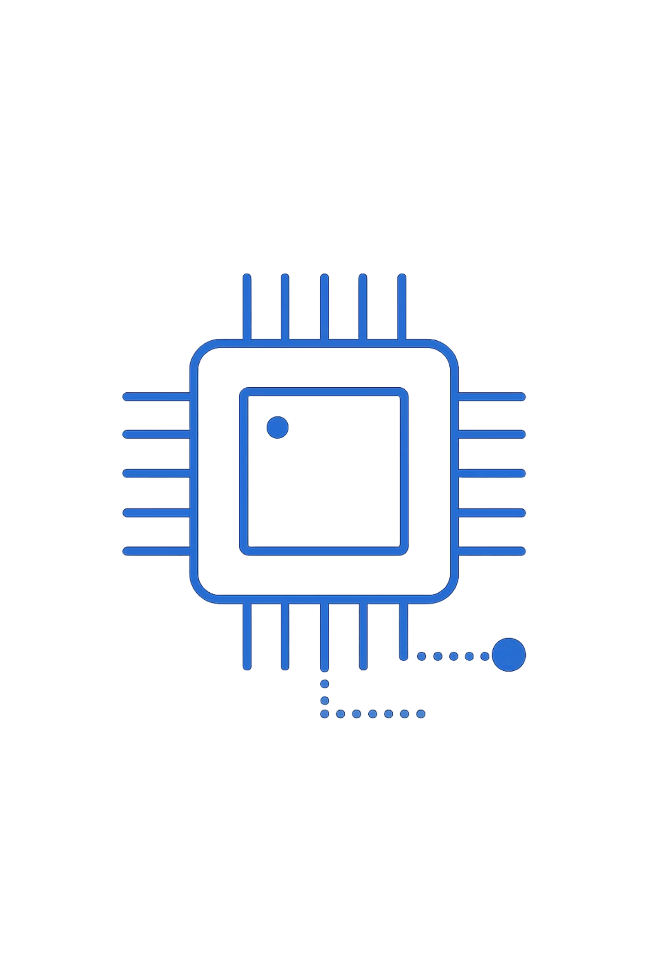
Powered by 8 Agents
DEMASCAS operates with a suite of specialized agents, each designed for specific tasks:
Browser Agent
— web and Gmail
File Agent
— local file management
System Agent
— app and UI control
Research Agent
— live web research
Comms Agent
— email and messaging

Slide 7
Beyond Basic Commands
Learns any new app by exploring it
Records and replays your workflows
Builds scripts and tools on demand
Recovers from failures automatically
Grows smarter with every session

Slide 8
Efficient by Design
All models run locally
2GB for AI
3GB for System
No GPU memory conflicts
Whisper for voice recognition
Kokoro for natural speech output

Slide 9
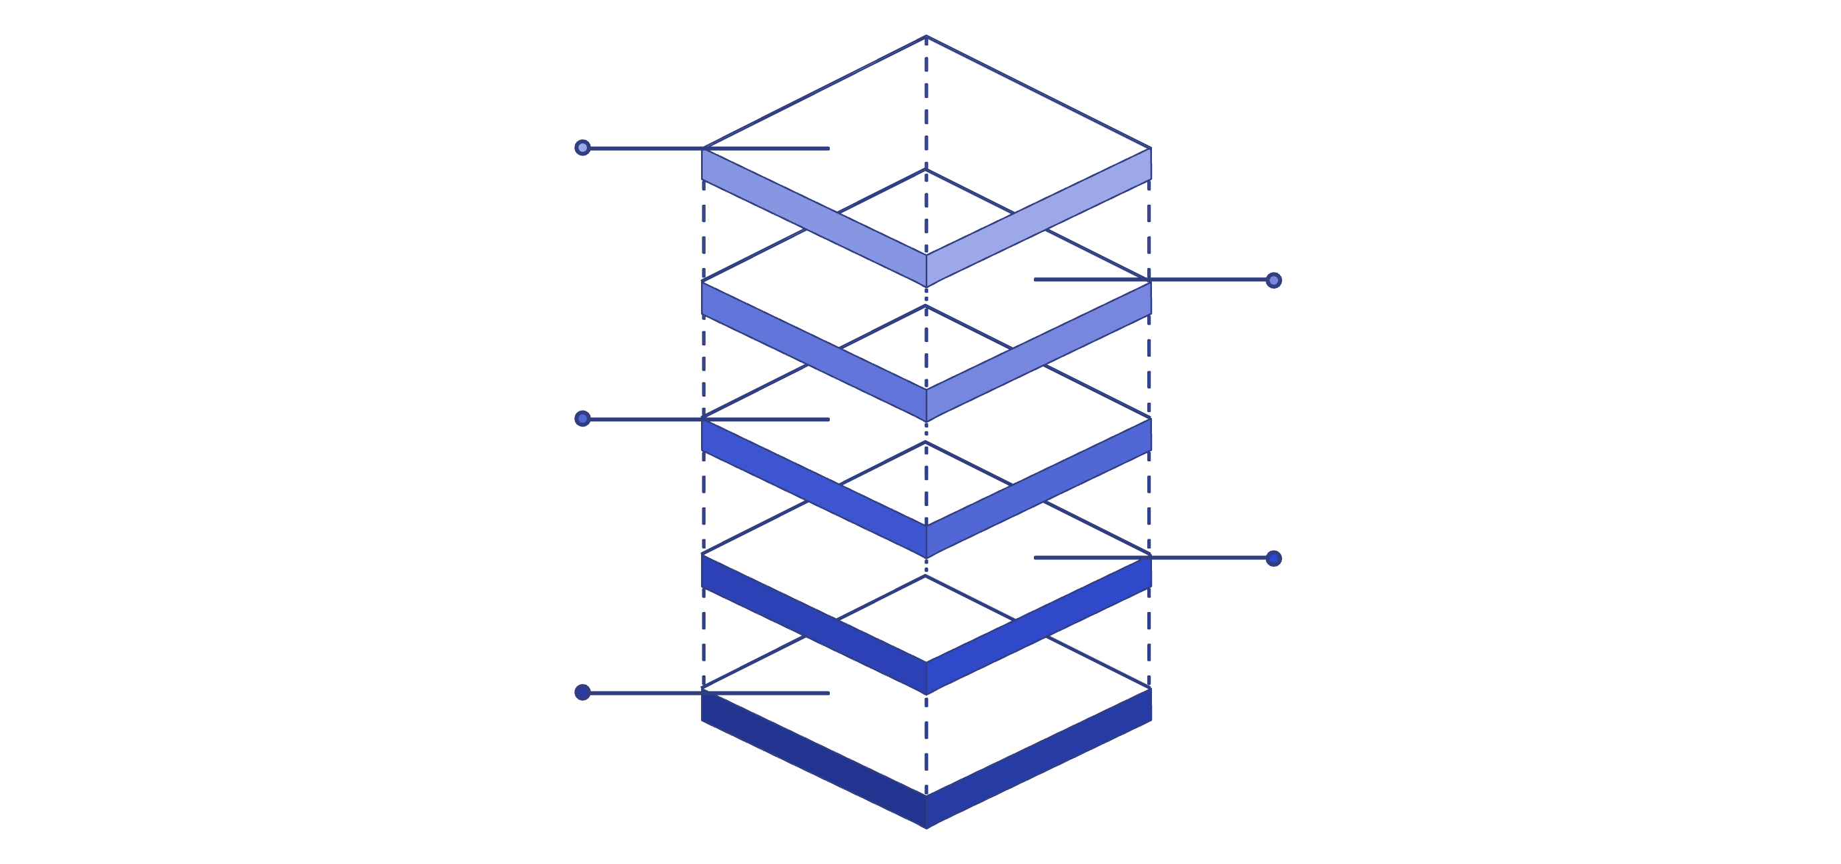
Under the Hood
whisper.cpp
On-device speech-to-text
ChromaDB
Persistent vector memory
Phi-4-mini
Local LLM for inference
Python Flask
Powers 96 integrated tools
C++ Daemon
Real-time audio processing
Our powerful architecture combines several cutting-edge technologies to deliver a seamless and private AI experience:
C++ daemon — real-time audio processing.
Python Flask — powers 96 integrated tools and functionalities.
Phi-4-mini — our efficient local Large Language Model (LLM).
ChromaDB — for robust, persistent memory and context.
whisper.cpp — handles accurate speech-to-text conversion locally.

Slide 10
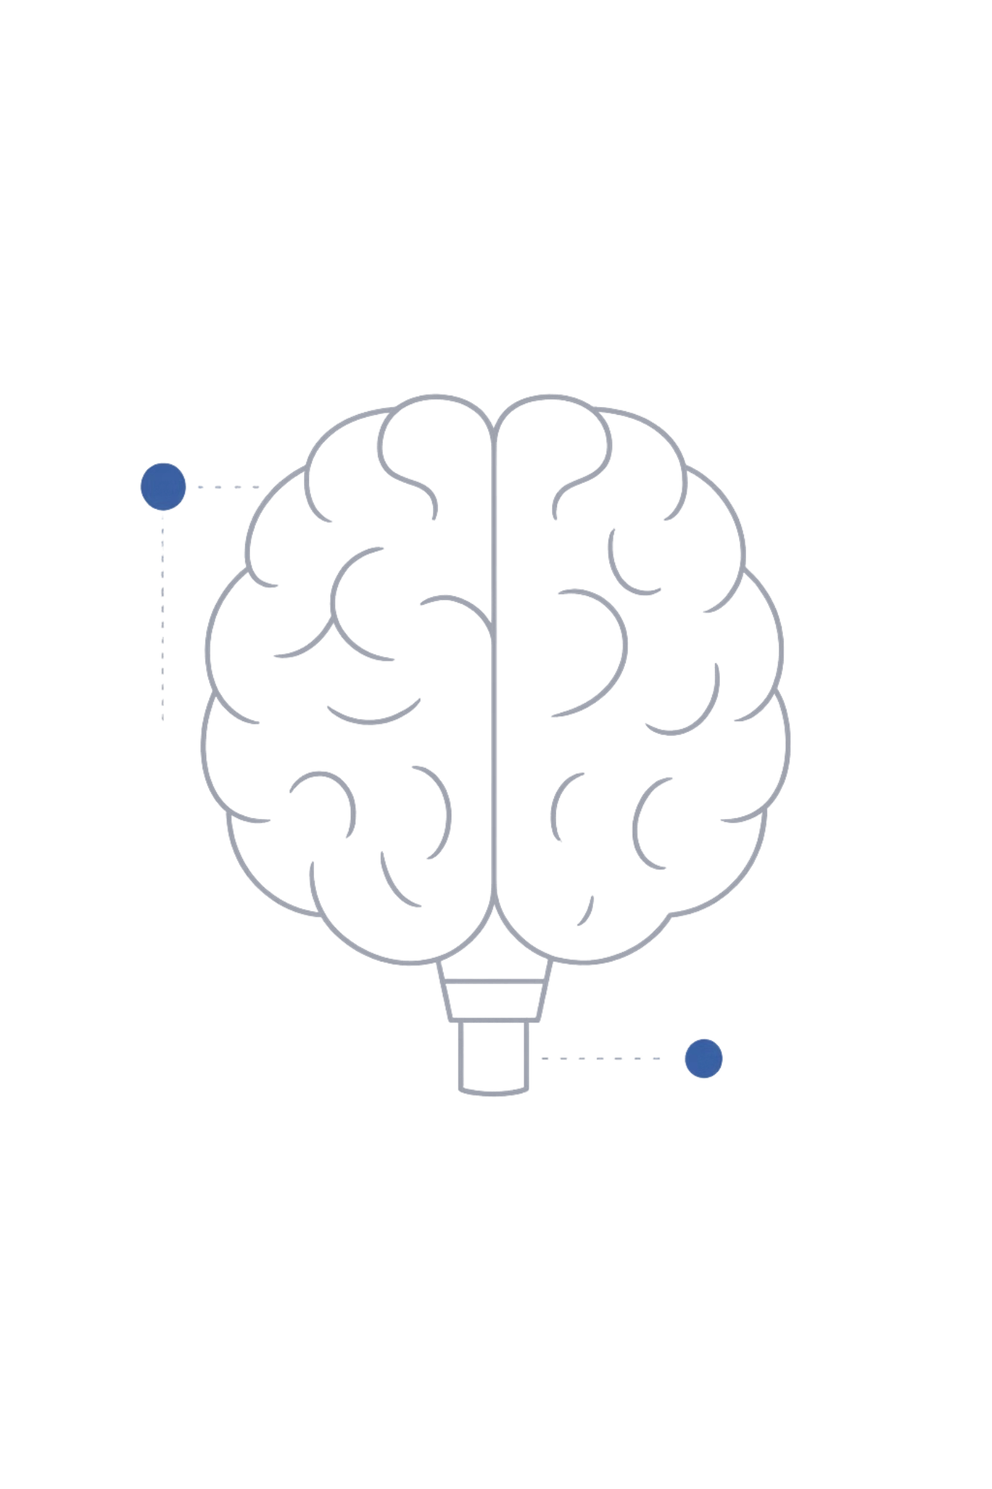
It Remembers You
Saves every interaction
Learns your preferences over time
Recalls past research instantly
Stores app profiles you teach it
Builds personal workflow library

Slide 11
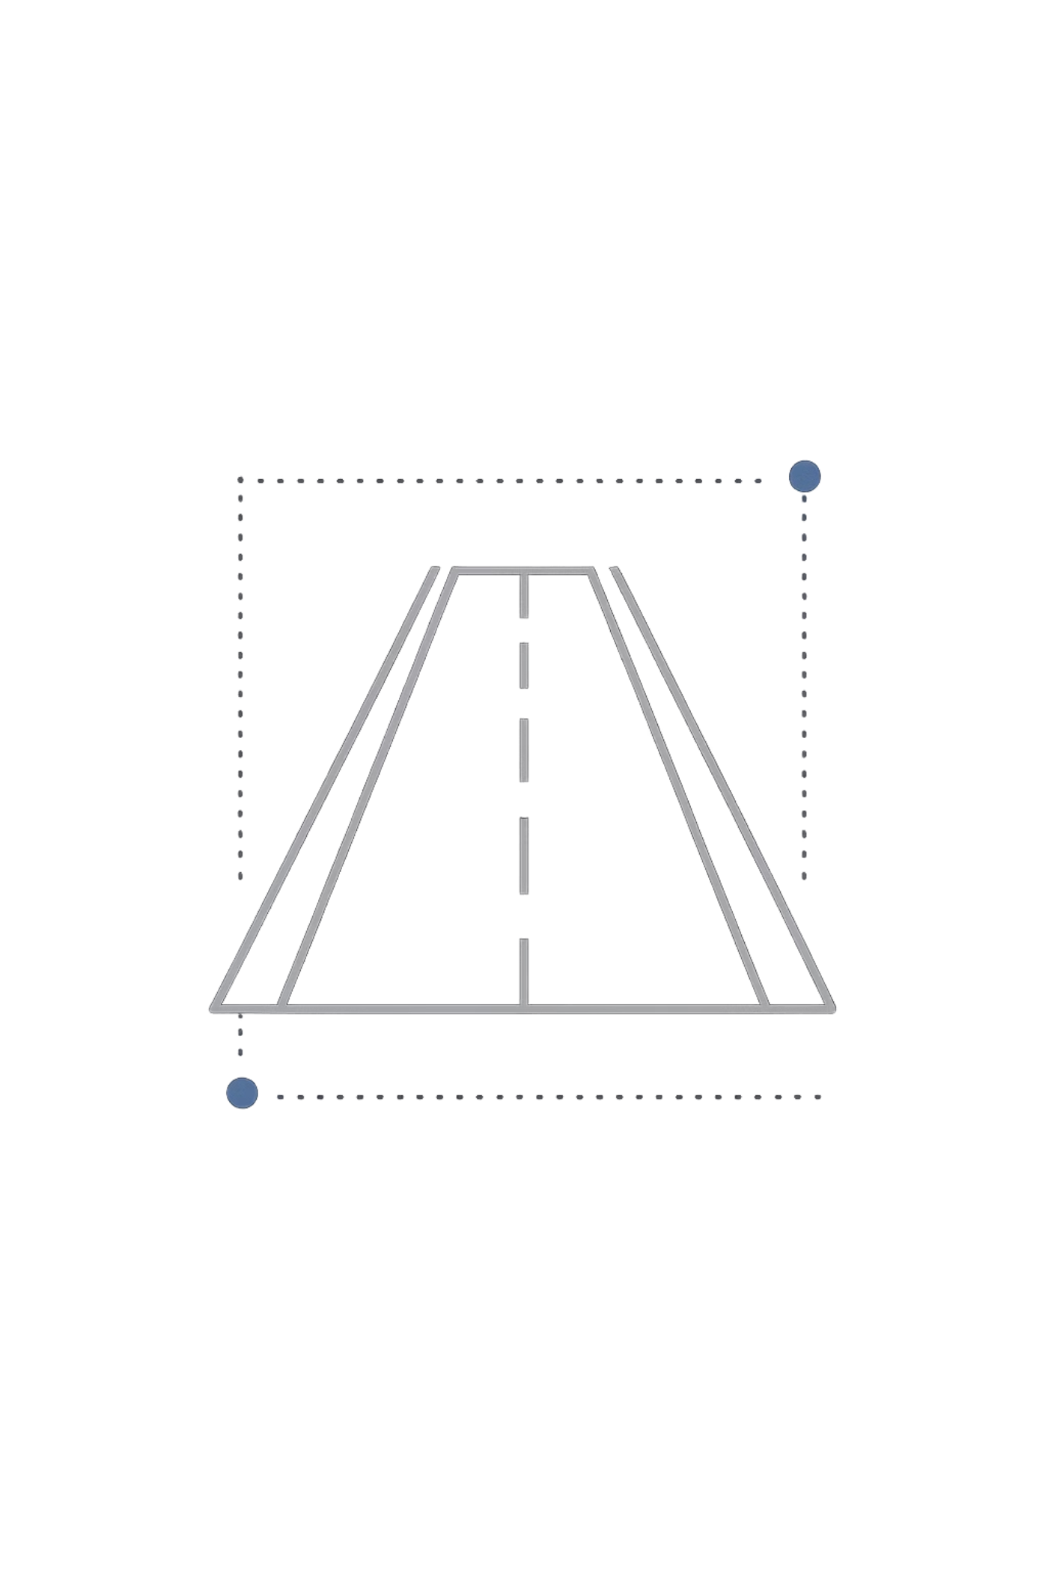
Roadmap
Here's a look at what's next for DEMASCAS:
1
Full browser form interaction
2
Multi-agent parallel tasks
3
Voice workflow recorder
4
VLM screen understanding
5
Mobile companion app

Slide 12
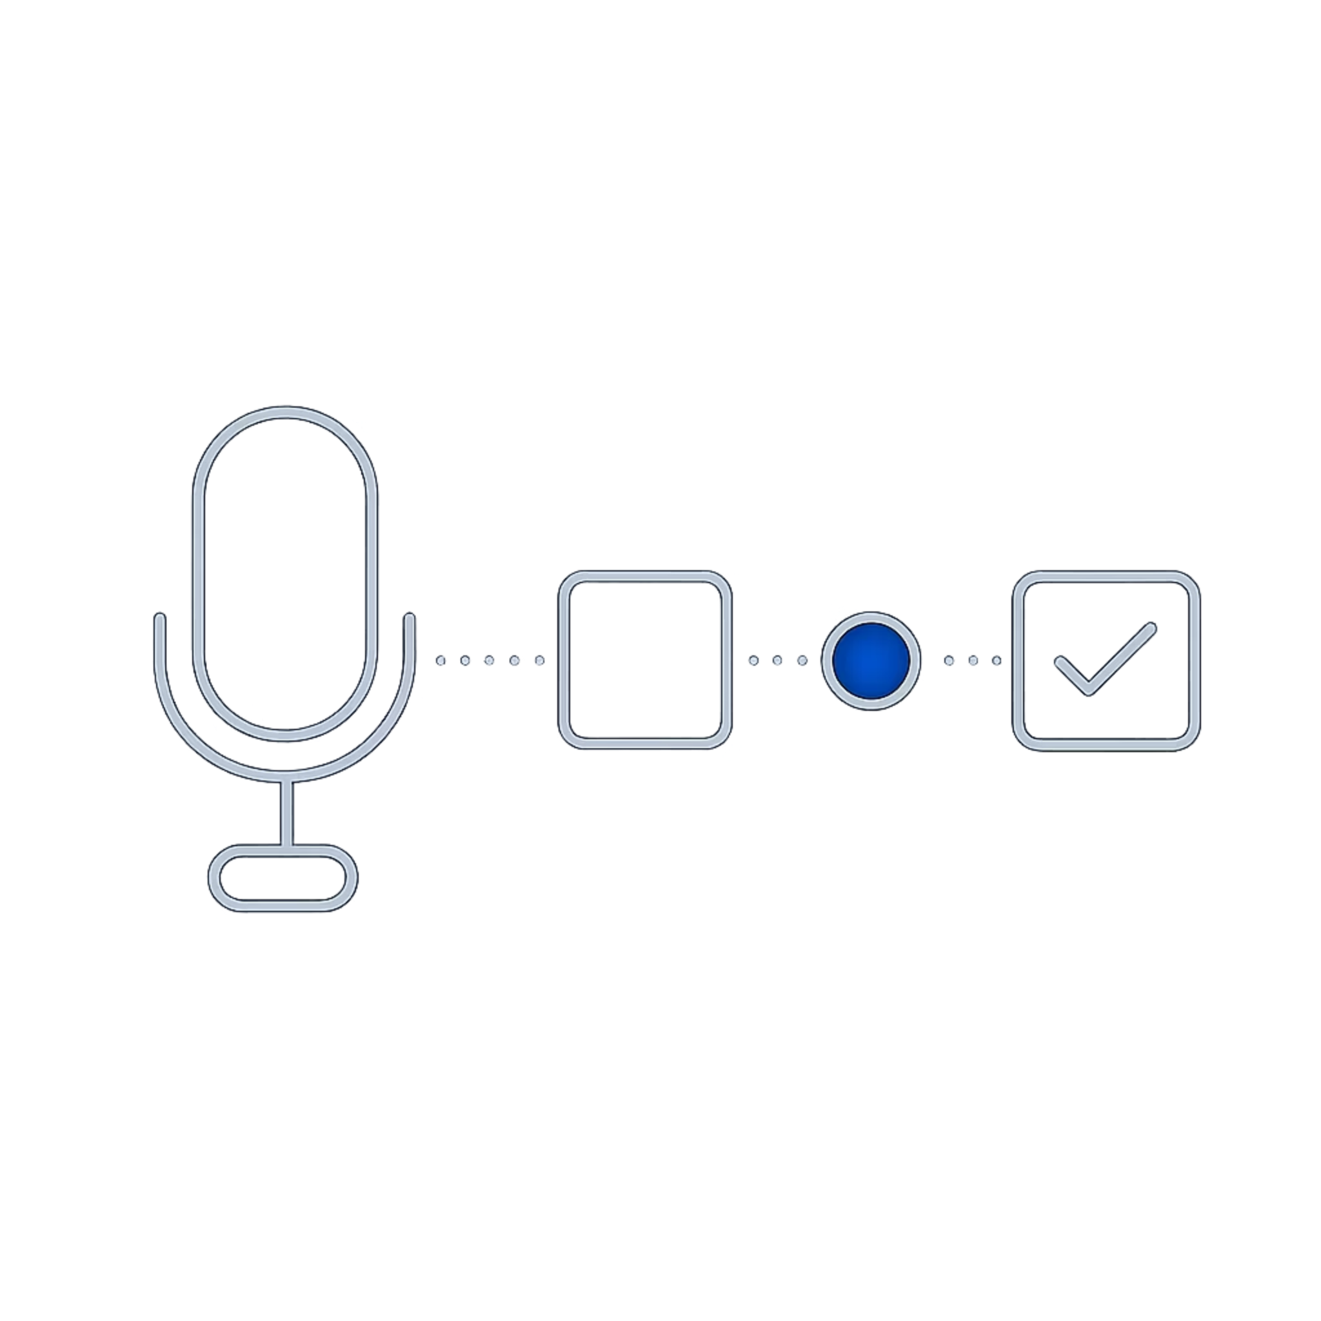
DEMASCAS
One voice. Full control.
Open source on GitHub
MacOS | Linux
Say the word. It listens.

