Slide 1


SOCIETY OF PETROLEUM ENGINEERS
UNIVERSITY OF LAGOS STUDENT CHAPTER
Society Of Petroleum Engineers Data Science Engineering And Analytics Technical Section(DSEATS) Africa Region Competition For Students And Young Professionals.
TITLE: Prediction of Oil, Gas & Water Production in the DSEATS Field Using Machine Learning
NAME: DEMILADE KOLAWOLE-JACOBS
SPE NUMBER: 5642865
SPE SECTION: LAGOS SECTION 61
COURSE OF STUDY: GEOPHYSICS
SCHOOL: UNIVERSITY OF LAGOS

Slide 2

OUTLINE
PROBLEM
METHODOLOGY
KEY INSIGHTS FROM EDA
MODEL BUILDING AND ANALYSIS
RESULTS
PATHWAYS FOR OPTIMIZATION

Slide 3
PROBLEM
Problem Definition
How accurately can I forecast future oil, gas, and water production rates given various characteristics and historical data of previous production rates?
Data Overview
The provided production data pertains to a conceptual oil field named DSEATS, encompassing historical production records.
Datasets Provided:
1. Training Dataset: Historical production data from 2008 to 2014.
2. Validation Dataset: Historical production data from 2015 to 2016.
Using the features in the training dataset, I will develop a machine learning model to predict the oil, gas, and water production rates in the validation dataset.

Slide 4
METHODOLOGY
PROBLEM DEFINITION
Defined the goal of accurately forecasting oil, gas, and water production rates using historical data.
DATA CLEANING
I cleaned the data to handle missing values and for sanity check.
EXPLORATORY DATA ANALYSIS
Manipulated the data to identify trends and find insights
FEATURE ENGINEERING
Created new features that would be beneficial to the model building stage
MODEL EVALUATION
Evaluated model performance using RMSE, R-squared, and MAE metrics for each target variable on validation dataset
DATA PREPROCESSING
Cleaned, transformed, and scaled the data, including cyclical transformations for date features.
MODEL BUILDING
Trained multiple multi-output regression models, including Random Forest, Gradient Boosting, Extra Trees, and XGBoost.
HYPERPARAMETER TUNING
Used RandomizedSearchCV to optimize Random Forest and Extra Trees models.

Slide 5
KEY INSIGHTS UNCOVERED FROM EDA
There were some interesting insights found during EDA:
There are only 2 types of Wells in our dataset Oil Producing(OP) and Water Injecting(WI)
Interestingly there’s only one WI well record out of 6,295 in the training dataset and this doesn’t occur in the validation dataset
WellBore 001-F-12 is the most prolific well in the dataset
In 2009, we observed the highest cumulative production volume of oil, gas, and water.
In 2014, we observed the highest production volume of water

Slide 6
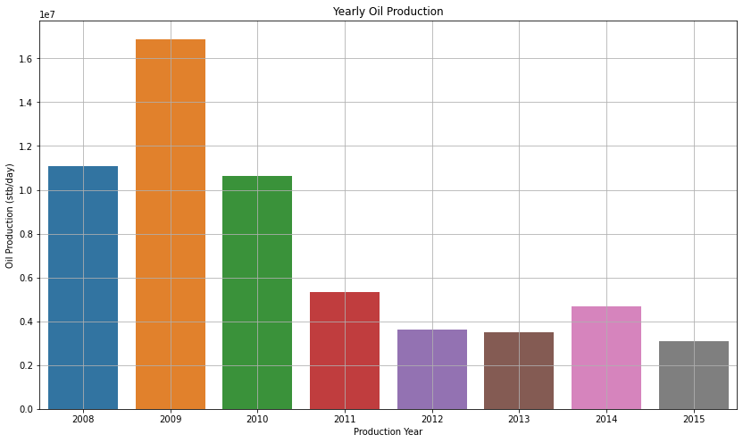
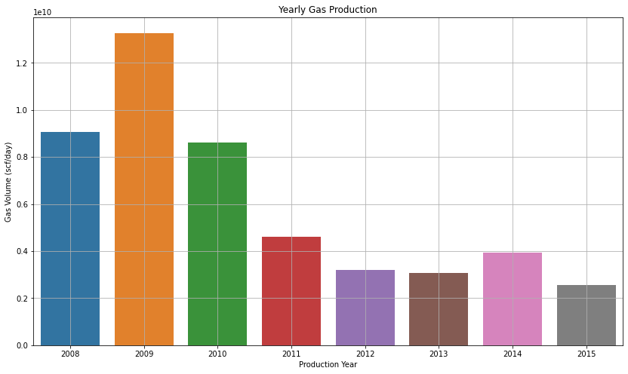
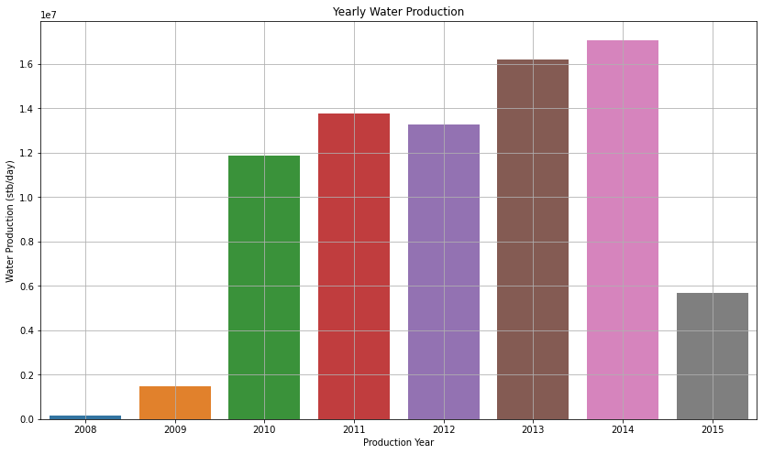
KEY INSIGHTS UNCOVERED FROM EDA
The plots above show yearly oil, gas and water production rates from 2008 to 2015:
The year 2009 recorded the highest production volume of oil and gas but year 2014 had the highest production volume for water.
Unlike the yearly oil and gas production rates; water production volumes experienced an increasing trend over the years

Slide 7
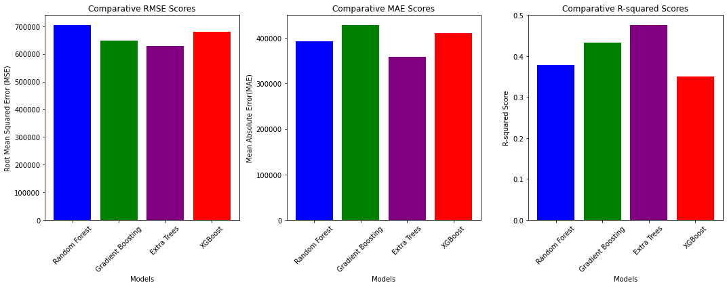
MODEL BUILDING AND ANALYSIS
Plot showing comparative analysis of multioutput regression baseline models
Four multioutput regression baseline models were built and evaluated and `ExtraTreesRegressor` was the best performing model
The baseline model was further optimized via hyperparameter tuning and it achieved a r2 score of 0.61 from a previous 0.47
This optimized model was used to make predictions on the test dataset and the forecast predictions were saved to a .csv file

Slide 8
RESULTS
 | HISTORICAL TOTAL VOLUME | FORECASTED TOTAL VOLUME | CUMULATIVE TOTAL PRODUCTION | INCREASE (% )
Oil Production(Stb) | 58,826,313.579 | 20,018,837.510340635 | 78,845,151.08934064 | 34.03
Gas Production(Stb) | 48,327,425,355.451996 | 16,465,594,231.006313 | 64,793,019,586.45831 | 34.07
Water Production(Stb) | 79,502,873.22209999 | 21,522,640.368773438 | 101,025,513.59087342 | 27.07
The table above presents the historical total production volumes from the training dataset (2008-2015), the model-forecasted total volumes from the validation dataset (2015-2016), the cumulative total production (i.e., the sum of historical and forecasted volumes), and the percentage increase.

Slide 9
PATHWAYS FOR OPTIMIZATION
Expanding the data pool: Acquiring additional data can enhance the robustness of our model, providing it with more information to learn from and improve its predictive accuracy.
Reducing Zero Values: Minimizing the presence of zero values in the dataset can help reduce noise and improve the quality of the data, leading to more accurate and reliable predictions.
Leveraging Deep Learning: Harnessing the power of deep learning will help to uncover more complex relationships within the data, generalize better, and ultimately achieve superior results.

Slide 10


THANK YOU

