Slide 1

NEUROHACK 2022
Team: Bioinformagicians
Project: Predicting ALS drug targets using integrative multi-modal machine learning
@Brian Schilder
@Davide Spalla
@Siddharth Grover
@Hanz Tantiangco
@Guan Wang
@Yizhou Yu
@Areda Elezi
@Renata Kabiljo
Jan 12th, 2022

Slide 2
Objectives
1. Identify molecular targets of ALS.
Phenotypes:
Status
Survival *
Target types
Genes *
Transcripts
Proteins
Cell-types
2. Identify potential therapeutics for ALS.

Slide 3
Workflow
Preprocess input datasets
Train predictive model
Extract key genes
Filter input features
Identify therapeutics
MND_ALS VCFs
External datasets

Slide 4
Pre-processing
Variants → Genes
Gene annotations in VCFs
combined SNP-to-gene (cS2G) predictions
Duplications/
Tandem repeats
Insertions
Inversions
Deletions
Genotype encodings
key | value
./. | 1
0/0 | 1
1/. | 0
1/0 | 0
0/1 | 0
1 | 0
1/1 | 2
1/2 | 3
2/2 | 4
Inter-sample correlations using gene-level scores

Slide 5
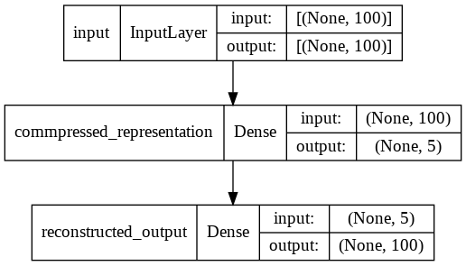
Feature filtering
Reduce feature space
Subset VCFs to only GWAS locus regions
No variance across individuals
Little contribution to latent representation loadings
Model types
PCA
Autoencoder

Slide 6
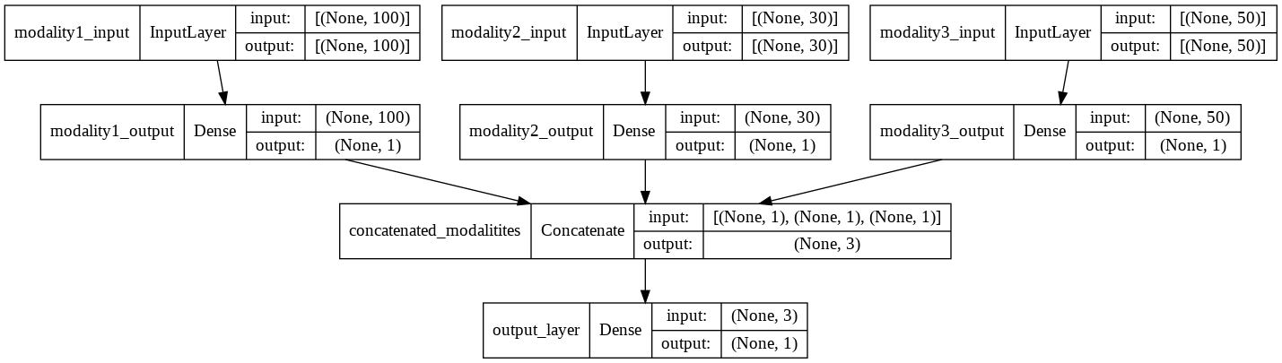
Classifier model
Train a classifier model to distinguish ALS patients with long vs. short survival times.
…
Functional impact predictions
Retroviral insertions
SV genotype matrix
SNP genotype matrix
Indel genotype matrix

Slide 7
Identify therapeutics
Resources
ChEMBL
LINCS
Geneshot
validated targets
experimentally-collected gene expression signatures
literature-extracted gene signatures

