Slide 1
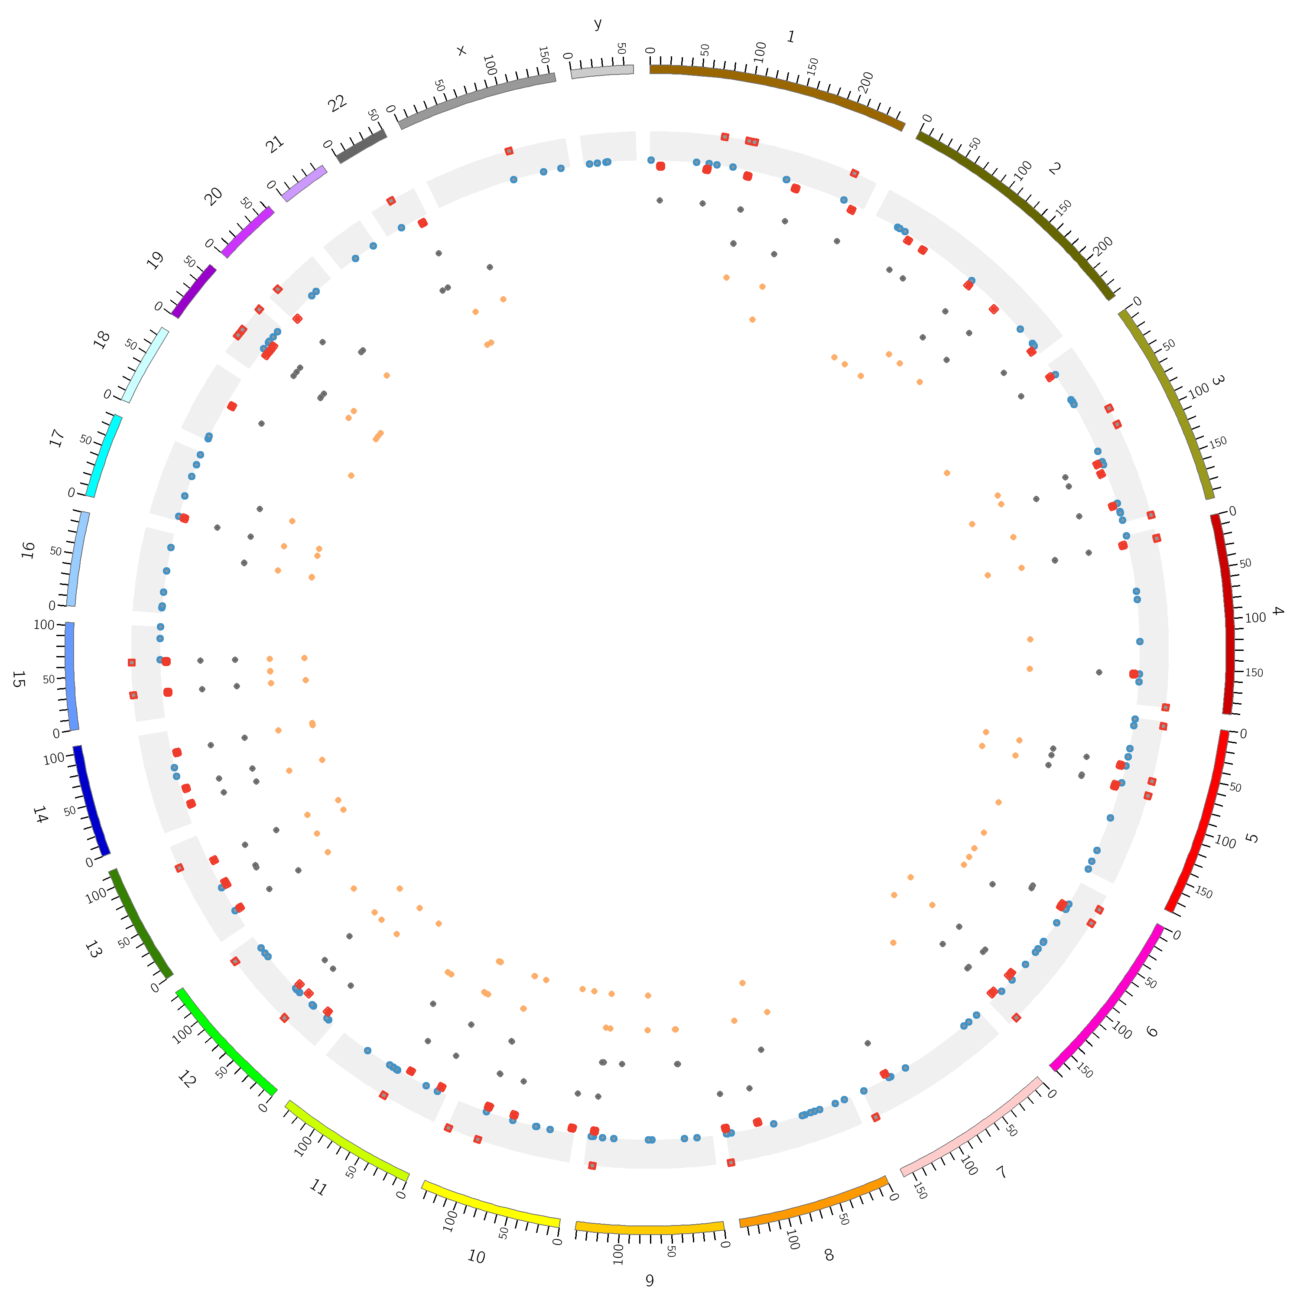


Bioinformagicians

