Slide 1
NSU 2025
TV TENNIS
4
3
STUDENTS:
IVAN KIRYUSHIN DANIIL SMOLIN ELIZAVETA KENIG
2
1
FIT

Slide 2
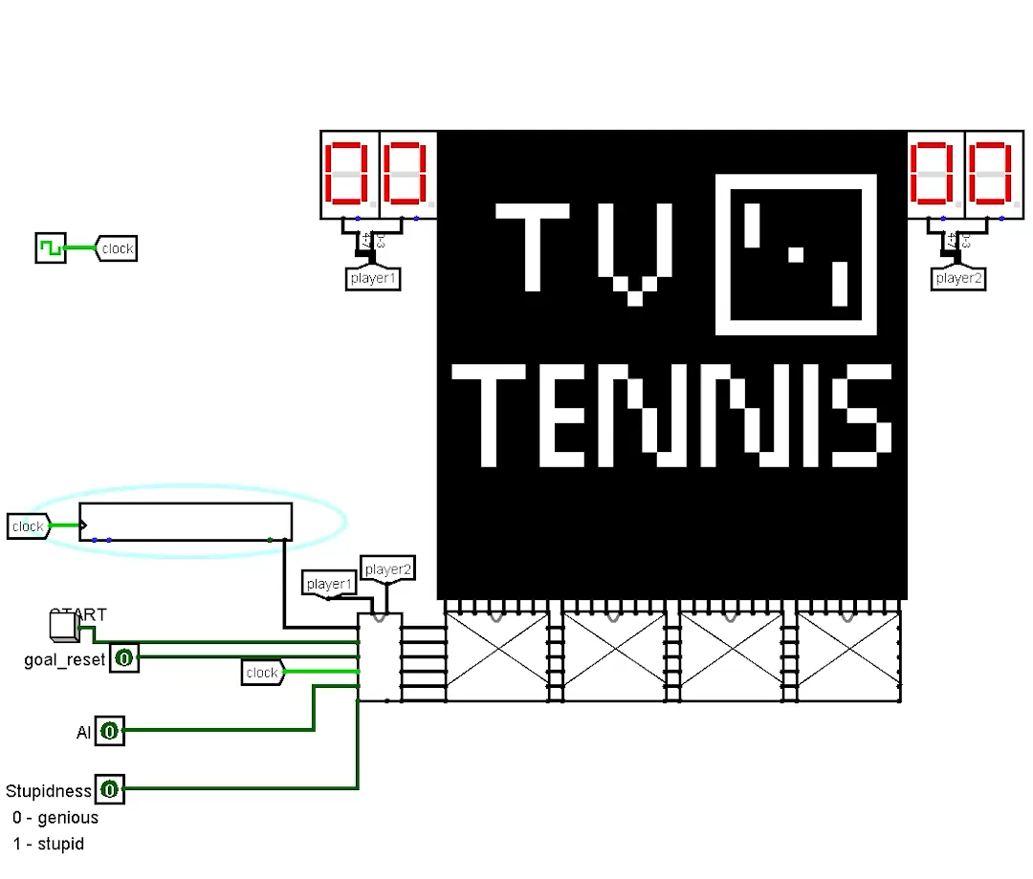
4
3
USER
INTERFACE
2
1

Slide 3
4
3
USER
INTERFACE
2
1

Slide 4
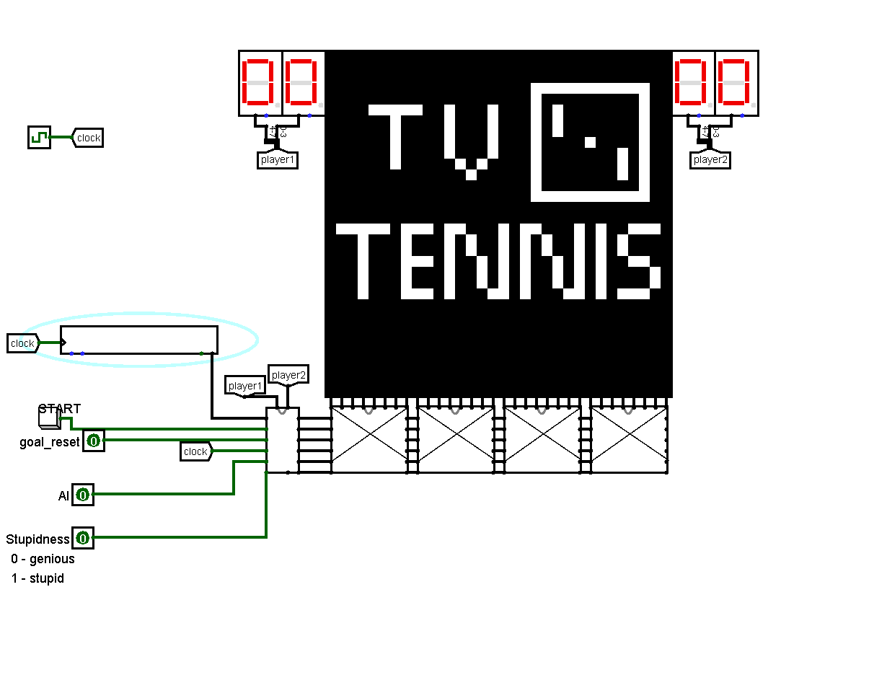
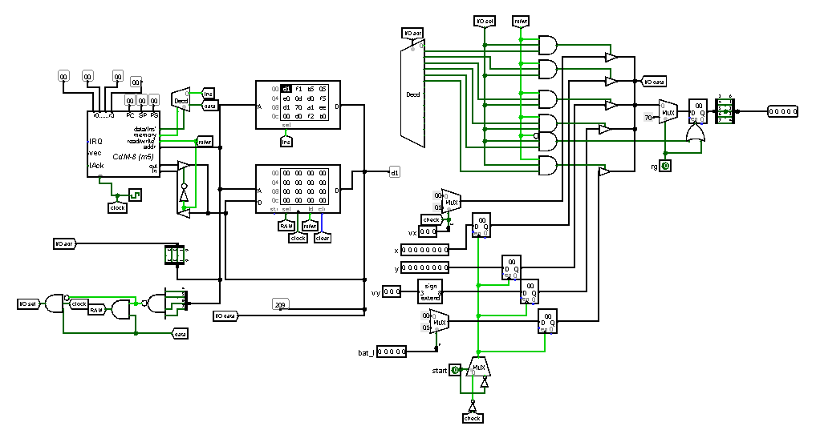
USER INTERFACE
4
3
CDM-8
for ai
2
1

Slide 5
USER INTERFACE
4
3
CDM-8
for ai
2
1

Slide 6
USER INTERFACE
4
3
CDM-8
for ai
2
1

Slide 7
USER INTERFACE
4
3
CDM-8
for ai
THANKS!
2
1

