Slide 1
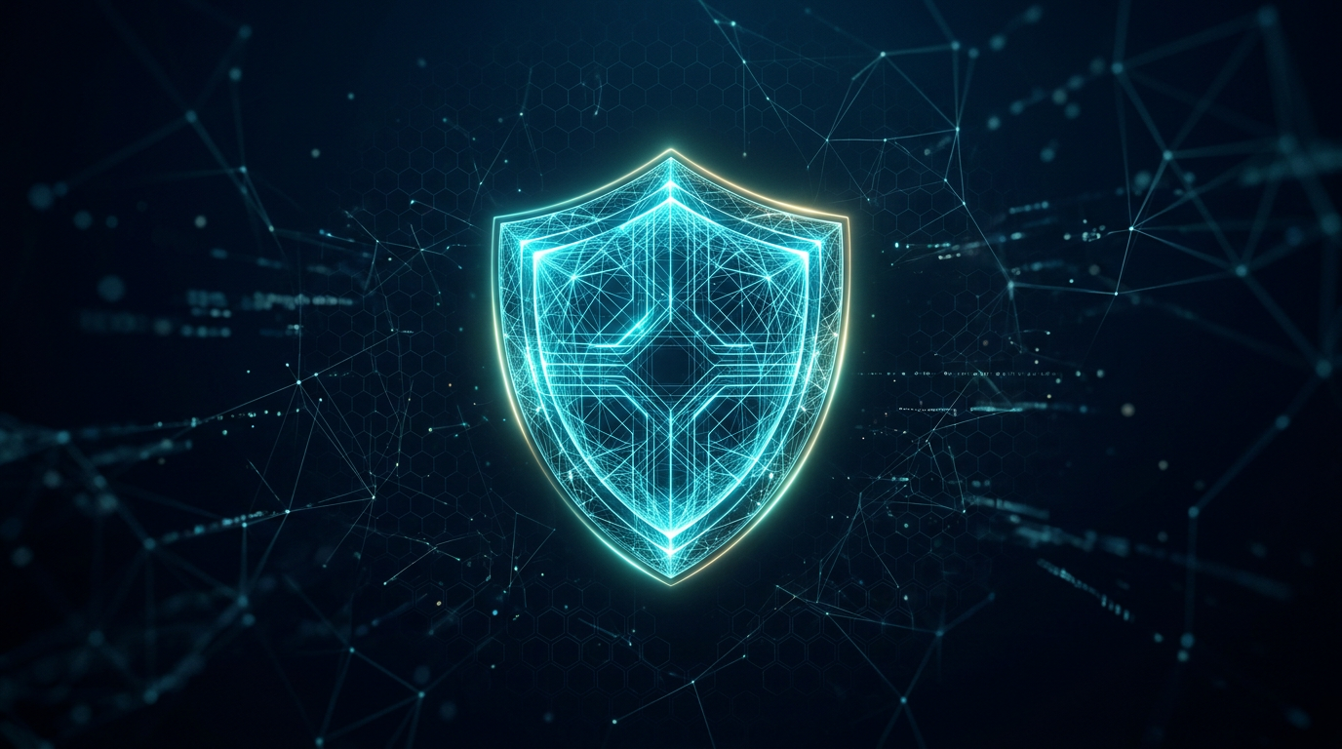
COMPETITION PRESENTATION
Vrindha AI
Intelligent AI-Powered
Cybersecurity and SOC System
What if a cybersecurity system could continuously monitor threats, understand what is happening, connect information, and recommend the right defensive action—while still keeping humans in control?
Defensive · Coordinated · Human-authorized
Notes:
What if a cybersecurity system could continuously monitor threats, understand what is happening, connect information from different systems, and recommend the right defensive action—while still keeping humans in control? Honourable judges, today we present Vrindha AI: an intelligent, AI-powered cybersecurity and SOC system.

Slide 2
01 · INTRODUCTION
Greeting the bench
Honourable judges, respected faculty, and fellow participants — thank you.
We are here to present Vrindha AI.
01
02
03
What we built
How it thinks
Who decides
An AI-assisted cybersecurity organization that helps a Security Operations Center detect, investigate, and defend.
Not one isolated detector. A coordinated team of specialized AI modules that share intelligence.
Vrindha can analyze and recommend. High-impact actions stay under human authorization.
VRINDHA AI · Intelligent Cybersecurity & SOC System
02 / 16
Notes:
Honourable judges, we present Vrindha AI — an intelligent cybersecurity platform designed to assist a Security Operations Center, threat intelligence operations, incident investigation, monitoring, risk analysis, and defensive response. Our long-term vision is a coordinated cybersecurity organization where specialized AI modules work together, while humans remain responsible for important and high-impact decisions.

Slide 3
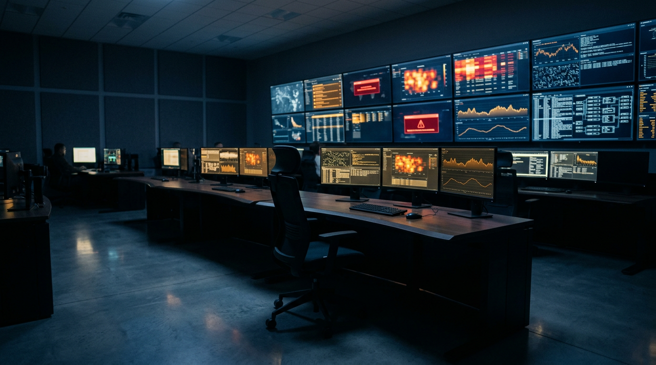
02 · THE PROBLEM
Cybersecurity is no longer a single-alert problem
Alert volume is exploding
Teams face more events than humans can review in time.
Threats move across systems
An IP, a login, a file, and a network spike may be one attack.
Intelligence arrives too late
Known threat data often sits outside the SOC workflow.
Tools do not talk to each other
SIEM, TI feeds, and response playbooks stay isolated.
VRINDHA AI · Intelligent Cybersecurity & SOC System
03 / 16
Notes:
Cybersecurity today is not a shortage of tools. It is a shortage of coordination. Attacks move faster than isolated dashboards. A SOC — a Security Operations Center — is the team that watches alerts and investigates incidents. At scale, that work becomes overwhelming.

Slide 4
03 · WHY SCALE BREAKS TRADITIONAL SOCS
Traditional SOC operations struggle at scale
A SOC is the security control room. At scale, the room fills faster than people can decide.
01
02
03
Too many alerts
Slow correlation
Isolated tools
Analysts spend hours triaging noise instead of investigating real incidents.
Connecting an alert to a known threat still depends on manual lookup.
SIEM, threat feeds, and response systems do not share a common intelligence layer.
04
05
06
Knowledge walks away
Fatigue and delay
Weak feedback loop
Lessons from past incidents stay in tickets, chats, or one analyst’s memory.
The more the environment grows, the longer it takes to understand what matters.
Yesterday’s incident rarely improves tomorrow’s detection automatically.
VRINDHA AI · Intelligent Cybersecurity & SOC System
04 / 16
Notes:
Why do traditional SOC operations become difficult at scale? Because the work is still mostly sequential and human-limited: see an alert, search another system, check a threat feed, write notes, then decide. When telemetry multiplies, that chain breaks. We needed a coordinated intelligence layer — not another isolated detector.

Slide 5
04 · THE PROJECT
Introducing Vrindha AI
Vrindha is a defensive cybersecurity platform that helps a SOC investigate, correlate, and respond — with specialized AI roles working as one organization.
1
Detect
2
Understand
3
Coordinate
4
Recommend
Watch telemetry, logs, and infrastructure for suspicious activity.
Check whether an indicator is known and what it means.
Share context across SOC, threat intelligence, and risk.
Prepare a defensive response for a human to approve.
The key innovation of our project is not “AI detects attacks.”
It is the coordination of multiple specialized AI capabilities — with accountability.
VRINDHA AI · Intelligent Cybersecurity & SOC System
05 / 16
Notes:
This is Vrindha AI. Instead of treating cybersecurity tools as isolated systems, we are creating a coordinated intelligence layer. Vrindha assists SOC operations, threat intelligence, investigation, risk analysis, and defensive response. It is designed to amplify cybersecurity professionals — not replace them.

Slide 6
05 · OPERATING MODEL
How Vrindha works
A simple loop. Every step feeds the next.
1
Detect
2
Understand
3
Correlate
4
Analyze
SOC sees suspicious activity
Threat Intelligence checks the indicator
Events from many systems are linked
Risk engine scores severity
5
Recommend
6
Approve
7
Defend
8
Learn
SOC Analyst AI investigates
Human authorizes high-impact action
Commander AI coordinates response
Knowledge AI stores lessons
VRINDHA AI · Intelligent Cybersecurity & SOC System
06 / 16
Notes:
Security telemetry arrives. The SOC detects suspicious activity. Threat Intelligence checks whether the indicator is known. The risk engine evaluates severity. The SOC Analyst AI investigates. Commander AI coordinates the response. A human administrator approves high-impact actions. Then the system stores the incident and learns. Detect. Understand. Correlate. Analyze. Recommend. Human approval. Defend. Learn.

Slide 7
06 · INTEGRATION
SOC + Threat Intelligence, working as one
Threat Intelligence is the process of collecting and understanding information about cyber threats so the organization can recognize attacks faster.
SOC · Security Operations
TI · Threat Intelligence
Watches the environment
Explains what the signal means
▸ Collects logs, alerts, and telemetry
▸ Identifies indicators of compromise (IOCs)
▸ Flags suspicious activity in real time
▸ Checks if an IP, domain, or file is known-bad
▸ Correlates security events
▸ Tracks emerging campaigns and actors
▸ Assists human analysts during incidents
▸ Shares useful intelligence back to the SOC
VRINDHA AI · Intelligent Cybersecurity & SOC System
07 / 16
Notes:
A SOC watches what is happening inside the organization. Threat Intelligence explains whether that activity is known in the wider threat landscape. An indicator of compromise — an IOC — is a clue such as a malicious IP or file hash. When these two work together, a suspicious IP is no longer just an alert. It becomes context: known actor, known campaign, known risk.

Slide 8
07 · ARCHITECTURE
Specialized AI modules — one organization
Commander AI
Threat Intelligence AI
SOC Analyst AI
Data Science AI
Oversees the system, coordinates information, and directs defensive response.
Collects threat data, identifies IOCs, and shares useful intelligence.
Investigates alerts, correlates events, and recommends response steps.
Analyzes security data and improves anomaly detection and risk models.
Infrastructure AI
Knowledge AI
Ethics & Compliance AI
Monitors servers, databases, networks, and service health.
Stores procedures, past incidents, and lessons learned.
Checks authorization, policy, and ethical limits before action.
VRINDHA AI · Intelligent Cybersecurity & SOC System
08 / 16
Notes:
Vrindha is not one model doing everything. Commander AI oversees. Threat Intelligence AI collects and explains threats. SOC Analyst AI investigates. Data Science AI improves detection. Infrastructure AI watches systems. Knowledge AI remembers incidents. Ethics and Compliance AI prevents inappropriate autonomous decisions. Each has a role. Together they form a team.

Slide 9
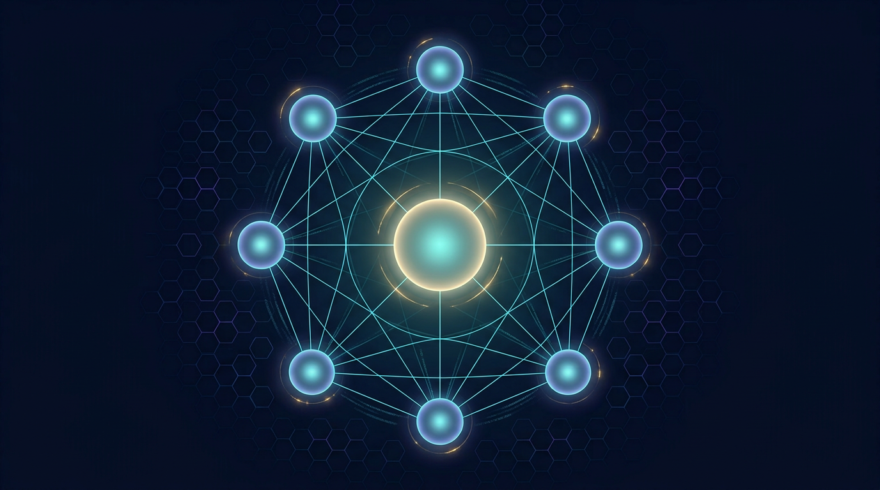
08 · CENTRAL INTELLIGENCE
Hive intelligence — a coordinated team
Each AI has a specific responsibility. They communicate. The center correlates.
Correlate events from multiple systems
Detect emerging attack patterns
Share defensive intelligence
Improve models using historical incidents
Generate situation reports for administrators
Recommend response strategies to humans
VRINDHA AI · Intelligent Cybersecurity & SOC System
09 / 16
Notes:
The system works like hive intelligence — a coordinated team of specialized agents. Information from one module improves another. A suspicious IP found by the SOC is sent to Threat Intelligence. If it is a known threat, the risk score rises. The Analyst AI investigates related events. Commander AI coordinates. Knowledge AI stores the lesson. That is how the hive learns.

Slide 10
09 · FUTURE NETWORK
A distributed, authorized cybersecurity network
Authorized computers can join the organization. This is not designed for unauthorized access.
Telemetry
Logs & alerts
Threat intel
Security signals from member systems
What each node is seeing
Indicators and campaign data
Detection rules
Model updates
Incidents
Shared defensive knowledge
Safer improvements over time
Lessons that raise the whole hive
Participation is voluntary · authorized · authenticated · encrypted · audited
VRINDHA AI · Intelligent Cybersecurity & SOC System
10 / 16
Notes:
The future vision is a network of authorized computers. Each member can contribute telemetry, logs, threat intelligence, malware indicators, detection rules, model updates, and incident information. The central AI correlates that information and sends useful defensive intelligence back. Participation is voluntary, authorized, authenticated, encrypted, and audited. This is not unauthorized access to computers.

Slide 11

10 · SAFETY PRINCIPLE
Ethics, authorization, and human approval
Vrindha can detect, analyze, investigate, recommend, and prepare a response. Important actions remain under human authorization.
Defensive by design
Vrindha is not built to autonomously launch attacks or run unauthorized offensive operations.
High-impact needs a human
Blocking, containment, and any action with real consequence requires approval.
Intelligence without control is dangerous
That is why human authorization is a core part of our architecture.
VRINDHA AI · Intelligent Cybersecurity & SOC System
11 / 16
Notes:
The most important safety principle: Vrindha is designed primarily for defensive cybersecurity. It should not autonomously launch attacks or perform unauthorized offensive operations. For high-impact actions, human approval remains required. We are not building an uncontrolled autonomous hacker. We are building an AI-assisted cybersecurity organization with accountability and safety controls.

Slide 12
11 · DIFFERENTIATION
What makes Vrindha innovative
The innovation is not “AI detects attacks.” The innovation is coordination.
COMMON APPROACH
VRINDHA APPROACH
Isolated tools
Coordinated intelligence
Each product sees only its own slice of the problem.
SOC, TI, risk, and response share one loop.
One-shot detection
Detect → Learn cycle
A model fires an alert and the story ends there.
Every incident can raise future detection quality.
Manual stitching
Specialized roles
Humans copy context from one screen to another.
Each AI does one job well, then reports to the hive.
No shared memory
Human remains accountable
Incidents do not reliably improve the next detection.
Recommendation is automated. Authority is not.
VRINDHA AI · Intelligent Cybersecurity & SOC System
12 / 16
Notes:
What makes Vrindha different is the coordination of specialized AI capabilities. A suspicious IP detected by the SOC can be sent to Threat Intelligence. Threat Intelligence can determine whether that IP is associated with a known threat. The risk engine can then raise or lower the score. The SOC Analyst AI investigates related events. Commander AI coordinates. The system stores the incident and uses the lesson to improve future detection.

Slide 13
12 · ROADMAP
Future scope
01
02
03
Richer hive
Better models
Authorized nodes
More specialized modules joining the same authorized event bus.
Data Science AI continuously improving anomaly and risk scoring from real incidents.
A growing network of voluntary, authenticated member systems.
04
05
06
Shared defense
Situation reports
Stronger audit
Detection rules and indicators flowing back to members safely.
Clear briefings for administrators, not only raw alerts.
Every recommendation and approval remains explainable and logged.
VRINDHA AI · Intelligent Cybersecurity & SOC System
13 / 16
Notes:
Looking ahead, Vrindha can grow as a coordinated organization: more authorized nodes, stronger models trained on historical incidents, richer situation reports, and safer distribution of defensive intelligence. The architecture is designed so new modules can join without bypassing safety, authorization, or human approval.

Slide 14
13 · WHY THIS MATTERS
Real-world impact
Faster understanding
Fewer missed connections
Safer response
Analysts spend less time stitching tools and more time deciding.
An alert is checked against known threats before it is dismissed.
Recommendations are prepared, but high-impact action stays authorized.
Institutional memory
Lower fatigue
Human amplification
Incidents become lessons the system can reuse.
Coordination reduces noise and highlights what is actually urgent.
Our goal is not to replace professionals. It is to amplify them.
VRINDHA AI · Intelligent Cybersecurity & SOC System
14 / 16
Notes:
In the real world, this means a SOC that understands faster, misses fewer connections, responds more safely, and remembers what it has already learned. We are not claiming a system that stops every attack. We are building a system that makes defensive teams stronger, calmer, and more accountable.

Slide 15
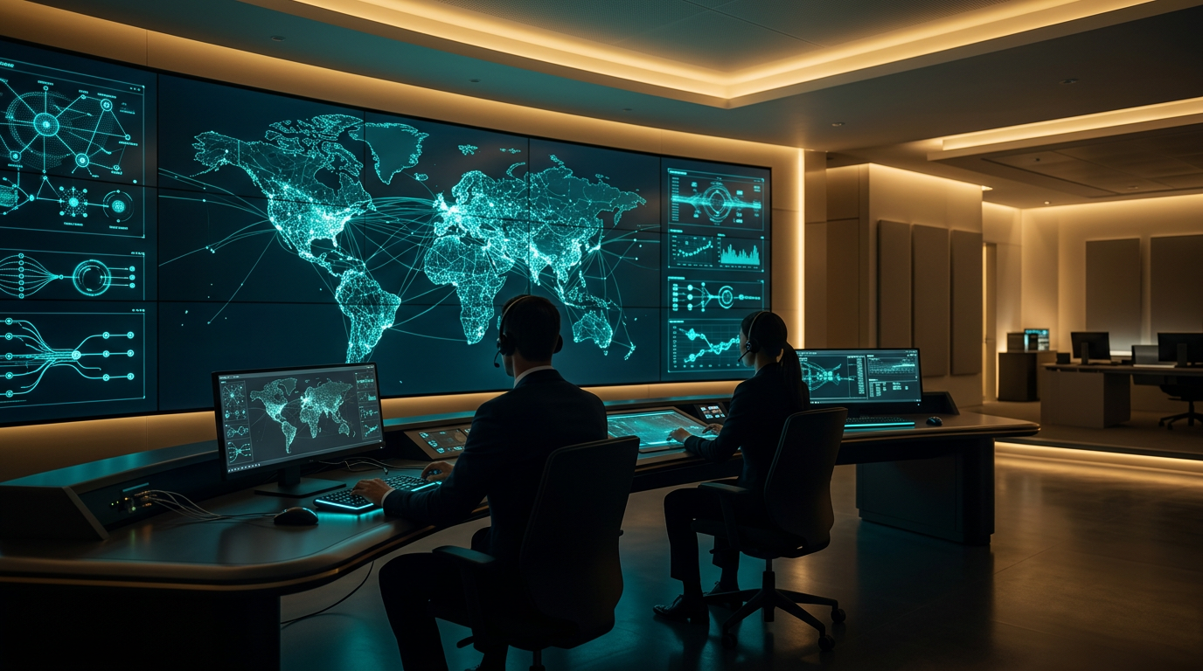
14 · CLOSING
The future is not humans versus AI
Our vision with Vrindha is not to build an AI that acts without limits. Our vision is to build an AI that understands threats, coordinates intelligence, assists humans, learns from incidents, and protects systems responsibly.
Because the future of cybersecurity is not humans versus AI.
It is humans and AI working together — with intelligence, authorization, and responsibility.
VRINDHA AI · Intelligent Cybersecurity & SOC System
15 / 16
Notes:
Our vision with Vrindha is not to build an AI that acts without limits. Our vision is to build an AI that understands threats, coordinates intelligence, assists humans, learns from incidents, and protects systems responsibly. Because the future of cybersecurity is not humans versus AI. It is humans and AI working together — with intelligence, authorization, and responsibility.

Slide 16
THANK YOU
Questions welcome.
Vrindha AI — defensive cybersecurity with coordinated intelligence and human authorization.
Detect → Understand → Correlate → Analyze
Recommend → Human Approval → Defend → Learn
Thank you, judges and audience.
Notes:
Thank you, honourable judges and the audience. We welcome your questions.

