Slide 1

IMDb: Top 400 Popular Movies Analysis
Aakash Perni
Enoch D

Slide 2
About Us
Background:
Name: Aakash
Qualification: BBA
Name: Enoch
Qualification: B.Tech

Slide 3
Content :
Introduction
IMDb in Brief
Problem Statement/Objective
Methodology
Website URL and Overview
Main DataFrame
Visualization & Insights
References
Conclusion

Slide 4

Introduction :
Movies have always been a source of entertainment, but they also have the power to influence our thoughts and shape our perspectives. That's why understanding the trends and patterns in the top 400 movies on IMBD can give us valuable insights into the film industry and society as a whole.

Slide 5
IMDb in Brief :
IMBD is a website that provides information about movies, TV shows, and celebrities. It has become a go-to source for movie enthusiasts and professionals alike, with millions of users visiting the site every day. The website allows users to rate and review movies, creating a database of the most popular films across different genres and time periods.

Slide 6
Problem Statement/Objective : Exploring Movie Data on IMDb: Uncovering Insights and Patterns in Film Industry.
Find the Top 10 and bottom 10 movies based on ratings.
Count of movies released across the years.
Top Actors based on ratings.
Top Directors based on ratings.
Demographic distribution.
Genre distribution.
Rating distribution.
Duration distribution.

Slide 7
Methodology :
Libraries used:
Numpy
Pandas
Matplotlib
Seaborn
Requests
Beautiful soup
RE (Regular Expressions)

Slide 8
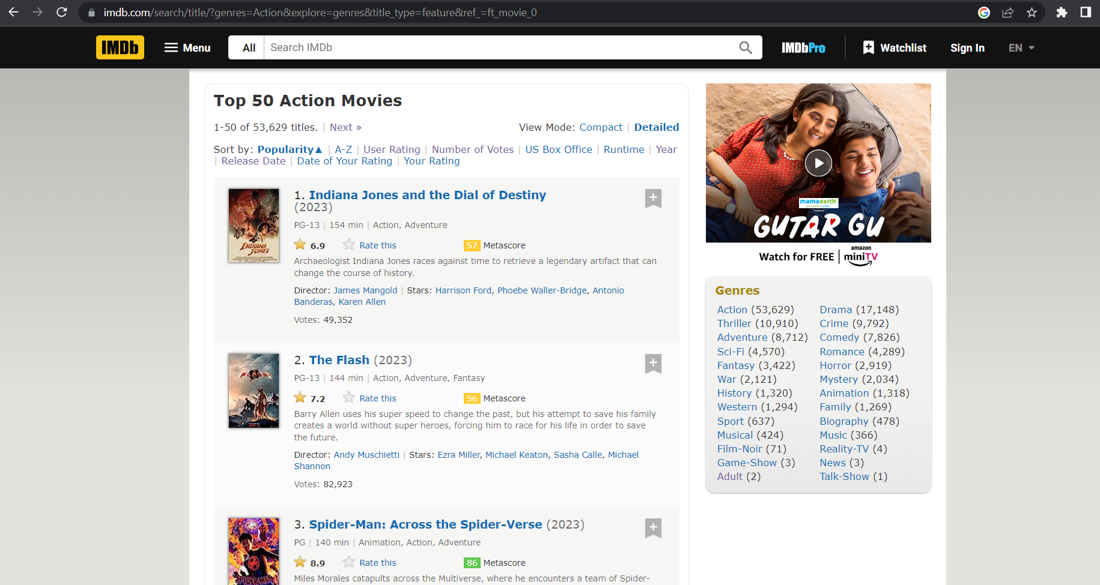
Website URL and Overview : URL : https://www.imdb.com/search/title/?genres=Action&explore=genres&title_type=feature&ref_=ft_movie_0

Slide 9
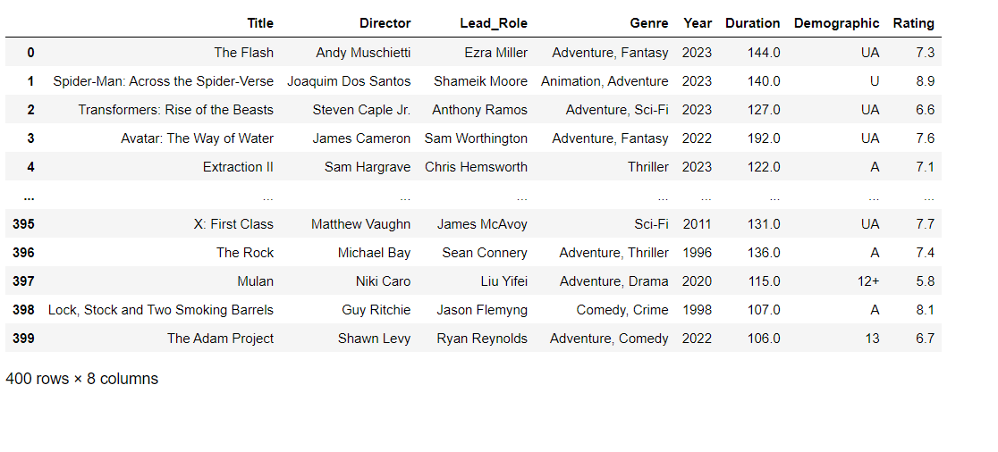
Main DataFrame :
t

Slide 10
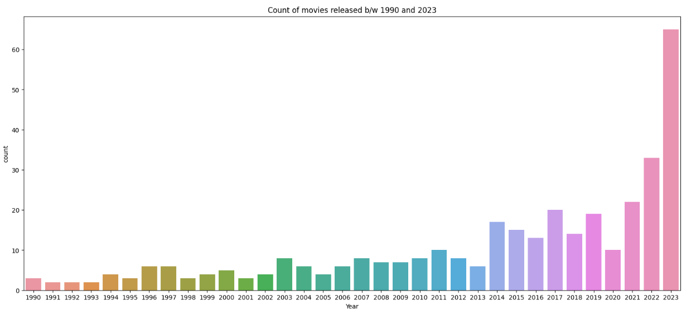
Visualization & Insights Univariate Plot (Count of movies released across the years)
Insight:
We observe that the most recent movies are the most popular.

Slide 11
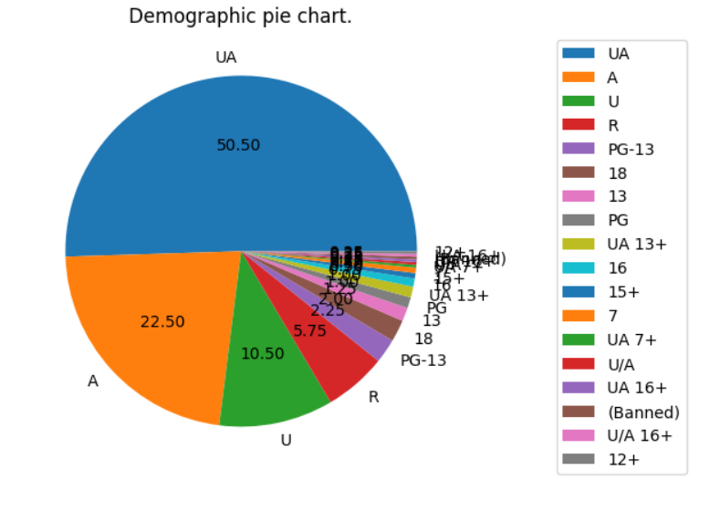
Demographic Pie chart
Insight:
The most popular demograpic rating for movies is ‘UA’.

Slide 12
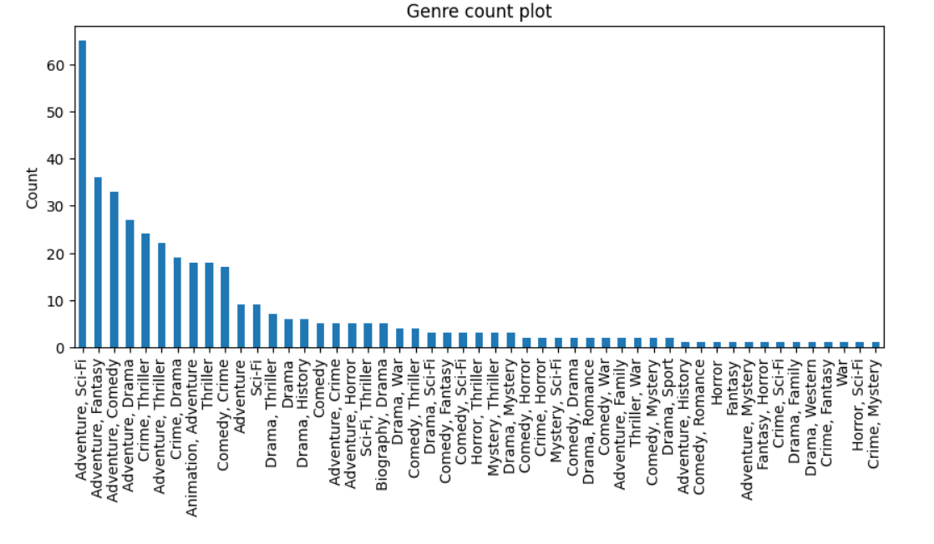
Genre Distribution
Insight:
The Adventure, Sci-Fi genre is the most popular genre

Slide 13
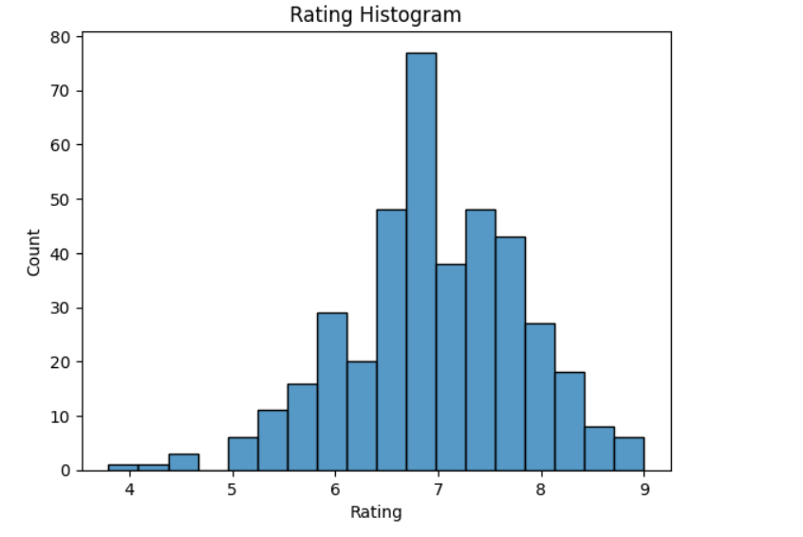
Rating Histogram
Insight:
The most number of movies lie between 6-7 Rating.

Slide 14
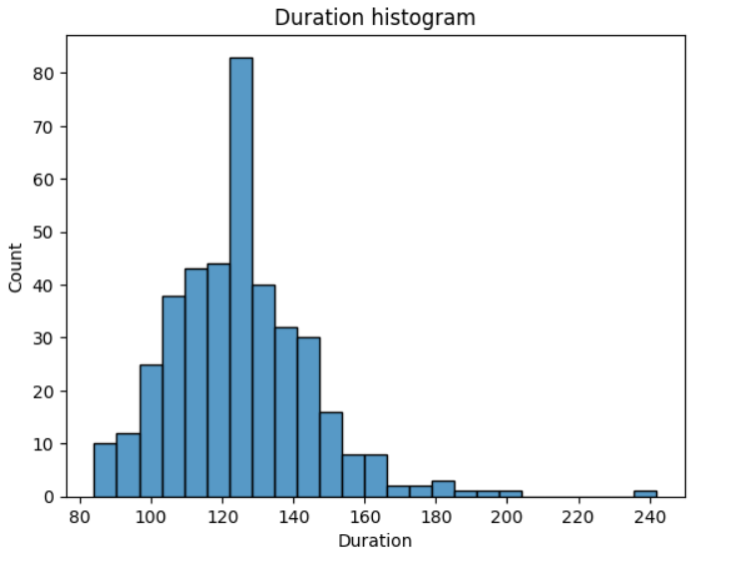
Duration Histogram
Insight:
Movies that are around 120-130 minuts or 2 hours are more popular.

Slide 15
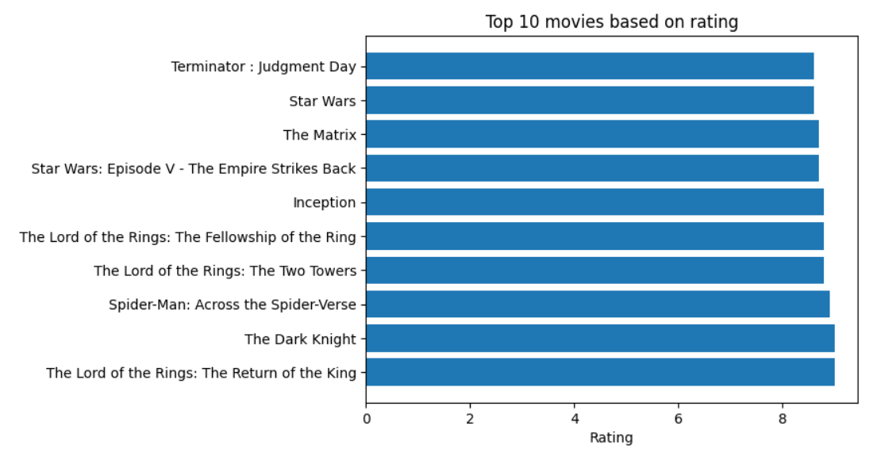
Bivariate Plots Top 10 movies Based on Rating

Slide 16
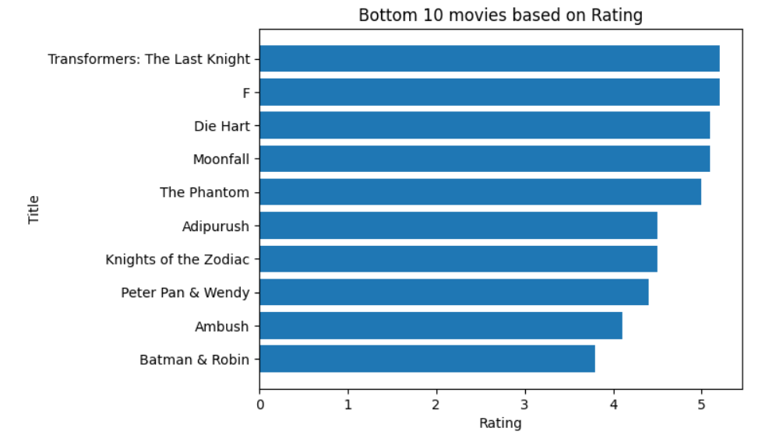
Bottom 10 movies based on rating.

Slide 17
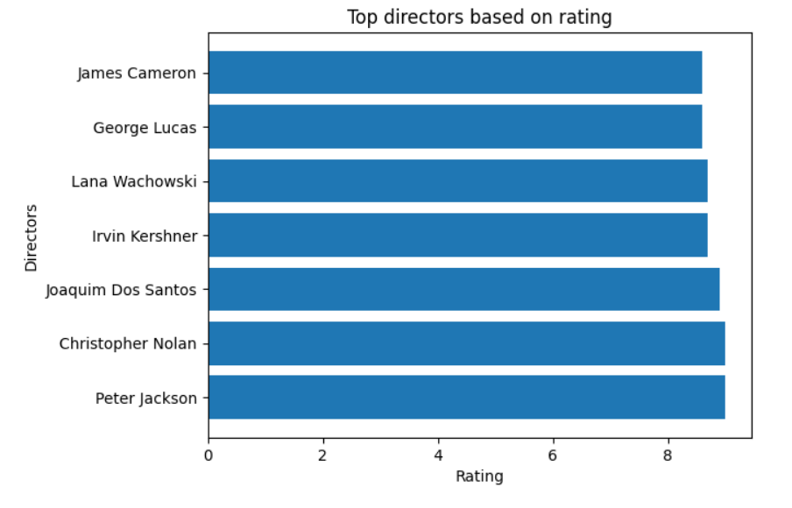
Top Directors based on rating
Insight: Peter Jackson is the highest rated director among the popular directors.

Slide 18
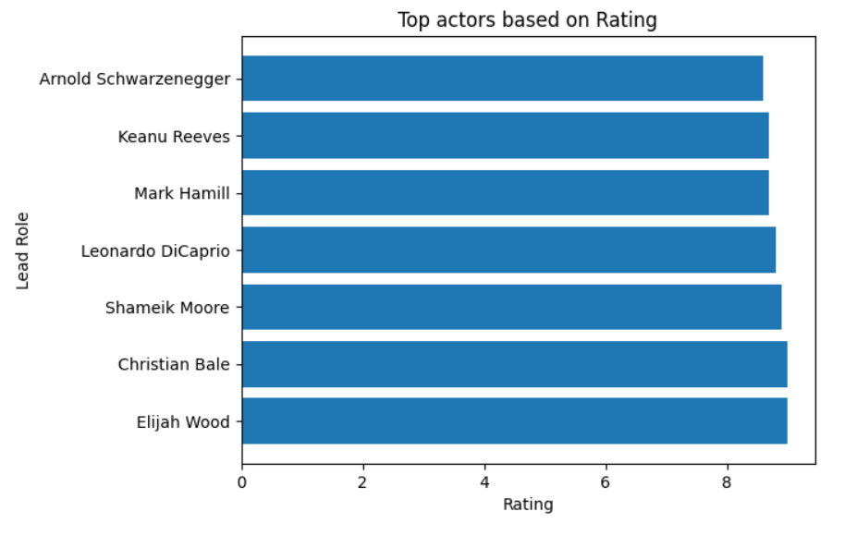
Top Actors based on Rating.
Insight:
Elijah Wood is the highest rated actor among the popular actors.

Slide 19
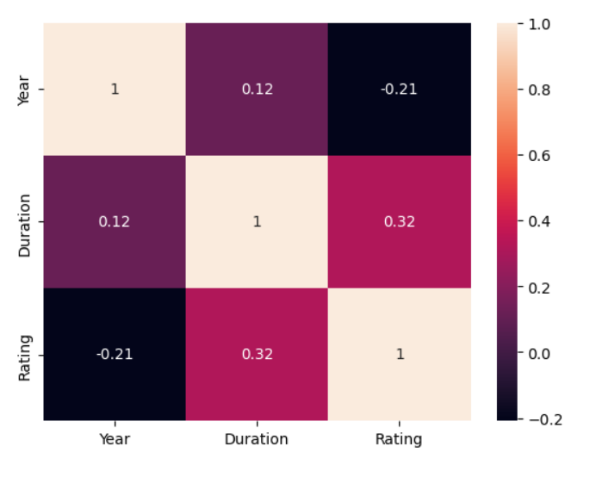
Multivariate Plot Heatmap of continuous data
Insight:
Year and Rating are negatively and weakly correlated.
Duration and Rating are positively and weakly correlated.

Slide 20
References :
https://www.imdb.com/search/title/?genres=Action&explore=genres&title_type=feature&ref_=ft_movie_0
https://cbfcindia.gov.in/cbfcAdmin/dashboard.php

Slide 21
Conclusion :
The IMBD Top 400 movies has revealed some fascinating trends and insights into the film industry. We have seen how certain Genres and demographic specific movies emerge at the top and do better than other movies. It is clear that the IMBD Top 400 movie analysis is an important tool for filmmakers, moviegoers, and anyone interested in the film industry. By understanding the trends and themes that emerge from this analysis, we can gain valuable insights into the art and business of filmmaking.

Slide 22

THANK YOU

