Slide 1
CoderZ

Slide 2
Aim:
The task of Your team is to create an efficient solution or application such that taken any two locations, the application should provide the shortest path distance between those two. the detailed image and distance depictions are portrayed in the below image as well as the description of the map. your application can be enhanced further as you wish (graphically or functionally ) provided the above required functionality is satisfied

Slide 3
Problem Identification
The main problem is to find the smallest distances from the starting node to any other node

Slide 4
Problem Solution
So we have created a user friendly web application to find the shortest distance between the two location By using Dijkstra’s Shortest Path Algorithm and we had implemented it

Slide 5
We step through Dijkstra's algorithm on the graph used in the algorithm above:
Initialize distances according to the algorithm.
Pick first node and calculate distances to adjacent nodes.
Pick next node with minimal distance; repeat adjacent node distance calculations.
Final result of shortest-path tree

Slide 6
Dijkstra’s Shortest Path Algorithm
Begin
create a status list to hold the current status of the selected node
for all vertices u in V do
status[u] := unconsidered
dist[u] := distance from source using cost matrix
next[u] := start
done
status[start] := considered, dist[start] := 0 and next[start] := φ
while take unconsidered vertex u as distance is minimum do
status[u] := considered
for all vertex v in V do
if status[v] = unconsidered then
if dist[v] > dist[u] + cost[u,v] then
dist[v] := dist[u] + cost[u,v]
next[v] := u done done End

Slide 7
Input − Total number of nodes n, distance list for each vertex, next list to store which node comes next, and the seed or start vertex.

Slide 8
Output − The shortest paths from start to all other vertices

Slide 10
Running the Application
You have to open the index file to run the apllication
Then select the two locations which u have to find the shortest distance
Then u will get answer
if u want to repeat the process just click on Reset button .

Slide 11
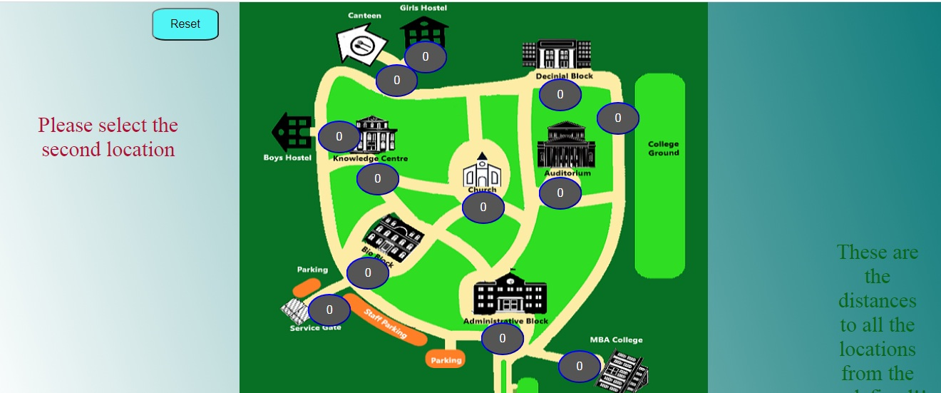
When we first enter into the web page , select the initial location

Slide 12
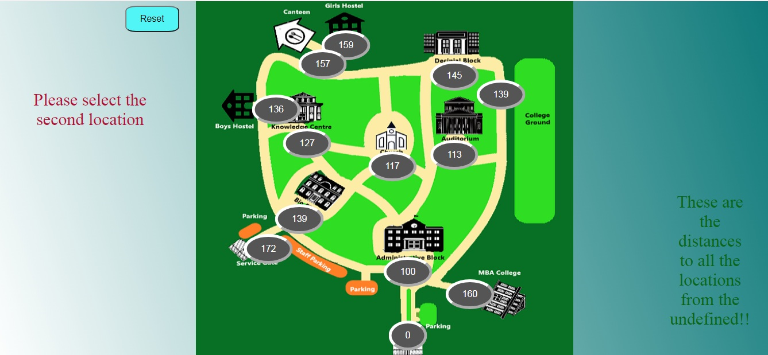
Then select the final location

Slide 13
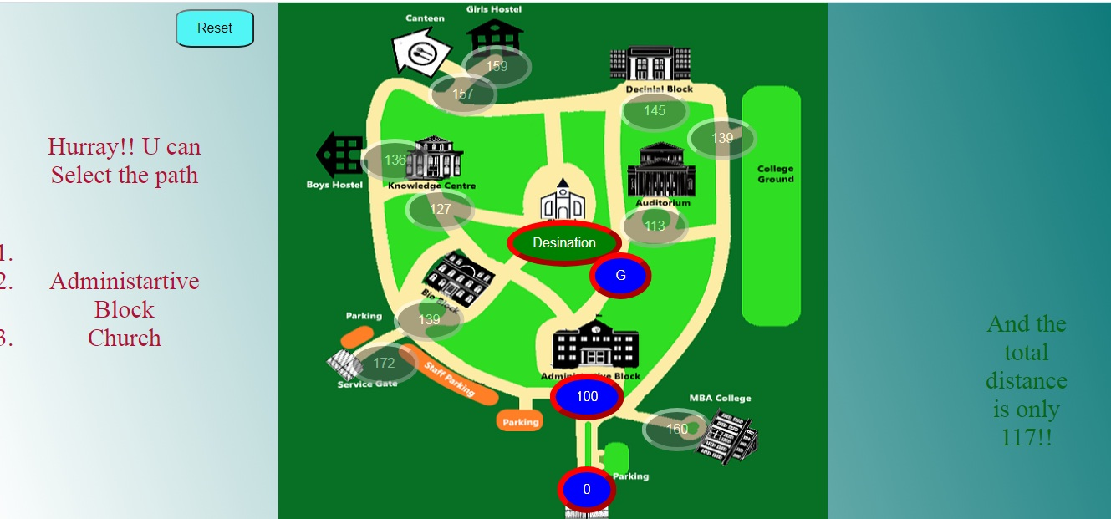
After both the selection of the location we will get the distance between the locations

Slide 14
Thank You

