Slide 1

AI Contract Hub
Bilingual Review of Service Agreements
Applied AI Agents for Legal Professionals
Presented by CAI5_IND6_G1, Group (2)
October 2026
AI-assisted analysis with qualified human legal review

Slide 2
Project idea
A structured starting point for legal review, delivered through Telegram
The Review Challenge
Proposed Solution
Time-consuming review
Human error and omissions
Misinterpretation
Understanding the issue
Precise alternative drafting
Limited productivity
Usability and prompting barriers
Upload a Service Agreement or paste a clause.
Receive a structured initial review with risks, contract references and proposed wording.
Distinctive Value
A 12-rule legal checklist, saved Arabic/English
preferences and original quotations with translations support a consistent review.

Slide 3
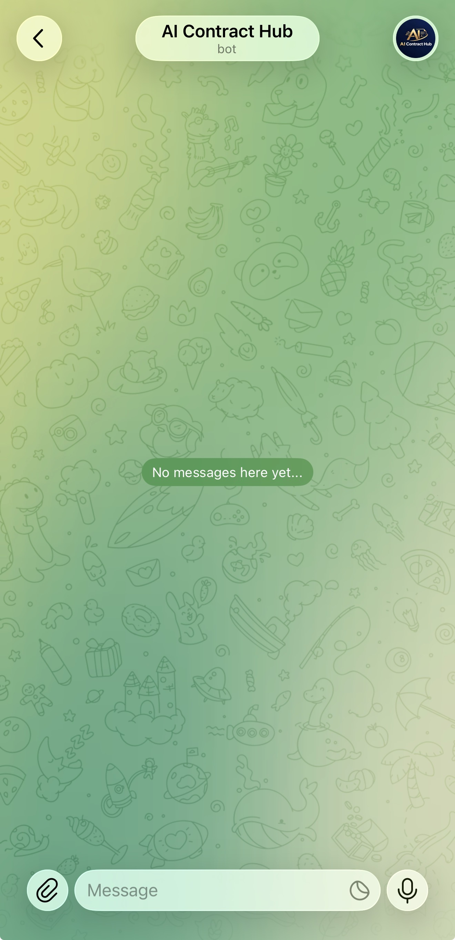
Project wireframe
Current Telegram interface and proposed web journey
Web interface prototype
01 SUBMIT
Arabic / English
PDF, DOCX or pasted text
Review perspective
Start review
02 REVIEW
Risk overview and findings
Original quote + translation
Suggested wording
Human review required
Choose language, submit, track processing, inspect findings.
Current bot entry screen

Slide 4
End users and features
Service Agreements and individual clauses, reviewed in Arabic or English
End user | Need | Feature and practical benefit
In-house counsel | Prioritize exposure | Risk ratings and clause references support negotiation priorities.
Law firm reviewers | Prepare first drafts | Checklist and suggested wording support lawyer verification.
Bilingual legal teams | Understand the text | Original quotes and translations make findings easier to understand.
Legal operations | Reduce routine work | File routing and split replies simplify preparation and delivery.

Slide 5
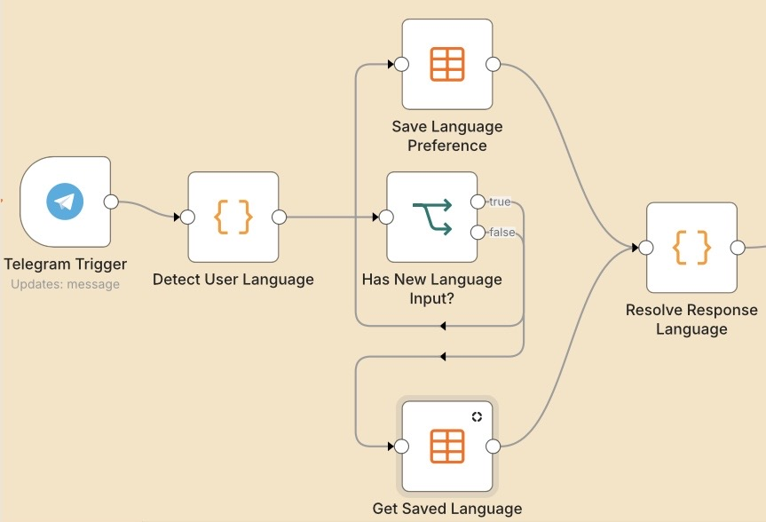
Data structure
Operational data in n8n, with a saved language preference for each chat
Data entity | Key fields / relationship
Chat preference | chat_id identifies the chat response_language stores its preference
Review input | A chat can submit multiple requests Input type, file or text, selected language
Review output | Linked to the current request Findings, risk levels, references, wording
Save or retrieve the chat language
Input enters the workflow, text reaches the
Agent, and the review returns to the chat.

Slide 6
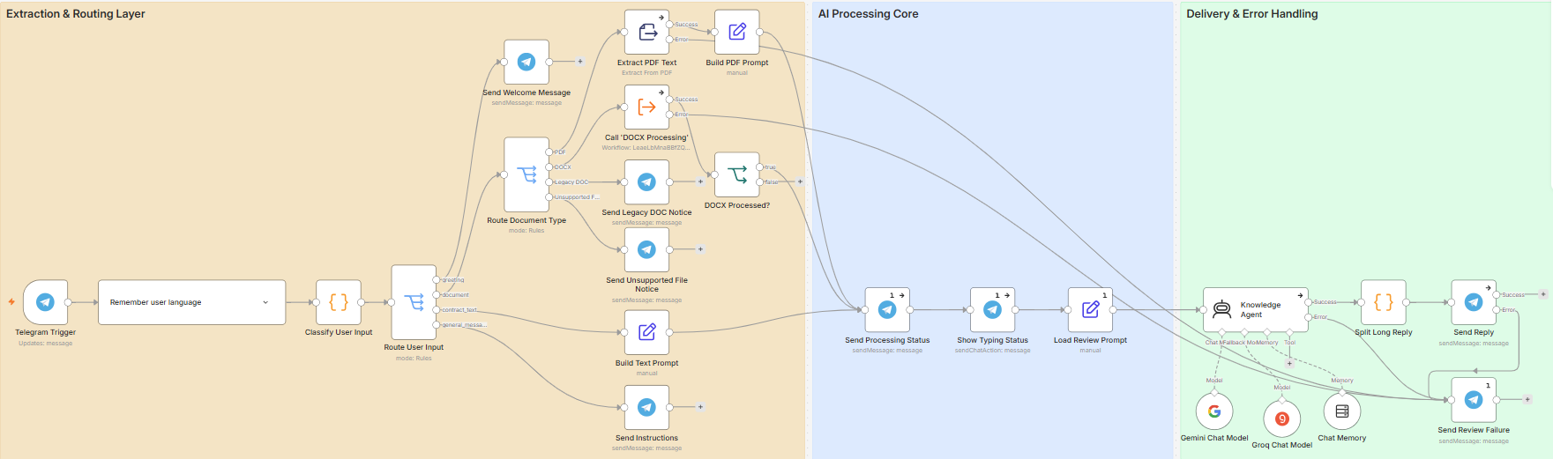
Programming languages and frameworks
n8n orchestrates the review workflow and supporting APIs
n8n + JavaScript
Telegram + model APIs
HTML, CSS, JavaScript
Routing, language logic
and response preparation
Bot interface, Gemini and
Groq model nodes
Web prototype, with no
backend integration yet

Slide 7
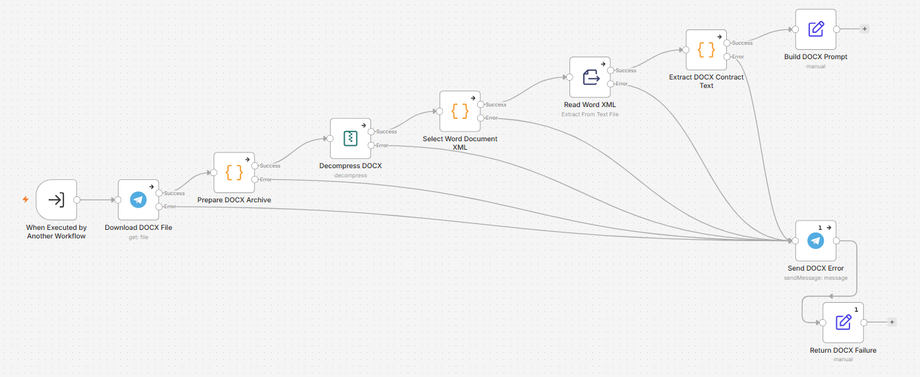
Live application and testing
Telegram capstone prototype is operational. The web interface is a separate demo.
Demonstration sequence
Testing status
1. Send an Arabic greeting.
2. Upload an anonymized PDF or DOCX.
3. Verify language, findings and references.
4. Check an unsupported-file response.
Development checks
Input routing, document extraction,
language persistence and error paths.
Before wider use
Record repeatable end-to-end tests
and lawyer-reviewed reference results.
Lessons from iteration
Language and node-reference fixes.

Slide 8
Deliverables and milestones
Project artifacts and the remaining handover steps
Milestone | Deliverable | Status / timing
Build | Telegram bot, n8n workflow and bilingual document review | Capstone implementation October 2026
Document | Paper, slides and workflow images | Prepared for submission
Demonstrate | Video, web UI/UX and frontend source | Prepared Verify links before submission
Handover | Sanitized workflow JSON, setup guide and documented test results | Verify before final handover
Extend | Web integration and evaluation | Future development Schedule to be agreed

Slide 9
Project team and roles
CAI5_IND6_G1, Group (2).
Team member | Project role | Key responsibility
Eman Mohamed Mahmoud Khodry | Legal review design | Checklist coverage and review criteria.
Ahmed Abdullah Ali Elbana | Workflow development | Routing and node integration.
Ahmed Saied Ali Elmezayen | Document processing | PDF extraction and DOCX handling.
Mazen Moustafa Elsayed Mohammed | Testing and quality | Test scenarios and error verification.
Mohamed Alm ElDin Ahmed Ammar | UI/UX and documentation | User journey and project materials.
Fady Medhat Beshay Ebrahim | Project Lead and integration | Project coordination, workflow architecture, prompt engineering, integration, and final quality review.

Slide 10
Thank you
Questions and feedback
AI Contract Hub
CAI5_IND6_G1, Group (2)
Project follow-up and materials
https://github.com/DEPI-5/AI-Contract-Hub

