Slide 1
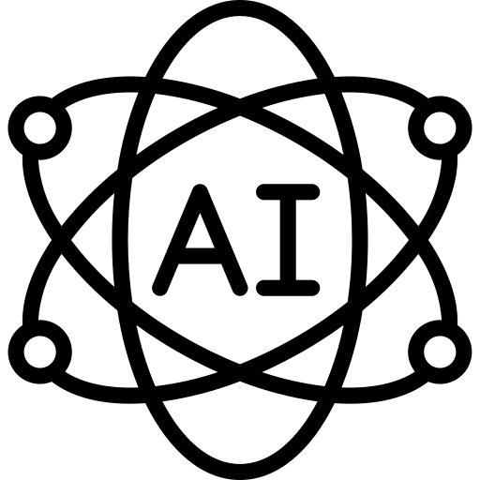










INSIGHT MINDS
AI-Powered Job Market Insights
Done by:
Reham Ayman
Sogoud Ahmed Moataz Samir
Elsayed Abdellatef
Youssef Mohammed
Supervised by: DR. Amal Mahmoud

Slide 2

INSIGHT MINDS
INTRODUCTION
This project analyzes the impact of Artificial Intelligence on the labor market using a simulated dataset of more than 500 job listings. It highlights automation risks, future growth trends, and emerging skill demands across industries.

Slide 3

INSIGHT MINDS
OBJECTIVES
TRENDS
Explore employment trends influenced by AI.
JOBS
Identify vulnerable job categories at risk of automation.
INSIGHTS
Provide insights for policymakers, companies, and professionals.
SKILLS
Highlight emerging skills needed in the workforce.

Slide 4
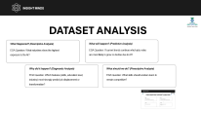
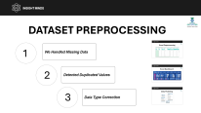
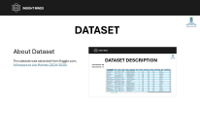
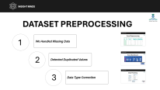
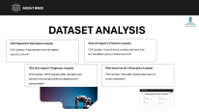
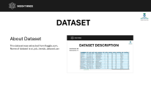
INSIGHT MINDS
METHODOLOGY
Dataset
About Dataset
Dataset Description
Data Preprocessing
Data Preparation.
Data Cleaning & Preprocessing.
Data modeling
Data Analysis
EDA
Data visualization

Slide 5
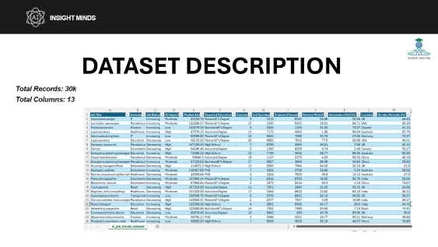
INSIGHT MINDS
DATASET
About Dataset
This dataset was extracted from Kaggle.com,
AI Impact on Job Market: (2024–2030)

Slide 6
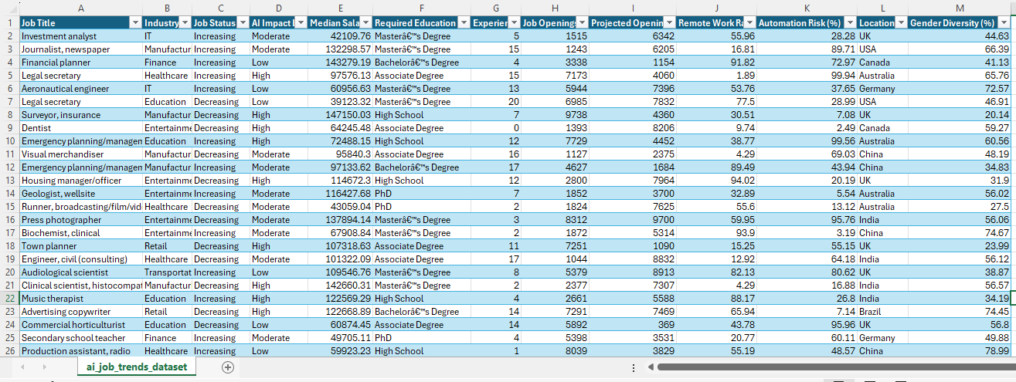
INSIGHT MINDS
DATASET DESCRIPTION
Total Records: 30k
Total Columns: 13

Slide 7
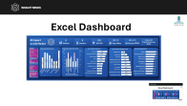
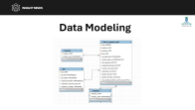
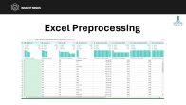
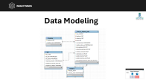
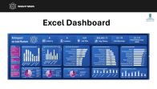
INSIGHT MINDS
DATASET PREPROCESSING
1
We Handled Missing Data
2
Detected Duplicated Values
3
Data Type Correction

Slide 8
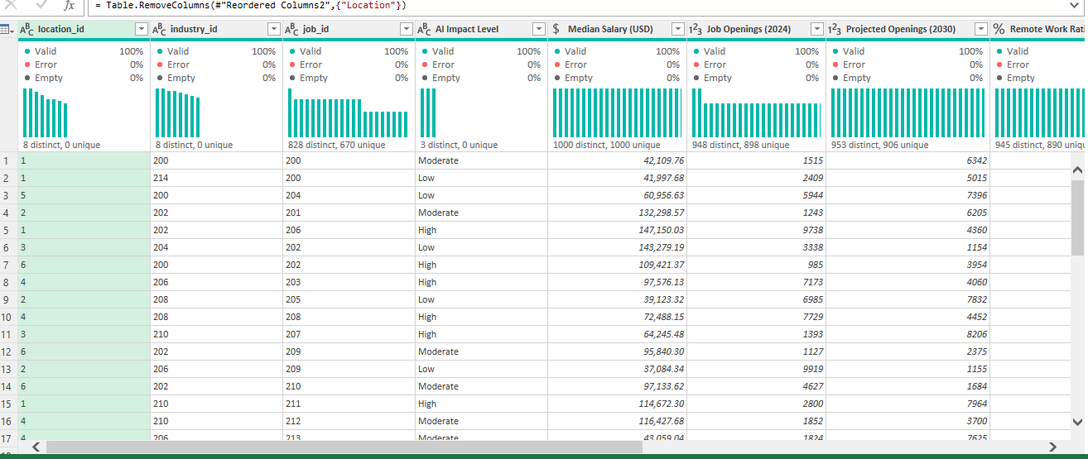
INSIGHT MINDS
Excel Preprocessing

Slide 9
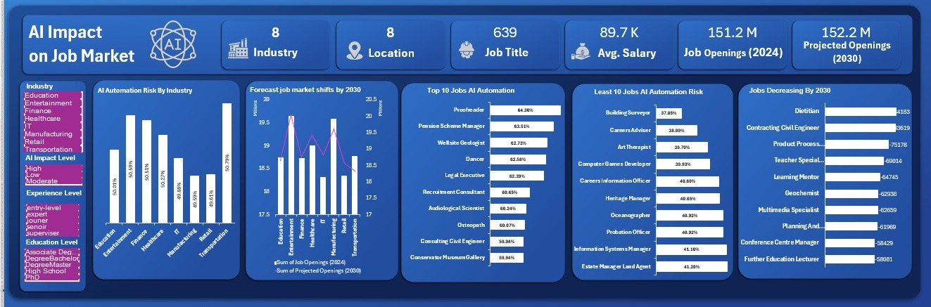
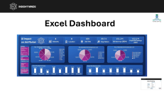

INSIGHT MINDS
Excel Dashboard

Slide 10
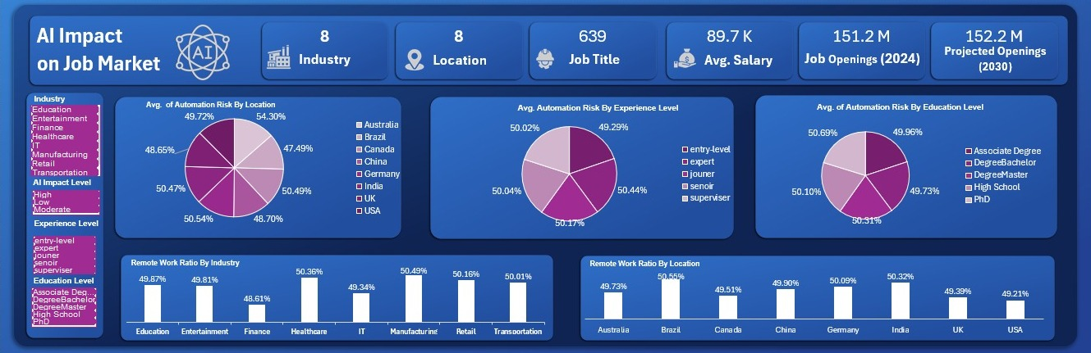


INSIGHT MINDS
Excel Dashboard

Slide 11
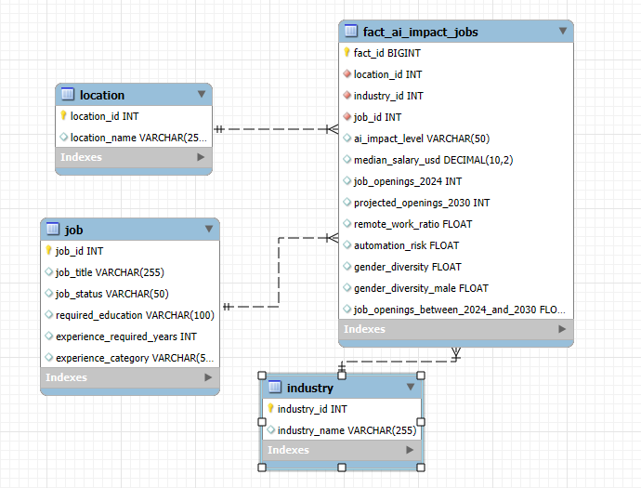


INSIGHT MINDS
Data Modeling

Slide 12
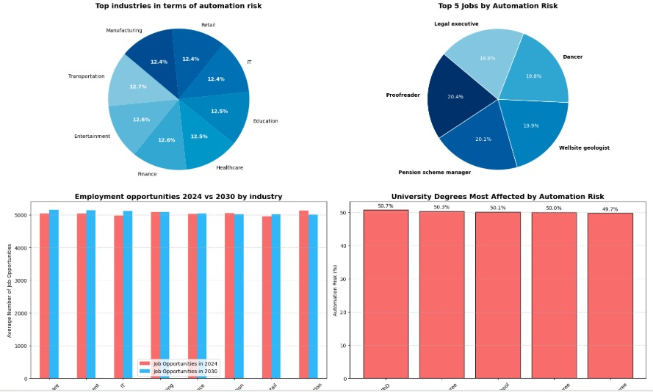


INSIGHT MINDS
Python Dashboard

Slide 13
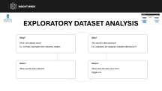
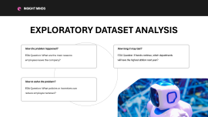
INSIGHT MINDS
DATASET ANALYSIS
What Happened? (Descriptive Analysis)
What will happen? (Predictive Analysis)
EDA Question: What industries show the highest exposure to the AI?
EDA Question: If current trends continue which jobs roles are most likely to grow or decline due to AI?
Why did it happen? (Diagnostic Analysis)
What should we do? (Prescriptive Analysis)
EDA Question: Which features (skills, education level, industry) most strongly predict job displacement or transformation?
EDA Question: What skills should workers learn to remain competitive?

Slide 14


INSIGHT MINDS
EXPLORATORY DATASET ANALYSIS
What?
Who?
What is the dataset about? Ex: Job roles, automation risks, industries, salaries.
Who does the data represent? Ex: Employees, job categories, industries affected by AI
When?
Where?
When was this data collected?
Where does this data come from?
Kaggle.com

Slide 15
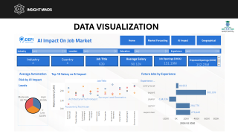
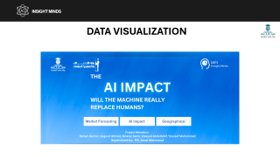
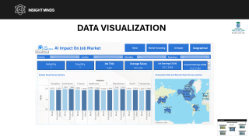
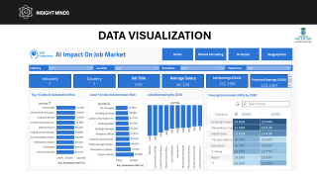
INSIGHT MINDS
DATA VISUALIZATION
TABLEAU

Slide 16
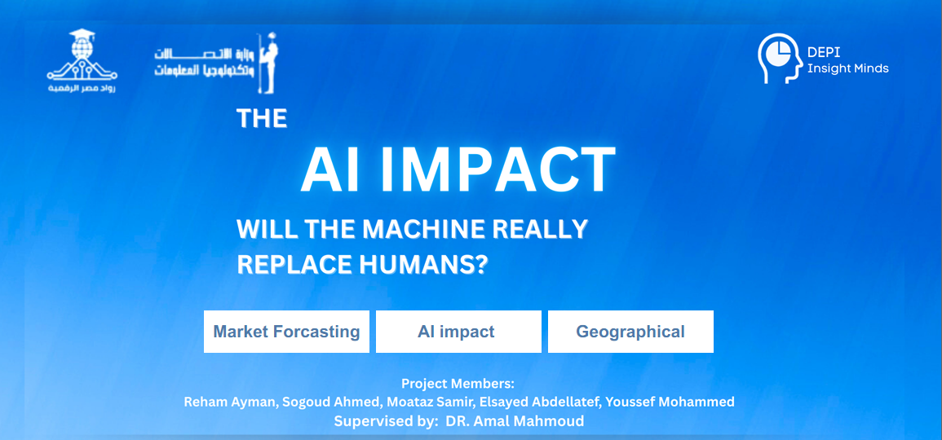
INSIGHT MINDS
DATA VISUALIZATION

Slide 17
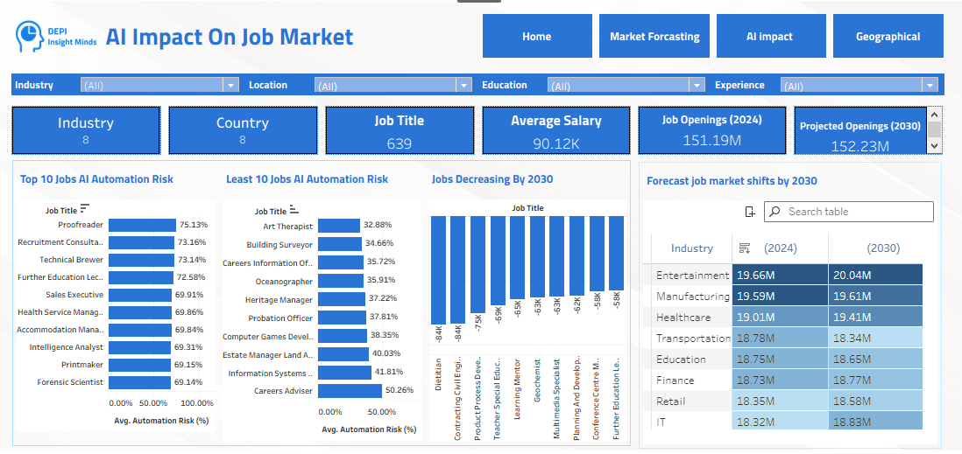
INSIGHT MINDS
DATA VISUALIZATION

Slide 18
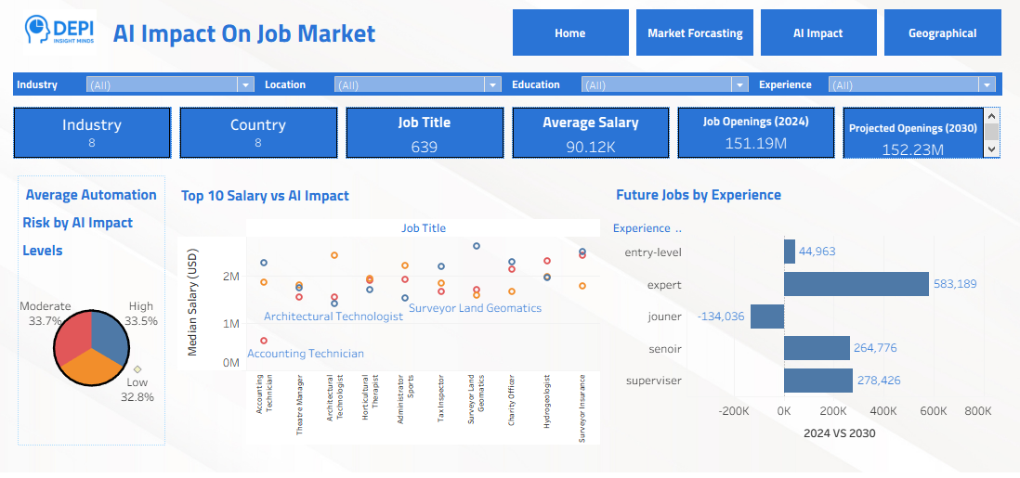
INSIGHT MINDS
DATA VISUALIZATION

Slide 19
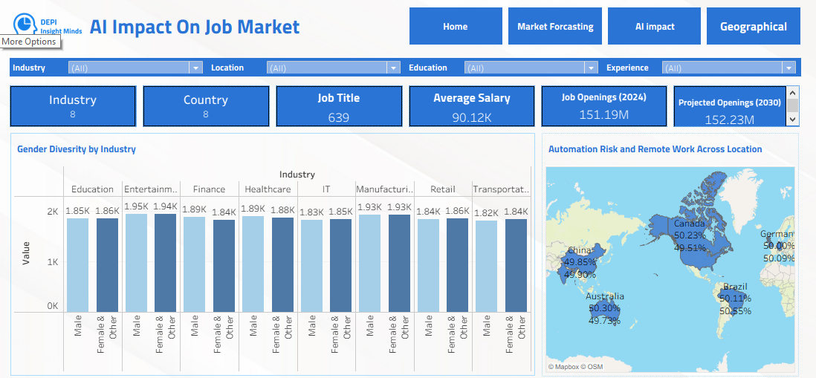

INSIGHT MINDS
DATA VISUALIZATION

Slide 20
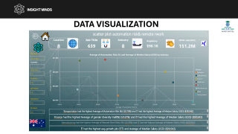
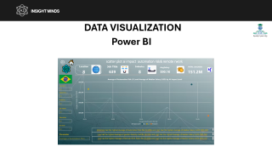
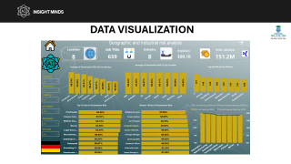
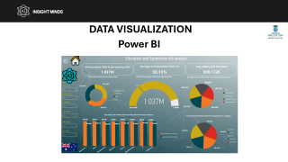
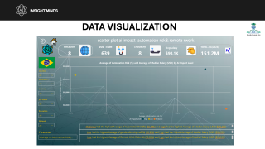
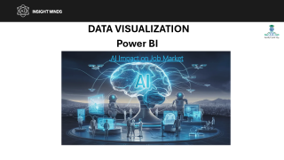
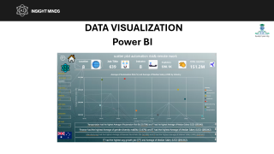
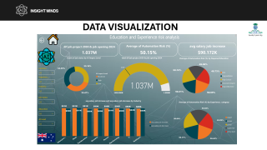
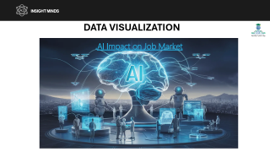
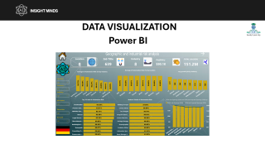
INSIGHT MINDS
DATA VISUALIZATION
Power BI

Slide 21
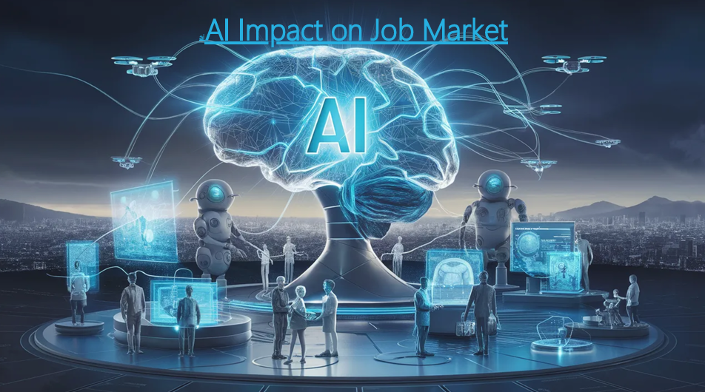
INSIGHT MINDS
DATA VISUALIZATION

Slide 22
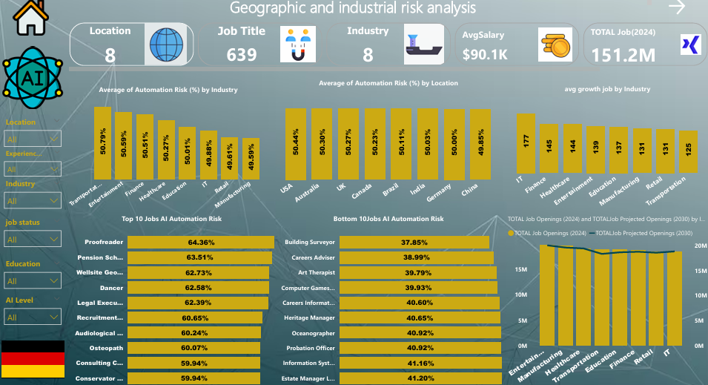
INSIGHT MINDS
DATA VISUALIZATION

Slide 23
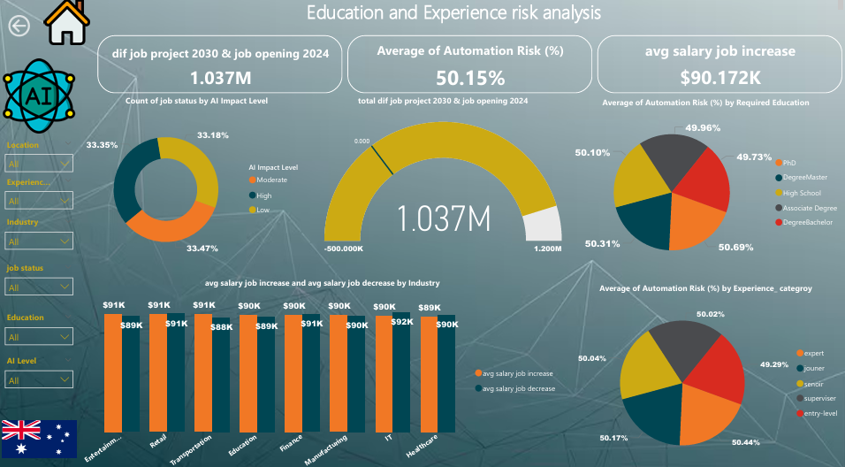
INSIGHT MINDS
DATA VISUALIZATION

Slide 24
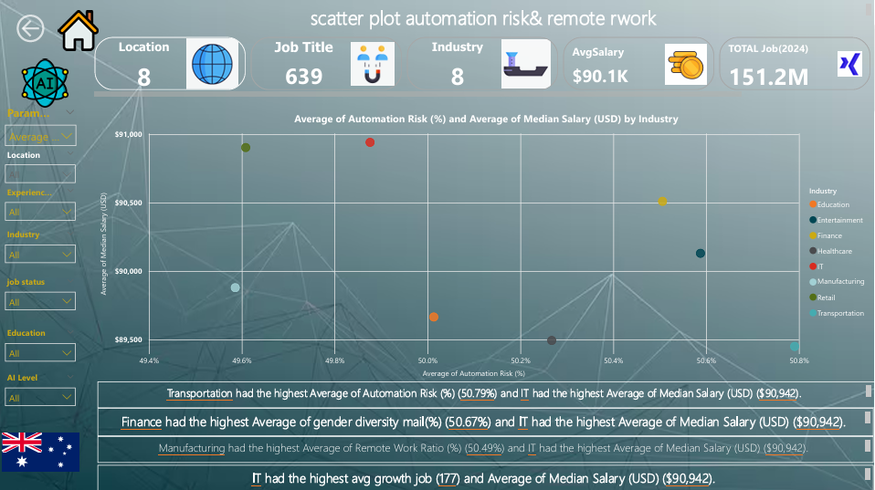
INSIGHT MINDS
DATA VISUALIZATION

Slide 25
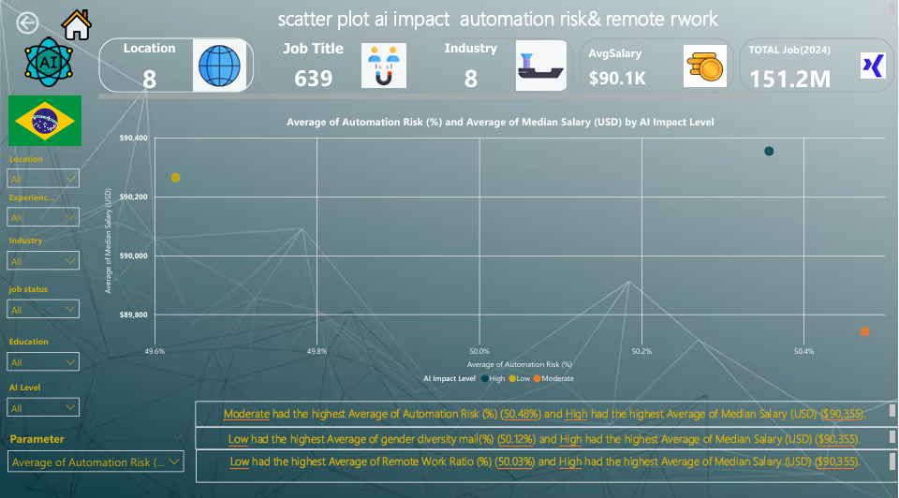
INSIGHT MINDS
DATA VISUALIZATION

Slide 26
INSIGHT MINDS
Conclusion
The analysis demonstrates that AI is reshaping the global job market through a balanced mix of automation, job shifts, and skill evolution. While certain job categories—particularly routine and operational roles—face high automation risk, the market remains stable overall, with projected openings showing only moderate change through 2030. Growth is concentrated in expert, supervisory, and high-skilled technical roles, reinforcing the increasing value of specialized expertise. Geographically, automation exposure is consistent across countries, indicating that AI’s impact is universal rather than region-specific. Industries such as entertainment, healthcare, education, and manufacturing are expected to experience steady growth, supported by evolving skill demands and technological integration. Overall, the findings highlight the need for continuous reskilling, stronger digital capabilities, and proactive market adaptation to ensure workforce readiness for the coming decade.

Slide 27
INSIGHT MINDS
Main Outcomes
1. AI Automation Risk
The job market shows balanced automation exposure, with risk levels distributed almost evenly across Low (32.8%), Moderate (33.7%), and High (33.5%) categories.
Certain roles—such as Proofreaders, Technical Brewers, Recruitment Consultants, and Sales Executives—face automation risks above 70%, indicating strong potential for AI-driven displacement.
In contrast, creative, specialized, and interpersonal roles (e.g., Art Therapists, Heritage Managers, Oceanographers) show significantly lower automation risk, mostly below 40%.
2. Job Demand Forecast (2024–2030)
Total job openings are projected to grow from 151.19M in 2024 to 152.23M in 2030, suggesting stable but slow market expansion.
Industries expected to grow most by 2030 include:
Entertainment (+0.38M)
Manufacturing (+0.02M)
Healthcare (+0.31M)
Education & Finance (moderate growth levels)

Slide 28
INSIGHT MINDS
Main Outcomes
3. Jobs Decreasing by 2030
Several roles show noticeable decline in demand, including Dietitians, Contracting Supervisors, Learning Mentors, and Manufacturing Specialists, with job losses ranging from 58K to 84K.
Declines are concentrated in roles with routine, manual, or repetitive task structures, reinforcing AI’s impact on operational positions.
4. Experience-Level Outlook
Expert-level roles experience the largest growth (+583K), reflecting increased demand for innovation-driven and decision-making positions.
Junior-level roles decline significantly (-134K), highlighting automation’s impact on entry-level and repetitive functions.
Supervisor and senior positions show moderate increases.

Slide 29
INSIGHT MINDS
Main Outcomes
5. Geographic Insights
Automation risk is relatively consistent globally, ranging between 49% and 51%, indicating AI’s universal market impact.
Countries like Canada, Brazil, Germany, China, and Australia display similar adoption and automation exposure rates.
6. Gender Diversity
Gender distribution remains balanced across industries, with male and female participation showing minimal variance, indicating that AI-driven shifts are industry-based rather than gender-based.

Slide 30
INSIGHT MINDS
Recommendations
1. Prioritize Reskilling and Upskilling
Invest heavily in training related to AI literacy, data analytics, automation tools, and digital workflows.
Industries with high automation risk should shift toward reskilling pathways to preserve employment levels.
2. Support Transition for High-Risk Occupations
Develop targeted programs for roles exceeding 70% automation risk, such as proofreading, sales, and administrative support.
Offer structured transition plans into emerging roles with lower automation exposure.
3. Strengthen Talent Pipelines for High-Growth Segments
Expand training for roles seeing high demand growth.
Encourage partnerships between governments, universities, and industries to align talent supply with market needs.

Slide 31
INSIGHT MINDS
Recommendations
4. Enhance Workforce Planning Through Data
Organizations should use forecasting models to predict skills shortages, job shifts, and market gaps.
Cluster analysis and predictive analytics can support smarter workforce planning.
5. Leverage AI as an Enabler, Not a Replacement
Encourage companies to adopt AI to augment employee productivity rather than replace roles.
Emphasize hybrid workflows where AI supports repetitive tasks while humans focus on strategic, creative, and customer-facing work.
6. Prepare Policy and Regulatory Frameworks
Governments should introduce policies supporting safe, ethical, and transparent AI adoption.
Incentives can help industries modernize without accelerating unemployment.

Slide 32

INSIGHT MINDS
Thank You

