Slide 1
Developing a Smart Office Network Solution
Mai Emad-Eldeen Mesllam
Manal Nabil Donia
Mohamed Hamza Ahmed

Slide 2
We propose a secure and scalable Smart Office Network for ByteWave Technologies, a software development company. The network is designed to: Ensure high performance and reliable connectivity Support IoT integration (smart lighting, climate control, security systems) Enhance productivity, collaboration, and employee comfort Provide advanced security (VPN, Zero Trust) Allow remote monitoring and future scalability
💡 Project Overview:

Slide 3
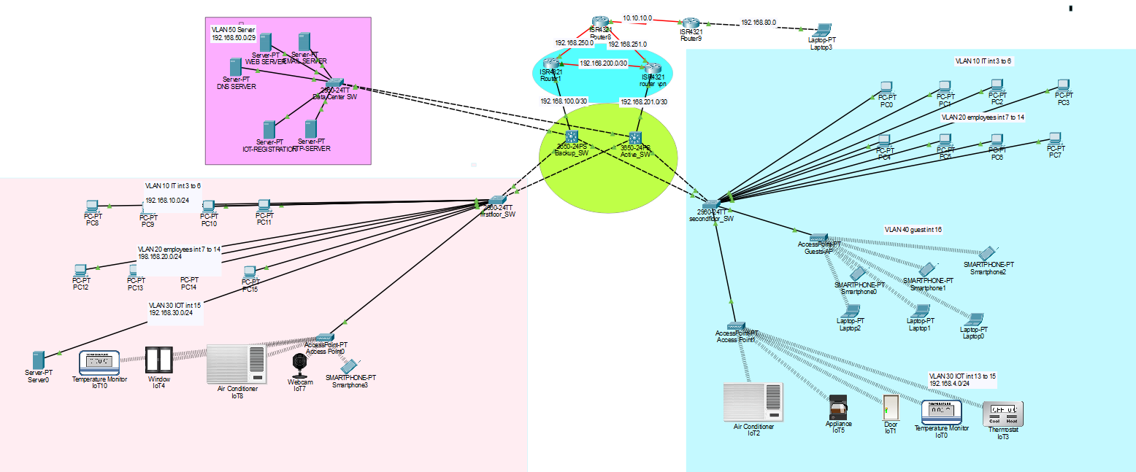
Network diagram

Slide 4
Topology Components
Component | Description
Core Layer 3 Switches | Handle inter-VLAN routing and HSRP
Access Layer 2 Switches | Connect end devices with VLAN tagging
Router | NAT, VPN termination, and ISP connectivity
IoT Devices | Smart lights, sensors, cameras
Wireless APs | Guest and employee wireless access

Slide 5
VLANS
VLAN ID | Name | IP Range | Purpose
10 | IT | 192.168.10.0/24 | IT PCs
20 | Employees | 192.168.20.0/24 | Office PCs & Phones
30 | IoT | 192.168.30.0/24 | Smart Devices
40 | Guest | 192.168.40.0/24 | Guest access
50 | Data Center | 192.168.50.0/24 | Servers

Slide 6
Protocols & Technologies
Technology | Purpose
VLANs | Traffic segmentation and security
HSRP | Gateway redundancy
SVIs (Layer 3 Switching) | Inter-VLAN routing
ACLs | Restrict unauthorized access
QoS | Prioritize VoIP and critical traffic
VPN | Secure remote access
OSPF | Routing protocol

Slide 7
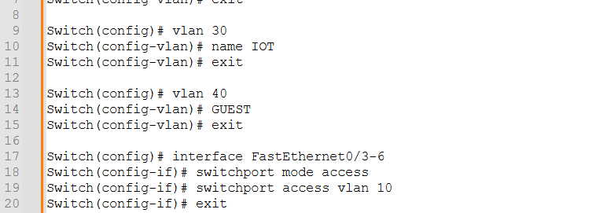
VLAN Configuration on sw layer2

Slide 8
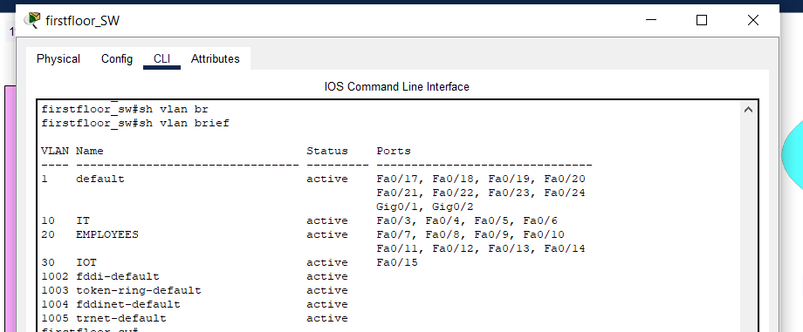
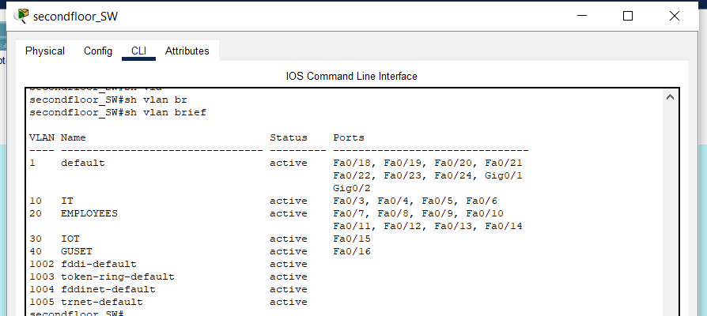
VLAN Configuration Verification: show vlan brief Output

Slide 9
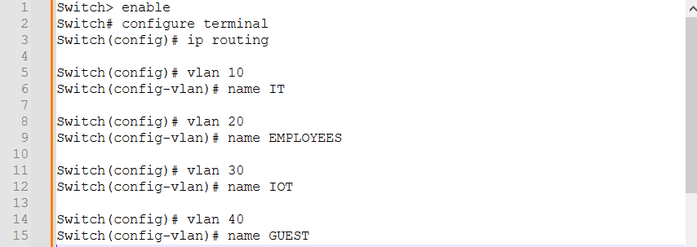
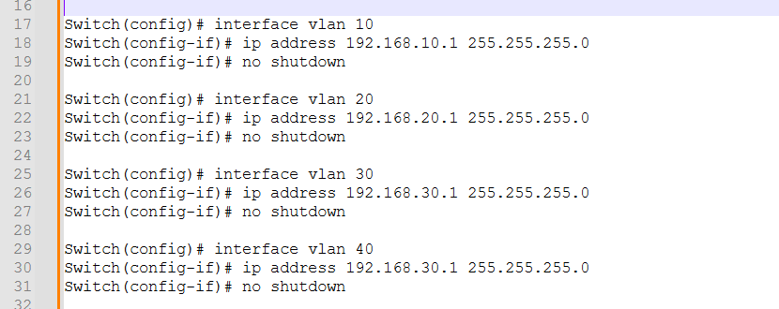
VLAN Configuration on sw layer3

Slide 10
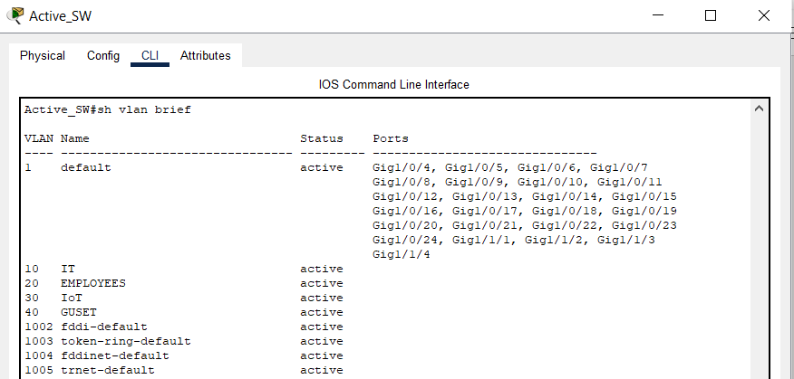
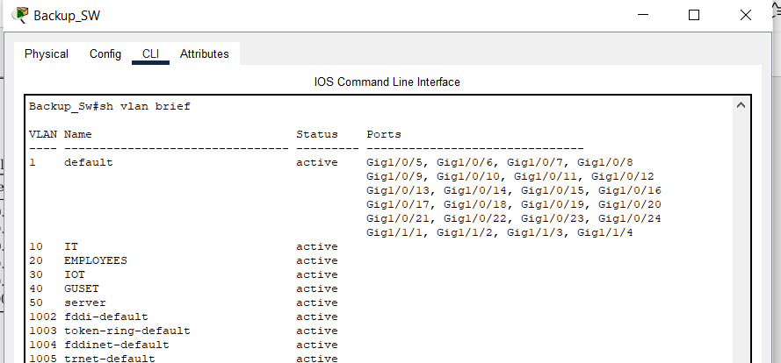
VLAN Configuration Verification: show vlan brief Output

Slide 11
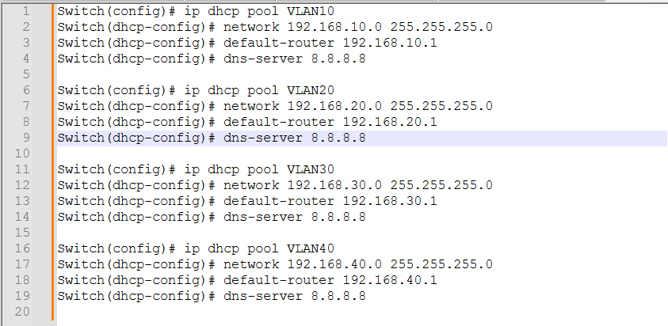
DHCP Server Configuration on Layer 3 Switch

Slide 12
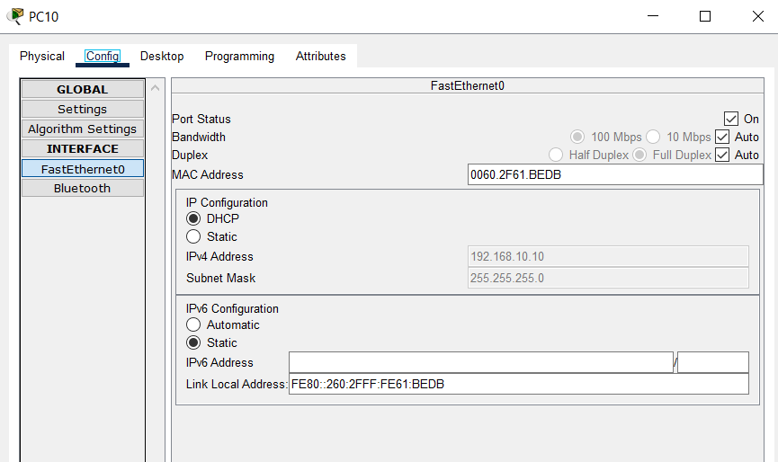
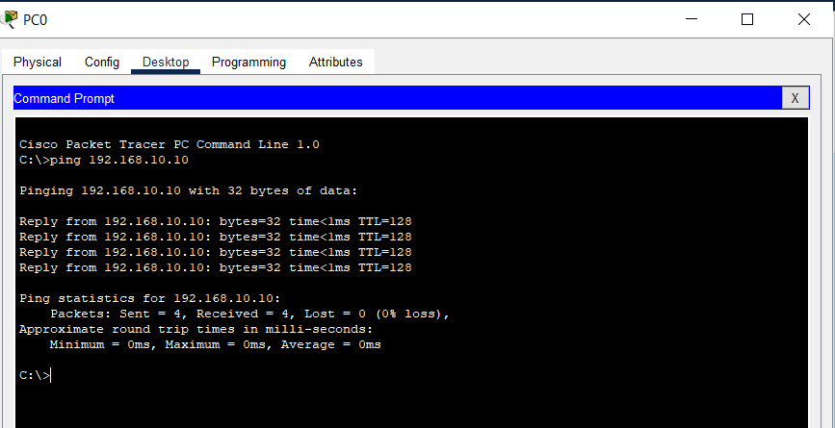
DHCP Connectivity Verification

Slide 13
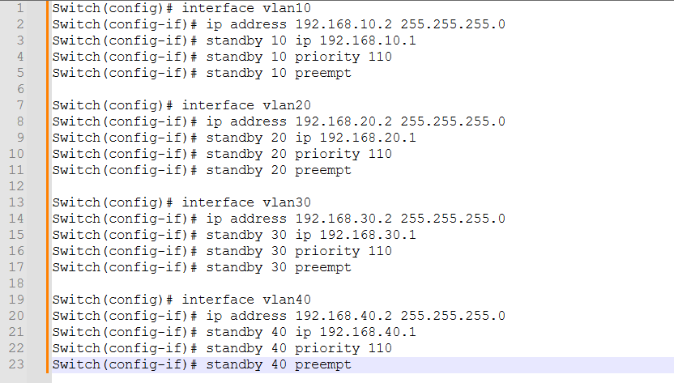
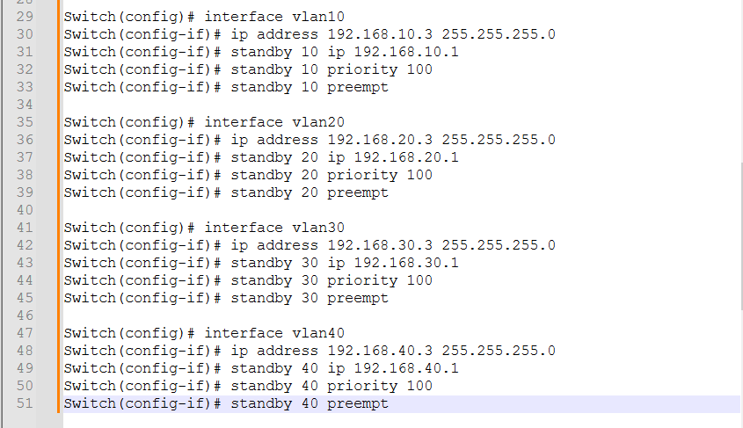
HSRP Implementation on Layer 3 Switches

Slide 14
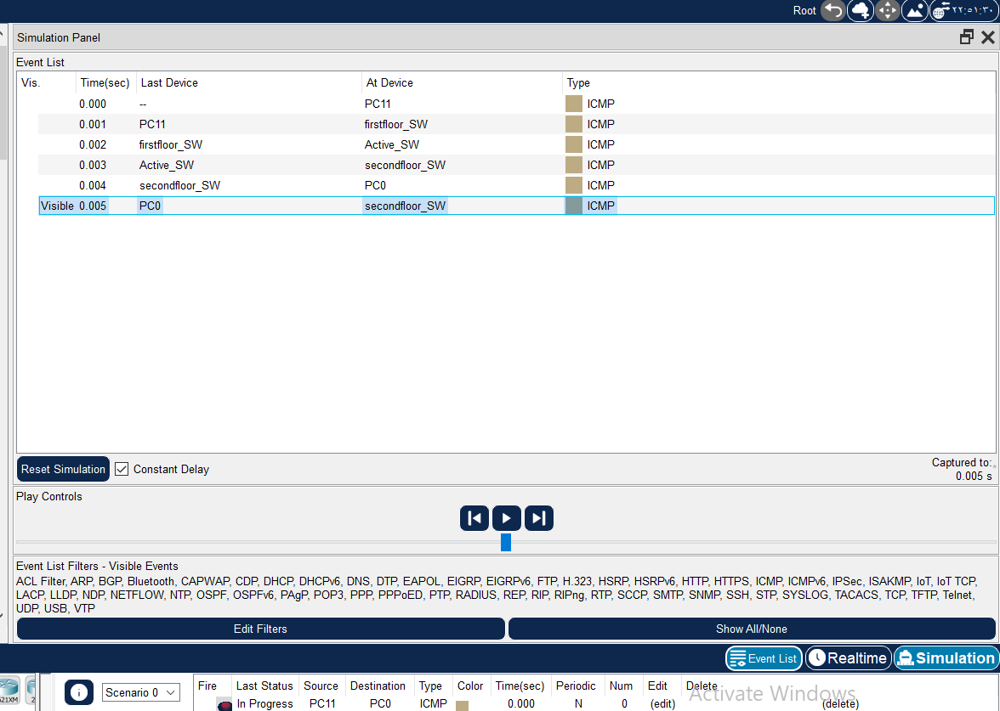
Validating HSRP Operation: Active/Standby Switchover

Slide 15
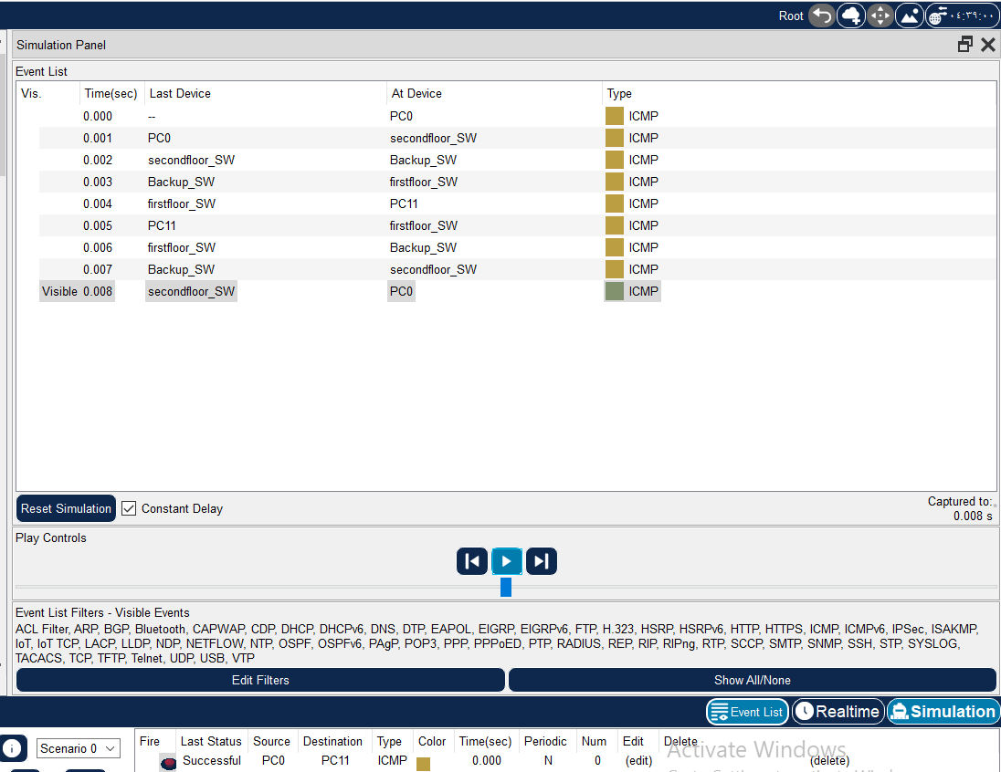
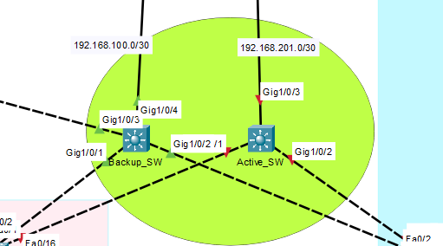
Validating HSRP Operation: Active/Standby Switchover

Slide 16
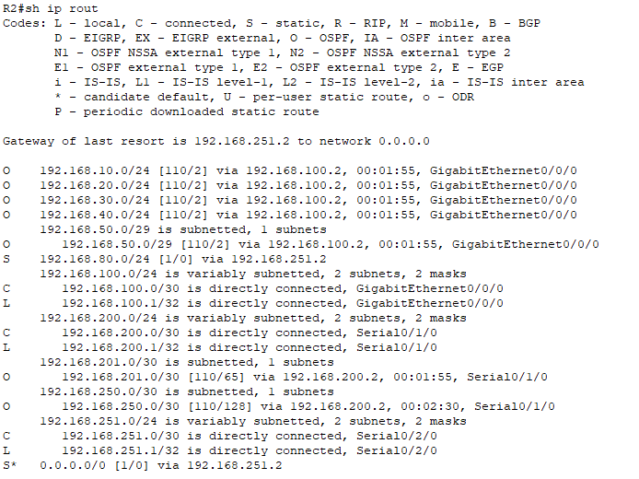
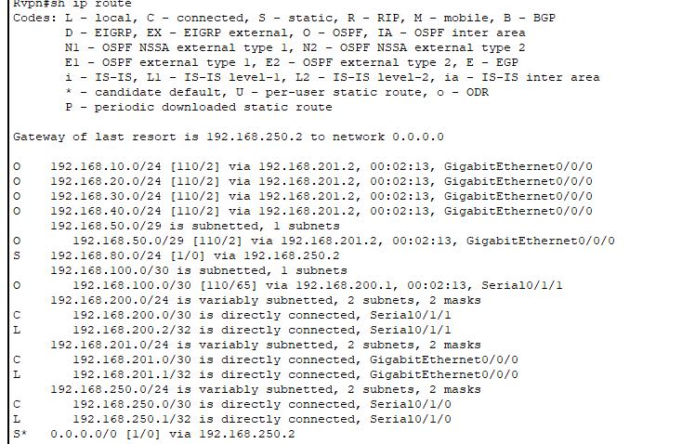
OSPF ROUTING PROTOCOL

Slide 17
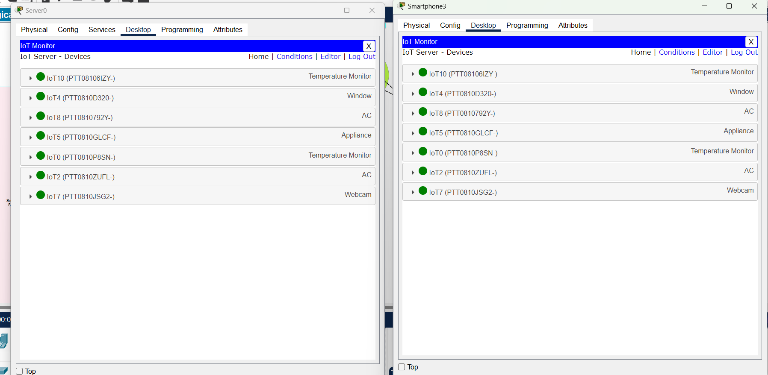
IOT DEVICES FULL CONTROLL

Slide 18
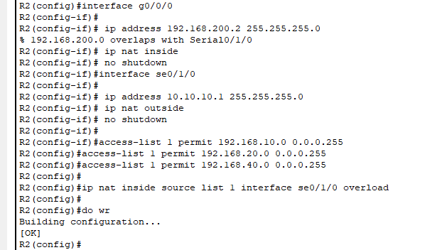
Enable NAT Overload to allow internal VLANs access to the internet.

Slide 19
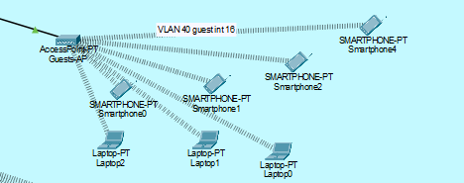
Wireless vlan 40 access with password : (Guests-AP123)

Slide 20
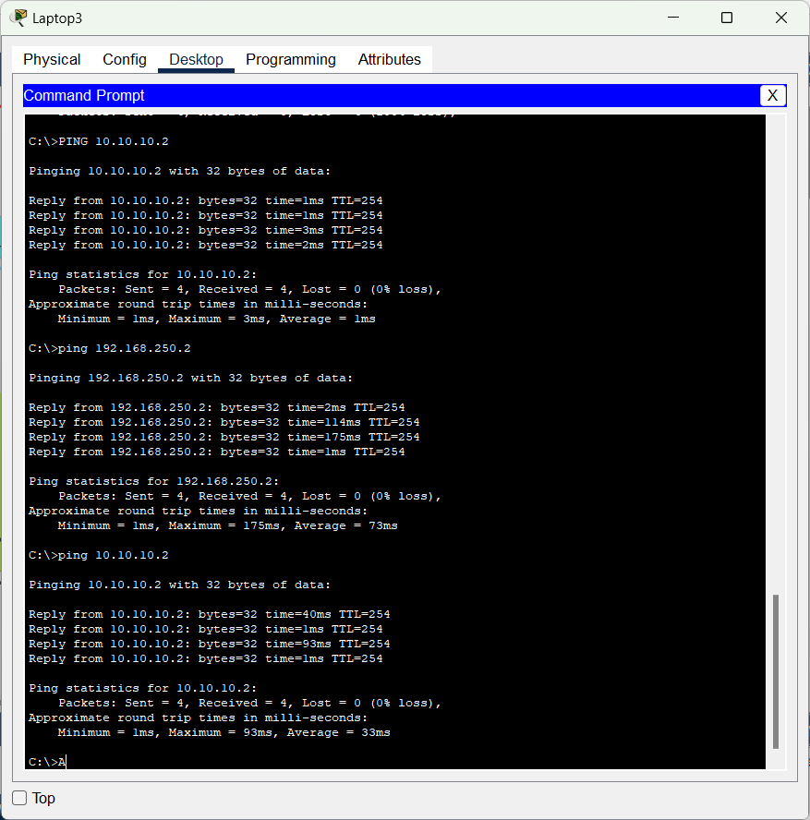
Vpn connectivity from laptop 1 through isp router to the network

Slide 21
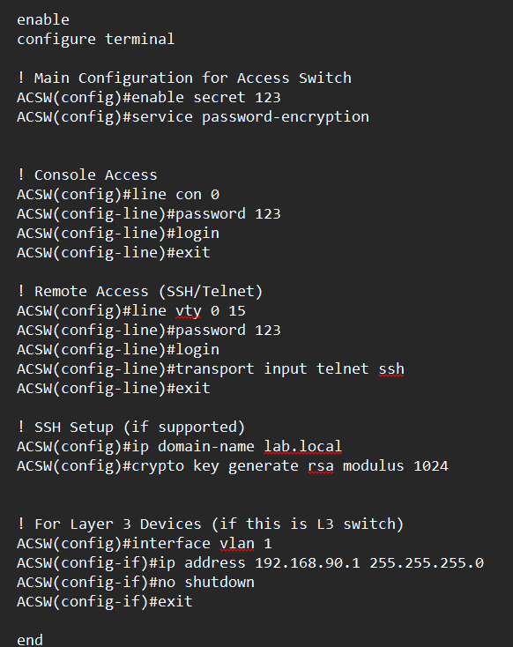
Ssh /telnet configuration

Slide 22
THANKS!

