Slide 1



GRADUATION PROJECT · POWER BI ANALYTICS
Egypt's Industrial Sector
Performance Analysis
A data-driven study of industrial economic growth, energy efficiency and environmental sustainability — in support of Egypt Vision 2030.
Economic Growth
Energy Efficiency
Environmental Sustainability
Study Period 1990 – 2023 | Constant 2015 USD | Egypt
Notes:
Open by framing this as a decision-support project, not just a dashboard build. The single sentence to land: over 33 years Egypt grew its industry while improving energy and carbon efficiency — but that progress is now under pressure. This deck tells that story and ends with actions.

Slide 2







HOW THIS STORY UNFOLDS
Presentation Roadmap
01
The Business Problem
Why the industrial sector matters
02
Alignment with Vision 2030
National goals this project serves
03
Project Timeline
From understanding to dashboards
04
Key Measures & KPIs
The analytical toolkit
05
Economic Performance
Dashboard 1 — growth & contribution
06
Energy Efficiency
Dashboard 2 — doing more with less
07
Environmental Sustainability
Dashboard 3 — the carbon question
08
Key Insights
What the data revealed
09
Recommendations
Turning insight into action
10
The Team
Who built this
Notes:
Signpost the flow: problem, national context, method, then the three analytical lenses, then insight and action. Emphasize it mirrors a real consulting engagement.

Slide 3
THE BUSINESS PROBLEM
Growth alone is no longer the goal
Industry is one of the largest engines of Egypt's economy — it drives GDP, employment and exports. But industrial expansion pulls on two constrained resources at once: it consumes energy, and it emits carbon. The real challenge for policymakers is not simply growing output, but growing it while keeping energy use and environmental impact in balance.
Economic Growth
Energy Consumption
Environmental Impact
Expanding industrial output to raise national income and living standards.
Every unit of output demands power — a finite, costly and emission-heavy input.
Industrial activity releases CO₂, placing Egypt's climate commitments at stake.
The core question: Can Egypt keep its industry growing while using less energy per unit and emitting less carbon per unit? This project answers that with data.
Notes:
Frame the tension as a genuine trade-off, not a slogan. The three cards are the forces; the gold bar is the exact question the three dashboards are built to answer.

Slide 4




NATIONAL CONTEXT
Built to serve Egypt Vision 2030
Vision 2030 commits Egypt to a competitive, diversified economy that grows responsibly. This project turns five of its pillars into measurable, monitorable KPIs.
Industrial Development
Sustainable Growth
Energy Efficiency
Climate Action
Data-Driven Decisions
Strengthen manufacturing as a driver of a diversified economy.
Grow output without exhausting resources or the environment.
Produce more value from every unit of energy consumed.
Cut the carbon intensity of industrial activity over time.
Govern with evidence through live analytical dashboards.
Notes:
Tie each pillar to something the committee already cares about. The fifth — data-driven decision making — is where this project itself becomes the deliverable Vision 2030 asks for.

Slide 5




HOW IT WAS BUILT
Project Timeline
Roughly three months, from framing the business problem to a tested, decision-ready set of dashboards.
1
2
3
Business Understanding
& Data Collection
Data Cleaning
& Preparation
Dashboard
Development
2 Months
2 Weeks
2 Weeks
Understanding the business problem
Research
Collecting datasets
Mapping Vision 2030 objectives
Selecting KPIs
Data cleaning
Power Query transformations
Data modeling
Creating relationships
Preparing calendar table
Creating DAX measures
KPI design
Dashboard design
Visualization
Testing
Notes:
Stress that two full months went into understanding the problem and data before a single visual — that front-loading is why the KPIs actually map to Vision 2030 rather than to whatever the dataset happened to contain.

Slide 6
THE ANALYTICAL TOOLKIT
Key Measures & KPIs
Thirteen DAX measures, grouped by the three lenses of the analysis — each chosen to answer a specific business question.
Growth
Energy
Environmental
Totals
GDP Growth YoY %
Pace of the whole economy
Industry Energy Consumption
Total energy demand of industry
Industrial CO₂ Emissions
Total carbon from industry
CO2 Industry
Energy Growth YoY %
How fast demand is rising
CO₂ Growth YoY %
How fast emissions are rising
GDP Value
Industry Growth YoY %
Pace of the industrial sector
Energy Intensity
Energy used per unit of output
Carbon Intensity
CO₂ emitted per unit of output
Industry Energy
Growth Efficiency Ratio
Output growth vs energy growth
Carbon Emission Factor
CO₂ per unit of energy used
Industry Contribution to GDP
How much industry drives GDP
Energy Decoupling Index
Is growth breaking free of energy?
Carbon Decoupling Index
Is growth breaking free of carbon?
Industry Value
Notes:
Don't read all 13 aloud. Explain the logic: raw levels, then year-on-year growth, then the ratio measures (intensity, efficiency, decoupling) that let us compare growth against its energy and carbon cost. The decoupling indices are the clever ones — call them out.

Slide 7
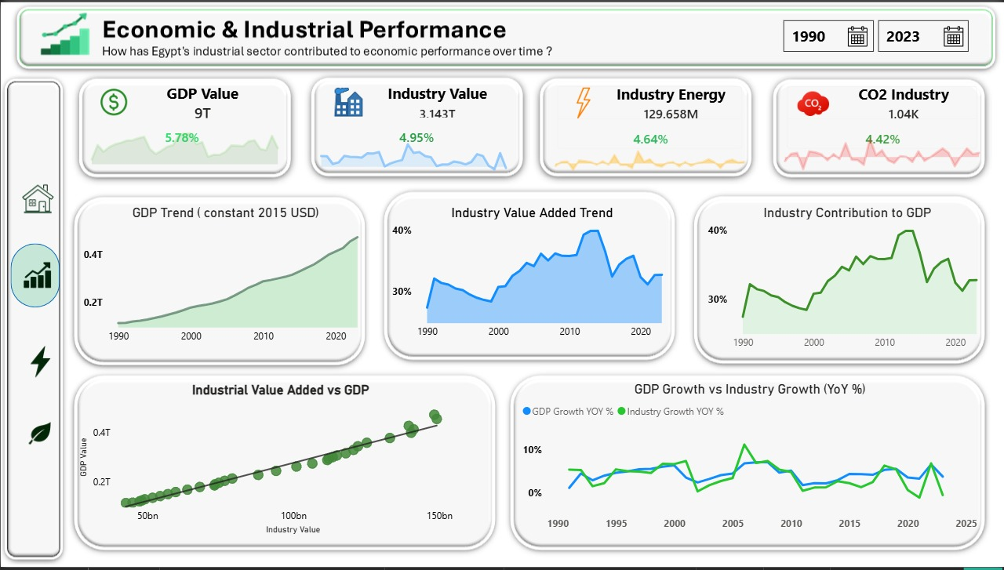


Economic & Industrial Performance
Business question: How has Egypt's industrial sector contributed to economic performance over time?
WHAT IT ANALYZES
The scale and trajectory of industrial value added (1990–2023) and how tightly it tracks national GDP — trends, growth rates and industry's contribution to the wider economy.
WHY IT MATTERS
It establishes industry as a core engine of Egypt's economy and quantifies how closely national prosperity is tied to industrial output — the baseline for every efficiency and sustainability decision that follows.
0.99
3.85%
32.7%
Live Power BI dashboard — interactive in the report file
GDP–industry correlation
Industry CAGR, 1990–2023
Industry share of GDP, 2023
Notes:
Lead with the 0.99 correlation — industry and GDP move together almost perfectly, so industry is not a side story, it's the engine. Note the share of GDP peaked ~40% around 2013-14 and has eased to ~32.7%, a structural signal to revisit later.

Slide 8
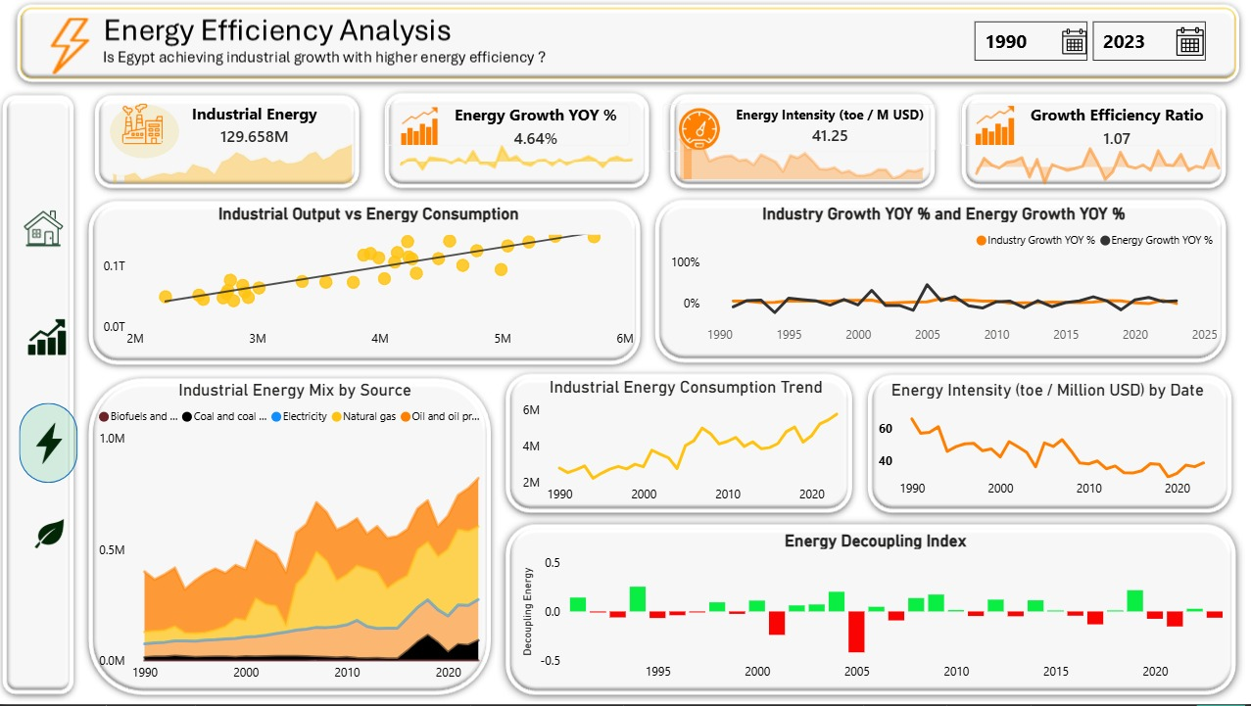
Energy Efficiency Analysis
Business question: Is Egypt achieving industrial growth with higher energy efficiency?
WHAT IT ANALYZES
How much energy industry burns to produce each unit of output — energy intensity, the industrial fuel mix, and whether output growth is decoupling from energy consumption.
WHY IT MATTERS
Efficiency decides whether industrial expansion stays affordable and sustainable. It shows if Egypt is producing more with less — and exposes the fuel-mix risk that drives future emissions.
2.2%
8.2 → 5.0
0.1%
Live Power BI dashboard — interactive in the report file
Energy CAGR vs 3.85% output
Energy intensity, toe / M$
Renewables in energy mix
Notes:
The good news: energy grew slower than output (2.2% vs 3.85%) and intensity fell from ~8.2 to ~5.0 over the period. The warning: intensity crept back up 2019-2023 (4.3 to 5.5). The risk: the mix is ~99.9% fossil, renewables just 0.1% — that's the single biggest lever.

Slide 9
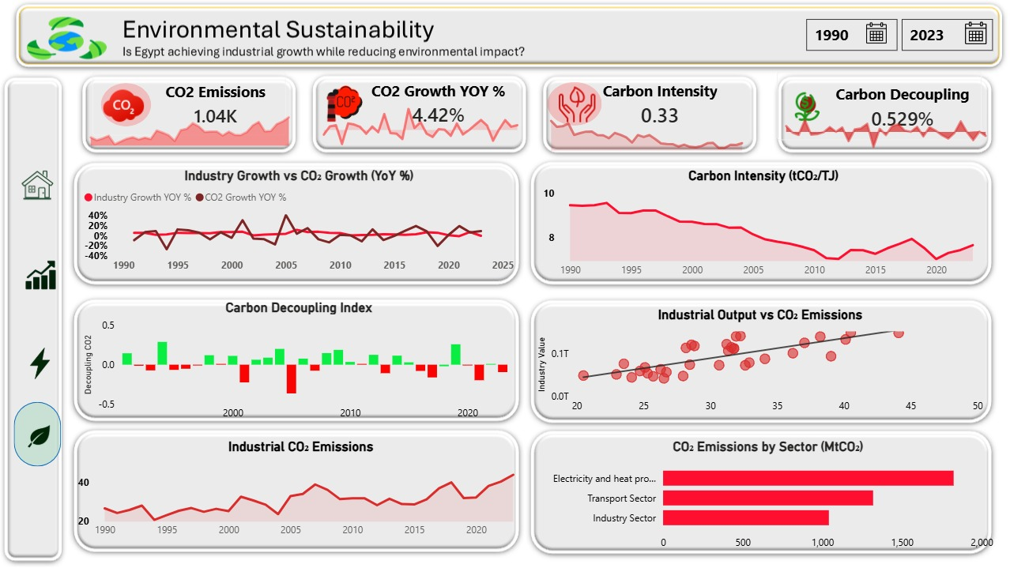
Environmental Sustainability
Business question: Is Egypt achieving industrial growth while reducing environmental impact?
WHAT IT ANALYZES
Industrial CO₂ emissions and carbon intensity over time, and whether emissions are decoupling from economic growth — the environmental cost of each unit of industrial value.
WHY IT MATTERS
It connects economic ambition to climate responsibility, testing whether Egypt can keep growing while cutting the carbon cost of that growth — the essence of Vision 2030's sustainability pledge.
1.55%
0.54 → 0.26
2023
Live Power BI dashboard — interactive in the report file
CO₂ CAGR vs 3.85% output
Carbon intensity, tCO₂ / M$
Decoupling turned negative
Notes:
Over 33 years emissions rose far slower than output (1.55% CAGR) and carbon intensity roughly halved — real decoupling. But flag 2023: output fell -0.6% while CO₂ rose +8.8% and energy +5.8%. That single recent year is the case for acting now rather than declaring victory.

Slide 10


WHAT THE DATA REVEALED
Key Insights
Industry is a true growth engine
Industrial value added rose from ~$43B to ~$148B (1990–2023) — a 3.85% CAGR that moves almost in lockstep with GDP (correlation 0.99).
But its GDP share is easing
Industry's contribution to GDP peaked near 40% around 2013–14 and has since settled around 32.7% — a structural shift worth monitoring.
Efficiency improved for decades
Energy intensity fell from ~8.2 to ~5.0 toe/M$, and industrial energy grew slower (2.2%) than output (3.85%) — more value from less power.
Emissions decoupled from growth
Industrial CO₂ rose only 1.55% a year while carbon intensity roughly halved (0.54 → 0.26 tCO₂/M$) — growth got cleaner over time.
A recent reversal is emerging
Since 2019 energy intensity crept back up (4.3 → 5.5); in 2023 output fell −0.6% while energy (+5.8%) and CO₂ (+8.8%) rose — decoupling turned negative.
Growth and sustainability can coexist
The 33-year record proves efficiency lets the economy grow while cutting energy and carbon per unit — provided the recent slippage is corrected.
Notes:
Group the six into a narrative: three decades of genuine progress (insights 1,3,4), a structural watch-item (2), a recent red flag (5), and the hopeful conclusion (6). The story is 'we proved it works — now defend it.'

Slide 11






TURNING INSIGHT INTO ACTION
Strategic Recommendations
Accelerate renewable adoption
Renewables are just 0.1% of the industrial energy mix. Even modest solar and wind investment directly improves the carbon emission factor.
Investigate the recent slippage
Diagnose why efficiency reversed after 2019 and decoupling turned negative — before short-term regression becomes a long-term trend.
1
2
Monitor KPIs quarterly, not yearly
Use the Growth Efficiency Ratio as an early-warning signal to catch slippage (as in 2021 and 2023) months earlier.
Diversify the industrial base
With industry's GDP share slipping from its 2014 peak, clarify whether other sectors are outpacing it or industry is stalling.
3
4
Cut reliance on gas and coal
Natural gas and coal are 66.5% of the mix combined; shifting toward cleaner sources reverses the recent carbon-intensity uptick.
Institutionalize Power BI
Adopt these dashboards as a standing decision-support tool for regular, evidence-based policy reviews.
5
6
Notes:
Order matters: renewables first (biggest lever, 0.1% today), then diagnose the slippage, then the monitoring cadence change. Close on recommendation 6 — this project itself becomes the governance tool Vision 2030 calls for.

Slide 12






THE PEOPLE BEHIND THE PROJECT
Meet the Team
Mohammed Shaban
TEAM LEADER
Khaled Ashour
Mohammed Alaa
Ahmed Hani
Saeed Yasser
Abdulrahman Saad
Notes:
Keep this brief in delivery — one line per person: name and what they owned (data modeling, DAX, dashboard design, research, etc.).

Slide 13
EGYPT'S INDUSTRIAL SECTOR PERFORMANCE ANALYSIS
Thank You
Questions & discussion welcome.
Economic Growth
Energy Efficiency
Environmental Sustainability
Built with Power BI · In support of Egypt Vision 2030
Notes:
Close by returning to the one-sentence thesis: Egypt has already shown growth and sustainability can move together — the job now is to defend that progress with renewables, tighter monitoring and evidence-based governance.

