Slide 1
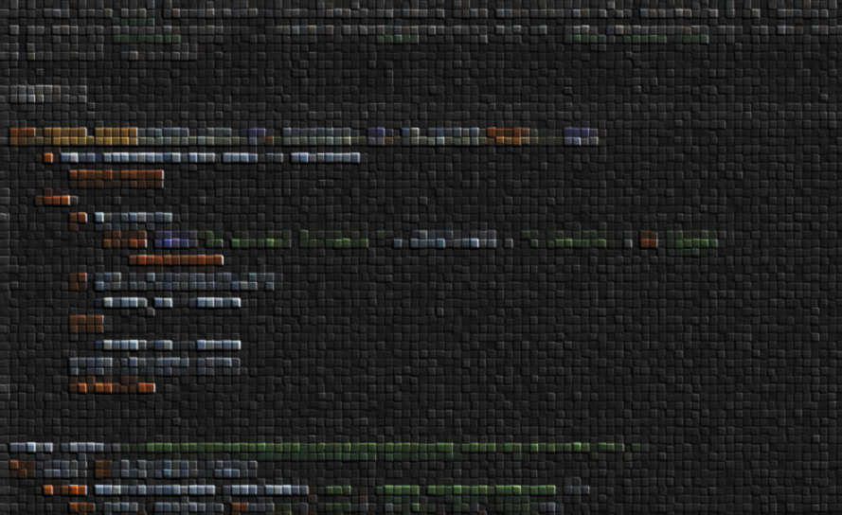
Processing the Nessun Dorma dataset
Maarten Poirot, May 2021

Slide 2
1 .Directory structuring

Slide 3
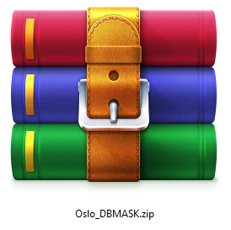
Original file structuring
Oslo_DBMASK.zip
├── nii
│ ├── 001_20181..nii.gz
│ ├── 001_20182..nii.gz
│ └── 002_20181..nii.gz
└── rawmask
├── 001_20181..nii.gz
├── 001_20182..nii.gz
└── 002_20181..nii.gz

Slide 4
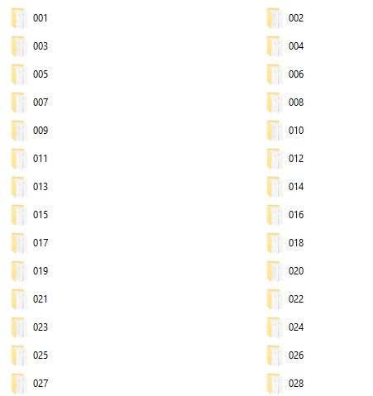
Final file structuring: patient subfolders
Oslo_DBMASK.zip
├── nii
│ ├── 001
│ │ ├── 20181..nii.gz
│ │ └── 20182..nii.gz
│ └── 002
│ └── 20181..nii.gz
└── rawmask
│ ├── 20181..nii.gz
│ └── 20182..nii.gz
└── 002
└── 20181..nii.gz

Slide 5
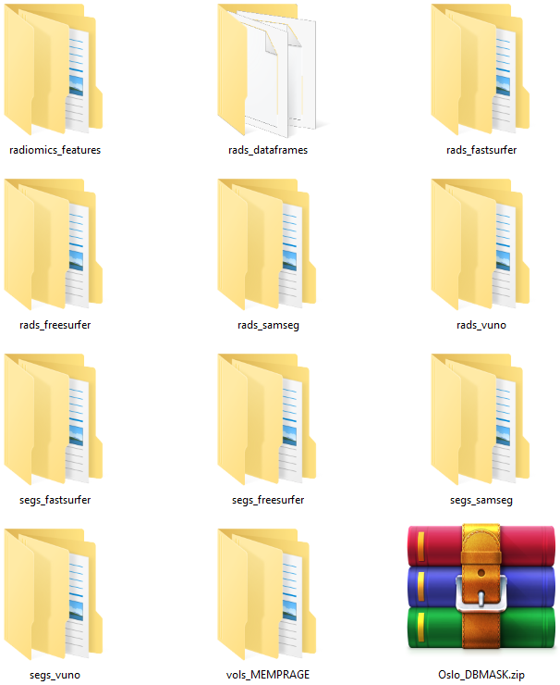
Keep is simple/shallow stupid (KISS)
Oslo_DBMASK.zip
├── vols_MEMPRAGE
│ ├── 001
│ │ ├── 20181..nii.gz
│ │ └── 20182..nii.gz
│ └── 002
│ └── 20181..nii.gz
└── segs_vuno
│ ├── 20181..nii.gz
│ └── 20182..nii.gz
└── 002
└── 20181..nii.gz
VOL-move.py
VUNO-rename.sh

Slide 6
2. Segmenting

Slide 7
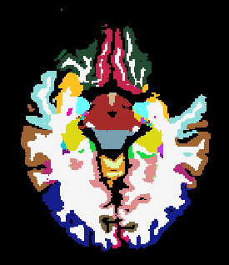
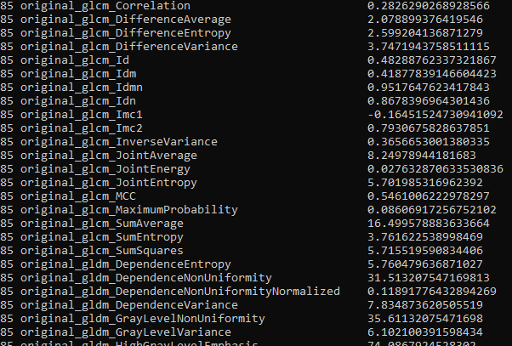
Overview of data generated:
Segmentations
segs_vuno (was provided to us)
segs_samseg
segs_freesurfer
segs_fastsurfer
Radiomic features
rads_freesurfer
rads_freesurfer
rads_fastsurfer
rads_samseg

Slide 8
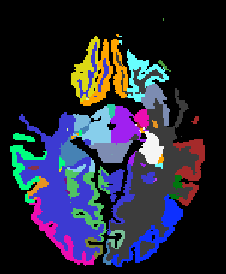
1. Generation of segs_vuno
Vuno segmentations were not perfect off the bat:
Labels were not conform FreeSurfer definitions
Affine transform was reset (this also flips L-R)
Done using a lookup-table (vuno-lut.pkl) and using the affine transform of the SAMSEG segs.
VUNO-relabel.py
002_20180701_055836_2

Slide 9
2. Generation of segs_samseg
This is the easiest as samseg can run straight on nifit files and v.7.1.0 came preinstalled on Hinton.
Results need to be moved and converted from mgz to nifti
SAMSEG-copy-and-convert.py
SAMSEG-run_bulk.sh

Slide 10
3. Generation of segs_freesurfer (1/2)
FreeSurfer only works from a specific directory format:
…data/sub-001/mri/orig/001.mgz
So we create a FreeSurferWorking directory
And copy everything over to our directory structure after we are done.
ASEG-run_bulk.sh
ASEG-copy-and-convert.py

Slide 11
3. Generation of segs_freesurfer (2/2)
Undoing resampling & registration
FreeSurfer results are registered and resampled by default and need to be put back to original space to overlap with Vuno and SAMSEG.
For this process we need to de- and recompress, and check if our issue has been fixed afterwards
FreeSurfer-revert_spacing.m
Freesurfer-clean_names_after_revert_spacing.py
Compress_niftis.py
Check_if_seg_shapes_are_OK.py

Slide 12
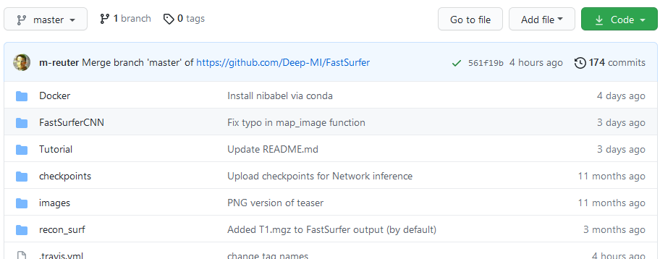
4. Generation of segs_fastsurfer
FastSurfer also makes use of the FreeSurferWorkingDirectory. However, destination of output can be specified, so no copy and conversion is required afterwards.
The exact version of FastsSurfer used is in the scripts dir as .zip FastSurfer uses a PyTorch backend. See fastsurfer-requirements.txt for versions.
FastSurfer-run_bulk.sh

Slide 13
4. Generation of segs_fastsurfer (2/2)
Undoing resampling & registration
The same steps for undoing registration & resampling are performed
FreeSurfer-revert_spacing.m
Freesurfer-clean_names_after_revert_spacing.py
Compress_niftis.py
Check_if_seg_shapes_are_OK.py

Slide 14
3. Dice Analysis

Slide 15
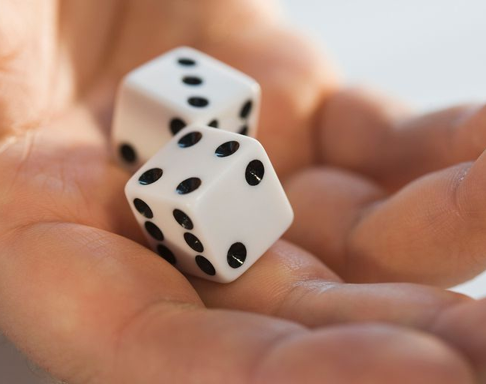
Computing Dice
roll_DICE.py

Slide 16
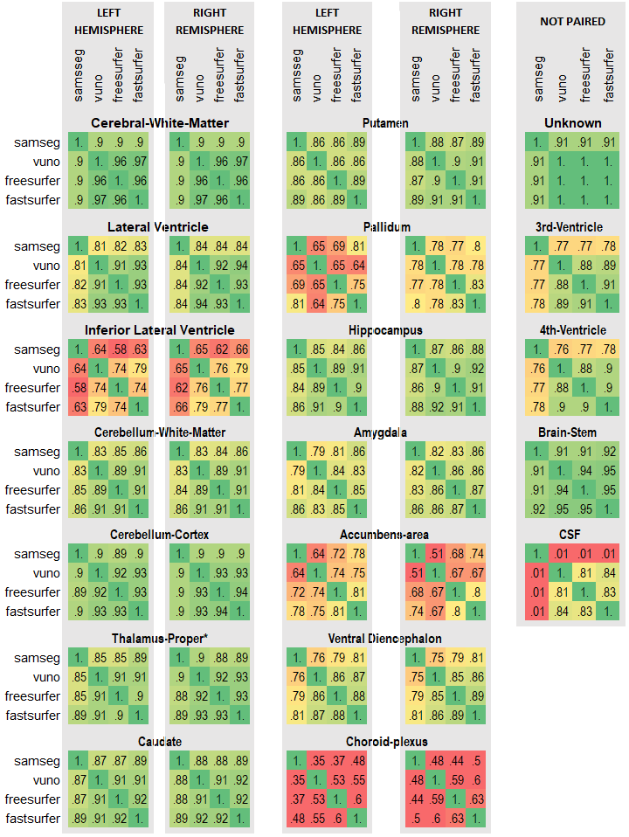
print_DICEs.py

Slide 17
4. Generation of radiomic features

Slide 18
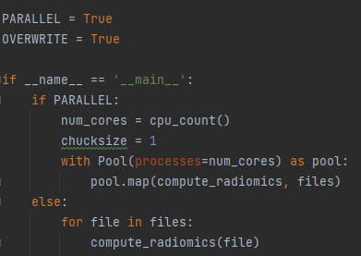
Computing Dice
Radiomics_compute.py
Radiomics_compute.py is used to compute radiomics (who would have thought)
This is actually some pretty neat totally parallelized code to speed up this otherwise lenthy process from hours to minutes.

Slide 19
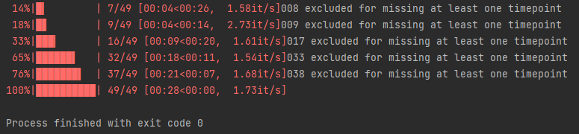
Conversion of individual radiomics to single dataframe
600S → 001
601D → 002
602S → 003
603D → 004
604S → 005
606D → 006
607S → 007
608D → 008
609 → 009
612S → 010
Etc.
I received 49 labels (but with different IDs
Pt. 8, 17, 33 and 38 were excluded for incomplete data
generate_dateframes.py
44 subjects

Slide 20
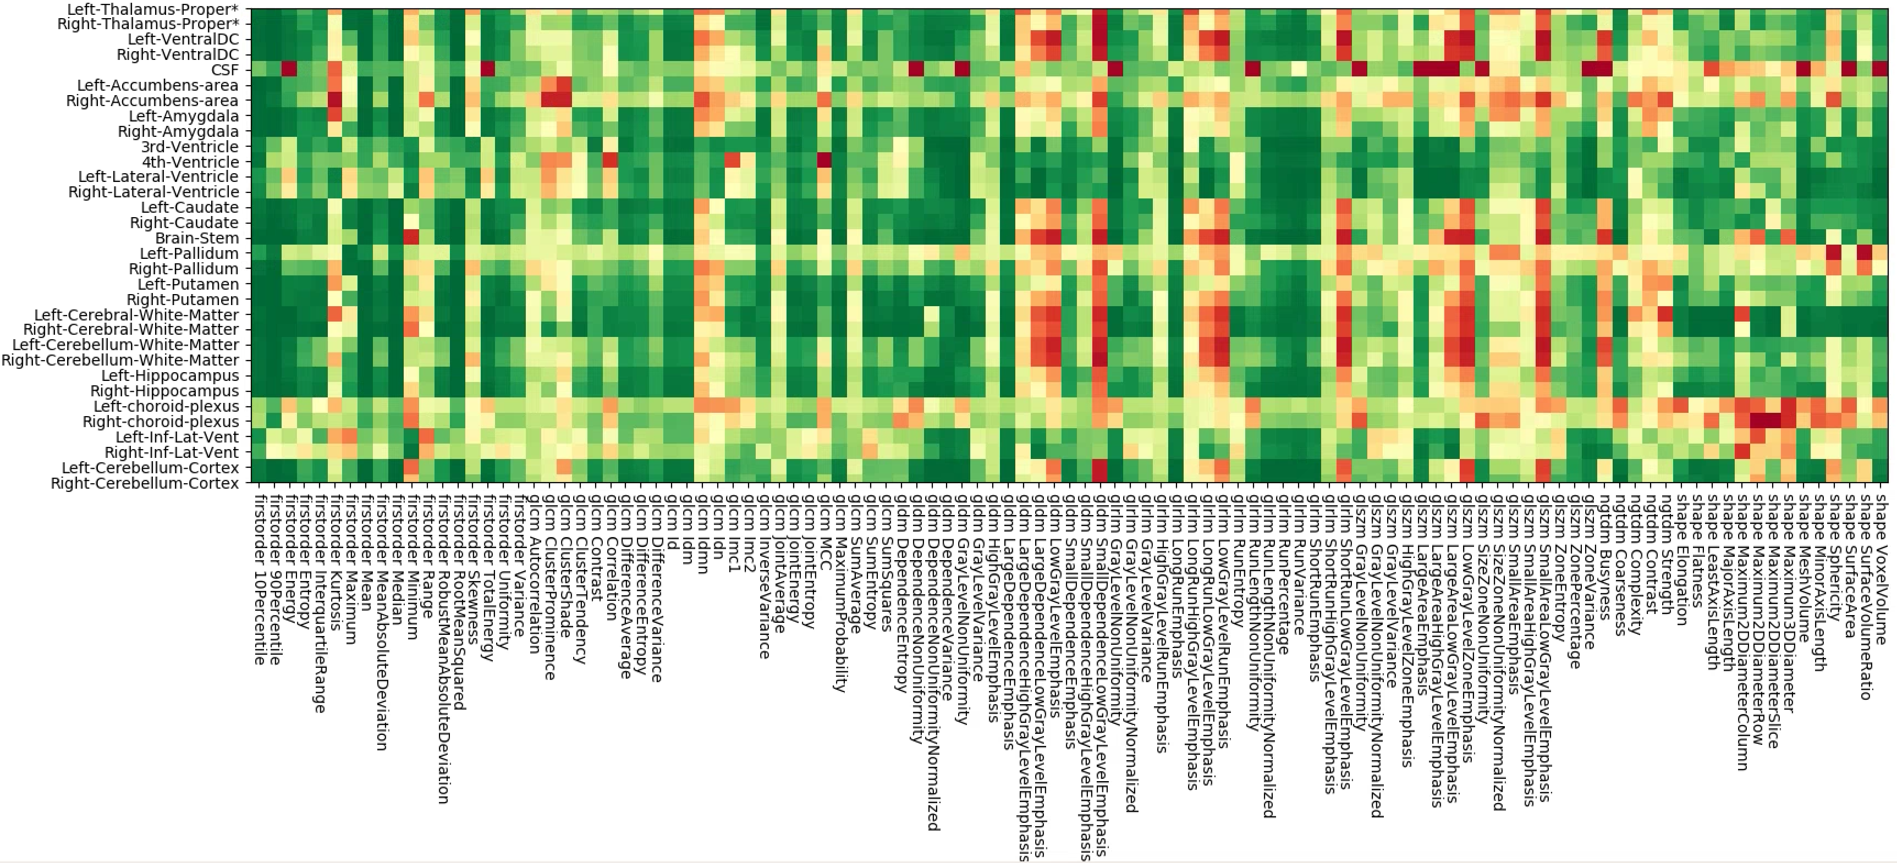
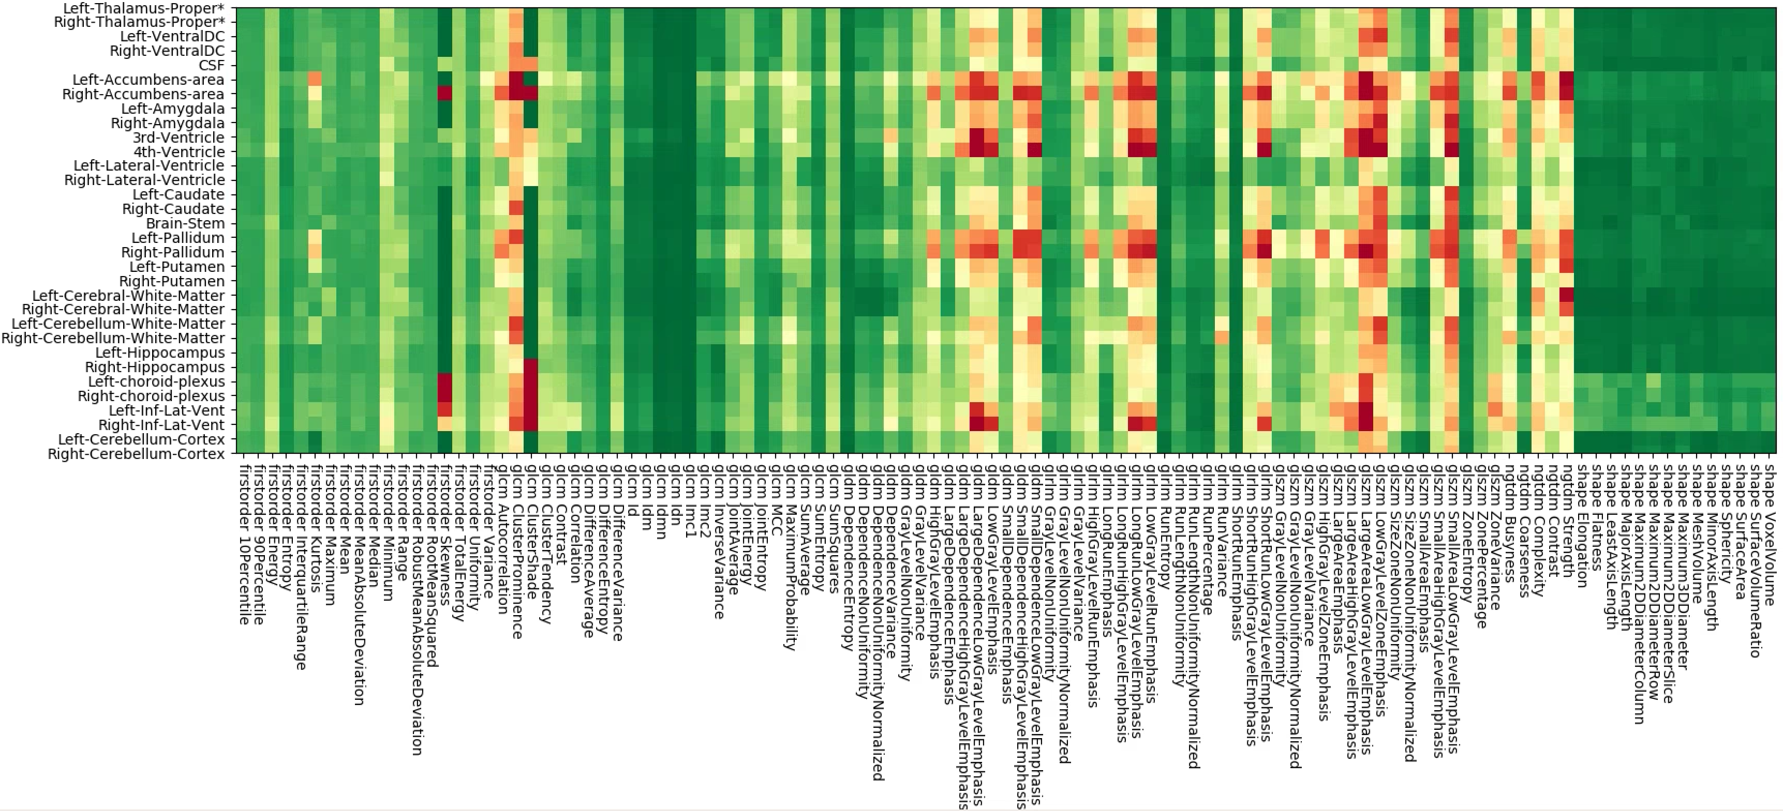
Stability of radiomics features
Stability of radiomics feature is quantified as:
interclass correlation (icc)
relative mean absolute error (rmae)
for each anatomical structure/label (in the image on the x-axis) and each feature (on the y-axis)
icc_compute.py
rmae_compute.py
icc_vis.py
rmae_vis.py

Slide 21
5. Feature Extraction & Prediction

Slide 22
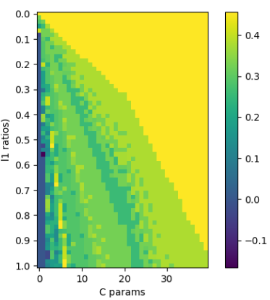
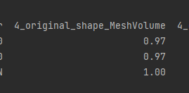
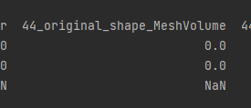
RENT hyperparameter grid search
Frist started with all 40.000 fields
Second attempt: Only difference in mean shape features: 1442 fields*
Cutoffs adjusted to retain 4 features: Τ₁ 0.9 → 0.5 Τ₂ 0.9 → 0.5 Τ₃ 0.975 → 0.8
*if every subject has two scans over two days this calculation is: (T1.1 + T1.2) – (T2.1 + T2.2)
Right
Matthews CorrCof
Left-Lateral-Vent_ original_shape_MeshVolume
Left-Lateral-Ven_original_shape_VoxelVolume
Right-Putamenricle_shape_Maximum2DDiameterColum
lh-middletemporal_shape_Maximum2DDiameterRow
1
3

Slide 23

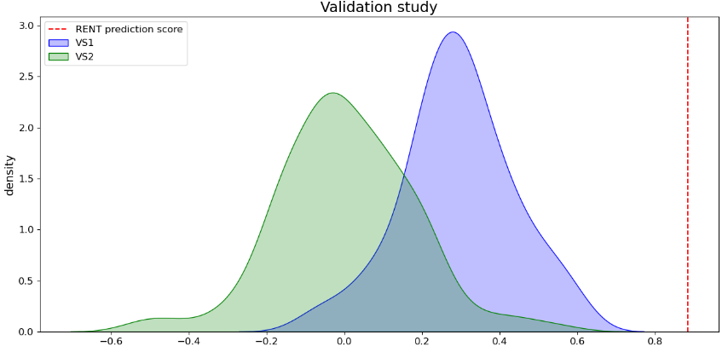
RENT hyperparameter Train Performance
Matthews CorrCof
f1 1: 0.94
f1 0: 0.95
Accuracy: 0.94
Matthews correlation coefficient: 0.88
1
3

Slide 24

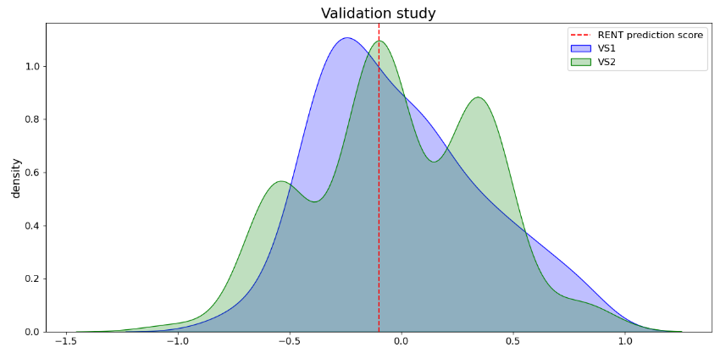
RENT hyperparameter Test performance 1
Left-Lateral-Vent_original_shape_MeshVolume
Left-Lateral-Ven_original_shape_VoxelVolume
Right-Putamenricle_shape_Maximum2DDiameterColum
lh-middletemporal_shape_Maximum2DDiameterRow
f1 1: 0.45
f1 0: 0.45
Accuracy: 0.45
Matthews correlation coefficient: -0.1
f1 1: 0.29
f1 0: 0.55
Accuracy: 0.44
Matthews correlation coefficient: -0.16

