Slide 1
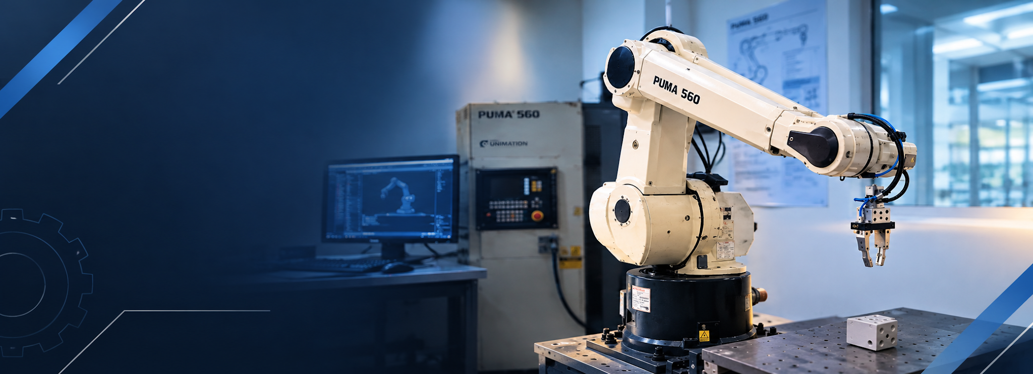
GROUP 7
PUMA 560 Robot
Manipulator
Satyanarayana
Sarvajith
Sathwik
Sreyas

Slide 2
Project scope
PUMA560: A six revolute joint manipulator with a spherical wrist
Robot specification and standard DH frames
Forward and analytical inverse kinematics
Velocity kinematics and singularity analysis
Independent checks against MuJoCo
GROUP 7 PUMA 560 2
Notes:
Source: README.md, src/ and run_all.py. All analytical algorithms use project NumPy code. MuJoCo supplies visualization and an independent kinematic reference.

Slide 3
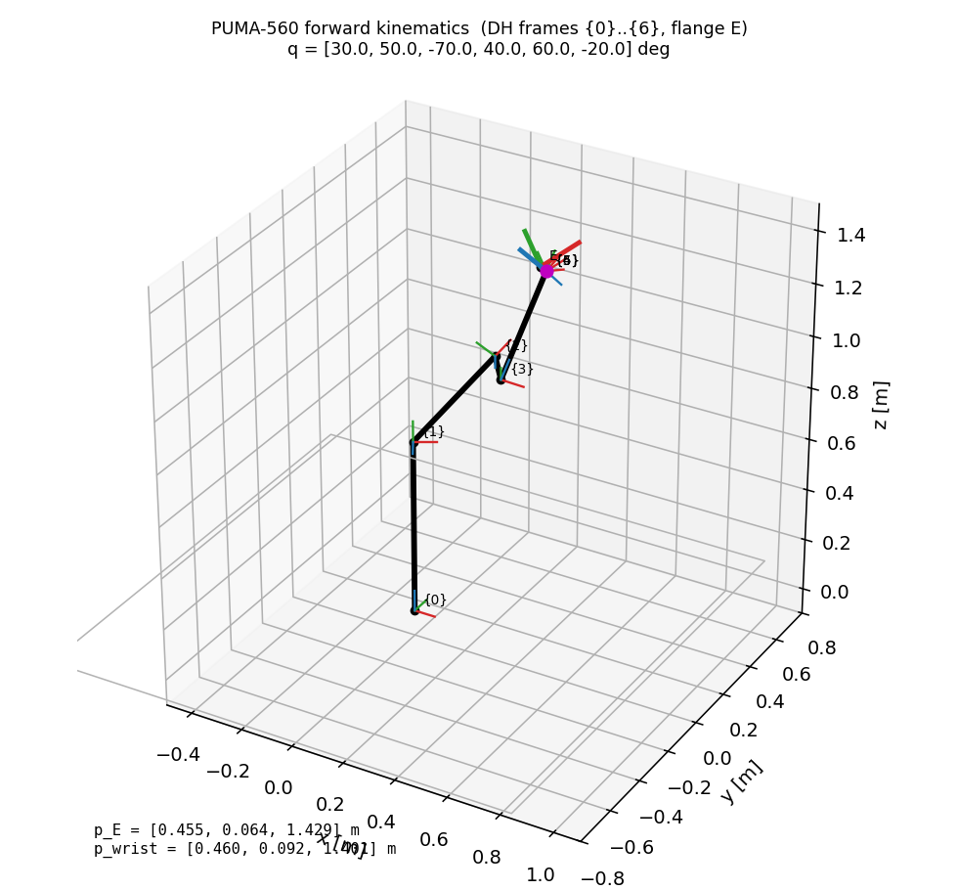
Robot geometry and reference frames
O0: mounting plane
O1: 0.67183 m above O0
O4 = O5 = O6: wrist centre
OE: 0.04 m along z6 from the wrist centre
GROUP 7 PUMA 560 3
Notes:
Source: README.md, src/robot_parameters.py. Frame 0 equals the MuJoCo world. Joint i rotates about z_(i-1). The 0.04 m flange distance is a model choice cited to ARTE.

Slide 4
Standard Denavit-Hartenberg model
Ai = Rz(qi) Tz(di) Tx(ai) Rx(alpha_i)
Joint | theta | d (m) | a (m) | alpha (deg)
1 | q1 | 0.67183 | 0 | 90
2 | q2 | 0 | 0.4318 | 0
3 | q3 | 0.15005 | 0.0203 | -90
4 | q4 | 0.4318 | 0 | 90
5 | q5 | 0 | 0 | -90
6 | q6 | 0 | 0 | 0
Flange transform: T6E = Trans(z, 0.04 m)
GROUP 7 PUMA 560 4
Notes:
Source: README.md, src/robot_parameters.py and src/dh_model.py. Lengths in metres, angles in degrees in this table. All theta offsets are zero.

Slide 5
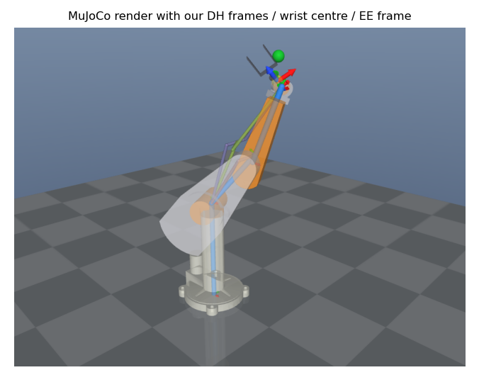
Forward kinematics
T0E = A1 A2 A3 A4 A5 A6 T6E
Input: six joint angles
Output: end-effector pose, all DH frames and wrist centre
The MuJoCo pose provides an independent comparison
GROUP 7 PUMA 560 5
Notes:
Source: README.md and src/forward_kinematics.py. Figure: results/fk_mujoco.png. The pose contains both position and orientation.

Slide 6
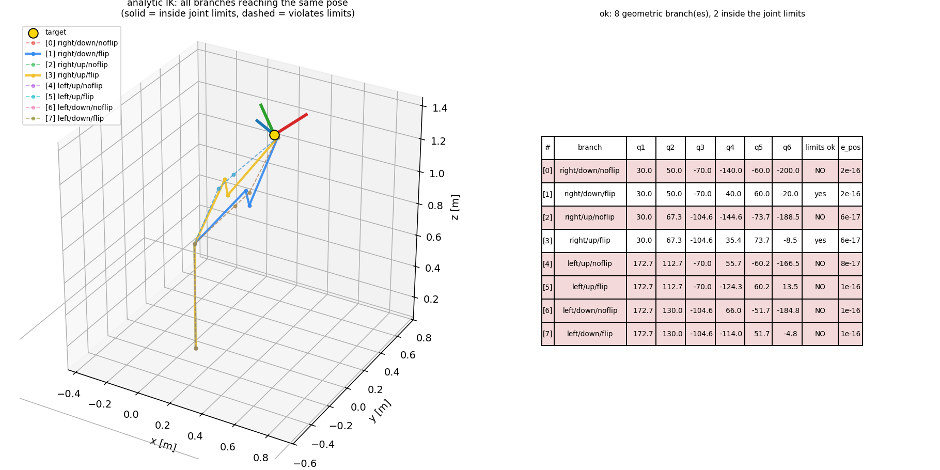
Analytical inverse kinematics
1. Remove the flange offset
2. Solve waist and elbow geometry
3. Solve shoulder angle
4. Extract wrist orientation
5. Verify each branch with FK
Up to 8 branches: 2 waist x 2 elbow x 2 wrist
GROUP 7 PUMA 560 6
Notes:
Source: README.md and src/inverse_kinematics.py. Figure: results/ik_branches.png. Eight geometric branches apply to generic nonsingular reachable targets. Limits can exclude branches and singularities can merge them.

Slide 7
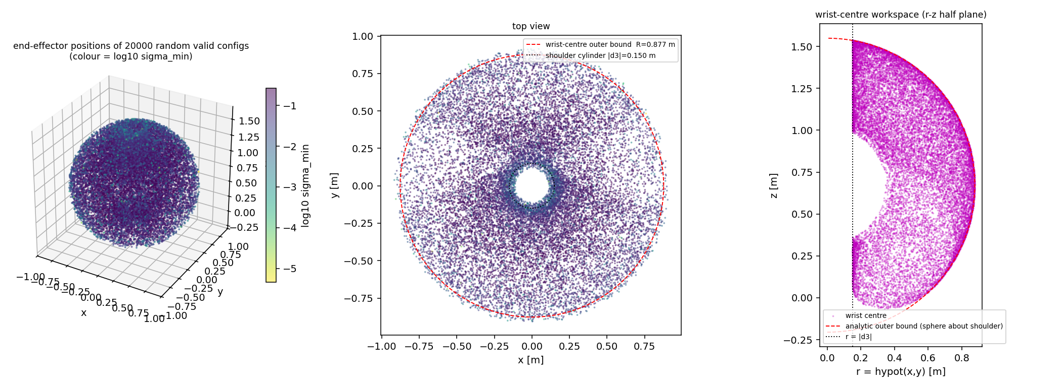
Reachability and joint limits
r >= |d3| = 0.15005 m
|a2 - L| <= rho <= a2 + L
L = sqrt(a3^2 + d4^2)
Outer planar reach: 0.8641 m
Joint | Minimum (deg) | Maximum (deg)
J1 | -160 | 160
J2 | -45 | 225
J3 | -225 | 45
J4 | -110 | 170
J5 | -100 | 100
J6 | -266 | 266
A reachable target can still violate every joint-limit branch
GROUP 7 PUMA 560 7
Notes:
Source: README.md, src/inverse_kinematics.py and results/verification_report.md. L = sqrt(a3^2 + d4^2), rho is the planar shoulder-to-wrist distance, and r is distance from the waist axis. The plotted workspace concerns the wrist centre.

Slide 8
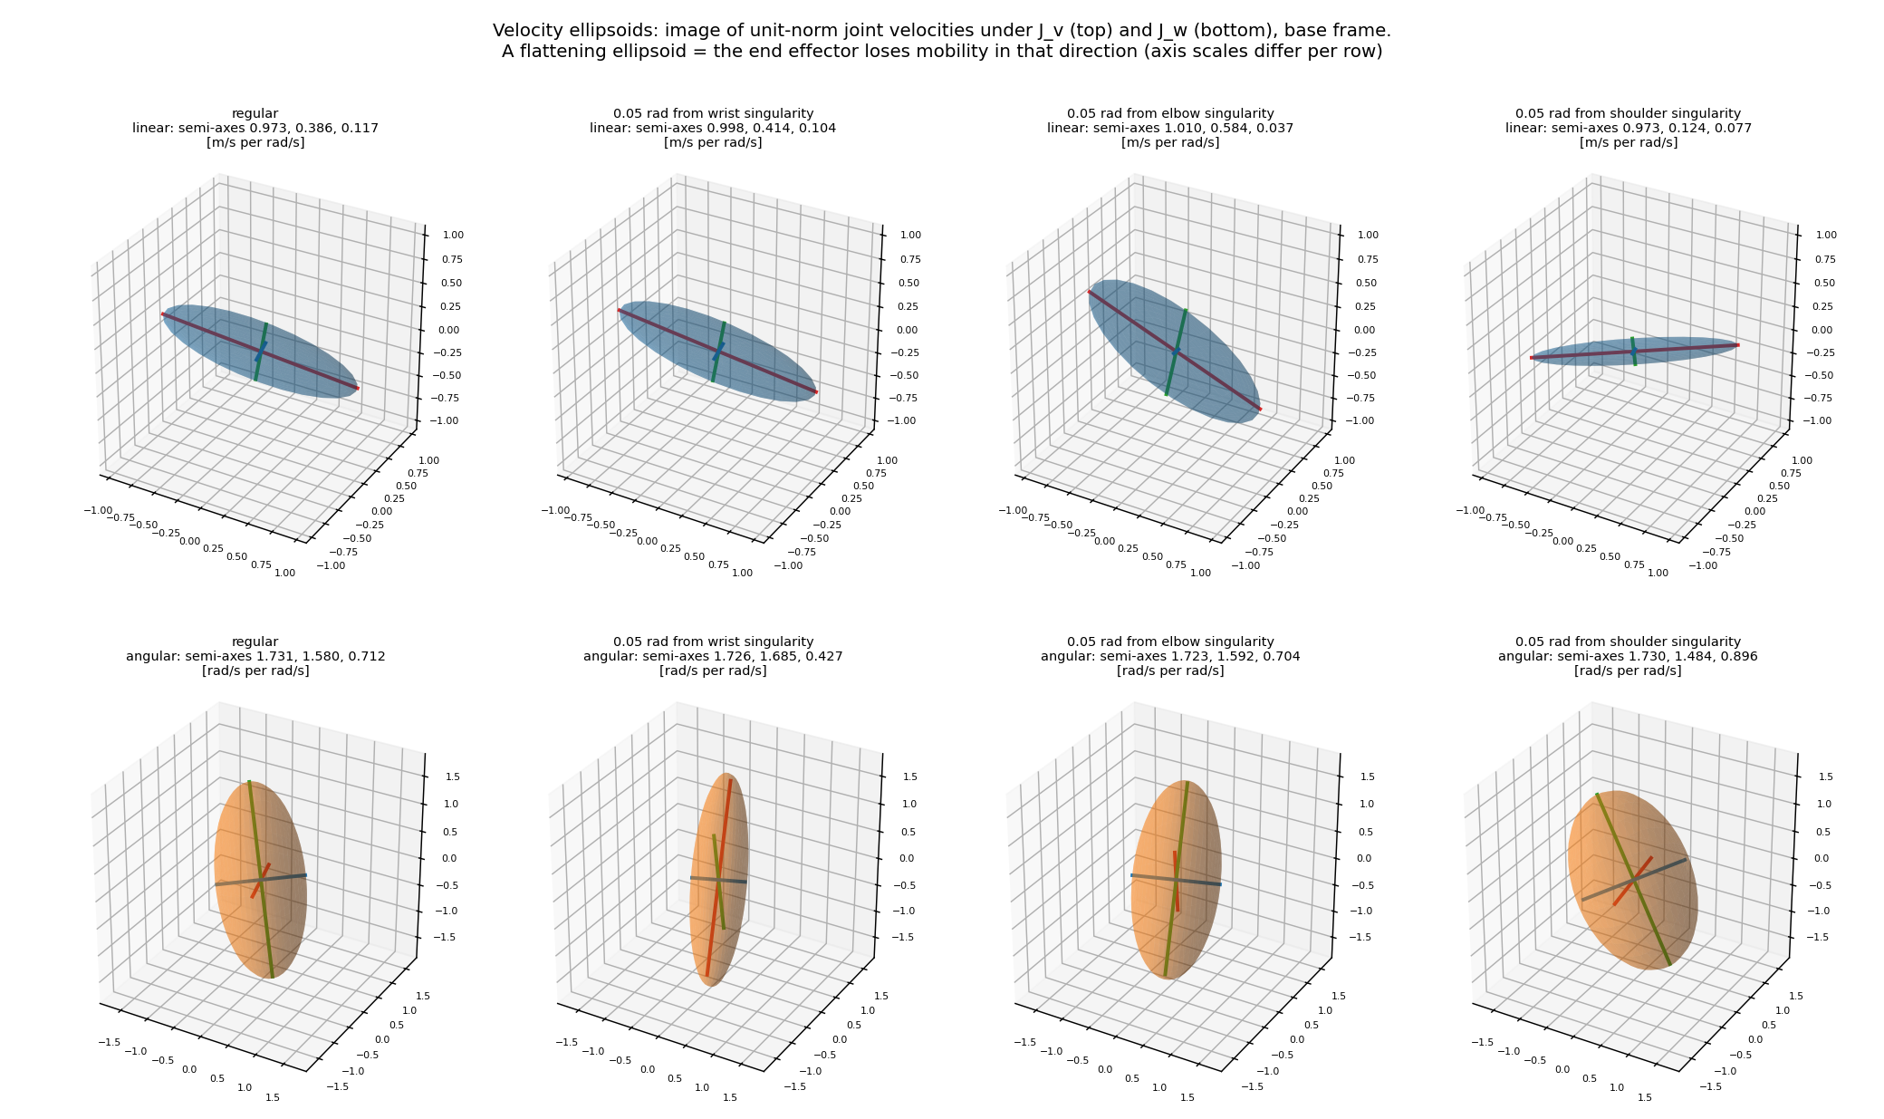
Velocity kinematics
[v; omega] = J(q) qdot
Jv,i = z(i-1) cross (pE - p(i-1))
Jw,i = z(i-1)
Inverse velocity: pseudoinverse or damped least squares
GROUP 7 PUMA 560 8
Notes:
Source: README.md, src/jacobian.py and src/velocity_kinematics.py. Figure: results/velocity_ellipsoids.png. The geometric Jacobian is expressed in the base frame at the flange by default. Cross denotes the vector cross product.

Slide 9
Singularity conditions
det(J) = a2 X (a3 sin(q3) + d4 cos(q3)) sin(q5)
Shoulder: X = 0
Wrist centre reaches the cylinder about the waist axis
Elbow: a3 sin(q3) + d4 cos(q3) = 0
Stretched configuration within limits: q3 is about -87.3 deg
Wrist: sin(q5) = 0
Joint 4 and joint 6 axes align. Within limits: q5 = 0 deg
GROUP 7 PUMA 560 9
Notes:
Source: README.md and src/singularity_analysis.py. det(J) uses the wrist-centre reference point. The flange offset preserves the determinant. X = a2 cos(q2) + a3 cos(q2+q3) - d4 sin(q2+q3). phi = atan2(d4,a3) = approximately 87.3 degrees.

Slide 10
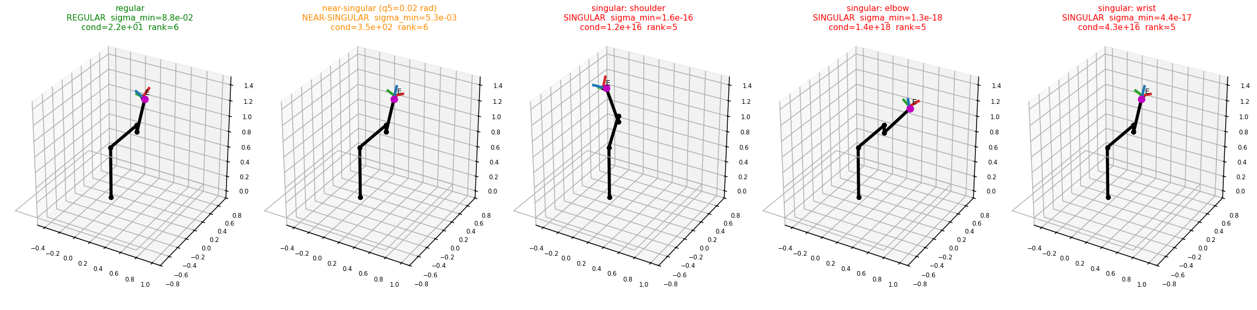
Singular configurations
The Jacobian loses rank and at least one twist direction becomes unavailable
GROUP 7 PUMA 560 10
Notes:
Source: results/singularity_gallery.png, README.md and src/singularity_analysis.py. Each illustrated family has rank 5 in the reported verification. The full six-dimensional Jacobian defines loss of controllable twist.

Slide 11
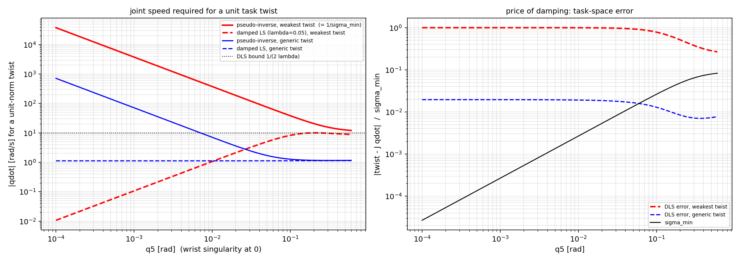
Near-singular joint speeds
For the weakest twist:
|qdot| = |twist| / sigma_min
At q5 = 0.0001 rad:
Pseudoinverse: about 37,500 rad/s
Damping bounds joint speed at the cost of task error
GROUP 7 PUMA 560 11
Notes:
Source: README.md, results/verification_report.md and results/joint_speed_vs_singularity.png. Values concern the weakest unit twist. Damping parameter lambda = 0.05 gives a 10 rad/s bound for that unit task. Singular values depend on units because J combines linear and angular rows.

Slide 12
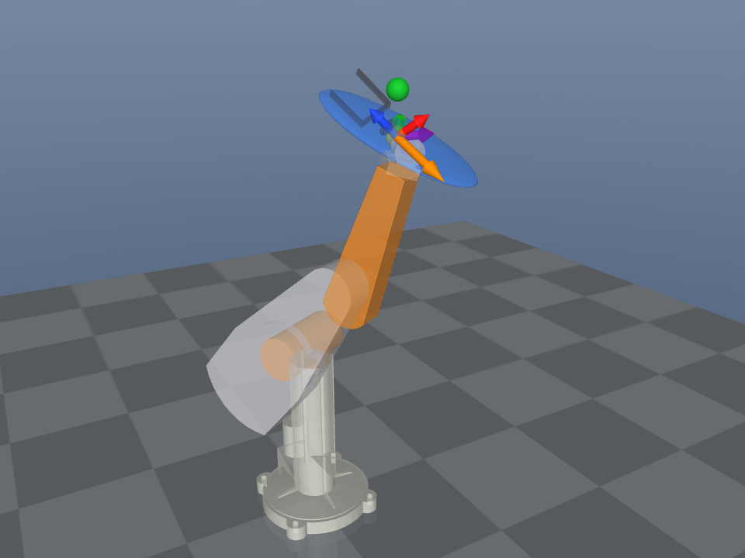
Interactive MuJoCo demonstration
Joint-angle or Cartesian input
DH frames and IK branch overlays
Velocity ellipsoid and arrows
Singularity indicator
GROUP 7 PUMA 560 12
Notes:
Source: README.md, run_all.py and src/simulation.py. Figure: results/velocity_mujoco.png. run_all.py uses smooth joint interpolation for visualization only, not physical control or a trajectory planner. Overlay calculations come from project code.

Slide 13
Numerical verification results
Check | Sample size | Reported result
FK vs MuJoCo | 2,000 poses | Max position error 6.8e-16 m
IK round trip | 3,000 poses | 3,000 / 3,000 recovered
Jacobian vs differences | 1,000 poses | Max absolute error 2.6e-10
Determinant formula | Report check | Max difference 1.2e-16
Boundary, unreachable and singular targets also have dedicated checks
GROUP 7 PUMA 560 13
Notes:
Source: results/verification_report.md and README.md. These are stored project report results, not measurements rerun during presentation creation. Fixed seeds and sample counts appear in that report.

Slide 14
Running the complete workflow
Default pose and interactive demonstration
python run_all.py
Choose joint angles in degrees
python run_all.py --q 30 50 -70 40 60 -20
Numerical workflow with quick verification
python run_all.py --no-sim --verify
GROUP 7 PUMA 560 14
Notes:
Source: run_all.py command documentation. --verify performs quick numerical checks. --no-sim prints the numerical workflow without opening the viewer. Joint inputs use degrees, positions use metres, Cartesian orientation uses degrees.

Slide 15
Conclusions and limitations
DH forward kinematics agrees with the MuJoCo reference
Analytical IK finds branches and diagnoses infeasible targets
The Jacobian explains lost motion and large joint speeds
Future work: dynamics, control and obstacle avoidance
GROUP 7 PUMA 560 15
Notes:
Source: README.md, run_all.py and results/verification_report.md. Dynamics, control, obstacle avoidance and trajectory planning remain outside this project. Viewer motion is visual interpolation.

Slide 16
References and project sources
Project implementation and verification
README.md, src/, run_all.py
results/verification_report.md
Robot parameters
Corke and Armstrong-Helouvry (1994)
Armstrong, Khatib and Burdick (1986)
ARTE and rtb-data: models/LICENSE_NOTICE.md
GROUP 7 PUMA 560 16
Notes:
Primary project evidence: README.md; src/robot_parameters.py; src/forward_kinematics.py; src/inverse_kinematics.py; src/jacobian.py; src/singularity_analysis.py; results/verification_report.md; run_all.py; models/LICENSE_NOTICE.md. External model provenance follows the repository notices. ARTE: https://github.com/4rtur1t0/ARTE

