Slide 1
Systems-Level Reliability and Robustness Evaluation Framework for Document AI
**Master's Thesis Defense**
Bridging the Perception-Cognition Gap in Multimodal Reasoning

Slide 2
The Motivation: High-Risk Document AI
The Challenge: Mission-critical sectors (Finance, Healthcare) require exact precision from unstructured PDFs.
The Bottleneck: Standalone Large Language Models (LLMs) are linguistically robust but lack spatial awareness.
The Perception-Cognition Gap: A disconnect between a model's reasoning and its ability to "see" fine-grained textual evidence.
The Cost of Failure: Hallucination-related errors in automated pipelines.
1 / 15

Slide 3
The Research Gap: Heuristics vs. Generative
Traditional OCR (Tesseract): Preserves literal characters but linearizes text horizontally, causing Structural Fragmentation.
Standalone VLMs (Gemini, LLaVA): Elegant multimodal perception but limited by Resolution-Loss Hallucination.
The Missing Link: Lack of benchmarking evaluating the trade-offs between deterministic parsing and semantic layout mapping.
2 / 15

Slide 4
Proposed Solution: Hybrid Dual-Stream Synchronization
Core Strategy: Simultaneously process two independent data streams:
Stream 1 (Deterministic): PaddleOCR for high-precision character detection.
Stream 2 (Semantic): Vision-Language Model for layout context.
Grounding Reliability: Grounding visual summaries in OCR character sequences to suppress resolution-loss errors.
3 / 15

Slide 5
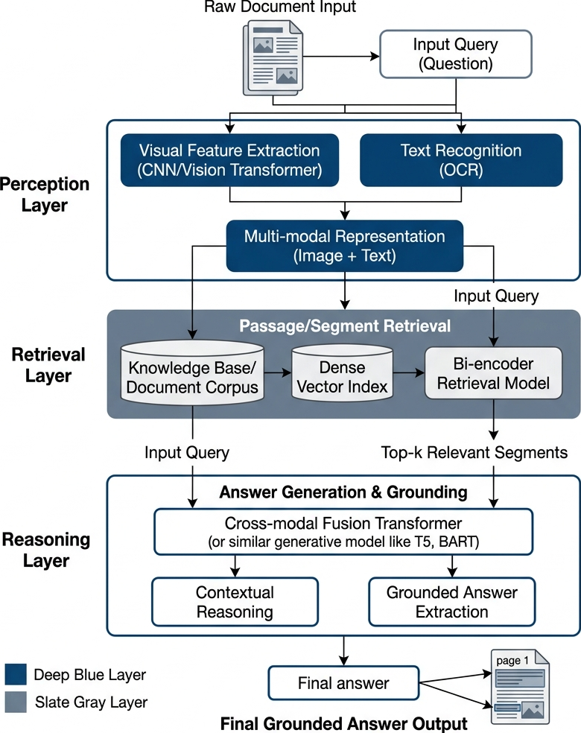
System Architecture: Modular Evaluation Pipeline
4 / 15

Slide 6
Layout-Aware Retrieval Strategy
Dual-Stream Logic: Fusing character tokens and spatial embeddings in a shared vector space (FAISS).
Zero-Shot Protocol: Evaluating robustness without task-specific fine-tuning.
5 / 15

Slide 7
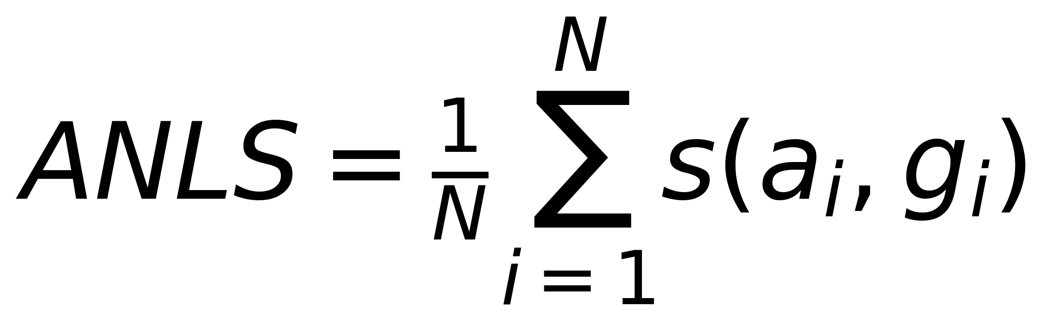
Mathematical Formalization of Reliability
Hybrid Synchronization: $C = S_{ocr} \parallel S_{vlm}$
Accuracy Metric: ANLS:
Fidelity Metric: Exact Match: Binary indicator of absolute precision.
6 / 15

Slide 8
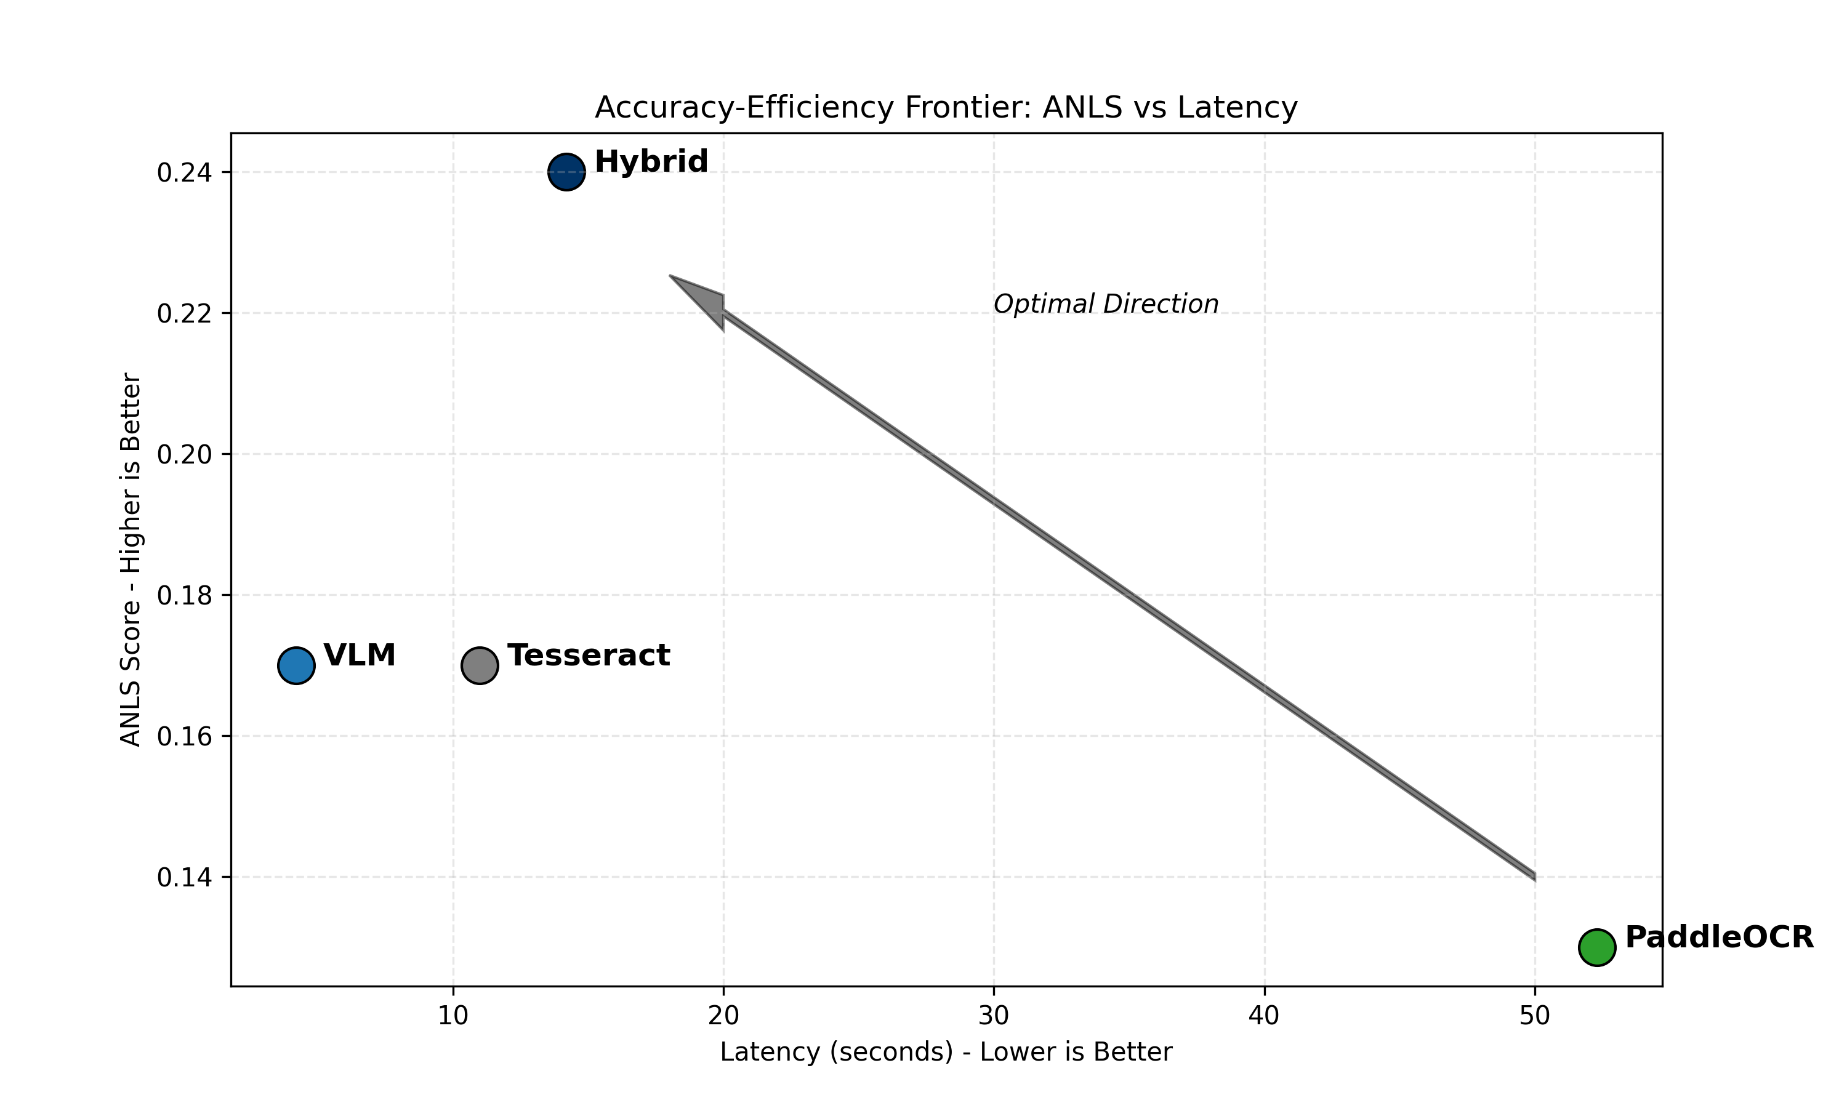
The Accuracy-Efficiency Frontier
7 / 15

Slide 9
Benchmarking Results: Performance Delta
Observation: The Hybrid model achieves significantly higher ANLS scores over standalone VLMs in dense tabular environments.
Trade-off: Improving perception fidelity requires a significant computational trade-off in inference latency.
8 / 15

Slide 10
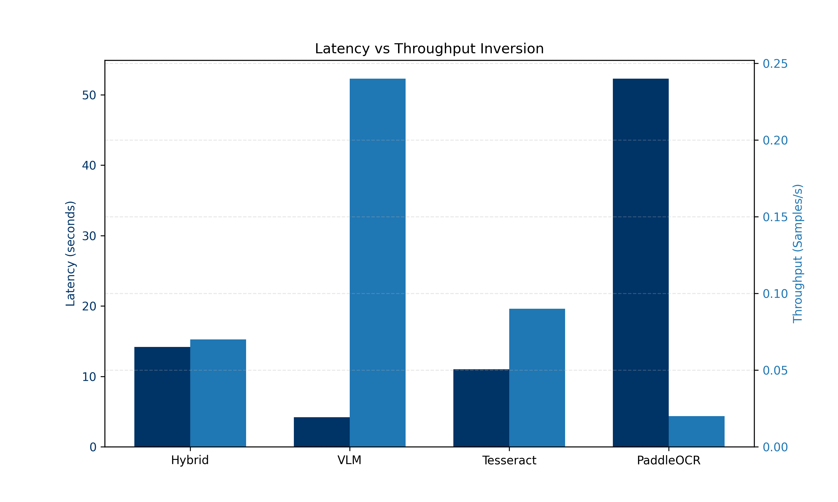
Quantitative Evidence: Efficiency & Memory
9 / 15

Slide 11
Resource Footprint Analysis
Throughput Inversion: While VLMs provide higher throughput, their reliability in zero-shot extractions is significantly lower.
Memory Consumption: Hybrid models demand higher memory (RSS) due to dual-stream synchronization overhead.
10 / 15

Slide 12
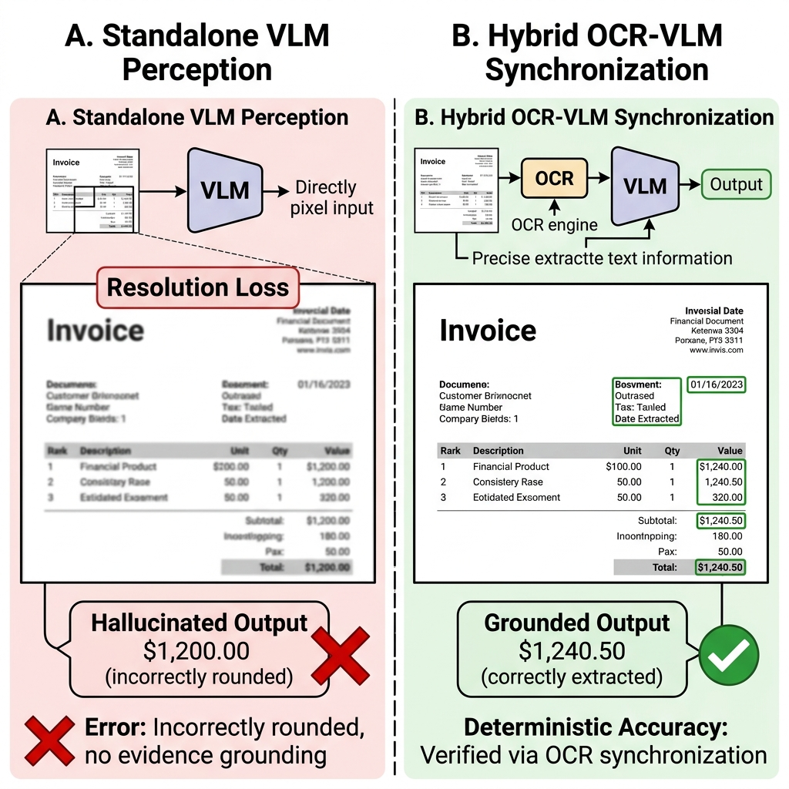
Visualizing Failure Modes: Hallucination Case Study
11 / 15

Slide 13
Qualitative Analysis: Standalone VLM vs Hybrid
VLM Failure: Resolution-loss causes rounding errors and "probabilistic guessing" in financial figures.
Hybrid Remediation: Deterministic OCR grounding recovers exact alphanumeric sequences ($1,240.50$ vs $1,200.00$).
12 / 15

Slide 14
Discussion: Structural Robustness & Limitations
Adversarial Complexity: Low ANLS scores reflect the benchmark's focus on high-complexity, multi-column adversarial layouts.
Computational Overhead: Dual-stream synchronization increases latency, necessitating future GPU-accelerated optimization.
13 / 15

Slide 15
Conclusion and Future Directions
Conclusion: Fusing character grounding with semantic layout awareness is essential for mitigating hallucinations in mission-critical AI.
Future Work: Scaling across dense tabular corpora and Investigating natively layout-aware architectures (LayoutLMv3).
14 / 15

Slide 16
Thank You
15 / 15

