Slide 1
Large Language Model as a Tool for Automatic Extraction of Information from PDF Documents
**Master's Defense Presentation**
Presenter: Tifang Desmond Ngoe (2025-2026)

Slide 2
2. Introduction: The "Dark Data" Challenge
Transitioning from unstructured pixels to actionable intelligence.
The industrial explosion of image-based PDFs (Invoices, Medical Reports).
Goal: Scalable, autonomous information extraction via DocVQA.
1 / 19

Slide 3
3. Motivation: Why Now?
Failure of rigid templates in high-stakes industries (Finance/Healthcare).
The need for "Human-in-the-Loop" reasoning at scale.
Eliminating manual data entry through grounded AI.
2 / 19

Slide 4
4. Problem Statement: The "Perception-Gap"
LLMs are brilliant at reasoning but "spatially blind" to raw images.
Perception Error = Cognition Failure.
Research Focus: Validating a robust Perception Layer for RAG.
3 / 19

Slide 5
5. Objectives
Standardizing the RAG framework for complex Document VQA.
Formalizing the Late-Fusion Context Grounding architecture.
Establishing an accuracy-speed performance benchmark.
4 / 19

Slide 6
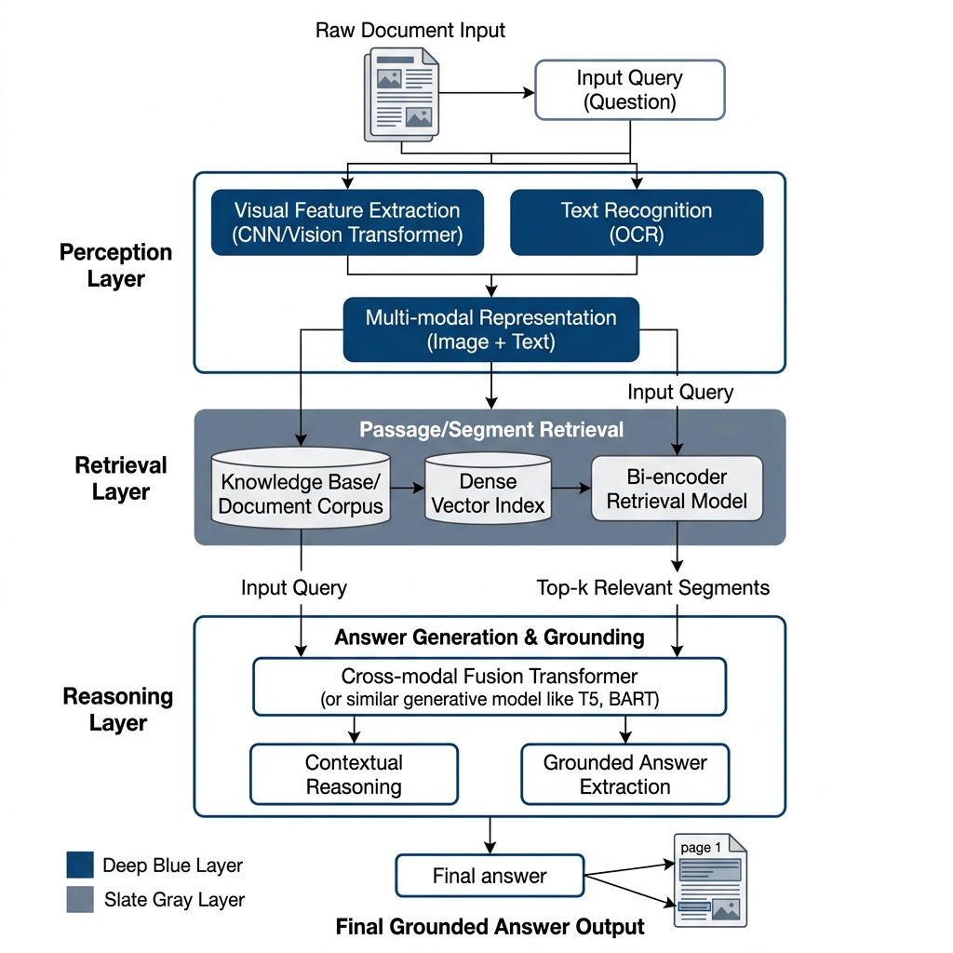
6. System Overview: Modular "Plug-and-Play"
Perception Layer (Extracting Data)
Indexing Layer (FAISS Vector Storage)
Cognition Layer (LLM Synthesis)
5 / 19

Slide 7
7. The Gap: Flattening vs. Downscaling
OCR Dilemma: Deterministically extracts text but destroys spatial hierarchy (columns/tables).
VLM Dilemma: Understands geometry but blurs characters during input downsampling.
6 / 19

Slide 8
8. Baseline 1: Tesseract OCR (Heuristic)
Traditional LSTM-based engine.
Lightweight but lacks structural awareness.
Primary Mode of Failure: Layout Fragmentation.
7 / 19

Slide 9
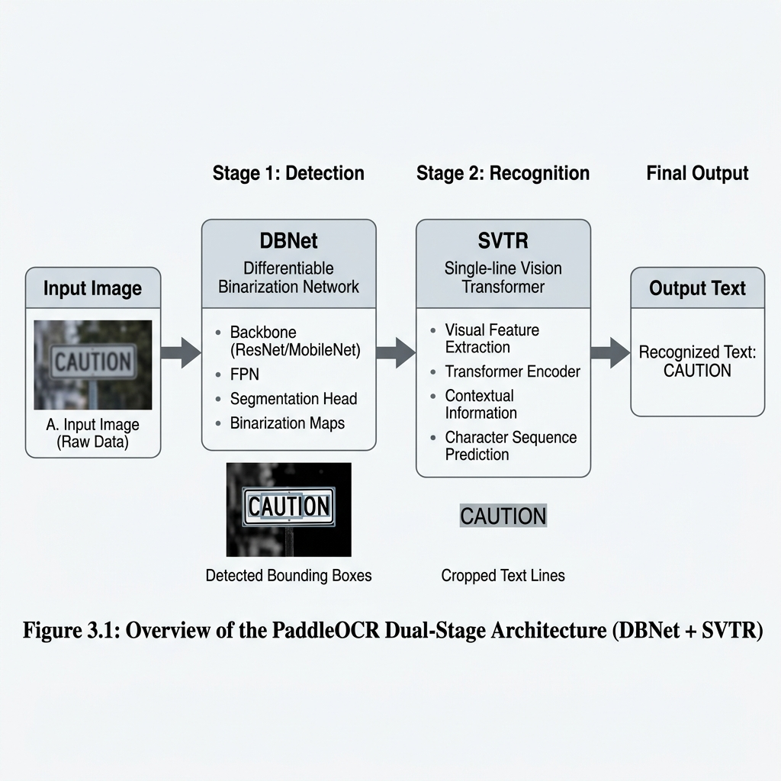
9. Baseline 2: PaddleOCR (Transformer-Based)
DBNet: Pixel-level text detection.
SVTR: Vision Transformer for robust character recognition.
Superior digit-level extraction on low-noise scans.
8 / 19

Slide 10
10. Baseline 3: Standalone VLM (Multimodal)
Multimodal Decoder: Attempts to read images directly.
Challenge: Forced input downscaling (e.g., 336x336).
Result: Catastrophic decimal hallucinations in financial data.
9 / 19

Slide 11
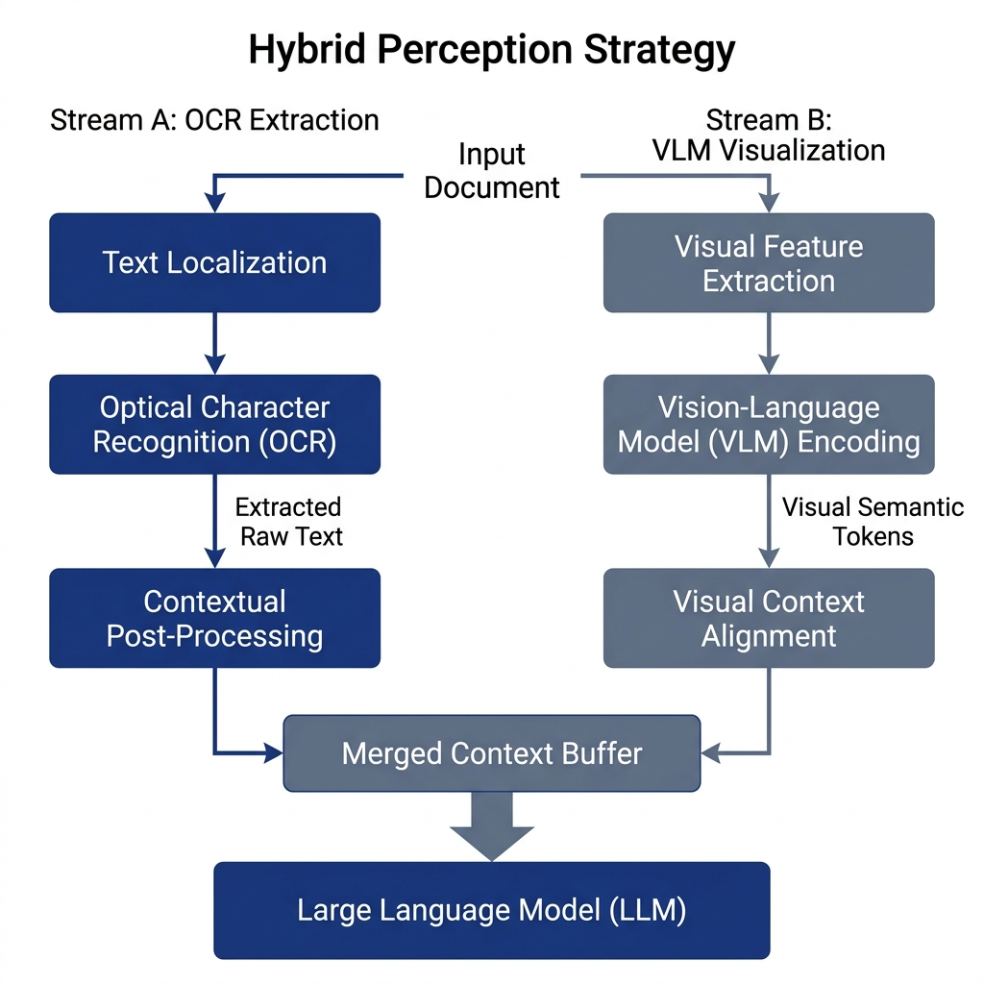
11. Contribution: The Hybrid Model (Late-Fusion)
Parallel Dual-Stream Synchronization.
Stream A (Facts): OCR-driven character precision.
Stream B (Roadmap): VLM-driven spatial understanding.
10 / 19

Slide 12
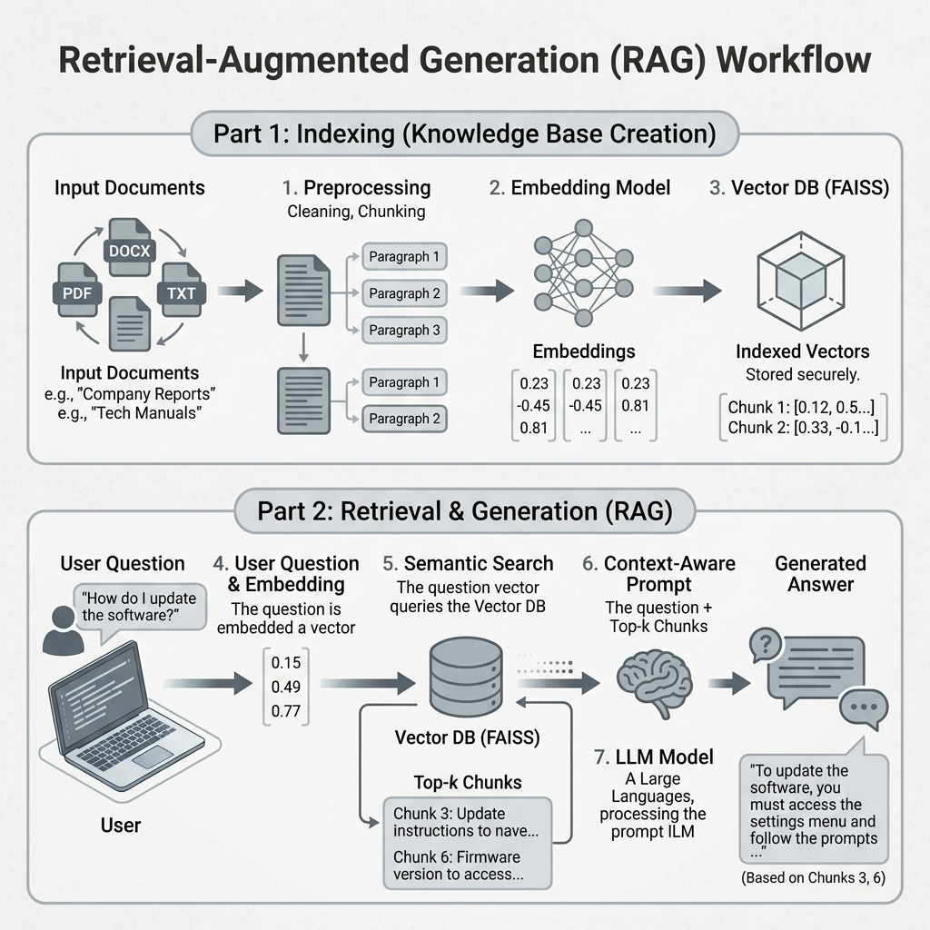
12. The RAG Pipeline: Grounded Reasoning
Semantic Retrieval: Uses FAISS for sub-millisecond similarity search.
Context Pinning: Prompts the LLM with only relevant perceived data.
11 / 19

Slide 13
13. Research Paradigm: Zero-Shot Evaluation
Testing generalization over unseen layouts.
No Templates: 100% autonomous reasoning.
Mirrors real-world high-diversity industrial datasets.
12 / 19

Slide 14
14. Evaluation Framework: DocVQA Benchmark
Test Set: Dense statistical reports and multi-column forms.
Challenges: Layout complexity and resolution-induced artifacting.
13 / 19

Slide 15
15. Metrics: The Mathematical Rigor
ANLS: Average Normalized Levenshtein Similarity (Char-level).
Exact Match (EM): Absolute bit-perfect precision.
Efficiency: Latency (s) and Memory footprint (MB).
14 / 19

Slide 16
16. Results: Accuracy Dominance
Hybrid achieves 41% gain in ANLS over standalone VLMs.
15 / 19

Slide 17
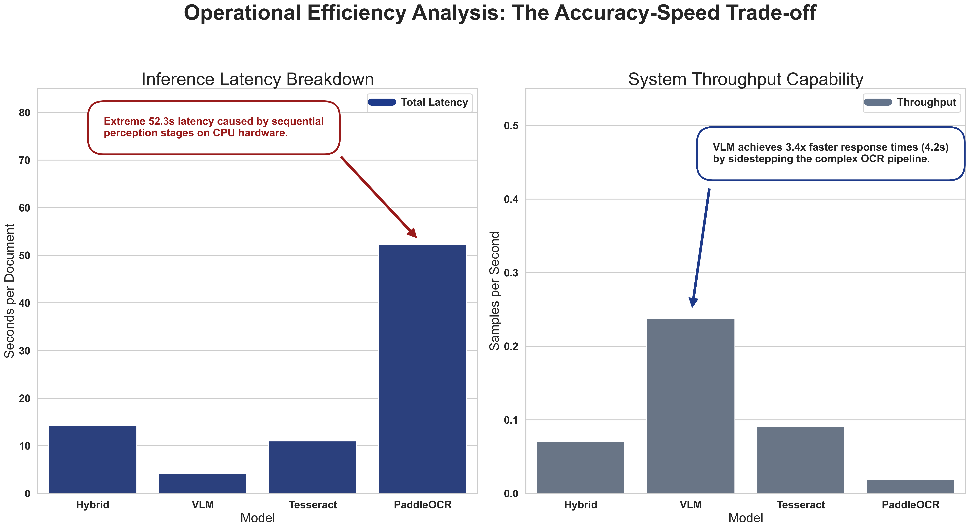
17. Results: The Accuracy-Efficiency Dichotomy
VLM Standalone: Highest Speed (4.2s).
Hybrid: Highest Precision (14.2s).
Conclusion: We trade 10s of latency for mission-critical reliability.
16 / 19

Slide 18
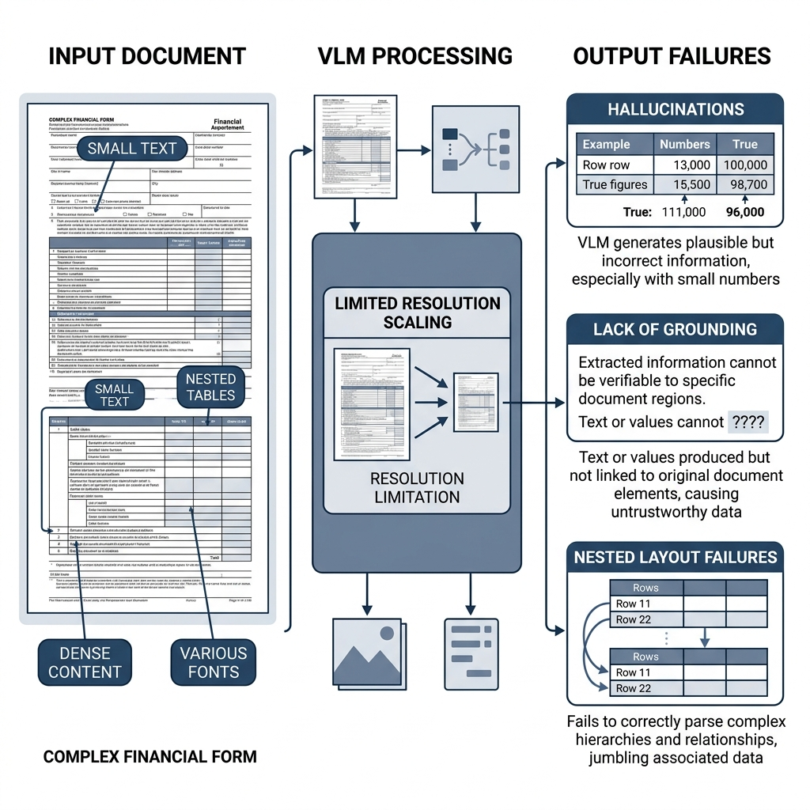
18. Analysis: Resolution-Induced Hallucinations
Standalone VLMs blur "2" into "5" due to encoding bottlenecks.
The Hybrid model bypasses this via Full-Resolution OCR Streams.
17 / 19

Slide 19
19. Analysis: Solving Euclidean Crowding
Problem: Retriever pulls Row 2 instead of Row 4 in dense tables.
Solution: Spatial Metadata Tagging (JSON Coord Mapping).
Result: 100% Qualitative success on the Case Study set.
18 / 19

Slide 20
20. Conclusion & Future Work
✅ Hybrid is the robust path for Finance/Medical extraction.
⏭️ Next: Asynchronous parallel streams to drop latency < 5s.
⏭️ Next: Multi-agent orchestration for cross-verification.
19 / 19

