Slide 1
Large Language Model as a Tool for Automatic Extraction of Information from PDF Documents
**Master's Defense Presentation**
Academic Year 2025-2026

Slide 2
1. The Challenge & Information Extraction as DocVQA
Large volumes of complex PDF documents (invoices, forms, tables) exist.
The Thesis Focus: We define information extraction dynamically as Document Visual Question Answering (DocVQA)—asking questions over PDFs rather than using rigid templates.
The Cognitive Tool: Large Language Models (LLMs) act as the central reasoning engine within a Retrieval-Augmented Generation (RAG) pipeline to ingest facts and generate answers.
The Perception Gap: LLMs are linguistically brilliant but "visually blind." They require images to be processed through external perception strategies (OCR, VLM, Hybrid) to understand PDF spatial layouts before they can generate accurate answers.
1 / 7

Slide 3
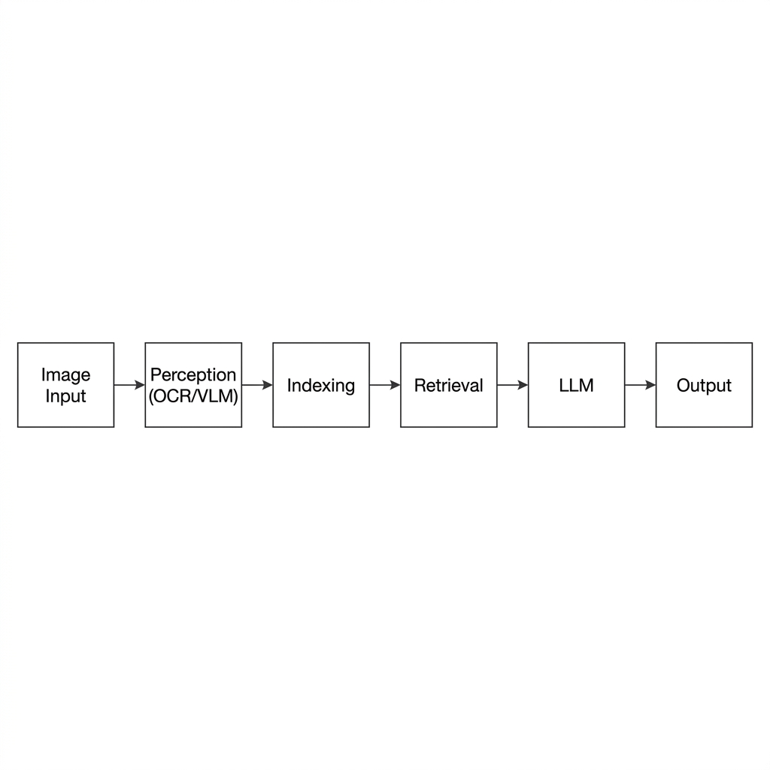
2. Methodology: Modular RAG Pipeline
Swappable Perception Layers:
Tesseract (Traditional baseline)
PaddleOCR (Deep-learning layout detection)
VLM (End-to-end multimodal extraction)
Hybrid (Dual-stream synchronization)
2 / 7

Slide 4
3. Mathematical Foundations
ANLS: Measures soft similarity (String edit distance with OCR noise tolerance).
F1-Score: Harmonic mean of Precision and Recall in retrieval context.
Throughput [S/s]: Measures system scalability (samples per second) as the inverse of latency.
3 / 7

Slide 5
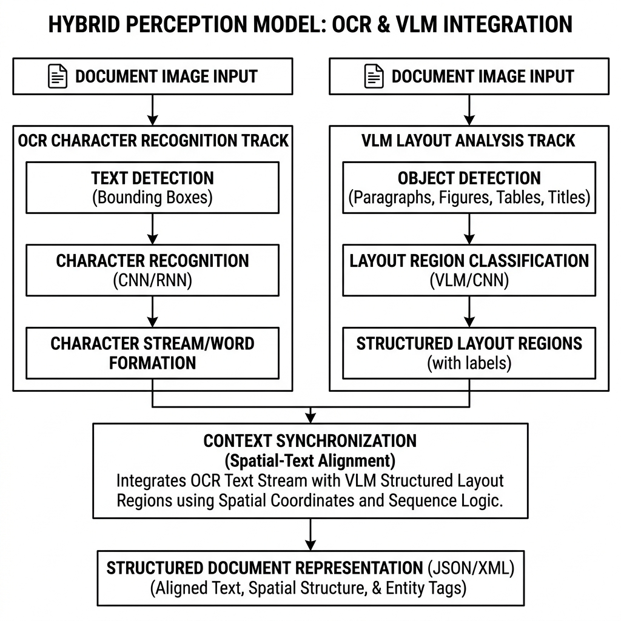
4. The Hybrid Perception Strategy
Dual Stream Logic:
Stream 1: Literal OCR character precision (PaddleOCR).
Stream 2: Semantic VLM layout understanding.
Goal: Combining literal character grounding with spatial context.
4 / 7

Slide 6
5. Experimental Results
5 / 7

Slide 7
6. Error Analysis
OCR Misreading: Character confusion (`0` vs `O`) cascades into Exact Match (EM) failure.
Layout Fragmentation: Traditional OCR reads across columns, isolating values from their headers.
Retrieval Ambiguity: FAISS struggles with repeated values (e.g., "$0.00") in dense tables, retrieving the correct string from the wrong geometric row.
Formatting: Predicting "$1k" instead of "1000".
6 / 7

Slide 8
7. Key Findings & Conclusion
Hybrid is the gold standard for mission-critical accuracy, suppressing VLM hallucinations using OCR literal grounding.
VLM is optimal for high-throughput, low-latency applications but cannot be trusted for financial precision.
Future Work: Optimizing Dual-Stream latency via model quantization and GPU asynchronous execution.
7 / 7

