Slide 1
Systems-Level Reliability Evaluation for Document AI: Bridging the Perception-Cognition Gap
**Master's Defense Presentation**
Academic Year 2025-2026

Slide 2
1. The Challenge: Reliability in Document AI
The Problem: Enterprise applications demand a robust approach to data corruption when extracting information from complex PDFs (invoices, medical records, financial forms).
DocVQA Architecture: We dynamically frame extraction as Document Visual Question Answering (DocVQA), using Large Language Models (LLMs) as the cognitive reasoning engine.
The Perception-Cognition Gap: While LLMs are linguistically brilliant, they lack spatial awareness. They must rely on external perception layers to understand layouts.
Research Gap: Current systems either flatten documents, losing layout structure (traditional OCR), or suffer from resolution-loss hallucinations due to input constraints (end-to-end VLMs).
1 / 8

Slide 3
2. Research Contributions
2 / 8

Slide 4
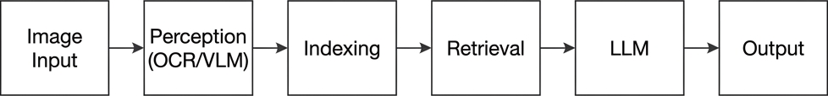
3. Methodology: Modular RAG Pipeline
Swappable Perception Layers:
Tesseract (Traditional baseline)
PaddleOCR (Deep-learning layout detection)
VLM (End-to-end multimodal extraction)
Hybrid (Dual-stream synchronization)
3 / 8

Slide 5
4. Mathematical Foundations
ANLS: Measures soft similarity (String edit distance with OCR noise tolerance).
Exact Match (EM): Absolute identity sim(\mathbf{P}, \mathbf{G}) = 1.
F1-Score: Harmonic mean of Precision and Recall in retrieval context.
Cosine Similarity: sim(\mathbf{q}, \mathbf{c}) = \frac{\mathbf{q} \cdot \mathbf{c}}{\|\mathbf{q}\| \|\mathbf{c}\|}.
Throughput [S/s]: Scalability metric (Tp = 1/L).
4 / 8

Slide 6
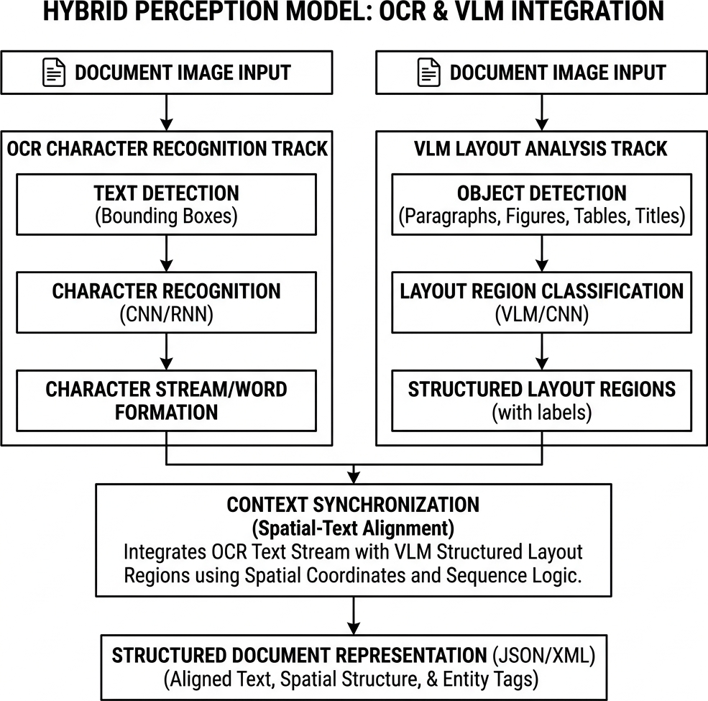
5. The Hybrid Perception Strategy
Dual Stream Logic:
Stream 1: Literal OCR character precision (PaddleOCR).
Stream 2: Semantic VLM layout understanding.
Goal: Combining literal character grounding with spatial context.
5 / 8

Slide 7
6. Experimental Results
6 / 8

Slide 8
7. Error Analysis and Hallucinations
Resolution-Loss Hallucinations: Standalone VLMs probabilistically guess numbers when input patches are downsampled, generating plausible but incorrect answers.
Layout Fragmentation: Traditional OCR reads across columns, degrading semantic relationships and poisoning the retrieval index.
Retrieval Ambiguity: FAISS struggles with repeated values (e.g., "$0.00") in dense tables, retrieving the correct string from the wrong geometric row.
7 / 8

Slide 9
8. Conclusion, Limitations, and Future Work
Conclusion: Fusing literal character grounding with semantic layout awareness is essential for suppressing resolution-loss hallucinations in multimodal tasks.
Limitations: The Hybrid architecture exhibits significant computational overhead, and experiments were constrained by CPU limitations and a 50-document validation scale.
Benchmark Context: Low absolute ANLS scores reflect the strict zero-shot evaluation protocol on high-complexity layouts, rather than model instability. Baseline models like LayoutLMv3 were omitted due to lack of task-specific fine-tuning resources.
Future Work: Optimizing Dual-Stream latency via GPU-accelerated tensor processing and scaling across dense tabular-specific corpora (e.g., TabFact).
8 / 8

