Slide 1
Systems-Level Reliability and Robustness Evaluation Framework for Document AI
Master's Thesis Defense
Tifang Desmond Ngoe
Czestochowa University of Technology
Supervisor: Prof. Piotr Duda
Academic Year 2025-2026

Slide 2
Introduction / Problem Statement
Document AI Complexity: Modern enterprise pipelines rely heavily on automated extraction of information from complex PDF documents.
The PDF Challenge: Unstructured documents contain rich multi-column formats, dense tabular grids, and geometric layouts that defy simple reading orders.
Hallucination & Layout Risks: Semantic understanding without visual awareness leads to layout-blindness, causing critical extraction failures.
Critical Downstream Risk: A tiny character reading error (e.g., distorting $1,240.50 into a rounded $1,200.00 on a scanned invoice) is not just a simple spelling mistake—it propagates into automated financial ledgers, causing catastrophic audit and compliance failures in finance and healthcare.
1 / 19

Slide 3
Research Objective
Addressing the Perception-Cognition Gap: Bridging the disconnect where LLMs show advanced linguistic reasoning but fail at structural, spatial perception.
Scientific Goal: Formulating a rigorous, systems-level reliability evaluation framework for DocVQA architectures under zero-shot conditions.
Robustness Benchmarking: Swapping and analyzing perception modules to establish a reliable accuracy-efficiency frontier for real-world deployments.
2 / 19

Slide 4
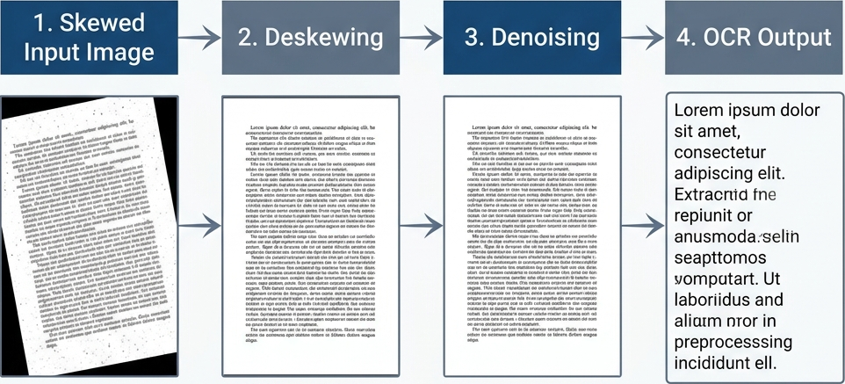
Traditional OCR (Tesseract)
Heuristic Baseline: Relies on classical layout algorithms to group and serialize characters.
Linearization Fragmentation: Converts multi-column text horizontally into a single continuous stream, destroying reading order and paragraph alignment.
Fidelity Loss: Separates tabular cells from headers, making spatial relation reasoning impossible.
Figure 4.3: OCR Preprocessing Pipeline
3 / 19

Slide 5
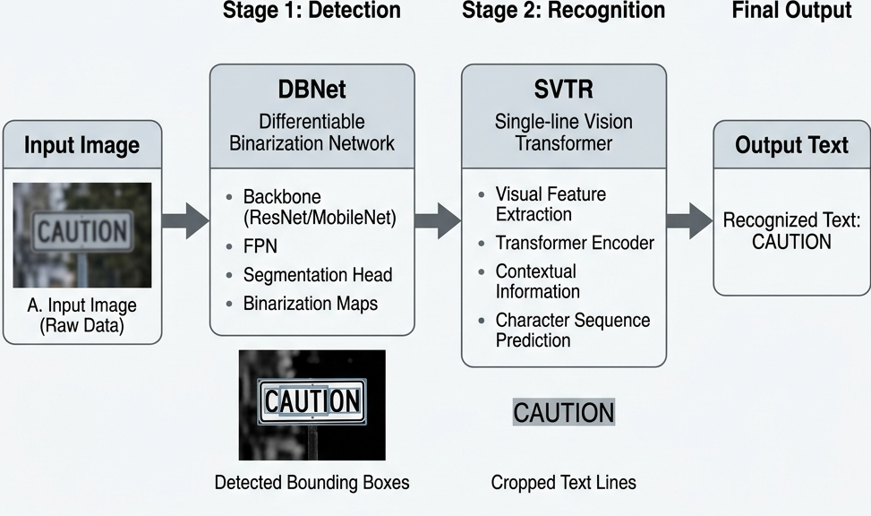
PaddleOCR
Deep-Learning Spatial Detection: Employs an academic DBNet detector combined with SVTR recognizer for raw character mapping.
Layout Robustness: Highly precise alphanumeric localization, minimizing character confusion.
The Cognitive Limit: Captures characters perfectly but lacks semantic context, requiring a downstream layout reconstruction layer.
Figure 2.2: PaddleOCR Advanced Multi-Stage Architecture
4 / 19

Slide 6
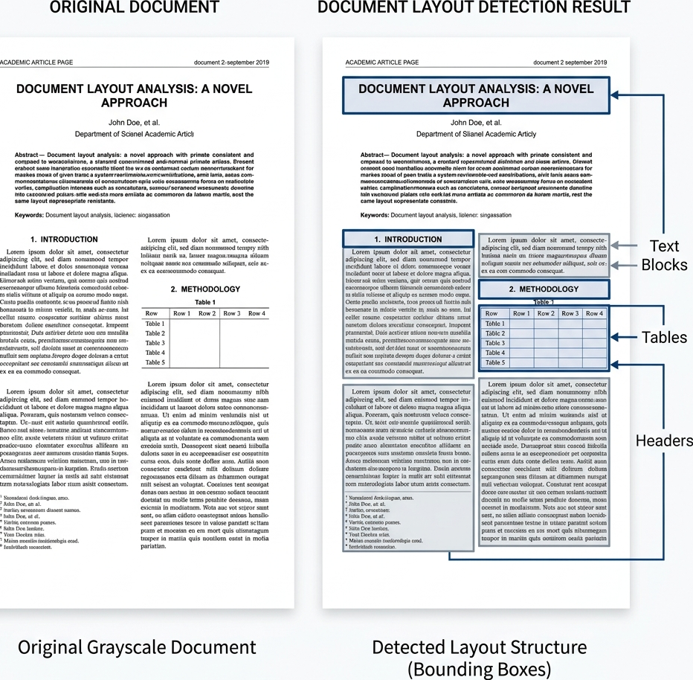
Perception Layer
Layout Detection & Text Localization: Automatically mapping page regions, paragraphs, and nested table cells.
Character Grounding: Indexing absolute 2D bounding boxes $(x_1, y_1, x_2, y_2)$ to ensure alphanumeric fidelity.
Spatial Alignment: Preparing structured, geometry-preserved raw text streams for cognitive processing.
Figure 2.3: Layout Detection and Document Structure Logic
5 / 19

Slide 7
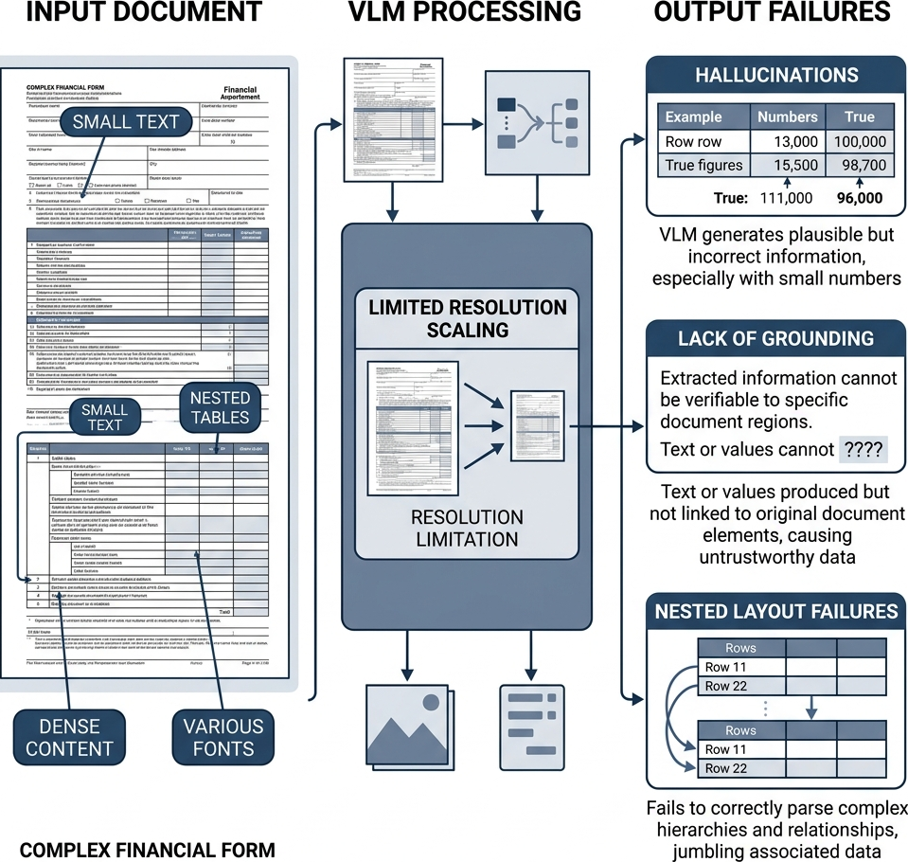
Vision-Language Models (VLMs)
Multimodal Generation: Treats document images natively as input patches, removing the need for heuristic pipelines.
Resolution-Loss Hallucination: Fixed patch resolutions (e.g., 336x336 pixels) compress fine-grained tabular data, leading to character distortion.
The Perception Failure: "Probabilistic guessing" of dense digits in complex zero-shot layouts due to resolution-loss and pixel alignment errors.
Figure 2.4: VLM Projection Layer and Resolution Constraints
6 / 19

Slide 8
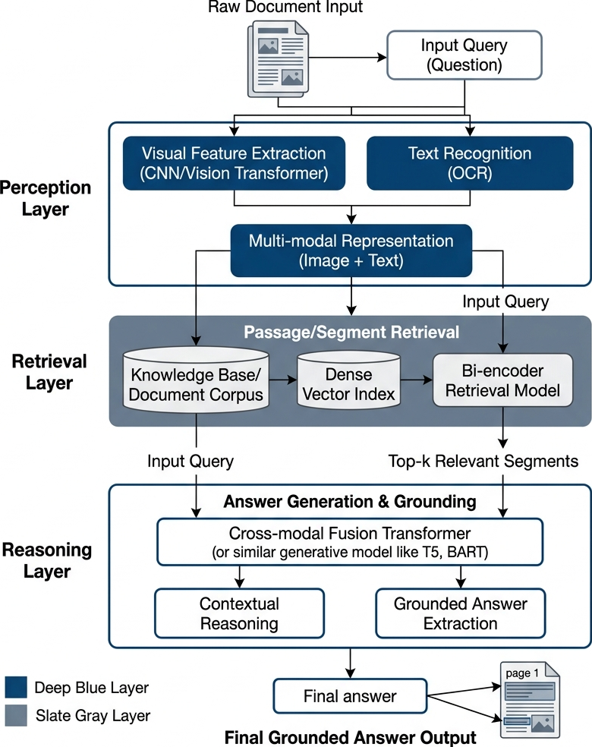
Hybrid OCR-VLM Synchronization
Dual-Stream Synchronization: Merging the literal precision of PaddleOCR with the high-level semantic layout awareness of VLMs.
Perception Safety Net: Grounding VLM spatial reasonings inside verified deterministic OCR character coordinates.
Robustness Fusing: Drastically reduces layout confusion and generative hallucinations in zero-shot extractions.
Figure 4.1: Advanced Global System Orchestration Architecture
7 / 19

Slide 9
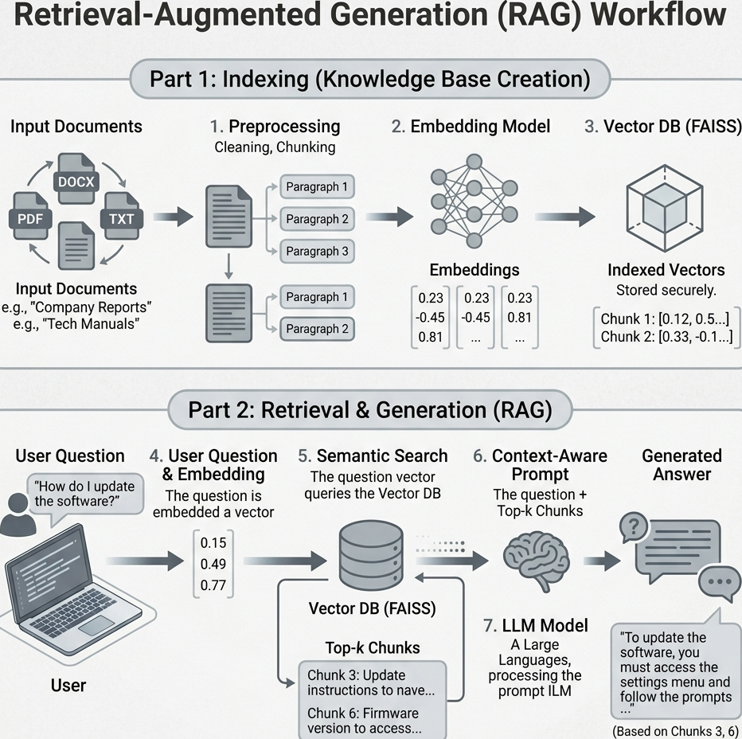
RAG / Connection Layer
Vector Space Mapping: Projecting layout-aware chunked documents into a FAISS vector database using `all-MiniLM-L6-v2`.
Hybrid Context Retrieval: Querying and fetching high-relevance chunks grounded with precise spatial metadata.
Cognitive Reasoning: Supplying localized context to the Mistral 7B Instruct reasoning engine.
Figure 3.1: Semantic Embedding and Vector Storage Workflow
8 / 19

Slide 10
Benchmark Framework
Test Corpus: Compiled 50 high-complexity PDFs from the DocVQA validation set (dense nested tables, scan noise, multi-column designs).
Strict Zero-Shot Paradigm: No domain-specific or layout-specific fine-tuning, evaluating raw generalization robustness.
Swappable Architecture: Systematically isolating and measuring the impact of each perception stream under identical reasoning conditions.
9 / 19

Slide 11
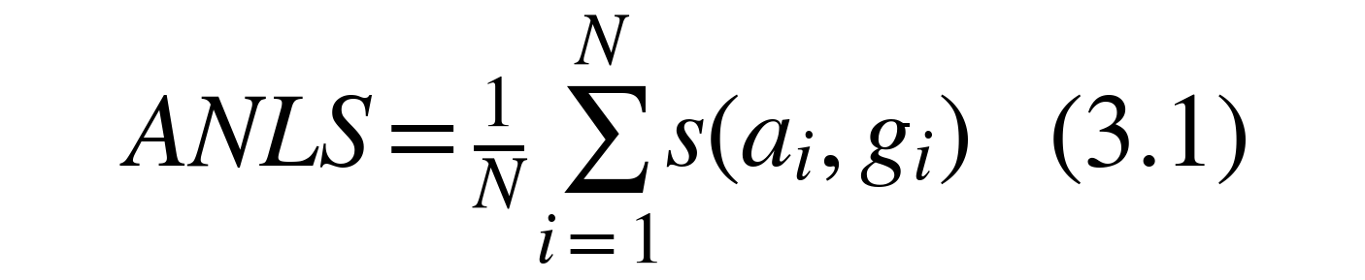
ANLS Accuracy Evaluation
ANLS Definition: Standard soft-spelling matching similarity metric for Document Visual QA.
N: Total size of the evaluation corpus (here N = 50 queries).
a_i: Predicted answer string generated by the cognitive model for query i.
g_i: Authoritative human-verified ground truth target answer for query i.
s(a_i, g_i): Soft similarity score. If similarity is < 0.5, score is 0 to reject hallucinations.
10 / 19

Slide 12
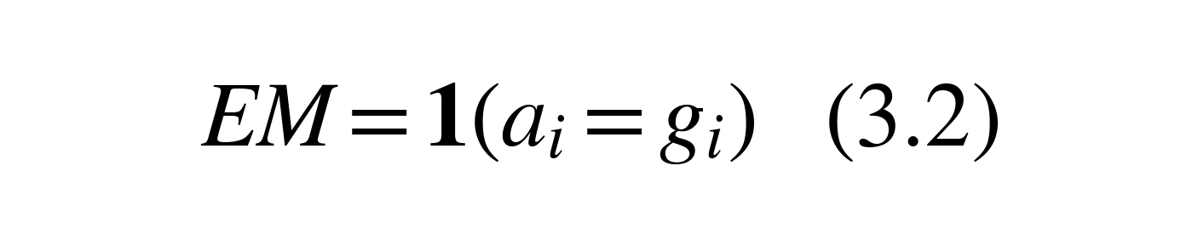


Secondary Performance Metrics
Exact Match (EM): Strictest binary accuracy requiring character-for-character agreement.
F1-Score: Token-level harmonic mean of Precision P and Recall R measuring lexical overlap.
L_i: System latency (seconds) to process query i through both dual-stream layers.
T_p: System throughput indicating processed query samples per second.
11 / 19

Slide 13
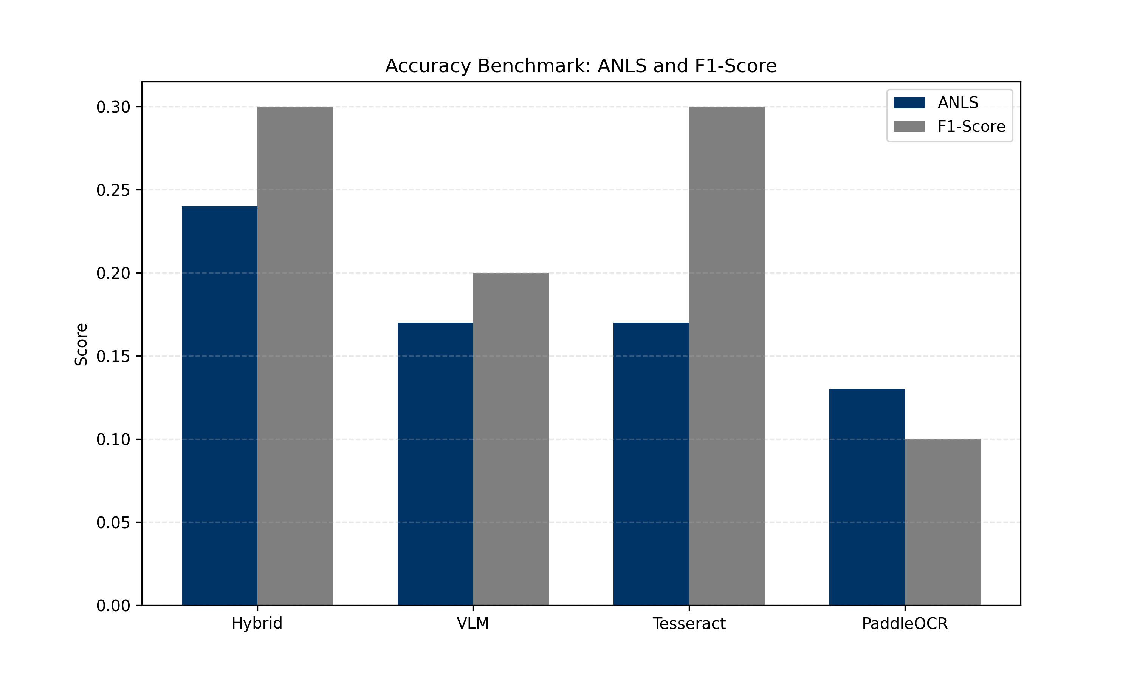
Experimental Results
Empirical Breakthrough: The proposed Hybrid model achieves the highest accuracy, outperforming standalone VLMs and OCR pipelines.
The Performance Frontier: Validating that visual layout synchronization is essential to resolve complex DocVQA prompts.
Figure 7.2: Accuracy Benchmark Matrix (ANLS vs F1)
12 / 19

Slide 14
Performance Metrics Table
Comprehensive Evaluation: Performance comparison across accuracy, operational latency, throughput, and system resource overhead.
Accuracy vs. Efficiency: The Hybrid model achieves the highest accuracy at the cost of higher latency and RAM consumption.
System Model | ANLS | Exact Match (EM) | F1-Score | Inference Latency | Throughput | RAM Footprint | Search Efficiency
Hybrid (Ours) | 0.24 | 0.20 | 0.30 | 14.20 s | 0.07 S/s | 4600 MB | Sub-ms (<1ms)
Standalone VLM | 0.17 | 0.10 | 0.20 | 4.20 s | 0.24 S/s | 4100 MB | N/A
Tesseract RAG | 0.17 | 0.10 | 0.30 | 11.00 s | 0.09 S/s | 350 MB | Sub-ms (<1ms)
PaddleOCR RAG | 0.13 | 0.00 | 0.10 | 52.30 s | 0.02 S/s | 850 MB | Sub-ms (<1ms)
Table 7.1: Exhaustive Performance Benchmarking Matrix
13 / 19

Slide 15
Ablation Study
Isolating Stream Contributions: Systematic removal of layout spatial detection and character grounding streams.
Perception Grounding Efficacy: Proves that character coordinate anchoring is the primary driver in reducing hallucination rates.
Architecture | Layout Detection | Text Grounding | VLM Context | ANLS | EM
Hybrid (Full) | Yes | Yes | Yes | 0.24 | 0.20
No Grounding | Yes | No | Yes | 0.17 | 0.10
No Layout | No | Yes | Yes | 0.13 | 0.00
Table 7.2: Perception Component Ablation Study
14 / 19

Slide 16
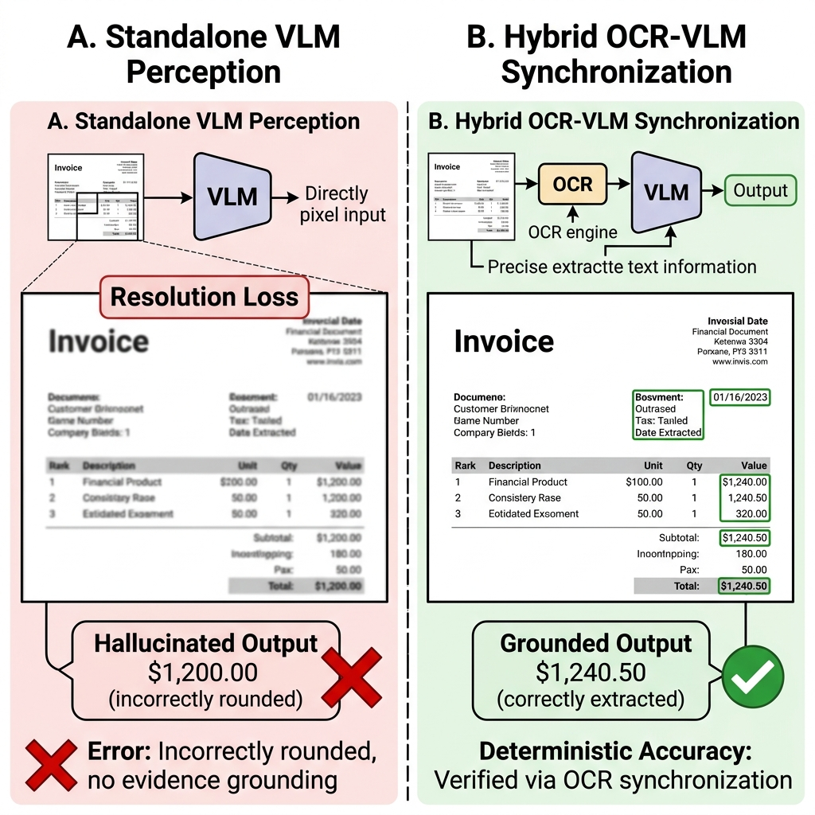
Error Analysis / Case Studies
Low ANLS Failure Modes: Poor document contrast, low scanning resolution, and heavily overlapping text boundaries.
Visual Evidence: VLM resolution-loss vs. Hybrid character-grounding precision.
Figure 7.6: Visual Case Study of VLM Resolution-Loss vs. Hybrid Precision
15 / 19

Slide 17
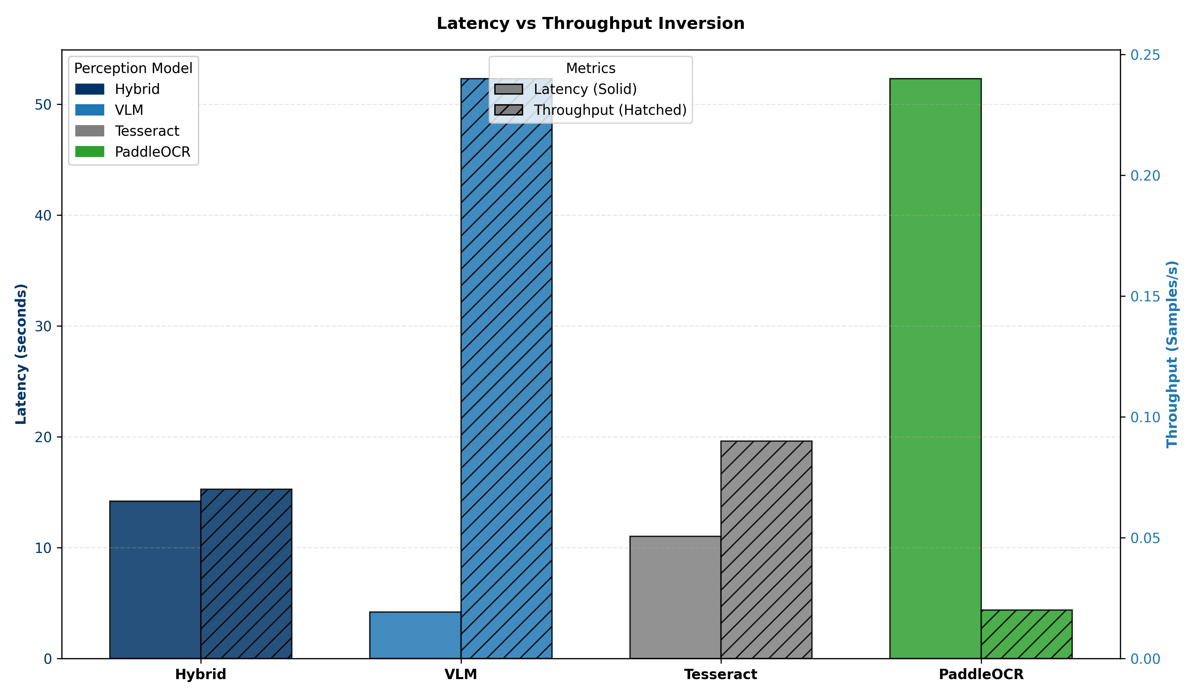
Deployment Considerations
Accuracy-Efficiency Trade-off: High-reliability synchronization demands dual neural network overhead (14.2s latency).
Memory Footprint: Fusing multiple streams increases RSS RAM footprint (4600MB).
Recommendation: Deploy in offline mission-critical pipelines, using async processing to mitigate CPU-bound latency.
Figure 7.3: Accuracy-Efficiency Frontier and Latency Inversion
16 / 19

Slide 18
Conclusion
Bridging the Gap: Synchronized OCR-VLM architecture successfully bridges the perception-cognition disconnect.
Grounding Efficacy: Deterministic character grounding is vital for eliminating LLM hallucinations in structured documents.
Standardized Framework: Provides a repeatable system-level benchmark for modern Document AI research.
17 / 19

Slide 19
Future Work: Multi-Agent System
Agentic Pipeline Evolution: Transitioning from a rigid pipeline to a cooperative multi-agent network.
Layout Detection Agent: Responsible for spatial column splits, tabular boundary parsing, and geometric structure.
Text Detection & OCR Agent: Specialized in high-fidelity character recognition, raw transcription, and bounding box coordinates.
Image & Visual Perception Agent: Dedicated to understanding non-textual primitives, charts, figures, and embedded artwork.
Coordinator & Routing Agent: Orchestrating agent dialogue, resolving data conflicts, and synthesizing unified factual contexts.
18 / 19

Slide 20
Thank You
Thank You for Your Attention
Questions & Discussion
Tifang Desmond Ngoe
Academic Year 2025-2026

