Slide 1
Systems-Level Reliability and Robustness Evaluation Framework for Document AI
Master's Thesis Defense
Tifang Desmond Ngoe
Czestochowa University of Technology
Supervisor: Prof. Piotr Duda
Academic Year 2025-2026

Slide 2
The Document AI Challenge
Enterprise Bottleneck: Modern pipelines rely heavily on extracting unstructured data from complex PDFs.
Visual Complexity: Dense tabular grids and multi-column geometries defy simple text reading orders.
The Perception Gap: Semantic LLMs without spatial awareness hallucinate structural data.
Critical Risk: A minor layout misread (e.g., distorting $1,240.50) triggers catastrophic failures in downstream financial audits.
1 / 15

Slide 3
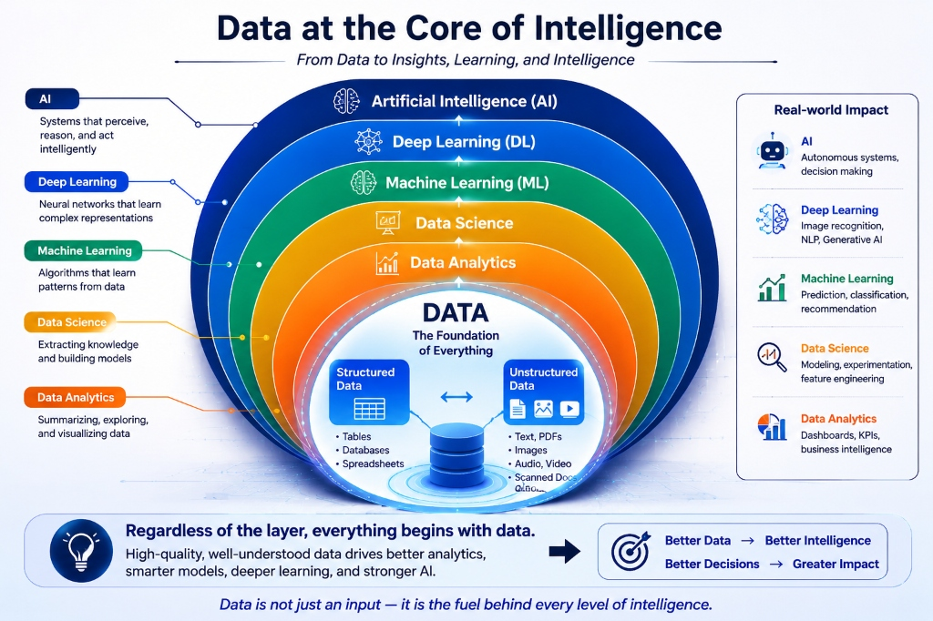
Data as the Core Foundation of AI
The Ultimate Catalyst: All downstream cognitive reasoning is fundamentally capped by the accuracy of the perception layer.
Bridging the Disconnect: We must bridge the gap where LLMs show advanced linguistic reasoning but fail at structural, spatial perception.
Figure 1.0: Data as the Core Foundation of AI Systems
2 / 15

Slide 4
Research Objective
Formulate a Benchmark: Create a rigorous reliability evaluation framework for DocVQA architectures under zero-shot conditions.
Investigate Perception: Isolate and evaluate the exact impact of spatial grounding on LLM hallucination rates.
Establish a Frontier: Map the accuracy-efficiency trade-offs across Traditional OCR, VLMs, and Hybrid models.
3 / 15

Slide 5
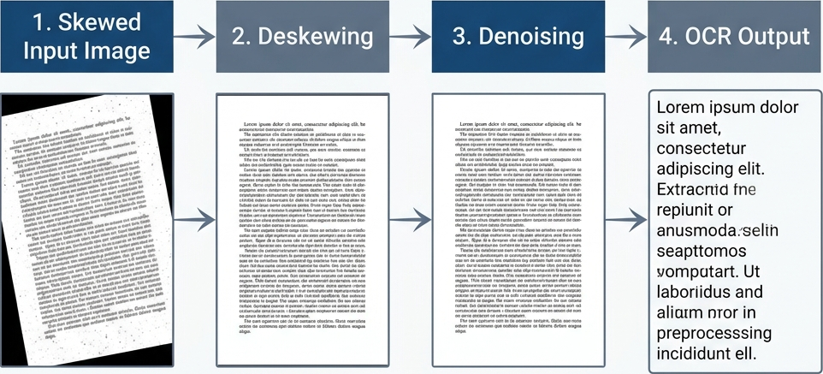
Traditional Baseline: OCR (Tesseract)
Heuristic Algorithms: Relies on rigid rules to group characters.
Linearization Failure: Converts multi-column layouts into a single, corrupted horizontal text stream.
Fidelity Loss: Completely destroys spatial relationships inside complex tables.
Figure 4.3: OCR Preprocessing Pipeline
4 / 15

Slide 6
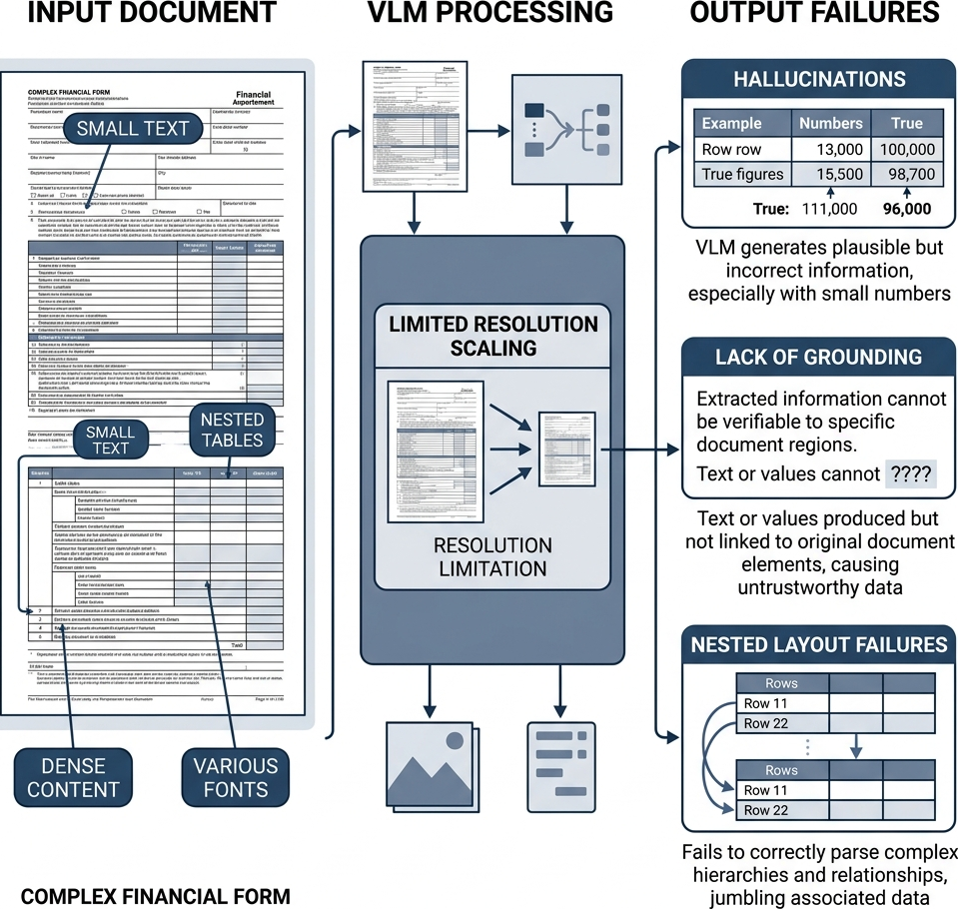
Modern Baseline: Vision-Language Models (VLMs)
Multimodal Promising: Treats entire document images natively as input patches.
Resolution Constraints: Fixed patch limits (e.g., 336x336 pixels) heavily compress dense tabular data.
The Perception Failure: Zero-shot VLMs probabilistically "guess" digits when pixel alignment is lost, leading to severe hallucination.
Figure 2.4: VLM Projection Layer and Resolution Constraints
5 / 15

Slide 7
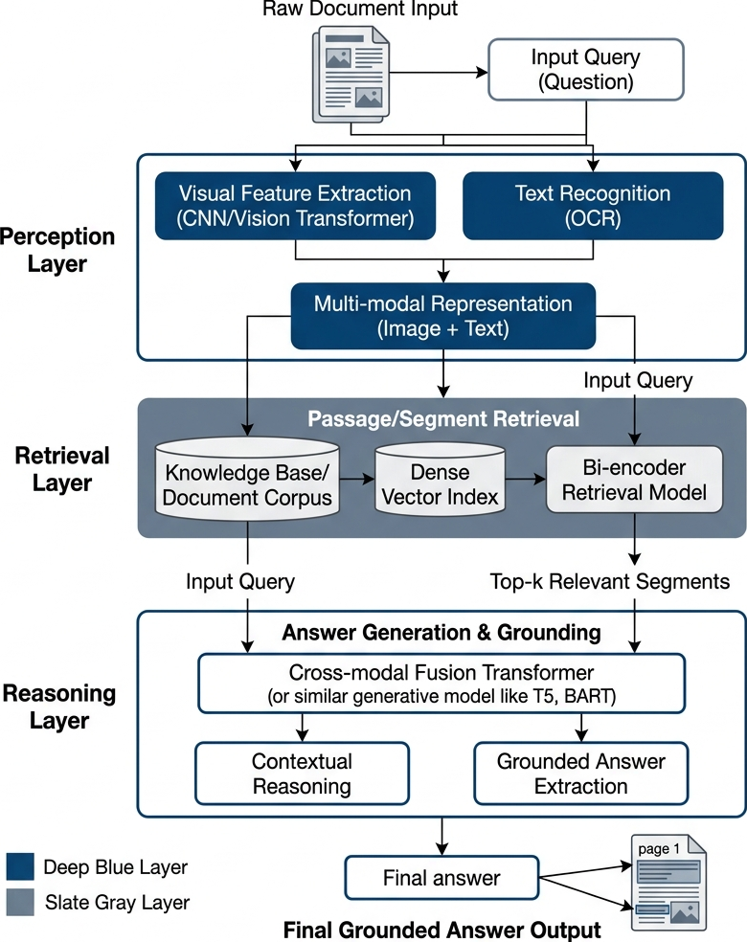
Proposed Solution: Hybrid OCR-VLM
Dual-Stream Synchronization: Merges the literal character precision of PaddleOCR with the semantic layout awareness of VLMs.
Spatial Anchoring: Indexes exact 2D bounding boxes $(x_1, y_1, x_2, y_2)$ for absolute alphanumeric fidelity.
Perception Safety Net: Grounds VLM reasoning inside verified, deterministic OCR coordinates to eliminate hallucination.
Figure 4.1: Advanced Global System Orchestration Architecture
6 / 15

Slide 8
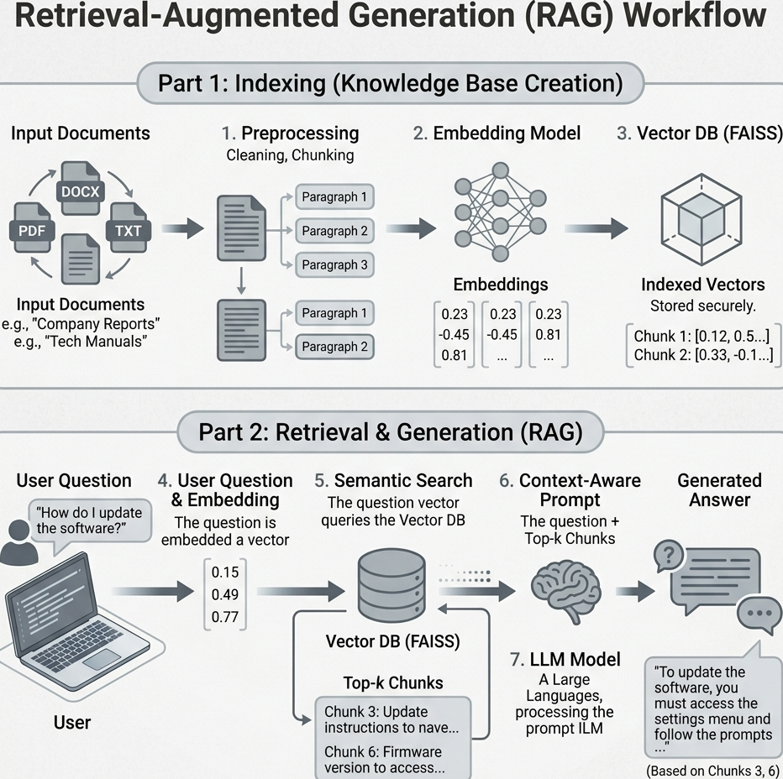
RAG Connection Layer
Vector Space Mapping: Layout-aware documents are chunked and projected into a FAISS database using `all-MiniLM-L6-v2`.
Hybrid Retrieval: Fetches high-relevance chunks mathematically grounded with precise spatial metadata.
Cognitive Reasoning: Feeds deterministic context directly into the Mistral 7B Instruct reasoning engine.
Figure 3.1: Semantic Embedding and Vector Storage Workflow
7 / 15

Slide 9
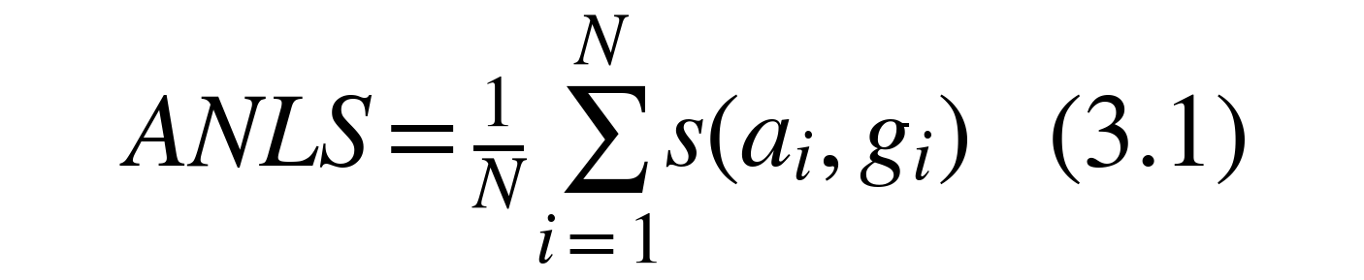
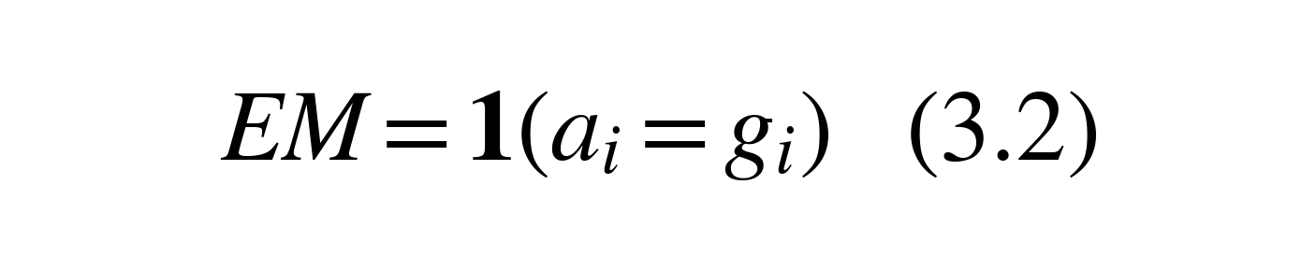
Evaluation Benchmark & Metrics
Test Corpus: 50 high-complexity zero-shot PDFs from the DocVQA validation set (dense tables, scans, multi-columns).
ANLS (Soft Similarity): Penalizes hallucinations while allowing minor formatting variances.
Exact Match (EM): Strictest binary accuracy.
F1-Score: Token-level lexical overlap measuring precision and recall.
8 / 15

Slide 10
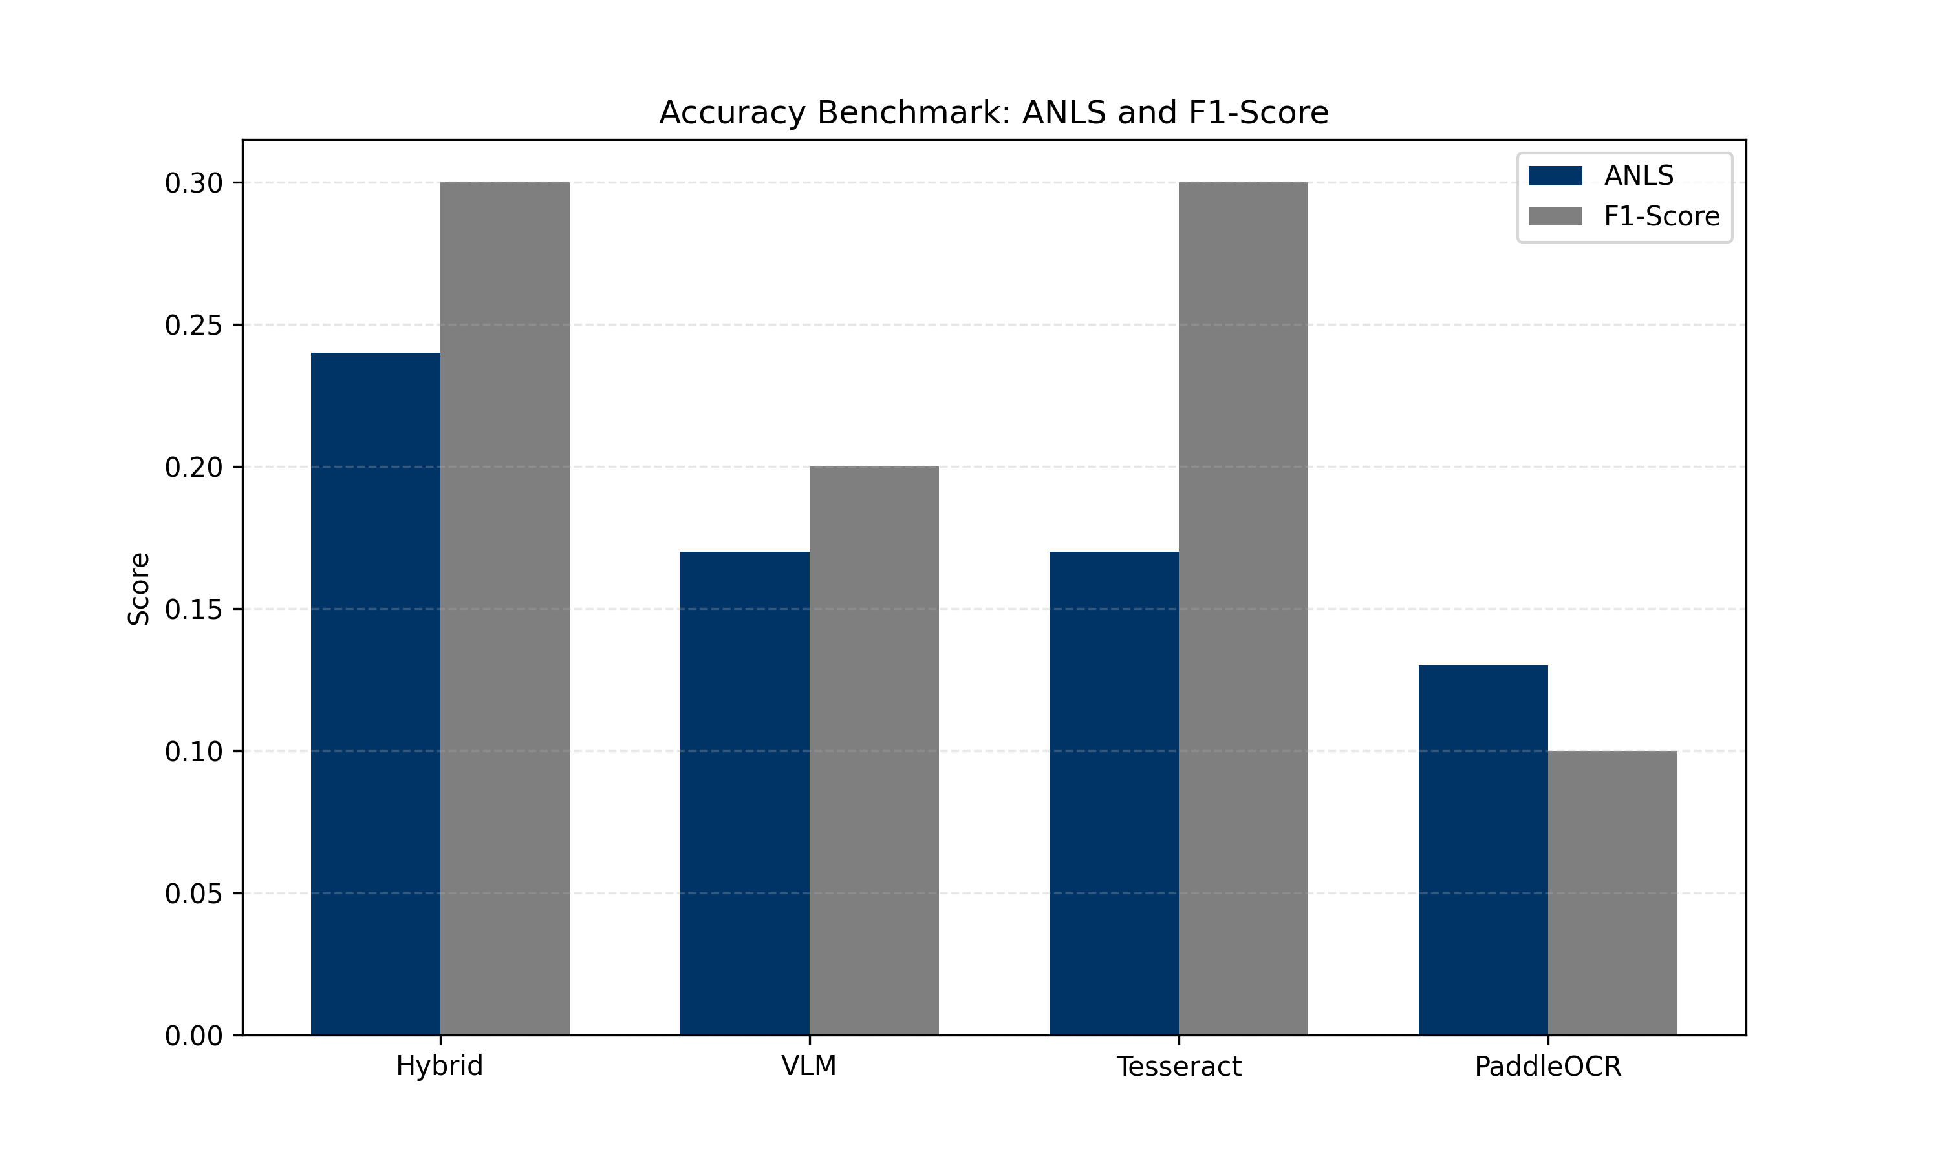
Experimental Results
Empirical Breakthrough: The Hybrid model strictly outperforms standalone VLMs and Traditional OCR.
Visual Evidence: Synchronization successfully prevents layout-blindness.
Figure 7.2: Accuracy Benchmark Matrix (ANLS vs F1)
9 / 15

Slide 11
Key Performance Findings
Massive Improvement: The Hybrid model achieves a 41% improvement in ANLS accuracy over standalone VLMs (0.17 $\rightarrow$ 0.24).
Trade-off: Superior accuracy requires significantly higher latency (14.2s) and RAM footprint (4.6GB) due to dual-stream processing.
Table 7.1: Exhaustive Performance Benchmarking Matrix
System Model | ANLS | Exact Match (EM) | F1-Score | Inference Latency | Throughput | RAM Footprint | Search Efficiency
Hybrid (Ours) | 0.24 | 0.20 | 0.30 | 14.20 s | 0.07 S/s | 4600 MB | Sub-ms (<1ms)
Standalone VLM | 0.17 | 0.10 | 0.20 | 4.20 s | 0.24 S/s | 4100 MB | N/A
Tesseract RAG | 0.17 | 0.10 | 0.30 | 11.00 s | 0.09 S/s | 350 MB | Sub-ms (<1ms)
PaddleOCR RAG | 0.13 | 0.00 | 0.10 | 52.30 s | 0.02 S/s | 850 MB | Sub-ms (<1ms)
10 / 15

Slide 12
Ablation Study: Why it Works
Isolating Variables: We systematically removed the layout parsing and character grounding layers.
The Core Finding: Removing deterministic character grounding collapses Exact Match accuracy back to zero.
Table 7.2: Perception Component Ablation Study
Architecture | Layout Detection | Text Grounding | VLM Context | ANLS | EM
Hybrid (Full) | Yes | Yes | Yes | 0.24 | 0.20
No Grounding | Yes | No | Yes | 0.17 | 0.10
No Layout | No | Yes | Yes | 0.13 | 0.00
11 / 15

Slide 13
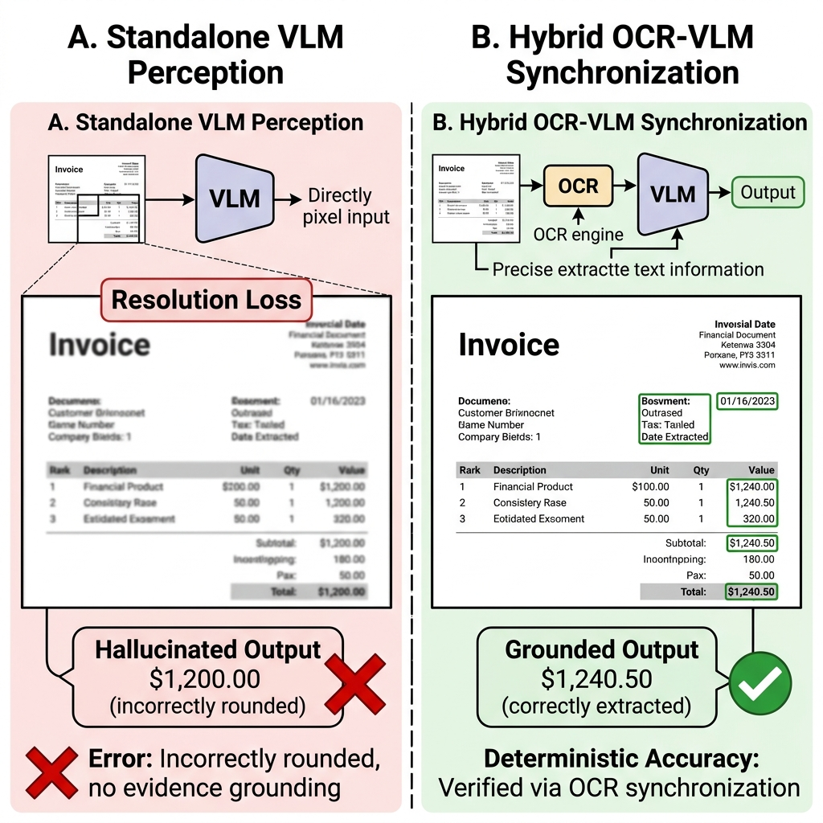
Error Analysis & Visual Evidence
VLM Failure Mode: Guessing digits incorrectly due to low patch resolution.
Hybrid Precision: Anchoring logic preserves exact numerical strings.
Figure 7.6: Visual Case Study of VLM Resolution-Loss vs. Hybrid Precision
12 / 15

Slide 14
Conclusion
Bridging the Gap: Synchronized OCR-VLM architecture successfully bridges the perception-cognition disconnect.
Grounding Efficacy: Deterministic character grounding is vital for eliminating LLM hallucinations in structured enterprise documents.
Standardized Framework: Provides a repeatable, zero-shot system-level benchmark for future Document AI research.
13 / 15

Slide 15
Future Work: Multi-Agent System
Evolution: Transitioning from a rigid linear pipeline to a cooperative multi-agent network.
Agent Roles:
Layout Agent: Parses boundaries and geometric structures.
OCR Agent: High-fidelity character transcription.
Visual Agent: Processes embedded charts and figures.
Coordinator Agent: Resolves spatial conflicts and synthesizes the final factual answer.
14 / 15

Slide 16
Thank You
Thank You for Your Attention
Questions & Discussion
Tifang Desmond Ngoe
Academic Year 2025-2026

