Slide 1
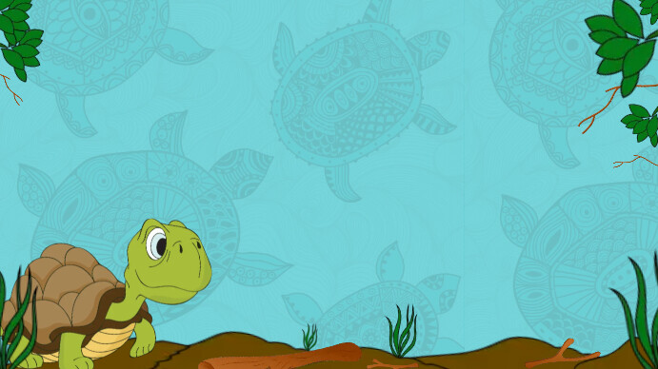
Title: HTMO – Hybrid Turtle Migration Optimization
Subtitle: A Bio-Inspired Algorithm Based on Sea Turtle Life Cycle
Vimal De Souza
1135446

Slide 2
Motivation & Bio-Inspiration Overview
The inspiration behind creating this new sea turtle-based algorithm stemmed from my interest in the Heuristic Optimization course. However, I initially struggled with where and how to begin the process.
To overcome this, I used a reverse-thinking approach. I started by identifying the types of problems I wanted the algorithm to solve mainly travel-related optimization problems such as the Travelling Salesman Problem (TSP), Vehicle Routing Problem (VRP), and logistics-related scenarios.
This led me to seek inspiration from nature, particularly creatures known for long-distance travel. I wanted the algorithm to reflect a wide search space. Considering that most of the Earth is covered by oceans, I focused on ocean-based creatures. I recalled that sea turtles are capable of traveling thousands of miles across the ocean and eventually return to the same beach where they were born. This unique behavior caught my attention.
I found that their life journey from hatching on a beach, surviving the vast ocean, migrating for years, and returning to the origin mirrored the structure of heuristic optimization algorithms. For instance, the initial hatching represents the initial population, the migration represents exploration paths (as in TSP or VRP), and the return to the nesting beach resembles convergence or solution refinement. This natural process aligned well with algorithmic principles, so I decided to dive deeper into sea turtle behavior, which eventually became the foundation for my algorithm.

Slide 3
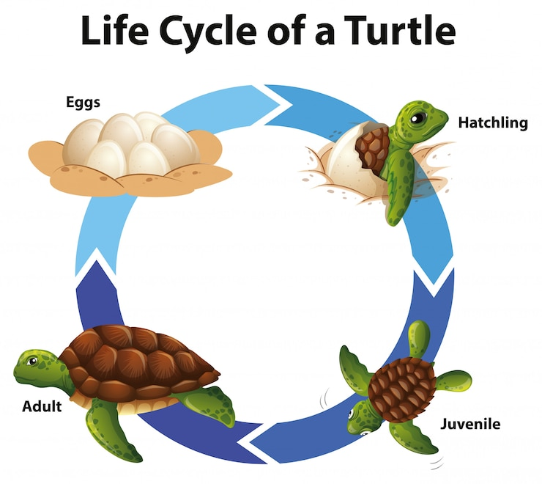
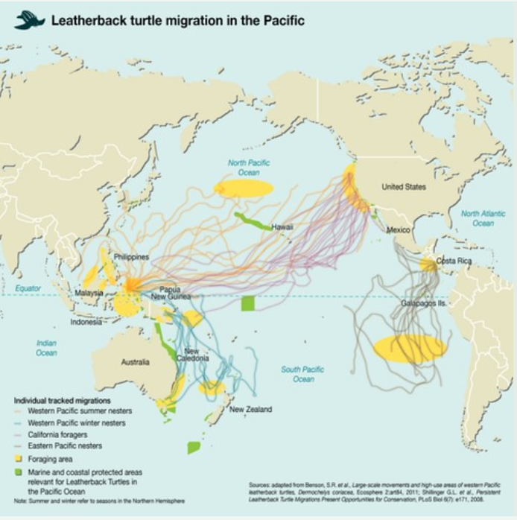

Slide 4
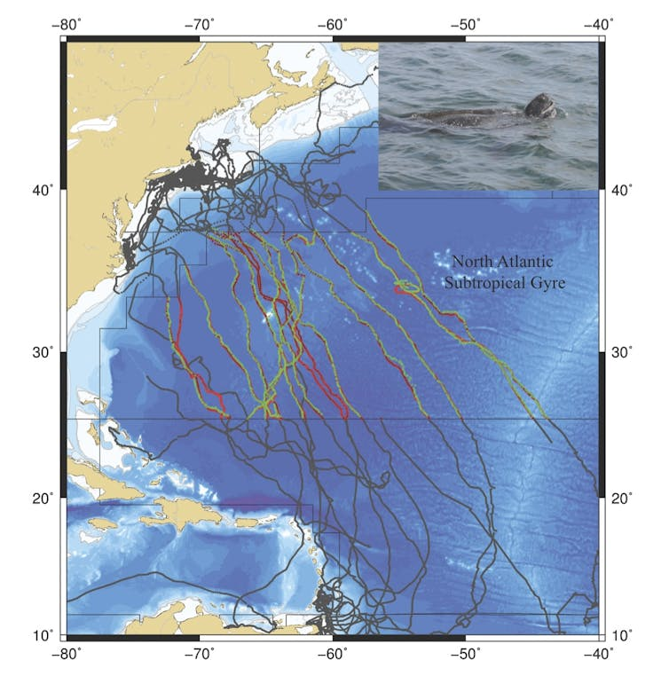
Ocean Current
Juvenile/Lost Stage- They carried by ocean currents (Random exploration)
Adulthood/ Foraging- They USE the deep sea current to travel between Nesting and food area
Magnetic Field
1.Strength of the magnetic Field
2. Angle/Direction of the magnetic field

Slide 5
High-Level Algorithm Structure
Turtle Life Stage | Biological Behavior | HTMO Component | Role in Optimization
🦩 Egg Stage | Laid on beach, stationary | Random Tour Initialization | Seeding the population
👶 Hatching | Rushing to sea, chaotic movement | OceanCurrentDrift() | Pure exploration with randomness
🌊 Juvenile Drift | Passive drifting in ocean; high mortality, no memory | Memory-Aware OceanCurrentDrift() | Smarter exploration: avoid known bad zones
🧑‍🌾 Adulthood | Develops navigation, remembers good/bad regions | ACMM() – Adaptive Cluster Magnetic Memory | Exploits strong clusters, avoids weak ones
🗺️ Mature Migration | Navigates toward precise targets using magnetic cues | MFBO(), CMA() | Local & group-level refinement and alignment
🌺 Nesting Site Fidelity | Returns to birth beach with learned route | NestSiteMemory() | Retain elite solutions for convergence

Slide 6
Detailed Algorithm Procedure – HTMO
Detailed Algorithm Procedure – HTMO FINAL
1. Initialization (Egg Stage):
- Generate an initial population of random tours.
- Initialize memory structures for elite solutions and cluster strengths.
2. Exploration – Hatching & Juvenile Stage:
- Apply OceanCurrentDrift() to introduce high-variance random variation.
- Apply Memory-Aware OceanCurrentDrift():
- Generate random tours.
- Reject tours containing weak clusters identified in prior generations.
3. Mutation Control – Adulthood:
- For each tour, apply ACMM():
- Divide tour into clusters (e.g., 3-city segments).
- Compute magnetic strength of each pair: 1/distance(i,j).
- Tag clusters as strong (preserve) or weak (avoid).
- Restrict mutation operators to act only on weak segments.
4. Directional Refinement – Mature Migration:
- Apply MFBO():
- Generate k neighbours.
- Compute magnetic strength (fitness gradient) for each.
- Move toward the best neighbour via guided swap or 2-opt.
- Apply CMA():
- From elite tours, extract frequent sub paths.
- Reconstruct current tour to align with those elite sub paths.
5. Fitness Evaluation:
- Calculate total tour distance as fitness.
- Rank all solutions.
6. Archive Update – Nesting Memory:
- Update elite memory (NestSiteMemory) with best-performing tours.
- Replace worst tours or apply elitism to maintain population quality.
7. Repeat:
- Repeat steps 2–6 until stopping condition is met (e.g., max iterations or convergence).
8. Output:
- Return the best tour from NestSiteMemory

Slide 7
Key Operators Summary
OceanCurrentDrift()
🔍 Purpose:
Used during early life (hatching and juvenile drift).
Introduces random movement to explore a wide range of solutions.
🧬 Bio-Inspiration:
Mimics how juvenile turtles are carried passively by ocean currents without control.
⚙️ Behaviour:
Generates random tours or performs high-variance mutations on current tours.
Ensures diversity in early iterations.
🔁 Role:
Exploration
Initial diversification

Slide 8
Memory-Aware Drift
Memory-Aware OceanCurrentDrift()
🔍 Purpose:
Prevents turtles from revisiting weak magnetic zones or bad structural patterns.
🧬 Bio-Inspiration:
Juvenile turtles that survived learn to avoid dangerous or food-poor regions.
⚙️ Behaviour:
Refers to ACMM’s weak cluster memory.
Generates new tours that do not contain known bad clusters.
Encourages directed exploration without wasting effort.
🔁 Role:
Smart exploration
Feedback loop with memory

Slide 9
Key Operators Summary
ACMM
Purpose:
Learn and preserve strong city clusters, avoid weak city subpaths.
🧬 Bio-Inspiration:
Adult turtles memorize rich feeding grounds and avoid areas with predators or low survival.
⚙️ Behaviour:
Splits tour into clusters (e.g., triplets).
Calculates magnetic strength:
Strength(i,j)=1Distance(i,j)\text{Strength}(i, j) = \frac{1}{\text{Distance}(i,j)}
Stores:
Strong clusters → prevent from being broken.
Weak clusters → avoid forming them again.
Guides mutation: only weak areas are mutated.
🔁 Role:
Exploitation
Mutation control
Structural memory

Slide 10
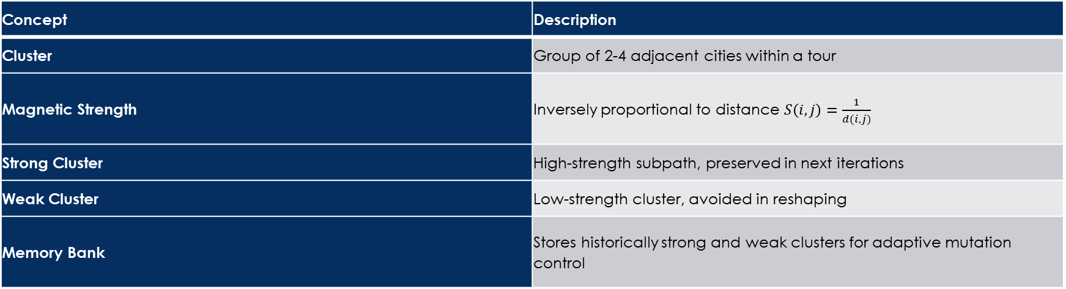
ACMM – Deep Dive
Concept | Description
Cluster | Group of 2-4 adjacent cities within a tour
Magnetic Strength | Inversely proportional to distance $S\left(i,j\right)=\frac{1}{d(i,j)}$
Strong Cluster | High-strength subpath, preserved in next iterations
Weak Cluster | Low-strength cluster, avoided in reshaping
Memory Bank | Stores historically strong and weak clusters for adaptive mutation control

Slide 11
ACMM – Deep Dive
Operator Workflow (ACMM)
Cluster Generation:
Generate candidate clusters from current tour (sliding window or combinatorial).
Strength Evaluation:
Calculate sum of magnetic strength (1/distance) for each cluster.
Memory Update:
Add clusters with high strength to memory as "strong".
Mark high-cost (weak) clusters as "negative" zones.
Guided Mutation:
During swap/2-opt, restrict breaking strong clusters.
Deprioritize forming known weak clusters.
Relearn Periodically:
Re-cluster every N iterations to adapt to new tour structures.
Example Walkthrough
Tour:
A → C → E → B → D → F → A
Step 1: Cluster Candidates
ACE, BDF
ADF, CBE
ABF, CDE
Step 2: Strength Evaluation (e.g., ACE)
Step 3: Memory Update
ACE added to strong memory
ABF (score = 0.67) marked as weak cluster
Step 4: Guided Evolution
Future swaps must not break ACE
Avoid forming ABF in reshuffled tour
Pair | Distance | Magnetic Strength
A-C | 2 | 0.50
A-E | 3 | 0.33
C-E | 4 | 0.25
Total |  | 1.08

Slide 12
ACMM – Deep Dive
ACMM is biologically inspired, structurally intelligent, and highly compatible with existing metaheuristics. It can be embedded in TSP solvers or generalized to VRP, routing, or layout optimization with slight modifications.
Biological Origin: Inspired by sea turtles' ability to navigate using Earth’s magnetic field and their tendency to revisit high-value feeding or nesting zones.
Behavioural Pattern: Turtles cluster near food-rich zones and avoid energetically costly paths.
Algorithmic Translation:
Cities in a TSP tour are treated as turtle checkpoints.
Pairs or clusters of cities with lower travel costs form "magnetically stable" patterns.
These patterns are stored and used to influence future iterations.

Slide 13
MFBO – Deep Dive
Magnetic Field-Based Orientation
🔍 Purpose:
Helps a turtle move toward the most promising local neighbour.
🧬 Bio-Inspiration:
Turtles sense Earth’s magnetic field to adjust direction during migration.
⚙️ Behaviour:
Generates several neighbour tours via small changes.
Computes magnetic pull based on fitness improvement:
Chooses the neighbor with strongest magnetic pull and moves toward it.
🔁 Role:
Local exploitation
Greedy direction-based movement
Let’s say we have these cities:
A, B, C, D, E, F
🧭 Current Tour (Turtle Position):
A → C → E → B → D → F → A Cost = 18
Now generate 3 neighbour tours via 2-opt or swap:
Neighbour | New Tour | Cost | Δf (delta fitness) | Magnetic Strength (M = e^(-α × Δf))
N1 | A → C → B → E → D → F → A | 20 | 2 | 0.135
N2 | A → C → E → D → B → F → A | 17 | -1 (better) | 2.718 (Strong pull)
N3 | A → D → C → E → B → F → A | 19 | 1 | 0.368
Best pull = N2 with lowest cost (better fitness)
So the turtle moves toward N2 by applying the corresponding 2-opt or swap (swap B and D)
New tour after MFBO:
A → C → E → D → B → F → A Cost = 17

Slide 14
One Iteration Explained
Phase | Operator Used | Explanation
🐣 1. Ocean Drift | OceanCurrentDrift() | Random perturbation → A → C → E → B → D → F → A
🌊 2. Memory-Aware Drift | MemoryAwareOceanCurrentDrift() | Weak clusters like (B,D,F) identified in past → skip them if formed
🧠 3. ACMM() | Finds strong cluster: (A,C,E) → preserve; Marks (B,D,F) as weak
🧲 4. MFBO() | Generates 3 neighbors → one gives better cost (19) → reorients toward that
🌌 5. CMA() | Looks at elite group → most have A → D → C → aligns current tour with this pattern
🐢 6. Evaluation | Cost is recomputed (e.g., 18) and compared to elite archive
🪺 7. NestSiteMemory() | If improved, store as elite solution

Slide 15
One Iteration Explained
Inputs:
Tour from Iteration 1 (above)
Updated memory:
Strong clusters: A–D–C
Weak clusters: B–F–E
Next Steps:
OceanCurrentDrift() attempts new variation e.g., generates: A → C → B → D → F → E → A
Memory-Aware Drift blocks this if it contains (B,F,E)
Iteration | Tour | Cost | Elite Update? | Cluster Memory Change
0 | A → B → C → D → E → F → A | 22 | Yes | Weak: B–C, E–F
1 | A → D → C → E → B → F → A | 18 | Yes | Strong: A–D–C
2 | A → D → C → F → B → E → A | 17 | Yes | Weak: B–F–E added
3. ACMM() detects:
A–D–C still strong → lock it
(C,B) = weak → candidate for swap
4. MFBO() senses neighbors:
Swapping B–F improves to cost = 17 → adopts it
5. CMA() checks elite patterns:
Reorders to A → D → C → F → B → E → A
6. Fitness updated → if better than 18, added to elite

Slide 16
Exploration vs Exploitation
Ocean Current
(Exploration)
Magnetic Cue
(Exploitation)
Component | Type | Mechanism
Ocean Current Drift | Exploration | Random tour reshuffling
Memory-Aware Ocean Drift | Exploration | Avoids known weak cluster structures
ACMM | Exploitation | Preserves high-quality subclusters and restricts damaging mutations
MFBO | Exploitation | Moves toward best local neighbor based on magnetic strength
CMA | Exploitation | Reorders based on frequent elite subpaths
NestSiteMemory | Exploitation | Keeps best tours and uses them for convergence
As turtle ages

Slide 17
Uniqueness & Contribution
Full simulation of a complete animal life cycle with biological accuracy
Memory-Aware Drift: Unlike typical random mutation, drift is conditionally restricted based on learned bad patterns
ACMM (Adaptive Cluster Magnetic Memory): Real-time scoring of subpath strength with memory-based mutation control
Combination of local (MFBO) and global (CMA) directional updates
Modular and phase-driven design, allowing future upgrades

Slide 18
parameter to tune
Parameter | Role
Population size | Number of turtles
Max Iterations | Stopping criteria
α (alpha) in MFBO | Magnetic pull sensitivity
Memory update rate | How often ACMM memory is refreshed
Drift intensity | Magnitude of randomization

Slide 19
Thank You

