Slide 1
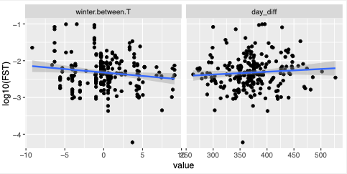
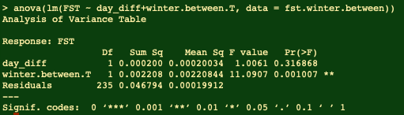
samp1
Winter T
samp2

Slide 2
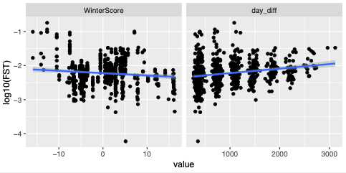
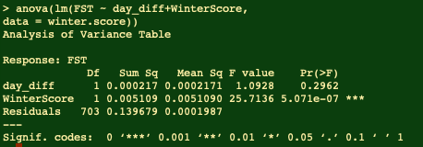
samp1
samp2
Winter 1
Winter 2
Winter n
Winter score =
-5
+
-2.5
+
-2.5

