Slide 1
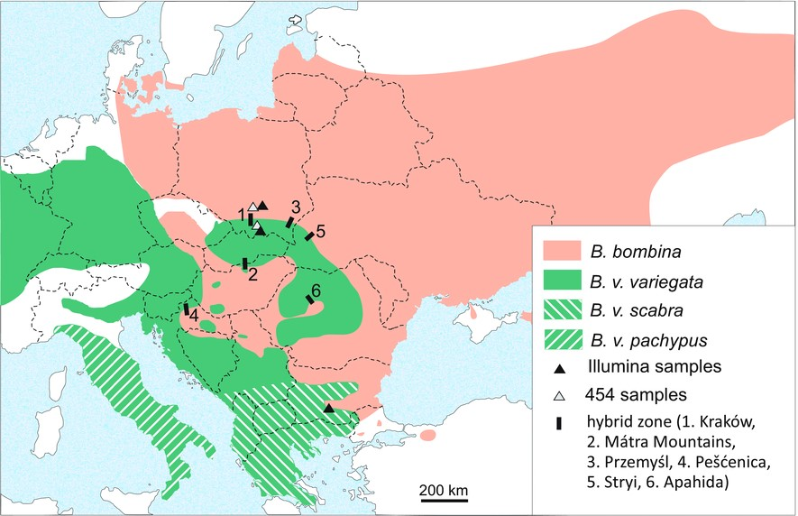
https://doi.org/10.1111/evo.12978

Slide 2
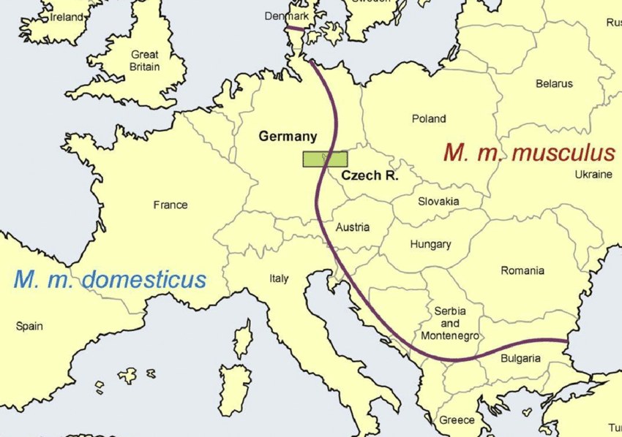
https://doi.org/10.1016/B978-0-12-809633-8.06558-4

Slide 3
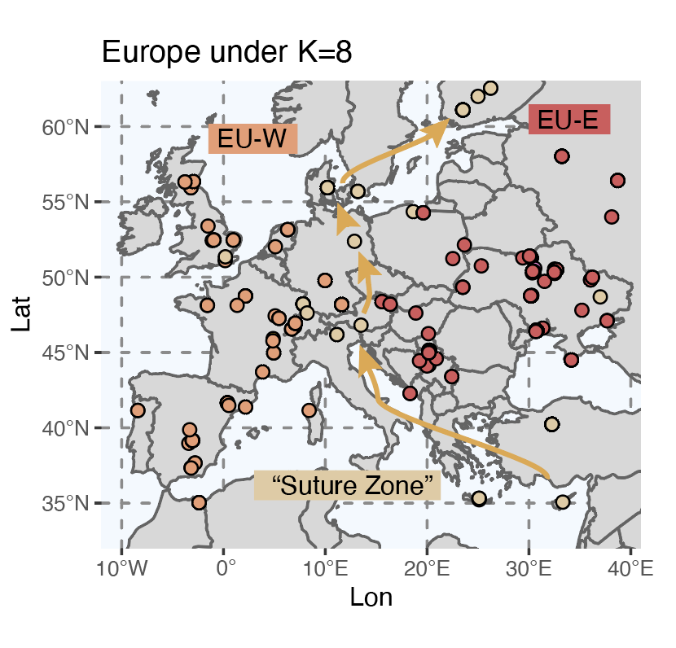
Drosophila
Bombas
Mus

