Slide 1

Optimized Machine Learning Framework for DDoS Attack Detection: A Hybrid Hierarchical Approach.
Diganta Das – 23WU0102051
Anohita Sen – 23WU0102016

Slide 2
ABSTRACT
Imagine a bustling e-commerce website that suddenly crashes due to a sophisticated DDoS attack, causing significant revenue loss. Traditional Intrusion Detection Systems (IDS) failed to detect the complex attack patterns and high data volume.
Our project addresses these limitations by developing a hybrid hierarchical machine learning IDS. This advanced system ensures real-time detection and mitigation of both known and emerging threats, enhancing network resilience and preventing costly disruptions.
By leveraging machine learning, our IDS adapts to the evolving landscape of cyberattacks, providing robust and accurate protection for modern networks.

Slide 3
INTRODUCTION
In the digital age, cyber threats like DDoS attacks are increasingly sophisticated, often overwhelming traditional Intrusion Detection Systems (IDS). These systems struggle with the complexity and volume of modern attacks, leading to significant security breaches. Our project introduces a hybrid hierarchical machine learning IDS designed to detect and mitigate both known and emerging threats in real-time. By leveraging advanced machine learning techniques, we aim to enhance network resilience and provide robust protection against evolving cyber threats.

Slide 4
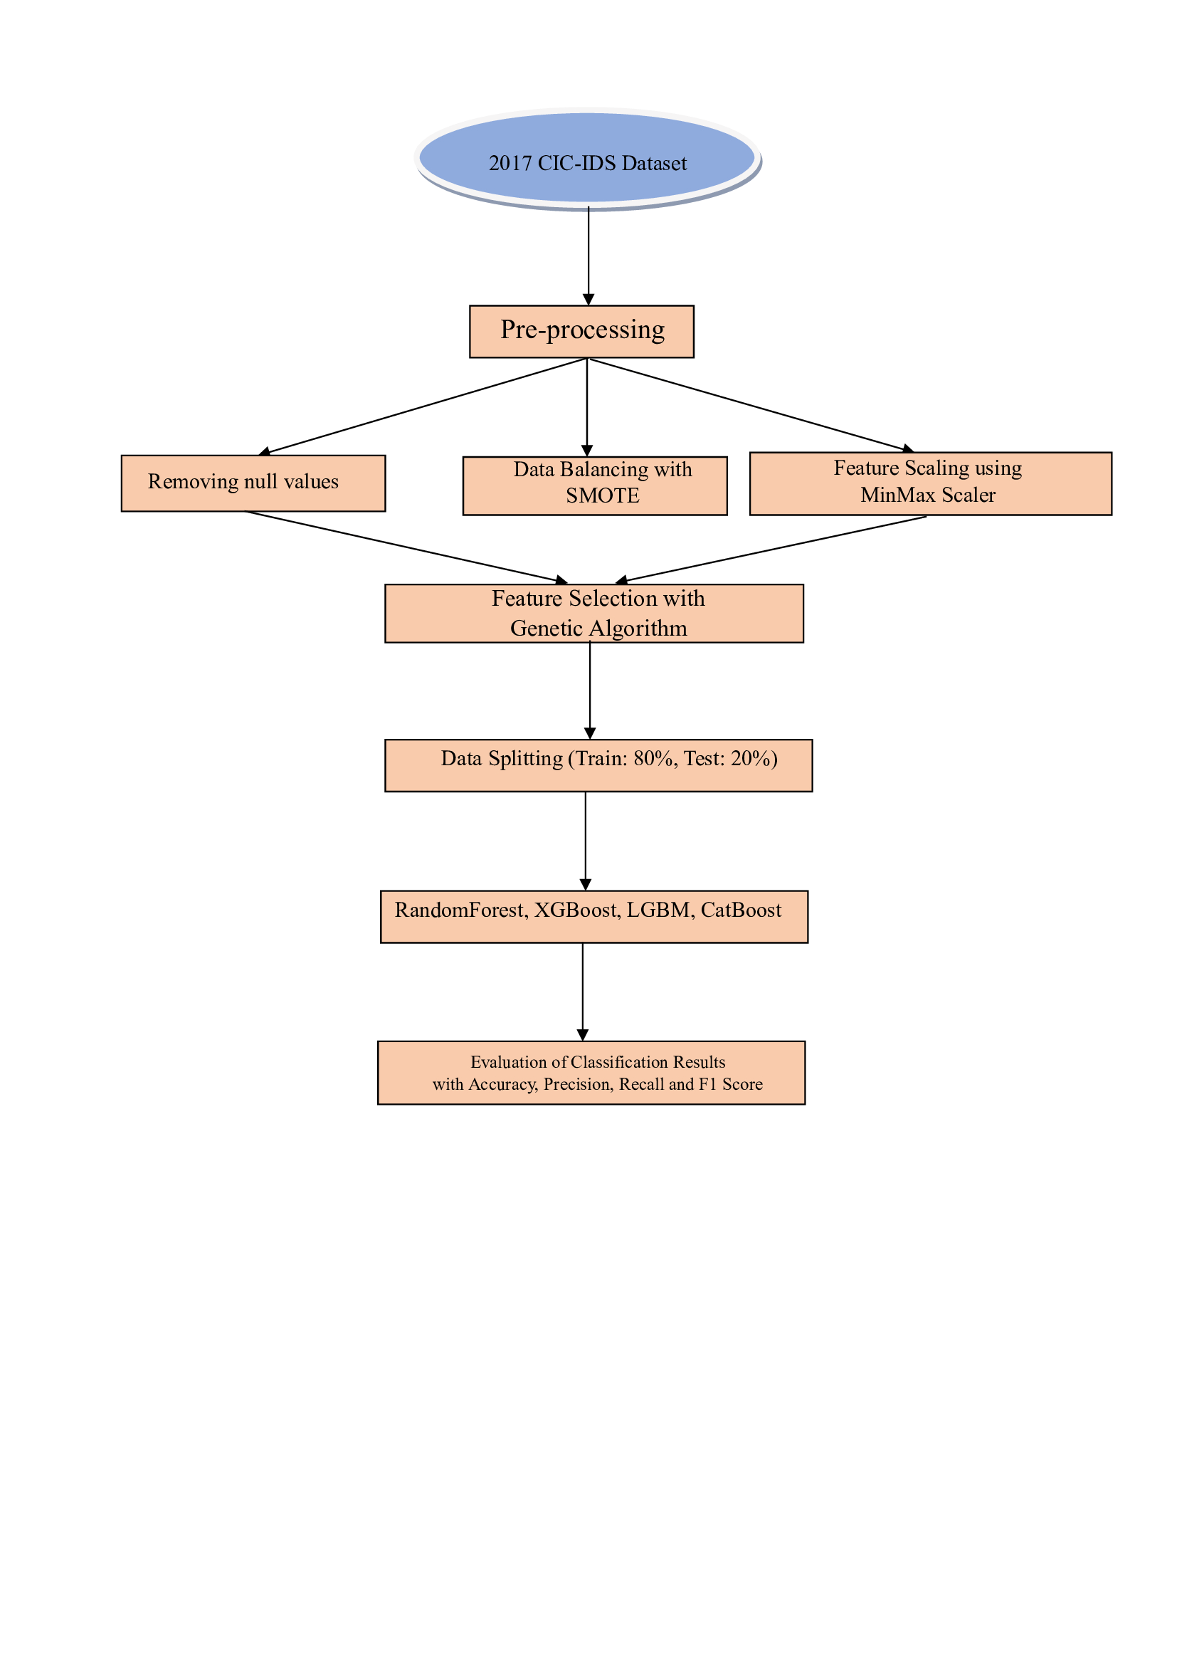
HOW IT WORKS (ARCHITECTURE)

Slide 5
WHAT HAVE WE DONE SO FAR
Data Collection & Preprocessing – Data loading from the dataset, setting up X and Y (features and labels for feature selection GA)
Feature Scaling – with MinMaxScaler()
Splitting Data for feature selection ( Genetic algorithm ) training and training purposes separately
Splitting up the selected dataset into training and testing.
Algorithm Selection – [RF, XGBOOST, MLP]
Model Training on the above-mentioned algorithms
Using stack operation to stack our predicted values from previously predicted to perform our hybrid approach.
Selecting Logistic regression as a meta model to fit our stacked trained set previously
Performing a final prediction on the stacked linear meta model getting accuracy of 78%
Optimizing it with a non-linear xgbclassifier model and got a final accuracy of 98%

Slide 6
RESULTS-1
Metrics Models | Accuracy | Precision | Recall | F1-score
RF-Classifier | 97 | 97 | 97 | 97
XGBoost | 92 | 97 | 98 | 97
MLP | 96 | 94 | 95 | 94
SVC | 81 | 69 | 81 | 74
LGBM | 60 | 70 | 73 | 71

Slide 7


RESULTS-2
Primarily, stacking 3 models on a single linear meta-model (Logisticregression) we get a final Accuracy of 74%:
After optimizing ,stacking 3 models on a single non-linear meta-model (XGBClassifier) we get a final Accuracy of 98%:

Slide 8
CONCLUSIONS
Objective: Successfully developed a machine learning model for detecting DoS and DDoS attacks using a real-time network traffic dataset.
Approach: Employed a meta model (stacked generalization) combining XGBoost, Random Forest, and MLP classifiers for enhanced accuracy.
Result: Achieved an impressive overall accuracy of 98%, demonstrating high reliability in identifying attacks.
Significance: This hybrid approach leverages diverse model strengths, providing a robust solution for real-time intrusion detection in network security.

Slide 9
REFERNCES
Alsaffar, Ali Mohammed, Mostafa Nouri-Baygi, and Hamed M. Zolbanin. "Shielding networks: enhancing intrusion detection with hybrid feature selection and stack ensemble learning." Journal of Big Data 11, no. 1 (2024): 1-32.
Hoque, M. S. et al. “An Implementation of Intrusion Detection System Using Genetic Algorithm.” ArXiv abs/1204.1336 (2012): n. pag.
Wagh, Sharmila Kishor, Vinod K. Pachghare, and Satish R. Kolhe. "Survey on intrusion detection system using machine learning techniques." International Journal of Computer Applications 78, no. 16 (2013): 30-37.
Dasari, Sandeep, and Rajesh Kaluri. "An effective classification of DDoS attacks in a distributed network by adopting hierarchical machine learning and hyperparameters optimization techniques." IEEE Access (2024).
Ahamad, Tariq, and Abdullah Aljumah. "Hybrid approach using intrusion detection system." International Journal of Engineering Research & Technology 3, no. 2 (2014).
Khalvati, L., M. Keshtgary, and N. Rikhtegar. "Intrusion detection based on a novel hybrid learning approach." Journal of AI and data mining 6, no. 1 (2018): 157-162.

Slide 10
THANK-YOU

