Slide 1
Retail Intelligence: Customer Loyalty and Transaction Insights
Leveraging SQL to uncover trends in customer loyalty and retail transactions
Presented by
Ayush Chaudhary
Project For
A Leading Indian Retail Chain

Slide 2
Introduction
In a competitive retail landscape, understanding customer loyalty and transaction behavior is crucial. This project leverages SQL-based analysis on raw transactional data to uncover actionable patterns in customer engagement ,payment trends, and product performance. The goal is to deliver meaningful insights that support smarter, data-driven retail strategies.

Slide 3
Business Context
The client is a large Indian retail chain aiming to better understand customer behavior, product performance, and payment patterns across multiple locations, This project focuses on transforming raw transactional and review data into reliable insights using SQL. The goal is to support business strategies in customer engagement, marketing, and inventory optimization through data- driven decision-making.

Slide 4
Problem Statement
Clean and validate raw customer, order and payment data
Analyze customer loyalty, satisfaction and purchasing behavior
Uncover key transaction trends using SQL-driven analysis
Support strategic decisions with actionable metrics and insights

Slide 5
Technology Stack
Tools | Purpose
CSV files, Excel | Data Storage
SSMS | Data Processing
SQL Queries | Analysis
Power BI | Visualization
Windows OS | Environment

Slide 6
Customer Table Overview
Key Columns | Data Types | Description
Cust_id | Int | Unique ID of customer
Customer_city | Varchar | City from where customer belong
Customer_state | Varchar | State from where customer belong
Gender | Varchar | Gender of customer

Slide 7
Orders Table Overview(1/2)
Key Columns | Data Types | Description
Order id | Varchar | Unique identifier for orders
Customer id | Int | Id of customer who placed order
Product id | Varchar | Id of product which is ordered
Channel | Varchar | Channel by which order is placed
Delivered StoreID | Varchar | ID of store at which order is placed
Bill_date_timestamp | datetime | Date timestamp of order

Slide 8
Orders Table Overview(2/2)
Key Columns | Data Types | Description
Quantity | Int | Quantity of product which is ordered
Cost_Per_Unit | Float | Cost of per unit product
MRP | Float | Maximum Retail Price of product
Discount | Int | Discount Per Unit applied for order
Total_Amount | Float | Total payable amount

Slide 9
Product Table Overview(1/2)
Key Columns | Data Types | Description
Product_id | Varchar | Unique identifier of Product
Category | Varchar | Category of Product
Product_name_length | Int | Total space occupied by name of product
Prduct_description_length | Int | Total space occupied by product description
Product_photos_qty | Int | Count of Product’s photo’s
Product_weight_g | Int | Weight of Product

Slide 10
Product Table Overview(2/2)
Key Columns | Data Types | Description
Product_length_cm | Int | Dimensional length of product in centimeter
Product_height_cm | Int | Dimensional height of product in centimeter
Product_width_cm | Int | Dimensional width of product in centimeter

Slide 11
Store Table Overview
Key Columns | Data Types | Description
Store ID | Varchar | Unique ID linked to Store
Seller City | Varchar | Store’s City
Seller State | Varchar | Store’s State
Region | Varchar | Store’s Region

Slide 12
Orders Review Table Overview
Key Columns | Data Types | Description
Order id | Varchar | Link to Orders table
Customer Satisfaction Score | Int | Feedback score of specific order

Slide 13
Orders Payment Table Overview
Key Columns | Data Types | Description
Order id | Varchar | Link to Orders table
Payment type | Varchar | Payment Method
Payment amount | Float | Amount Paid

Slide 14
Meta Data(1/2)
S.No | Table Name | Total Rows | Total Columns | Potential Primary Keys | Potential Foreign Keys
1. | Customer | 99441 | 4 | Customer id | NA
2. | Orders | 112650 | 11 | Order id | Product id, Customer id, Delivered Store id
3. | Product | 32951 | 9 | Product id | Order id

Slide 15
Meta Data(2/2)
S.No | Table Name | Total Rows | Total Columns | Potential Primary Keys | Potential Foreign Keys
4. | Orders Payment | 103886 | 3 | NA | Order Id
5. | Orders Reviews | 100000 | 2 | NA | Order id
6. | Store | 535 | 4 | Store ID | NA

Slide 16
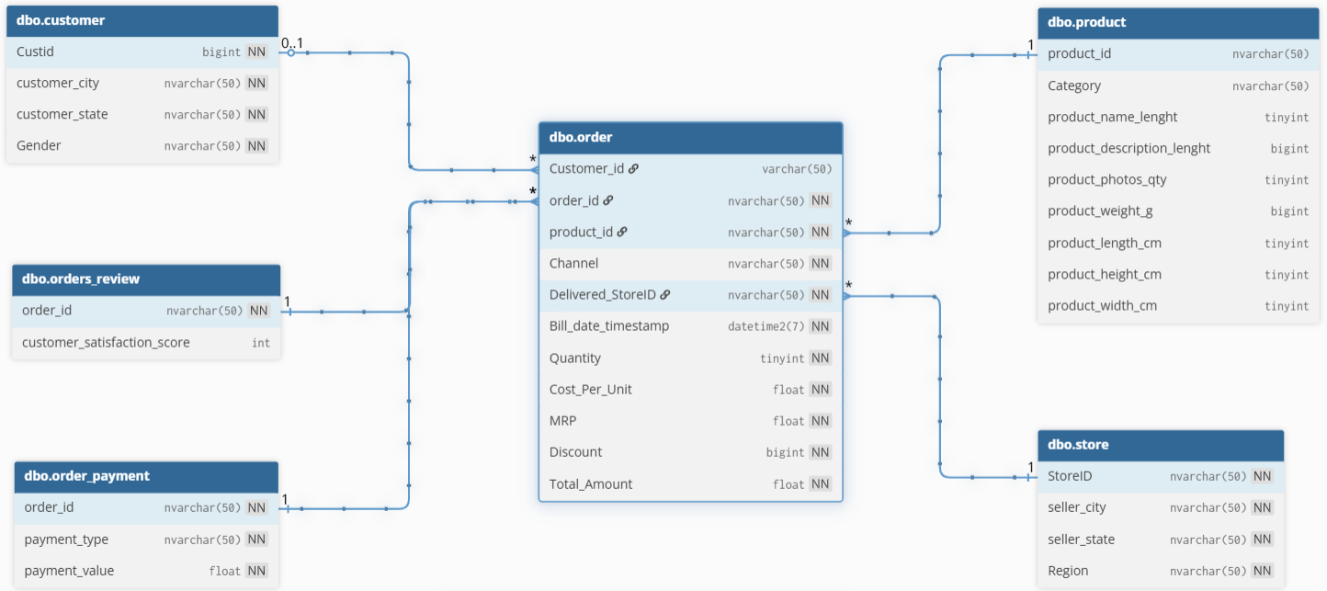
E-R Diagram

Slide 17

Inconsistencies & Discrepancies in Data(1/5)
Data type of customer_id in Customers and Orders table is Int which is prone to error.
Date Type of Bill_Date_TimeStamp is inconsistent.
10,000+ Records have redundancy with respect to quantity in Orders table.
4 records are outside of out given scope of data.

Slide 18

Inconsistencies & Discrepancies in Data(2/5)
12 records are such that where order_id is linked with more than one Customer_id.
840 records with same order_id but with different bill_date_timestamp in orders table.
1391 records with same order_id but with different delivered_Storeid while channel is “Instore”.
623 records with #N/A as category in Product table.

Slide 19
Inconsistencies & Discrepancies in Data(3/5)
615 records with nulls as atleast one of the attribute.
Records with Product_weight as 0 , also exists in Product table.
One Duplicate record in Store table.
348 records are redundant in Orders Rating Review table.

Slide 20

Inconsistencies & Discrepancies in Data(4/5)
555 records are such as same order_id with multiple different satisfaction score in Orders Rating Review table.
778 records in Orders Rating Review tables without having corresponding order_id in Orders table.
Three Records with Payment_value zero in Orders Payment table.
10,013 records with Mismatch Payment in Orders Payment table with respect to Orders table.

Slide 21
Inconsistencies & Discrepancies in Data(5/5)
Three records in Orders table without corresponding records in Orders Payment table.
830 records in Orders Payment table without corresponding records in Orders table.

Slide 22
Data Cleaning & Fixes Applied(1/2)
Change Datatype of customer_id from int to varchar(50).
Change Datatype of Bill_date_timestamp to DateTime.
Remove all the records except the one with maximum quantity .
Remove records which are outside of scope.
Remove all records except the one with maximum TotalAmount.
Consider only latest records.
Consider record with lower store_id.
Rename category with “#N/A” to “Unclassified”.
Replace nulls with zeros.

Slide 23
Data Cleaning & Fixes Applied(2/2)
Remove Duplicate Records from tables.
Take average of satisfaction score corresponds to order id’s in Order Rating Review table.
Remove records without any corresponding links with Orders fact table.
Remove records with zero payment_values
Apply window of Rs.5 for mismatched payment records and remove rest of them.

Slide 24
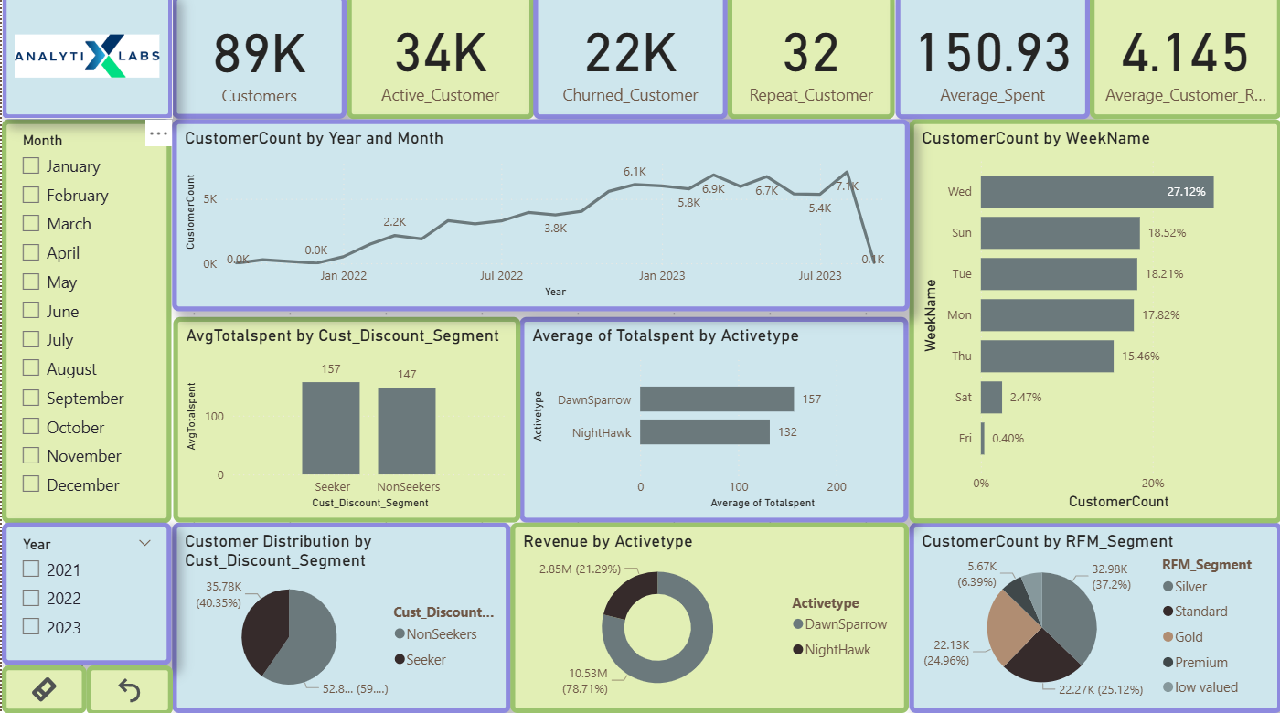
Customer Level Dashboard

Slide 25
Recommendations
Re-engage 33K inactive customers.
Reduce customer churn.
Increase repeat Purchases.
Boost average customer spend.
Enhance customer satisfaction.
Segment and personalize outreach.

Slide 26
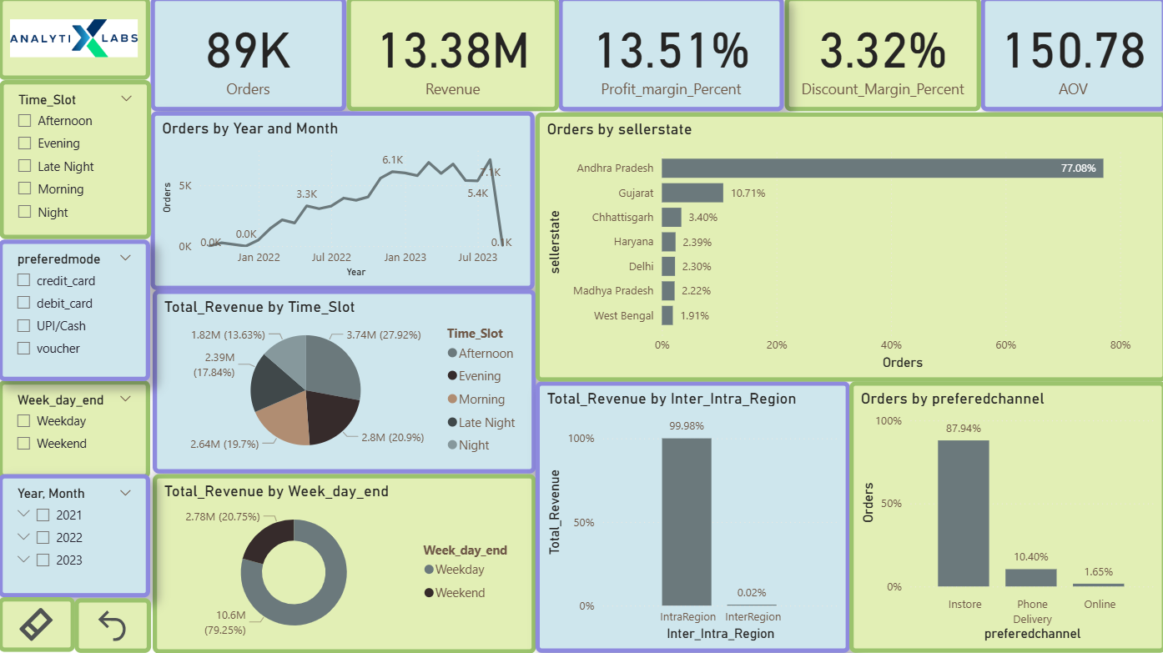
Order Level Dashboard

Slide 27
Recommendations
Increase online order volume.
Boost performance in low-order states.
Optimize credit card payment experience.
Expand revenue in underperforming time slots.
Leverage weekday revenue advantage.
Strengthen Inter-region sales.

Slide 28
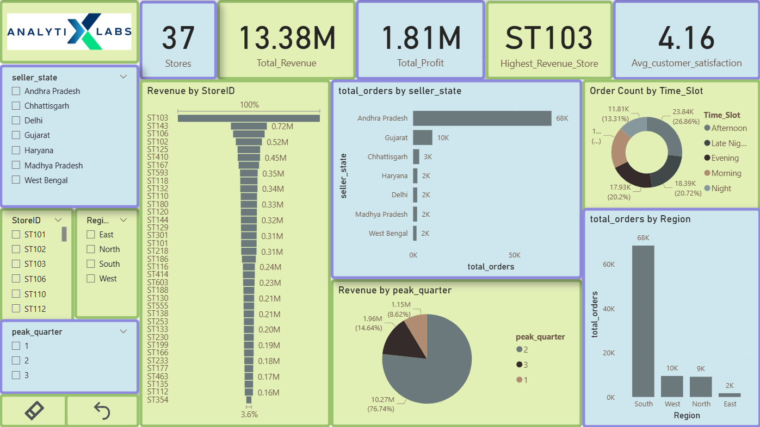
Store Level Dashboard

Slide 29
Recommendations
Replicate success of top-performing store.
Focus on high-order states like Andhra Pradesh.
Improve Performance in low-order states.
Leverage peak quarters for revenue growth.
Optimize time slot performance.
Enhance regional strategies.
Increase profit margins.

Slide 30
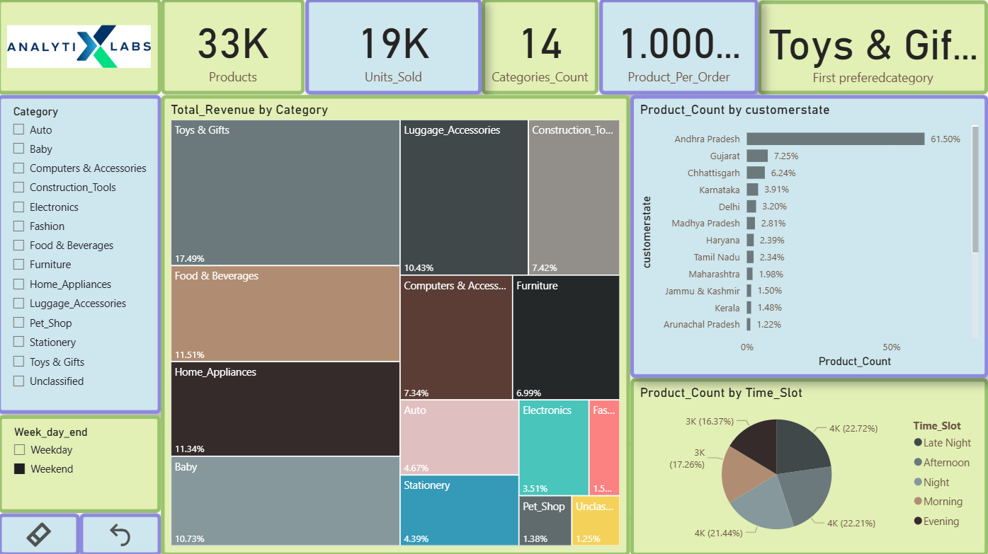
Product Level Dashboard

Slide 31
Recommendations
Capitalize on top-performing category.
Boost underperforming categories.
Optimize inventory for high-demand states.
Improve performance in low-volume states
Leverage peak time slots for sales.
Enhance category diversity per order.
Refine category strategy using revenue insights.

Slide 32
COHORT ANALYSIS

Slide 33
Acquisition Cohort Analysis
There are two clusters forming, K1 (P1,P2,P3,P4) K2(P7,P8,P9,P10,P11,P12)
Mixed buying behaviours
Segment based campaigns: target K1 and K2 segments and encourage them with loyalty rewards , Reminder through emails and time-limited offers to reactivate

Slide 34
Discount Segment Based Cohort Analysis (Seekers)
2 clusters are forming with K1((P2,P3,P4) and K2(P8,P9,P10,P11) with cohort Q1 and Q2 quarters.
Peaks align with New Year and Independence Day Sales.
Personalize outreach to each cluster on buying timing.
Offers to encourage Seekers to buy more during New year and independence Day sales.

Slide 35
Discount Segment Based Cohort Analysis(Non-Seekers)
Mainly Purchase for personal needs, not influenced by promotions.
Very Low Repeat Buying with little to not specific pattern.
Create Demand
Personalized reminders

Slide 36
Active type Segment Based Cohort Analysis (Dawnsparrow)
DawnSparrows avoid Late night orders (12am to 5am)
Steady repeat buying with consistent engagement overall.
Major part of orders are from Q3
Schedule daytime promotions and communications.
Highlight morning delivery options and early bird deals.

Slide 37
Active type Segment Based Cohort Analysis (NightHawks)
NightHawks orders late night( 12am to 5am)
Less frequent overall repeated orders
Mainly consist of onetime buyers
Optimize late night delivery channels.
Target ads and reminders in the evening
Offer special late-night deals

Slide 38
RFM SEGMENTATION

Slide 39
RFM Segment Based Cohort Analysis (Premium)
Premium segmented customer forms a huge cluster at P8,P9,P10,P11 of cohort Q1 and Q2 of 2022.
Tends to spend more during new year and end of current FY.
Plan segment based promotion during year end and fiscal close
Launch loyalty campaigns in Q4
Personalize offers and early access deals

Slide 40
RFM Segment Based Cohort Analysis (Gold)
There are two clusters forming, K1 (P1,P2,P3,P4) K2(P7,P8,P9,P10,P11,P12)
Mixed buying behaviours
Segment based campaigns: target K1 and K2 segments and encourage them with loyalty rewards , Reminder through emails and time-limited offers to reactivate

Slide 41
RFM Segment Based Cohort Analysis (Silver , Standard & Low Valued)
Low loyalty and retention
Few repeat orders
Mainly consist of onetime buyers
Introduce entry level loyalty programs
Offer small incentives like discount , free shipping when ordered within month, ask for detailed feedback.

Slide 42
Store Wise RFM Segment Distribution
Gold, Silver ,Standard ,low valued shows consistent trend with showing dependency on customer count per store
Premium customers show uneven trend which shows some independency with customer count and thus diversified.
Encourage ,by Providing timely reminder of offers which reduce recency and increase frequency of gold, silver ,standard customers to Push them into upper segment.
Provide better consumer experience to retain upper segment customer by perks as free deliveries, Early access and offers

Slide 43
Rfm Segments Of AciveType
Standard and At risk combined holds more than 30% shares where as premium customers are only 7% in OneTimers
More than 50% of Repeater are At risk.
Encourage ,by Providing timely reminder of offers which reduce recency and increase frequency of gold, silver ,standard customers to Push them into upper segment.

Slide 44
EDA

Slide 45
Category Wise Penetration Percent
Fashion, Pet shop, Electronics are categories with lowest penetration where as Home appliances, Baby products and Toys gifts are with highest penetration.
Optimize inventory with latest fashion.
Offer services like on-site veterinarian clinic and pet grooming
Offer private space for baby feeding and play areas for parents.

Slide 46
Month Wise Category Penetration
Q3 21-22 FY performance is not up to the mark
Fashion , Unclassified shows seasonal decline in Q2 23-24 FY and pet shop shows decline in Q3 and Q4 of 22-23 FY
Restock inventory with latest Fashion and upgrade winter collection of Pet Products.
Order the unclassified categories and maintain proper records

Slide 47
Month Wise New Customer
New Customers Peaked in Q1-23 around 6800+
Steady decline, below 1000 by Oct 2023
This Suggests market saturation or weaker campaigns
Re-evaluate channels, Taget new product segments, Align campaigns with seasonal trends

Slide 48
Customer Discount Segments Of Active Type
Discount Seekers shows 17% decline in Repeat Buyers
Consumer base is mainly consisting of Non-Discount Seekers.
Use cross selling strategies with daily use segment for Non-Discount Seekers and work on optimizing consumer experience.
Provide Timely reminder to seekers to boast seasonal sales.

Slide 49
Month Wise Repeat customer rate
Sudden spike in sep 2023 to around 1.3% compared to other months
Analyze what triggered the spike and follow strategies centric towards the cause of that spike

Slide 50
Top 10 Most Expensive Product sale percent contribution
The contribution of top 10 most expensive product is even less than 1% of total sales
We should optimize our inventory based on customer demands and avoid storing product which are expensive as well as not contributing in our overall sales in bulk.

Slide 51
Average Category Rating
We are working great on overall customer satisfaction level
Baby , Furniture and Computers Categories are rated lower compared to others.
we should create a feeding space for mothers
For furniture, may be there is issue with delivery handling.
Computer , we can provide better aftersales service.

Slide 52
Average Rating With Respect to Transaction Type
Inter-Region, Intra-State and Inter-City are Rated least which shows weak demographical reach.
Large distance delivery channels are not optimized.
Optimize long distance like Inter- Regional and Intra-State channels to provide safe and timely deliveries.
Increase demographical reach by adv in local language.

Slide 53
Month Wise Revenue of New Customer and Existing Customer
New and Existing Customer’s follows almost same graphical trend but the revenue generated from Newer ones is almost 1000 times of Existing ones.
Apply Retention strategies like , sms promotion in local language, provide space for local anchor stores to attract local traffic, offer competitive pricing

Slide 54
Month Wise Sales
Saturation is reached at Q1 FY 22-23 and after that we can see sudden decline in sales.
Q3 FY 21-22 shows very low revenue.
Launch target marketing campaigns before Q1 to sustain momentum.
Introduce seasonal promotions and products

Slide 55
Region Wise Customer Spread
East Contributes least with 2% of customers whereas south holds 77% of customers and both north and west holds around 10% of customer’s share.
Increase demographical reach with local campaigns in local languages.
Optimize channel according to harsh environment of East.

Slide 56
ONE TIMERS vs REPEATERS

Slide 57
Active Type Distribution of One Timers and Repeaters
NightHawks are mainly consisting of MNC’s employees , hostel students and Night shift customers
NightHawks (12am to 5am) dominated by DawnSparrows(5am to 12am) in both OneTimers and Repeats Segmentation.
Offer late night deals and fast delivery options for nighthawks.
Offer early bird discount and offers to Dawnsparrows.

Slide 58
Region Wise OneTimers Vs Repeaters
Repeaters as more saturated in south region and there is no repeat customer in north region at all.
Optimize channel to deliver in harsh environment of East
Increase demographical reach in East.

Slide 59
RFM Segmentation of OneTimers And Repeaters
Standard and At risk combined holds more than 30% shares where as premium customers are only 7% in OneTimers
More than 50% of Repeater are At risk.
Encourage ,by Providing timely reminder of offers which reduce recency and increase frequency of gold, silver ,standard customers to Push them into upper segment.

Slide 60
Gender Distribution of OneTimers vs Repeaters
Females are dominant with around 70% share as both One-Timers as well as Repeaters.
Add Male centric categories like sports product, fashions, perfume.

Slide 61
Customer Discount Segmentation of OneTimers and Repeaters
Discount Seekers shows 17% decline in Repeat Buyers
Consumer base is mainly consisting of Non-Discount Seekers.
Use cross selling strategies with daily use segment for Non-Discount Seekers and work on optimizing consumer experience.
Provide Timely reminder to seekers to boast seasonal sales.

Slide 62
Preferred Categories by OneTimers and Repeaters
Electronics, Pet-Shop, Fashion are contributing least in sales for one timers .as well as Repeaters
Optimize inventory with latest fashion.
Offer services like on-site veterinarian clinic and pet grooming
Offer after sales services on Electronics..

Slide 63
Preferred Channel by OneTimers and Repeaters
Around 90% customers prefer buying threw instore channel
Optimize product positioning with cross selling and positioning strategies like V-Shaped display, Pyramid,
Create better interface of online application

Slide 64
State of OneTimers and Repeaters
Andhra Pradesh contributes around 60% of both One-timers and Repeaters whereas goa only contributes even less than 1%.
There is no Regional diversification.
Invest Resources to diversify sales by expanding demographical reach, channel optimization, promotions and campaigns in local languages.

Slide 65
Prefered Payment Mode of Onetimers and Repeaters
Credit card contributes around 75% of total transactions done by both One-Timers and Repeaters where as debit card and vouchers are contributing around 5%.
Establish collaboration with banks for offers.
Offer vouchers with great discount on minimum purchase value which will increase sales and retain customers.

Slide 66
Preferred Quarter of OneTimers and Repater
Quarters are diversified
Target Q2 and Q3 which will increase seasonal sales due to festive seasons like Diwali, Navratri, Independence day, Christmas, new year and more.

Slide 67
NIGHT-HAWK vs DAWN-SPARROW

Slide 68
Store Wise Active Type
We see a Trend of south region having highest contribution which once broke buy west.
North contributes least.
The Distribution of Nighthawks and Dawnsparrows are similar for all store
Initiate Segment based promotion in North Region to boast engagement of customers
Optimize channel for better delivery at night and provide early bird discounts

Slide 69
Dawnsparrows vs Nighthawks Preferred Category Percent Distribution
Fashion, Pet shop, Electronics are categories with lowest penetration where as Home appliances, Baby products and Toys gifts are with highest penetration.
Optimize inventory with latest fashion.
Offer services like on-site veterinarian clinic and pet grooming
Offer private space for baby feeding and play areas for parents

Slide 70
Payment Mode Percent Distribution of Dawnsparrows and Nighthawks
DawnSparrows prefer Credit card which is around 90% as payment mode where as NightHawks prefer UPI/Cash.
Offer exclusive credit card promotions to attract and retain DS.
Enable fast UPI/Cash counters and instant payment offers to cater to NH preferences.

Slide 71
Channel Preference Distribution of Active Type
Around 85% customers prefer buying threw instore channel
Optimize product positioning with cross selling and positioning strategies like V-Shaped display, Pyramid,
Create better interface of online application

Slide 72
Gender Distribution of Active Type
Females are dominant with around 70% share as both DawnSparrows as well as NightHawks.
Add Male centric categories like sports product, fashions, perfume.

Slide 73
State Wise Distribution of Active Type
Andhra contributes almost 60% in both NightHawks and DawnSparrows.
Upgrade inventory with environmentally friendly and healthier options and charge premium for it.
Increase Demographical reach.
Create space for anchor stores to attract traffic

Slide 74
Region Wise Active Type
Both NH and DS more saturated in south region and East contributes only 2%.
Optimize channel to deliver in harsh environment of East
Increase demographical reach in East.

Slide 75
Quarter Wise Distribution of Active Type
Quarters are diversified
Target Q2 and Q3 which will increase seasonal sales due to festive seasons like Diwali, Navratri, Independence day, Christmas, new year and more.

Slide 76
Average Order, Average Discount, Average Profit wrt Active Type
DawnSparrows have a higher AOV indicating stronger spending potential where as Profit per order for both are similar around ₹20.64, showing similar margins.
Target DawnSparrows with premium product promotions and loyalty programs for sustain high-value purchases.
Introduce late night bundles or time-limited offers.

Slide 77
Average Rating and Average LifeTime wrt Active Type

Slide 78
INTER-CITY vs INTRA-CITY

Slide 79
Customer Distribution by InterCity Intra City
InteCity Orders shows consistent trend while Intracity Distributions has multiple lows and highs.
Stroe with 2nd highest customer count performs poorly and contributes even less than 1%.
Demographical Reach is very weak.
Strengthen Demographical Reach with local campaigns in local language.
Provide offers on national as well as Regional festivals.
Build strategies to compete with local vendors and stores.

Slide 80
InterCity vs IntraCity of Weekend and Weekday Sales
Weekend contributes 21% of total sales.
Launch weekend-specific promotions, offer discounts on paid games in play areas to attract parents.

Slide 81
InterCity vs IntraCity by Channel Preference
Around 85% customers prefer buying threw instore channel
Optimize product positioning with cross selling and positioning strategies like V-Shaped display, Pyramid,
Create better interface of online application

Slide 82
Time Slot Distribution
Both InterCity and IntraCity sales peaks at Night and LateNight contributing around 50% of total sales.
Increase Night slot staffing and promotions.
Enable fast billing counters and instant payment offers to cater more traffic.

Slide 83
Preferred Payment Mode
Credit card contributes around 75% of total transactions done by both One-Timers and Repeaters where as debit card and vouchers are contributing around 5%.
Establish collaboration with banks for offers.
Offer vouchers with great discount on minimum purchase value which will increase sales and retain customers.

Slide 84
Hourly traffic

Slide 85
Quarters Wise Distribution
Quarters are diversified
Target Q2 and Q3 which will increase seasonal sales due to festive seasons like Diwali, Navratri, Independence day, Christmas, new year and more.

Slide 86
Average Sales , Discount, Profit

Slide 87
Average Days Between Orders

Slide 88
INTER-STATE vs INTRA-STATE

Slide 89
Customer Distribution of InterState IntraState
West Region store with second highest customers perform very poor in its own state as its IntraState transaction Percent is less then 2%..
InterState Distribution shows consistent trend but IntraState Distribution shows impulsive trend with multiple lows and highs.
Promote local campaigns , to strengthen demographical reach.
Optimize Channels for IntraState orders
Use local languages to attract more local customers

Slide 90
InterState vs IntraState of Weekend and Weekdays Sales
Weekend contributes 21% of total sales.
Launch weekend-specific promotions, offer discounts on paid games in play areas to attract parents.

Slide 91
Distribution of Preferred Channel
Around 85% customers prefer buying threw instore channel
Optimize product positioning with cross selling and positioning strategies like V-Shaped display, Pyramid,
Create better interface of online application

Slide 92
Distribution of Time Slot
Both InterState and IntraState sales peaks at Night and LateNight contributing around 50% of total sales.
Increase Night slot staffing and promotions.
Enable fast billing counters and instant payment offers to cater more traffic.

Slide 93
Distribution of Preferred Payment mode
Credit card contributes around 75% of total transactions done by both One-Timers and Repeaters where as debit card and vouchers are contributing around 5%.
Establish collaboration with banks for offers.
Offer vouchers with great discount on minimum purchase value which will increase sales and retain customers.

Slide 94
Distribution of Hourly Traffic

Slide 95
Distribution of Quarters
Quarters are diversified
Target Q2 and Q3 which will increase seasonal sales due to festive seasons like Diwali, Navratri, Independence day, Christmas, new year and more.

Slide 96
Average Sales , Discount , Profit

Slide 97
Average Days Between Orders

Slide 98
INTER-REGION vs INTRA-REGION

Slide 99
Customer Distribution of InterRegion IntraRegion
Only 10 out of 37 Store offers Inter-Regional transactions.
Region West dominates in inter-regional transactions.
Offer Region specific product to other regions by developing strong supply chain and delivery networks.

Slide 100
InterRegion Vs IntraRegion Weekend and Weekdays Sales
Weekend contributes 21% of total sales.
Launch weekend-specific promotions, offer discounts on paid games in play areas to attract parents.

Slide 101
Distribution of Prefered Channel
Around 85% customers prefer buying threw instore channel
Optimize product positioning with cross selling and positioning strategies like V-Shaped display, Pyramid,
Create better interface of online application

Slide 102
Distribution of Time Slot
Around 65%of sales of Inter-Region is done at Late night and afternoon Where as in Intra-Region, Night , Late Night, evening contributes around 70%of sales.
Increase Night slot staffing and promotions.
Enable fast billing counters and instant payment offers to cater more traffic.

Slide 103
Distribution of Payment mode
Credit card contributes majority of total transactions done by both Inter-Region and Intra-Region where as debit card and vouchers are contributing around 5%.
Establish collaboration with banks for offers.
Offer vouchers with great discount on minimum purchase value which will increase sales and retain customers.

Slide 104
Distribution of Hourly Traffic

Slide 105
Distribution of Quarters
Quarters are diversified
Target Q2 and Q3 which will increase seasonal sales due to festive seasons like Diwali, Navratri, Independence day, Christmas, new year and more.

Slide 106
Average Sales , Profit , Discount

Slide 107
Average Days Between Orders

Slide 108
STORE ANALYSIS

Slide 109
Top 10 , Bottom 10 Stores by Revenue Distribution

Slide 110
Top 10 , Bottom 10 Stores By Orders

Slide 111
Top 10 , Bottom 10 Stores By Profit Distribution

Slide 112
Top 10 , Bottom 10 Stores By Average Order Value

Slide 113
Store Wise Average Orders per Customer
All values are closed to one which shows our customer base Is mainly consisting of one Timers and we are not able to retain them for longer purchases.
Investigate product mix, pricing strategy, and customer demographics of East.
Introduce cross-selling and upselling campaigns in low-AOV regions.
Provide timely remainder to attract traffic in fest season.
Provide space for local anchor stores to attract traffic

Slide 114
Region Wise Revenue , Orders , Profit and AOV Distribution
Revneue, Profift and Order’s count follows similar trend with south contributing 75% and East contributing only 2%.
Optimize channel to deliver in harsh environment of East
Increase demographical reach in East.

Slide 115
Average Order Value
AOV of East is comparably low.
Investigate product mix, pricing strategy, and customer demographics of East.
Introduce cross-selling and upselling campaigns in low-AOV regions.

Slide 116
State Wise Revenue , Order Distribution
Andhra contributes almost 75% in both Revenue and in Order distribution.
Upgrade inventory with environmentally friendly and healthier options and charge premium for it.
Increase Demographical reach.

Slide 117
State Wise Profit and AOV distribution
Andhra contributes almost 75% in profit whereas its AOV is second lowest.
Upgrade inventory with environmentally friendly and healthier options and charge premium for it.
Increase Demographical reach.

Slide 118
Ordered by Profitablity and satisfaction Score
Profit-Discount Ratio helps compare profitability relative to discounts given by store.
Profit-Discount-Ratio ST180 performs poorly in both PD-Ration as well as Average customer Rating.
Stores as higher Profitability are not among highly rated ones.
Investigate ST180 Operational inefficiencies.
Invest in staff training, product quality checks and service improvement programs.
Consider upselling strategies or optimizing discount policies to improve profitability without losing customer trust.

Slide 119
AOV Most Preferred Category
Furniture, Food & Beverages and toys are categories with high AOV where as Baby and Home-Appliance AOV comparably low.
Offer Proper Delivery channels for furniture.
Provide healthier options of food and Beverages.
Create play area and feeding space for parents.

Slide 120
Time slot and Quarterly sales
Q1 contributes least around 9% of total.
Late night (89%) and afternoon (8%) contributes more than 95% of total
Diversify Quarterly sales with monthly target strategies.
Provide space for local anchor stores to attract local traffic, offer competitive pricing.

Slide 121
Store Wise Customer Discount Segment
South is dominating for with west holds second most share of both seekers and non seekers.
We can see steady decline in seekers and relatively sharp decline in non seekers as we move down.
Non seekers are hospitality based segment, so work on customer experience
Region Focused Promotions to maximize impact

Slide 122
THANK YOU!

