Slide 1
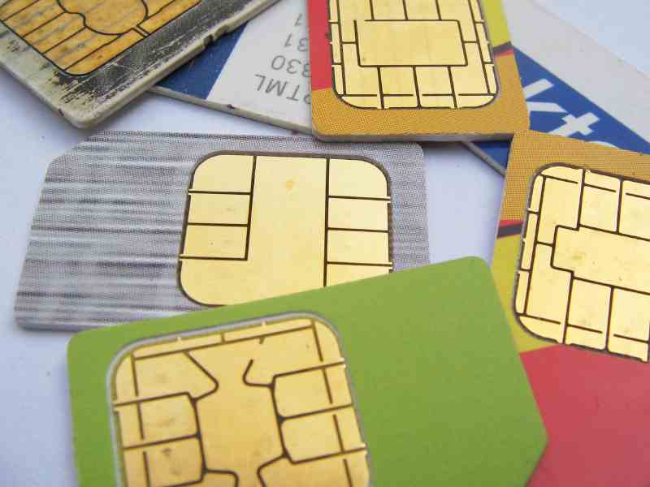

SIM CARDS
Seminar Mobile Security
By Theodora Kontogianni
08.02.2011
Assigned tutor:
Daniel Loebenberger

Slide 2

GOAL
SECURITY OF SIM CARDS
=
SECURITY OF CRYPTOGRAPHIC ALGORITHMS

Slide 3
OVERVIEW
Definition and structure of SIM cards.
A3
A8
COMP128 implementation
A5
Attacks

Slide 4
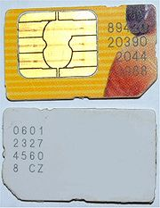
Definition and key points
Subscriber Identity Module Cards(SIM Cards)
A special case of smart cards
with a microprocessor
Two major types
Full size SIM
Embedded SIM card (for mobile phones)
Embedded SIM card

Slide 5
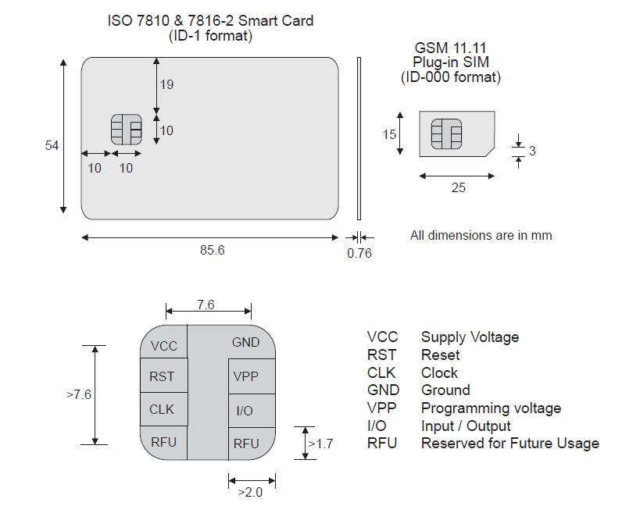
Comments on different types of SIM cards
Same thickness on all the types
Same pins
Difference in length and width according to the devices´ needs

Slide 6
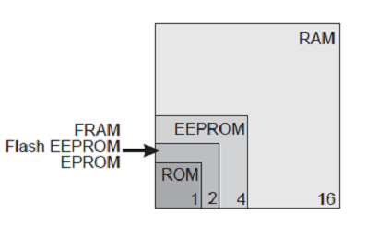
Components of SIM Card
CPU
ROM
EPROM or E2PROM
RAM
Serial communication module

Slide 7
Important information stored in SIM cards.
Besides SMS and Contacts
Passwords PIN and PUK
International mobile subscriber identity (IMSI)
Integrated circuit card identifier (ICC-ID)
Security authentication (K_{i})
Ciphering information (K_{c})
And many others!

Slide 8
Main levels of defence
Prevention of unauthorized access and usage
PIN (4~8 digits)
PUK (0~9 digits)
Local security measure –network not involved
Customer Identity Authentication
Algorithm A3 (Authentication)
Algorithm A8 (Cipher Key Generation)
Both algorithms stored in SIM card
Ciphering of air sent information
Algorithm A5 (Encryption)
Embedded in hardware
New ciphering key (Kc) for each call
Kc and Ki never transmitted over network
Anonymity
TMSI sent instead of IMSI

Slide 9
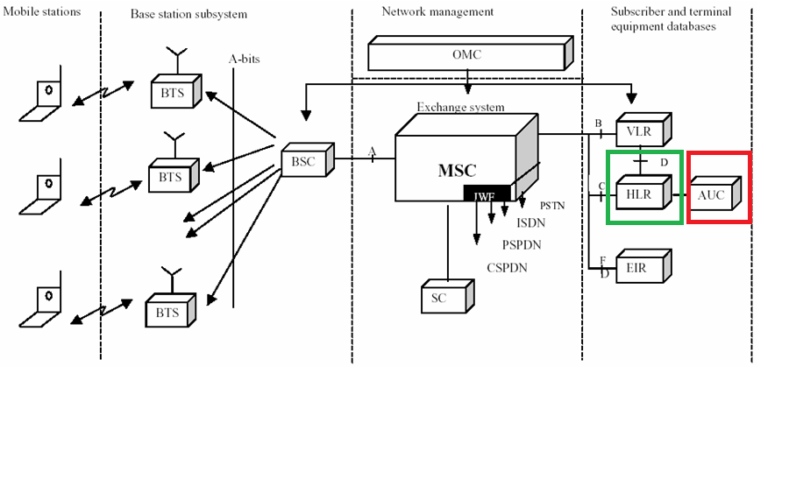
GSM Architecture
a
Home Location Register
Authentication Center

Slide 10
A3-GSM Authentication
An 128-bit random challenge(RAND) is generated by HLR and sent to ME.
SIM card encrypts RAND using A3 and K_{i} stored in SIM card.
A 32-bit response is generated(SRES)
SRES is sent back to the network.
Same operations take place in HLR.
If both SRES are equal then authentication is successful.

Slide 11
A3 Graphical Overview
Mobile Equipment (ME)
Radio Link
HLR
128-bit challenge RAND
A3
A3
K_{i}
K_{i}
?
SIM
32-bit response SRES
If challenges equal then authenticated
IMPORTANT : Ki is never transmitted over the radio link.

Slide 12
A8-Cipher Key Generation
The same 128-bit random challenge (RAND) used in A3 is the input to A8 also.
SIM card encrypts RAND using A8 and K_{i} stored in SIM card.
A 64-bit cipher key is generated (K_{c}).
K_{c} is used in A5 algorithm.

Slide 13
COMP128 implementation
A3/A8 are both implemented together in COMP128 since they have the same input.
It was developed in secret so it lacked peer review and testing.
In 1998 a document with its implementation leaked with only a few lines missing that where reverse engineered.
COMP128
128-bit RAND
32-bit SRES
128-bit K_{i}
64-bit K_{c}

Slide 14
COMP128 implementation details
8 rounds – 5 layers
Based on a hash function
Input = 256 bits = 32 bytes= 16 bytes + 16 bytes
Output = 128 – 32leftmost – 64 rightmost = 32 bits
K_{i}= X[0..15]
RAND= X[16..31]
MAC Adress
Kc

Slide 15
COMP128- Implementation Details
Order of events
RAND and K_{i} concatenated in input X[0..31].
The input is hashed 8 times which reduces it from 32 to 16 bytes.
After each hashing but the last the X is permuted.
The output of permutation is the input of the next round.
After 8 rounds the last hash value is the output.

Slide 16
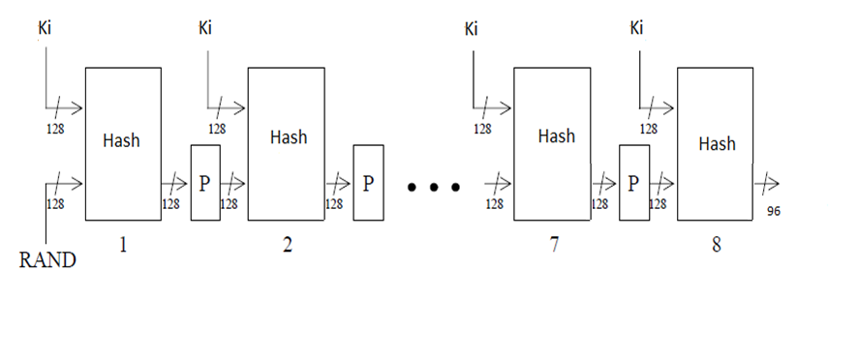
COMP128

Slide 17
COMPRESSION-Hash function
Butterfly Structure
16 combining operations of input pair to output pair for each layer.
5 look-up tables T_{i} (S-box), one for each of the 5 levels i
Each T_{i} contains 2 ^{9-i} (8-i)-bit values
So T₀ has 512 8-bit values, T₁ has 256 7-bit values and so on....

Slide 18
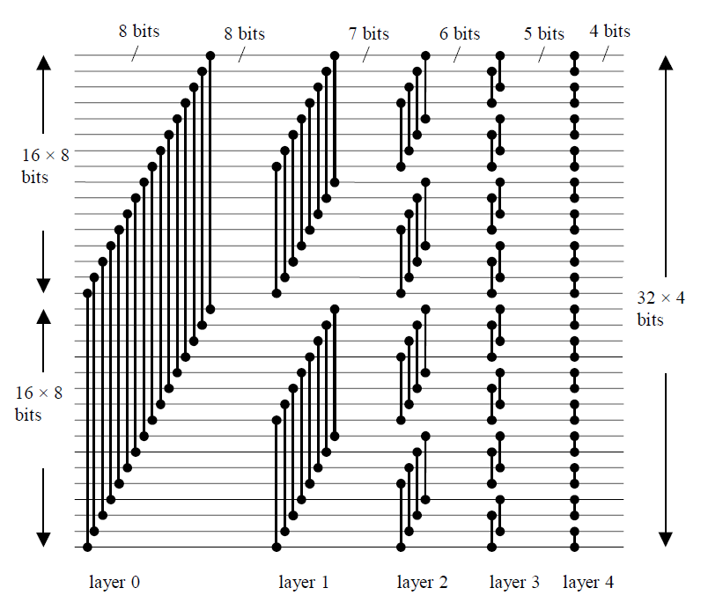
Butterfly Structure

Slide 19
Hash function example
Example: On level 0 X[ ] is split in X[0..15] and X[16..31]
The value of each one element of the right part
(X[i+16]) is combined with each element of the left (X[i]) to compute y= (X[i]+2*X[i+16])mod 512 and z=(X[i+16]+2*X[i])mod 512
Finally the X[i] = T₀[y] and X[i+16] = T₀[z]
So the size of elements is reduced from table to table.

Slide 20
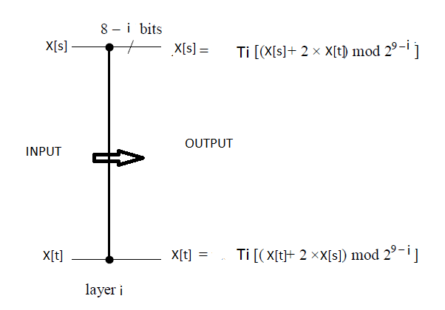
Substitution of Elements

Slide 21
A5-Encryption
Built-in inside the hardware
3 major versions
A5/1: the stronger
A5/2: the weaker
A5/3: for 3GPP-Kasumi systems
Also secret
Design leaked in 1994
Reverse engineered by Briceno

Slide 22
A5/1 Logical Details
Conversation in GSM system is a sequence of frames
Each frame is 114 bits from A(ME) to B(Base Station) and 114 bits from B to A.
Mobile Equipment
BTS
F_{n} (22 bit)
K_{c} (64 bit)
F_{n} (22 bit)
K_{c} (64 bit)
A5
A5
114 bit
114 bit
Data (114 bit)
XOR
Ciphertext (114 bit)
XOR
Data (114 bit)

Slide 23
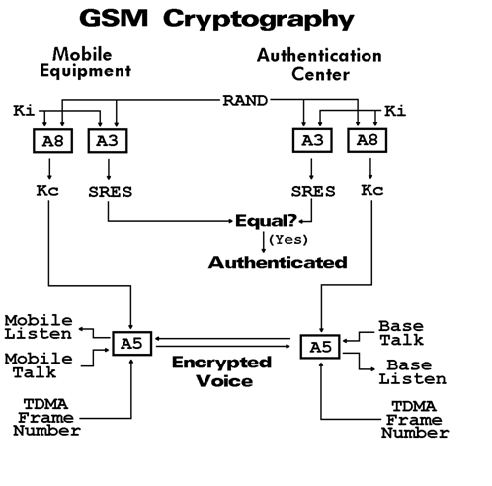
System Overview

Slide 24
Attacs on COMP128
First in 1998 (Smart Card Developer Association)
Exploits weakness in the Butterfly Structure called narrow pipe.
After the second layer of the first round, the output bytes
X[i], X[i+8], X[i+16], X[i+24] depend ONLY on the
input bytes with the same indices.
X[i]=Ki[i] and X[i+18]=Ki[i+18] i=0..7
Size of narrow pipe is 4 bytes.

Slide 25
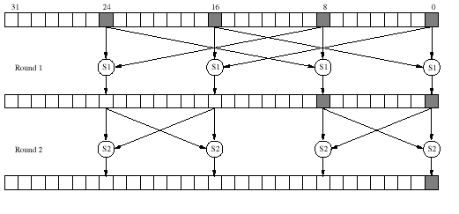
Narrow pipe

Slide 26
Collision
We vary X[i+16], X[i+24]
The rest constant
With chosen text attacks we can hope for a collision.
When collision occurs in round two, it propagates until the last round.
According to the birthday paradox, 2¹⁴ random challenges are needed to find 2 bytes of K_{i}[i] and K_{i}[i+8].
2¹⁷ chosen texts for the whole K_{i}

Slide 27
Other attacks on COMP128
More attacks based on side channels
Partitioning Attack by IBM
Look up table emit data, especially on the first round
8 chosen plaintext

Slide 28
Conclusion
COMP128 attacks needs 2¹⁷ queries and possession of the SIM card
SIM cards stop functioning after so many queries
Partitioning attack more than 1000 random challenges
More and more attacks
Companies are afraid of the cost of changing.
Reluctant to put their algorithms under peer review.

Slide 29
Thank you!
Images on slides 16,18, 20 are modified by
COMP128 : A Birthday surprise

