Slide 1
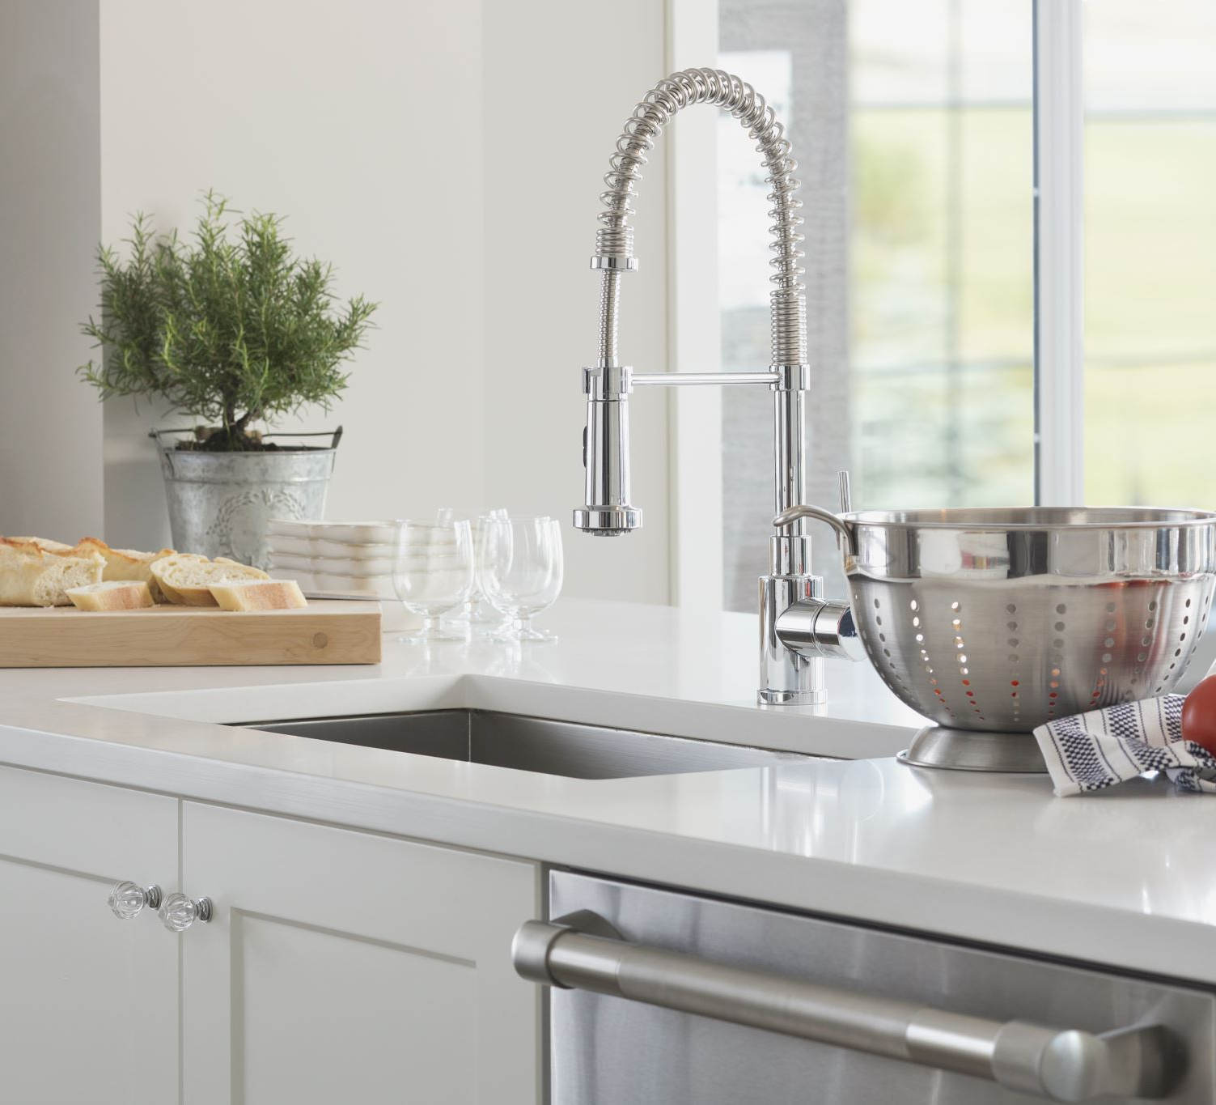


Kitchen accelerator

Slide 2
OVERVIEW TECHNOLOGY wireframes demo outlook
Idea for an outline
Delete me

Slide 3
The problem
Communal KITCHENS ARE A NIGHTMARE
You WANT TO KNOW THAT YOU CAN COOK WHEN YOU NEED TO

