Slide 1
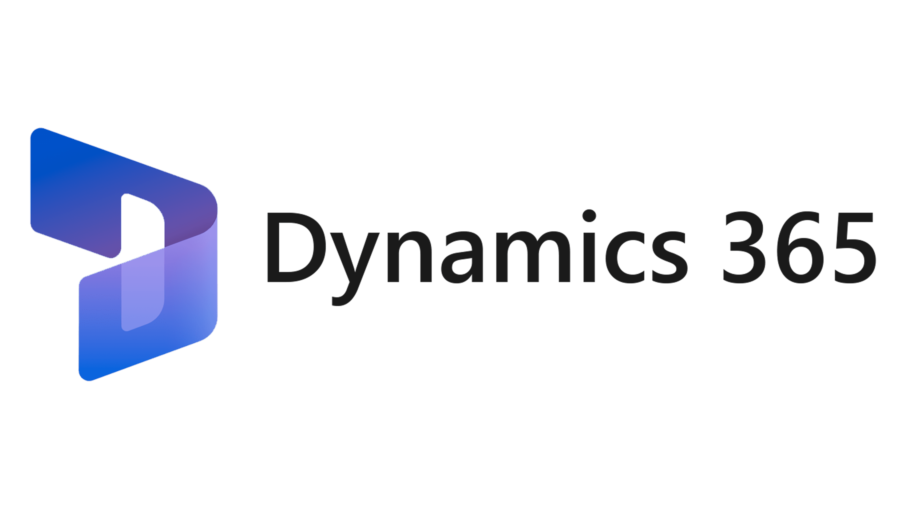



Travel and Hospitality Reference Architecture Functional diagram
Travel and Hospitality Platforms
Stays catalog
leisures offerings
distribution channel
Sales main features:
Customer Lifecycle
Household
Customer
Loyalty program
Travel History
Reservations
Agencies
Quotes
Orders
Customer Service main features:
Incidents
Litigation Management
Task Management
Marketing main features:
Marketing Campaigns
CDP
Analytics
Data Quality Management Services
DQM object
Postal address validation
Phone numbers validation
Email address validation
Sales
Customer Service
Marketing

Slide 2









Travel and Hospitality Reference Architecture Application diagram
Travel and Hospitality Platforms
Content Management & Delivery
1
6
2
DCCP - Omni Channel
Customer Insights
Customer Voice
Customer Service Portal
Azure AD B2C
4
Sales
Customer Service
Marketing
Data Quality Management Platforms
5
3
Internal Collaboration
Azure AD

